Slide 1
Open Source Digital Preservation Workflows
Gather up the bits, standardize the AIPS, and preserve them indefinitely?
Nathan Tallman
iPRES 2015, UNC Chapel Hill
November 6, 2015
https://goo.gl/sPmbR6

Slide 2
Basic Digital Preservation Workflow @ UC
Gather the bits
Make the AIPS
Preservation
DSpace
LUNA
HTML/CSS GUI
Hydra/Fedora
Filesystems
BitCurator
Archivematica
Bash scripts
XSLT
ImageMagick
PDFtk
FFMPEG
and more
Fedora
Geo-spatially redundant storage
Fixity checks
Forward migrations
Notes:
And don’t forget that the endgame is access!
This is all theory at this point… Working on launching ASpace, AMatica this year and would love to develop integrated work flows. DA using BitCurator. Will check out BitCurator Access.
Watching UMich ASpace/AMatica/DSpace project, can we start with ASpace for descriptive records

Slide 3
Ignore the man behind the curtain, he has problems

Slide 4
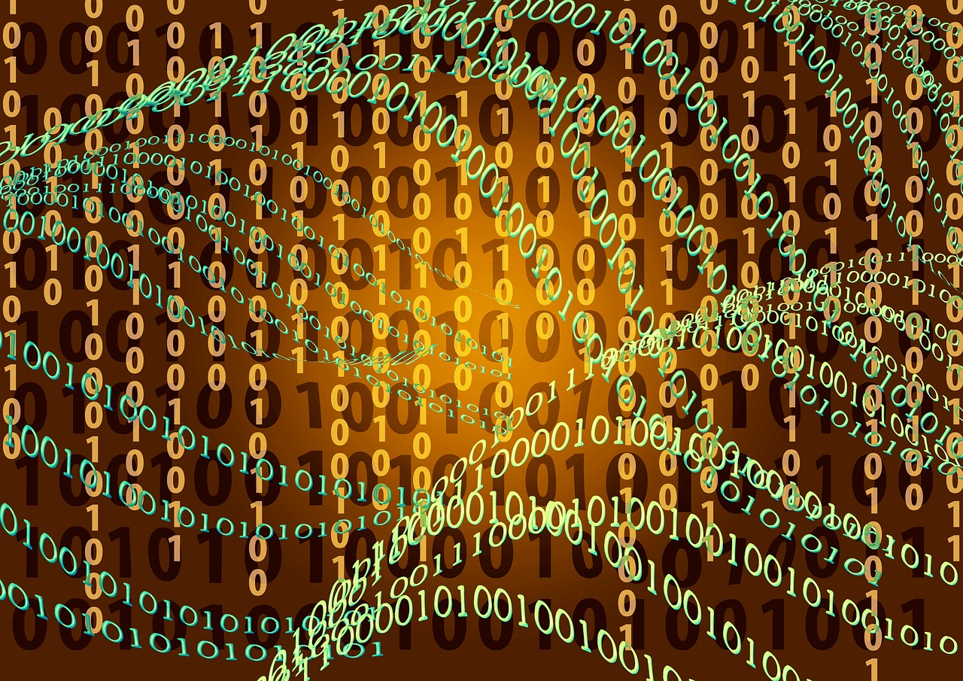
Gather the Bits
Exports all look different
Sometimes little or no metadata
Base64 encoded binary bitstreams
Rights information
Restricted bitstreams
Notes:
One day everything will all be in Hydra/Fedora and life will be easier. But it’s not right now and we can’t wait for the perfect situation to act.
Fedora 3 -- Base64 -- how act on to make AIP?
Rights Information -- both access and use -- trapped in platform (DSpace)
Do we save everything? What is the role of appraisal for digital preservation?
Photo credit: https://pixabay.com/p-507790/?no_redirect

Slide 5
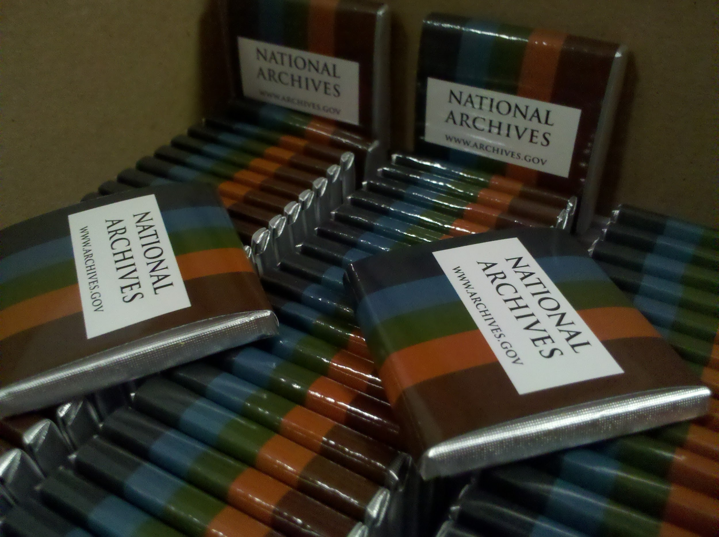
Make the AIPS
Boutique scripts don’t scale
Derivatives (include?)
  Normalization
Versioning of content or metadata
Notes:
AIPS are not all as tasty as chocolate.
Include derivative in AIP or preservation master only?
File format migrations/normalization at time of creating AIP? Include these? (cost) -- Evidence is starting to suggest we overblew the file format thing, to a degree
How to handle changes to metadata without having to reprocess entire AIP
Versioning of digital content? Keep old versions, only new?
Photo Credit: https://upload.wikimedia.org/wikipedia/commons/6/62/NARA_chocolate.jpg

Slide 6
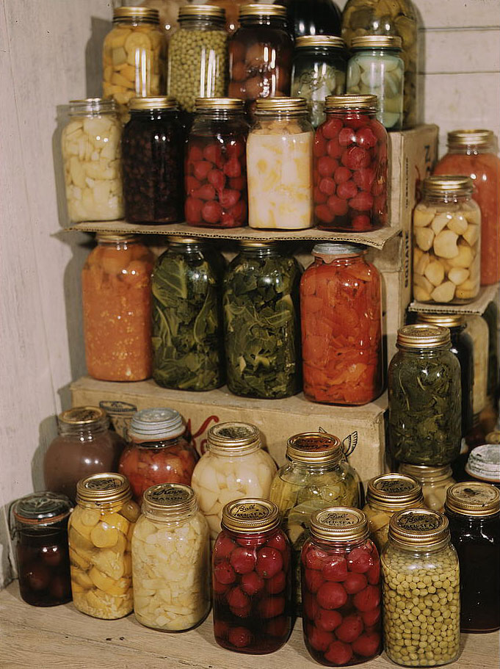
Preservation
Local copies
Remote copies
Tie-breakers
Synchronization
Notes:
More on copies next. But how many do we need
which is tie-breaker in event of fixity change? Re-run all content through characterisation?
If relying on preservation repo to do file format migrations in future, how get back to all other AIPs?
Detect changes in self-submission IR?
Photo Credit: https://upload.wikimedia.org/wikipedia/commons/7/7e/PreservedFood1.jpg

Slide 7
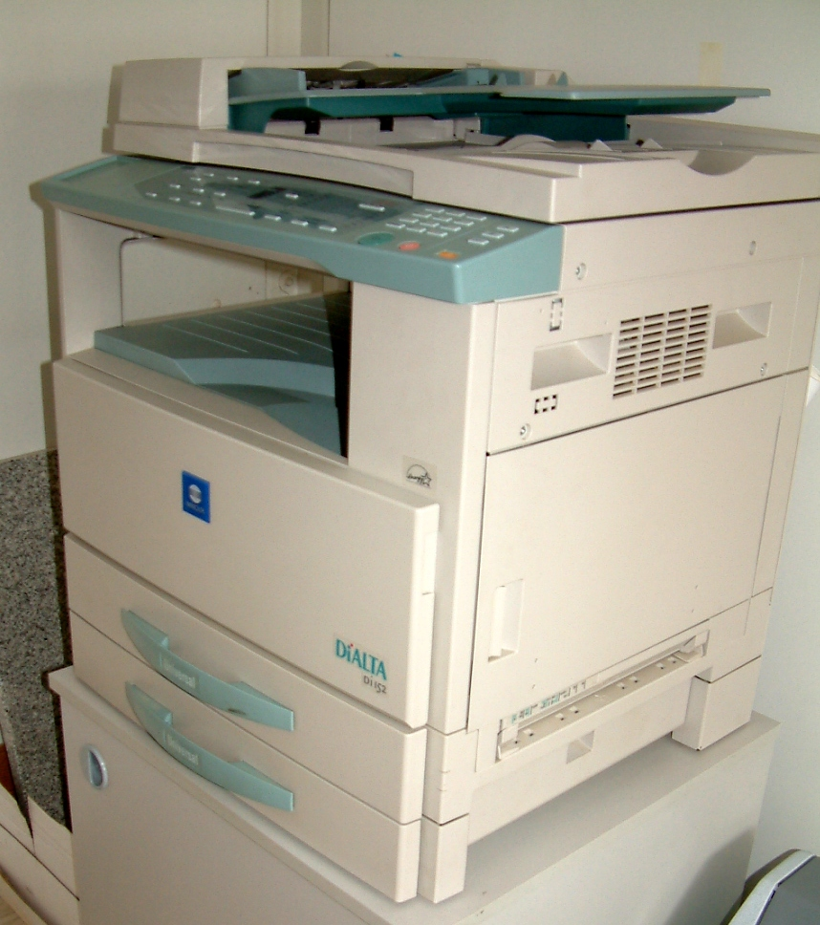
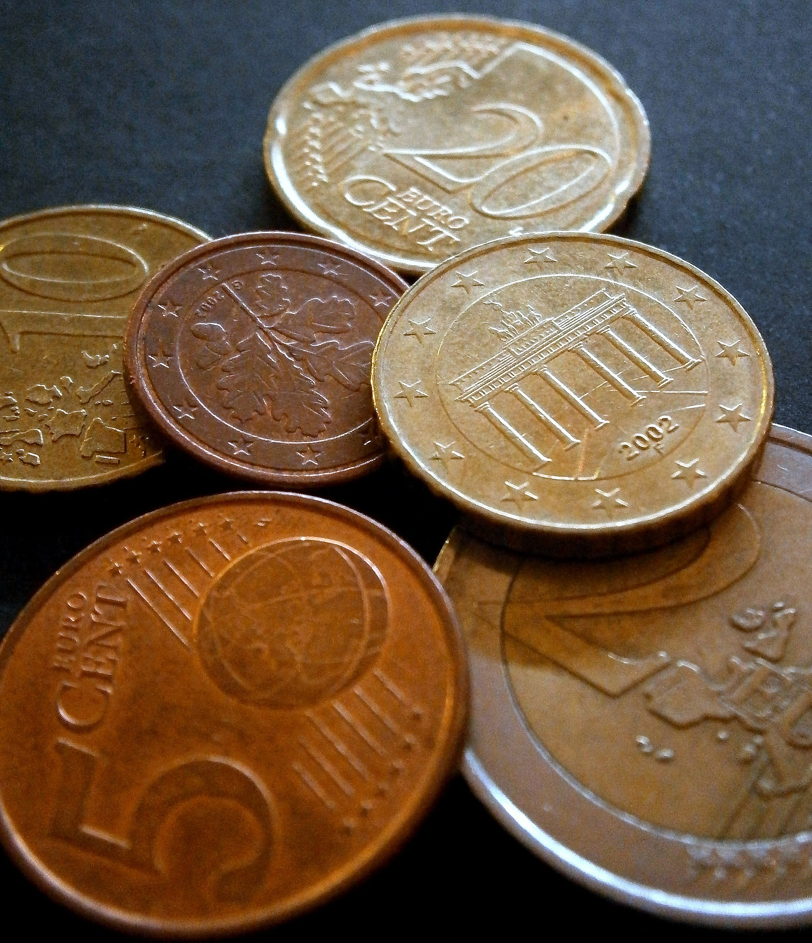
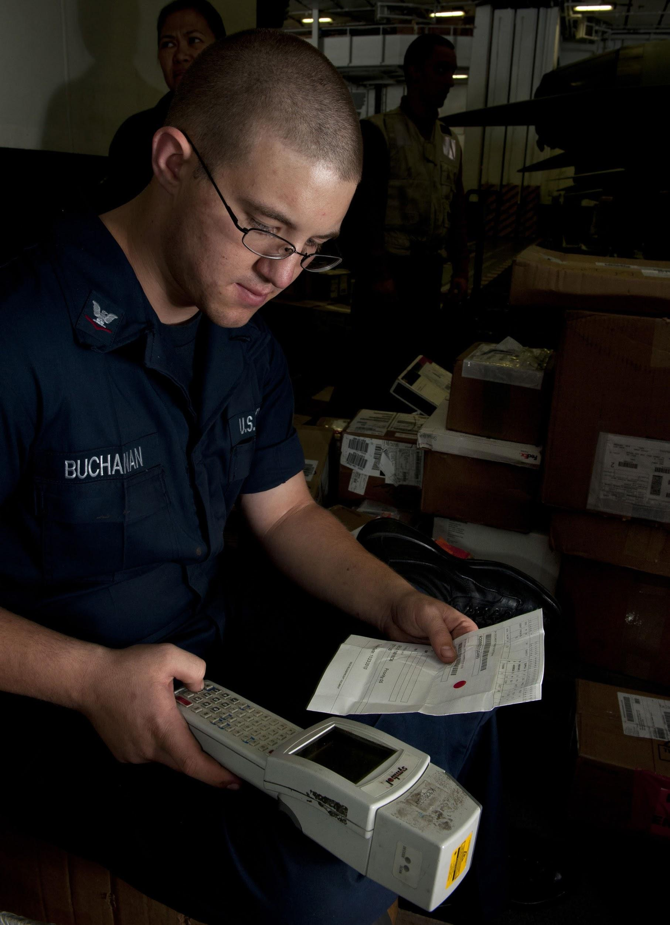
Some of the major concerns
How many copies
Metadata changes
Logistics
Notes:
Costs! Can’t afford to keep unlimited copies locally or remotely. Can’t afford to reprocess big content over and over again because of metadata updates.
How many copies and where are they stored: Already have copies in live repository, also stored on filesystem, in backups, archivematica storage, remote preservation repositories (which may have up to 9 copies). Storage is cheap, managed storage is not -- geo-spatial diversity, redundancy rate, . And how to prevent replication of corrupt copies, overwriting valid copies? Photo Credit: https://upload.wikimedia.org/wikipedia/commons/7/7e/Photocopying_kserokopiarka.jpg
Metadata changes: Don’t want to waste resources on entire workflow if only two words were changed in metadata. And all that storage! Photo Credit: https://pixabay.com/en/money-cash-and-cash-equivalents-209722/
Logistics: With all those copies, it’s necessary to have an sophisticated management system to keep it running smoothly. What’s where? When did it go, who sent it? How to quickly tell. Photo Credit: https://upload.wikimedia.org/wikipedia/commons/b/b4/US_Navy_101203-N-7981E-245_Logistics_Specialist_3rd_Class_Maston_Buchanan,_shipping_and_receiving_supervisor_for_the_Supply_Department's_S-8_Divis.jpg

Slide 8
It’s Complicated

Slide 9
Possible Partial Solutions
Send DIP to ATOM with notes on where it has been sent
  Binder?
Git-like versioning for metadata
  possible stored separately
Rely on backups for disaster recovery, only include master files in AIP
  Risk of holey or corrupt backups
What about
Rights metadata?
Base64?
Normalization?
How many copies?
Bi-directional synchronizations?
Notes:
Workflow implications for separating metadata?
Risk of bad backups
Rights information is non-existent, incomplete, or platform specific
Normalization -- do it? are our choices correct? do we need to include this in AIP or do this with master file in future
How many copies -- locally and remote --
Bi-directional syncing -- if preservation does formate migration, getting the new derivative to all places where the content lives
Changes to content -- redo entire workflow and overwrite old copies? save both copies? Proper way to version content.

Slide 10
It’s Expensive

Slide 11
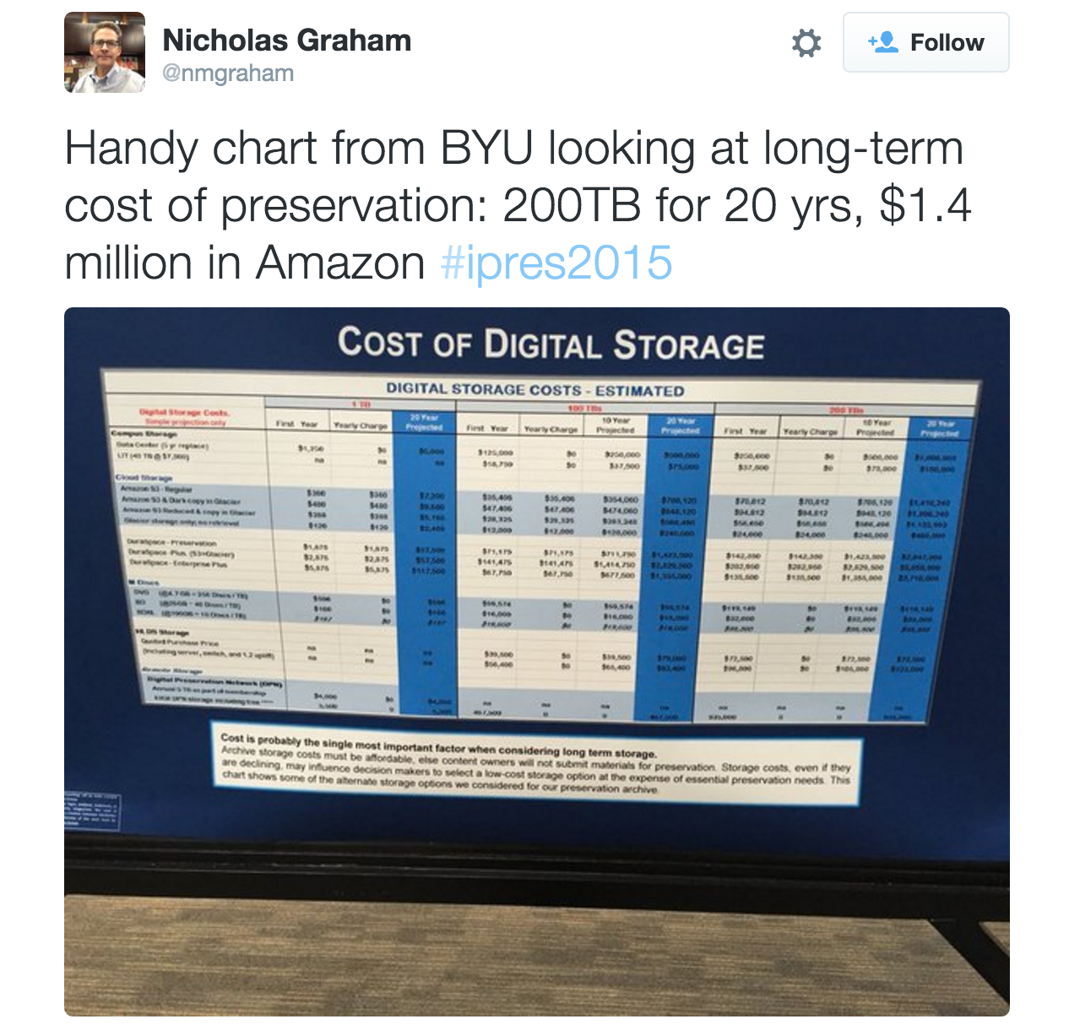
Notes:
Not all of us have big endowments. And even those that do, want to keep it.
That managed storage, ain’t cheap. Local central IT $1M for 20 years for 200 TB, $5M for 200 TB in DuraCloud Enterprise Plus (S3 and Glacier)! We can’t bankrupt our institutions. THis is why derivatives and normalization choices matter.
Some say if we preserve everything to the “gold standard” libraries will bankrupt their host institutions/governments. We can’t keep unlimited copies of everything forever. We will need to make hard decisions at some point about how many copies we can realistically keep and how much processing and enhancement we can do.
Is there room for appraisal? If we have poor quality digital content created in 1996, is it worth the cost of digital preservation?
Photo credit: https://twitter.com/nmgraham/status/661602597514690560

Slide 12
What are you doing? Surely we’re not the first
Are these all local implementation decisions?
Communities of best practice?
Can we have confidence in our due diligence?
Do you compute cost/benefit analysis for some of these choices?
Notes:
Looking forward to a discussion afterwards and to hear more about the choices others have made.
Do you have an appraisal step in workflow? Or do you preserve everything
Did you make some of these decisions five years ago? Where they the right ones for you? Lessons learned?
And let’s not even talk about encrypting content!

Slide 13
Thank You
Nathan Tallman
Digital Content Strategist
University of Cincinnati Libraries
nathan.tallman@uc.edu
@tallman1029

