Slide 1

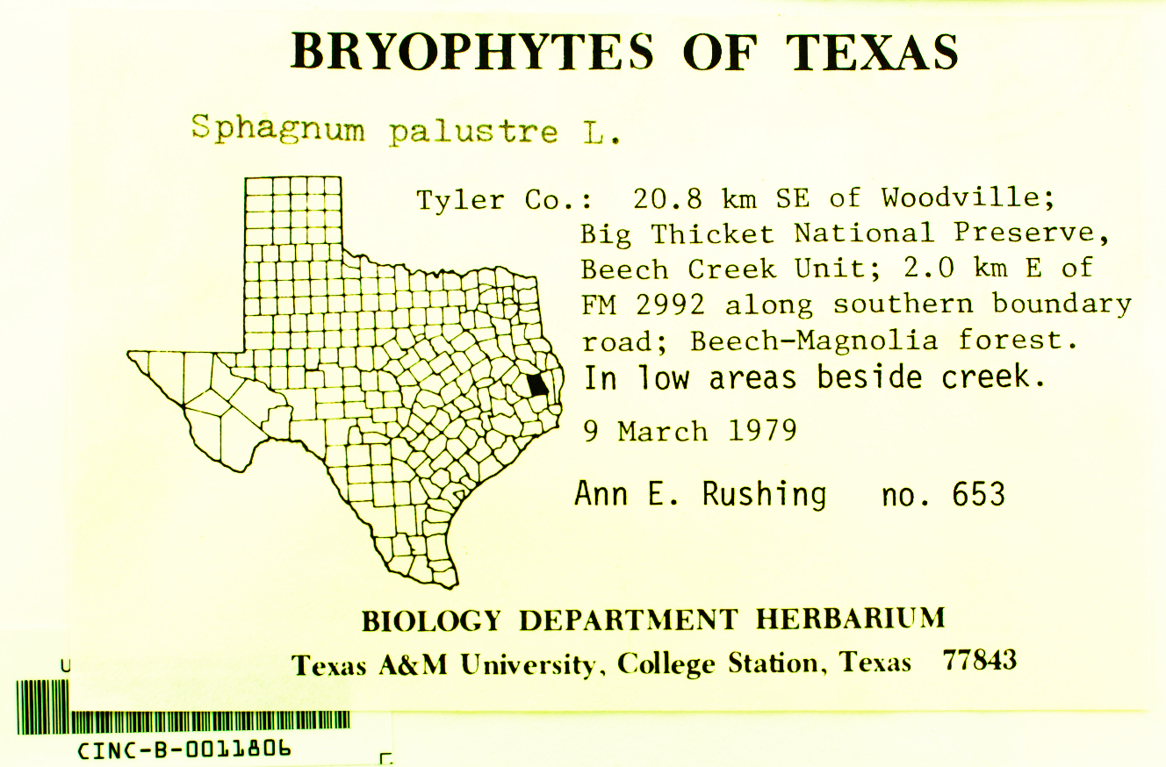
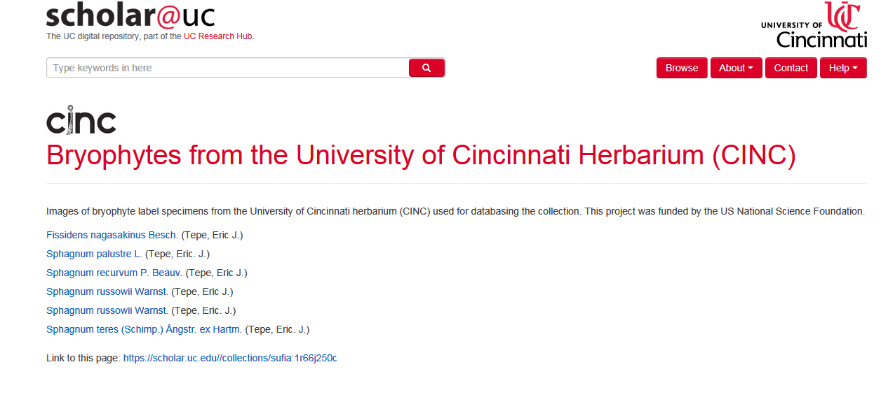
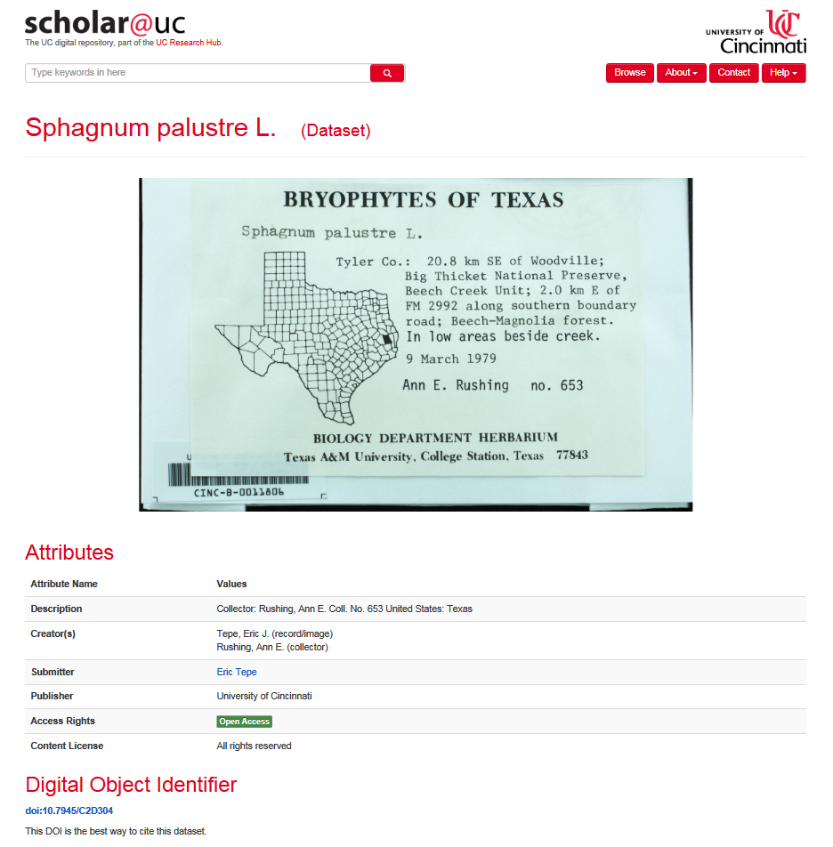
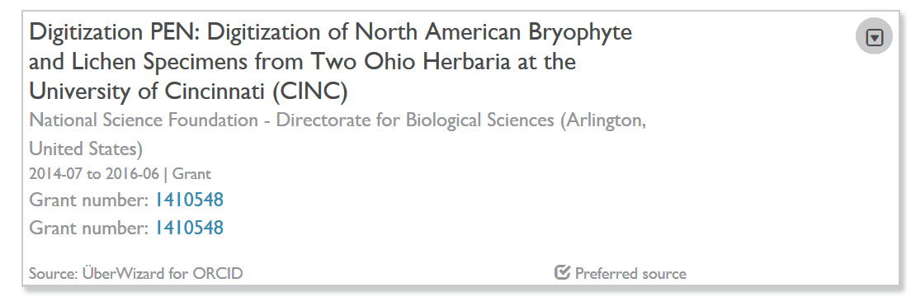


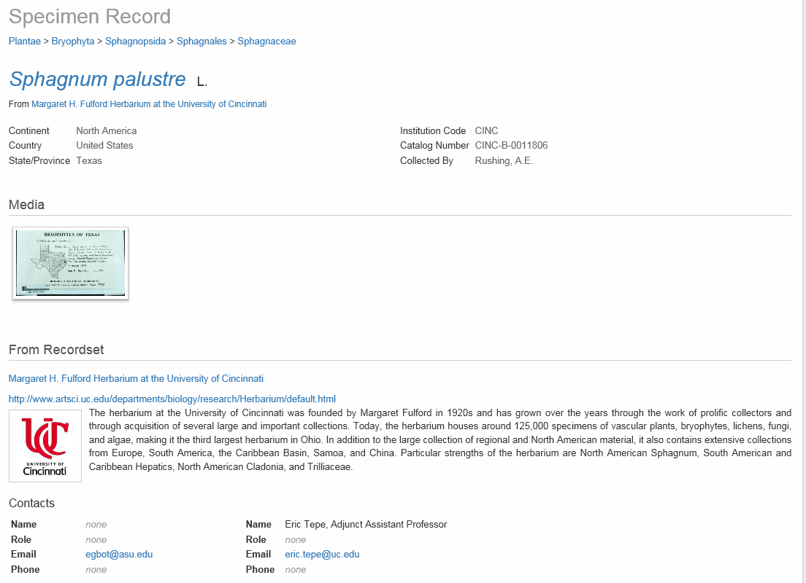
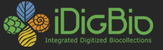
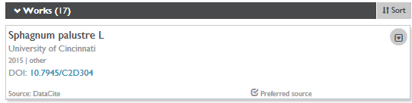
Challenges and Opportunities in a Self-Submission
Institutional Repository (IR) Model
Amy Koshoffer, Science Informationist, UC Libraries, University of Cincinnati
Eric J. Tepe PhD, Assistant Professor, Department of Biological Sciences, University of Cincinnati
Factors that Makes Data Unique
Subject area
Metadata requirement
Challenges of the Self Submission Model
Submitter is in control of content
Benefits of Self Submission Model
Submitter takes ownership of the process
Ability to assign a DOI /citations
File size limits
Public and private settings
Standardization issues
Providing adequate context for data – inclusion of readme files, etc.
Metadata issues
Can get low quality /quantity
Questions regarding process may go unanswered
Unintended uses - storage vs. sharing
Submitter can see the creation of record and submitted files immediately
Submitter can submit content any time – before journal deadlines, etc.
Process can generate feedback from users
Feasible scalability
File formats
Library Opportunities
Education
Not self-explanatory
File formats
Complex file structure
Description – documentation
Result of collaborations
Reflects life work – personal aspect to it
Repositories Features for Data Preservation
Workshops on data preservation
Research guides
Consultation
Partnerships
No standards of format, names, documentation
Handouts
Demonstration of added value for submitted content to researchers
Researcher Opportunities Start With
Building the Data Story…
1
From Data Generation…
2
To Submission to IR…
3
With Detailed Description…
4
…Making an Impact…
REPLACE
5
Through Sharing/Linking…
6
Through Relationships.
Resources:
Koshoffer A., Hansen C. and Newman L. (2016) Challenges with Quality of Dataset Metadata in a Self-Submission Repository Model” Johnston L. Ed., Curating Research Data: Practical Strategies for Your Digital Repository ACRL
Scholar Website http://scholar.uc.edu
Scholar Record of Rushing Sphagnum Collection https://scholar.uc.edu/works/datasets/1r66j251n
Eric J. Tepe’s ORCID profile - http://orcid.org/0000-0002-8493-0736
iDigBio Record for Rushing Sphagnum collection https://www.idigbio.org/portal/records/b1ff57aa-351e-4a22-97d7-9d502d2c557a
Tepe E.J., Culley T.M. and Rogstad S.H - NSF-Funded Research Grant: Digitization of North American Bryophyte and Lichen Specimens from Two Ohio Herbaria at the University of Cincinnati (ADBC – 1410548)
This work is licensed under a
Creative Commons Attribution 4.0 International License.

