Slide 1

The Connected Repository: What more can your IR do?
Thomas Scherz
thomas.scherz@uc.edu
https://github.com/scherztc
scholar.uc.edu

Slide 2
The Semantic Web
Moving from a web of human readable documents (web pages) -> a web of machine readable documents.
This provides automatic interpretation of the meaning of data on the web through algorithms and AI.

Slide 3
Resources: Repositories as Sources
Digital Objects as Resources (URI/URL)
Repositories as Publishers
Bitstreams and Metadata Wrappers
  (Descriptive, Technical, and Relational)

Slide 4
Linking (Relational) Metadata :
Linked Open Data, RDF, and Graphs
Naming things with URIs
Describing things with RDF
Resource Linking : Make triples that link to other resources

Slide 5
Our First Initiatives: Community and Local
DOIs
ORCIDs
Cloud Services Storage (AWS, Google, Box, Dropbox)
Campus Research Directory
Campus LMS – Archive IT

Slide 6
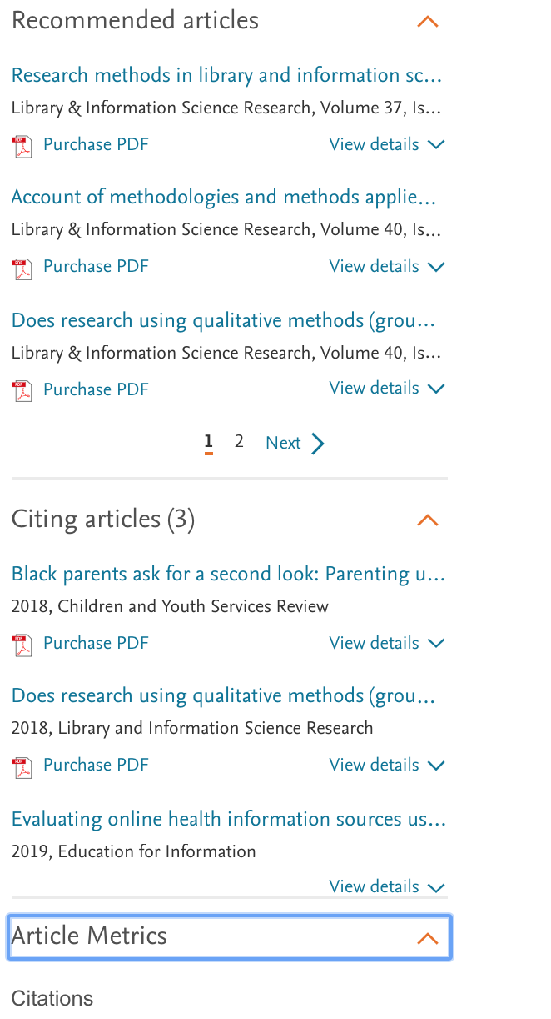
What’s next?
Validation and Verification
Linking as validation.
Leverage our expertise. Be the authority.
Build a Killer App!
(CrossRef Cited-by for Universities)
What can we learn?
Next steps

Slide 7
Key Features of a Connected Repository
Build/Expose an API for your repository. Be a good citizen.
UX Design… Use the right side bar for Linked Experience.
  (Recommendations, Citing, Metrics)
Use Namespacing in Metadata. Provides Provenance.
Participate in consortiums. Code together.

Slide 8
Reference
http://linkeddatabook.com/editions/1.0/#htoc36
http://www.linkeddatatools.com/
https://www.crossref.org/services/cited-by/

