Slide 1

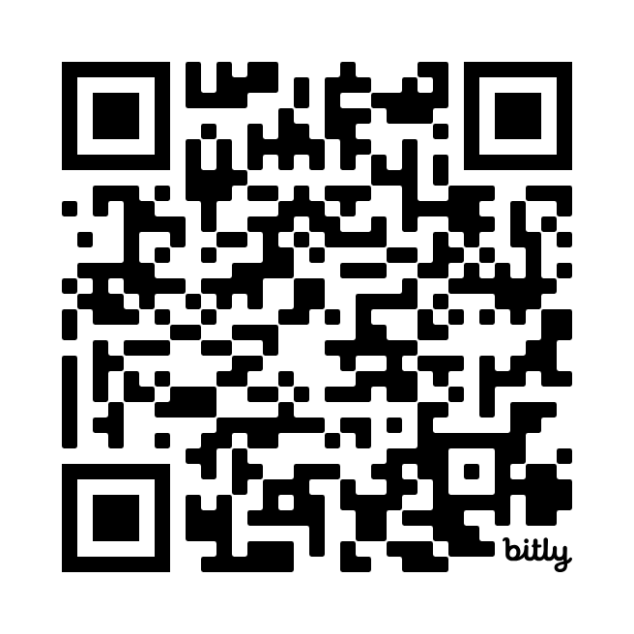
Introducing
An Open-Source Curriculum for LIS Researchers
Saturday, June 29, 2024
9:00am – 10:00am
take our pre-session survey!
Notes:
Survey short link
https://bit.ly/LPOLALA1
Outline notes: https://docs.google.com/document/d/1Dis7Y806AWePBpBD7wLC0FYUSHwEfXrhLZ9CFgDmnMA/edit?usp=sharing
Hailley
Hi everyone. Thanks so much for being here this morning. Our session is “Introducing LibParlor Online Learning: An Open-Source Curriculum for LIS Researchers.” As you can see from this slide, we do have a pre-session survey that we’d love for you to take. You’ll see this QR code again if you haven’t snagged it yet.

Slide 2
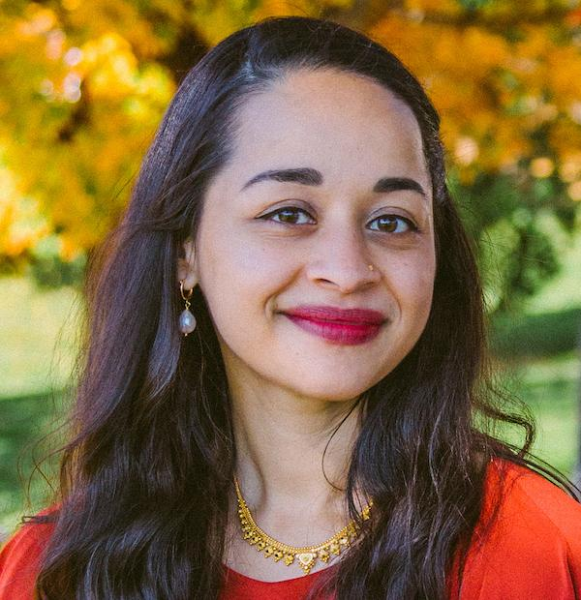
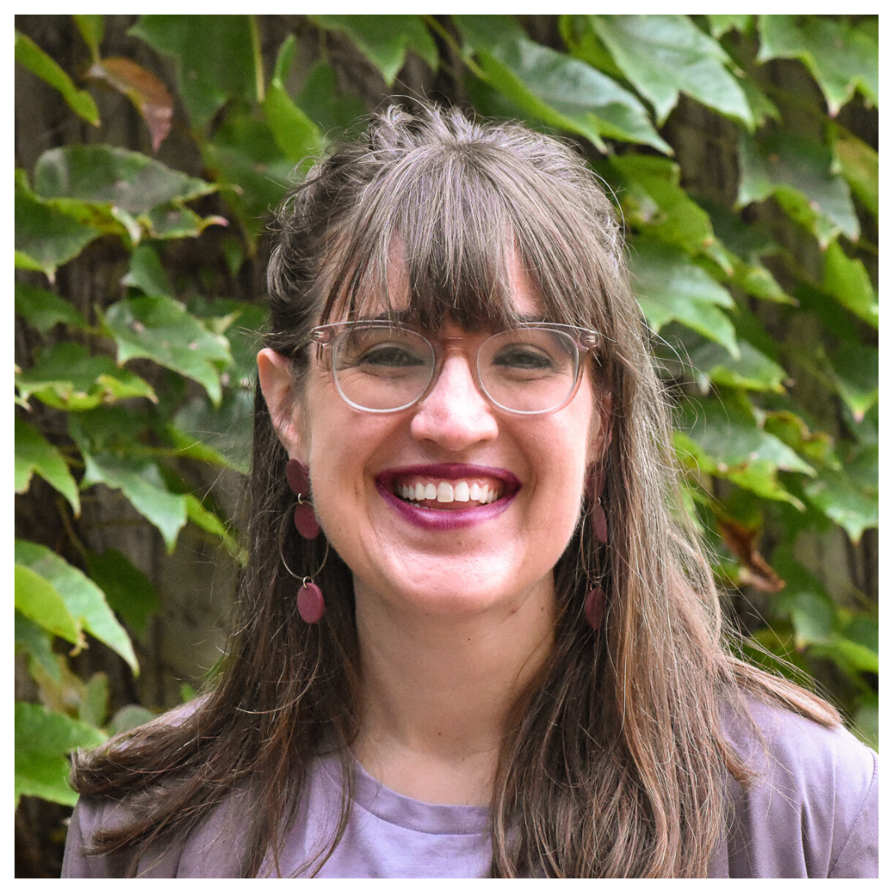
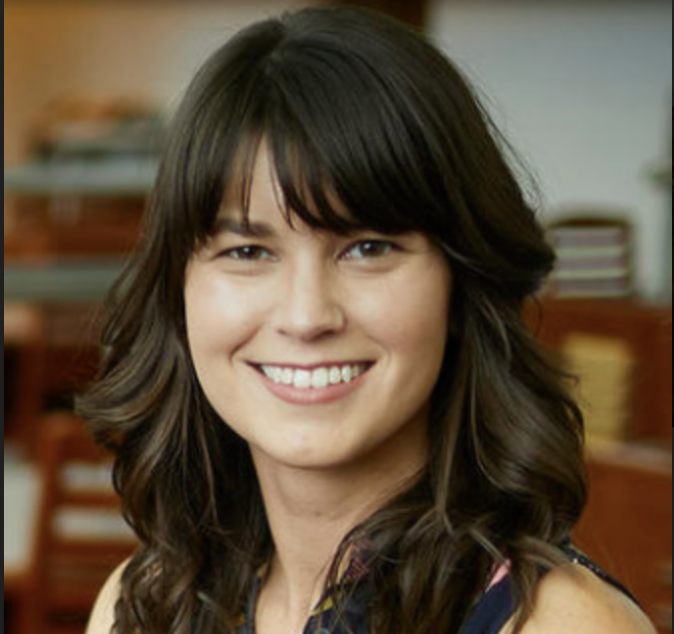
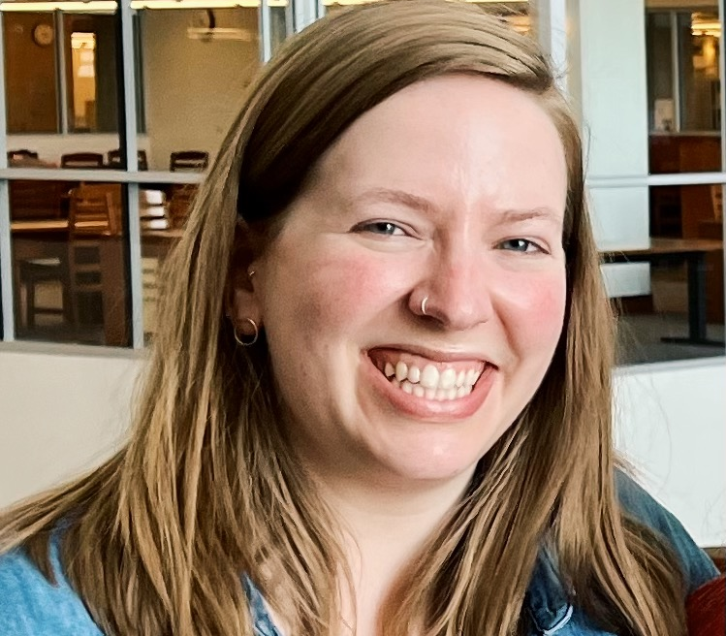
Nimisha Bhat
she/her/hers
Subject Librarian, University of Cincinnati
@mishiebhat
Hailley Fargo she/her/hers
Head of Education
and Outreach
Northern Kentucky University
@hailthefargoats
Chelsea Heinbach she/her/hers
Teaching & Learning Librarian
University of Nevada, Las Vegas
@chelseaheinbach
Charissa Powell she/her/hers
Head, Student Success and Curriculum Partnerships
University of Delaware
Notes:
Hailley
We’d like to start off with some introductions. My name is Hailley Fargo and I’m the Head of Education & Outreach Services at Northern Kentucky University. With me today is…[Chelsea intros herself]. We also have two other team members who cannot be here with us this weekend, but are incredibly important co-PIs with Chelsea and I on LPOL. We have Nimisha Bhat, who is a subject librarian at the University of Cincinnati, and we have Charissa Powell, who is the Head of Student Success and Curriculum Partnerships at the University of Delaware. The four of us have worked closely for many years, including the last three as we created and will soon launch LPOL.
All- Introductions (5-8 minutes)
Intro of hailley/chelsea
Introduce nimisha/charissa as not there

Slide 3
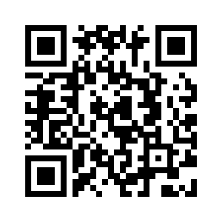
Land acknowledgement + action
Kumeyaay Land Acknowledgment created by Mike Connolly Miskwish (Kumeyaay)
For millennia, the Kumeyaay people have been a part of this land. This land has nourished, healed, protected and embraced them for many generations in a relationship of balance and harmony…we acknowledge this legacy. We promote this balance and harmony. We find inspiration from this land; the land of the Kumeyaay.
Donate to the Kumeyaay Diegueño Land Conservancy:
Notes:
Hailley
We’d like to take a moment and acknowledge the land we are on today. This land acknowledgement comes from San Diego State and was created by Mike Connolly Miskwish. We have the abbreviated version of this land acknowledgement up on the slide [read land acknowledgement].
We recognize the limitations of land acknowledgement statements and that there are specific things we can do as librarians towards decolonization. We have to combine land acknowledgements with concrete and direct action. This direct action can look like donating to nonprofit organizations and efforts that center Kumeyaay needs, the Kumeyaay Community College, the Kumeyaay Diegueno (D-ay-gain-yo) Land Conservancy, or the Southern Indian Health Council. The QR code on the slide takes you to the Kumeyaay Diegueno Land Conservancy. We also encourage you to engage more personally by researching the different lands you currently inhabit.
—----------------------------------------------------------------------------------
-Land acknowledgement + action
Donating to nonprofit organizations and efforts that center Kumeyaay needs-Kumeyaay Community College, Kumeyaay Diegueno Land Conservancy, and Southern Indian Health Council to name a few. - I think we should pick one of these and if we can all donate
http://kdlc.org/
Land acknowledgements from:
https://www.sandiego.edu/inclusion/tribal-liaison/land-acknowledgement.php
“For events on campus at San Diego State, please use the full or abbreviated Land Acknowledgment statement below: Kumeyaay Land Acknowledgment created by Mike Connolly Miskwish (Kumeyaay)
[Full Version] We stand upon a land that carries the footsteps of millennia of Kumeyaay people. They are a people whose traditional lifeways intertwine with a worldview of earth and sky in a community of living beings. This land is part of a relationship that has nourished, healed, protected and embraced the Kumeyaay people to the present day. It is part of a world view founded in the harmony of the cycles of the sky and balance in the forces of life. For the Kumeyaay, red and black represent the balance of those forces that provide for harmony within our bodies as well as the world around us. As students, faculty, staff and alumni of San Diego State University we acknowledge this legacy from the Kumeyaay. We promote this balance in life as we pursue our goals of knowledge and understanding. We find inspiration in the Kumeyaay spirit to open our minds and hearts. It is the legacy of the red and black. It is the land of the Kumeyaay.
[Abbreviated Version] For millennia, the Kumeyaay people have been a part of this land. This land has nourished, healed, protected and embraced them for many generations in a relationship of balance and harmony. As members of the San Diego State community we acknowledge this legacy. We promote this balance and harmony. We find inspiration from this land; the land of the Kumeyaay. “

Slide 4
Housekeeping
If you haven’t already done so, please take our pre-session survey!
Our session today will involve some small group work
We’ll end the session with time for Q&A
Notes:
Hailley

Slide 5
Learning Objectives:
Attendees will be able to describe the types of support librarian-researchers require in order to effectively publish rigorous research and identify ways to advocate for these resources.
Attendees will evaluate lessons from a new, innovative, and free online curriculum that will meet the support needs of librarian-researchers.
Attendees will identify ways that the curriculum can be incorporated into their work and institutions.
Notes:
Hailley

Slide 6
Introductions
At your tables, please introduce yourselves with:
  Your name and pronouns
  Your institution + role
  What brought you to this session today
Notes:
Hailley

Slide 7

The Librarian Parlor
libparlor.com
Established in 2017, LibParlor is a space for conversing, sharing expertise, and asking questions about the process of developing, pursuing, and publishing library research. We feature interesting research methodologies, common challenges, in progress work, setbacks and successes. In providing this space, LibParlor aspires to support the development of a welcoming community of new researchers.
Notes:
Chelsea
Today we will mainly be discussing LPOL, the new curriculum we are launching at the end of the summer. However, we started our work together back in 2017 as brand new librarians when we founded The Librarian Parlor, or LibParlor.
The Librarian Parlor is a space for conversing, sharing expertise, and asking questions about the process of developing, pursuing, and publishing library research. We started LibParlor in 2017 as a blog for LIS researchers to share their research experiences, and it has since grown into a platform where we also publish
Reflections
Research methodologies
Podcast episodes where LIS researchers undergo open peer review
Community board posts where LIS researchers can post calls for research partners, participants, etc
We felt that there were many barriers to conducting research, and wanted to make a space to demystify the research process.

Slide 8
Barriers to research in the field
Master of Library and Information Science (MLIS) programs are inconsistent in their offerings for learning about research
The field lacks affordable, accessible, and effective training opportunities, and many librarians do not have the resources, time, or support to learn how to do research
Challenges are exacerbated for BIPOC librarians and this uneven support leads to unequal representation in the literature
Can lead to unpursued research questions, poorly designed research projects, or unpublished results
Notes:
Chelsea
Master of Library and Information Science (MLIS) programs are inconsistent in their offerings for learning about research, and often LIS researchers new to the field struggle with XYZ
The field lacks affordable, accessible, and effective training opportunities, and many librarians do not have the resources, time, or support to learn how to do research
Challenges are exacerbated for BIPOC librarians and this uneven support leads to unequal representation in the literature
Can lead to unpursued research questions, poorly designed research projects, or unpublished results
-(pulling from previous research) (very brief) (humanizing early career researchers)
Notes:
This leads to a field that lacks diverse, inclusive, and robust scholarship
Crampsie, C., Neville, T., & Henry, D. (2020). Academic librarian publishing productivity: an analysis of skills and behaviors leading to success. College & Research Libraries, 81(2), 248–271.
Walker, S. (2015). Critical race theory and the recruitment, retention and promotion of a librarian of color: A counterstory. Library Faculty Scholarship.1.

Slide 9
Our Core Question:
What do LIS professionals need to get started with research?

Slide 10
Support for librarians conducting research
Knowledge
opportunities for rich and ongoing education around research methods and methodologies
Finances
financial support for travel, professional development, and research expenses
Community
fellow LIS researchers to be share ideas, refine work, provide emotional support, and serve as co-researchers
Notes:
Chelsea
Describe the elements that support researchers and how we identified that we should do a curriculum
Knowledge
opportunities for rich and ongoing education around research methods and methodologies
Finances
financial support for travel, professional development, and research expenses
This is why it was important to us to provide access to the curriculum for free
Community
fellow LIS researchers to be share ideas, refine work, provide emotional support, and serve as co-researchers
We hope the curriculum will offer opportunities for people to connect over shared ideas and challenges
We even hope to create an opportunity for institutions to use the curriculum with cohorts

Slide 11
An Open-Source Curriculum for LIS Researchers
Notes:
Chelsea
This led us here, to create Libparlor Online Learning, an open source curriculum for LIS researchers
To provide access to privileged knowledge
This is why it was important to us to provide access to the curriculum for free
We hope the curriculum will offer opportunities for people to connect over shared ideas and challenges
We even hope to create an opportunity for institutions to use the curriculum with cohorts

Slide 12

Thank you
Advisory Board
Erin Ackerman, The College of New Jersey
Zara T. Wilkinson, Rutgers University
Jason Clark, Montana State University
Dr. Rachel Fleming May, University of Tennessee Knoxville
This project was made possible in part by the Institute of Museum and Library Services RE-250054-OLS-21
Notes:
Chelsea
We are grateful that the institute of museum and library services has funded this work with a three year project grant through the Laura bush 21st century librarian program. We are also so thankful for the guidance of our advisory board, whose expertise includes
MLIS education
Developing curricula
Barriers to LIS research
It’s all of our first national grant, and the guidance of both IMLS and our advisory board has been invaluable throughout the process.

Slide 13
Thank you to our curriculum creators
Andrew Asher | Rachel Borchardt | Vivian Byone | Angelica Bennett | Nimisha Bhat | Brianna Chatmon
Sojourn Cunningham | jaime ding | Sandra Aya Enimil | Nina Exner | Nancy Falciani-White | Hailley Fargo
Erin Gow | Jessica Hagman | Sara Hare | Chelsea Heinbach | Kirsten Hostetler | kYmberly Keeton
 | Erin Owens | Charissa Powell | Eamon Tewell | Elaine Thornton
For more information, see https://libparlor.com/2023/05/15/lpol-curriculum-creators/
Notes:
Chelsea
22 creators from various backgrounds and expertise and institution type

Slide 14
A brief timeline
Spring 2022: Needs assessment survey and focus groups
May 2022: In-person forum at UNLV Libraries
October 2022: Virtual forum
Spring 2023-Fall 2023: Curriculum Creation
Spring 2024: Curriculum Pilot
Early Fall 2024: Launch
Notes:
Chelsea

Slide 15
Curriculum Overview
Full curriculum contains six courses:
Who Are You As a Researcher?
The LIS Research Process and Methodologies
Project Planning
Writing and Editing
Publication and Peer Review Process
Putting It All Together
Notes:
Hailley
-some sort of visual of the curriculum
-slides vs. website.
-using slides to open up the landing page :)

Slide 16
Curriculum Overview
Each course = 2-5 lessons with readings & activities
Whole curriculum = 20-30 hours to work through
Can be completed as whole curriculum or individual lessons & courses
Notes:
Hailley
-some sort of visual of the curriculum
-slides vs. website.
-using slides to open up the landing page :)

Slide 17
LPOL Curriculum Learning Outcomes:
Develop and articulate a personal understanding of their research identity and values
Identify and navigate the institutional and professional systems that intersect with LIS research
Describe the LIS research process and articulate disciplinary norms
Notes:
Hailley
Learning outcomes part 1
Develop and articulate a personal understanding of their research identity and values in order to create short- and long-term research goals
Identify and navigate the institutional and professional systems that intersect with LIS research in their given context
Describe the LIS research process and articulate disciplinary norms in order to make informed decisions about their own research projects

Slide 18
LPOL Curriculum Learning Outcomes:
Assess various LIS research methodologies
Apply project planning skills and strategies
Critically evaluate the field of LIS research
Notes:
Hailley
LPOL learning outcomes
Assess various LIS research methodologies in order to choose an appropriate approach for their own projects
Apply project planning skills and strategies in order to develop a research proposal and timeline
Critically evaluate the field of LIS research in order to advocate for change and promote an inclusive, supportive, and rigorous research community

Slide 19
By completing the entire curriculum, learners will leave with the following artifacts:
A researcher identity statement
A research agenda
A support ecosystem
A research proposal
Notes:
Hailley
A researcher identity statement: This is a personal narrative that demonstrates their interests, values, and positionality as a researcher.
A research agenda that articulates their short and long-term research goals.
A support ecosystem which demonstrates the various places in their personal and professional life to seek support during the research process.
A research proposal that includes a full formed research topic, a practice literature review, proposed methods, a data management & ethics plan, a project schedule, and a practice CFP submission

Slide 20
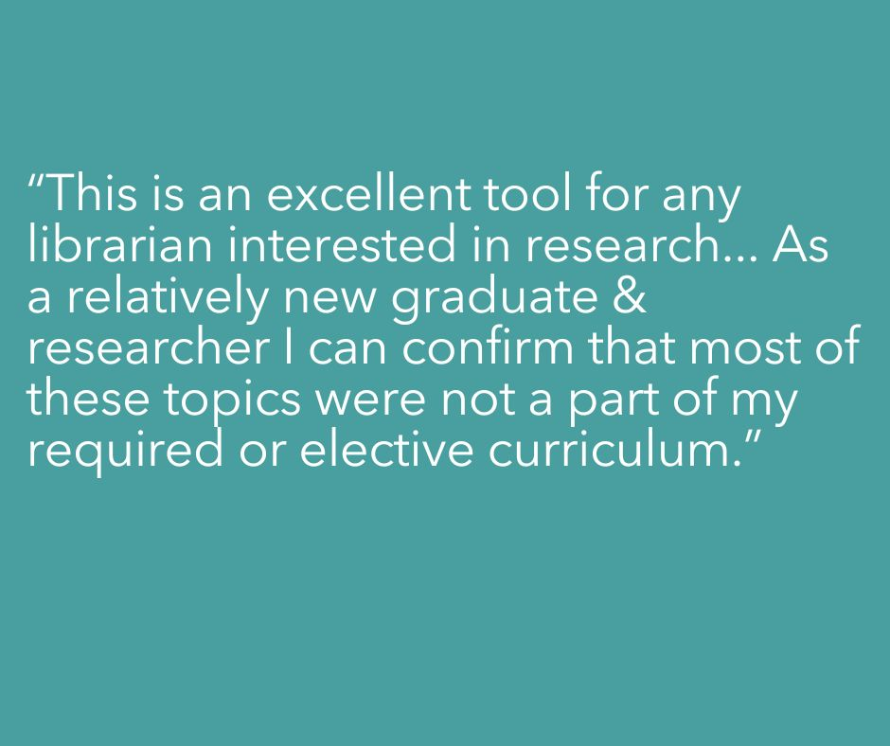
Notes:
501a3a
1d7b83
Hailley

Slide 21
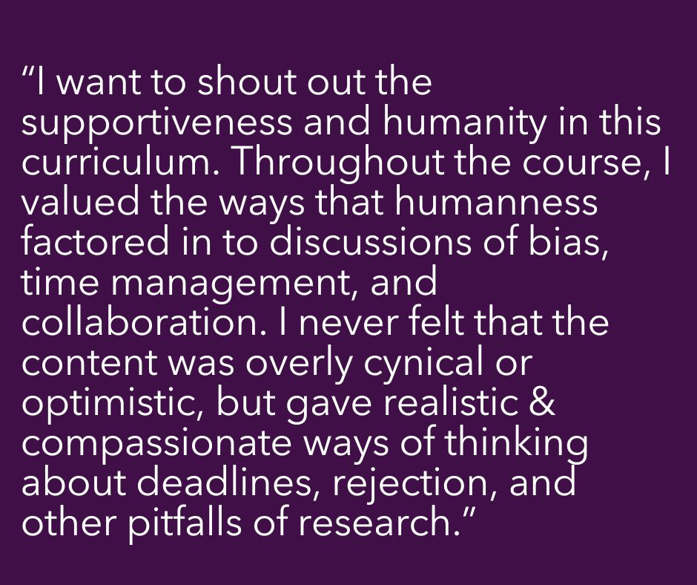
Notes:
Hailley

Slide 22
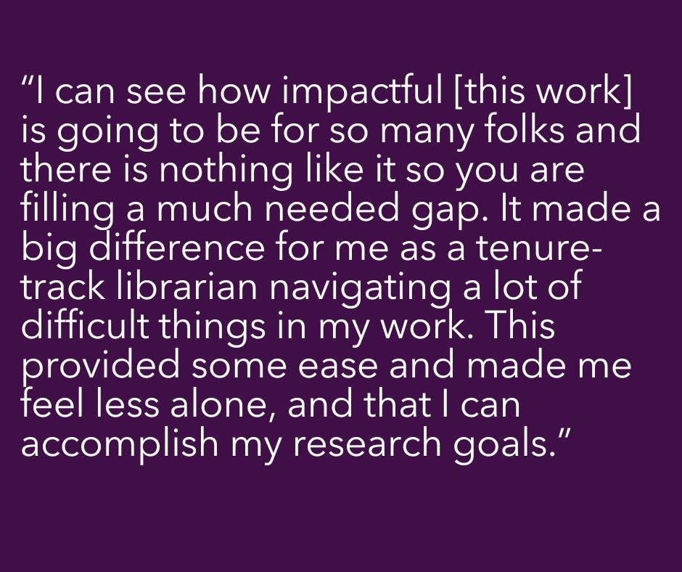
Notes:
Hailley

Slide 23
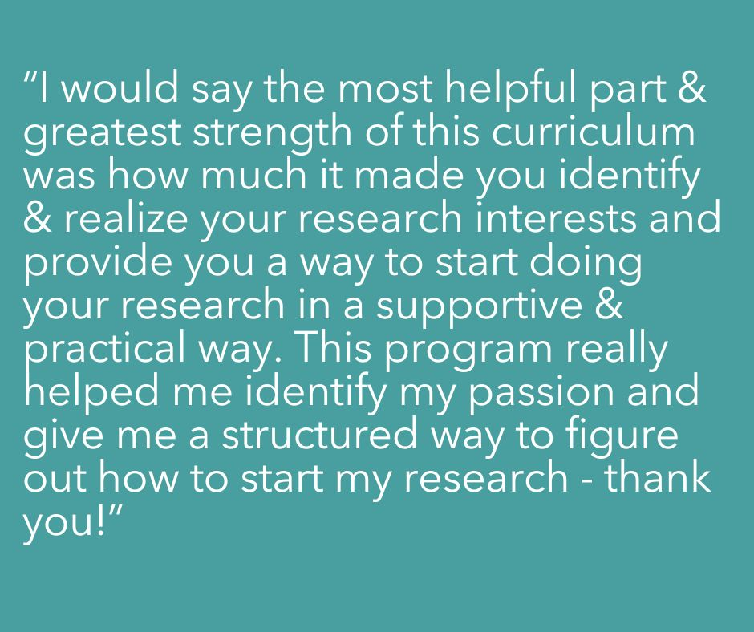
Notes:
Hailley

Slide 24
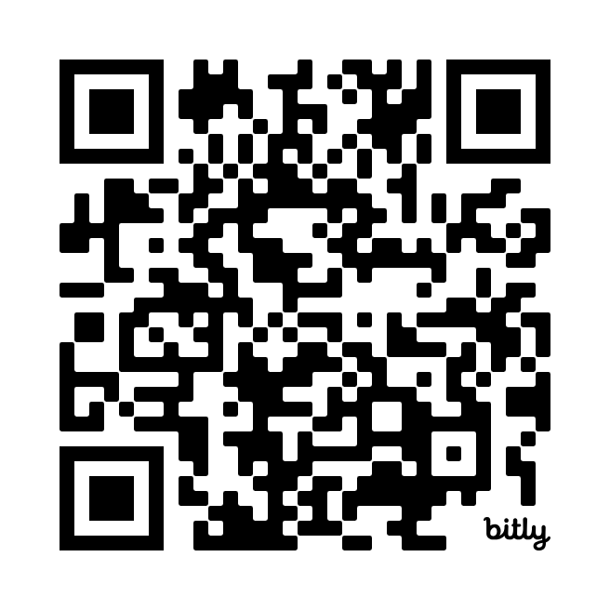
Group Activity
bit.ly/LPOLALA3
  Your table has been assigned a persona. With your tablemates, discuss what kind of research education needs this persona might have.
  Look at the curriculum outline and pick out 3-5 lessons you think should be recommended to this persona.
  Record your thoughts and observations as comments in the Padlet under your role.
Notes:
Both
High level look at the curriculum - identifying pathways
If you at your table dont feel comfy replying to that persona feel free to reply to the padlet
10 minutes to dig in and will check back in with you
Role play scenario
Roles (assigned randomly to each table):
MLIS student who has taken a research methods course and is interested on collaborating on a research project for the first time
Early-career librarian who took a library research methods course in grad school, is now in their first tenure-track academic library job
Mid-career librarian who has shifted roles a few times, not tenure-track, wants to pursue original research based on a project for a new service they are proposing at their library
Established librarian who oversees a popular program at their library, has done some research over the years but not extensively, and wants to publish an extensive study to assess the outcomes of their program
LIS faculty instructor who teaches in a program with a research methods course available
Department head in charge of the junior faculty cohort at their institution, tasked with education & mentoring support
Directions on the slide: Your table has been assigned a persona. With your tablemates, discuss what kind of research education needs this role might have. Look at the curriculum outline and pick out 3-5 lessons you think should be recommended to this persona. Record your thoughts and observations in the Padlet under your role.
Padlet for responses

Slide 25
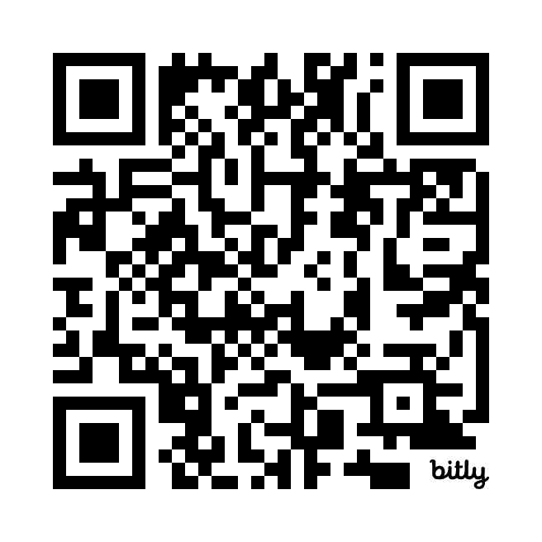
Individual Reflection
bit.ly/LPOLALA4
Think about your own context and research needs. How might you use LPOL?
Consider your institution. How might your institution use or benefit from LPOL?
Where else do you think we should share this curriculum once it has been launched?
Feel free to add something to the padlet or come to the mic and speak about your own needs
Notes:
Both
Take five minutes to reflect individually on how this curriculum might work for you
Feel free to continue to talk with your group if you would like
If you feel comfy, add your context so we can get a sense of what resonates with different user groups - are you early career? mid-career? R1, community, college, etc.

Slide 26
Next steps
Getting ready for launch in Fall 2024!
  Finalizing graphic design + activities!
  Developing routes for particular user groups
  Developing ways to utilize the curriculum in a cohort
Notes:
Chelsea

Slide 27
Q&A
Notes:
-10 minutes Q&A
Both

Slide 28

Thank you!
Get in touch: libparlor@gmail.com
Notes:
Chelsea

