Slide 1
Hanging with Hydra
If you want to go fast, go alone
If you want to go far, go together
Nathan Tallman
Digital Content Strategist
University of Cincinnati Libraries
Ohio IR Day
24 October 2014
Notes:
This is not a talk about Hydra, although there’s a brief introduction; it’s a talk about getting started with Hydra. UC recently launched Hydra based faculty, self-submission IR.
Please see me or any other Hydra shop for more details.

Slide 2
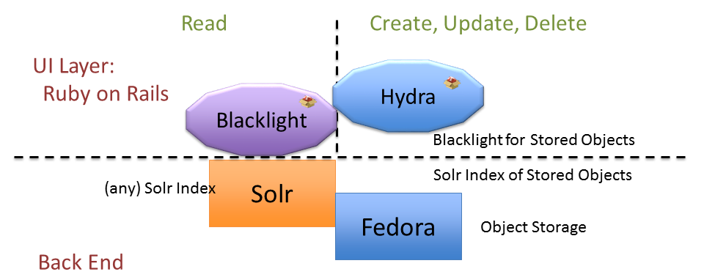
What is Hydra?
Hydra is a technical framework to build a digital repository
Ruby on Rails -- web application framework
Fedora -- digital repository software
Solr -- lightning fast indexer
Blacklight -- faceted discovery interface
Notes:
Hydra is about building a framework rather than a closed application. It is designed so that adopters can each have their own design mix of features; variation is part of the plan.
Rails can take some getting used to, but is very powerful. It’s possible to quickly build web interactive applications. For example, you can build Twitter a couple of days.
Hydra Partners are committed to contributing back to the project: code for the core, documentation, design patterns and more. Agreeing to common some standards
Hyda does mean you need developers, but you can still be a small shop. There are many Hydra adopters/partners with only one developer.
Hydra is a Community -- Hydra is a large, multi-institutional collaboration. The project gives like-minded institutions a mechanism to combine their individual repository development efforts into a collective solution with breadth and depth that exceeds the capacity of any individual institution to create, maintain or enhance on its own. The motto of the project partners is “if you want to go fast, go alone. If you want to go far, go together.”

Slide 3
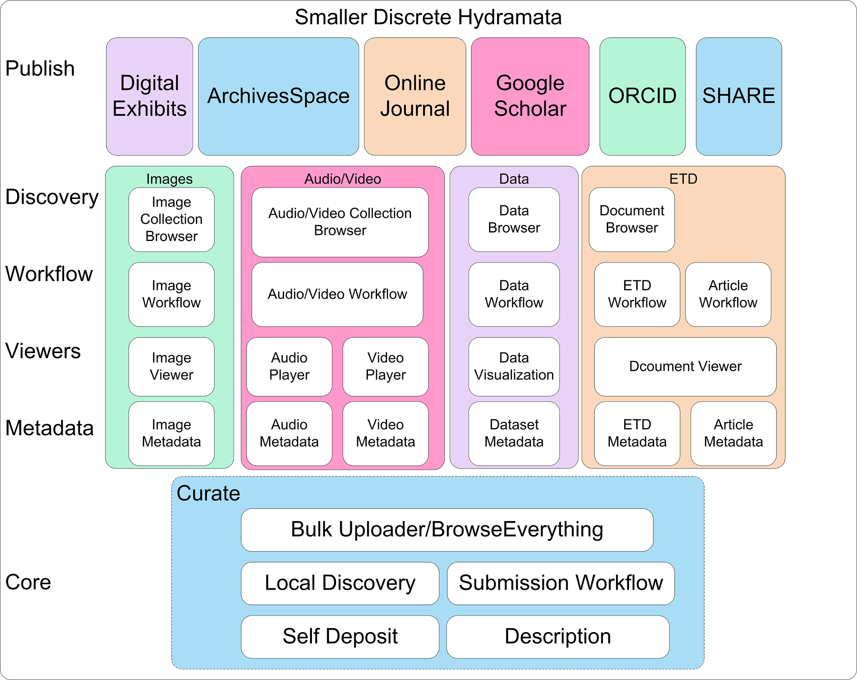
Notes:
Called project Hydra, because you can have one body and many heads.
Hydra heads for different purposes or even collections.

Slide 4
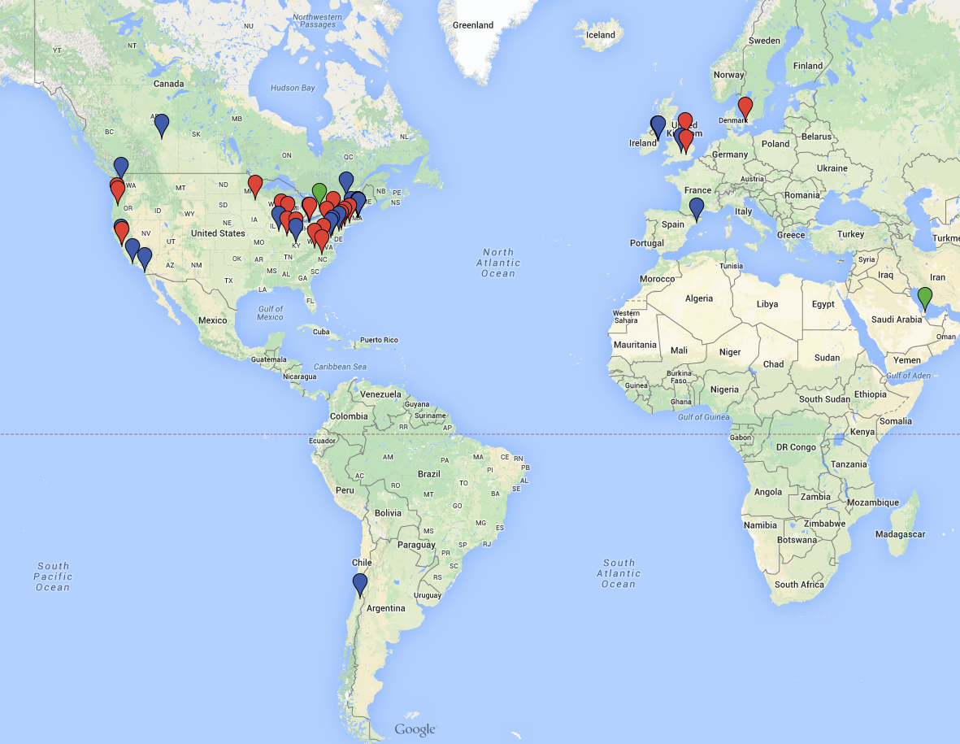
Hydra community is growing exponentially.
Notes:
big part of the Hydra community is the sharing principle and developing with similar abstractions. On the sharing side of things, I am still working on getting a monthly Skype call together with any hydra or interested hydra developers together. Informal conversations where we can talk about what we are working on and ask questions. Giving the developers a resource regionally.

Slide 5
Decisions and Dates
Fall 2013 -- Join Project Hydra as a Partner, hire developer
January 2014 -- Join shared development project for Curate, an Hydra IR
March 2014 -- Start building server environment
May 2014 -- Curate development suspends, bug squashing
Notes:
Fall 2013 -- joined Hydra as a partner, attended Hydra camp, established sandbox and installed sufia, avalon, curate
January 2014 - joined the shared Curate development project with Northwestern, Notre Dame, Indiana University, University of Virginia. Learned agile, gitflow, coding and testing local app on laptops, sandbox before committing to project github. Kept our sandbox app up to date with “vanilla curate”-- the sandbox app of the shared project.
March 2014 -- work begins -- a software developer and devops person working together -- to establish dev, qa, and production server environment, and create a deploy strategy using bamboo and puppet.

Slide 6
Decisions and Dates
August 2014 -- Name chosen: Scholar@UC
September 2014 -- Server environment up and running, test and abuse application in name of security.
October 6, 2014 -- Launch Scholar@UC with small group of early adopters
Spring 2015 -- University wide roll out
Notes:
August -- name and URL chosen: scholar@uc -- scholar.uc.edu
September 5 - Dev, QA, and production environments operational, puppet scripts on bamboo server working, re-deploy tested. [Our puppet scripts are available at https://github.com/uclibs/scholar-puppet.]
September 10-12 -- Fedora 3 XACML policies in place, our application (based on a fork of Curate, with some modifications) is deployed.
September 19 -- UC IT Office of Information Security begins ‘Hailstorm’ security scan.
September 25 - Branch for Metadata changes and support for DOI merged with our fork, testing checks out, ‘must fixes’ done -- we are ready to deploy.
September 26 - We deploy to sandbox and dev
September 29 - We deploy to QA
Goal of opening up to Early Adopter content on Oct. 6th is in sight.
But -- backwards motion
September 29 - OIS says we failed Hailstorm scan and are vulnerable to cross-site scripting and cannot run a production system.
Forward motion again
September 30 -- OIS agrees with us that we are not vulnerable and reverses decision.
September 30 - We deploy to production.
https://github.com/uclibs/curate_uc

Slide 7
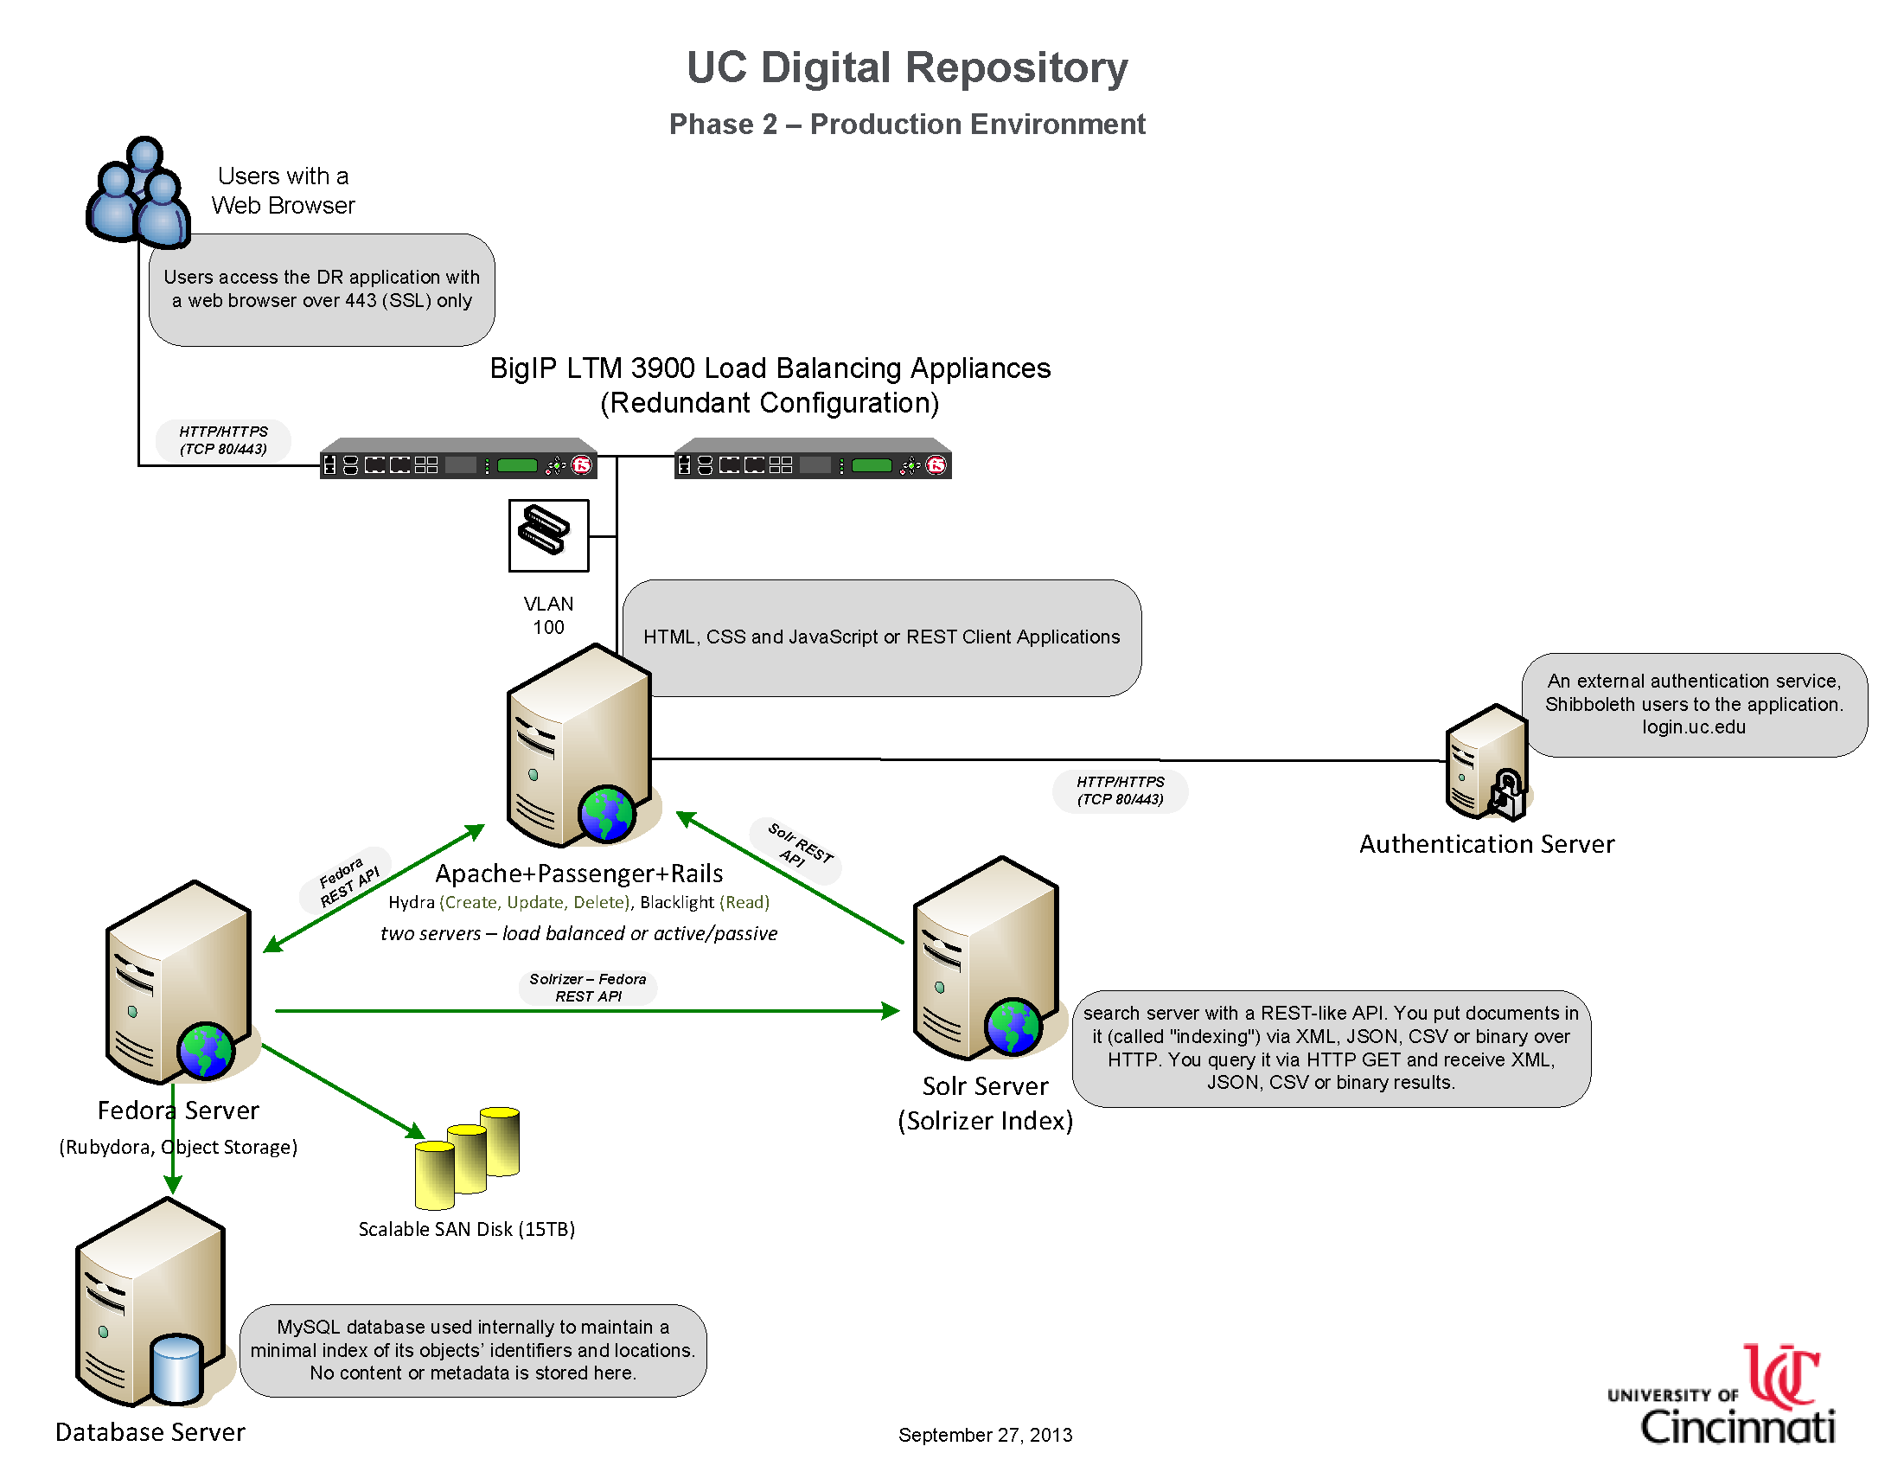

Slide 8
It Takes a Village Small City
Steve Marine, Associate Dean (10%)
Linda Newman, Head of Digital Collections and Repositories (80%)
Glen Horton, Software Developer (90%)
Thomas Scherz, Software Developer (90%)
Patrick Burke, Software Developer (25%)
James Van Mil, Software Developer/Librarian (65%)
Carolyn Hansen, Metadata Librarian (20%)
Nathan Tallman, Digital Content Strategist (20%)
Elizabeth Meyer, Visual Resources Librarian (15%)
Dan Gottlieb, Associate Dean (15%)
Ted Baldwin, Director of Science and Engineering Libraries (15%)
Eira Tansey, Digital Archivist/Records Manager (10%)
Arlene Johnson, Digital Humanities Strategist (10%)
Mark Faulkner, A.J. Bothe, Andy Carlson, Jim Dusing, Bev Upton -- system administration (dev ops), Central IT
Notes:
1 task force, 7 working groups, 32 individuals
Emphasize the importance of dev ops, and having a good working relationship

Slide 9
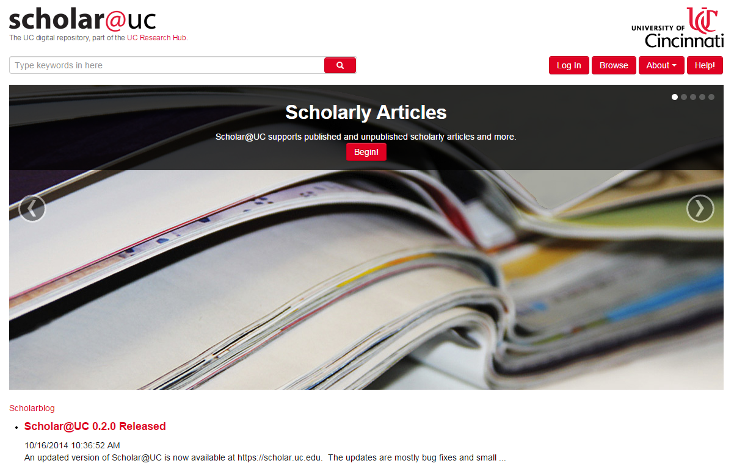
scholar.uc.edu projecthydra.org github.com/uclibs/scholar_uc
Notes:
Right now basic IR
Next:
viewers for images, media, and documents
improvements based on EA feedback
a second hydra head?
digitized library collections?
Spotlight

