Slide 1
Packaging and Pushing
Experimenting with workflows for APTrust
Nathan Tallman
Digital Content Strategist
University of Cincinnati Libraries
APTrust Fall Meeting
6 October 2014

Slide 2


Sources of Digital Content
Digital Resource Commons
  Dspace 1.8.2
LUNA Image and Media Repository
  LUNA 6.3.6.2
Scholar@UC
  Hydra
SAN Filestore
Notes:
We have three (then two) digital repositories: Dspace 1.8.2, LUNA 6.x, and now Hydra. (As well as some assorted content on a file system.)

Slide 3
DSpace: Simple Archive Format
item_000/
dublin_core.xml
contents
file_1.doc
file_2.pdf
Notes:
Choose to focus on Dspace first, looked at Simple Archive Format and Packages which are available by default in DSpace. Then discovered Replication Task Suite.

Slide 4
DSpace: AIP METS Packages
item_000/
mets.xml
bitstream.doc
license
Notes:
Choose to focus on Dspace first, looked at Simple Archive Format and Packages which are available by default in DSpace. Then discovered Replication Task Suite.

Slide 5
DSpace: Replication Task Suite Bags
item_000/
bagit.txt
manifest-md5
tagmanifest-md5
data/
license/
metadata.xml
object.properties
ORIGINAL/
Notes:
RTS was designed to manage internal fixity and backup of content through GUI. Exports Archival Information Packages (OAIS) in METS or Bagit (huzah!). Creates bag for every object: collections, communities, and records

Slide 6

http://fc03.deviantart.net/fs50/f/2009/326/b/8/Hydra_monster_by_velinov.jpg
Notes:
However, dev team was in throes of Hydra repo, so RTS had to wait.

Slide 7
Sample Bags
Call to Dspace forum for sample RTS produced bags
  Markus Wust, NCSU Libraries
Make copies, change properties
XSL transformations to conform to APTrust bagit spec
Notes:
In meantime, sent message to Dspace tech and Macus Wesst (NCSU) sent me a sample RTS bag.
Sample bag allowed me to see how the bags appeared when came out of RTS, and write XSLT to transform the bag to meet the APTrust Bagit spec. Used bag to create a few others, modifying some metadata to make it unique.

Slide 8
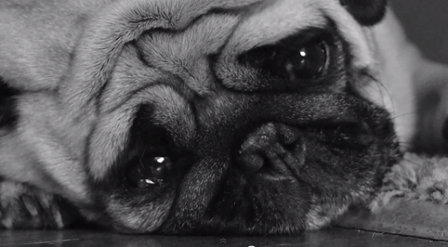
Sample Bags
Push bags to APTrust receiving bucket using AWS CLI
Wait, wait, wait…
  fail?
http://editorial.designtaxi.com/news-dog030613/1.jpg
Notes:
Pushed new bags to SW3 receiving bucket using CLI, wait wait wait... failure. What happened? I had change the metadata without updating checksum!

Slide 9

Replication Task Suite
Install RTS on test Dspace instance
Bash script
  unzip
  apply XSLT
  tar
  push to APTrust
Wait, wait, wait…
  partial success!
http://rwtrainingkennel.com/wp-content/uploads/Happy-Dog-Pictures-3.jpg
Notes:
Dev team has a break, RTS installed on test system. UC bags generated. Wrote bash script to chain together unzip RTS bag, transformation, tar bag, moving it into proper folders, and pushing to APTrust receiving bucket. Success! At least partially. Initial transformations were written for records, nor comm/coll. Had to adjust scripts to accommodate other types. Re-push. Success!

Slide 10

But wait...
Administrative sets vs. flat bags
Platform provenance
File system metadata
  dates
Thumbnails
http://www.prwatch.org/files/images/dogheadtilted.jpg
Notes:
But wait, bag name is opaque, bags/fluctis are flat. Our content is hierarchical. How can we collocate content in Fluctis by collection or other administrative set? Considering adding comm, coll, record status to bag name, rely on search to collocate. Also, what about platform? We have content in four places, how do we track that? Bag name? Internal identifier for both? Add this to bag metadata using custom fields?
But wait, we noticed that RTS produced bags zero-outs filesystem metadata, such as dates. Intentionally done. Filesystem metadata isn't important when checking fixity on a single file, but when you tar that content with other files, a change filesystem metadata changes the checksum of the tar object. RTS zeros-out dates so that file system metadata doesn't affect its own fixity checks. Is the filesystem metadata important? Our descriptive metadata doesn't always include things like date digitized, so the file system metadata is useful to give an estimation for creation date.
But wait, installing RTS also broke thumbnail generation! Horrors, what to do? This is likely a local issue, but does affect the decision to adopt RTS.
Solutions
bag names?
internal identifiers or other fields?

Slide 11
Next Steps
Use AWS SW3 API?
Test restoration of content and collections
RTS or not?
Refactor bash script and put on github, more automating
Send more content! Other platforms!
Notes:
Evaluate whether we should be using SW3 API, is getting the etag at time of push important? Shows up in Fluctis anyways. Might be more important if we incorporate this into a GUI.
Need to test restoration. Only recently discovered there's a separate restoration bucket! Didn't realize what the restore button on the GUI did. Still need to workout restoration at scale, such as for an entire collection.
Fix thumbnail issue or start from scratch with SAF or Dspace package
If using RTS: Refactor script and work on automating entire process.
Put scripts on Github.

Slide 12
Questions
Are others preserving file system metadata?
How are others tracking administrative context of collections?
Has anyone tested restoration?
Is anyone creating bags containing additional bags? Or do you repackaging existing bags?

