Slide 1
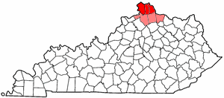
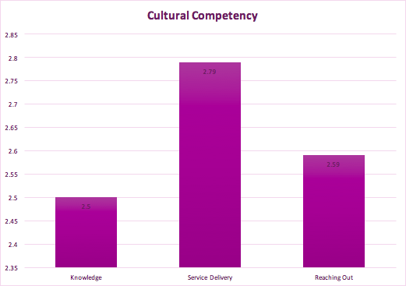
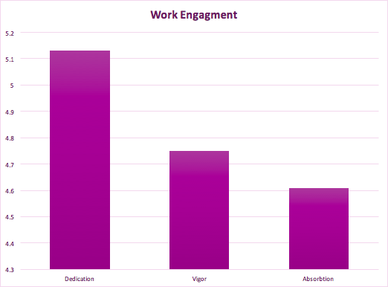
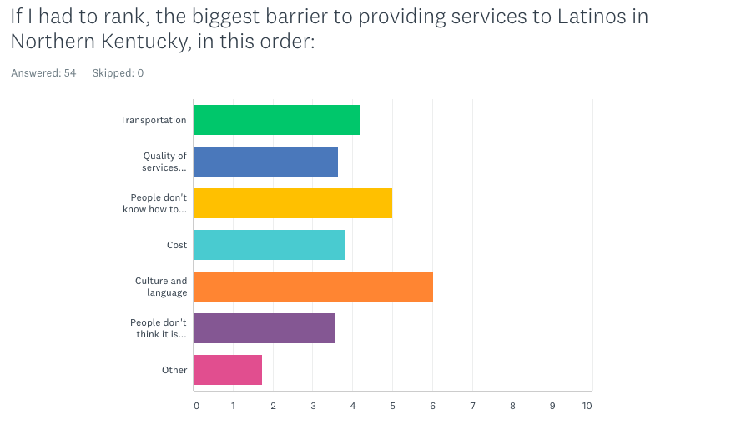
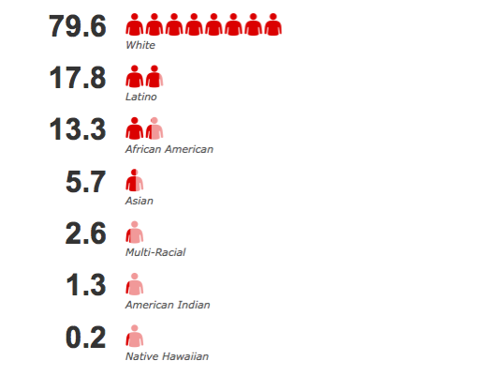
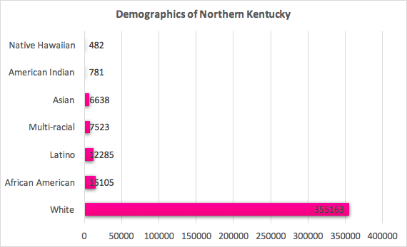
Barriers to Serving the Latino Community in Northern Kentucky
- Nicholas Burkhart, Tiffany Merkel, Jenny Zhen-Duan and Supporting Latino Families in Northern Kentucky -
Boone, Kenton, & Campbell Counties
ABSTRACT
RESULTS
Service providers of Latino families in Northern Kentucky are experiencing barriers that are preventing them from being able to effectively connect with the communities they are serving. Previous research has indicated language, culture and resources, as well as cultural competence and work engagement, as possible causes. Supporting Latino Families in Northern Kentucky partnered with students in Jenny Zhen-Duan’s Community Psychology class to assess work engagement and cultural competence among service providers as well as to examine the barriers that service providers face when serving the Latino population in Northern Kentucky.
QUANTITATIVE
Knowledge
The awareness of one’s culture that is not their own
Service Delivery
How well Service Providers administer assistance
Reaching Out
Finding out what the Latino Community needs/wants
Dedication
Commitment to providing services
Vigor
The amount energy one puts into their work
Absorption
Being engrossed in one’s work
Aims of the Study
To explore cultural competence and work engagement in relation to service providers
To seek to understand barriers and strengths from the providers’ perspective
To assess how the barriers faced contribute to the gaps in cultural competence and work engagement
QUALITATIVE
Language
Lack of English classes for ESL learners
Need for spanish interpreters
Need for bilingual service providers
Culture
Lack of knowledge of the culture being served
Issues with knowing how to reach out to the community
Lack of trust between providers and community members
Lack of Resources
Lack of state funding
Perpetuated poverty
Issues of being understaffed
Background
If I had to rank the biggest BARRIER to providing services to Latinos in Northern Kentucky, in this order:
DEMOGRAPHICS - UNITED STATES
DEMOGRAPHICS – Northern Kentucky
The Census Bureau now projects the Latino population to grow by 86% from 2015 to 2050.
12,285 Latinos – 3rd largest population (3.1%)
CONCLUSION
- Our sample consisted of 55 service providers in the Northern Kentucky with average age being 43 and average years of work experience being 11. The sample was also mostly female (67%) with 9% identifying male and 24% not disclosing.
Our research confirmed that language, culture, resource shortages, cultural competence, and work engagement all hinder Service Providers in Northern Kentucky from effectively connecting with the Latino Community they serve.
Methodology – Quantitative / Qualitative
QUANTITATIVE
Used a Cultural Competence Self-Assessment Questionnaire
Measured the cultural competence of providers based on Knowledge, Service Delivery, and Reaching Out
Used Likert-type responses ranging from Never (0) to Very Well (4).
Measured the WORK ENGAGEMENT of providers based on Dedication, Vigor, and Absorption
Used Likert-type responses ranging from Not At All (1) to Very Well (6).
RECOMMENDATIONS
Dedicate resources to reducing language and cultural barriers.
Improve familiarity and communications with Latino community to better understand their needs.
Understand/Connect to Latino communities first then deliver tailored services to care for them.
Promote trust between Service Providers and Latino Community by hosting culturally sensitive events.
Research ideas: Look at origin of Latinos and survey wider area as well as Latino communities themselves.
QUALITATIVE
Used Free Response Questions
Identify BARRIERS your organization currently has towards providing services
For example - “In my opinion the biggest barrier to providing services to Latino Families in Northern Kentucky is…”
Identify Assets and challenges your organization currently has towards providing services as well as how they would use new resources:
For example -“My organization can be proud of…” and “The biggest resource/ challenge in my organization is…”
REFERENCES:
Bruin, D. P., Hill, C., Henn, C. M., & Muller, K.-P. (2013). Dimensionality of the UWES-17: An item response modelling analysis. SA Journal of Industrial Psychology, 39(2), 8 pages. https://doi.org/10.4102/sajip.v39i2.1148
Bureau, U. C. (2016, October 12). Newsroom. Retrieved September 24, 2017, from https://www.census.gov/newsroom/facts-for-features/2016/cb16-ff16.html
Clark, M. A., Ponjuan, L., Orrock, J., Wilson, T., & Flores, G. (2013). Support and barriers for Latino male students' educational pursuits: Perceptions of counselors and administrators. Journal Of Counseling & Development, 91(4), 458-466. Doi:10.1002/j.1556-6676.2013.-0118.x
Demographic and Economic Profiles of Hispanics by State and County, 2014. (2011, July 26). Retrieved September 24, 2017, from http://www.pewhispanic.org/states/county/21037/
Division of Behavioral and Social Sciences and Education, Committee on Population, Panel on Hispanics in the United States, & National Research Council. (2006). The health status and health behaviors of Hispanics--José J. Escarce, Leo S. Morales, and Rubén G. Rumbaut. (pp. 362-409) National Academies Press
Fernandez, A., Schillinger, D., Grumbach, K., Rosenthal, A., Stewart, A. L., Wang, F., & Perez-Stable, E. J. (2004). ORIGINAL ARTICLES Physician Language Ability and Cultural Competence An Exploratory Study of Communication with Spanish-speaking Patients. J GIM: Journal Of General Internal Medicine, 19(2), 167-174.
Hooper, L. P.-W. (April 2014). Cultural competency, culturally tailored care, and the primary care setting: Possible solutions to reduce racial/ethnic disparities in mental health. Journal of Mental Health Counseling, 173-188.
Langelaan, S., Bakker, A. B., Doornen, L. J., & Schaufeli, W. B. (2006). Burnout and work engagement: Do individual differences make a difference? Personality and Individual Differences 40(3), 521-532. doi:10.1016/j.paid.2005.07.009
Othman, N., & Nasurdin, A. M. (2012). Social support and work engagement: a study of Malaysian nurses. Journal of Nursing Management 21(8), 1083-1090.
Teasley, M., Gourdine, R., & Canfield, J. (2010). Identifying Perceived Barriers and Facilitators to Culturally Competent Practice for School Social Workers. School Social Work Journal, 34(2), 90–104.
Ransford, H. E., Carrillo, F. R., & Rivera, Y. (2010). Health care-seeking among Latino immigrants: Blocked access, use of traditional medicine, and the role of religion. Journal of Health Care for the Poor and Underserved, 21(3), 862-878. doi:10.1353/hpu.0.0348
Rosenburg, J., & Wilcox, W. B. (2006). Cultural Competence Self-Assessment Questionnaire- Service Provider Version
Schaufeli, W.B., Bakker, A.B.m Salanova, M. (2006). The measurement of work engagement with a short questionnaire. Educational and Psychological Measurement, 66(4),701-716.
17-item Utretcht Work Engagement Scale (UWES)
Schmidt, Hank & M Waltner Mph, Audrey & T Muller, Solange. (2017). The Immigrant Health Initiative: A Study of Health Care of Recent Immigrants in Dutchess County, New York.
Steinberg, E. M., Valenzuela-Araujo, D., Zickafoose, J. S., Kieffer, E., & DeCamp, L. R. (2016). The "battle" of managing language barriers in health care. Clinical Pediatrics, 55 (14), 1318-1327. doi:10.1177/0009922816629760

