Slide 1
What is Different About Clinical Data?
Part II: Processes & Resources for Working with Clinical Data

Slide 2

UC Davis Health is:
  focused on discovering and sharing knowledge and providing the highest quality of care; and
  a hub of innovation that encompasses:
    UC Davis Medical Center
    UC Davis School of Medicine
    The Betty Irene Moore School of Nursing
Christy Navarro
  Assists students, faculty and staff navigate the research data lifecycle, health data resources, and software tools for research and beyond.
  Passionate about helping break down barriers health research by providing education and support when & where health researchers need it.
  Brings 15 years of health privacy, security & research expertise
https://www.library.ucdavis.edu/author/christy-navarro/

Slide 3
Health Data Challenges

Slide 4
“We need more data literate clinicians and more clinically literate analysts and programmers”
Kent Anderson, Director of Medical Informatics UC Davis Health

Slide 5
Challenge
Health Data:
is not always tidy;
systems are often not interoperable;
assets are federated across different business owners;
is highly regulated during the entire data lifecycle and all access, use and disclosure has to be managed within the requirements; and
users may have data fluency limitations….

Slide 6

More Challenges
“Length of Stay”: Concept Definition
ICU service admits patient
Patient Discharged Home
02
05
5 days
9 days
Day
1
2
3
4
5
6
7
9
4 days
01
03
04
Patient Admitted to Emergency Department
Patient Transferred from the ED to ICU
Patient Transferred to non-ICU

Slide 7
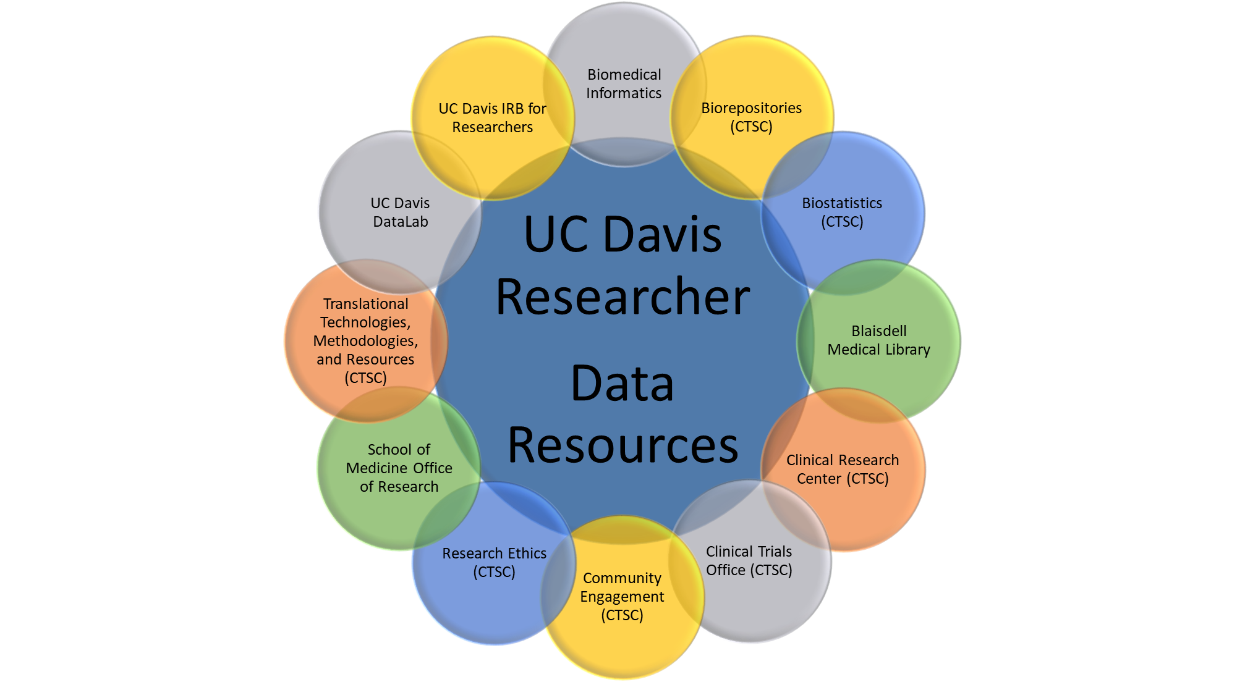
Data Resources Not Necessarily Centralized
Biomedical Informatics

Slide 8
UCDH – IT Health Informatics Overview
Vertically Integrated Teams
  Acquisition & Architecture
  Data Curation
  Access and Delivery Team
Domain Specific Operational Units
  Example pulmonary care (clinical SME) has IT support for their data requests.
Focus on Data Curations Hubs, Data Governance, Partnering with Domain Level Clinical & Technical
Services provided for all purposes (research, clinical etc.)

Slide 9
UC Davis Health Data Resources Website
Access to high-quality data
The site is a compilation of the data assets, software tools, and analytics support resources available at UC Davis Health to optimize access to, and facilitate the most effective use of data.
https://health.ucdavis.edu/data/
Health Data Science Day (1st year!) https://www.eiseverywhere.com/website/9324/

Slide 10
Do: Learn to Speak Clinical Data
As a requestor plan on partnering to curate the data set with a subject matter & data expert
  Avoid “give me all the data and I’ll work it out”
  Protect the privacy of patients by not asking for data you don’t need
  Resources: Privacy Office, IRB, Contracting, Clinicians, IT, Library & many others

Slide 11
Do: Create A Data Dictionary & Minimum Necessary Document
Field Name | Data Type | Data Format | Field Size | Description | Example | Minimum necessary
Pt_First_Name | Text |  | 50 | First Name of the Patient | Minnie | A unique randomly generated participant ID would be sufficient in lieu of name.
Pt_Last_Name | Text |  | 50 | Last Name of the Patient | Mouse | A unique randomly generated participant ID would be sufficient in lieu of name.
DOS | Mixed | MM-DD-YYYY | 10 | Date of Service | 01-01-2020 | Date is required as an input into the analysis to determine if they were seen before or after the intervention

Slide 12
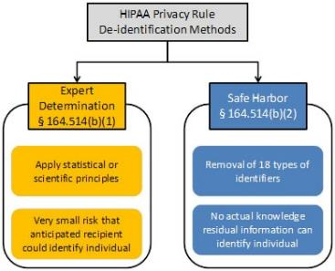
Do: Consider the Data Classification look for the highest utility with the lowest risk
De-Identified Data Sets – No longer considered Protected Health Information (PHI)
Limited Data Set
  Similar to Safe Harbor De-Identified Data Set
  Allows ZIP Code
  Allows Dates
  Still considered PHI

Slide 13
De-identified Datasets
No longer considered PHI
  Could be used for system and interface testing
  Safe – harbor method is the removal of 18 identifiers
  Expert method – requires certification and extensive documentation
Verification process for confirming de-identification

Slide 14
Do: Consider Limited Data Sets
Don’t forget limited data sets used for internal purposes
  High utility and lower risk
    Similar to a safe-harbor data set but allows dates and zip code information
  Limited data sets are still PHI
    HIPAA security rule applies
    Partner with Information Security
      (mover to notes) work with IT Security to do risk assessments for broad use cases. Future use cases can leverage previous risk assessments.

Slide 15
Transition to Lori Sloane
REDCap!

Slide 16
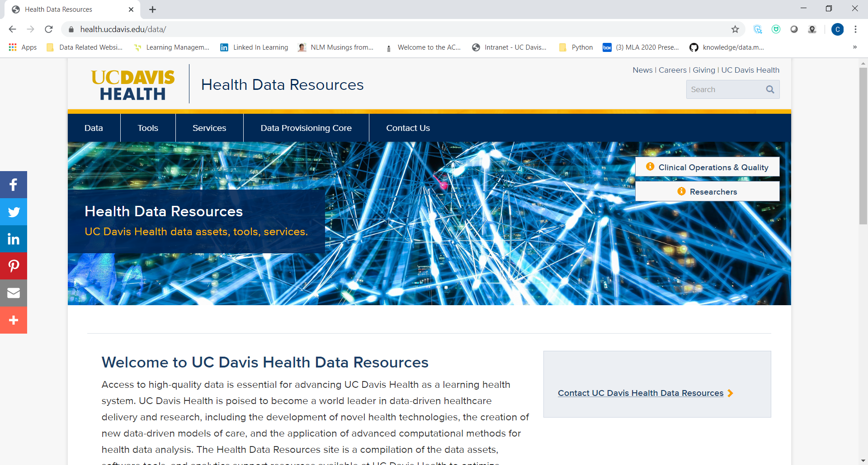

Slide 17
