Slide 1
Understanding Health Disparities and Perceptions of Discrimination in Greater Cincinnati
Tammy Mentzel, MPH
Assistant Director for Programs and Projects
Cincinnati Cancer Center
College of Medicine

Slide 2

Research Team
Greer Glazer, RN, PhD, CNP, FAAN
Dean College of Nursing
Associate VP of Health Affairs
Barbara Tobias, MD
Chair, Dept. of Family & Community Medicine, College of Medicine
Medical Director, Health Collaborative

Slide 3

Understand health disparities including importance and contributing factors and gain a baseline knowledge of existing health and economic disparities in Cincinnati.
Recognize the connections between the perceptions of discrimination in Cincinnati and its’ health disparities.
Appreciate the importance, strengths, and limitations of working in partnership with community stakeholders to improve health equity, produce a culturally competent health care workforce, and increase the diversity of the local health care workforce to reflect the population.

Slide 4

Health Disparities
A higher burden of illness, injury, disability, or mortality experienced by one population group relative to another group.
Notes:
Disparities are commonly viewed through the lens of race and ethnicity, they also occur across other dimensions such as socioeconomic status, age, location, gender, disability status and sexual orientation.

Slide 5

Importance
Limit improvement in overall quality of care and population health and result in unnecessary costs.
Notes:
Recent analysis estimates that 30% of direct medical costs for African Americans, Hispanics, and Asian Americans are excess costs due to health inequities and that the economy loses an estimated $309 billion per year due to direct and indirect cost of disparities. As our population becomes more diverse, with people of color estimated to account for over half of population by 2050, it is increasingly important to address health disparities. And it is the right thing to do. Your health and well-being should not be based upon your race/ethnicity, your economic situation and where your live.
“Of all the forms of inequality, injustice in health care is the most shocking and inhumane.” — Dr. Martin Luther King, Jr.

Slide 6
Cincinnati Disparities
Significant social and economic inequities exist associated with health disparities by race, gender, poverty status and neighborhood.
Life expectancy at birth varies by up to 20 year difference for residents in Cincinnati neighborhoods.
Notes:
According to Wikipedia, we have 9 Fortune 500 companies and 15 Fortune 1000 companies headquartered here. Having 9 Fortune 500 company headquarters in our area, ranks us in the United States Top 10 markets for number of Fortune 500 headquarters per million residents, higher than New York, Boston, Chicago or Los Angeles.
Yet, we have significant disparities in our region.

Slide 7
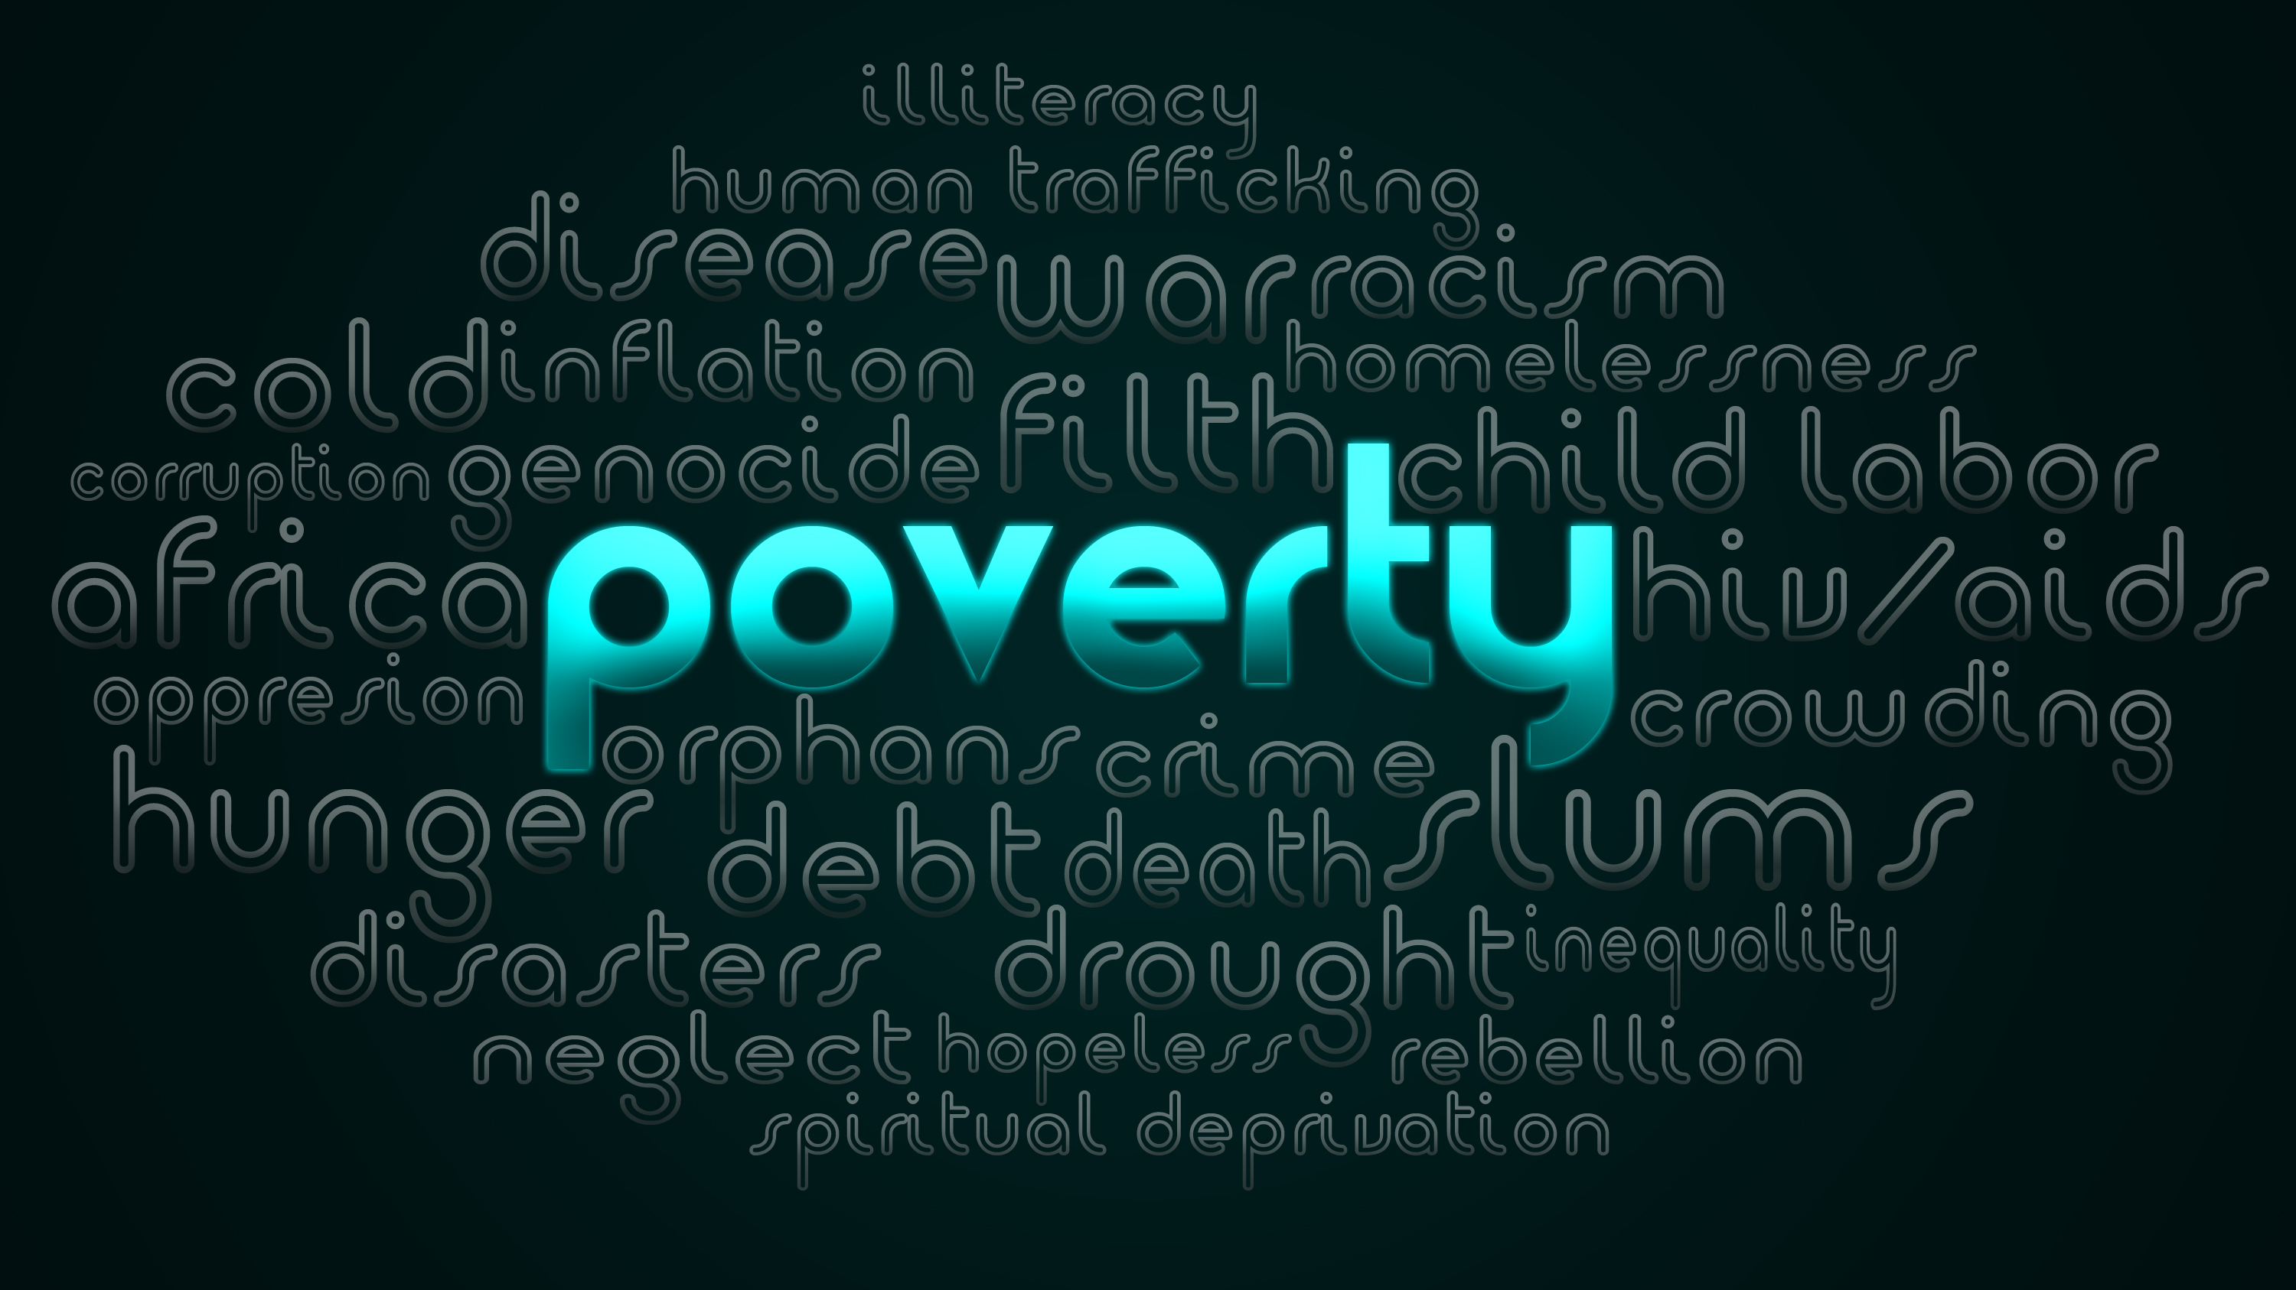


Economic Disparities
14,000 families living in poverty in City of Cincinnati; 76% African American.
CPS – 63% are African American and 73% are economically disadvantaged
Homeownership – 75% whites vs. 33% African Americans
Source: The State of Black Cincinnati 2015: Two Cities
Notes:
In 2015, the Urban League of Greater Southwestern Ohio published an excellent report titled (The State of Black Cincinnati 2015: Two Cities) detailing many disparities. Excellent read and resource and highly recommend if you are interested.
Focusing on economic disparities:

Slide 8
Life Expectancy by Gender and Race in Cincinnati, Ohio and US (2001-2009)
Source: Community Health Assessment (2017)
Notes:
The City of Cincinnati Health Department published the Community Health Assessment in 2017 with this graph.

Slide 9
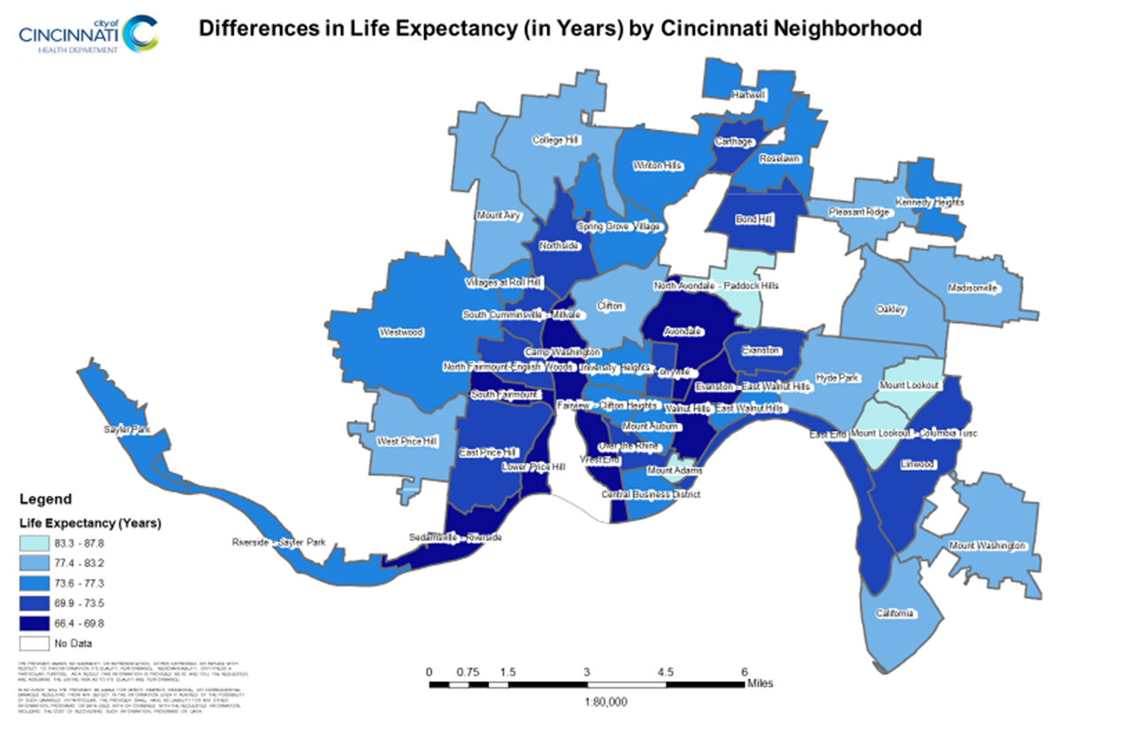
Notes:
Also published in Community Health Assessment in 2017 by the City of Cincinnati Health Department.
20 year difference in life expectancy based on neighborhood.
North Avondale – Paddock Hills – can expect to live to about 87 compared to
Avondale with a life expectancy of 68 years.

Slide 10
Health and Education
Source: Interact for Health Community Health Status Survey, May 2017
Notes:
Interact for Health is an independent foundation serving 20 counties in Ohio, Kentucky and Indiana focused on improving the health of all people in our region. Serving as a catalyst by promoting health equity through grants, education, research and poly engagement. Interact for Health regularly conducts research and collects data in order to monitor and evaluate our region’s health status and to measure public opinions about health policy. If you are interested, you can sign up for a biweekly email newsletter called the Greater Cincinnati Health Watch.
People were asked, “in general, would you say your health is excellent, very good, good, fair or poor?”
More educated adults report better health.
Nearly 7 in 10 adults with a college degree or more (66%) reported excellent or very good health. Compared to only a little more than 2 in 10 adults with less than a high school education (24%) reported excellent or very good health; this is a decline from 2013 (29%).

Slide 11
Health and Poverty Status
Source: Interact for Health Community Health Status Survey, May 2017
Notes:
This graph compares health and poverty status.
People in poverty less likely to report very good or excellent health. Fewer than 3 in 10 adults earning 100% or less of the Federal Poverty Guidelines (28%) reported excellent or very good health. Compared to nearly 5 in 10 adults (48%) earning between 100% and 200% FPG and nearly 6 in 10 adults (56%) earning more than 200% FPG.
This disparity has been consistent in our community for more than a decade. These findings match national and international work that has identified economic stability and education as some of the key social factors that influence health.

Slide 12
Contributing Factors
Individual
Provider
Health System
Societal
Environmental
Notes:
Individual – variety of health behaviors from maintaining healthy weight to following medical advice
Provider – provider bias, cultural competency, linguistic barriers, patient-provider communication
Health System – organized, finance, access
Societal/Environmental – poverty, education, proximity to care and neighborhood safety

Slide 13

Perceptions of Discrimination
2012
2014
2017
Surveys in Cincinnati
Notes:
There have been several surveys conducted in our region asking individuals if they have ever felt discriminated or treated differently because of their race/ethnicity or type of health insurance.

Slide 14
2012 Aligning Forces for Quality Survey
Notes:
In 2007, the Robert Wood Johnson Foundation launched Aligning Forces for Quality, a signature effort to lift the overall quality of health care in 16 targeted communities. Cincinnati had the opportunity to participate in this initiative. One opportunity was for us to measure and publicly report equitable receipt of care by surveying constituents.

Slide 15
Greater Cincinnati Community Health Status Survey, June 2014
Notes:
In 2013, our research team worked with Interact for Health to add questions about barriers that might make it difficult to having a trusted provider because of their type of health insurance, lack of health insurance and race/ethnicity.
We asked if either a lack of health insurance or the type of health insurance has been a barrier to finding a trusted health provider.
1. Lack of or type of insurance as a barrier to finding a trusted provider
2. Young, poor, less educated more likely to report insurance as barrier
3. African Americans more likely to report insurance as barrier to finding trusted provider

Slide 16
Race/ethnicity barrier to finding trusted provider?
Greater Cincinnati Community Health Status Survey, June 2014
Notes:
We also asked is your race/ethnicity a barrier to finding a trusted provider?
Results showed:
1. African Americans and other races more likely to say race or ethnicity is barrier
2. Poor, uninsured more likely to report race or ethnicity as barrier

Slide 17
Winter 2017 Greater Cincinnati Survey
Notes:
In 2017, we worked again with Interact for health to survey perceptions of discrimination. We received feedback from Interact to clarify the wording of our questions for this next survey so that is why we asked questions differently. We asked …
Results
Among African American adults in the region, 14% felt they had been judged unfairly or treated with disrespect by a doctor or medical staff because of their race/ethnicity. This compares to 1% of white adults.
Ability to pay and type of health insurance also influenced perceptions of care. Overall, about 1 in 10 adults (13%) in the region, felt they had been judged unfairly or treated with disrespect by medical staff because of their ability to pay for care or their type of health insurance. These responses varied by race. Nearly 2 in 10 African American adults (19%) felt they had been judged unfairly or treated with disrespect because of their ability to pay or type of health insurance they had. This compares with 12% of White adults.

Slide 18
Winter 2017 Greater Cincinnati Survey (continued)
Notes:
When asked if they thought they would have received better care if they belonged to a different race or ethnic group?
More than 2 in 10 African American adults (21%) said yes. This compares to only 5% of white adults.
When asked if they thought they would have received better care if they spoke English more fluently?
7% of African American adults said yes compared to 2% of white adults.

Slide 19

What can we do to improve?
Notes:
As the only Academic Health Center in our region, we have a moral and ethical obligation to work on these health disparities and improve the perceptions of discrimination. We are also the educator for many of the students who will be our future health care workforce in our region so we do have the opportunity to move the needle on this work.

Slide 20








UU HEALTH
Notes:
In 2012, UC was selected as 1 of 5 academic institutions to participate in the Urban Universities (UU) for HEALTH (Health Equity Alignment through Leadership and Transformation of the Health Workforce) learning collaborative. UU HEALTH was grounded on the premise that universities and academic health centers serve as “anchors” for urban communities and as regional educational centers for the health professions and are positioned to drive improvements in local health outcomes. The initiative’s goal was to identify and disseminate knowledge, tools, and metrics that would aid universities and their academic medical centers in enhancing healthcare workforce diversity.
Significant accomplishments achieved include:
1) Executive Council – critical as effecting change and championing our other initiatives developing Mission-based health care goals including goals to increase diversity in the AHC colleges. 2) Pipeline programs and a social media campaign to increase enrollment of diverse students 3) Institutional data dashboard to track outcomes with diversity 4) Community Advisory Board – discuss more in a few slides
As the UU HEALTH project ended in 2016; our team was funded for three more years by then President Santa Ono to continue this work into 2019.

Slide 21






















Community Advisory Board
Align consensus around health equity, health workforce development and diversity in the community with the institutional health workforce goals and to support sustainability
Notes:
One of our biggest accomplishments was the development of a Community Advisory Board made up of a cross-section of community leaders that include representation from the following sectors: faith, public schools, business, philanthropy, advocacy, healthcare, and government. We have meet faithfully with this group once a quarter over the past 7 years. We have glowing accolades from the members that this board has been the best community group to which they have ever belonged. We believe this is because we set the agenda with them not for them, we solicit their advice and feedback and actualize it, from this group has evolved a Healthcare Workforce Diversity Workgroup charged with identifying a menu of strategies to guide in facilitating ALL of our health system efforts to improve health disparities and workforce diversity.

Slide 22

Evaluating Cultural Competency
Self-Reported Cultural Competency Assessment
Interprofessional Education
E-curriculum Review
Service Learning
Notes:
Other initiatives our work has been responsible for include:
Surveying all of our students to have them self evaluate their own cultural competency and the cultural competency of our curriculum in each AHC college with the goal to share best-practices and processes.
Completed an E-curriculum review to evaluate our curriculum and to remind our faculty the value of embedding it directly into it.
Service Learning – various opportunities for our students to participate in service learning project connecting learning objectives with community service.
Interprofessional education - Our desire is to educate our students so they will be prepared to actively participate and lead Interprofessional teams that deliver care that results in enhanced patient outcomes in contemporary models of health care.

Slide 23
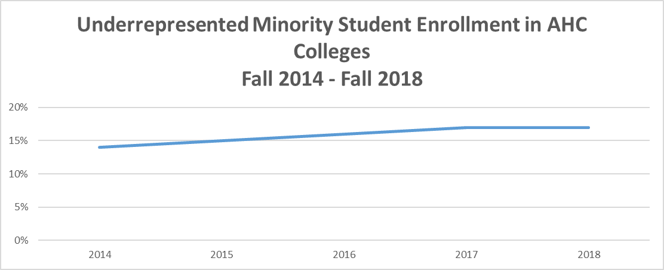
Source: UC IR Institutional Dashboards
Notes:
This is an example of the Institutional Data Dashboard that was first developed because of our participation in the UU Health project. Before this dashboard, tracking our enrollment of underrepresented students was cumbersome to say the least and there was not an effort or importance to look at this across the AHC.
URM – self report as American Indian/Alaskan Native, African American, Hispanic/Latino, native Hawaiian or other Pacific Islander, and those who identify with “more than one race.”
AHC = Allied Health Sciences, Medicine, Nursing and Pharmacy
14% to 17%

Slide 24


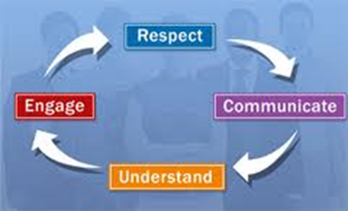
Next Lives Here
Urban Health Goals
Goal 1 - Partner with and build on the resources of the community to co-create solutions to improve equitable health and well-being by using evidence based practice
Goal 2 – Develop diverse, culturally-competent, interdisciplinary members to create a diverse healthcare workforce
Notes:
As the funding for our team is coming to a close, this work will live on and continue under President Pinto’s Next Lives Here Strategic Plan where Urban Health is a pathway.
Goal 1
S1: Improve outcomes and reduce disparities for traditionally underrepresented individuals and communities. Example: Hotspotting
S2: Develop inclusive cross-disciplinary approaches for creating a healthy community. Example: Cradle Cincinnati, First Ladies Health Initiative
S3: Increase transdisciplinary research opportunities that addresses urban health challenges impacting our communities and translate into practical applications.
Example: Opioid Task Force, Cincinnati Initiative to Reduce Violence
Goal 2
S1: Increase quality urban health K-12 pathway programming and partnerships
Example: Leadership 2.0, Student-run health clinic, health pathways, OMH
S2: Increase the number of UC graduates in health related fields that are diverse and culturally competent. Example: (a) Assess cultural competence of graduating health care professional (b) Set targets for admissions recruitment, retention, and graduation of diverse groups in colleges with health related professions.
S3: Co-create culturally competent and diverse health care settings. Partner with healthcare settings in providing scholarships/clinical experiences for students.

Slide 25
References
City of Cincinnati Health Commissioner’s Accreditation Lead Team. (2017, December). Community Health Assessment. Retrieved from https://www.cincinnati-oh.gov/health/assets/File/EDIT%20THIS%20CHA_12_21_17%20FINAL.pdf
Henry J. Kaiser Family Foundation. (2012, December). Focus on Health Care Disparities. Retrieved from https://kaiserfamilyfoundation.files.wordpress.com/2013/01/8396.pdf
Interact for Health Greater Cincinnati Community Health Status Survey. (2014, June). Income, race pose barriers to finding trusted providers.
Interact for Health Community Health Status Survey. (2017, May). Income, age and education affect health in our region.
Interact for Health. (2017, December). Perceptions of discrimination when accessing health care among adults in Greater Cincinnati and Northern Kentucky.
Robert Wood Johnson Foundation. (2017). Aligning Forces for Quality Survey.
University of Cincinnati Institutional Research Institutional Dashboard.
Urban League of Greater Southwestern Ohio. (2015). The State of Black Cincinnati 2015: Two Cities. Retrieved from http://www.ulgso.org/news/68/150/State-of-Black-Cincinnati/d,CustomStateofBlackCinciandDaytonNewsDetail

Slide 26


Slide 27

Tammy Mentzel, MPH
Tammy.Mentzel@uc.edu
513-558-5574

