Slide 1
Big Data
For or Against
Health Disparities
Deborah Guadalupe Duran, PhD
Director, Office of Science Policy, Planning Reporting and Data
National Institute of Minority Health and Health Disparities

Slide 2
OVERVIEW
“Imagine most of the world is getting healthier because of some new technology, but you’re getting left behind”
NIMHD Mission
Need for Big Data – Minority Health/Health Disparities
Big Data: Structured and Unstructured (Use with Caution)
Big Data: Importance for Health Disparities Research and Clinical Care
NIMHD - Big Data into Health Disparities Research

Slide 3
NIMHD Mission

Slide 4
NIMHD’S MISSION
To improve minority health
To reduce health disparities
To achieve:
  Plans, coordinates, reviews, and evaluates NIH minority health and health disparities research and activities
  Conducts and supports research in minority health and health disparities
  Promotes and supports the training of a diverse research workforce
  Translates and disseminates research information
  Fosters innovative collaborations and partnerships

Slide 5
MINORITY AND *HEALTH DISPARITIES POPULATIONS
Racial/Ethnic Minorities
  American Indian or Alaska Native
  Asian
  Black or African American
  Hispanic/Latino American
  Native Hawaiian or Other Pacific Islander
*Low socio-economic status
*Rural
*Sexual and gender minorities
*Others subject to discrimination who have poorer health outcomes
Source: Duran DG, Perez-Stable, EJ, Novel Approaches to Advance Minority Health and Health Disparities Research, AJPH Supplement 1, 2019

Slide 6
MINORITY HEALTH DEFINITION
“Health characteristics and attributes of racial and/or ethnic minority groups who are socially disadvantaged due in part by being subject to potential discriminatory acts.”
Minority health research examines singularly and in combination the attributes, characteristics, behaviors, biology, and other factors that influence the health outcomes of minority racial and ethnic groups, including within-group or ethnic subpopulations, with the goal of understanding mechanisms and improving health.

Slide 7
HEALTH DISPARITIES DEFINITION
A health difference that adversely affects defined disadvantaged populations, based on one or more health outcomes.
HD OUTCOMES:
Higher incidence/prevalence, including earlier onset or more aggressive progression
Premature or excessive mortality
Greater global burden
Worse self-reported outcomes measures that reflect daily functioning or symptoms from specific conditions
Poorer health behaviors and clinical outcomes (related to above)
Source: Duran DG, Perez-Stable, EJ, Novel Approaches to Advance Minority Health and Health Disparities Research, AJPH Supplement 1, 2019

Slide 8
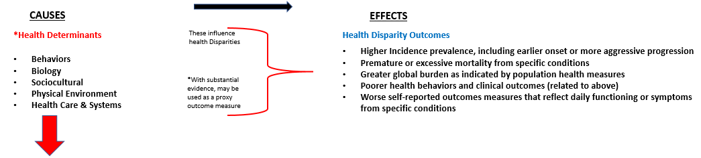
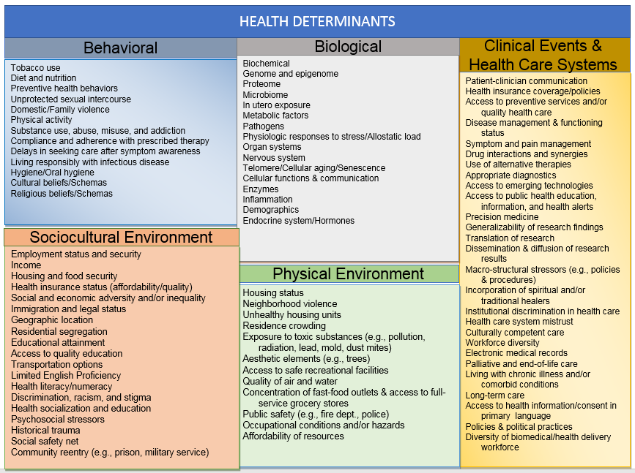

Slide 9
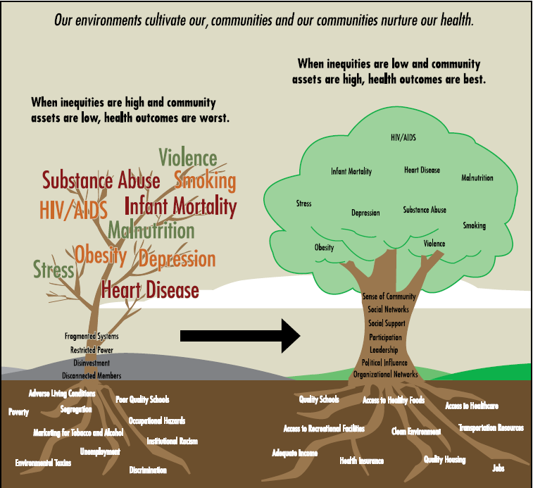
Social Determinants of Health
Shape Population Health
https://www.cdc.gov/nccdphp/dch/programs/healthycommunitiesprogram/tools/pdf/sdoh-workbook.pdf
From Brennan Ramirez et al, Promoting Health Equity, CDC, 2008 et al. Figure adapted from Anderson et all, 2003; Marmot et al, 1999; and Wilkinson et al, 2003
Notes:
This graphic illustrates some root causes of health and disease.
Broadly, when community assets are low and inequities are high, health outcomes are poor
When community assets are high and inequities are low, health outcomes are much better.

Slide 10
NIMHD INVESTED IN BIG DATA
Need Data
  Population representation that is adequate and accurate
  Social determinants of health, the causes of health disparities
Improve
  Clinical care
  Population health/Reduce health disparities
Prevent additional health disparities generated by technological advances

Slide 11
Need for BIG DATA
TO IMPROVE MINORITY HEALTH
TO REDUCE HEALTH DISPARITIES

Slide 12
DEMOGRAPHICS – USA 2017 to 2019 Data
Estimated population of 328,285,992 (~40% minorities/~50% HD populations)
82.3% of the population resides in cities and suburbs
Hispanic and Latino Americans 18.1%
African Americans 13.4%
Asian Americans 5.8% / fast growing: 3% growth rate
American Indian/Alaska Native 1.3%
SGM/LGBT: 3-5% or 9 million Americans (adult population)
  Estimated 19 million Americans (8.2%) report that they have engaged in same-sex sexual behavior
  25.6 million Americans (11%) acknowledge at least some same-sex sexual attraction.
Poverty: 13.5% or 39.7 million Americans (2017 data)
Rural: 19.3% or 60 million Americans (2017)
https://www.census.gov/quickfacts/fact/table/US/PST045218
https://williamsinstitute.law.ucla.edu/research/census-lgbt-demographics-studies/how-many-people-are-lesbian-gay-bisexual-and-transgender/
https://poverty.ucdavis.edu/faq/what-current-poverty-rate-united-states
https://www.census.gov/library/stories/2017/08/rural-america.html

Slide 13
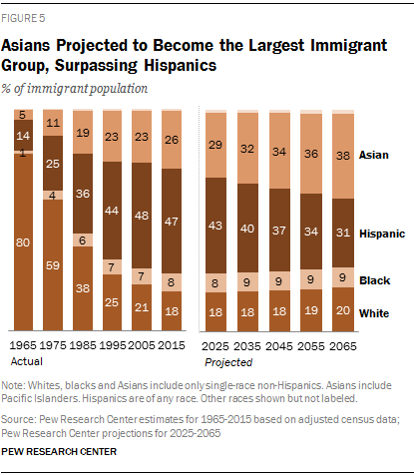
Asians Projected to Become the Largest Immigrant Group, Surpassing Hispanics

Slide 14
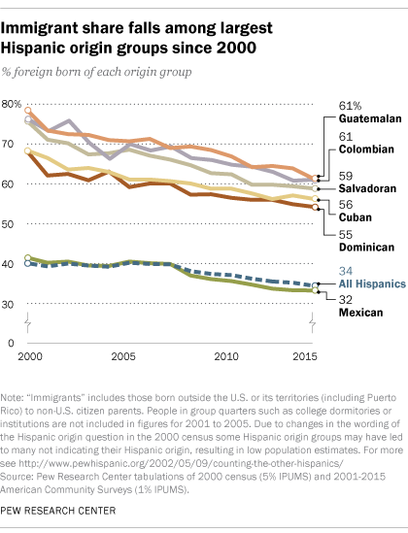
Hispanic Immigration Declining

Slide 15
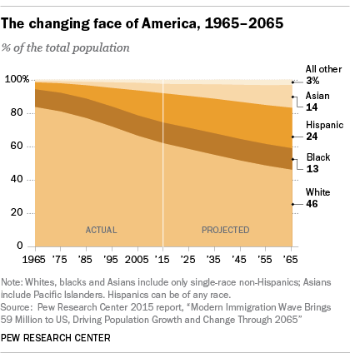
Americans are more Racially and Ethnically Diverse than in the past, and the U.S. is projected to be even more diverse by 2055

Slide 16
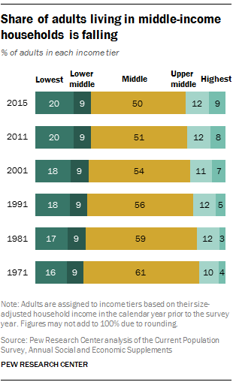
INCREASING LOWER CLASS

Slide 17

USA EDUCATION
US Overall High School Education 89%
College Degree
  Whites 37%
  Blacks 23%
  Hispanics 16.4%
  Asian American 55.9%
Students from low and moderate income households could afford to pay for just 1% to 5% of college tuition in USA
Adults with HS education earned - $35,615 ave
Adults with BS degree earned - $65,482 ave
Census Data 2016

Slide 18
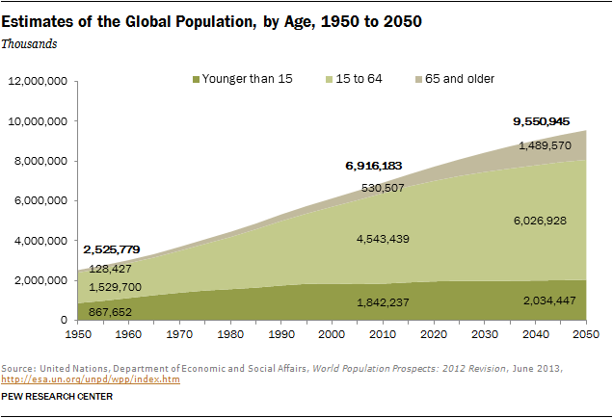
1950-2010 POPULATION: AGING USA DOUBLED
GLOBAL TRIPLED

Slide 19
BIG DATA
Structured
Unstructured
Use with Caution

Slide 20
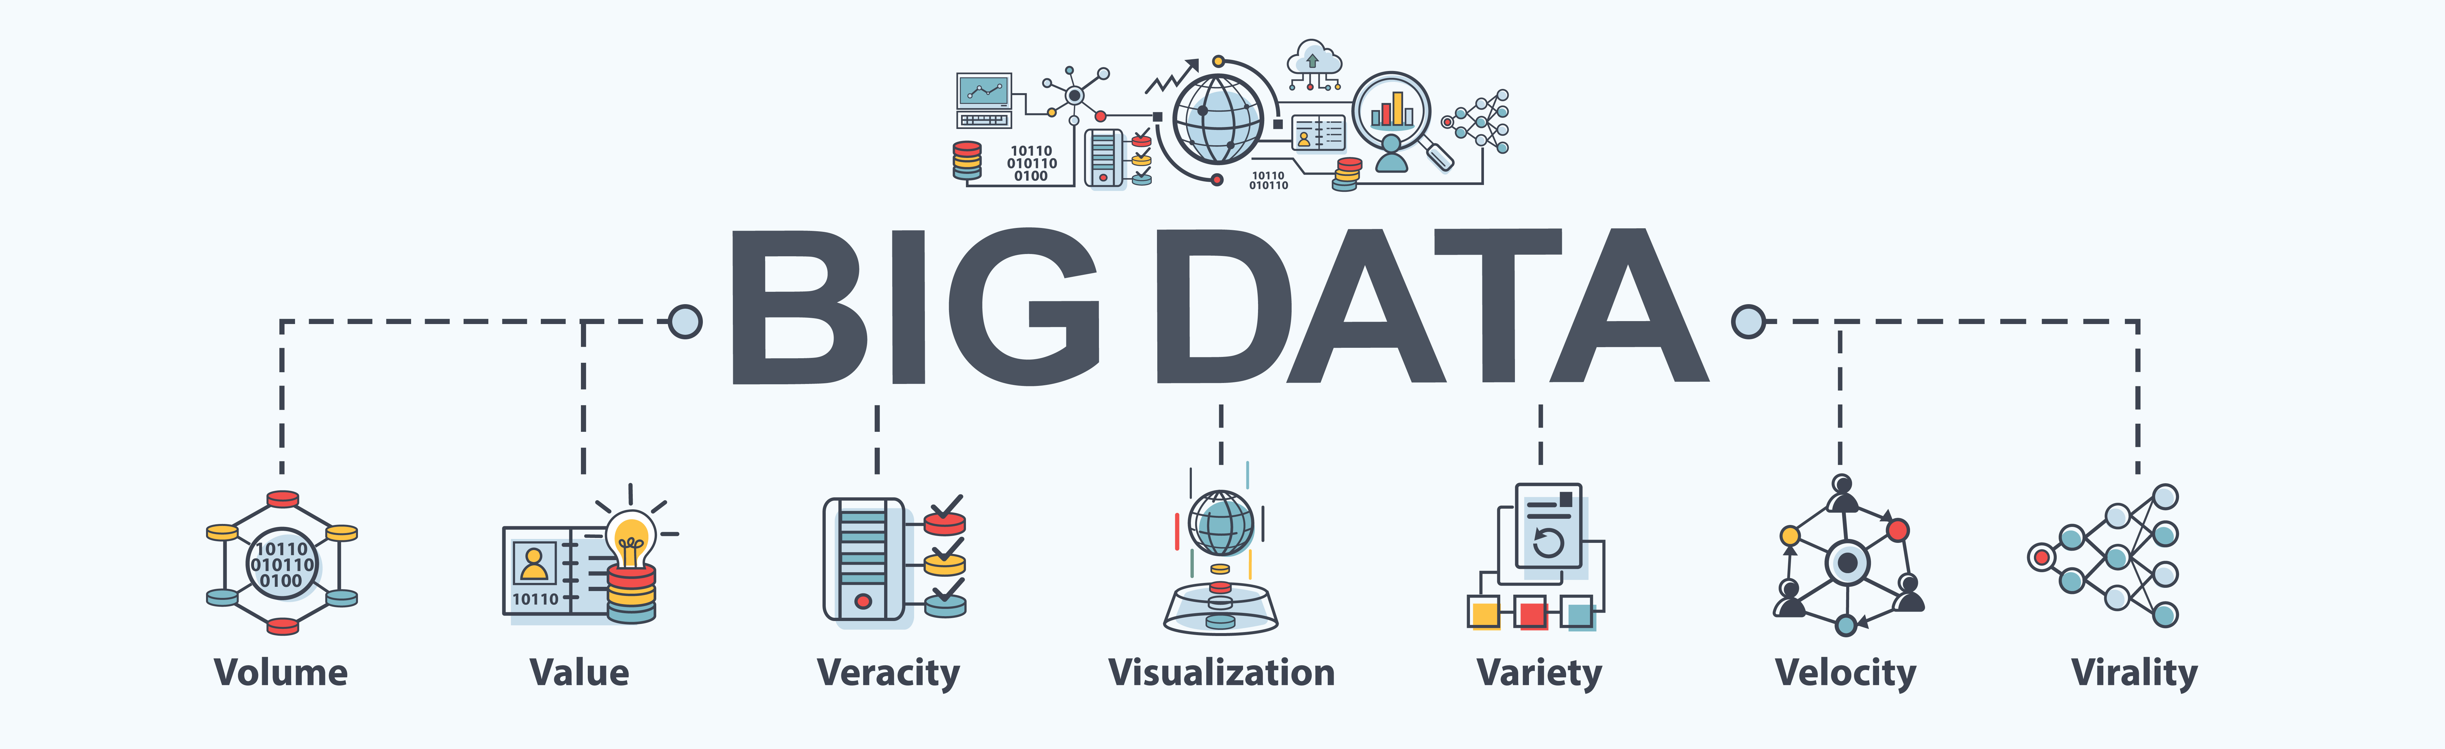
Platforms
Structured - organized such that data can be described and analyzed in conventional ways, including hypothesis testing. The unit is an individual with well-defined characteristics.
  Examples: Medicare, SEER-Medicare, National Health Interview Survey, American Community Survey
Unstructured – analyzed using a new discipline, data science that looks for patterns. The unit of analysis is usually a location without well-defined personal characteristics. Artificial intelligence algorithms.
  Examples: Genome data, Google searches, Facebook, mobile sensors, and data collected for marketing purposes

Slide 21
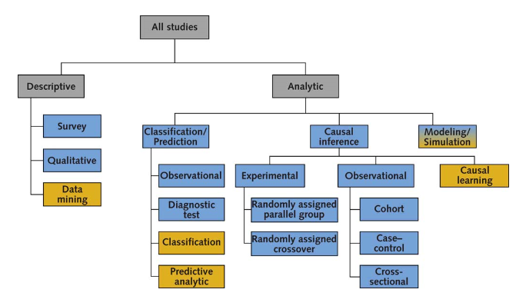
Two Ways of Knowing: Structured and Unstructured Data
Source: Sim I., Two Ways of Knowing: Big Data and Evidence-Based Medicine
Annals of Internal Medicine 2016
Notes:
Yellow boxes are unstructured data
Blue boxes are structured data

Slide 22
Race/Ethnicity in Structured Data
Census data has evolved
  Beginning in 1960, Americans reported their own race
  Beginning in 1980, ancestry/ethnic origin was asked
  Since 2000, respondents could report more than one race
  Missing racial categories
  Hispanic/Latino (ethnicity)
Census data are used to:
  Make policy and allocate funding ($800 billion)
  Test hypotheses
Gold Standard: Self Reported Race/Ethnicity
Ancestry biomarkers
Movement to collect Social Determinants of Health

Slide 23
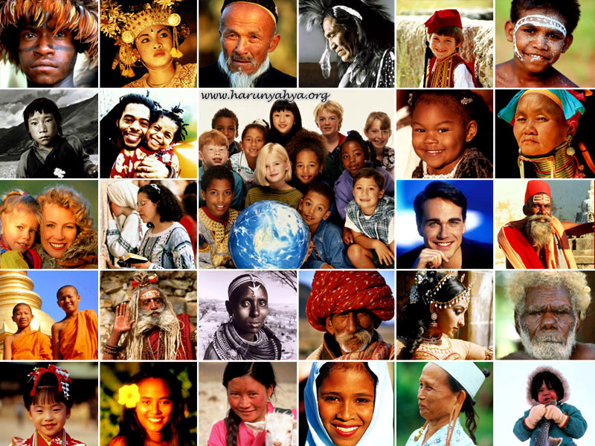
Unstructured Data: Adequate and Accurate Racial/Ethnic Data?

Slide 24
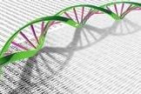
Genome / Omic Data Bases

Slide 25
Misclassified Ancestry in AA Cancer Cell Lines (inadequate and inaccurate)
Cell lines are used by cancer researchers to probe molecular mechanisms. Few cell lines are non-European
Observed differences in how certain cancers behave at the biological level in various ethnic groups, highlighting the need for ethnically diverse cell lines to probe the molecular basis for these differences.
A team of researchers analyzed genetic ancestry of 15 prostate, breast, and cervical cancer cell lines and found that several lines labeled as mixed or black/African-American were misclassified
  A common prostate cancer cell line classified as African-American actually carries more than 90% European ancestry (22Rv1 had 99% European ancestry)
  E006AA-hT, (prostate) labeled as African-American actually carries 91% European ancestry.
  HeLa (Heneritta Lacks) cells contain 66% West African ancestry, which is slightly lower than the average of about 80% West African ancestry for US born African-Americans.
Published studies using misclassified cell lines may be inadequate to understand the disease within a population group and inaccurate for the development of personalized medicines
Source: Hooker SE, Woods-Burnham L, Lloyd SM et al, CEBP, 2019 / (Cancer Epidemiol. Biomarkers Prev. 2019, DOI: 10.1158/1055-9965.EPI-18-1132).
Notes:
http://cebp.aacrjournals.org/content/early/2019/02/20/1055-9965.EPI-18-1132
https://cen.acs.org/biological-chemistry/cancer/Genetic-tests-reveal-cancer-cell/97/i10

Slide 26
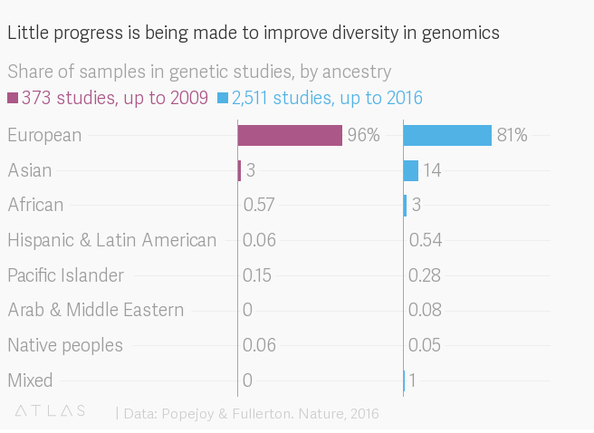
Human Genomics–Homogenous Don’t know what we don’t know
2016 meta-analysis: 2,511 studies from around the world found that 81% of participants in genome-mapping studies were of European descent. (2009, 96% of European descent)
https://qz.com/1367177/if-ai-is-going-to-be-the-worlds-doctor-it-needs-better-textbooks/

Slide 27
‘Omic Limited Data Sources
International Cancer Genome Consortium (ICGC)-20 countries 32 projects in USA, 1 in India and 0 in Africa
Some inherent bias in genomic data stems from non-scientific roots
  Over-represent people who get sick more
  Demographics around hospital
  Clinical trial enrollment
  Costs
2015 study found that 2% of the more than 10,000 NIH-funded cancer studies include adequate sample of minority groups to measure statistically significant change.
Too frequently, rely on observation classification for race/ethnicity
https://qz.com/1367177/if-ai-is-going-to-be-the-worlds-doctor-it-needs-better-textbooks/

Slide 28
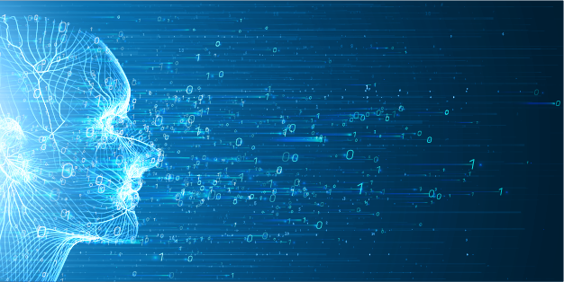
Artificial Intelligence

Slide 29
Artificial Intelligence (AI) Plays Integral Role in Medical Diagnostics
AI will sift through the vast amounts of health information produced by our society
  Find patterns that will help us be more efficient, wealthier and happier
  Assist clinical decision making
  Reduce diagnostic and therapeutic errors
  Inferences for health risks
To address diagnostic error, researchers and companies are leveraging artificial intelligence
  Chatbots: Speech recognition capability to identify patterns in patient symptoms to
  form a potential diagnosis, prevent disease and/or recommend an appropriate course of action.
  Oncology: Train algorithms to recognize cancerous tissue at a level comparable to
  trained physicians.
  Pathology: Pathology is the medical specialty that is concerned with the diagnosis
  of disease based on the laboratory analysis of bodily fluids such as blood and urine, as well as tissues. Machine vision and other machine learning technologies can enhance the efforts traditionally left only to pathologists with microscopes.
  Rare Diseases: Facial recognition software is being combined with machine
  learning to help clinicians diagnose rare diseases. Patient photos are analyzed using facial analysis and deep learning to detect phenotypes that correlate with rare genetic diseases.
https://emerj.com/ai-sector-overviews/machine-learning-medical-diagnostics-4-current-applications/
Notes:
https://emerj.com/ai-sector-overviews/machine-learning-medical-diagnostics-4-current-applications/
“…more recent efforts to use artificial intelligence in medicine have focused on programs organized around models of disease. Efforts to develop such programs have led to substantial progress in our understanding of clinical expertise, in the translation of such expertise into cognitive models, and in the conversion of various models into promising experimental programs. Of equal importance, these programs have been steadily improved through the correction of flaws shown by confronting them with various clinical problems.” Szolovits P, Patil RS, Schwartz WB Annals of Internal Medicine 1988

Slide 30
Correctional Offender Management Profiling for Alternative Sanctions (COMPAS)
US justice system, reviled for its racial bias, turned to technology for help-algorithms had a racial bias too.
More prone to mistakenly label black defendants as likely to reoffend – wrongly flagging them at almost twice the rate as white people (45% to 24%)
Black defendants were 77 percent more likely to be assigned higher risk scores than white defendants.
White defendants who re-offended within the next two years were mistakenly labeled low risk almost twice as often as black re-offenders (48 percent vs. 28 percent)
PedPol Crime Hot Spots: Suggested majority black neighborhoods at about twice the rate of white ones / when the statisticians modelled the city’s likely overall drug use, based on national statistics, it was much more evenly distributed.
https://www.newscientist.com/article/2166207-discriminating-algorithms-5-times-ai-showed-prejudice/

Slide 31
Dark-Skinned People & Females
AI-Driven Dermatology: potential to save thousands of people from skin cancer each year—while putting others at greater risk
  African-Americans have the highest mortality rate for skin cancer so AI trainers are missing skin cancer in African-Americans
  Particularly bad at identifying women of color: 34% less accurate at recognizing darker-skinned females compared to lighter-skinned males
Three of the latest gender-recognition AIs (Megvii)
  Id person’s gender 99% of time for white men
  Id person’s gender 35% of time for dark-skinned women
Google search for CEO
  11% resulted in women (27% female CEOs in US)
  Online advertising showed high-income jobs to men more than women
https://www.newscientist.com/article/2166207-discriminating-algorithms-5-times-ai-showed-prejudice/
Notes:
https://www.theatlantic.com/health/archive/2018/08/machine-learning-dermatology-skin-color/567619/

Slide 32
Discriminating Algorithms
Amplified Racist Sexist Age Biases
If you don’t teach the algorithm with a diverse set of images, then that algorithm won’t work out in the public that is diverse. Algorithms have:
  mistaken images of black people for gorillas
  misunderstood Asians to be blinking when they weren’t
  “judged” only white people to be attractive
  Linkedin showed a preference for male name searches
  Chatbot-Tay learned from twitter and began spouting anti-sematic messages
AI systems are calibrated for younger, more urban bodies because poorer and older members of society don’t have access to the digital technologies and therefore do not end up in trainer data
The highly selective nature of randomized control trials (RCT) systemically disfavors women, racial/ethnic minorities, the elderly, and those with co-morbidities
https://www.newscientist.com/article/2166207-discriminating-algorithms-5-times-ai-showed-prejudice/

Slide 33
Weapons of Math Destruction
Public/Patient perception might be that the algorithms are impartial.
Garbage In-Garbage Out / Racism In-Racism Out (Khan 2017)
Danger of outsourcing decisions to computers with biases
Most vulnerable in society who are exposed to evaluation by automated systems
Prevent AI from amplifying the inequalities of our past and affecting the most vulnerable members of our society. Data fed the machines reflects the history of our own unequal society--in effect, asking the program to learn our own biases.
Bryson describes the way that machine learning can expose the prejudices embedded in our use of language. It encodes both the wisdom and the folly of all those who have used language.
Guardian Inequality Project: Rise of the racist robots – how AI is learning all our worst impulses by Stephen Buranyi Aug 2017

Slide 34
Do Not Automate Biases Computers Learn from Us
The formula for AI-powered systems is almost the same across all medical disciplines
  Gather data on patients
  Use it to predict what will happen when a new patient come in
AI Training data are crucial to accuracy.
  If data don’t accurately represent a population of patients then any algorithm relying on the data is at a higher risk of making a mistake
  Patients not in the training data set will not get an accurate diagnosis
Deep learning – finding patterns in the data it is trained on– is especially susceptible to bias
The Food and Drug Administration (FDA) is now paying close attention to subject demographics in AI software.
Notes:
https://qz.com/1367177/if-ai-is-going-to-be-the-worlds-doctor-it-needs-better-textbooks/

Slide 35
AI Algorithms Need to Include Groups at Risk of Health Disparities
Applications of AI in medical diagnostics are in the early adoption phase with limited data on patient outcomes
AI applications have the potential to impact
  How clinicians and health care systems approach diagnostics
  How individuals understand changes to their health in real-time.
Rigorous testing of applications will be needed to validate utility
Unless AI algorithms represent all racial/ethnic and other groups at risk of health disparities, undetected disease will result in undetected disparities

Slide 36
Think of Problem from Beginning
Biased Outcomes from a Biased Algorithm (easier to spot than the biased data fed into the machine)
Consider what could happen when doctors begin relying on AI to diagnose diseases like skin cancer, or determine which drug treatment is best for a serious illness based on biological markers. In products like Google Photos, these biases reaffirm false stereotypes and have detrimental impacts on users, but in the field of medicine, they can be the difference between life and death.
Bias at any point in data handling for precision medicine can lead to the recapitulation of longstanding health disparities,” wrote Ferryman and Pitcan in a February report for Data & Society. That means a world where black Americans die more often than white Americans will, at best, remain unchanged; worse, that demographic gap could widen.
In health care, these biased outcomes tend to mean one group of people gets better medical treatment than another. Groups are often characterized by gender or race, or other traits, like language, skin type, genealogy, or lifestyle.
HEAL THYSELF, ALGORITHM If AI is going to be the world’s doctor, it needs better textbooks
By Dave GershgornSeptember 6, 2018

Slide 37
Successful AI Kidney Matching
AI can identify potential donors and recipients who are biologically suited for one another; but not who gets one
The algorithms evaluate all the transplants possible among the patient-donor pool at once. Matches are made primarily on biological suitability, with the hardest-to-match patients getting first priority. The technology weighs criteria including the time the recipient has been on the waiting list, his or her age (children get priority), and whether the person who needs a kidney has been a living organ donor in the past (with the reasoning that people who have stepped up to give before should get priority if they one day find themselves in need).
Machine making a decision based on what it has learned about human values.
Fumo, D. E., Kapoor, V., Reece, L. J., Stepkowski, S. M., Kopke, J. E., Rees, S. E., Smith, C., Roth, A. E., Leichtman, A. B., … Rees, M. A. (2015). Historical Matching Strategies in Kidney Paired Donation: The 7-Year Evolution of a Web-Based Virtual Matching System. American journal of transplantation : official journal of the American Society of Transplantation and the American Society of Transplant Surgeons, 15(10), 2646-54.

Slide 38
AI Kidney Matching – Systematic Racial and Gender Discrimination
In the kidney question, fair-minded principle that kidneys should be given to the people who will likely have the most years of productive life after receiving one. Before a computer can calculate the longevity of potential recipients, scientists have to feed the algorithm data on life expectancy for various populations.
But this leads to some problems. Men tend to die before women do. Black Americans die younger than Americans of any other ethnicity. A 65-year-old white woman in the US could expect to live another 20.5 years in 2015, four years longer than a black man of the same age.
What started with good intentions ends in systematic racial and gender discrimination.
Back to the drawing board – deal with it in beginning

Slide 39
Importance of Big Data for
Health Disparities Research and
Clinical Care for Minorities
FUSING

Slide 40
Fusing Data Platforms
Structured big data (surveys, health/medical records, and administrative data) have the advantage of including demographic information about individuals included, and a defined population with known representation
  Disadvantage is lack of granularity.
    National Health Interview Survey is designed to measure outcomes at the national level
    Behavioral Risk Factor Surveillance system is designed to measure outcomes at the state level
Unstructured big data (Google, Facebook) has the advantage of millions of observations, hence plenty of granularity
  Disadvantage is lack of knowledge about the representativeness of the data.
    Who is included?
    Who is missed?
Limitations suggest that unstructured data needs to be fused with structured data for maximum utility in health disparities research
Source: Sim I., Two Ways of Knowing: Big Data and Evidence-Based Medicine, Annals of Internal Medicine 2016

Slide 41
Fusing Data: Mining for Racism
The study calculated an Internet-based geographic measure of “racism” from Google searches of 196 market areas.
  More N-word hits = More racism
Used geographic area racism measure to test for an association with higher African American mortality (structured data) in those same areas
Found a one standard deviation increase in area racism was associated with a 6% increase in the all-cause Black mortality rate, after adjusting for covariates
  More racism = Excessive AA Mortality Rates
Source: Chae DH, Clouston, Hatzenbuehler, et al, PloS One 2015

Slide 42
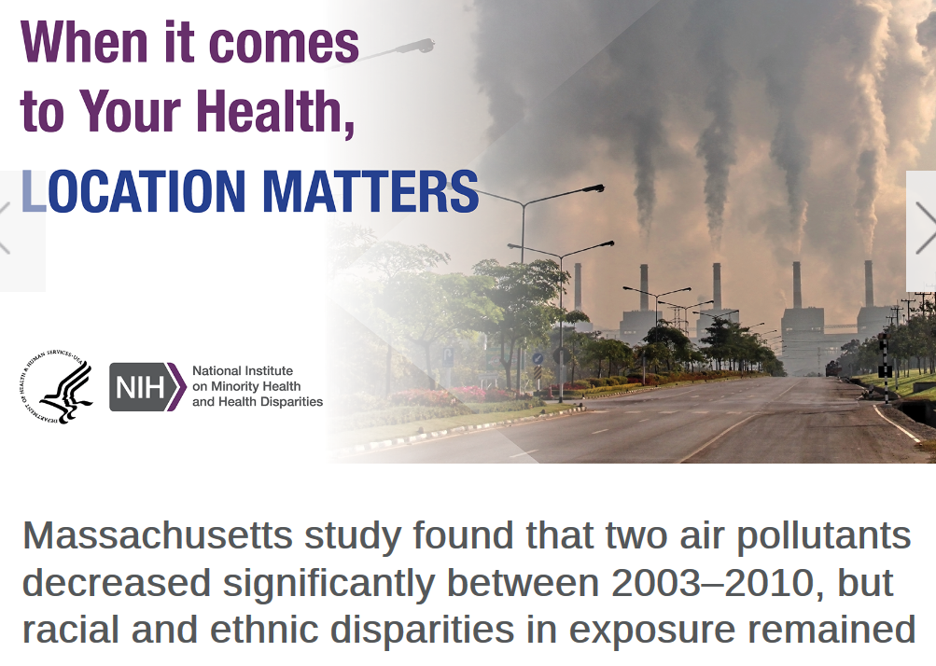
Fusing Data: Environmental Health Disparities
Fused Environmental Data with Census Data and Mortality Data
Notes:
CDE are important for health disparities research. Health disparities are local. Action to reduce health disparities largely takes place at the local level. Using CDE makes it possible to compare important findings in one location with findings from other locations to generalize how health determinants affect population health disparities.
Mass Study by Jonathan I. Levy, Sc.D., and Francine Laden, Sc.D. The study, “Temporal trends in air pollution exposure inequality in Massachusetts,” was funded by the National Institute on Minority Health and Health Disparities (NIMHD), the National Institute of Environmental Health Sciences (NIEHS), and the Environmental Protection Agency (EPA). The data for fine particulates was from 2003–2010. The nitrogen dioxide data was from 2005–2010.
The study is part of a larger effort of the Center for Research on Environmental and Social Stressors in Housing Across the Life Course (CRESSH) , a partnership between the Boston University School of Public Health and the Harvard T.H. Chan School of Public Health. CRESSH studies differences in pollution and health outcomes in communities in Massachusetts and the drivers of these differences. The studies involve a range of scientific disciplines and involve a strong community engagement component. Levy and Francine Laden, Sc.D., of the Harvard T.H. Chan School of Public Health, lead CRESSH.

Slide 43
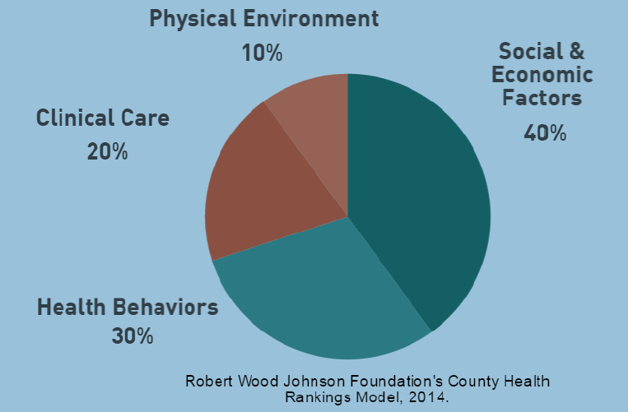
Relative Impact of Determinants on Health – Need Social Economic Data
Notes:
Clinical care is important and the focus of most biomedical research. However, as this pie chart shows, clinical care accounts for a relatively small share of the determinants of health. Clinical care and health behaviors are proximal determinants that together account for about half the share. Both clinical care and health behaviors are shaped by social and economic factors and by the physical environment. This makes it important to study not only what’s happening in the clinic, but also for clinicians to know what happened before the patient entered the clinic, and whether there are unmet needs preventing patients from getting treatment and care, adhering to medication, healthy or special diets, etc.

Slide 44
Clinicians Need to Know about their Patients’ Social Determinants
The Spirit Level by Wilkinson and Pickett -provided evidence that decreasing income, education, social status, and social support is correlated with increased morbidity and premature mortality.
A survey conducted by the Robert Wood Johnson Foundation found that 4 out of 5 physicians do not feel confident in their capacity to meet their patients’ social needs, and they believe this impedes their ability to provide quality care.
Examples of social determinants role in clinical care:
Treatment options – social risk
Adherence
Better care for underserved marginalized individuals (reduce health disparities)
Impact on DNA (other biological changes)
Public Health Rev. 2018; 39: 19. Published online 2018 Jun 22. doi: 10.1186/s40985-018-0094-7
PMCID: PMC6014006 PMID: 29977645 Screening for social determinants of health in clinical care: moving from the margins to the mainstream Anne Andermann

Slide 45
Who you are as a person is not just defined by your DNA, but by which parts of it your epigenome permits to be expressed-
Fusing Poverty Stressors & DNA
Stresses of being poor have a biological effect that can last a lifetime. Lower socioeconomic status during adolescence is associated with an increase in methylation of the proximal promoter of the serotonin transporter gene,” which primes the amygdala—the brain’s center for emotion and fear—for “threat-related amygdala reactivity.”⁵ While there may be some advantages to being primed to experience high levels of stress (learning under stress, for example, may be accelerated⁶), the basic message of these studies: Chronic stress and uncertainty during childhood makes stress more difficult to deal with as an adult.
Evidence suggesting that these effects may be inheritable, whether it is through impact on the fetus, epigenetic effects, cell subtype effects, or something else. The science of the biological effects of the stresses of poverty, although in is its early stages, has presented us with multiple mechanisms through which such effects could happen, and many of these admit an inheritable component. If a pregnant woman, for example, is exposed to the stresses of poverty, her fetus and that fetus’ gametes can both be affected, extending the effects of poverty to at least her grandchildren. And it could go further.
Scientific understanding of the experience of poverty can also inform medical treatments later in life. Hippocampus samples from suicide victims with a history of childhood abuse and tested for DNA methylation controlling the expression of the gene NR3C1.⁴ They discovered an increased methylation around the NR3C1 promoter, which, in other studies, has been directly linked to a reduced expression of a protein called brain-derived neurotropic factor (BDNF). BDNF is among the most active neurotrophic factors, which drive the growth and development of new neurons even in adulthood. And the degree to which it is expressed may be inheritable. A 2015 study linked NR3C1 and reduced expression of BDNF in infants born to mothers who reported prenatal depressive symptoms.¹³
Blair, C., & Raver, C. C. (2016). Poverty, Stress, and Brain Development: New Directions for Prevention and Intervention. Academic pediatrics, 16(3 Suppl), S30-6.

Slide 46
NIMHD: Big Data into Health Disparities Research

Slide 47
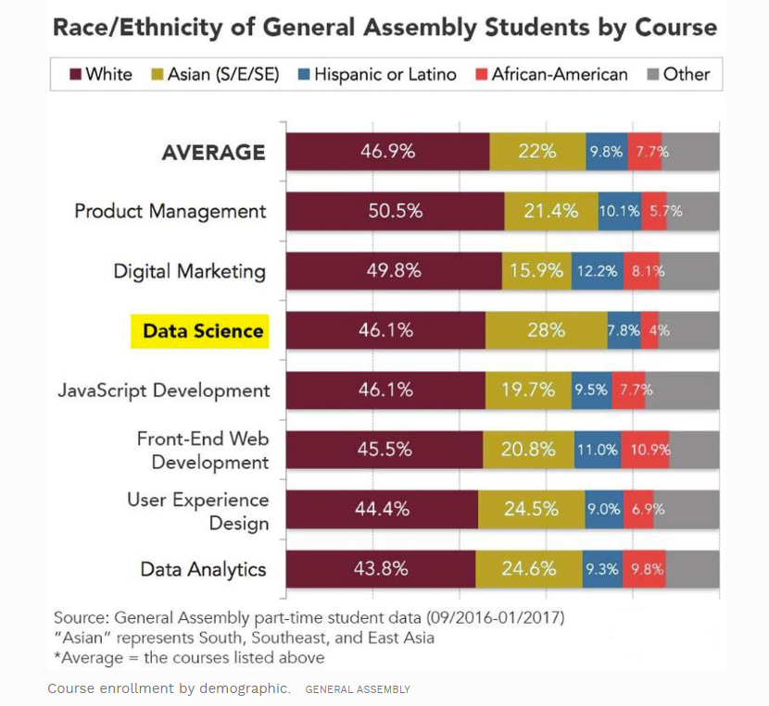
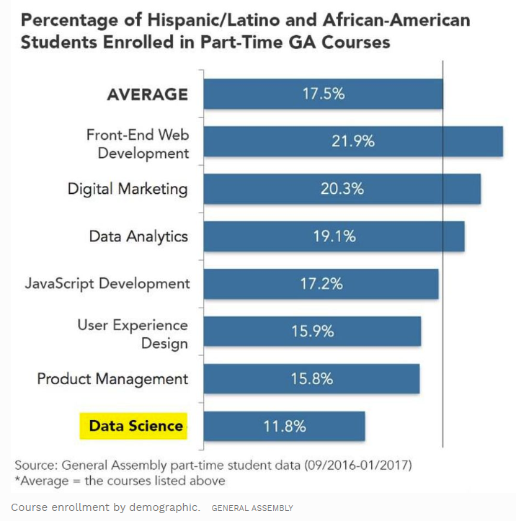
Data Science Diversity Gap-Students

Slide 48
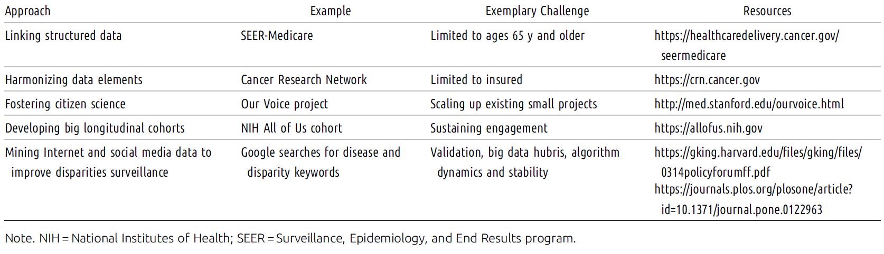
Incorporating Big Data into Health Disparities Research
Source: Breen N, Jackson JS, Wood F, Wong DWS, Zhang X, Translational Health Disparities Research in a Data-Rich World, AJPH Supplement 1, 2019

Slide 49

nation
HDPulse combines data sources to offer quick access to state and county data
https://hdpulse.nimhd.nih.gov/

Slide 50
Publications to Encourage Use of Big Data in Health Disparities Research
Publications:
Zhang X, Perez-Stable EJ, Bourne PE et al, Big Data Science: Opportunities and Challenges to Address Minority Health and Health Disparities in the 21st Century, Ethnicity and Disease, 2017
Breen N, Jackson JS, Wood F, Wong DWS, Zhang X, Translational Health Disparities Research in a Data-Rich World, AJPH Supplement 1, 2019
Bagby SP, Martin D, Chung ST, Rajapakse N, From the Outside In: Biological Mechanisms Linking Social and Environmental Exposures to Chronic disease and to Health Disparities, AJPH, 2019
Kasman M, Breen N, Hammon RA, Complex Systems Science in The Science of Health Disparities Research and Applications, Wiley, forthcoming

Slide 51
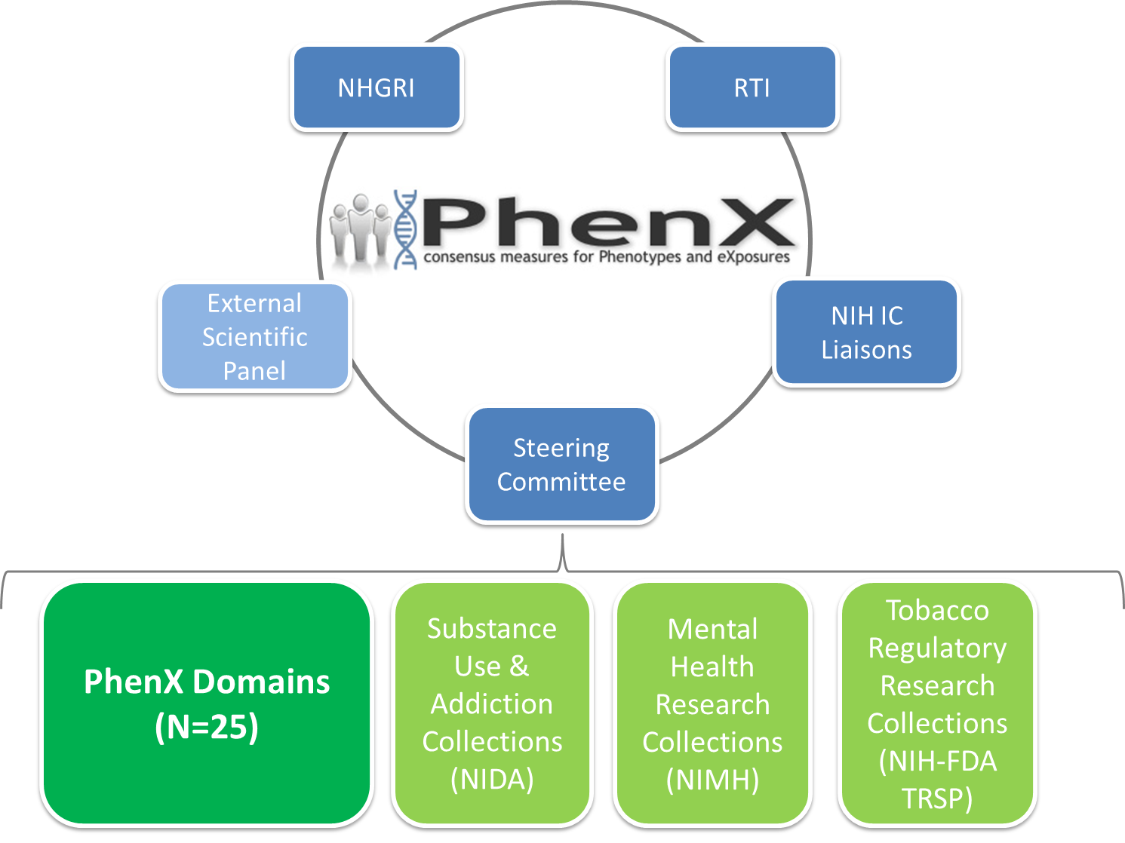
Forthcoming: Common Data Elements-Social Determinants of Health
Common Data Element - standard measure for a variable
  precisely specified question
  fixed set of permissible answers (discrete or continuous)
  Core/key variables – not all variables
  Used across multiple sites, projects, initiatives, etc.
PhenX Toolkit – web-based catalog of high-priority measures for genome-wide studies
  CDEs for SDOH can facilitate cross-study analyses
  Validate studies or combine to increase statistical power

Slide 52
Funding Announcements

Slide 55



Connect With NIMHD
  Visit us online www.nimhd.nih.gov
  Connect with us on Facebook www.facebook.com/NIMHD
  Follow us on Twitter
  @NIMHD
durande@mail.nih.gov
Notes:
Please connect with us via social media. Certainly email me, if we can be of assistance to you.

