Slide 1
Developing Best Practices to Address LGBTQ+ Health Disparities
Sarah Pickle, MD
Associate Professor
Family & Community Medicine
University of Cincinnati College of Medicine
Stef Murawsky, MA
Ph.D. Candidate, Department of Sociology
University of Cincinnati

Slide 2
Disclosures
Sarah Pickle has no disclosures.
Stef Murawsky has no disclosures.

Slide 3
Session Objectives
Describe health disparities experienced by in transgender individuals and medical professionals role in these disparities
Discuss effective educational strategies to train future physicians in transgender medicine
Identify best practices for data collection in LGBTQ patients

Slide 4
Considerations on Medical Training for Gender-Affirming Care: Motivations and Perspectives
Shanna Stryker, MD
Harini Pallerna, MS
Sarah Pickle, MD

Slide 5

Healthcare for Transgender Persons
Transgender persons self-identity crosses established gender categories or they may feel a disconnect from the gender they were assigned at birth based on their presumed sex
Transgender persons report less access to health care and lack of providers knowledgeable in gender-affirming care
  Outcomes: delays in seeing a health care provider, fear of interfacing with the medical system, mistreatment
Most US Medical Schools lack training in gender-affirming care and transgender health
No clear consensus on how to develop core competencies in transgender health among medical trainees
James, et al. National Center for Transgender Equality. 2016
Notes:
Lack clear data on what learning opportunities motivate providers to incorporate gender-affirming care into their practice

Slide 6
Considerations on Medical Training for Gender-Affirming Care: Motivations and Perspectives
Methods: Voluntary cross-sectional electronic survey was distributed to interdisciplinary providers who self-identified as being providers experienced in providing care to transgender individuals.
Purpose: Identify professional motivators and training experiences that were most beneficial to providers’ career development in gender-affirming care
Notes:
The survey was sent through professional listservs and publicly-available referral lists and respondents were invited to share the survey with professional colleagues.

Slide 7
Results
473 interdisciplinary providers of gender-affirming care/transgender health
32.6% (n=151) of the overall survey respondents were physicians (n=125), physician assistants (n=5), nurse practitioners (n=21), or midwives (n=3)
Notes:
151

Slide 8
Results: Motivations for training in gender-affirming care
Motivator | n | %
Filling a need in the community (e.g. there were no other providers doing this work) | 103 | 73.00%
Professional experience (e.g. transgender patient inspired my professional interest) | 90 | 63.80%
Institutional expectation | 53 | 37.60%
Personal experience (e.g. self, family, friend who identifies as transgender) | 50 | 35.50%
Lecture/course/rotation while in school/training | 21 | 14.90%
Article in a professional journal/news source or presentation at a professional conference | 6 | 4.30%

Slide 9
Results: Experts’ Recommendations for Training Experiences
Experience | n | %
Clinical experience/rotation | 49 | 34.5%
Mentorship | 27 | 19%
On-site training provided by employer | 16 | 11%
Professional Conference | 12 | 8.5%
Residency (Post-Graduate) Training | 10 | 7%
Fellowship (Post-Graduate) Training | 7 | 4.9%
Self-Study of Literature or Guidelines | 2 | 1.4%
Graduate Course | 1 | 0.7%

Slide 10
Conclusions
Multi-step and multi-modal approach to training the next generation of healthcare providers
  Longitudinal exposures through clinical rotations
  Mentorship
Limitations: Does not address the timing of experiences during training
  Structural differences between MD/DO, PA, NP

Slide 11
Best Linguistic Practices in LGBTQ+ Research
Stef Murawsky, MA, WGSS
Ph.D. Candidate, Sociology murawssr@mail.uc.edu

Slide 12
Research on Sexuality and Gender
Use current terminology
  LGBTQIA
Have options
  “Check all that apply”
  Write in options

Slide 13
Questions about Sexuality
Identity
Attraction
Behavior
Notes:
Self-identification – how you identify
Sexual behavior – who you actually have sex with
Sexual attraction – who you’re sexually attracted to

Slide 14
Sexual Identification
Which term best describes your sexual orientation?
  Straight
  Lesbian
  Gay
  Bisexual
  Queer
  Pansexual
  Asexual
  Other (please fill in): ___________

Slide 15
Sexual Behavior
In the past (time period e.g. year) who have you had sex with? Check all that apply:
  Men
  Women
  Non-binary/genderqueer people
  I have not had sex

Slide 16
Sexual Attraction
Which best describes your feelings of sexual attraction? Check all that apply:
  I am attracted to men
  I am attracted to women
  I am attracted to non-binary/genderqueer people
  I am not attracted to anyone

Slide 17
Questions about Gender
Include more options than “man” or “woman”
Use a two-step question

Slide 18
Self-Identification (Two Step)
What is your gender identity?
  Man
  Woman
  Transgender Man
  Transgender Woman
  Non-binary/Genderqueer
  Other (please fill in): __________

Slide 19
What sex were you assigned at birth?
  Male
  Female
  Intersex
  Note: In the future, “X” maybe need to be added as an option to this question, depending on where the survey is distributed.

Slide 20
When and What You Ask
Priming
Wording of questions
  “Do you currently have a partner or partners?”
  “Do you receive preventative care for having either a cervix or prostate?”
Notes:
Priming – demographic stuff before, during or after main questions; can result in outing, distrust if done first

Slide 21
Grouping Respondents in Findings
Be specific and intentional with your words
The LGBT+ moniker includes people with marginalized sexes, genders and sexualities
  Sexuality: Lesbian/Gay/Bisexual/Queer/Asexual
  Gender: Transgender
  Sex: Intersex
Notes:
Sometimes these categories overlap, sometimes they don’t

Slide 22
Are you talking about sex or gender?
  “Sex” should describe sex assigned at birth
    male / female / intersex
  “Gender” should describe gender identity
    man / woman / non-binary or genderqueer
Notes:
Social scientists have a lot of epistemological thoughts about whether sex and gender need to be differentiated (bc “sex” is also socially constructed); but for the sake of clear and accurate clinical writing, follow the biological vs social distinction.
If you have to pick one term, use gender.

Slide 23
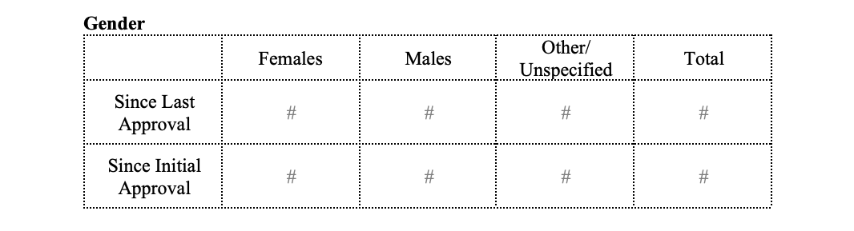
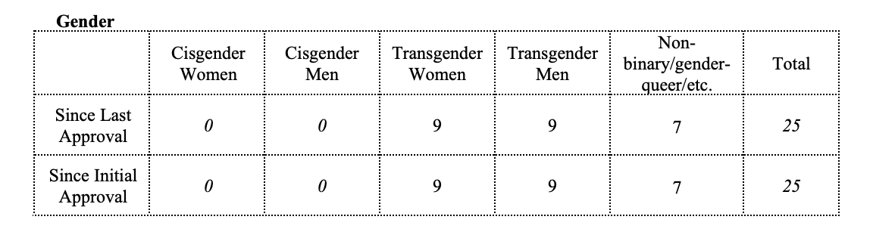
vs.
Notes:
IRB example, Table 1 in a paper would be an example (demographics)

Slide 24
Don’t be afraid to use the term cisgender
  “Cisgender” just means you don’t feel any incongruence between your gender identity and the sex you were assigned at birth
Notes:
it’s not a derogatory term for non-transgender folks
Saying everyone in your study was cisgender helps normalize that language!

Slide 25
Everyday Applications for Practitioners
Use language that doesn’t make normative assumptions about bodies with LGBTQ clients
Add inclusive language and options to intake forms and medical charts
Notes:
Asking a gender-nonconforming person what pronouns they prefer is most likely going to be perceived as polite, not intrusive.
Intake forms and chart language can mirror the same types of questions discussed in quantitative research earlier.

Slide 26
Resources
Best Practices for Asking Questions to Identify Transgender and Other Gender Minority Respondents on Population-Based Surveys (Williams Institute)
Data Collection Methods for Sexual Orientation and Gender Identity (Williams Institute)
Planning and implementing sexual orientation and gender identity data collection in electronic health records (2019)

