Slide 1
Lessons From Publishing: Do Researchers in Developing Countries Receive Credit for Their Work?
Theresa M. Culley
Dept. Biological Sciences

Slide 2
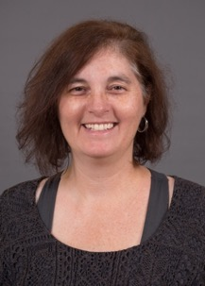
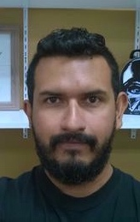

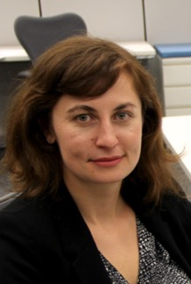
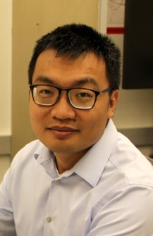
Pub Bias Team Members
Amy Marwa Jose Ben Megan Eric
Koshoffer Ammar Barreiro Merritt Philpott Tepe
Maria Rob James Arlene Erin Zhaowei
Torres Tunison Lee Johnson McCabe Ren
Notes:
And Amy Koshoffer

Slide 3
Steps to Publishing
Not the same for all authors
© BrainAura
Identify your research question
Conduct your research project – gather data & analyze
Write up your manuscript
Submit to a peer-reviewed journal
Wait for the review feedback
Revise or resubmit
Publication!!

Slide 4
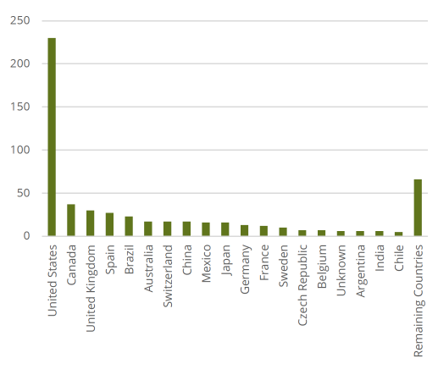
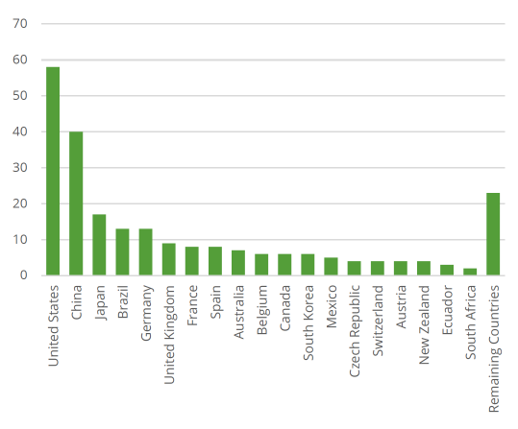
Number of Published Articles by Country - 2017
* Determined by country of corresponding author

Slide 5
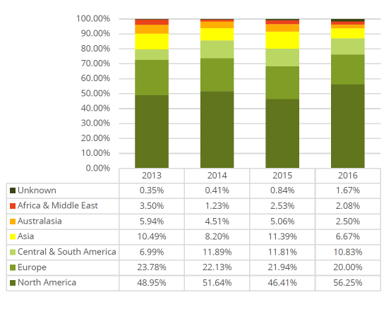
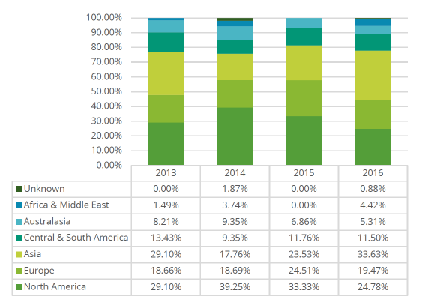
Proportion of Total Published Articles by World Region - 2017

Slide 6
2018: Submissions received from 29 countries
In several countries, salary is tied to number of publications in English journals

Slide 7
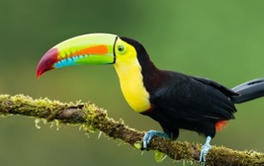
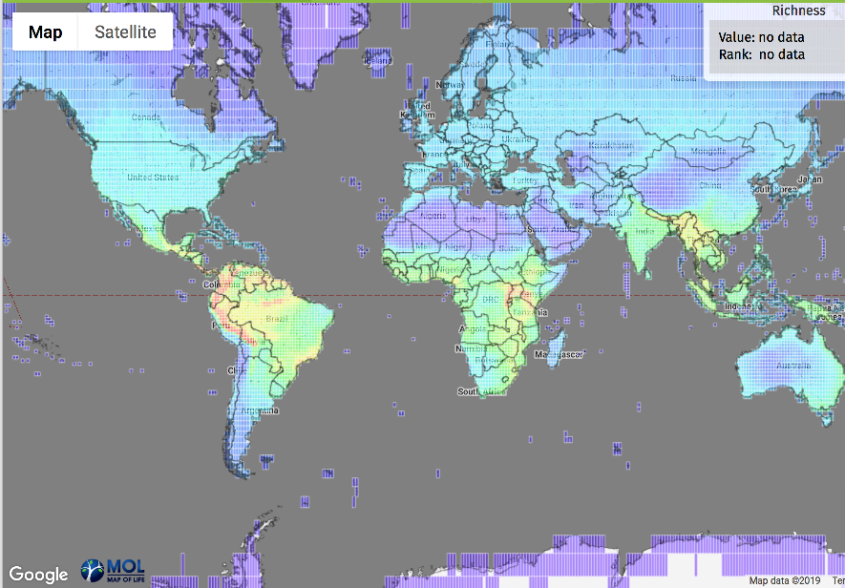
Species Richness = Number of Species
Birds

Slide 8
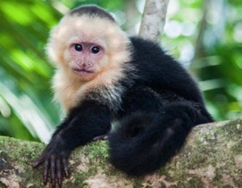
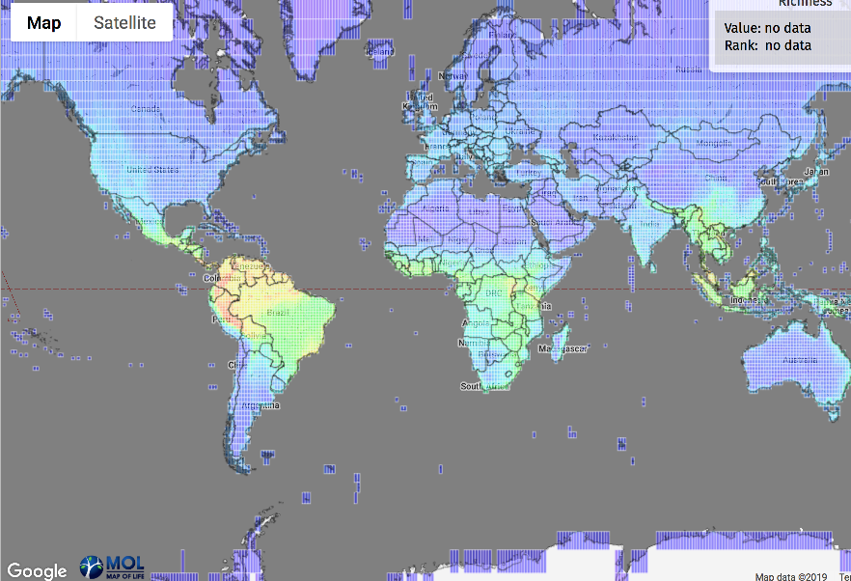
Species Richness = Number of Species
Mammals

Slide 9
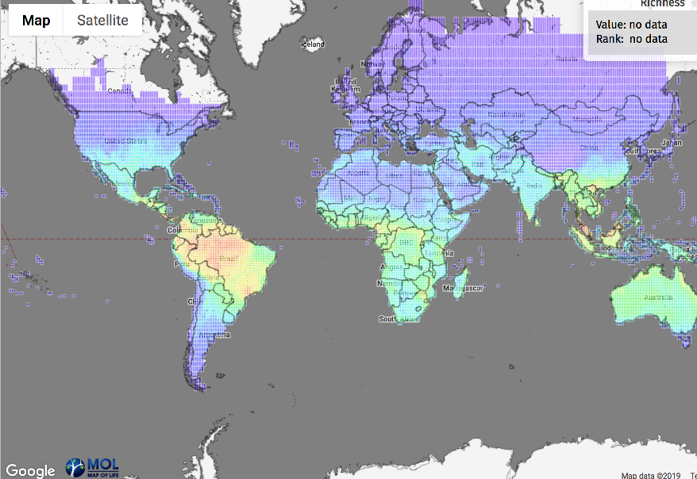
Species Richness = Number of Species
Reptiles

Slide 10
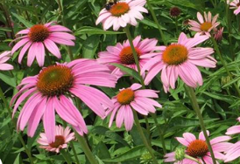
Species Richness = Number of Species

Slide 11
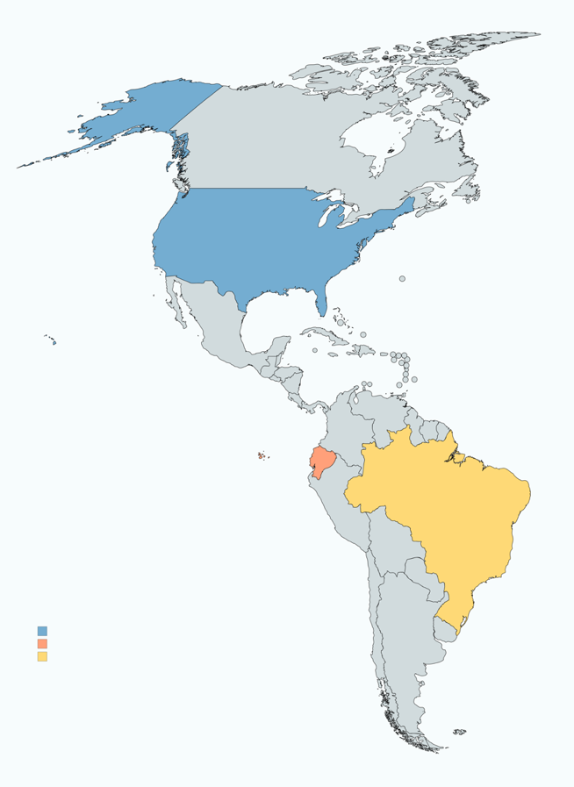
Plant Species Richness
- Greatest in tropical areas!
Country Area (km²) R
United States 9,156,793 462
Brazil 8,358,140 521
Ecuador 262,21 1856

Slide 12
The world regions of highest biodiversity are also usually those with the lowest economic resources

Slide 13
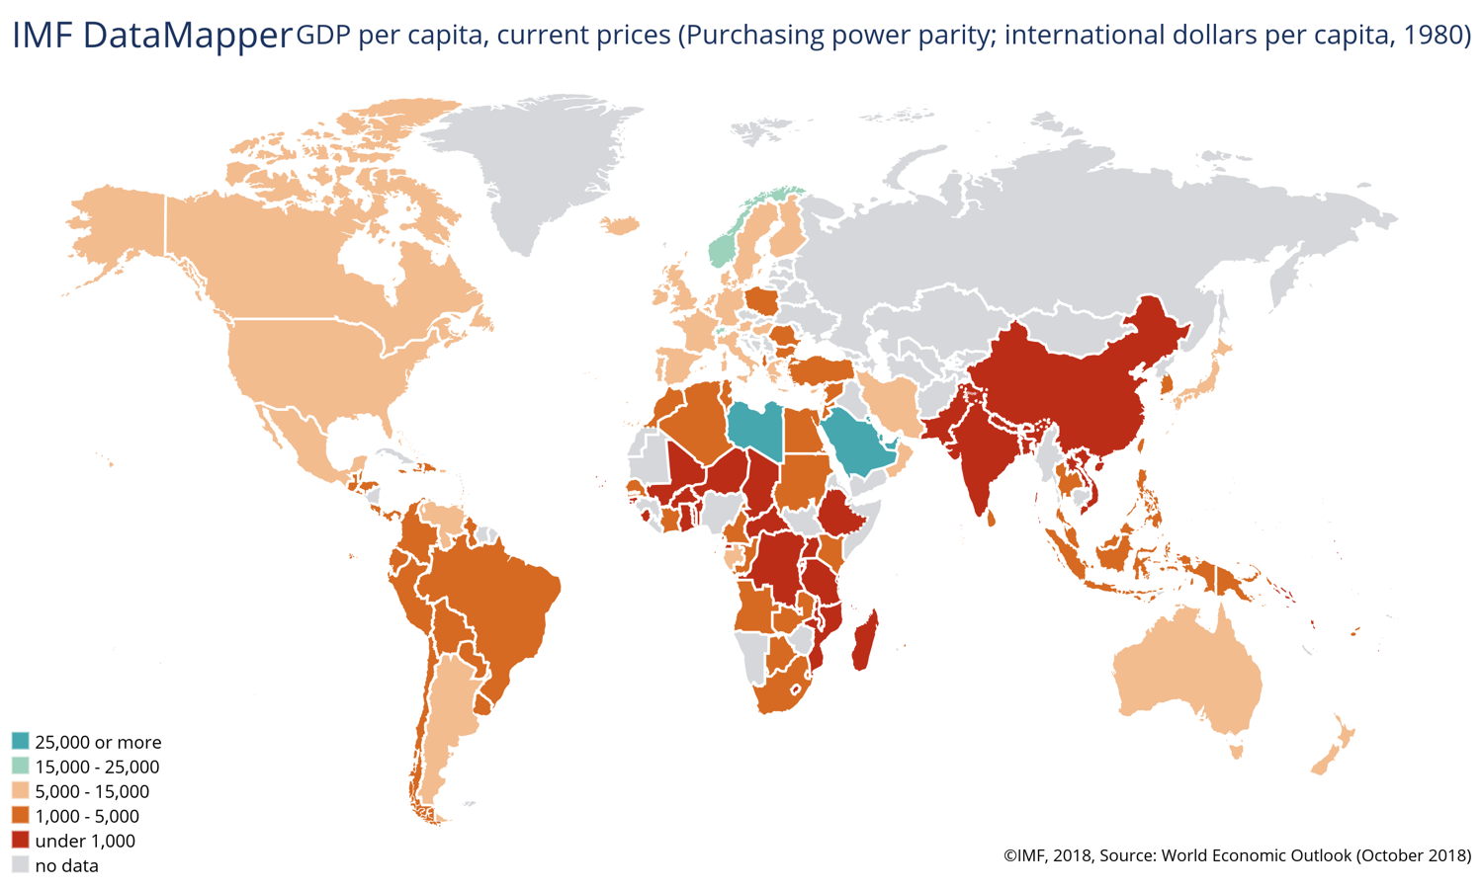
Global Gross Domestic Product Per Capita
Notes:
https://www.imf.org/external/datamapper/PPPPC@WEO/OEMDC/ADVEC/WEOWORLD

Slide 14
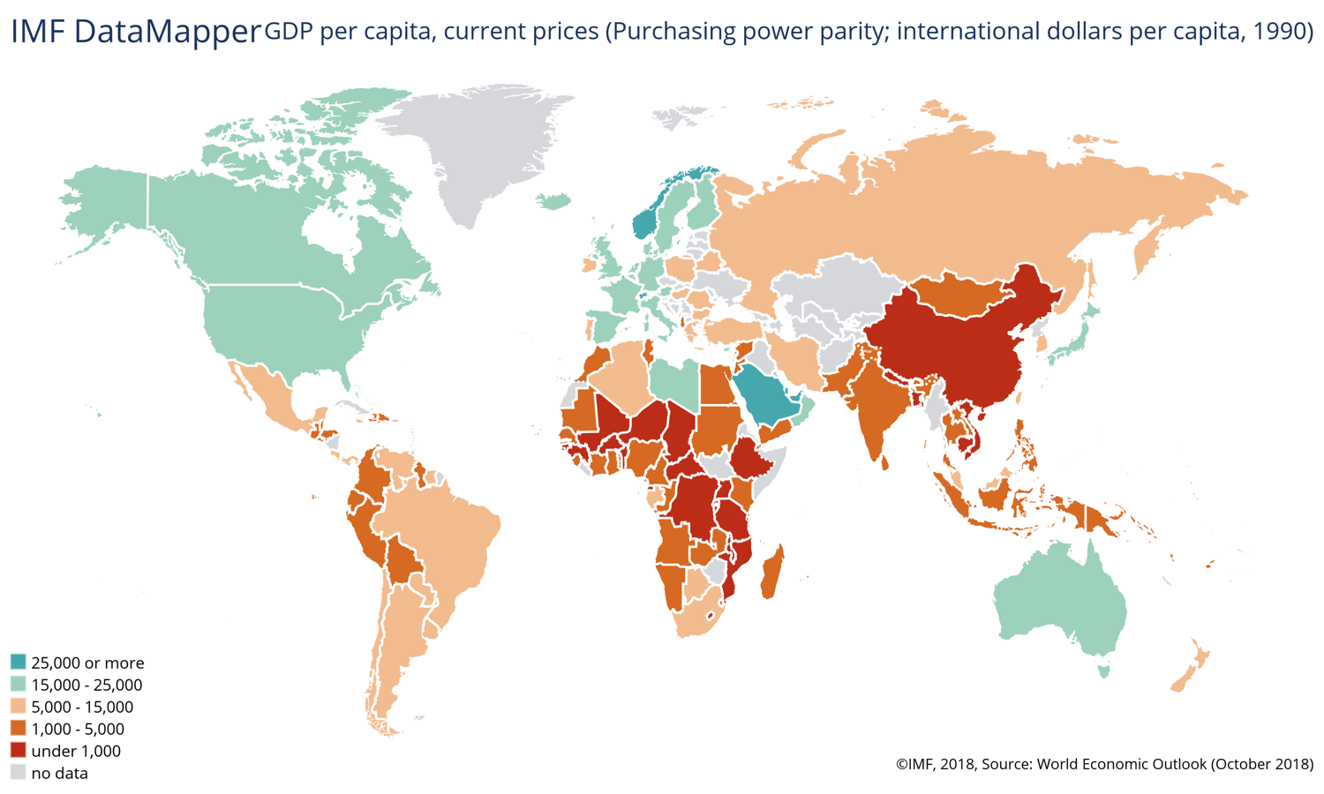
Global Gross Domestic Product Per Capita

Slide 15
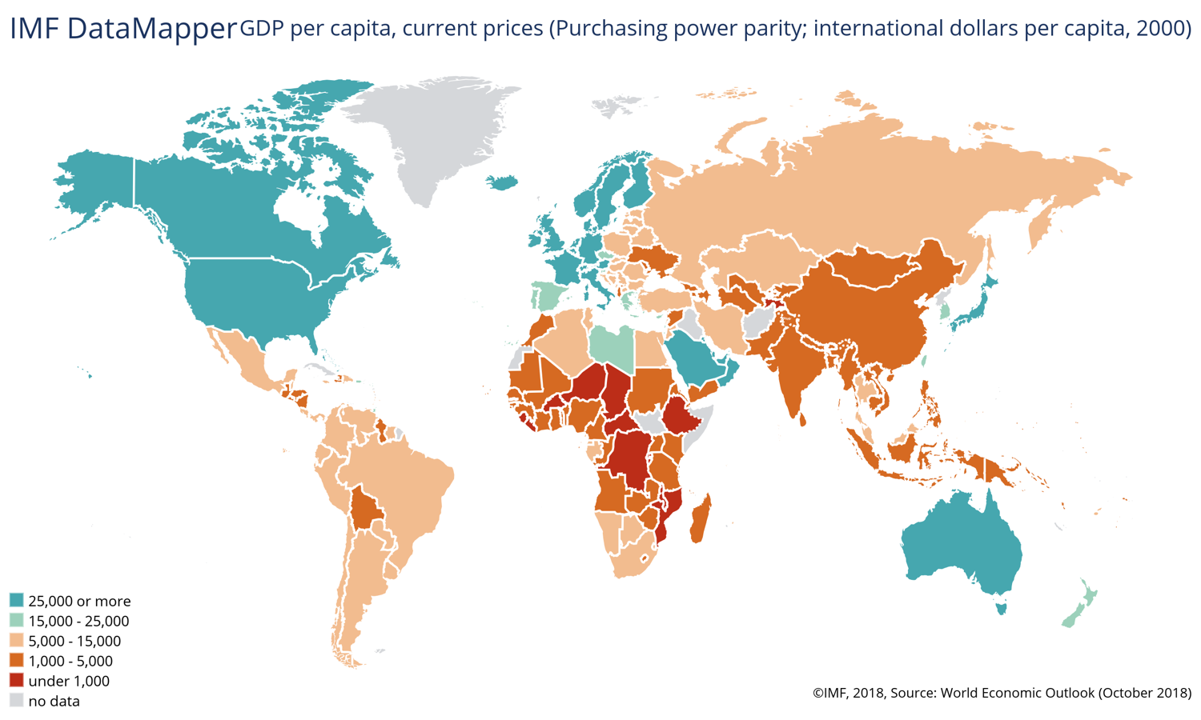
Global Gross Domestic Product Per Capita

Slide 16
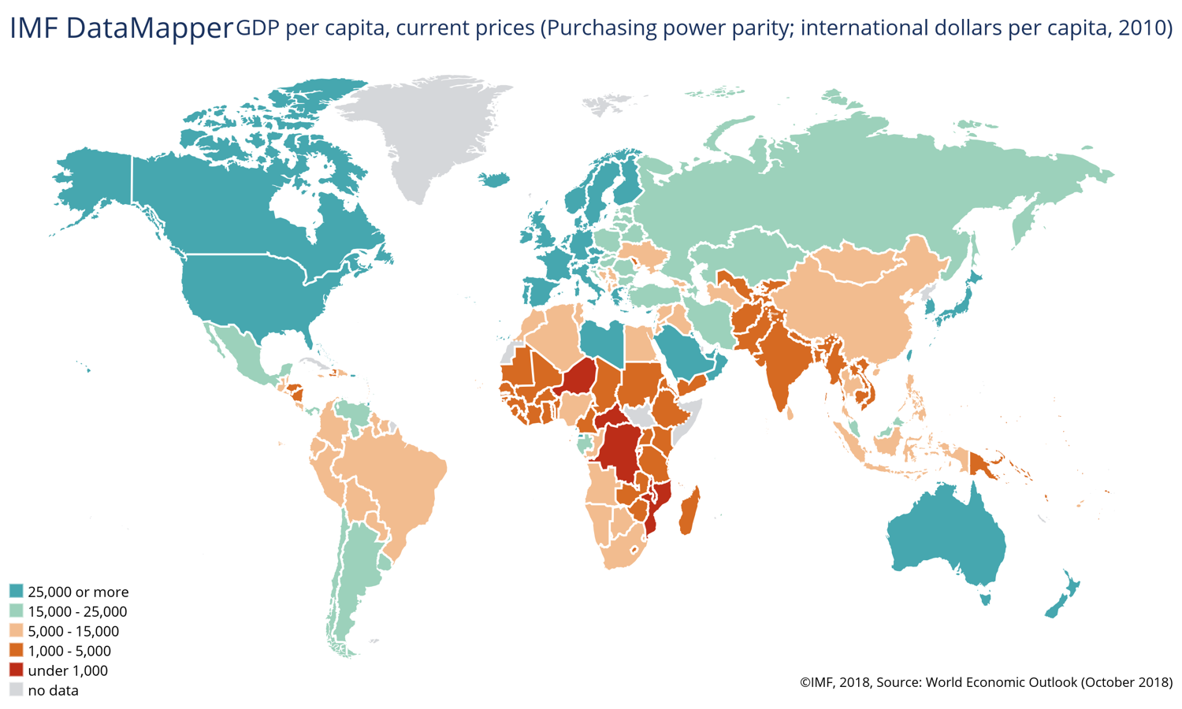
Global Gross Domestic Product Per Capita

Slide 17
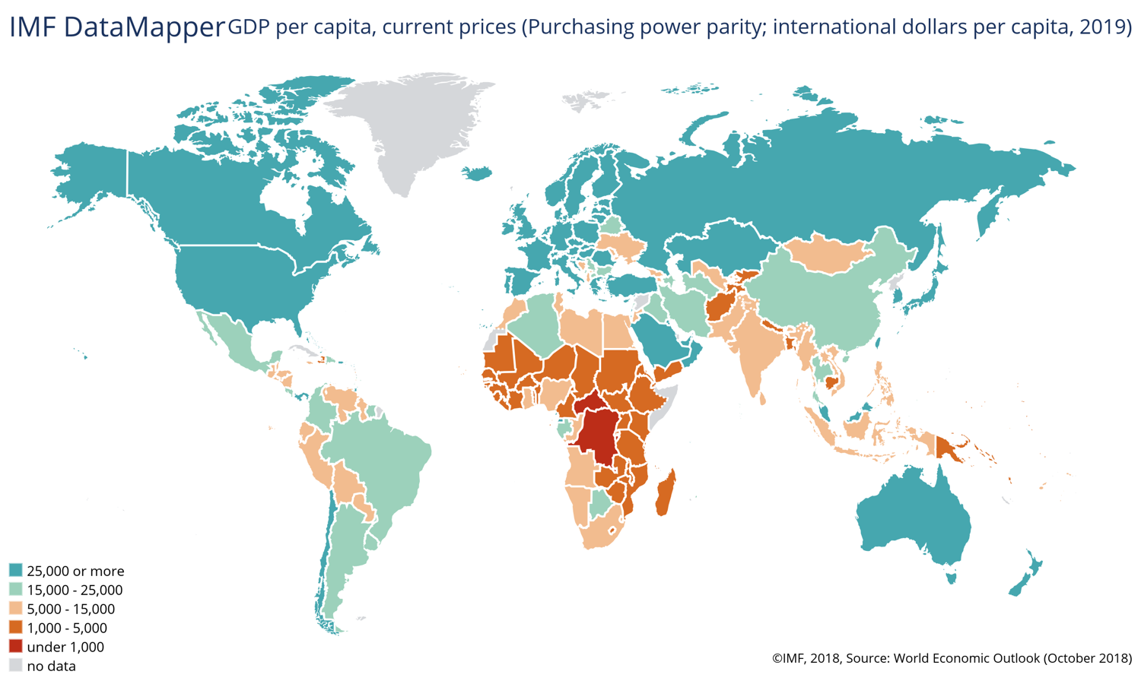
Global Gross Domestic Product Per Capita

Slide 18
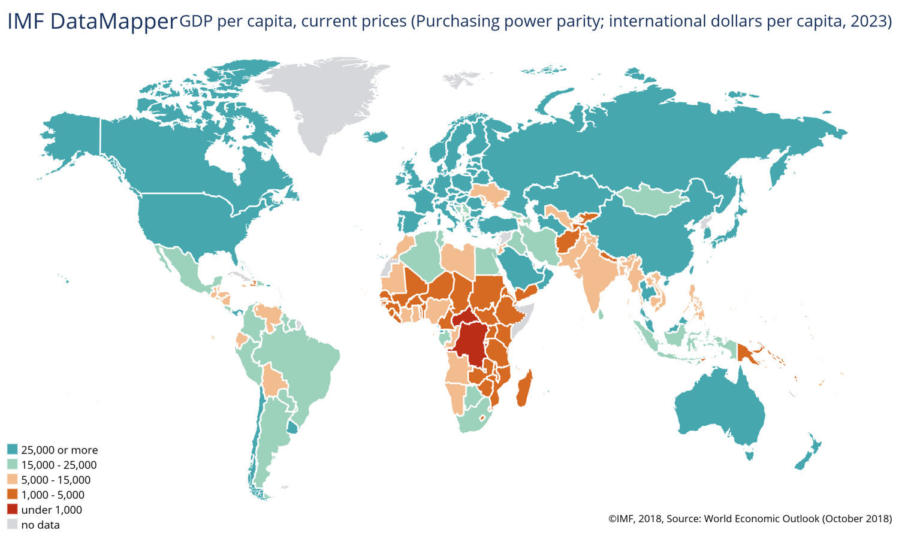
Global Gross Domestic Product Per Capita

Slide 19
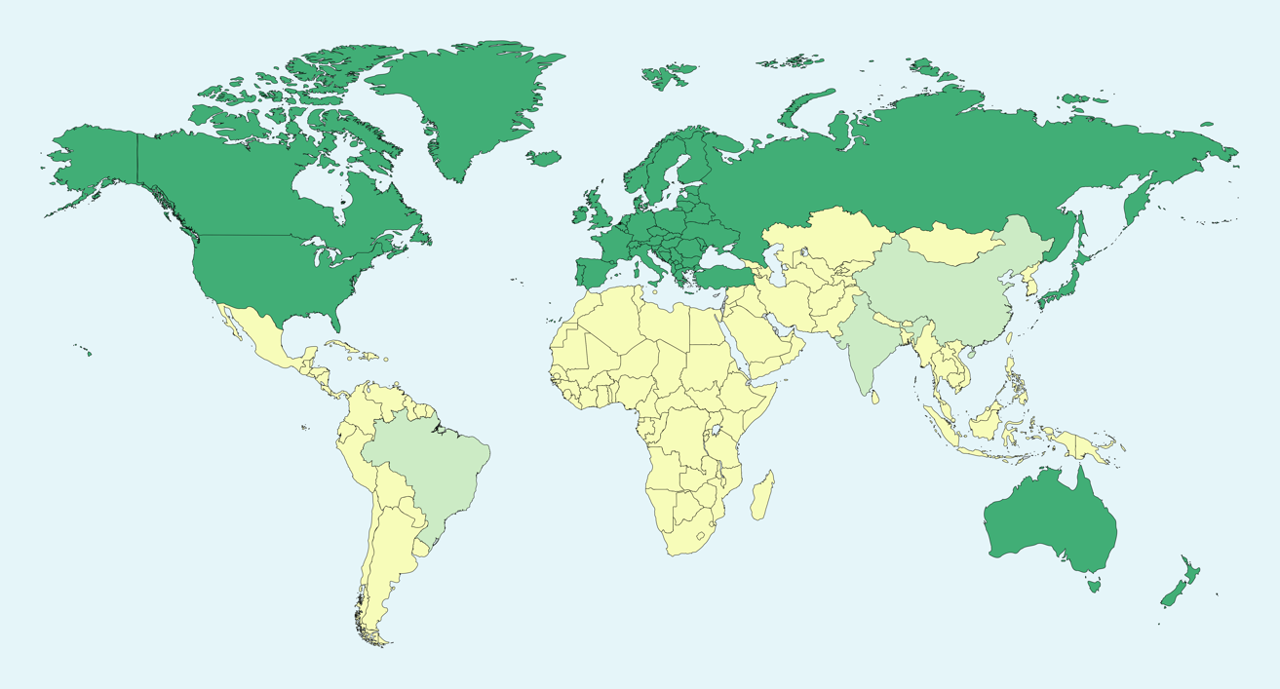
Developed vs. Developing Countries
213 Countries identified into these categories
Originally based on CIA criteria
Now based on UN, World Bank, and International Monetary Fund
87 Developing
126 Developing

Slide 20

Challenges Often Experienced by Authors from Developing Countries:
Lack of fluency in English (or perceived as such)
Reported difficulty in getting work published
Limited access to many modern genetic methods
New:
Next-Gen Sequencing
SNPs
Microsatellites
Old:
ISSRs
Allozymes
RFLPs
Cost
Time
© NY Daily News

Slide 21
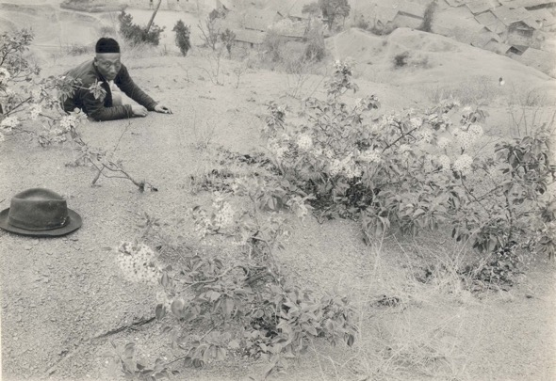
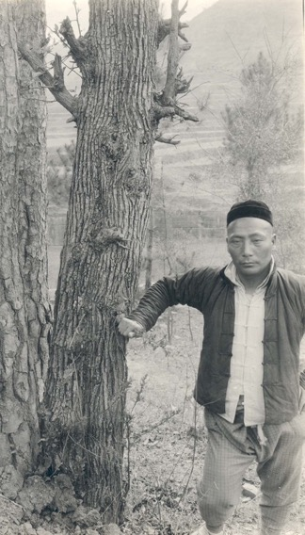
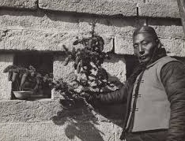

Has this inequality in resources and language barriers led to a publication bias?
Frank Meyer
(1875-1918)

Slide 22
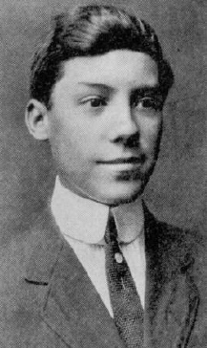
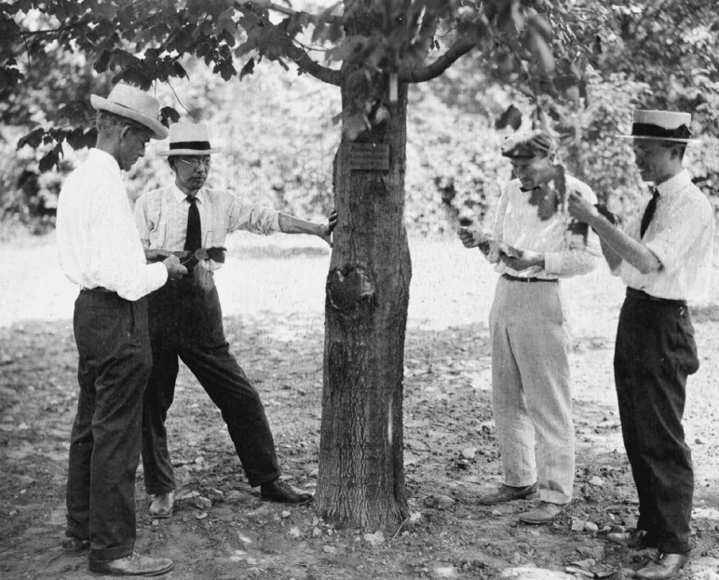
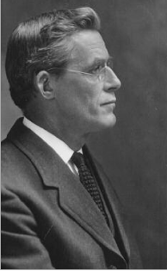
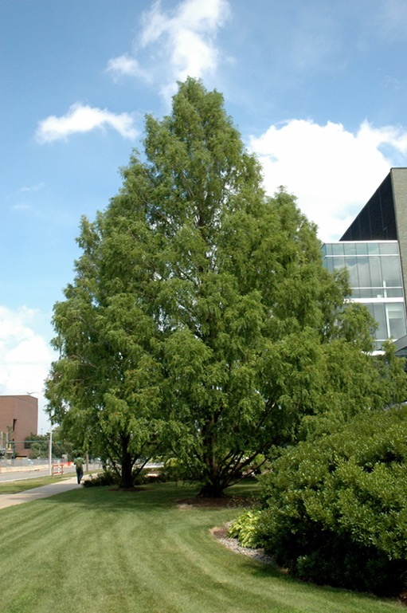
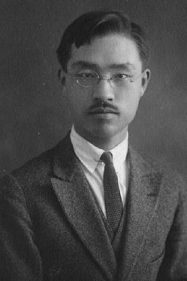
Another approach….
Dawn Redwood
Woon-Young Chun
John G. Jack
(1861-1949)
Hsen-Hsu Hu

Slide 23
Do researchers in developing countries receive proper credit for their work?

Slide 24
Who should be an author?
Substantially contributed to conception & design, or data acquisition, or analysis of data
Involved in drafting the manuscript or revising it for important intellectual content or approves of it
Participated sufficiently to take public responsibility for appropriate portions of the content
    - Can explain their contribution
The project could not have been done otherwise without this persons’ contribution

Slide 25
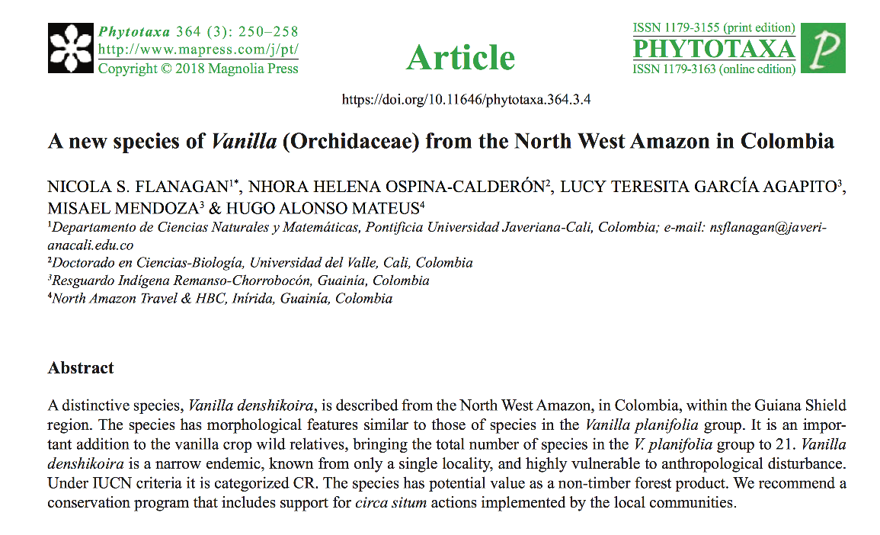
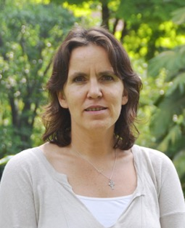
How about non-researchers?
Debate on how to properly recognize “para-scientists”
Def. Members of indigenous and local communities with substantial knowledge, yet a lack of formal training
Dr. Nicola Flanagan

Slide 26
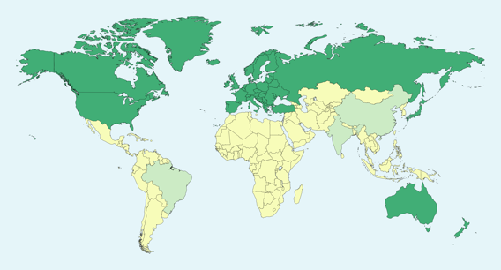
Our Analysis
Examined 87 Developed and 126 Developing Countries
Targeting Plant Conservation Genetics
Country Data:
  Land Area
  Gross Domestic Product
  Species richness (# of species)
  Diversity

Slide 27
How to Calculate Diversity by Country
Not as easy as it seems!
Exploring with different measures:
Diversity is equivalent to species richness
UN Diversity
Average Taxonomic Difference (AvTD) – Tunison
Species richness by area
Number of threatened species (per UN) divided by GBIF richness

Slide 28

Our Analysis
Publication Data:
  Plant species name and country where native
  Country of first author
  Country of the corresponding author
  Country of last author
  Countries of all other authors
Range: 2004-present
Owned by Elsevier
36,377 titles
69 million abstracts & metadata
FREE upon request
Range: 1900-present
90 million abstracts & metadata
$$$

Slide 29
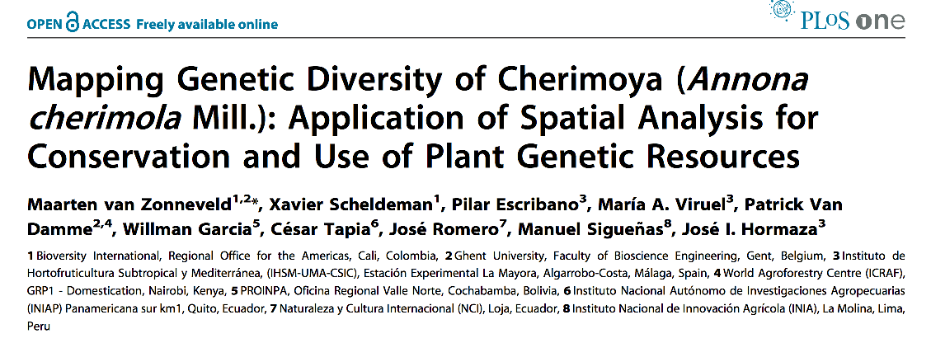
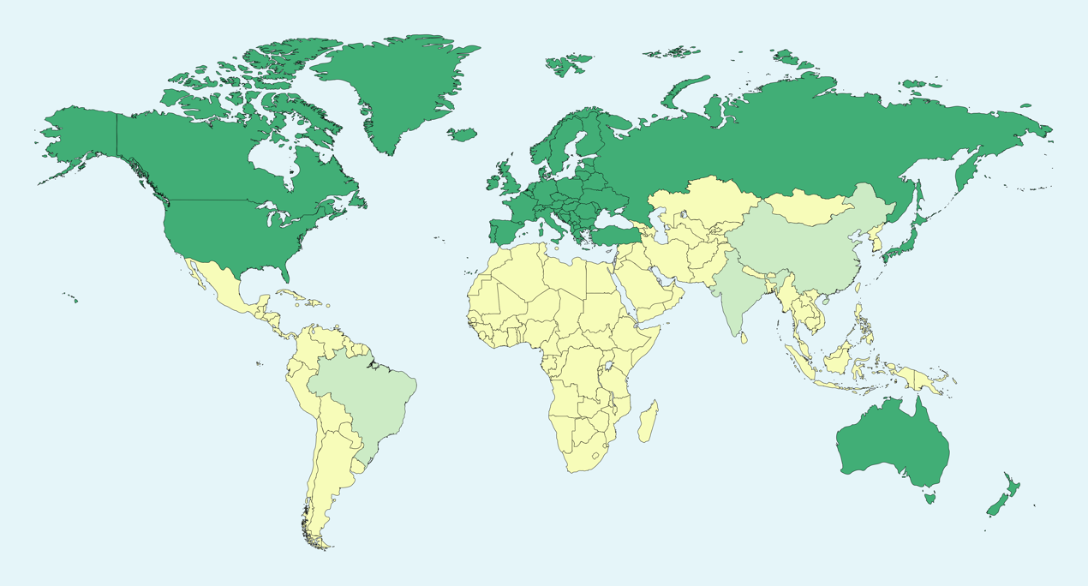

Slide 30
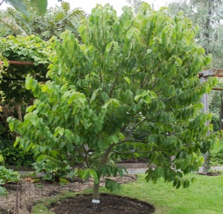
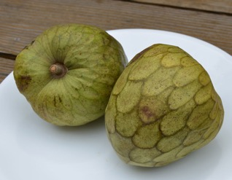

Eucador
Peru
Bolivia

Slide 31
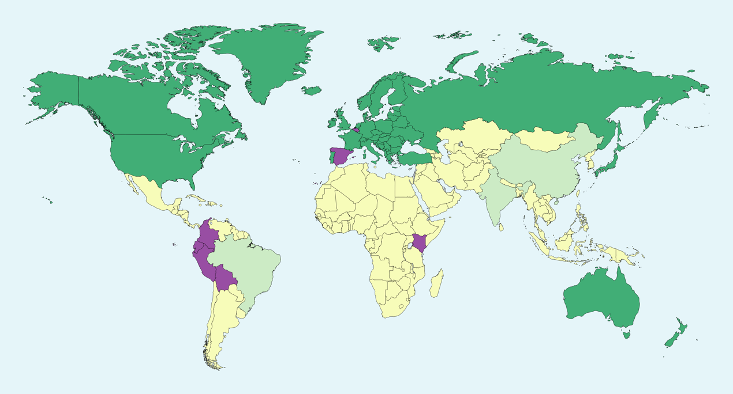
Eucador
Peru
Bolivia

Slide 32
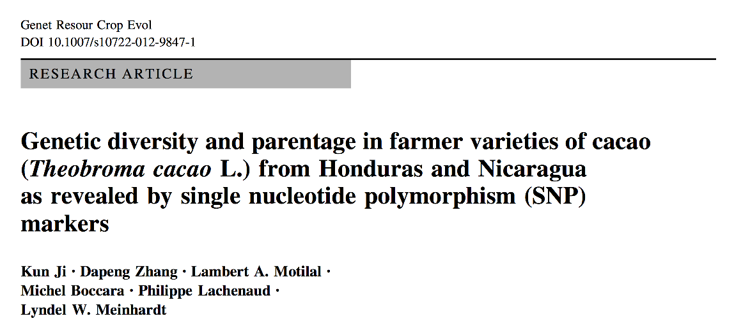

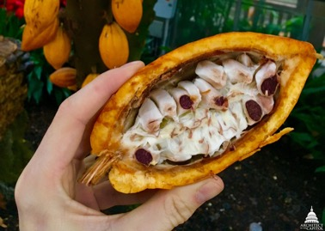
Honduras
Nicaragua

Slide 33
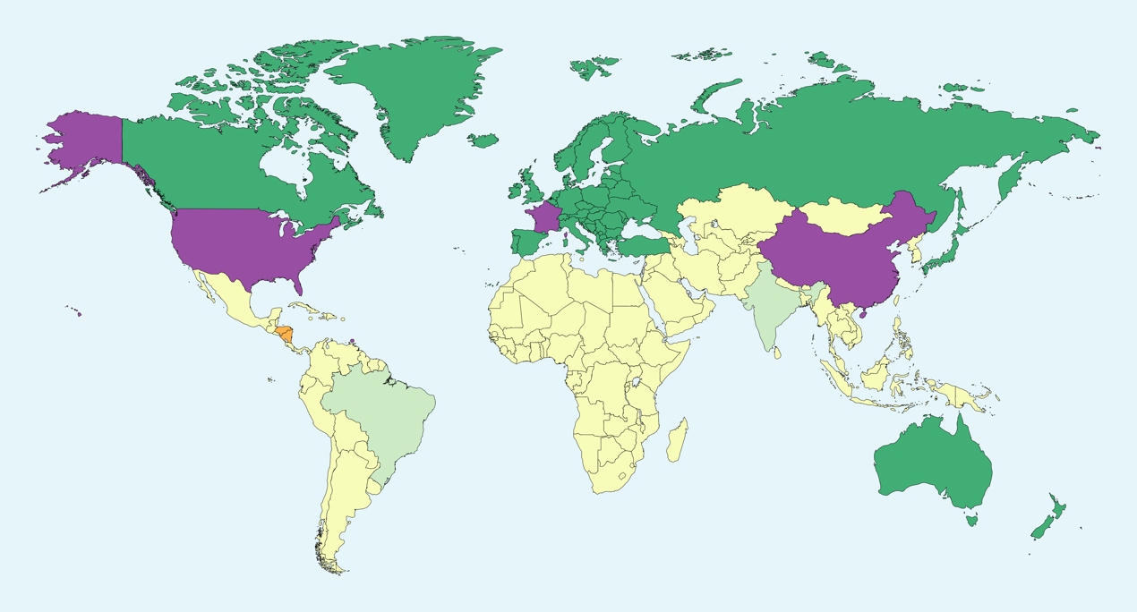
Honduras
Nicaragua

Slide 34
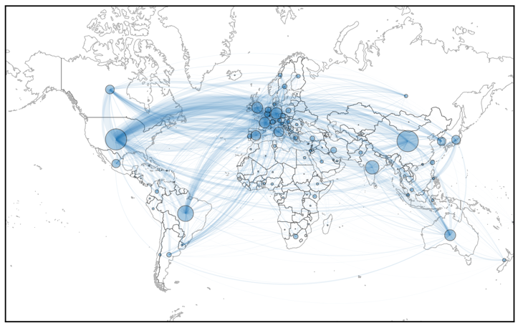
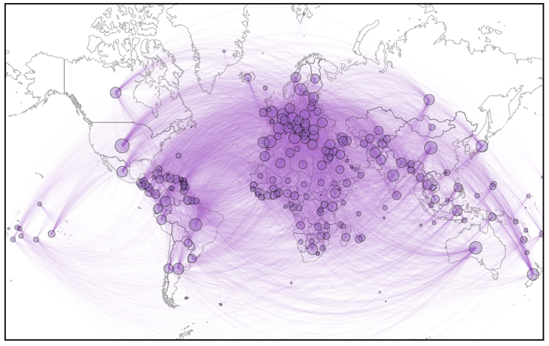
Some Results Thus Far…
Distribution of authors on published papers in plant conservation genetics
Distribution of plant species from the same dataset
Size of circles represent the number of researchers or species within each country
Lines indicate collaborations among authors (left) or network of species distributions (right)
Notes:
Figure 1. Geographic distribution of authors on published papers in plant conservation genetics. The size of the circles represents the number of researchers on publications from each country. Lines represent institutional collaborations among authors.
Figure 2. Geographic distribution of plant species from the dataset. The sizes of the circle represent the occurrences of species in that country. Lines indicates a global network of species distributions.

Slide 35
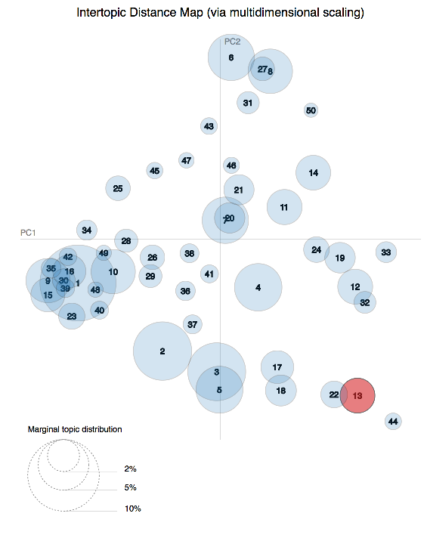
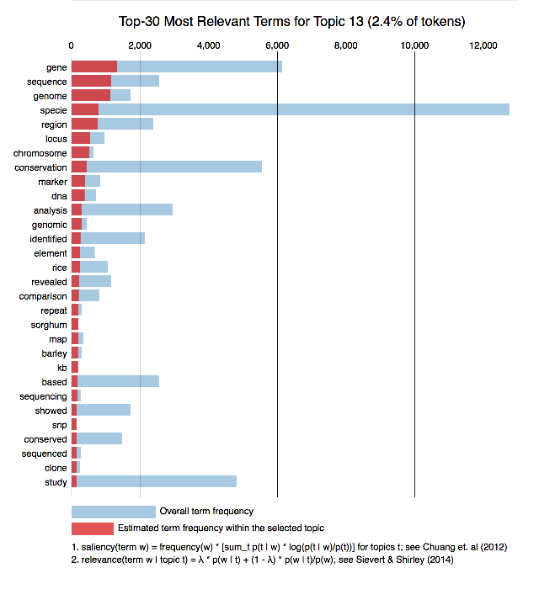
Semantic Analysis
- By country
- JSTOR full article database

Slide 36
What We Have Learned So Far
Collaboration is essential!
Access to data sets can be challenging
Some indices is not readily available
There is a publication bias problem, but we do not yet know the full extent.

Slide 37
Which, if any, of the following influence your decision on where to submit your manuscripts?
“The journal has a reputation to provide a through reveiw process that will improve my manuscript but with editors who understand the limitations that science has and are empathetic. Science is done in premier institutions but also under difficutl circustances in far corners of the world. A journal that has editors who are genuinly interested in imrpoving science and hence more equitable is important to me. I judge this by knowing whether most of their papers come only from developed countries, well established institutions or only senior scientists (this is possible only within my field but the autor institution address is a good clue).”

