Slide 1

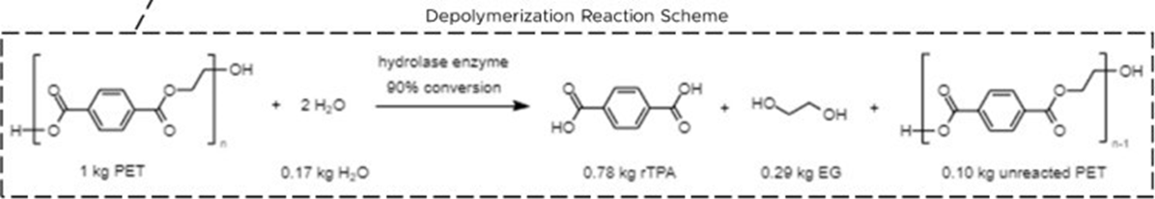
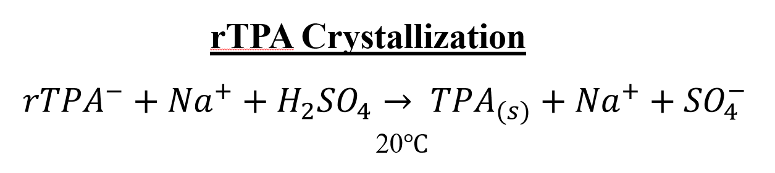
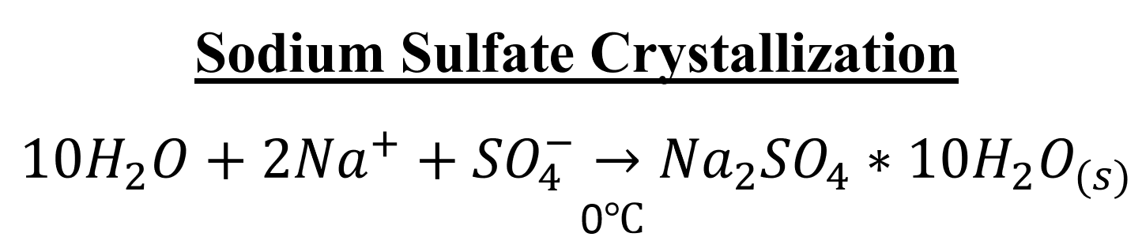
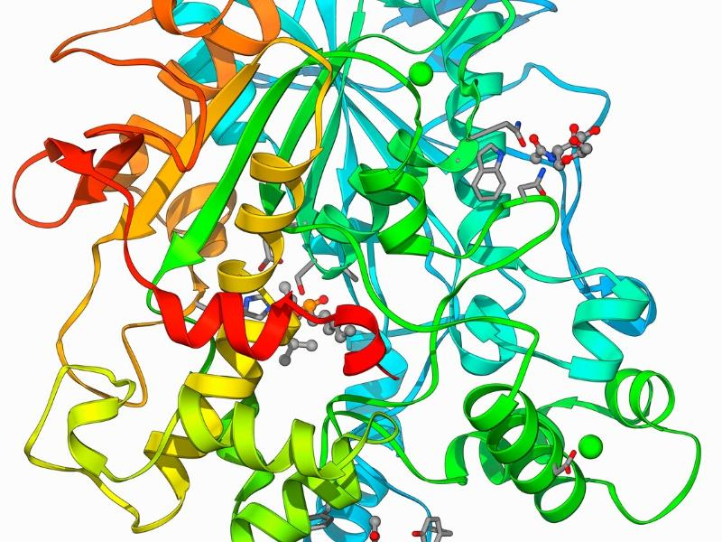
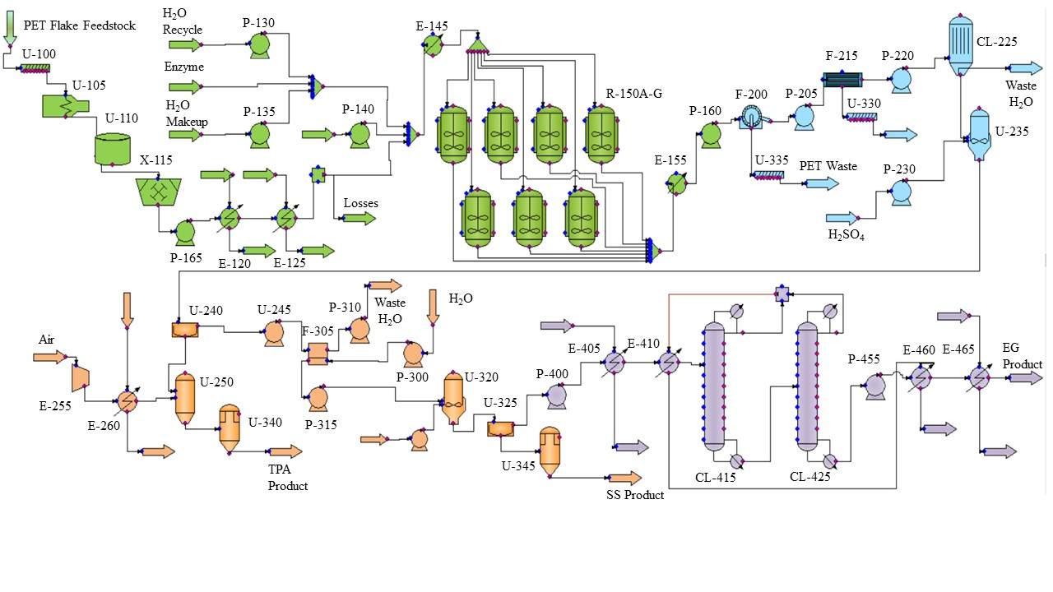
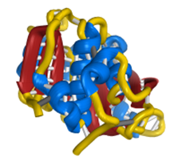


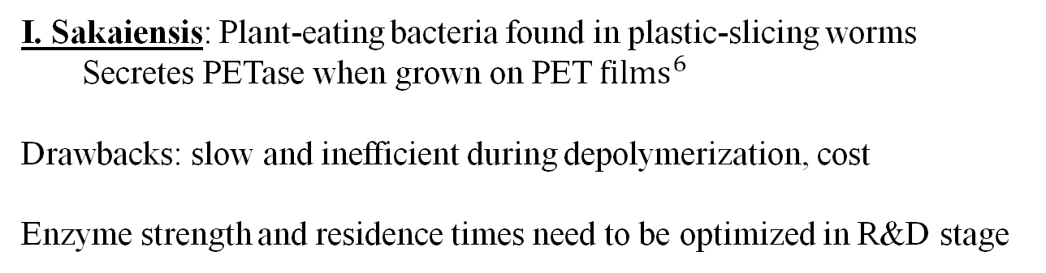
Enzymatic Recycling of Polyethylene Terephthalate
Miread Brandes, Chelsea Ker, Margaret McCluskey,
Robert Newman, Amanda Sauls
University of Cincinnati College of Engineering and Applied Science
Abstract
Process Flow Diagram
Key Chemistry
The goal of this project was to research and propose the implementation of a polyethylene terephthalate (PET) recycling plant. The recommended process is recycling PET flakes into its base polymers and monomers via a hydrolase enzyme biocatalyst. The current design with supporting utilities and operations has an estimated total capital investment of $54.68 million dollars. The team is recommending selling terephthalic acid (rTPA) at $2.21 per kilogram to reach a net present value of $0 after 10 years. This price is not competitive with the current market of virgin TPA, which historically has been between $1.00 and $1.50 per kilogram. This process also produces liquid ethylene glycol (EG) and sodium sulfate salt (SS) that can be sold as co-products. The return on investment (ROI) is 24.5% and the venture profit is $1.35 million.
The current state of the economic and PHA analyses leads the team to recommend proceeding with the process under the condition that there is opportunity for further optimization. This process is an important emerging green technology and proposes a circular approach to plastic production. Optimization of on-site wastewater treatment, and unit operation modification could bring the price of rTPA closer to that of virgin TPA.
Research into process and safety hazards of this process has been conducted using the What-If methodology and is discussed in the Process Hazard Analysis and Environmental Consideration section. There are a few notable process hazards and safety recommendations to remedy those identified.
Depolymerization Section
PET Flake Feedstock extruded, cooled, and microgranulated
Process stream cooled
Water, NaOH, and PET heated and introduced to reactors
Reactor catalyst: Hydrolase enzyme
Reactor product cooled
Clarification Section
Filtration methods: solids filter, membrane unit, activated carbon column
PET and biocatalyst leave process and are sent to landfills as nonhazardous solid waste
Activated carbon column waste sent to be treated for proper disposal
${rTPA}^{−}$ and ${Na}^{+}$ions combine with H₂SO₄ to precipitate TPA(s)
Technology Risk: Catalyst Choice
Economic Analysis
Hydrolase: Biochemical Catalyst
Catalyst uses esterases (ex: Lipase) to cleave ester bonds
Current industries: Food, detergent, pharmaceuticals
Catalyzes esterification reactions in solid environments
Total Capital Investment: $54.68 MM
  Bare module cost of 56 pieces of equipment
  Cost of utilities, contingencies, contractors, land, royalties, and construction
  Working capital estimation
  Operating Costs: $61.54 MM
  Raw materials, utilities, operations and overhead, depreciation, and general expenses
  Based upon 8,000 operating hours per year
  Based upon 5 shifts of 4 operators each
  Profitability:
  rTPA price set to reach NPV of 0 dollars
  Selling price of rTPA: $2.21/kg
  Expected revenue: $83.9 MM
  Return on Investment: 24.5% with payback period of 2.2 years
Lipase Hydrolase Enzyme
I. Sakaiensis: Plant-eating bacteria found in plastic-slicing worms
Secretes PETase when grown on PET ${films}^{6}$
Drawbacks: slow and inefficient during depolymerization, cost
Enzyme strength and residence times need to be optimized in R&D stage
PETase Enzyme
Recommendations and Future Work
The final recommendation is to sell the rTPA at a market price of $2.21 per kilogram to reach a $0.00 net present value and return on investment of 24.5%. However, this price is not competitive when compared to the price of virgin TPA which is approximately $1.00 - $1.50 per kilogram. Further optimization of the process is recommended to directly compete with virgin TPA prices.
Cost Savings Recommendations
Currently, the wastewater streams have a large biological oxygen demand due to the presence of ethylene glycol and TPA despite having a low volumetric flow.
  Further wastewater treatment would greatly decrease the cost of the utility price of the wastewater streams
  The increased price of the wastewater utility operating cost led the unit price of rTPA to increase from $1.88 per kilogram to $2.21 per kilogram
  If the price can be lowered back down to $1.88 per kilogram, it is a semi-competitive price and much more attractive proposal
Further Considerations:
The increasing price of pure PET flakes from manufacturers and recyclers
Due to the increased demand for renewable feedstocks, companies may be willing to pay more for a recycled product so as to deem their products greener
Public sentiment shifting towards an expectation of green and sustainable products
Governmental incentives to develop green chemistry and recycled products
Future Work:
The efficiency and yield of the filtration steps in the clarification process needs to be evaluated with real time data. This information should be compared to theoretical data for ultrafiltration, crystallization, and centrifugal sedimentation units. A closer look at cyclones, and vacuum filtration are examples of alternatives to be considered.
From the process chemistry perspective, further lab development and research regarding which enzyme (PETase, lipase, or another hydrolase) to use in the process is needed. Since this is the beginning stage of the process, bench scale testing, then pilot plant testing, and large-scale production testing are needed.
Partner with the MRFs to obtain a reliable source of PET feedstock
Project Scope
Table 1: Feedstock and Product Hourly Rates
Feedstocks |  | Products
Material | Usage (kg./hr.) | Material | Production (kg./hr.)
PET Flake | 6,250 | rTPA | 3,946
Caustic | 2,184 | Wastewater Streams | 19,811
Enzyme | 28 | SS | 6,569
Sulfuric Acid | 2,702 | EG | 827
 |  | Solid Waste | 1,025
Figure 1: Overall Process Flow Diagram
Co-Product Recovery Section: Sodium Sulfate and rTPA
TPA flake is dried and purified and stored in supersac as final product
Filtration methods: Centrifugal sedimentation, and RO membrane
RO wastewater sent to be treated for proper disposal
${Na}^{+}$ and ${SO}_{4−}$ions combine to precipitate sodium sulfate salt
Supersacs store final sodium sulfate salt product
Co-Product Recovery: Ethylene Glycol Separation Section
E-405 and E-410 pre-heat the Water/EG mixture
CL-415 removes 8,200 kg/hr of water via the tops but leaves 2,700 kg/hr of water with the EG
CL-425 removes the remaining water, leaving the EG stream 99.9% pure
E-460 and E-465 cool the EG product while using the wastewater stream as the utility
The scope of this project involved the creation and isolation of the main product, recycled terephthalic acid. Throughout completion of the project a supplemental paper¹³ was used as a reference for key process decision making. A process hazard analyses was created to determine the safest method of producing the final product. This project did have some major challenges. Most notably the unknown and experimental chemistry involving the use of the enzyme used to break down the recycled polymers.
The goal of this project is to present a method of producing rTPA from recycled plastics at a rate of 50,000,000 kilograms per year. This will be completed on a basis of 8,000 annual operating hours with a continuous process. The feed material usage for this process is displayed below in Table 1 at an hourly basis. The table also presents the hourly production rates, product, and waste streams.
Material and Energy Balance
Process Hazard Analysis and Environmental Considerations
References
Table 2: Overall Material Balance for Process
Table 4: Chemical Hazards
Authors, Guest. “Prices for Most Recycled Plastics Continue to Rise - Resource Recycling.” Resource Recycling News, Resource Recycling, 16 Feb. 2021, https://resource-recycling.com/recycling/2021/02/16/prices-for-most-recycled-plastics-continue-to-rise/#:~:text=The%20national%20average%20price%20of,over%20the%20course%20of%202021.
Authors, Guest. “Prices Stabilize for PET and HDPE Bales.” Plastics Recycling Update, Plastics Recycling Update, 15 Sept. 2021, https://resource-recycling.com/plastics/2021/09/15/prices-stabilize-for-pet-and-hdpe-bales/.
Barbero, Robert, et al. “Increasing the Transparency, Coordination, and Predictability of the Biotechnology Regulatory System.” National Archives and Records Administration, National Archives and Records Administration, 4 Jan. 2017, https://obamawhitehouse.archives.gov/blog/2017/01/04/increasing-transparency- coordination-and-predictability-biotechnology-regulatory . (accessed 12.6.21).
“Hydrolase.” Wikipedia, Wikimedia Foundation, 17 Oct. 2021, https://en.wikipedia.org/wiki/Hydrolase.
“Hydrolase Introduction.” Hydrolase Introduction - Creative Enzymes, https://www.creative-enzymes.com/resource/hydrolase-introduction_21.html.
“Microbial Products of Biotechnology Summary of Regulations under the Toxic Substances Control Act.” Environmental Protection Agency, Sept. 2012.
“Microbial Products of Biotechnology; Final Regulation Under the Toxic Substances Control Act.” Environmental Protection Agency, 11 Apr. 1997.
Mufara, K., n.d. Title V air permit: Everything you need to know about the operating permit. [WWW Document]. ERA Environmental. URL https://www.era- environmental.com/blog/title-v-air-permit (accessed 12.3.21)
OSHA, n.d. Department of Labor Logo United Statesdepartment of Labor [WWW Document]. 1910.119 App A - List of Highly Hazardous Chemicals, Toxics and Reactives (Mandatory)| Occupational Safety and Health Administration. URL https://www.osha.gov/laws- regs/regulations/standardnumber/1910/1910.119AppA (accessed 12.3.21).
Rachael. “Plastic Eating Bacteria - How They Work - Petase That Can Break down Plastic.” Rs' Science, 10 Aug. 2021, https://rsscience.com/plastic-eating-bacteria/#How_plastic-eating_bacteria_actually_work .
Ryan, Carol. “Empty Plastic Bottles Go from Trash to Hot Commodity.” The Wall Street Journal, Dow Jones & Company, 9 Nov. 2021, https://www.wsj.com/articles/empty-plastic-bottles-go-from-trash-to-hot-commodity-11636455644#:~:text=The%20cost%20of%20food%2Dgrade,PET%20Container%20Resources%20(NAPCOR).
Seider, W.D.; Seader, J.D.; Lewin, D.R.; Widagdo, S.; Gani, R.; Ng, K.M. Product and Process Design Principles: Synthesis, Analysis, and Evaluation, Fourth Edition, John Wiley & Sons, Inc. (2016).
Singh, Avantika, et al. “Techno-Economic, Life-Cycle, and Socioeconomic Impact Analysis of Enzymatic Recycling of Poly(Ethylene Terephthalate).” Joule, vol. 5, no. 9, 15 Sept. 2021, pp. 2479–2503., https://doi.org/hrttps://doi.org/10.1016/j.joule.2021.06.015.
“Sodium Sulfate Price and Market Analysis - Echemi.” ECHEMI, https://www.echemi.com/productsInformation/temppid160705011365-sodium-sulfate.html
Standard enthalpy of formation, Gibbs energy of formation, entropy and molar heat capacity of organic substances. https://www.engineeringtoolbox.com/standard-enthalpy-formation-value-Gibbs-free-energy entropy-heat-capacity-organic-d_1979.html (accessed Mar 9, 2022)
Turton, Richard, et al. Analysis, Synthesis, and Design of Chemical Processes. Pearson Education, Inc., 2018.
Vishali, S, et al. “Ultrafiltration.” Ultrafiltration - an Overview | ScienceDirect Topics, 2017, https://www.sciencedirect.com/topics/chemical-engineering/ultrafiltration.
Water baths. https://www.berlynecm.com/pages/BerlynECM-Products.cfm?id=1007 (accessed Mar 8, 2022).
 | rTPA Production
 | Input (kg/h) | Output (kg/h)
PET Flake | 6,250 | 0
Caustic | 2,184 | 0
Enzyme | 28 | 0
Sulfric Acid | 2,702 | 0
Water | 22,683 | 21,480
rTPA | 0 | 3,946
SS | 0 | 6,569
EG | 0 | 827
Solid Waste | 0 | 1,025
Total | 33,847 | 32,178
Compound | Health Hazards | Fire Hazards | Reactivity
PET | N/A | Explosive in dust form | N/A
Ethylene Glycol | Targets cardiovascular and nervous system, eye irritation | NFPA Category 1 | Reacts with strong acids and bases
Hydrolase Enzyme | Category 1 respiratory hazard | NFPA Category 1 | N/A
TPA | N/A | N/A | N/A
NaOH | Severely corrosive to skin and eyes | N/A | N/A
H₂SO₄ | Corrosive and toxic by inhalation | N/A | N/A
Na₂SO₄ | Skin, eye, and respiratory tract irritation | N/A | N/A
PHA Recommendations
Consider adding leak detection on all lines that contain EG, SA, and SS.
Consider inerting piping that contains dust or small particles.
Evaluate and design alarms, interlocks, and fail safes.
Look into adding catch systems for spills on the conveyor belts.
Consider installing weight sensors on the conveyer belts.
Consider keeping spare microgranulator blades in stores.
Look into designing manual override on valves and controls.
Think about adding in check valves to prevent back flow before necessary equipment.
Table 3: Overall Energy Balance for Process
Environmental Performance
 | rTPA Production
 | Input (MMBtu/h) | Output (MMBtu/h)
Feed Streams | -1.9 | 0
Product Streams | 0 | -73.2
Total Heating | 79.0 | 0
Total Cooling | -3.9 | 0
Power Added | 0 | 0
Power Generated | 0 | 0
Total | 73.2 | -73.2
There are four waste streams identified
  PET waste out of the filter press
  Enzyme waste out of the ultra filtration membrane
  Wastewater out of the activated carbon column
  Wastewater out of the RO membrane
PET and SS do not break down in the environment
SA and EG are toxic to fish but do not bioaccumulate
Open Issues:
The main open issue found through the PHA was to have a team better trained and with more process knowledge perform a HAZOP analysis instead of the What-If analysis performed by this team.

