Slide 1


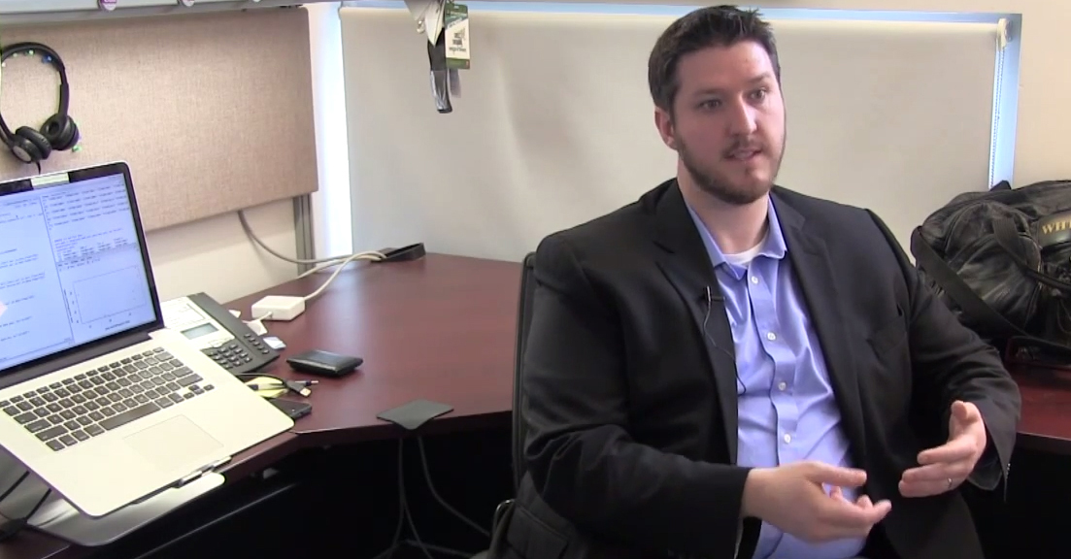
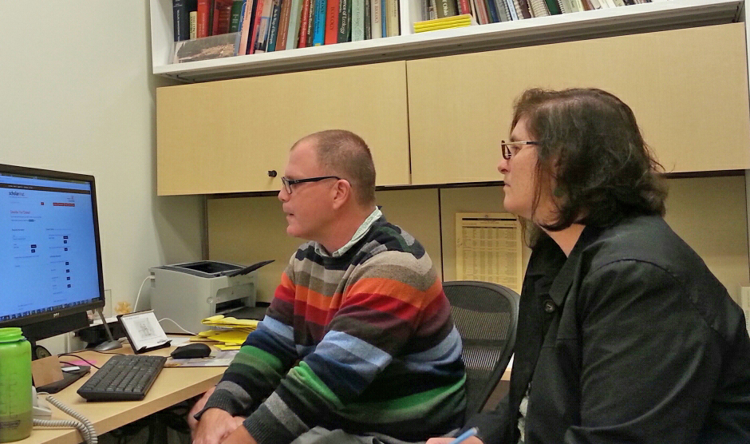
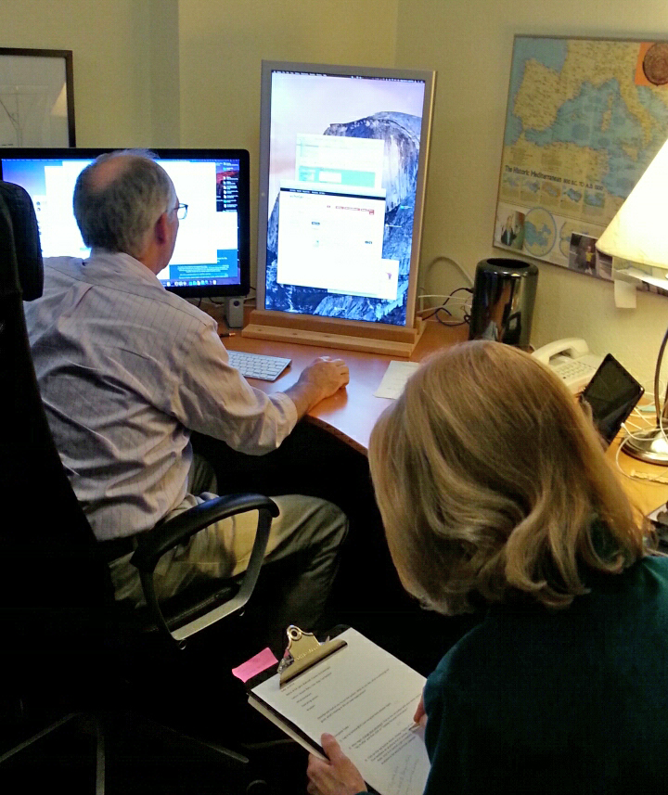
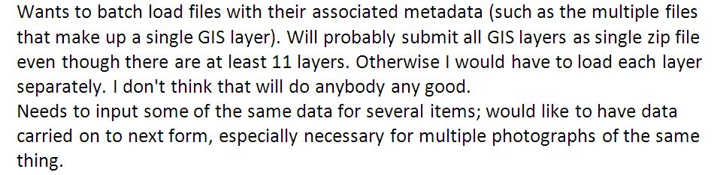

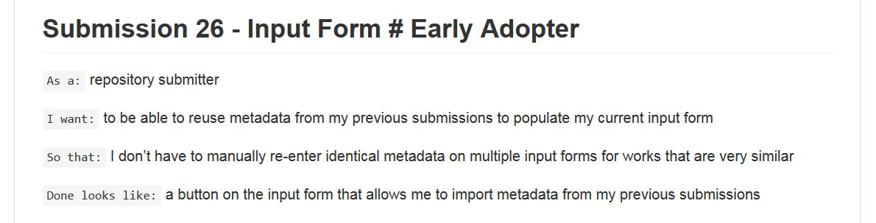
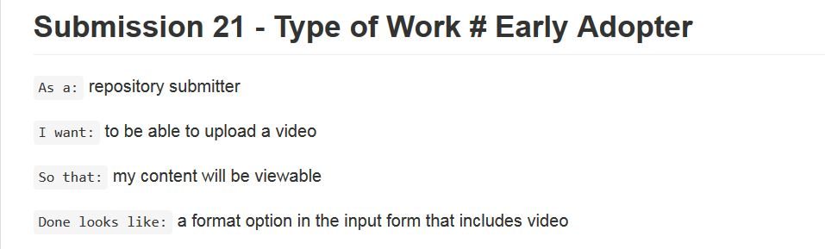
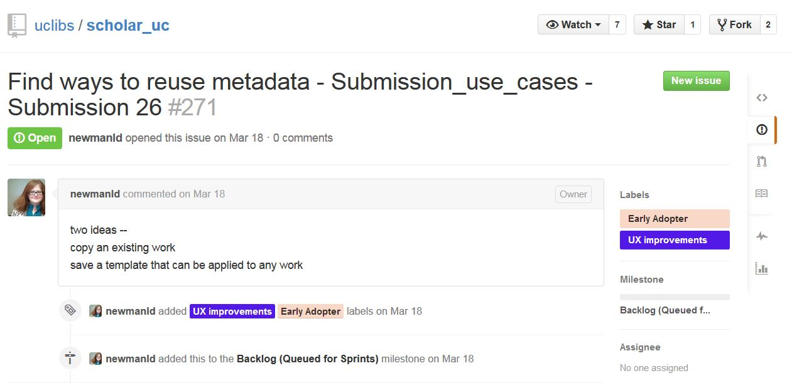
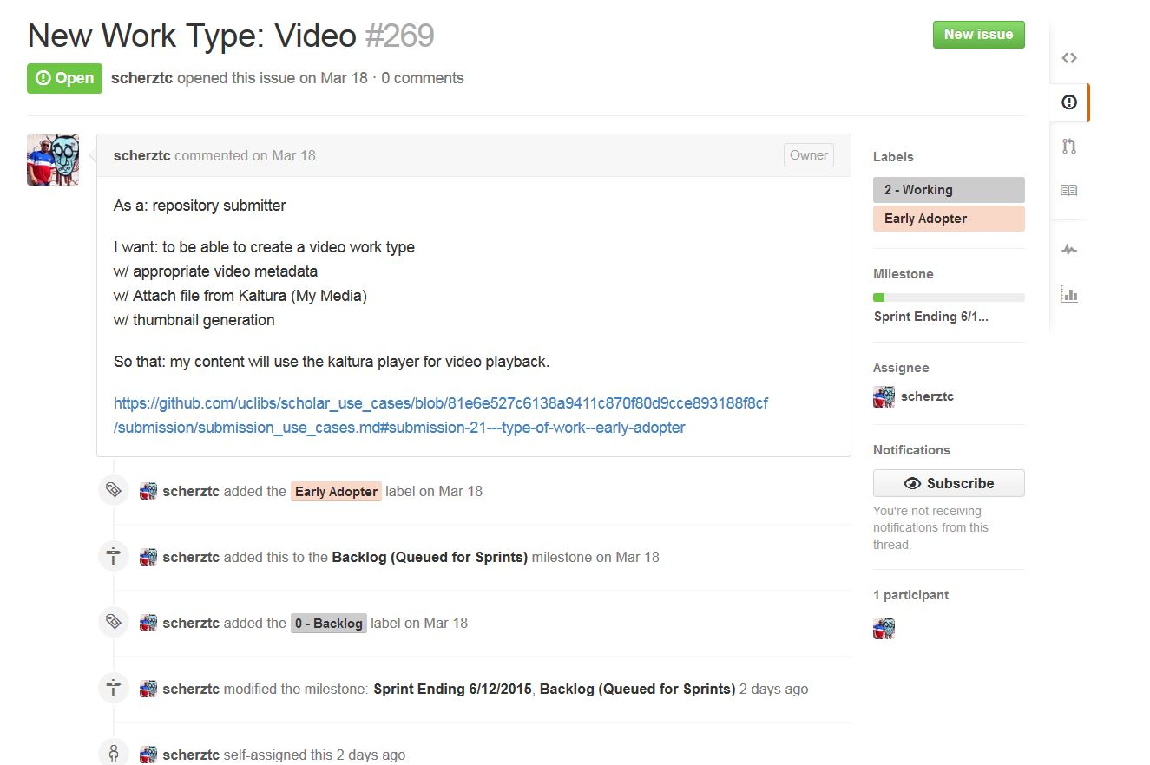
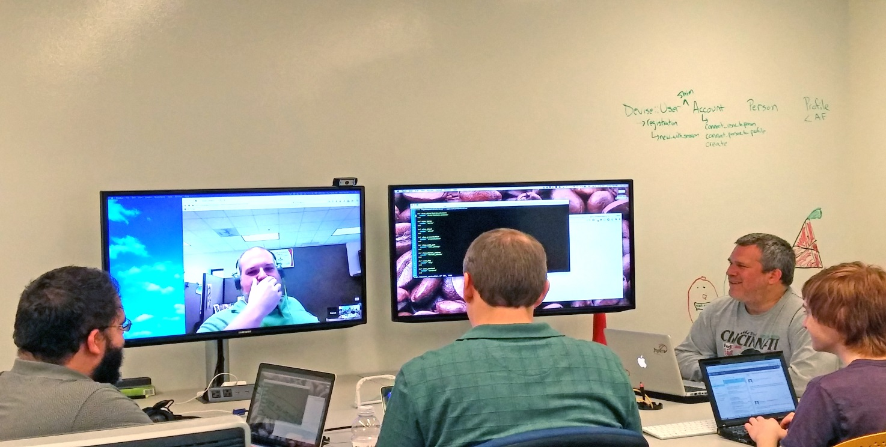
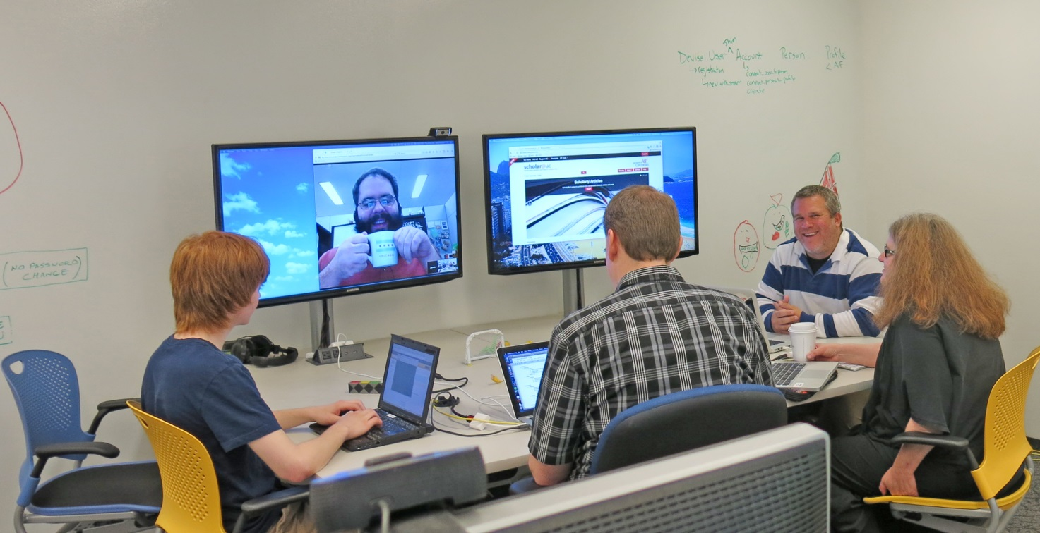
Achieving Ambitious Agendas with Limited Means
at the University of Cincinnati
Linda D. Newman, Ted Baldwin, Eira Tansey
https://scholar.uc.edu
Early Adopters
Chris Swoboda, Education
Early Adopter
John Wallrodt, Classics Early Adopter &
Jacquie Riley,
EA liaison
Steve Matter, Biology
Early Adopter &
Amy Koshoffer, EA liaison
Use Cases
github.com/uclibs/scholar_use_cases
Software Development
github.com/uclibs/scholar_uc
&
github.com/uclibs/curate_fork
Scholar@UC Dev team: James Van Mil, Patrick Burke, Glen Horton, Lukas Miciunas, Thomas Scherz, Linda Newman
Open Repositories 2015: Indianapolis, IN, June 8-11, 2015

