Slide 1
Beyond a College Paper:
Teaching Best Practices in Visual Communication
Danielle Bessett, A&S Sociology
Olga Hart, UC Libraries
Regan Johnson, CECH Human Services

Slide 2



The skills necessary to be an effective communicator today are different than in the past. Today, literacy is not only about reading and writing—which are necessary—but also about understanding visual communication. Today, we need a higher degree of visual literacy and an understanding of the great power that imagery has for conveying important messages.

Slide 3

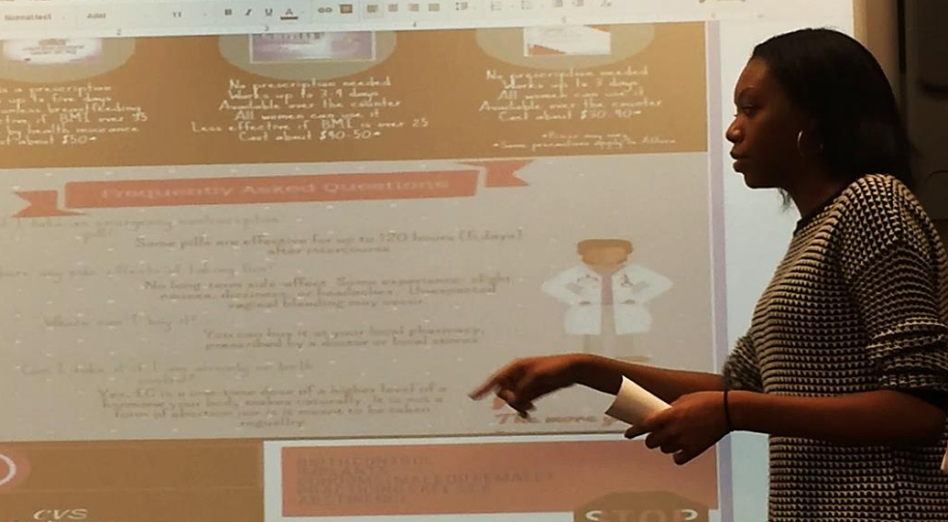
Trend:
Students as Creators of Information
Image source: http://expertbeacon.com

Slide 4
Typical Library Instruction Requests
Developing a research question
Finding sources
Evaluating sources
Citing sources
“Sources” usually = text.

Slide 5
Left Out
Finding and evaluating visual information
Tools and techniques for visual communication

Slide 6
An Attempt to Fill the Void
Introducing students to infographics:
  power of visual information
  finding existing infographics and images
  tools for creating infographics and best practices

Slide 7


Pregnancy, Birth, and Health (2014): Examples of Students’ Work

Slide 8

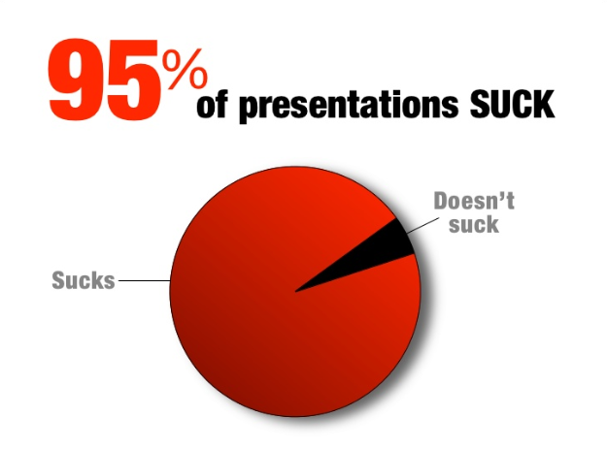

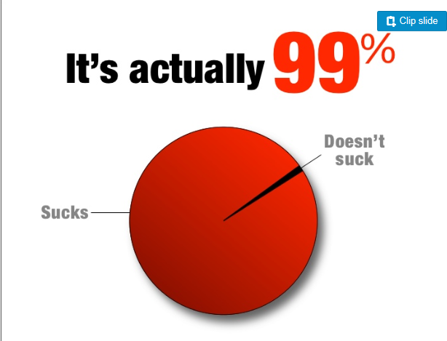
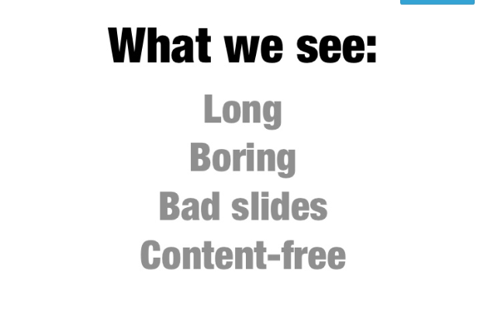
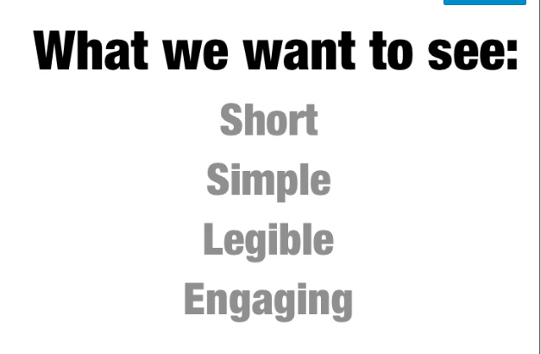
http://www.slideshare.net/garr/guy-kawasakis-foreword-for-presentation-zen

Slide 9
Next Step
Introducing students to best practices in presenting information:
  PowerPoint dos and don’ts (hands-on)
  Infographics
  Best practices for brochures and newsletters

Slide 10
HPE 2051: Peer Health Education
Health Promotion & Education (HPE) elective course
Health education for college campuses
25 minute interactive, educational presentation using PowerPoint

Slide 11
Advantages
Importance of skill
Final presentation requirement
Guest presenter
Brought students to the library
Motivated students to seek more information
Consideration of non-traditional students’ needs

Slide 12
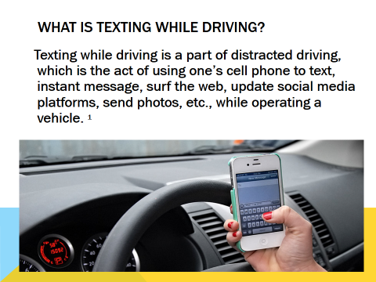
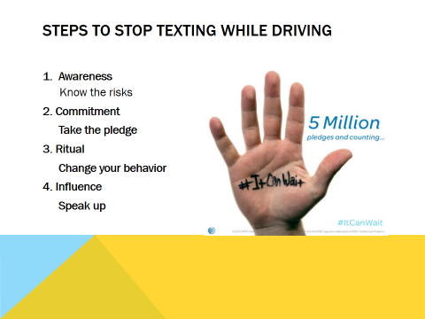
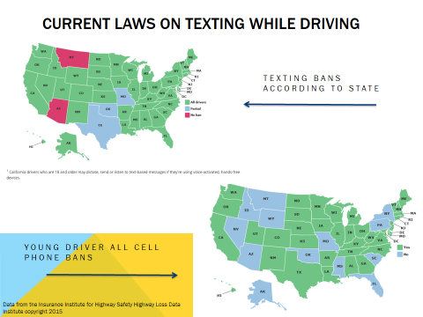
Texting & Driving
Presentation

Slide 13
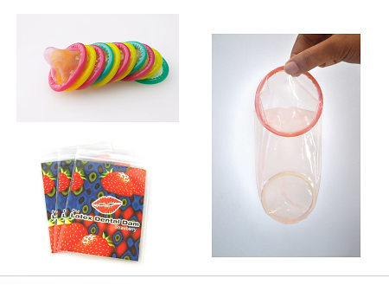
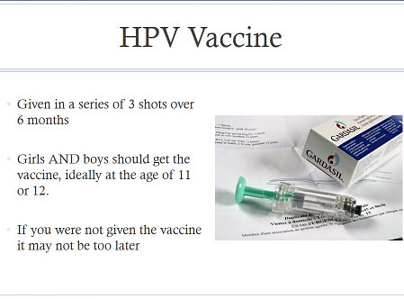
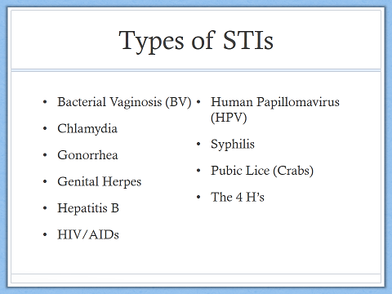
Sexual Health
Presentation

Slide 14
Testimonials
“Taught us something we have been expected to know”
“Feel more comfortable with PowerPoint””
Included more graphics, fewer words
Didn’t read off slides as much

Slide 15
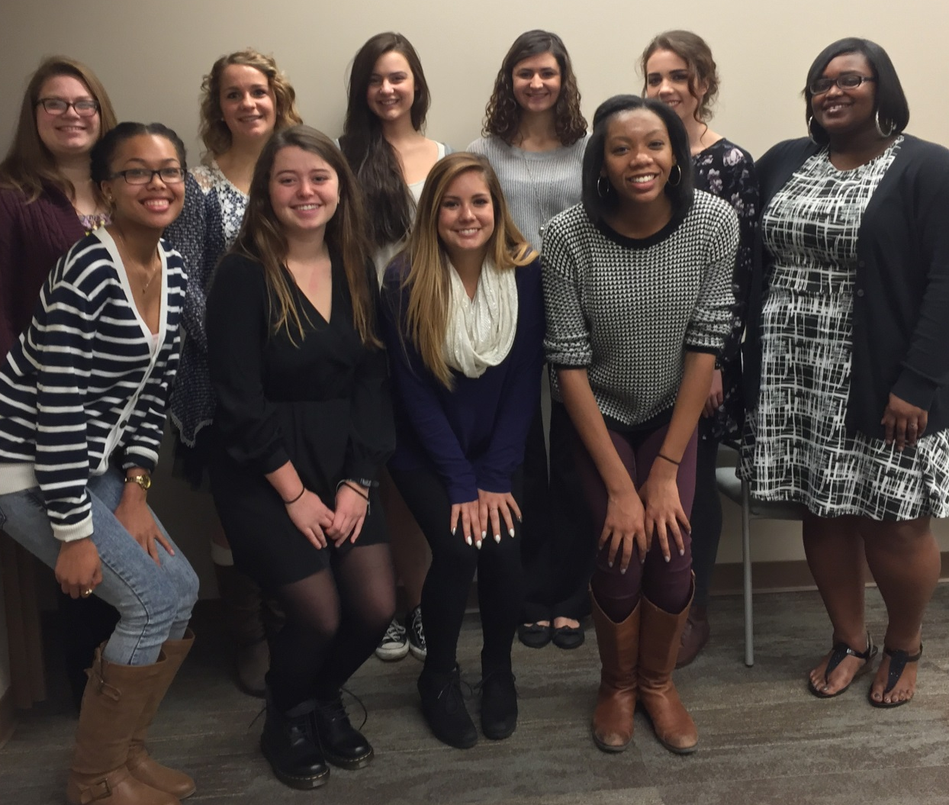
SOC 1099: Pregnancy, Birth, and Health
Fall 2015
McMicken freshman seminar
Group-based service learning course
Final presentations

Slide 16

Planned Parenthood Group:
Assess Local Availability of Emergency Contraception

Slide 17
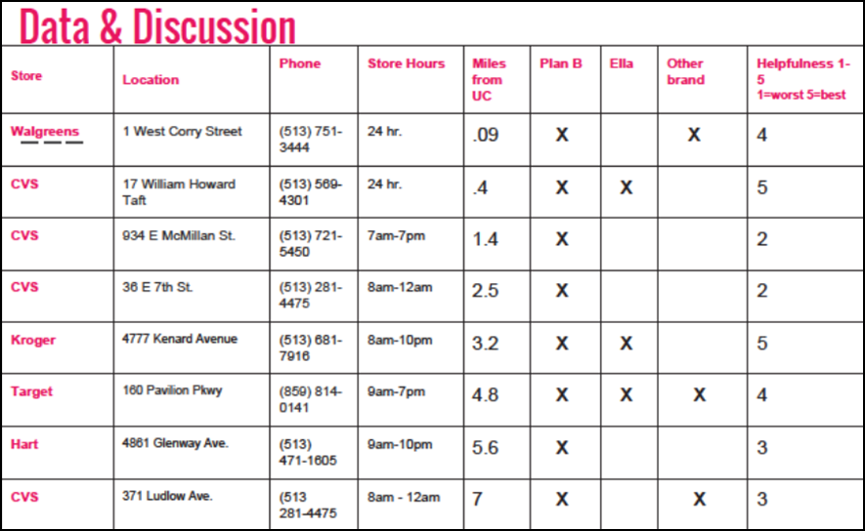

Slide 18
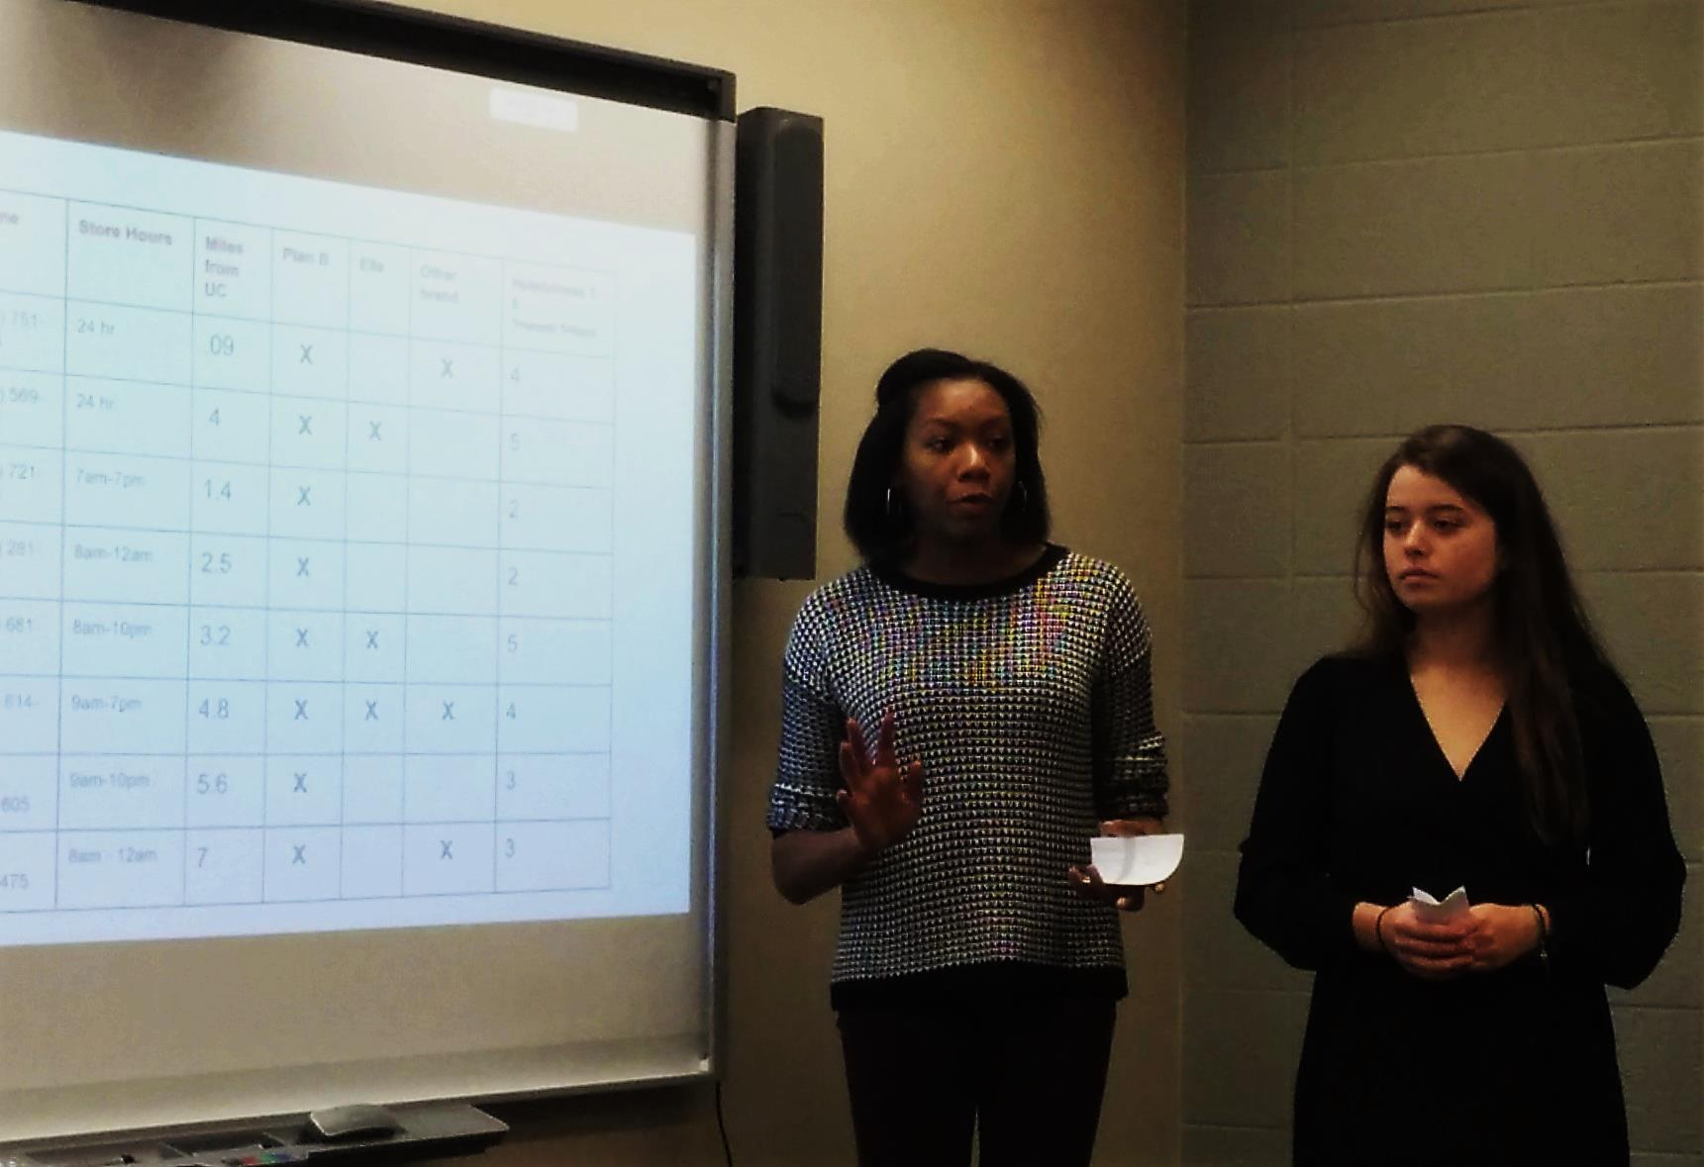

Slide 19
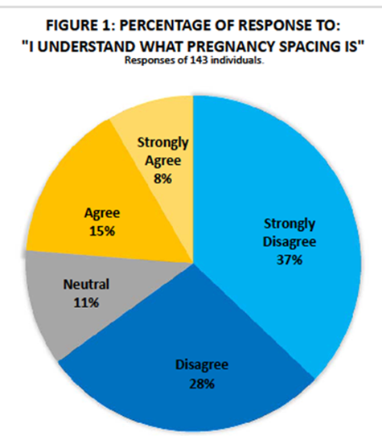
Cradle Cincinnati Group:
Assess Knowledge of Pregnancy Spacing

Slide 20
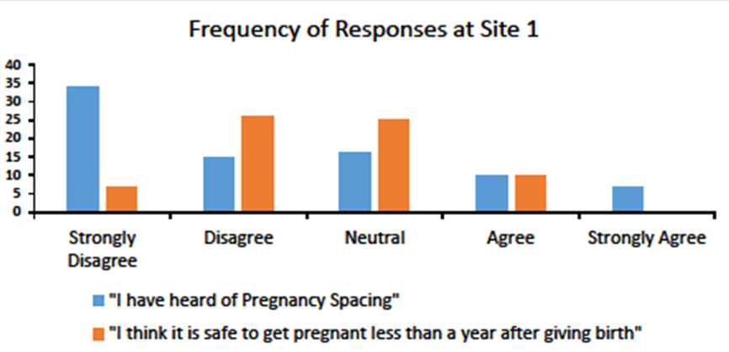

Slide 21
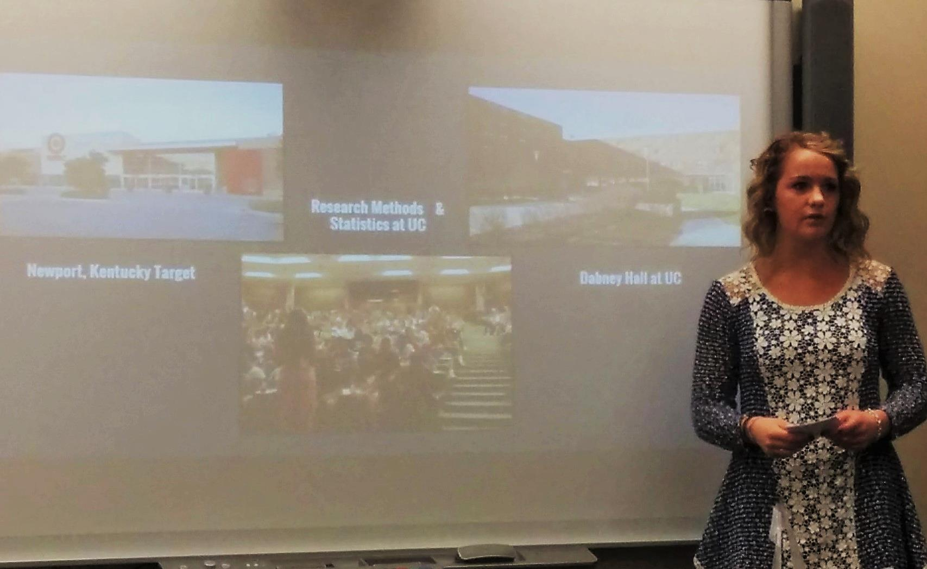

Slide 22
Testimonials
“It was nice to be able to apply some of the concepts of my Research Methods class to actual research!”
“Enjoyed being able to make a difference in women’s lives.”
“I found value in providing info to people in need of sexual health education.”

Slide 23

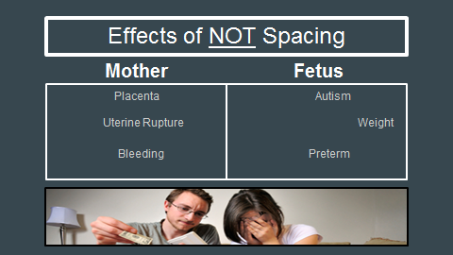

"Knowing the techniques in presenting information in formats such as my slideshow has provided me a way to grab the audience's attention and informing them better of the topic, visually."
Brianna Napier Cortez ,
(Cradle Cincinnati Group)

Slide 24
Student support
Blackboard: handouts, practice files, PPT, links
STRC
online guide
consultation with librarian upon request

Slide 25
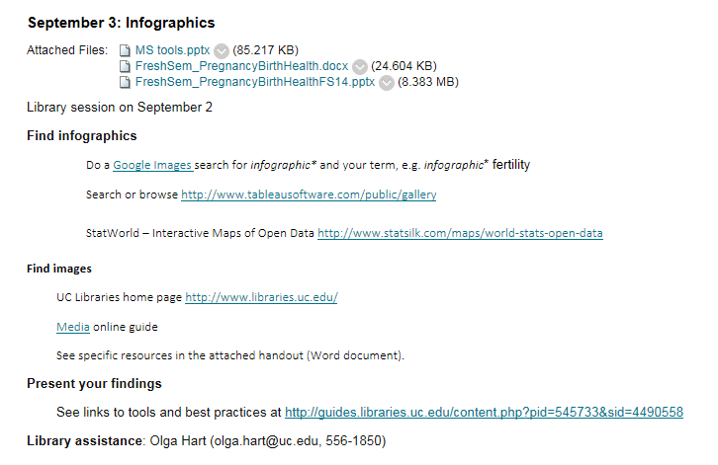
Blackboard

Slide 26
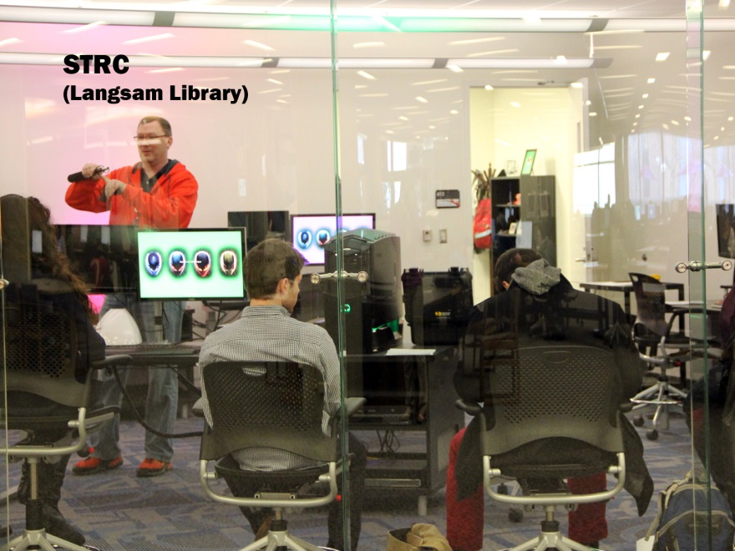
Student Technology Resource Center (STRC) and Multimedia
Use computers and high-end software
Learn to make videos and get help
Check out equipment

Slide 27
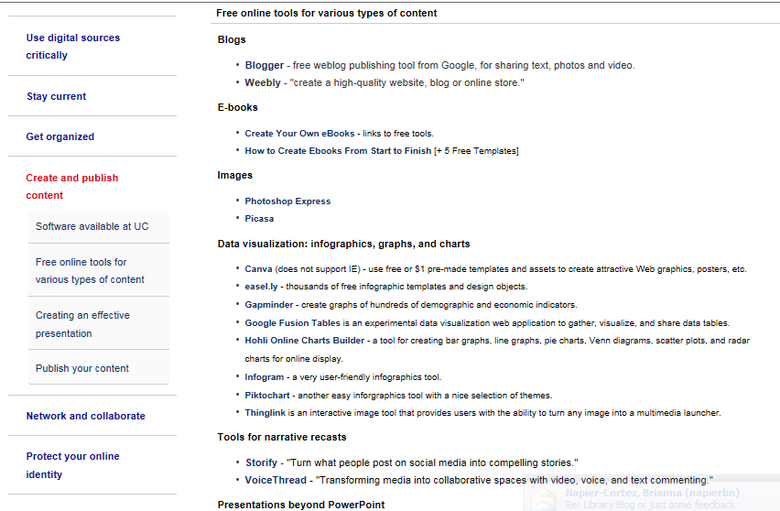
Online guide http://guides.libraries.uc.edu/digliteracy/createpublish

Slide 28

Thank you!

