Slide 1

Reduce, Reuse, Recycle:
Flipping the Classroom
Reduce, Reuse, Recycle:
Flipping the Classroom
ACRL 2015 Conference
Pam Bach
Olga Hart
Deborah Tenofsky
Notes:
Welcome to our virtual poster presentation, “Reduce, Reuse, Recycle: Flipping the Classroom.” Our names are Pamela Bach, Olga Hart, and Deborah Tenofsky, and we are from the University of Cincinnati.

Slide 2

The Problem
Increased enrollment, 1 less librarian.
Instruction for 100 + English Composition classes per term.
Students arrive without research questions,
search terms, etc.
Notes:
According to the Project Information Literacy Research Report: “Learning the Ropes,” college freshmen, while technologically savvy, have trouble navigating the college-level digital landscape. They particularly struggle conducting research with academic literature. The report confirms our long-time belief that the freshman year is the perfect time to expose students to contextual library instruction coordinated with faculty. With a large cohort of first-year students at the University of Cincinnati efficiency and sustainability are key factors in determining instruction strategies.
In 2013, the University of Cincinnati experienced an increase in enrollment which led to a record number of English Composition classes, and requests for library instruction flooded in. In the past, many classes requested two library sessions; the first more formal instruction and the second a follow-up lab session. Students frequently arrived without a clear topic in mind, consequently the one hour library instruction session was spent on deciding on a topic versus using resources for exploring a topic and developing information literacy skills.

Slide 3
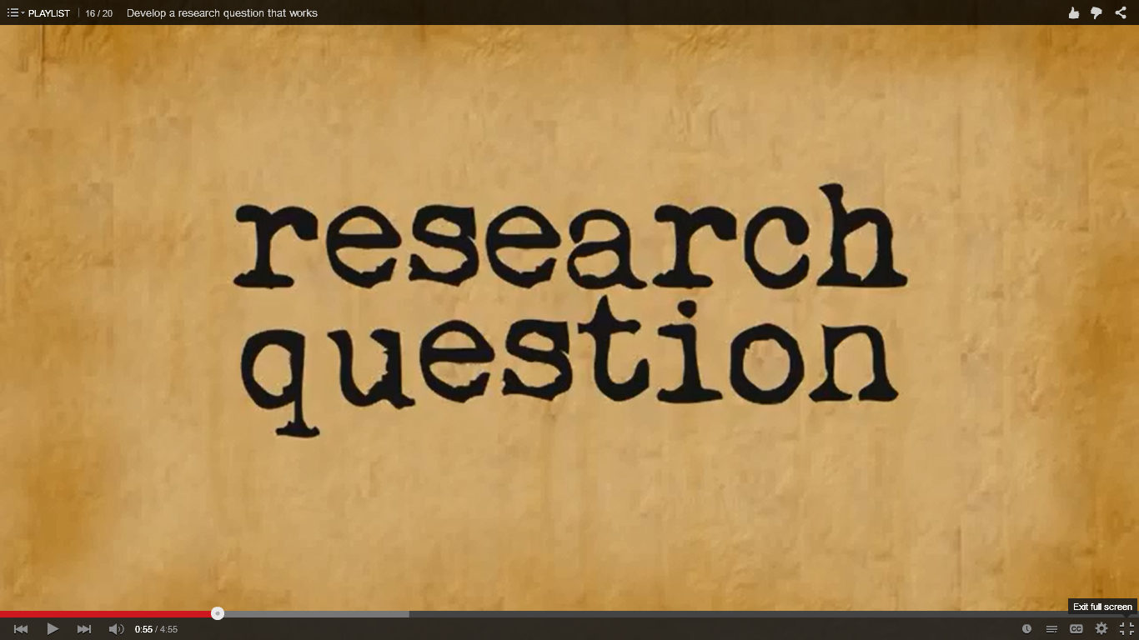
The Solution: Flipping Pre-work Video
Notes:
We solved our problem using the flipped classroom activity. This method combines asynchronous instruction through the use of incorporating existing resources as pre-work with active learning instruction in the classroom. We ask the English Composition professors to have the students watch this video on the research question as a part of their pre-library work.

Slide 4
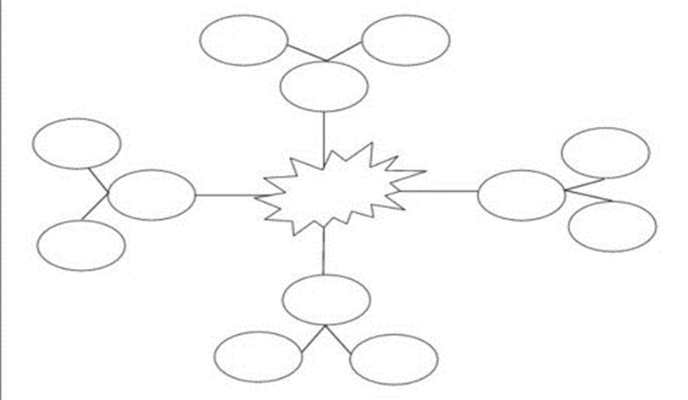
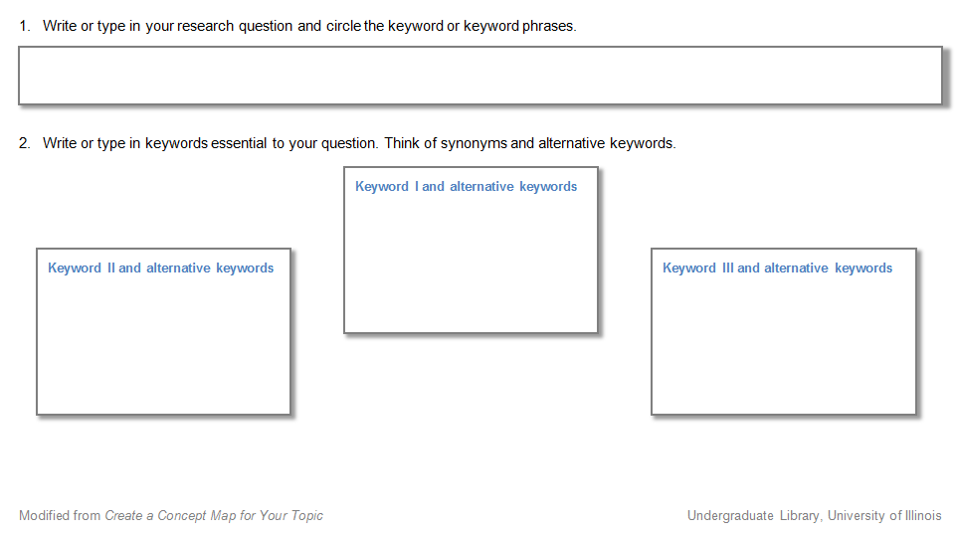
Flipping: Prework
Video: From Question to Keyword Tutorial
(from University Libraries, University of North Carolina Greensboro)
Identify concepts and terms: Concept Map
Notes:
Another video explains how to take their research question and come up with keywords. Next, the students populate a concept map with keywords and alternatives. All this work is completed before the students arrive for the face-to-face instruction session.

Slide 5
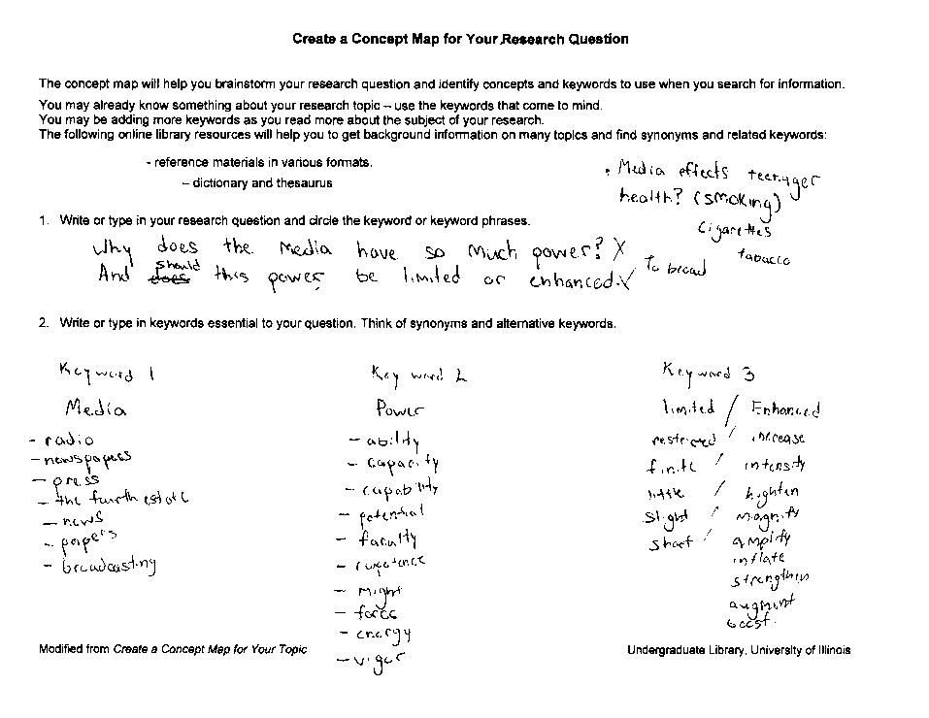
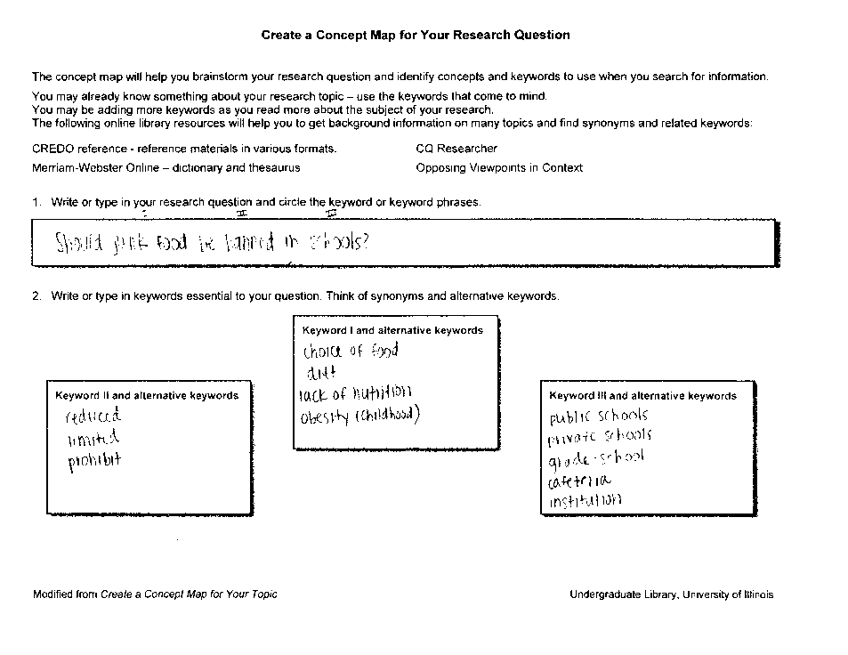
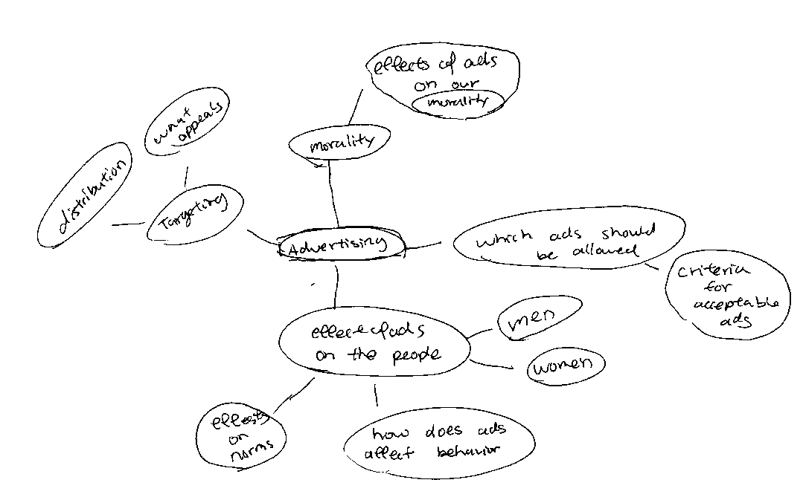
Flipping: Samples of Student Work
Notes:
At the beginning of the library session, students peer review the robust and detailed concept maps. After a brief presentation on research tools and techniques by the librarian, students are likely to modify the maps as they search. The flipped activity allows us to spend more time on the research process and digital literacy skills.

Slide 6


Faculty Outcomes
Faculty:
Support and promote flipped classroom activity.
The activity:
Establishes collaborative working relationship.
Reuses course campus guide.
Reduces the # of instruction sessions from 2 to 1.
Notes:
A faculty outcome is greater collaboration. Also, many of the faculty are willing to use their classroom time for the pre-work. Some of the faculty assign the pre-work through the course management system. The activity maximizes the student learning of the research process in one face-to-face session consequently a second lab session is not necessary thus repurposing staff resources.

Slide 7

Student Outcomes
Students:
Arrive with a research topic & search terms.
Explore the course guide prior to session.
Are more invested in the session.
The activity:
Sets expectations about the role of library.
Time for engagement with research process.
Recycles the digital learning objects.
Notes:
The students are more invested in the library session. The pre-work establishes expectations about the libraries’ role in their academic experience. During the session, faculty and librarians work in tandem one-on-one with students to develop their research question and to find specific resources.

Slide 8
Reduce
Reuse
Recycle
Optimize
the number of library sessions.
online instruction guides.
digital learning objects.
your contact time with students.
Pamela.Bach@uc.edu Olga.Hart@uc.edu Deborah.Tenofsky@uc.edu
Notes:
Thank you for your interest in our presentation. Please feel free to contact us if you would like more information.

