Slide 1

Leveraging Change to Transform our Teaching Practice
Pamela Bach
Olga Hart

Slide 2
“Librarians love change.”

Slide 3
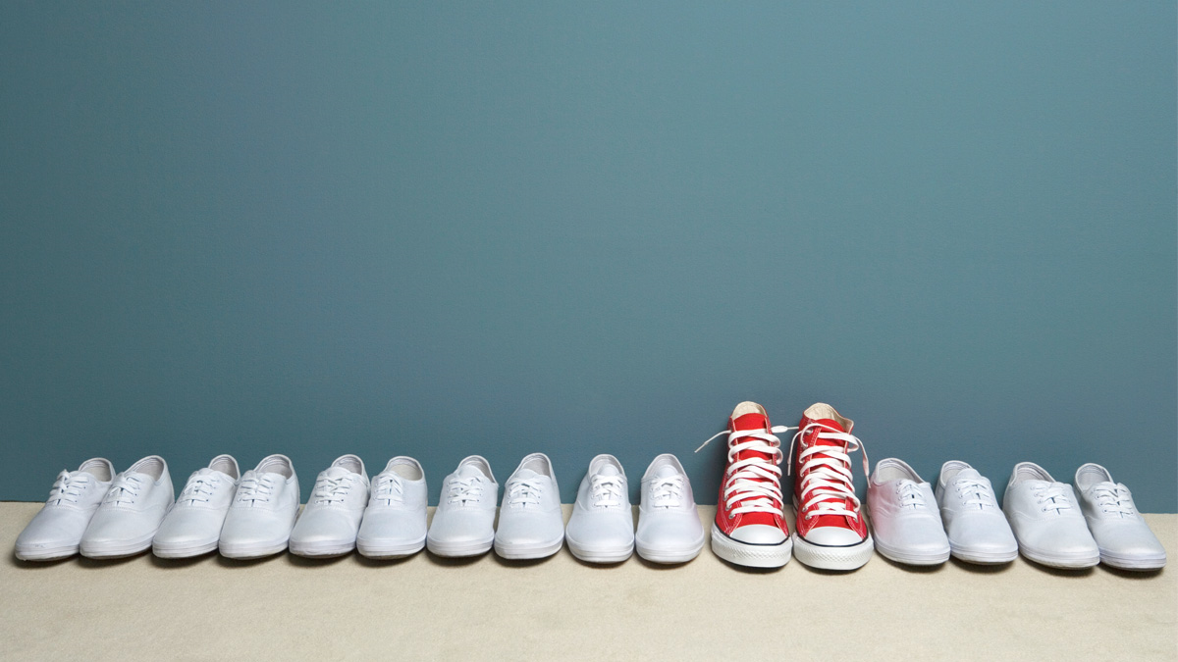
change

Slide 4

CHANGE

Slide 5
2015: Agents of Change
LibGuides upgrade
ACRL Framework
New strategic directions
???
Classroom redesing

Slide 6
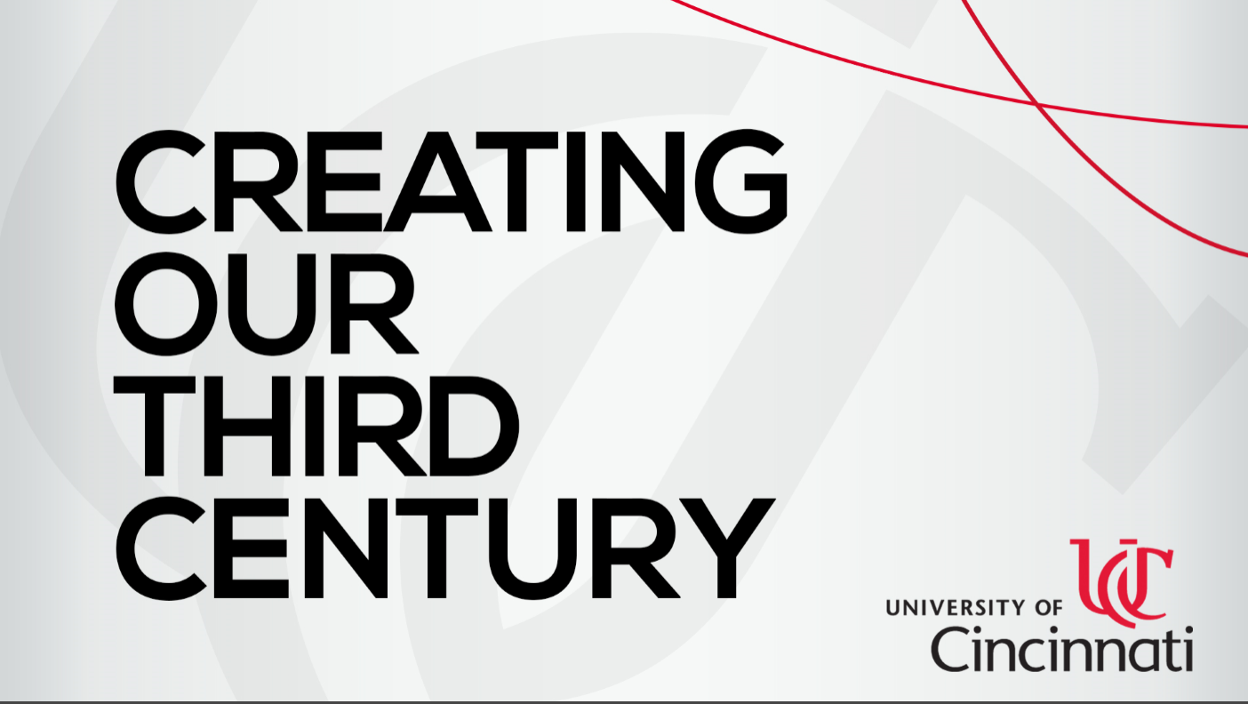
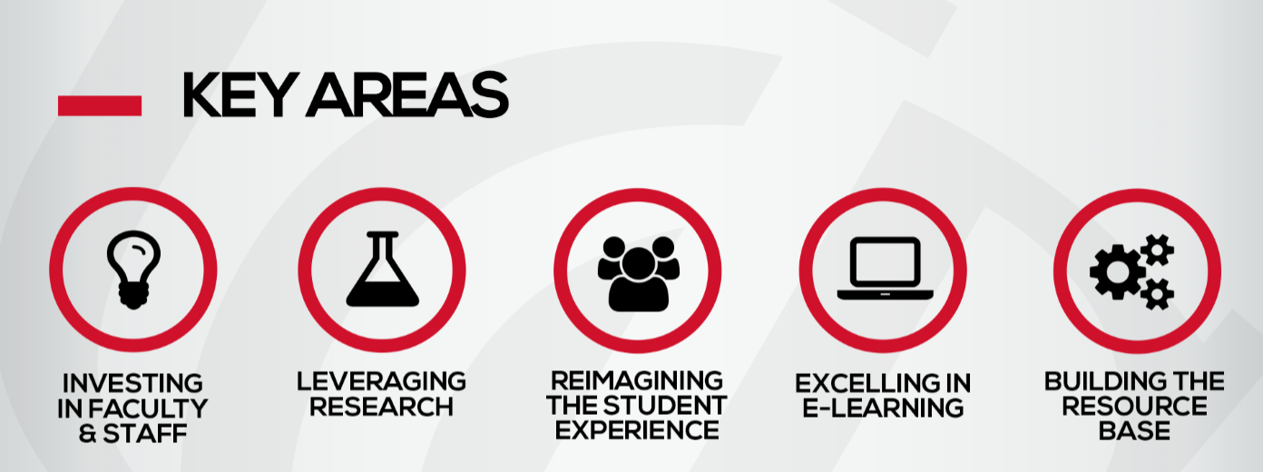


Slide 7
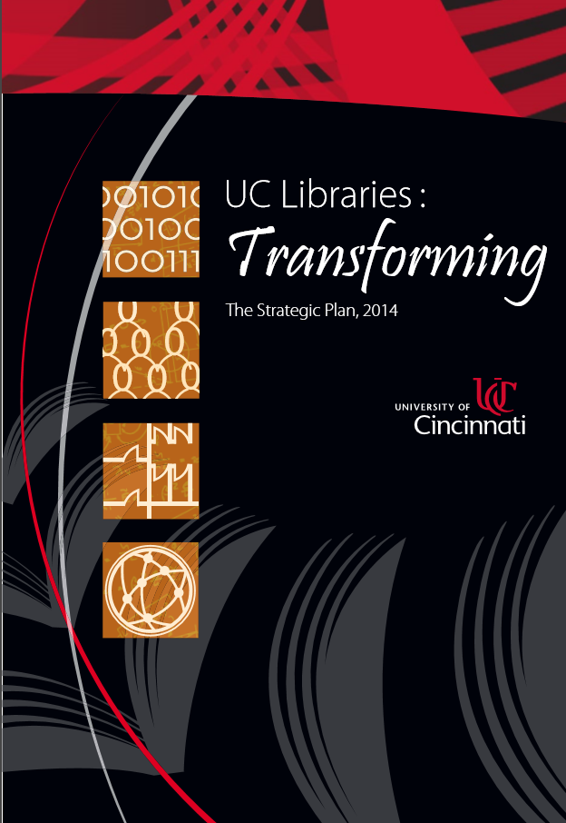
Through innovative teaching, instruct students in information and digital literacy and inspire self-directed learning in a complex and dynamic information environment.
Build and enhance physical spaces within the libraries making them more inspirational, diverse, flexible, dynamic, collaborative and resourceful.

Slide 8
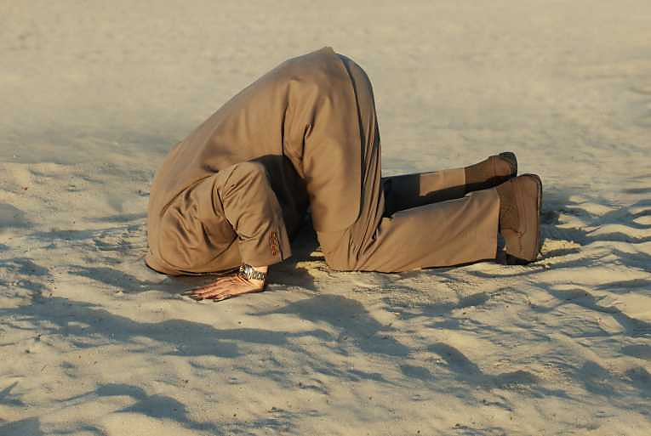

Slide 9


Slide 10
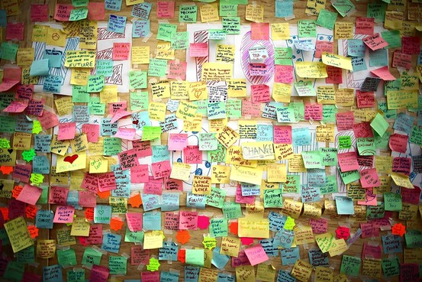
chaotic

Slide 11
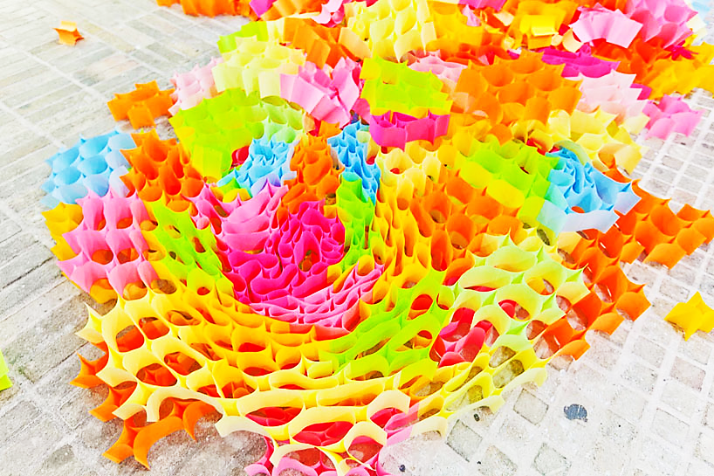
by design

Slide 12
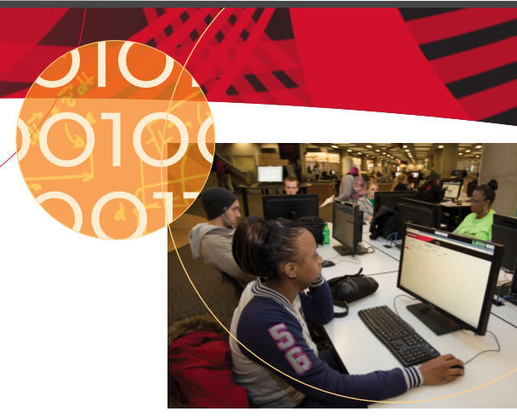
Strategic Initiative: eLearning and Digital Literacy
Think tank for implementation of the Framework
Pedagogies drive technology
Bringing multiple stakeholders to the table
Notes:
Investigate resources and pedagogical approaches to advance UCL elearning practices and better support elearning at UC in the broader context provided by the Framework for Information Literacy for Higher Education.
Guide the implementation and provide initial training for newly adopted e-learning pedagogies and tools.
Solidify relationships with campus units focusing on improving teaching and learning.

Slide 13
Re-envisioning Our Guides:
A Case Study
Usability Testing
Mapping Threshold Concepts
Collaboration with English Composition
Assessment
Accessibility
Audit
Notes:
In preparing to move our research guides to Springshare’s LGv2 platform, several forces came into play. Our LGv2 working group conducted usability testing on the current version of the guides to ascertain changes that should be made. Our eLearning and Digital Literacy committee served as a think tank for implementing ACRL’s Framework for Information Literacy and the threshold concepts. Campus stakeholders in the English Composition program provided targeted feedback and collaborated with the guide content.

Slide 14
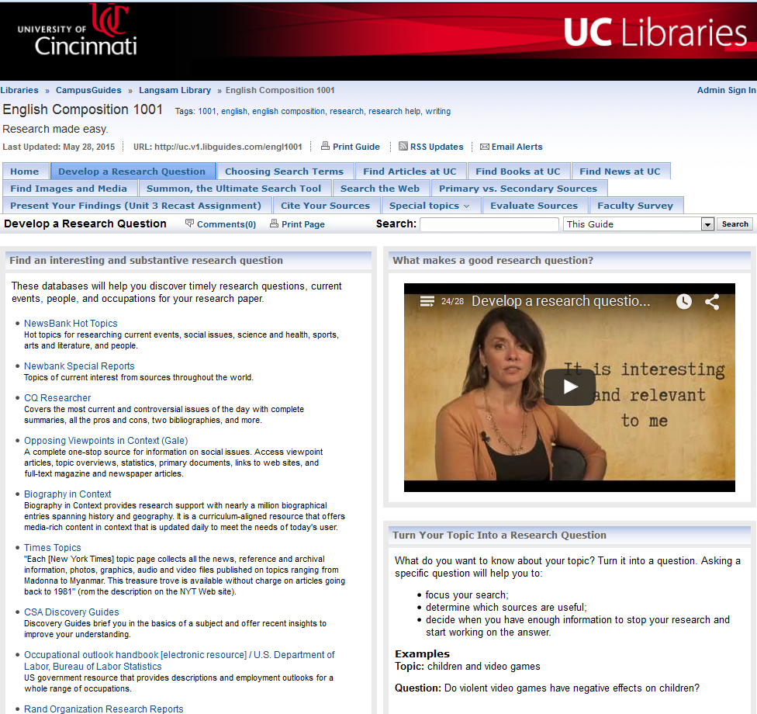
Any Problems?

Slide 15
Usability Testing
Questions | 1 to 5 Scale
1. If you use UCL Research Guides, how do you get to the guides you use? | 0.27
2. Looking at the UCL site, how would you find the research guide on Biology? | 3.13
3. Find the librarian contact information on the Biology guide. | 1.93
4. Find the “Browse All” link for the Research Guides. | 1.80
5. On this page, find the guides associated with the Geology-Mathematics-Physics Library. | 2.07
6. Was it easy for you to find the above guides and information? | 2.20
Notes:
The usability testing of the guides indicated our users from faculty to graduate students to undergrads all experienced challenges navigating and finding information on the guides. Here is a sample of about a dozen questions on navigating & using our campus guides, used camtasia to capture the session, determine length of time, points where struggled, 3 faculty, 7 undergraduates, 4 grad students; used a scale of 1 to 5.

Slide 16
Accessibility Audit
Usability and accessibility are closely linked
Current Site
  content overwhelming
  3 columns is too much unless a true index
  increase font size
Navigation
  left hand navigation becoming standard
  one layer of sub-pages preferable
Colors/Design
  keep color consistent across guides
  remove all box borders
Notes:
At the same time, while showcasing a guide at an eLearning Committee meeting, one of the members began identifying accessibility problems with the guide, informing us that the Department of Education had conducted an audit of the University’s websites and issued a report.
Left hand navigation versus 2 levels of horizontal navigation

Slide 17
Mapping
Threshold Concepts
ACRL Framework concepts | English Comp 2089 Learning Outcomes | 2089 Assignment Sequence Literacy Analysis-> Genre -> Research as lived &studied practice
Authority Is Constructed and Contextual Information reflects their creators’ expertise and credibility, and are evaluated based on the information need and the context in which the information will be used. Constructed: various communities may recognize different types of authority. Contextual: the information need may help to determine the level of authority required. | Understand that discourse communities, genres, and research are situated literacy practices and that knowledge is not static. Recognize that social, historical, cultural, and political contexts affect the production and understanding of texts and genres. Identify and distinguish among kinds of evidence used in discourse communities. | Knowledge of how to participate & communicate in a group or context; how language functions in communities: personal, academic, public. Researchers make knowledge and communicate that knowledge in academic and/or public ways.
Notes:
We started by mapping the Framework’s threshold concepts to the course learning outcomes and assignment sequence.

Slide 18
Guide Assessment
Comp 1001 | How Useful | Comments
Develop a Research Question Research Inquiry | 4 | In the part on the research question, I have a problem with the wording in the third bullet point. We don't want students to "start working on an answer." Instead, we want them to determine an argument or point of analysis. Regarding the examples, they are trite; I would never allow my students to write on either of these topics. The violence in video games topic has been around for 10-15 years, and students have no right or authority to determine whether or not gay couples can adopt. If possible, I would highly recommend finding better examples.
Notes:
Next we conducted a thorough assessment of each page on the guide, receiving targeted feedback from the English Comp faculty.

Slide 19
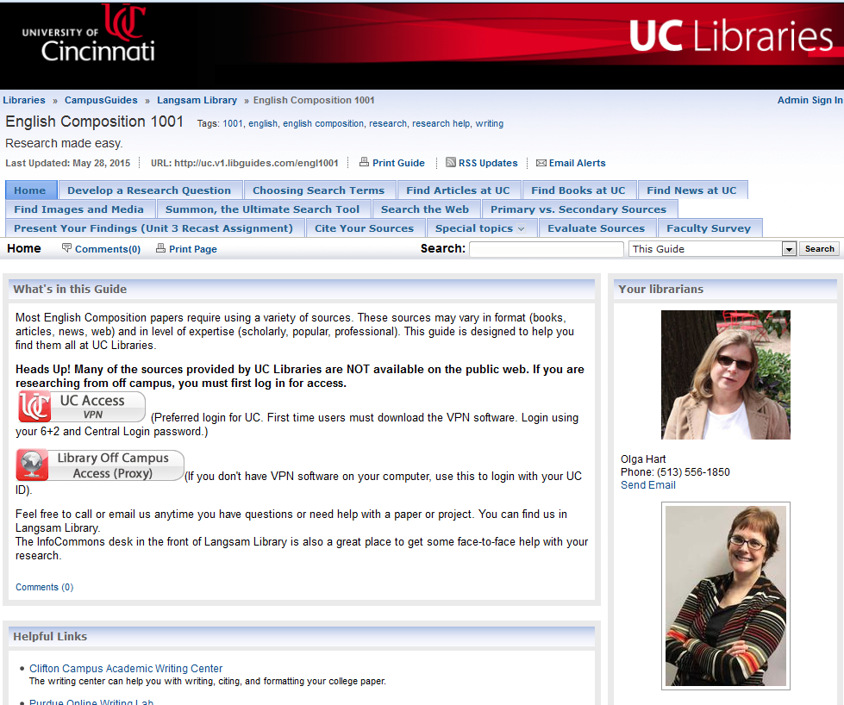
Before
Notes:
Before and after shots…..

Slide 20
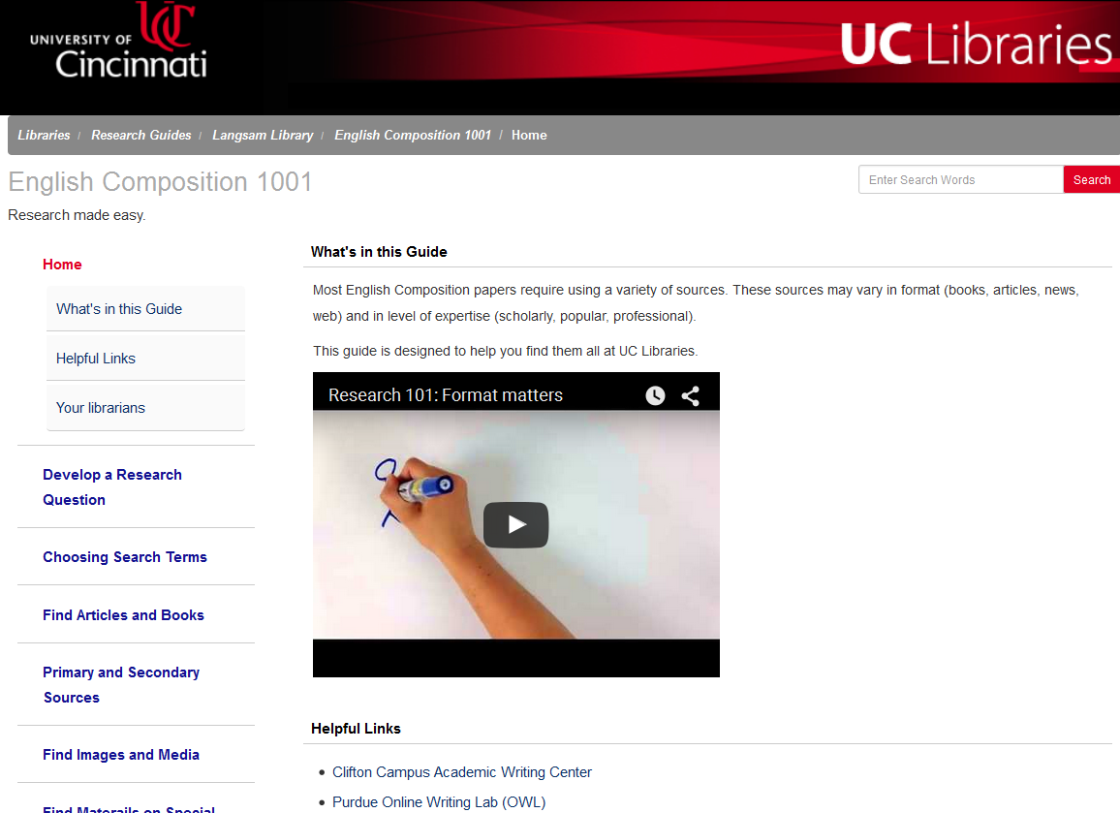
After

Slide 21
Usability Testing
Scale 1 (found quickly) to 5 (did not find) | Pre | Post
1. Looking at the UCL site, how would you find the research guide on Biology? | 3.13 | 2.67
2. Find the off campus access information on the Biology guide. | 3.27 | 1.83
3. Find the “Browse All” link for the Research Guides. | 1.80 | 1.25
4. On this page, find the guides associated with the Geology-Mathematics-Physics Library. | 2.07 | 3.50
5. Using the research guides, find a list of key journals for Athletic Training. | 3.00 | 2.55
6. How would you find a research guide with information on how to cite sources? | 3.27 | 2.60
7. How would you find a research guide about newspapers? | 3.53 | 2.75

Slide 22

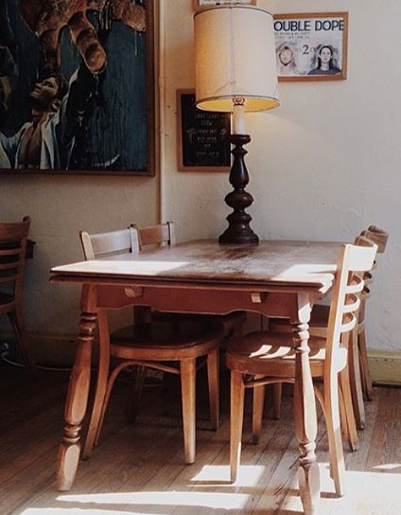
Our Collaborators
English Composition Faculty
eLearning Group
Instructional Technology
Accessibility Team
Notes:
The final phase included reconnecting with the composition faculty to collaborate on the content language.

Slide 23
Toolkits for
Students and Faculty
Digital literacy guide
Introducing students to research guide
Notes:
In addition to the course research guides, other toolkits were created for students and faculty. A digital literacy guide identifies technologies, materials and sources, evaluation tips, information on how to create and publish content, copyright and ethics information. Another guide for faculty provides videos and a context on the threshold concepts to introduce students to research.

Slide 24
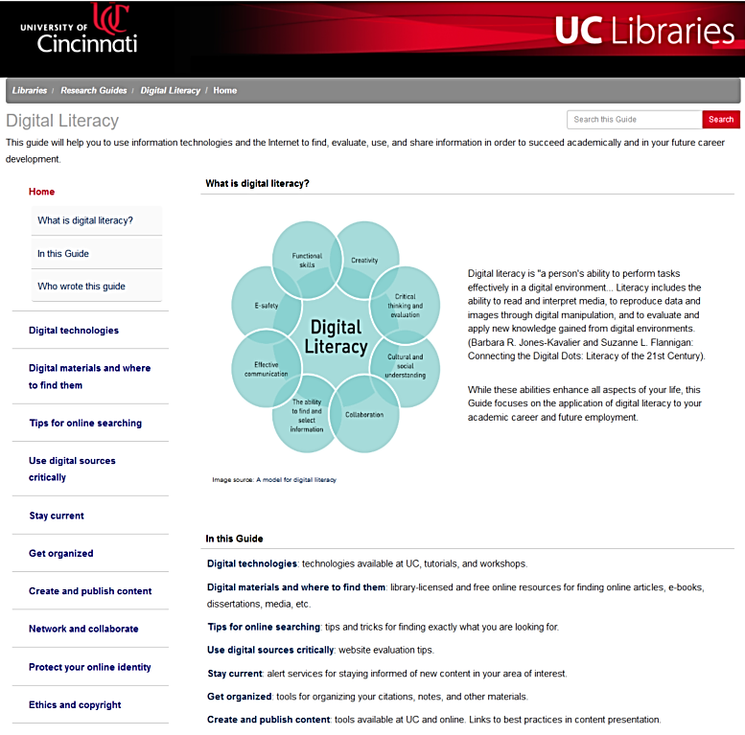

Slide 25
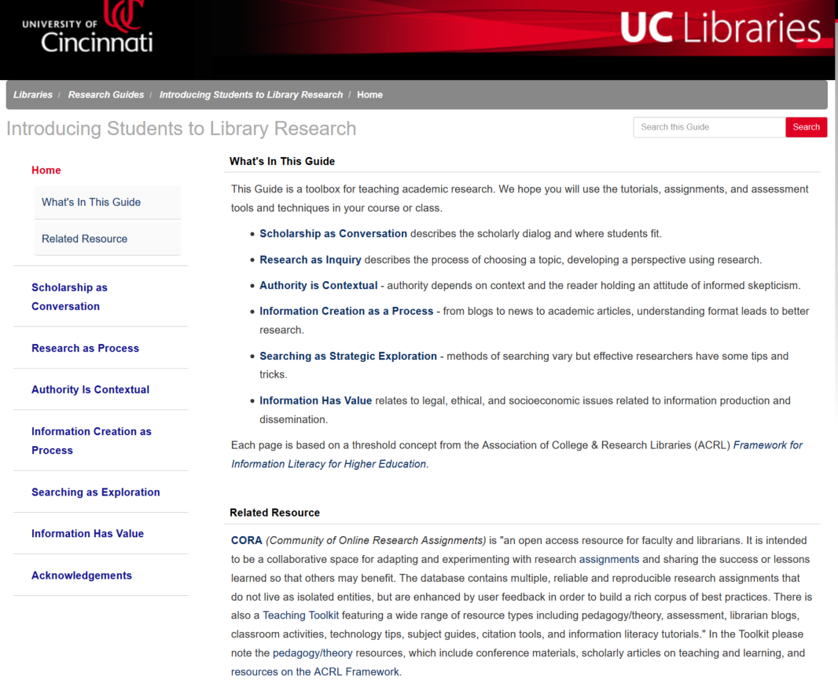

Slide 26
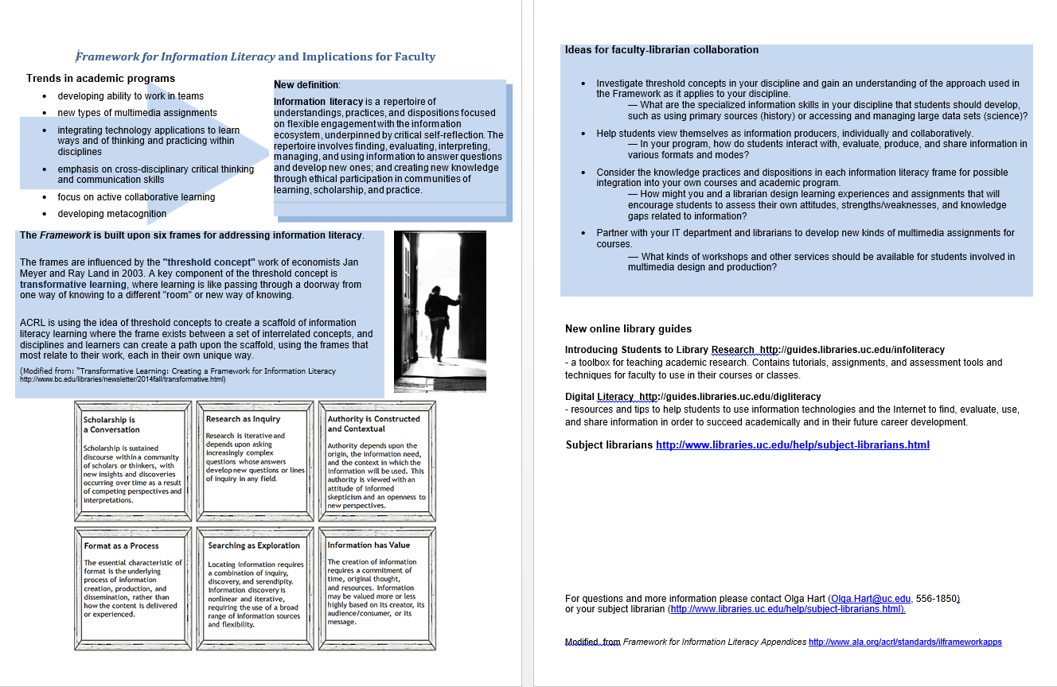
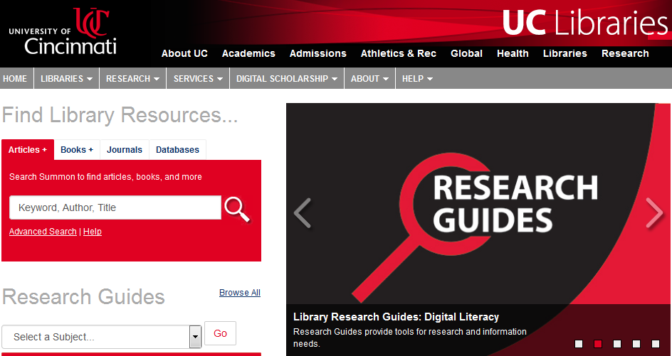
Marketing Plan
Flyers
  Librarians
  Faculty
  Administrators
Website carousel and blog posts
Notes:
The final phase after launching the guides, was the implementation of a robust marketing plan. 2 page flyers for different stakeholders and showcasing guides on the main Libraries’ website.

Slide 27
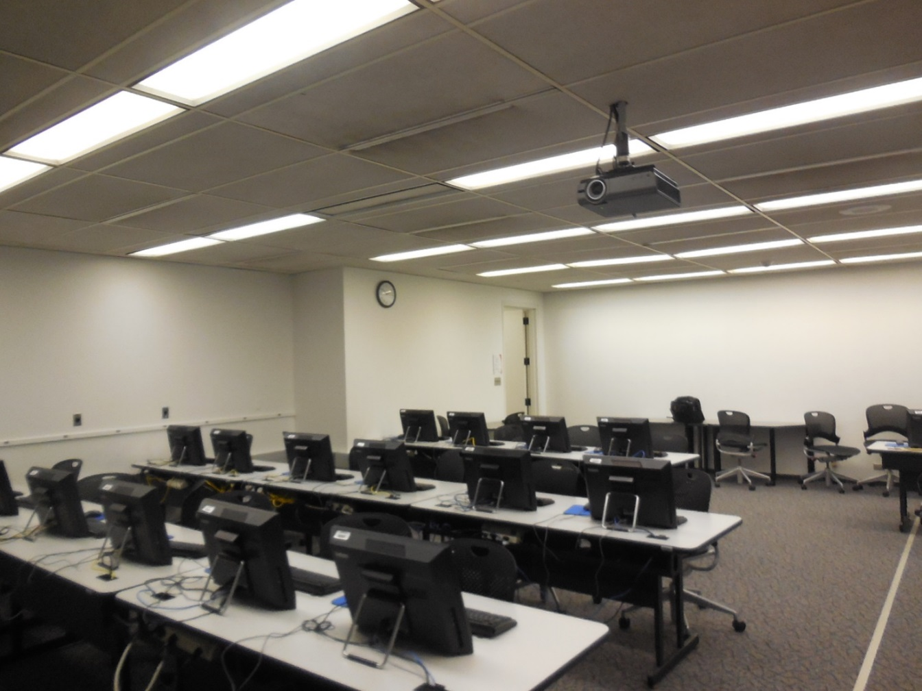
Classroom Transformation:
Before…..

Slide 28
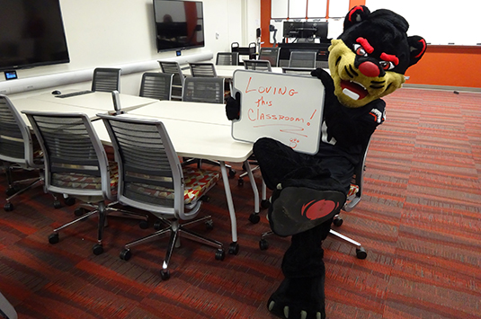
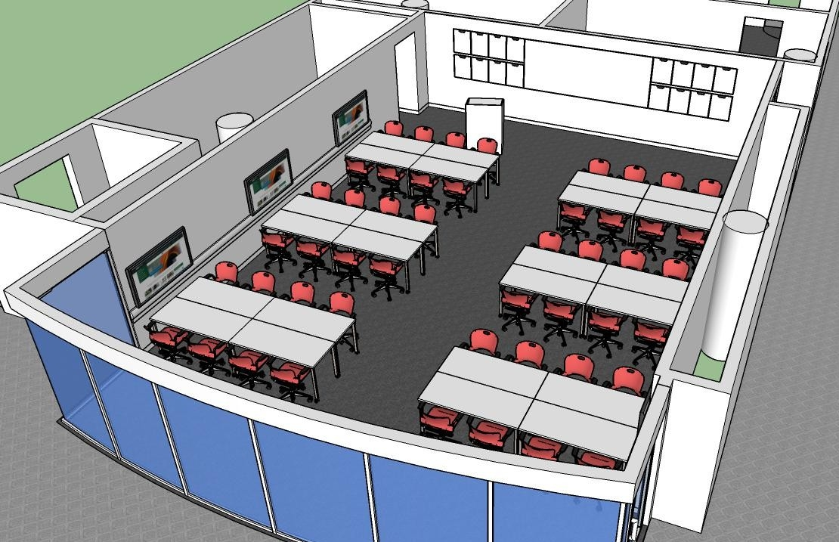
After: A Collaborative
Teaching & Learning Space

Slide 29
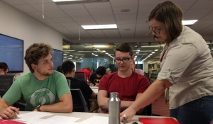
Testimonials
Students:
Faculty:
I felt like students were more willing to share information, and as a part of that the class was more interactive and social.
“Student work is the center in Active Learning Classroom. It gave me permission to experiment in productive ways, especially with group work.”
I liked how we sat at tables in groups. it made it easy to communicate and work together .
"The openness of the space facilitates greater collaboration and more robust discussion."
More technical and makes me excited to come to class.

Slide 30

“First comes thought; then organization of that thought, into ideas and plans; then transformation of those plans into reality. The beginning, as you will observe, is in your imagination.”
Napoleon Hill

Slide 31
Image credits
Title slide: Hurst, Julie. Convergence. [Online image]. Retrieved October 16, 2015 from http://blogs.amdocs.com/socialmedia/2012/03/20/tweetchat-artofconvergence/#.VgwwNVLnHlw
Slide 3: [Photograph of sports shoes]. Retrieved September 29, 2016 from https://www.theodysseyonline.com/change-is-not-always-bad
Slide 4: Changes Crossroad Sign. [Photograph]. Retrieved September 29, 2016 from http://ryanpolly.com/organizational-change-why-resilience-is-the-key-to-change-management/
Slide 8: [Photograph of a man with head buried in sand]. Retrieved September 29, 2016 from http://thehospitalitycoach.net/embrace-change-and-innovate/
Slide 9: [Photograph of a woman with open arms]. Retrieved September 29, 2016 from http://justbetweenus.org/health/emotional-health/handling-and-embracing-change/
Slide 10: [Photograph of a poster board covered with post-it notes]. Retrieved October 5, 2016 from http://www.wsj.com/articles/SB10001424053111903918104576502300673027230
Slide 11: [Photograph of Yo Shimada’s post-it installation]. Retrieved October 29, 2016. http://www.designboom.com/design/yo-shimada-sticky-note-structures/
Slide 30: [Online image of profiles with clouds and swirls of color]. Retrieved October 5, 2016 from http://www.theeventchronicle.com/metaphysics/spiritual/2016-the-year-of-transformation/

