Slide 1

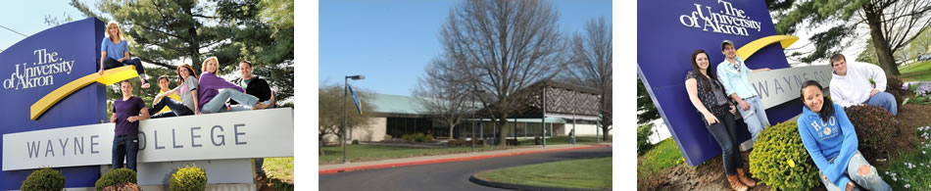


Colleagues Empowering Colleagues Through Teaching Observations
Dr. Shawn DiNarda Watters
Education Paraprofessional Program Coordinator
sw94@uakron.edu
March 17th, 2017

Slide 2
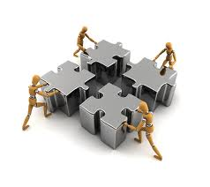

Professional Development
PD allows educators to learn new ideas and techniques (Fullan, 2008).
Peer Feedback is one form of PD that is practical and effective in helping educators better understand the impact on student performance.

Slide 3

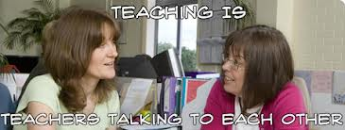
What is Peer Feedback?
Peer feedback is reciprocal teaching – pairs of professionals observe one another as they incorporate new teaching techniques in the classroom.

Slide 4

What do you see?

Slide 5



What do you see?

Slide 6




3-Step Process
Planning Conference
Observation/Data collection
Feedback Conference
Notes:
Question: Who has PLCs in their districts/buildings? What are the goals?

Slide 7
Goals of Collaborative Feedback
Analysis
Collaboration
Reflection

Slide 8

Importance of Reflection:
Reflection is encouraged because the written, objective feedback collected can be reviewed to look for recurring patterns and set instructional goals (Wilkins-Canter, 1997).

Slide 9
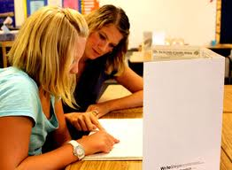
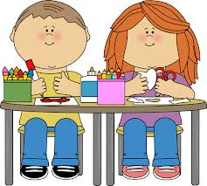
Step 1: Planning Conference
The teacher being observed explains to the peer reviewer the following:
  Lesson objectives
  Instructional activities
  Assessment strategies
  Class demographics that impact instruction

Slide 10
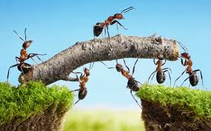
Impact of Peer Feedback:
Valuing collaborative process
Increase in teaching confidence
Classroom climate
Classroom management

Slide 11
Replication of Wilkins and Shin (2010)
My emerging themes mirrored the original findings. N=25 pairs and 2 triads of pre-service teachers; N=6 pairs of higher education faculty across disciplines.
  Reflections on classroom climate
  Instructional planning and delivery of lesson
  Classroom management skills
  Recognized the value in peer collaboration
  Positive impact on teaching confidence

Slide 12
Why Peer Feedback Matters:
Reflection and Collaboration are qualities that help educators grow professionally.
Peer feedback promoted more frequent reflection.
Helpful in seeking out quality collegial support and encouraging professional lifelong learning.
Peer feedback incorporates collaboration.

Slide 13

Take a risk

Slide 14


ASK
QUESTIONS

Slide 15
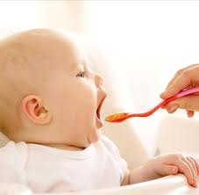

Be open-minded

Slide 16
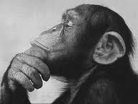
Reflect on what you know

Slide 17
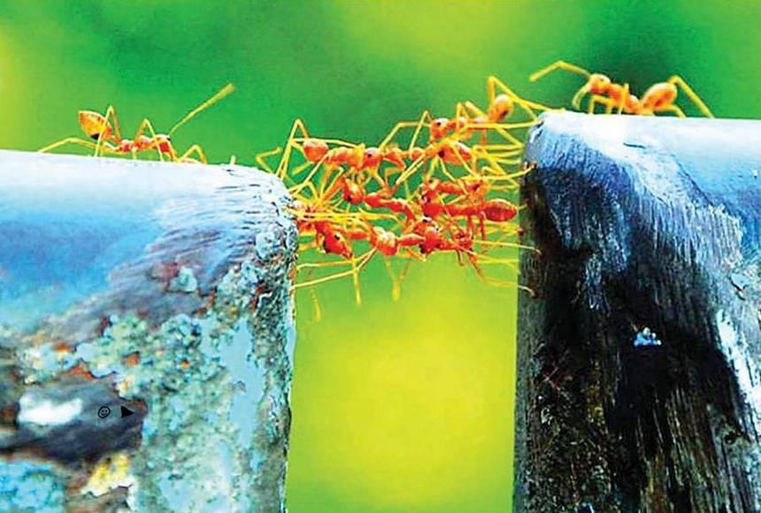
Collaborate

Slide 18
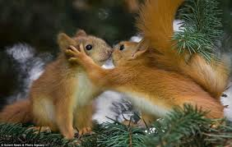
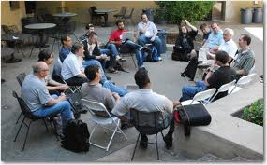
Share experiences

Slide 19


Finally…
“A precondition for doing anything to strengthen our practice is the existence of a collegial culture in which professionals talk about practice, share their craft knowledge, and observe and root for the success of one another. Without these, no sustained change is possible.” (DuFour, 2008)

Slide 20
References
DuFour, R. (2011). Work together but only if you want to. Phi Delta Kappan, 92(5), 57-61.
Fullan, M. (2008). The six secrets of change: what the best leaders do to help their organizations survive and thrive. San Francisco: Jossey-Bass,
McTighe, J., & Emberger, M. (2006). Teamwork on assessments creates powerful professional development. Journal of Staff Development 27(1): 38-44)
Nelson, T., Deuel, A., Slavit, D., & Kennedy, A. (2010). Leading deep conversations in collaborative inquiry groups. Clearing House, 83(5), 175-179. doi:10.1080/00098650903505498
Professional learning communities need tools for collaboration. (2011). T H E Journal, 38(8), 42.
Thessin, R. A., & Starr, J. P. (2011). Supporting the GROWTH of effective professional learning communities districtwide. Phi Delta Kappan, 92(6), 48-54.
Wilkins, E. A. & Shin, E. K. (2010). Peer feedback: Who, what, when, why, & how. Kappa Delta Pi Record, 46 (3), 112-117.

Slide 21
