Slide 1




Paraprofessional Education Candidates and a Dynamic Research Based Experience
Dr. Shawn DiNarda Watters
Education Paraprofessional Program Coordinator
sw94@uakron.edu
March 17th, 2017

Slide 2
Abstract:
Recent demands on professionalism and scholarship in teacher preparation requires institutions to prepare active practitioner scholars prepared to teach. This is supported through the research of Levin & Rock (2003), Price & Valli (2005), and Mertler (2009). This workshop focuses on paraprofessional education (associate degree level) candidates who conducted qualitative research during program coursework. They did this as a way to understand, inform, and then reflect on current research-based educational practices related to current topics in education. The students were required to complete the following three projects:
1) critical research portfolio (CRP)
2) interactive notebook (INB)
3) paraprofessional teaching guide

Slide 3
Why Have This Experience?
Candidates need to be active, cognizant professionals able to see the ‘BIG” picture of Education.
We must provide opportunities for pre-service teachers/paraprofessionals to practically apply educational theories and specialized professional association standards in authentic ways in the P-12 classroom.
We need to develop the skills necessary to authentically apply research and expect professional behaviors.

Slide 4

The Critical Research Portfolio (CRP)
The topic selected must focus on an aspect of course content: behavior management, family involvement, inclusionary practices, preschool, school-wide behavior plans, etc…
Candidates must complete a qualitative process through developing a plan to triangulate data. Data includes: research support; focus group guide; focus group responses; candidate reflection; prospective interview subjects, refinement of topic.
Candidates take on the role of principle investigator for the selected topic and design a basic qualitative inquiry for the semester based on the assigned field placement that corresponds with the course.
Image courtesy of Keattikorn at FreeDigitalPhotos.net

Slide 5
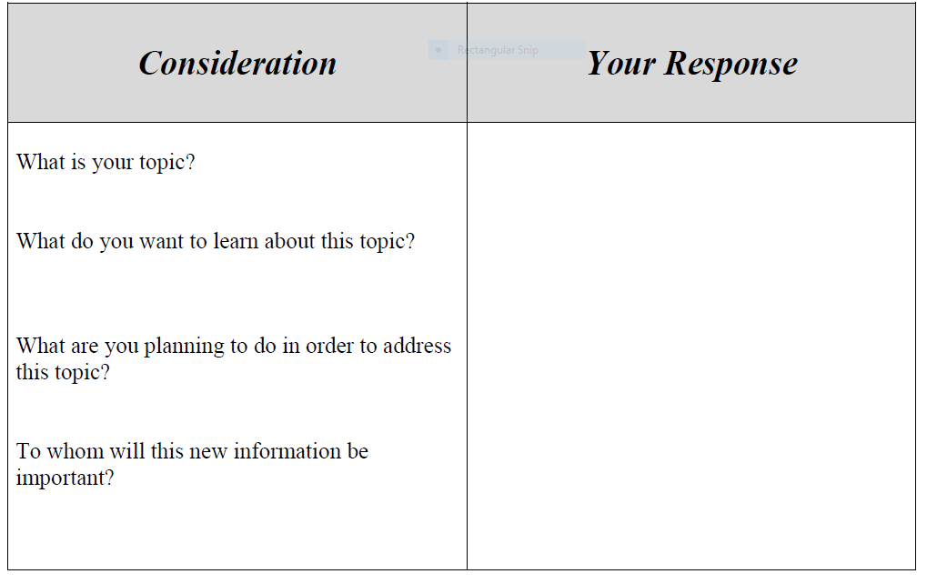
The 1st Step of the CRP Process:

Slide 6
The CRP Requirements:
Select 4 research articles based on your topic from a Professional Education Journal – create an annotated bibliography – essentially summarize each article (1/3 of written submission) and reflect on what you learned, professionally (the ‘so what’ of the paper, 2/3 of the written submission)
Develop a list of 10 questions based on your specific topic that is influenced by your research articles (selected above) and lead a class discussion about your topic. (minimum use of 5 questions for discussion) Take notes during the dialogue on responses.
Reflect on the class discussion – what do you think, how did you feel? What should you do next? How did your class colleagues influence your thinking?
List people you could interview based on your topic – how are they related to your topic? What makes their thought processes credible? What makes them an expert? How difficult would it be to schedule interviews? (the individuals may be listed by professional title, category, or affiliation, if you do not have specific names, e.g. director of special education, school superintendent, etc.)
Identify documents that could be reviewed? (test scores, attendance, school assessments, etc..)
Finally, sit down, review all notes (brainstorming chart, articles, class discussion notes, reflection, interview and document lists) and determine how the topic can be refined, and expanded for further study.
Next, develop an electronic poster/infographic (do not use PowerPoint or Prezi) for your topic presentation describing your Critical Research Portfolio process.
Develop an informational handout for your class colleagues for presentation distribution that summarizes your topic and recommended resources.

Slide 7

CRP Sample Topics:
The Benefits of Full-Day Kindergarten
Is Grade Retention Harmful to Elementary School Students?
The Benefits of Music in the Everyday Classroom!
Males in Early Childhood and Special Education
The Impact of SES on Children’s Vocational Aspirations
The Importance of Home Visits and its Impact on Academics
The Importance of Sound Nutrition on Learning
The Impact of Homework When Connected to Academics
Parent Involvement in Education
Is Phonics Enough?
Full-Day Kindergarten, How it Benefits Students
Should Recess be a Part of the School Day?
Bullying
Relationship Between Parental Involvement & Academic Achievement
Math Assessments – What Do Teachers Use?
How Early Childhood Teachers Structure the Academic Day & Why?
Is Time-Out an Effective Behavior Management Tool?
What are Effective Ways to Teach Self-Management Behaviors?
Should Preschool Be Part of the Universal School System?

Slide 9




Slide 11
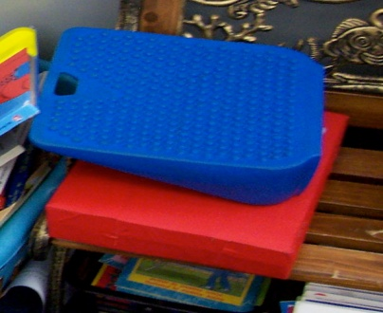
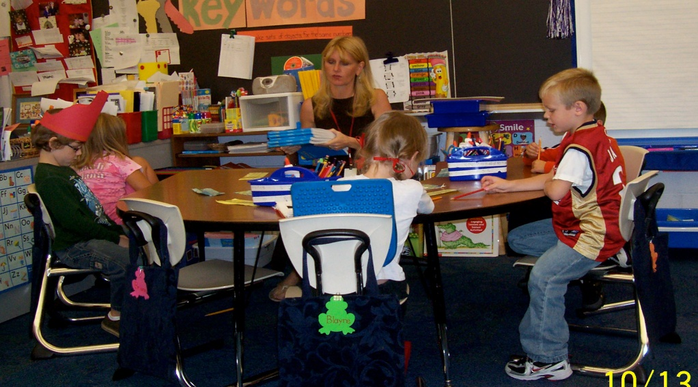
Candidates find support in the field placement for their topics:
Brianne, a student with severe cerebral palsy is always sure to be incorporated into classroom activities. When situations do not permit her access, the adults do everything possible in order to make sure is not left out.
“Brianne, a student with severe cerebral palsy is always sure to be incorporated into classroom activities. When situations do not permit her access, the adults do everything possible in order to make sure she is not left out.”
To the right is a picture of materials that make it easier for her to sit up straight in a classroom chair. The blue one is for back support while the red one is used for her to rest her feet on.
Notes:
Better picture of pippy being included

Slide 12

The Interactive Notebook
The intent of the INB is for pre-service teachers/paraprofessionals to ‘live’ the course content through professional reflection, data collection, and extension activities (in class). One’s education is best acquired through continual learning and seeking of information from multiple sources. A textbook is 1 source and a course professor is only 1 source. The INB should help pre-service teachers/paraprofessionals to make connections between courses, life experiences, the media, field placements, class colleagues, and professionals.

Slide 13

INB Guidelines:
Each pre-service teacher/paraprofessional’s INB will contain the following minimum requirements:
10 vocabulary words defined per textbook chapter
Vocabulary word cloud generator 1 per chapter
Daily class quote reflection, 1 per week – 14 minimum
Current news event related to chapter content – 1 per chapter
Post class reflection exercises, minimum 10 @ midterm and 20 @ final
Qualitative data collection – extension of class content through discussion and reflection, 1 per week with outside source
Video link or website source – reference and professional impact reflection – 1 per chapter
Theorist/Theory/Class Content social media page (FaceBook, Twitter, Instagram, Pinterest, etc…) OR Follow a Teacher/Education Professional BLOG/Twitter account and incorporate into INB
Field observation/Education environments – incorporate class content connections
Connect course objectives to learning – minimum of 10 throughout the semester per course enrolled with Dr. Watters

Slide 14

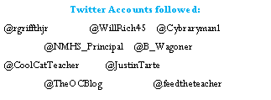


Sample Social Media Followed:

Slide 15
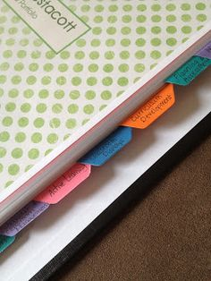
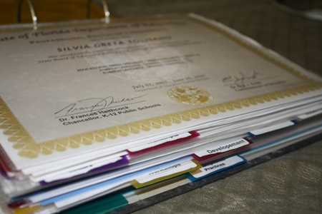
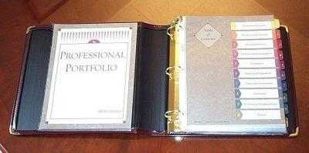
Paraprofessional Teaching Guide
The Guide is practical tool that can be used by candidate during the interview process. It is the candidates’ description of how he/she will function as an effective education paraprofessional. The content covered is:
    A one sentence summary of the education philosophy
    Academic instruction techniques (e.g. multilevel, differentiated, adaptations)
    Classroom community building
    Building/School-wide community building
    Behavior Management
    Classroom design/assistive technology
    Support and collaboration for children with disabilities (special education teachers, paraprofessionals, and other specialists-SLP, OT, PT, etc)
    Parent Involvement and support

Slide 16


Shawn DiNarda Watters, Ed. D.
Paraprofessional Program Coordinator
Assistant Professor
The University of Akron Wayne College
1901 Smucker Road
Orrville, Ohio 44667
sw94@uakron.edu
330.972.8788
Inspire life-long learning in others with trust, integrity, and joy.

