Slide 1

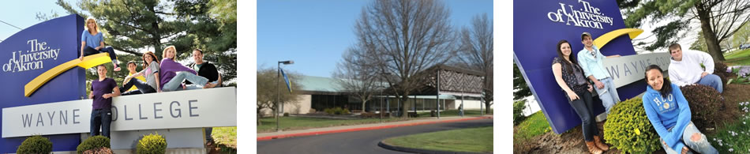


Visible Teaching Strategies in
Teacher Preparation
Dr. Shawn DiNarda Watters
Education Paraprofessional Program Coordinator
sw94@uakron.edu
March 17th, 2017

Slide 2

Abstract:
Paraprofessional education candidates (associate degree level) and pre-service teachers (initial teacher licensure, bachelor’s degree) participated in Visible Thinking (Ritchart, Church & Morrison, 2011) activities during undergraduate coursework to understand, inform, and then reflect on current topics in education while forming professional identities.

Slide 3
Why Have This Experience?
Candidates need to be active, cognizant professionals able to see the ‘BIG” picture of Education.
We must provide opportunities for pre-service teachers/paraprofessionals to practically apply Visible Thinking Strategies in the P-12 classroom.
We need to develop the thinking skills necessary to authentically apply research and positively impact P-12 students.

Slide 4
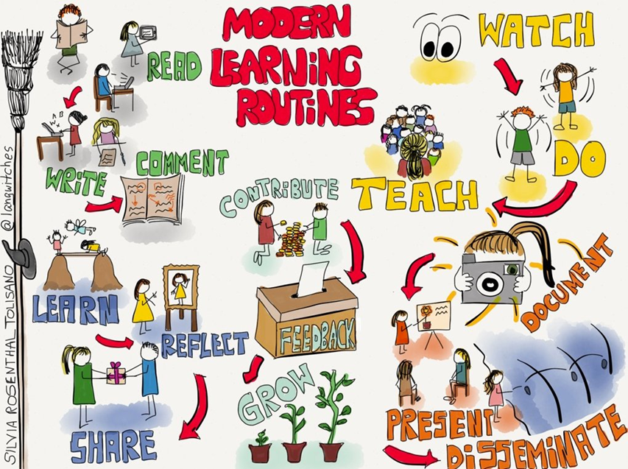
What is Visible Thinking?
Visible Thinking is a flexible and systematic research-based approach to integrating the development of students' thinking with content learning across subject matters.
The goal is to cultivate students' thinking skills and to deepen content learning by building a culture of thinking.

Slide 5
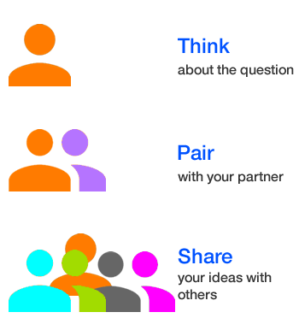
A Culture of Thinking, a couple of questions:
Is thinking promoted in your classroom?
What kind of thinking do you value and want to promote in your classroom?
What type of thinking do your lessons force your students to do?
What type of thinking do your assignments force your students to do?

Slide 6
We must move past the simple, short responses. As educators we must ask our students to think, to process information. We must push them to new levels and not accept just opinions.
Making the Invisible Visible: Questioning
What makes you say that?
What does that tell you then?
What are you basing your answer on?
What’s your evidence?

Slide 7
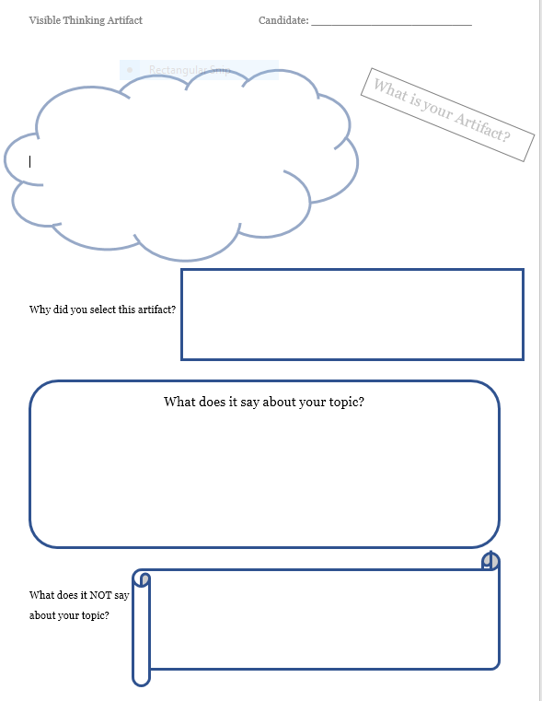
Implemented during a Critical Research Portfolio topic selection and Annotated Bibliography assignment.
VT Strategy: Artifact

Slide 8
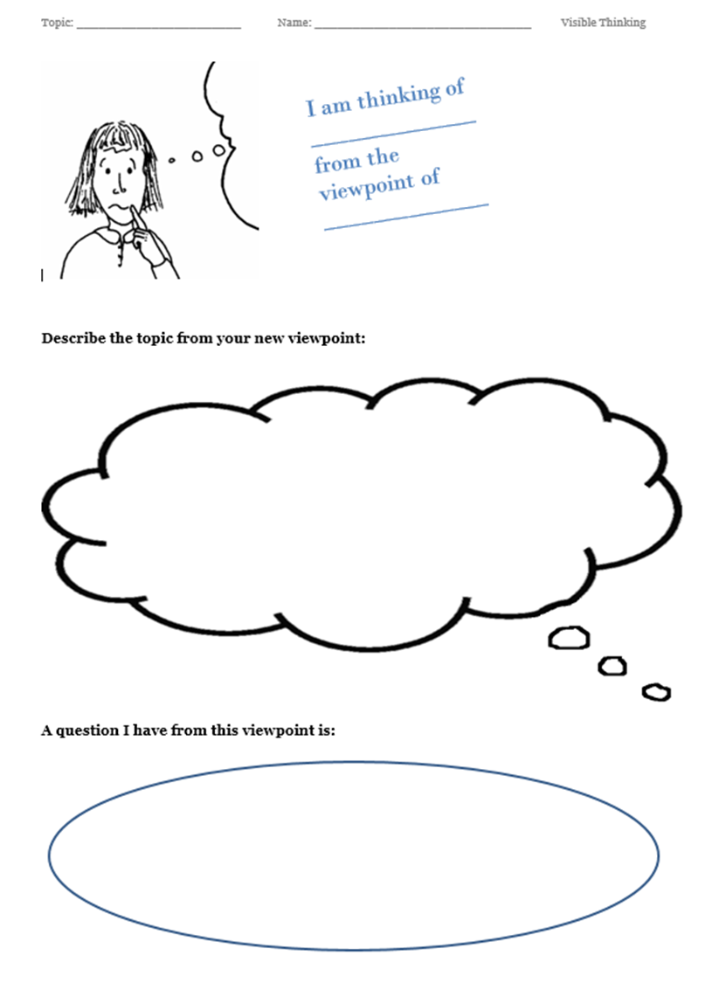
VT Strategy: Exploring Viewpoints
Exploring Viewpoints
Putting yourself in someone else’s shoes.
Present a picture or an idea and have students imagine they are a person in the picture.
What do they see, how do they feel?

Slide 9
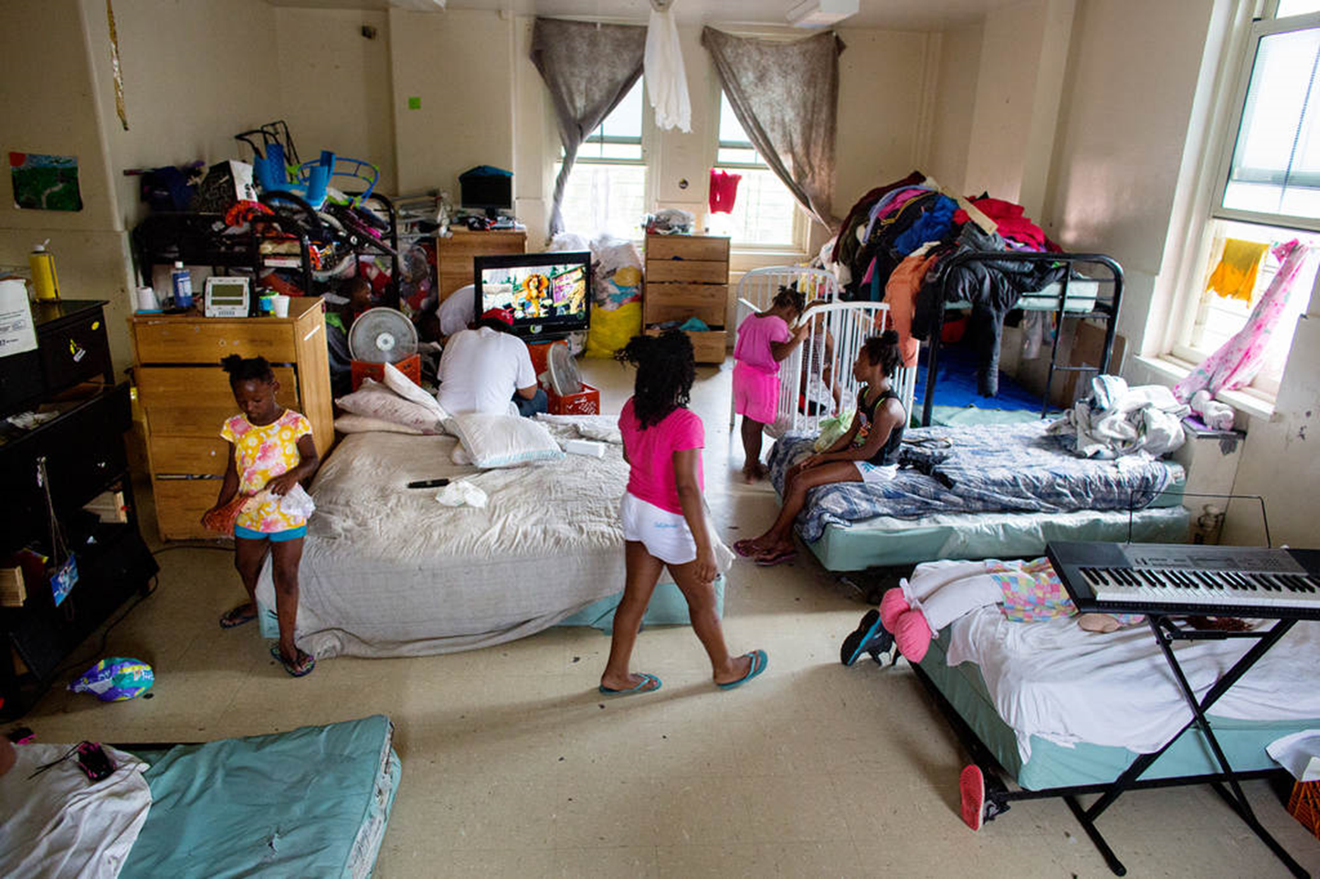

Slide 10
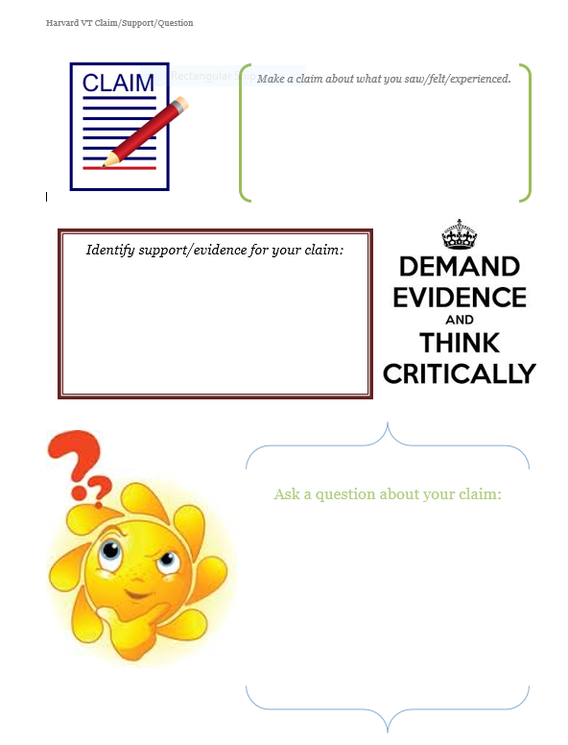
VT Strategy: Claim, Support, Question

Slide 11
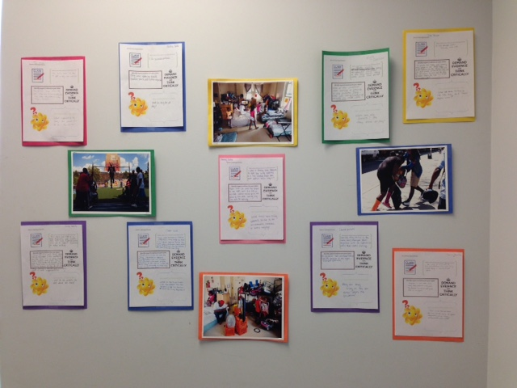

Slide 12
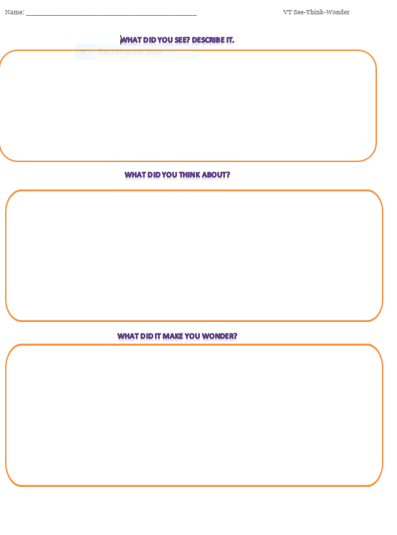
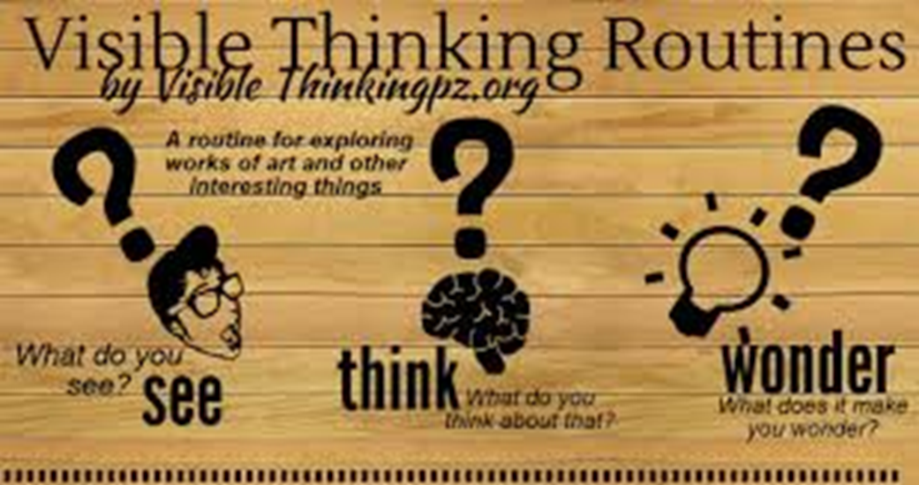
VT Strategy: See Think Wonder
I used this strategy with preservice teachers AFTER a field visit to discuss their classroom observations.

Slide 13
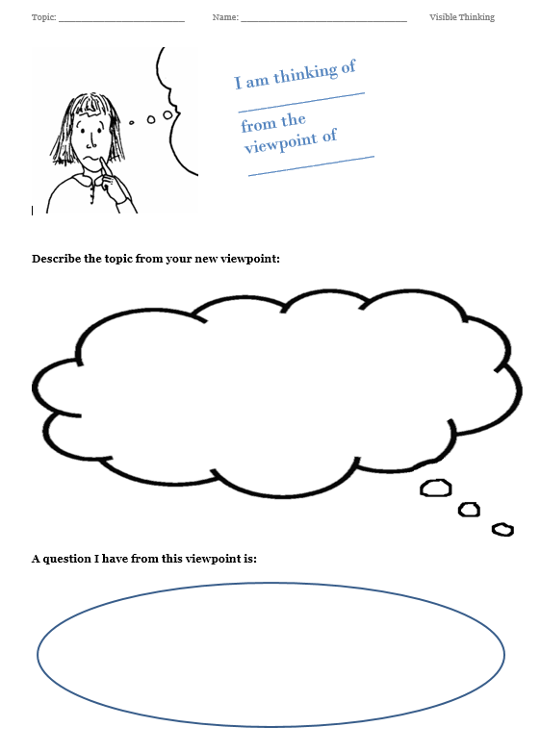
VT Strategy: Circle of Viewpoints
I implemented this during book groups for various courses to deepen the processing of the text. The students looked at events through different constituents’ viewpoints.

Slide 14
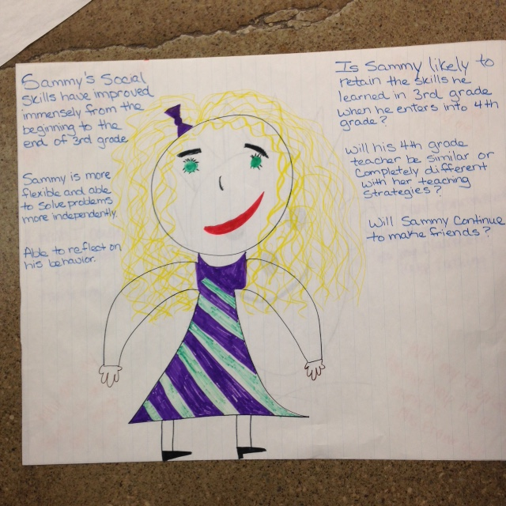
The teacher’s viewpoint in Sammy’s Behavior Problem, Crowe, C. (2012).

Slide 15
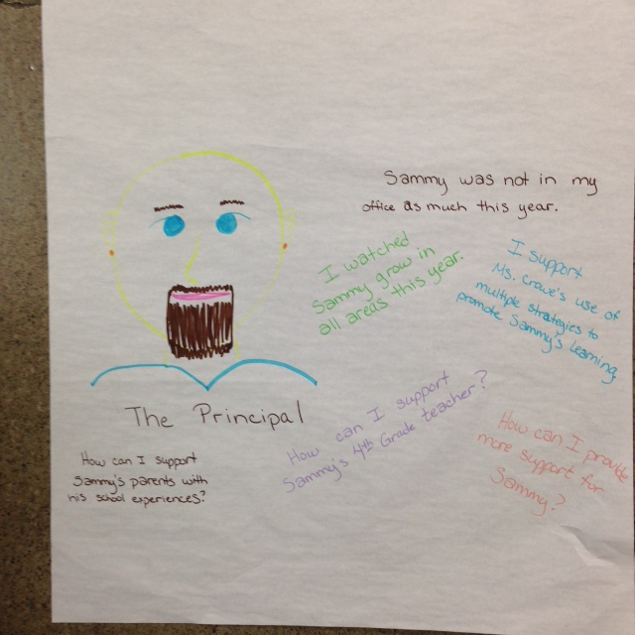
The principal’s viewpoint in Sammy’s Behavior Problem, Crowe, C. (2012).

Slide 16
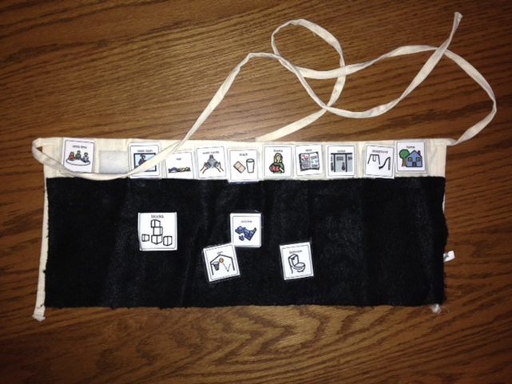
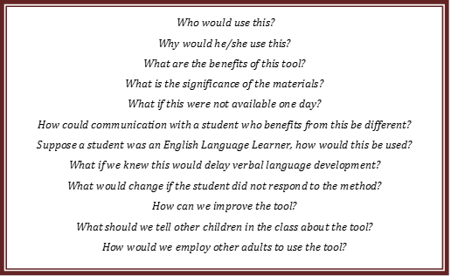
VT Strategy: Object of Their Attention

Slide 17
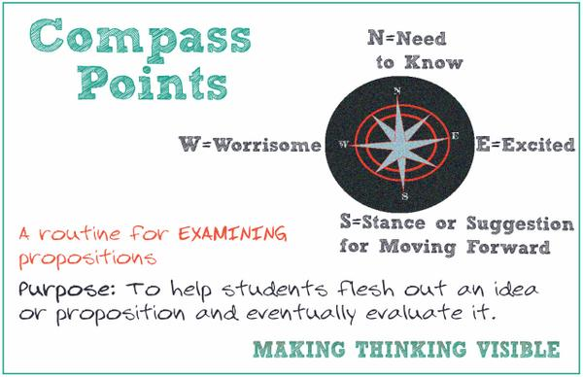
VT Strategy: Compass Points

Slide 18
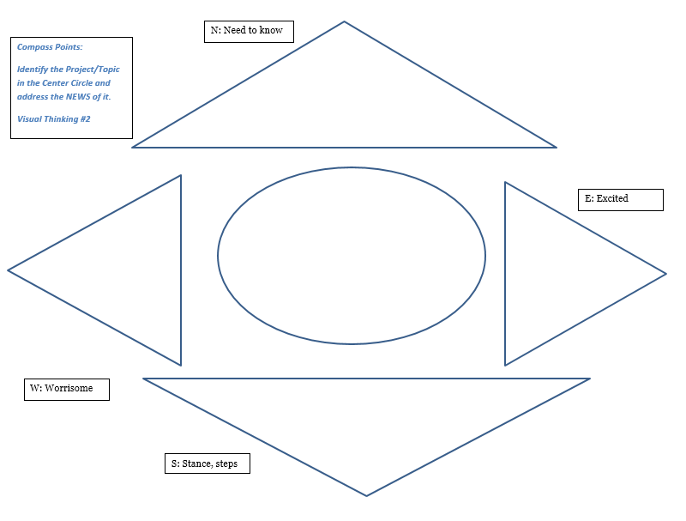
VT Strategy: The NEWS of an Event…..

Slide 19
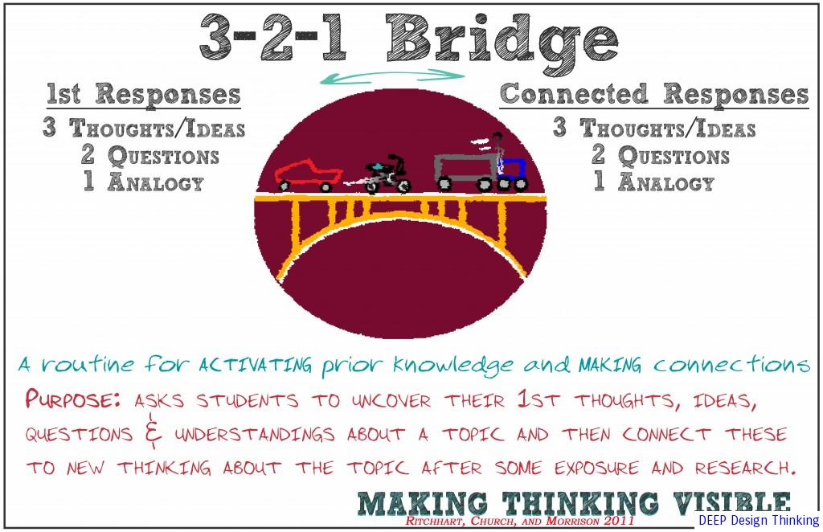

The Interactive Notebook

Slide 20
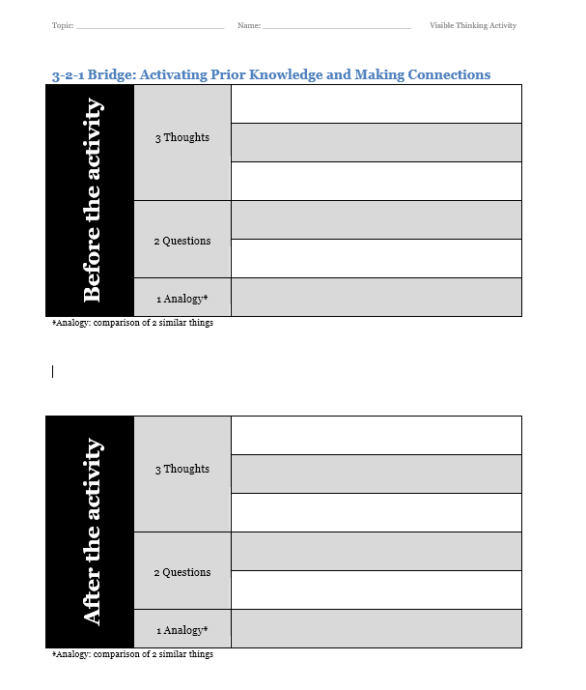
VT Strategy:
3-2-1 Bridge
Implemented in various in class activities:
SES lifestyle quizzes (poverty discussion)
Diversity activity (Uno)
Caring Educator (Nel Noddings, Paula Caldwell)
Marshmallow Tower (group experience)

Slide 21

Visible Thinking Participant
These strategies really made me think deeper about class topics, in ways I had not considered before this. - Paige S.
It gave me an opportunity to apply my previous experiences with current coursework and truly process information. - Josh B.
Visible thinking is something I want to do with my kids in the field—it made me consider different perspectives—it made me think honestly—it opened my mind—I want to see the kids think and have evidence of it. –Sarah L.
In reflection, I need to give students time to process content and really interact with it—these strategies do this. –Amanda M.

Slide 22


Sample Social Media Accounts:
@RonRitchart @visibleLearning
@kalebrashad @phillipoittman7
@scitechyEDU @mk5
@langwitches @MichaelFullan1
@artykris @JayneAnnYoung
@surreallyno @edutopia
www.makingthinkingvisible.wordpress.com
www.langwitches.org/blog/
www.rcsthinkfromthemiddle.com
http://making-teaching-visible.blogspot.com/
http://acultureofthinking.weebly.com/whats-new.html

Slide 23


Shawn DiNarda Watters, Ed. D.
Paraprofessional Program Coordinator
Assistant Professor
The University of Akron Wayne College
1901 Smucker Road
Orrville, Ohio 44667
sw94@uakron.edu
330.972.8788
Inspire life-long learning in others with trust, integrity, and joy.

