Slide 1


Slacking: How We Can Prepare Students for the Cloud-Based Workplace
A
Technology in the Classroom
Workshop

Slide 2
Facilitator
Slacking: How We Can Prepare Students for the Cloud-Based Workplace
Brodie Theis, Assistant Professor
Career Education & Experiential Learning
Moderator
Ganesh Malla, Assistant Professor
Mathematics

Slide 3
agenda
Slacking: How We Can Prepare Students for the Cloud-Based Workplace
Recent Trends in Workplace Communication
The Modern Classroom vs. The Modern Workplace
Content & Delivery
Why Slack?
What I’ve Noticed & Heard
Lessons Learned & Limitations
Application & Questions

Slide 4
CURRENT WORKPLACE trends
Global Offices
Telecommuting
Virtual Teams
Cloud-based Tools

Slide 5
Project Management
Customer Relationship Management
Intra-Office Communication
Global Barriers
Generational Expectations
Data Management
The Why
The How
Multiple Devices
Instant Communication
Virtual Meetings
Sharable & Searchable Information
Personal & Professional Intermingling
Collaborative (Real Time) Workplaces
Seamless Tool Integration

Slide 6












The Modern classroom
Slacking: How We Can Prepare Students for the Cloud-Based Workplace
The Modern
Workplace

Slide 7
Content & Delivery
Experts
Know the Content
Experts
Can Defend the Content
Experts
Can Address Student Content-Related Needs & Questions
The Content Can Be Delivered Differently

Slide 8
What is Slack

Slide 9

Slacking: How We Can Prepare Students for the Cloud-Based Workplace
#why
Student Population
Multiple Devices
Instant Communication
Virtual Meetings
5. Sharable & Searchable Information
6. Personal & Professional Intermingling
7. Collaborative (Real Time) Workplaces
8. Seamless Tool Integration

Slide 10
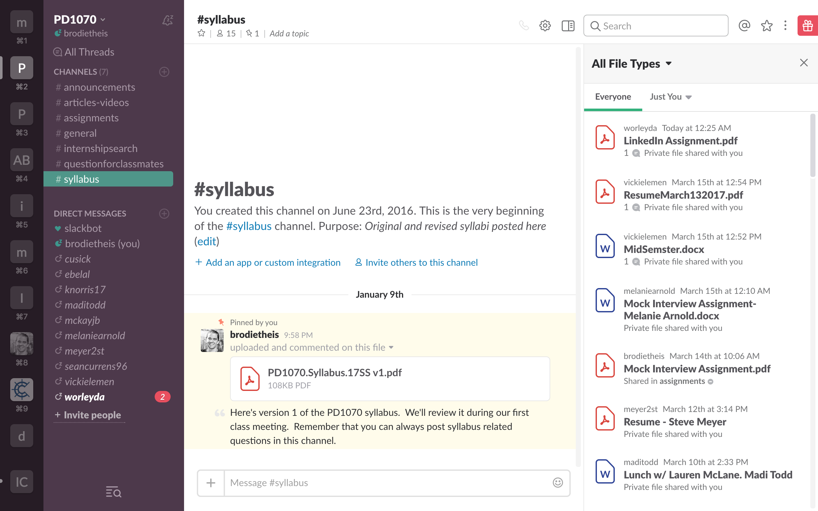
PD1070 Dashboard

Slide 11
Slacking: How We Can Prepare Students for the Cloud-Based Workplace
What I’ve Noticed
What I’ve Heard
Increased Interaction (student w/ instructor)
Regular Discussion & Conversations
Quick Information Dissemination
Learning Names & Faces
Ownership of Group Formation
“Ask A Classmate” Success
Little to No Email
Easy
Simple
Nice to See Others’ Comments
Quick Responses from Classmates
Finding Documents & Assignments
Enjoy the “Social Feeling” of Slack

Slide 12
Slacking: How We Can Prepare Students for the Cloud-Based Workplace
Lesson’s Learned
Limitations
Crucial to Communicate Clear Expectations
Set a Good Example
Thankful for Excellent Customer Support
Employers Appreciate the Effort
Simplicity of Everything in One Place
Not Designed as an Education Tool
Some Students Get Left Behind
Requires Forethought and Organization
Best When Parties Go “All-In”
Students Can Create Content
Notes:
Brodie
How will you use this with students?

Slide 13
Slacking: How We Can Prepare Students for the Cloud-Based Workplace
Application
Is there a workplace technology specific to your student population?
Does it make sense for your course?
Are you willing to forego existing course tools and communication methods?
How & when might you integrate a cloud-based tool into your course?
Questions?
brodie.theis@uc.edu

