Slide 1

Libby turpin & Tom mobely

Slide 2
Our story
Who had who first?
A Miami Connection
Social Media Bond

Slide 3
Details Behind Job Readiness Recruitment/Selection Service Learning Project
Service Learning Project Recruitment & Selection
I am excited that we will be partnering with a HS Class this semester where you will be able to put into practice topics that we are covering and have the opportunity to make a substantial impact on a high school student.
Points | Action Item | Due Date
10 | Initial Post – Organizations that employee teens and types of jobs | 1/20
 | Organization Selections | 1/24
 | UC students assigned to Organizations - Teams Announced | 1/26
 | Class time given for teams to work on SLP assignments due 2/21 | 2/21
20 | Organization Description | 2/21
20 | Job Descriptions (2) | 2/21
30 | Job Application (1) | 2/21
30 | Job Ads (2) | 2/21
 | In class discussion to determine grading rubric for job application, resume and interview (based on 100 total points) | 2/23
 | Interviewing and Job Application/Resume Prep Presentation – Job Application Process Explained to HS Students) | 2/22 (capstone) done by
 | HS Students Job Applications and Resumes due | 3/3
 | Resume and Application – Review and selection | 3/7
20 | Interview Guides | 3/21
 | Interviews at HS | 3/28 &30 (2 days)
70 | Application (25), Resume (25) and Interview Feedback (50) | 4/6
200 | UC Student Maximum Project Score
 | Peer Review (Final grade will be based on peer and self-feedback) | 4/6
 | (Excellent 100%, Good 90%, Acceptable 80%, Needs Improvement 70%, Poor 60%)
 | HS Students Grades Returned | 4/11

Slide 4
Job Description
Title: Lifeguard
Job Summary:
  Under general supervision, ensures the safety of patrons of an aquatic facility by preventing and responding to emergencies.
Duties and Responsibilities:
  Maintains constant surveillance of patrons in the facility; acts immediately and appropriately to secure safety of patrons in the event of emergency.
  Provides emergency care and treatment as required until the arrival of emergency medical services.
  Presents professional appearance and attitude at all times, and maintains a high standard of customer service.
Knowledge, Skills, and Abilities:
  Knowledge of lifesaving methods and procedures, including first aid and standard resuscitation measures.
  Knowledge of rules and regulations governing conduct of the public at pools.
  Skilled in the application of lifesaving techniques.
  Ability to perform rescue actions, administer first aid and CPR.
Minimum qualifications:
  Be at least 15 years of age
  Must be able to work holidays, evenings, and weekends, as directed
  Must possess current Lifeguard Certificate upon employment

Slide 5
Organization Description
Lebanon Swim Club Organization Description
Lebanon Swim club is a community driven organization dedicated to creating a fun and safe environment for families to enjoy summers at. Since 1952, the Lebanon Swim Club has offered first-class facilities and services consistent with our tradition of excellence as a family-oriented swim club. These include a clean and relaxing club pool as well as an elegantly decorated clubhouse, a convenient snack bar, and free Wi-Fi. The Lebanon Swim Club welcomes everyone. The large facility is a place where families of all shapes and sizes can come to exercise, socialize, compete, dine or simply relax. Our mission is to provide exceptional service while providing a safe and fun environment for all of our members.

Slide 6

Job Ad

Slide 7
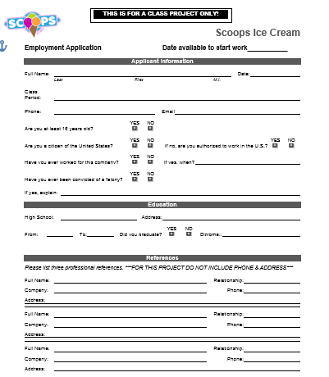
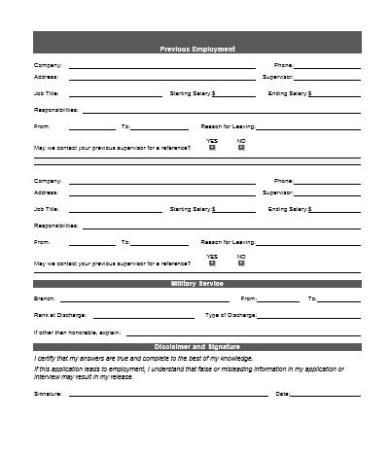
Application

Slide 8
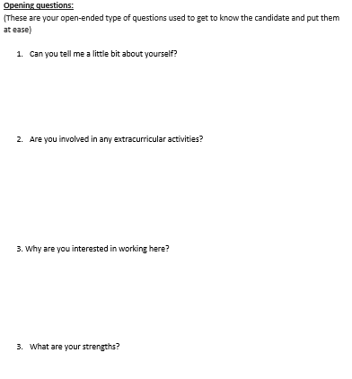
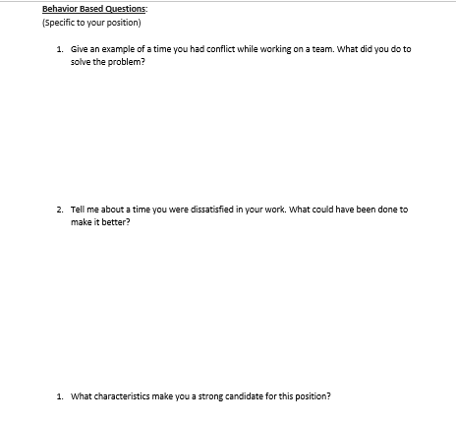
Interview Guide

Slide 9
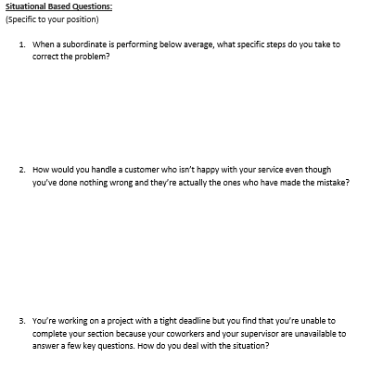
Interview Guide

Slide 10
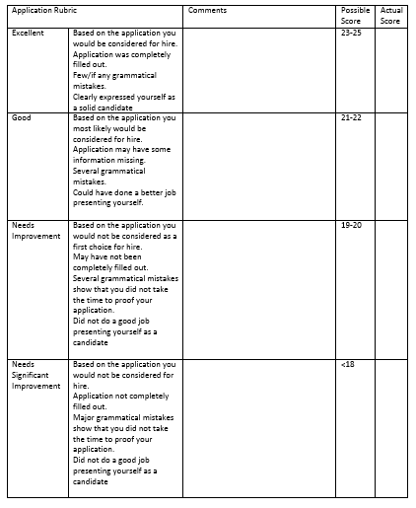
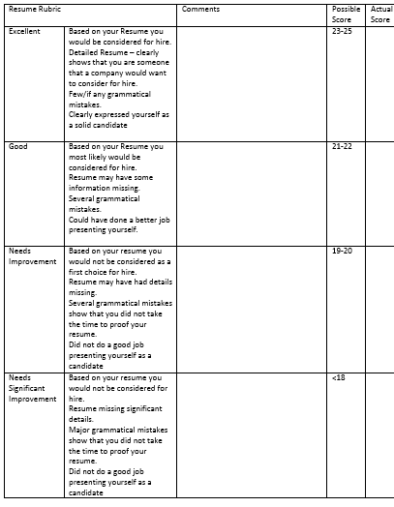
Grading Rubric

Slide 11
Ways to establish K-12 University Partnerships
Social Media
LI
Facebook
College Students
Spin off Networks
Open Opportunities
HS Teachers College Contacts

Slide 12
WIIFM (What’s in it for me?)
Demonstrates Excellence in Teaching
Opportunity to get students excited about material
Desire to see our students succeed
Potential for new students
HS Teacher gets a gradable assignment

Slide 13
Oh-By-The-Way
On site college visit
Capstone Project for UC Students
Survey Students

Slide 14
Based on our Model, How Could You Do This?

