Slide 1
Making Online Contents Accessible to Learners
Prince Ellis, DBA
March 28, 2017
Notes:
eLearning may include text, video, and audio and must be accessible to all users.

Slide 2
Why Am I Here?
2015-2016 Incentive Grant
  Prince Ellis, Page Beetem, & Girija Nair-Hart
Organized Accessibility Conference @ UCC
  Speaker Series (Part 1): Create Awareness on Accessibility
  Workshop (Part 2): Creating Accessible contents
  Created Bb Course for DIAs ‘Creating an Inclusive University’
Presentation of Work
Sharing Best Practices
Notes:
2015-2016 Incentive Grant Recipients: Girija Nair-Hart, Prince Ellis or Page Beetem
Conference focused on making eLearning inclusive to those with disabilities, will be on Wednesday, October 7, 2015 at University of Cincinnati Clermont College.
Certificate: “Disability Inclusiveness Ambassadors (DIA)” by Quality Matters (QM)

Slide 3
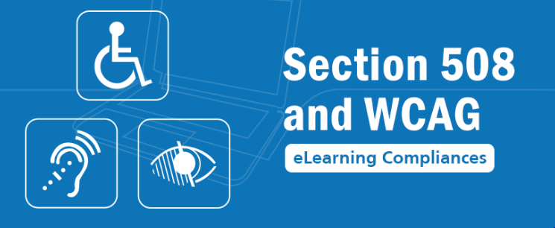
Why focus on eLearning accessibility?
Notes:
One Word to Describe eLearning Accessibility
Disability is a subject you may read about online, or in a newspaper, but not think of as something that might actually happen to you. But your chances of becoming disabled are greater than you realize. Today more people live with a disability than ever before due to our aging societies as well as improved medical treatments helping manage long-term health problems. Some people are born with a disability, others become disabled as a result of an illness or injury, and some people develop them as they age. At some point in our lives almost all of us will have some type of disability. Rates of disability are increasing due to population aging and increases in chronic health conditions. We should avoid stereotyping them as "disabled person".
Accessible eLearning provides equivalent access or equivalent alternative access to any user needing accommodations because of a disability.
Under the Americans with Disabilities Act, public and private universities are prohibited from discriminating against individuals with disabilities. State and federal law require all electronic media to be made accessible to everyone.

Slide 4
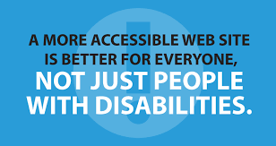

Slide 5
ACCESSIBILITY STATISTICS
54% of adults living with a disability
  (PEW Internet Project, 2011)
60-80% of students with disability DO NOT report
20% of people have a disability in the U.S.
  (Census Bureau Reports, 2012)
Notes:
Benefits of eLearning Accessibility
Ensure full compliance with US Law
Improve learning outcomes all students (with and without disabilities)
And this doesn’t only help students with disabilities. In a San Francisco State University study, students who received captioned videos were more engaged and responsive to retrospective questions about the video, and even more impressive, they averaged a 1 GPA point increase.

Slide 6
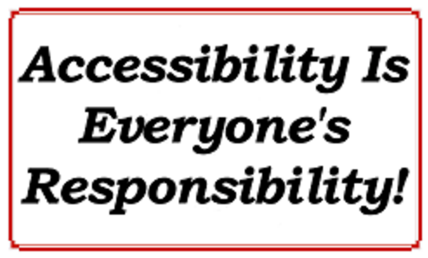

Slide 7
Creating Accessible eLearning Videos
Tools
  Cielo²⁴
  Amara
  YouTube
Notes:
Irrespective on method of eLearning videos (narrated presentation, screen-casting, animations, light bulb, etc…), there are different tools for creating them. No matter what method you choose for making your video, it is easy to add captions and a transcript in order to make your video accessible to students and ensures full compliance with U.S. law.
Closed captioning using Cielo24, Amara and YouTube
While video can be a perfect punch to make your content stick, it is crucial to make sure all your students have equal access to your amazing videos by making them accessible.

Slide 8
Captioning for Audio and Video
Cielo²⁴
Notes:
Help improve content accessibility and maximize ROI through searchable captions
The need for open or closed captions
There are two choices for captioning – closed or open captions. With closed captioning, you may turn caption off or on as the captions themselves are not integrated into the course. It’s best to use closed captioning for e-learning material that isn’t exclusively for the hearing impaired.
However, open captions cannot be turned off and are always visible. Because of this, open captioning is the best option for online education courses specifically for the deaf community, or for online courses that have audio errors or language barriers.
No matter what type of captioning you use, both kinds are beneficial to a wide range of learning methods. Some people learn better with text than with speech, and others may learn best with both speech and text, a combination captioning provides.
Besides meeting compliance standards, there are several additional benefits to providing captions for your course.
It helps students better retain course knowledge so they can apply it to different real life situations.
Captions allow your course to reach more people by improving your search engine page rankings or Search Engine Optimization.
Most of all, people are able to access your captioned e-learning courses from any device. If the video or audio course has captioning, they use it even in a noisy environment.
The Right Transcript
When getting captions done, think about having transcriptions done at the same time. Having a transcript with time stamps ensures completeness and accuracy. It also allows students to search for specific information within the course and ensures that the captions run at the same time as the course narration, displays, and video.

Slide 9
Caption and Translate Videos
Amara

Slide 10
Add Captions or Interactive Transcript to Video
YouTube
Notes:
You can add captions or interactive transcript to YouTube videos
This makes your YouTube videos accessible, searchable, and interactive.
You must upload video to YouTube and be the video owner to add captions
Automatic is not recommended. (always review and edit before publishing)

Slide 11
Best Practices: Creating Accessible eLearning Videos
Short & Sweet
Interactive
High Quality
Compressed
Good Visualization
Notes:
Follow Best Practices for Creating Accessible eLearning Videos
Once you decide which type of video you will make and ensure its accessibility, make sure to keep in mind these best practices:
Short & Sweet:
Short videos around two to three minutes are the most engaging. Consider splitting your content into small digestible chunks to keep your videos snappy. For longer videos, note that engagement drops sharply after 6 minutes.
Interactive:
Keep your audience engaged with interactive elements such as quizzes or opportunities for students to give feedback.
High Quality:
Make sure the visuals and audio are high quality to ensure professionalism and to capture your students’ focus.
Compressed:
Videos should be compressed, so that users can easily download them, even through a slow Internet connection.

Slide 12
Creating Accessible eLearning Documents
MS Accessibility Checker
Portable Document Format (PDF) Accessibility Checker

Slide 13
Accessibility Checker
  Microsoft Office Documents
Notes:
Word has many features built-in that help people with different abilities to read and author documents. Word also offers the Accessibility Checker that locates elements that might cause problems for people with disabilities.
Use Accessibility Checker rules to help ensure your Office documents, spreadsheets, and presentations are accessible.
How To:
File ->Info -> Check for Issues ->and the select the “Check Accessibility” option

Slide 14
Accessibility Checker
  Portable Document Format (PDF)
Notes:
ADA law apply to files made available in the portable document format (PDF). PDF is often used as a way to preserve a document’s look and feel across a wide variety of platforms, as well as to add protection against alterations.
PDF Accessibility
For PDFs to be 508 compliant, they need to be tagged. Tagged PDFs allow various assistive technologies (AT) to interact with the content of a document and make sense of it. There is no automated solution for creating accessible PDFs.
The most effective way to begin the process of making a PDF accessible is to create a document directly from an authoring application that produces tagged PDFs, such as Microsoft Word, and then convert it to PDF format.
Software Needed
Adobe Acrobat
NetCentric Technologies CommonLook
Nuance PDF Converter
In order to focus on a consistent approach to making PDFs accessible, these tutorials assume that you are using Adobe Acrobat. It produces reliable, accessible results
Regardless of which software you use, you will need to be sure that your document is structured and tagged correctly.
Acrobat DC tools make it easy to create accessible PDFs and check the accessibility of existing PDFs.
Make PDFs accessible: A predefined action automates many tasks, checks accessibility, and provides instructions for items that require manual fixes. Quickly find and fix problem areas.
Check accessibility: The Full Check tool verifies whether the document conforms to accessibility standards, such as PDF/UA and WCAG 2.0.
Report accessibility status: The Accessibility Report summarizes the findings of the accessibility check. It contains links to tools and documentation that assist in fixing problems.

Slide 15
Best Practices: Creating Accessible eLearning Documents
Caption all videos
Structure documents properly
Use Tags (especially for PDFs)
Use contrasting colors
Include ALT text to describe images.
Notes:
https://support.office.com/en-us/article/Make-your-Word-documents-accessible-d9bf3683-87ac-47ea-b91a-78dcacb3c66d
Structure documents properly.
Allow users to download and print all digital content, such as recorded lectures, documents and presentations.
Use a well-sized, legible font.
Use Headings such as H1 in HTML or Heading 1 in Word® to denote titles and sections for screen readers.
Use bulleted lists to denote key terms, organize ideas and sequence.
Tag PDFs.
Using Adobe® Acrobat®, you can “tag” a PDF file to improve the document’s accessibility. This will create a structure tree with information for users with assistive technology software. Tags provide them with ability to consume information in the correct order and reflow content for large type display. Tags do not disrupt the documents’ visual appearance, and they allow PDFs to display well on small devices.
Choose contrasting colors.
Selecting colors with accessibility in mind will affect users with vision deficiencies, including color blindness, and as a result improve the experience for all users. Foreground and background color combinations should be tested to ensure high readability.
Include ALT text to describe images.
ALT, or Alternative, text is the first principle of web accessibility. This provides a text description to substitute for images and other forms of content on webpages. ü✓ ALT text is read by screen readers to aid disabled users. ü✓ It also loads in the place of an image when one does not load properly. ü✓ ALT text is used in search engines’ evaluation of webpages, and can help index your content. ü✓ The LONGDESC attribute can be used in addition to ALT text to provide a description beyond 250 characters.

Slide 16
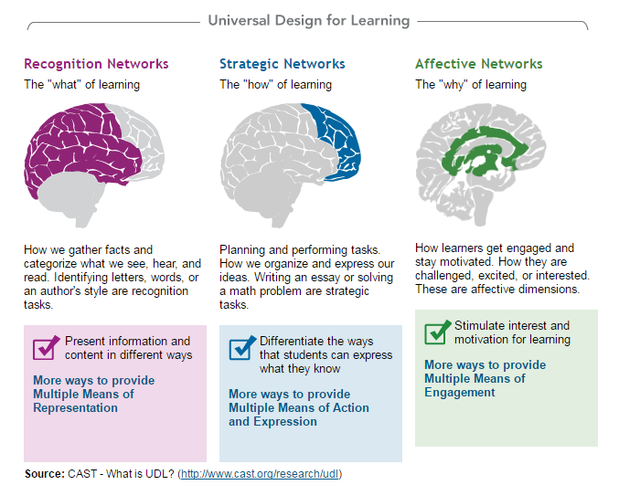
UDL: Long-term Goal
Notes:
Universal Design for Learning (UDL)
Why is UDL necessary?
Individuals bring a huge variety of skills, needs, and interests to learning. Neuroscience reveals that these differences are as varied and unique as our DNA or fingerprints. Three primary brain networks come into play:
CAST = Center for Applied Special Technology

Slide 17
Our Role as …
e Accessibility Agents

Slide 18
Thank You
Q/A
My Contact Information
  Prince Ellis, DBA
  Assistant Professor
  ellispc@uc.edu
  513-658-1699 cell

Slide 19
References
CAST - http://cast.org/
Web accessibility – WCAG (W3C) http://www.w3.org/TR/WCAG20/
WebAIM (Utah State University) http://webaim.org/

