Slide 1
COMM-IT
Committed to Collaboration

Slide 2
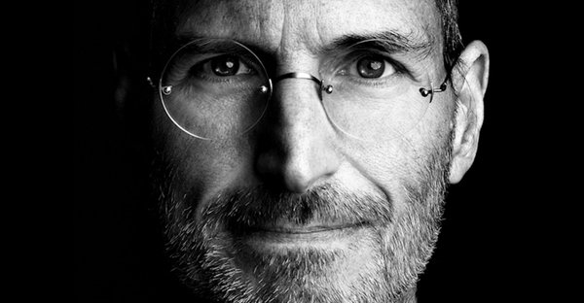
Why IT & COMM?
“You can have the greatest idea in the world, but if you can’t communicate your ideas, it doesn’t matter.” –Steve Jobs
Notes:
What else is there?

Slide 3
COMM+IT = Jobs
#3 Top Job – Computer Systems Analyst
IT Top 5 Fastest Growing Jobs
Communication Platforms – IT Required
-US News & World Report 2016

Slide 4
8 of Top 12 Skills
2. Ability to Work in a Team
3. Communication Skills (written)
5. Communication Skills (verbal)
11. Interpersonal Skills
4. Problem Solving Skills
8. Analytical/Quantitative Skills
10. Technical Skills
12. Computer Skills
-Job Outlook 2016, National Association of Colleges and Employers (NACE)

Slide 5

Before COMM-IT
1 COMM Class Required for BSIT
IT Co-op Employers #1 Negative – Poor Communication Skills
COMM Students – Which IT Class?

Slide 6
What To Do?
Develop Partnership
Get Support from Unit Heads and Deans
Create Committee
Develop Mutual Goals
Sign MOU

Slide 7
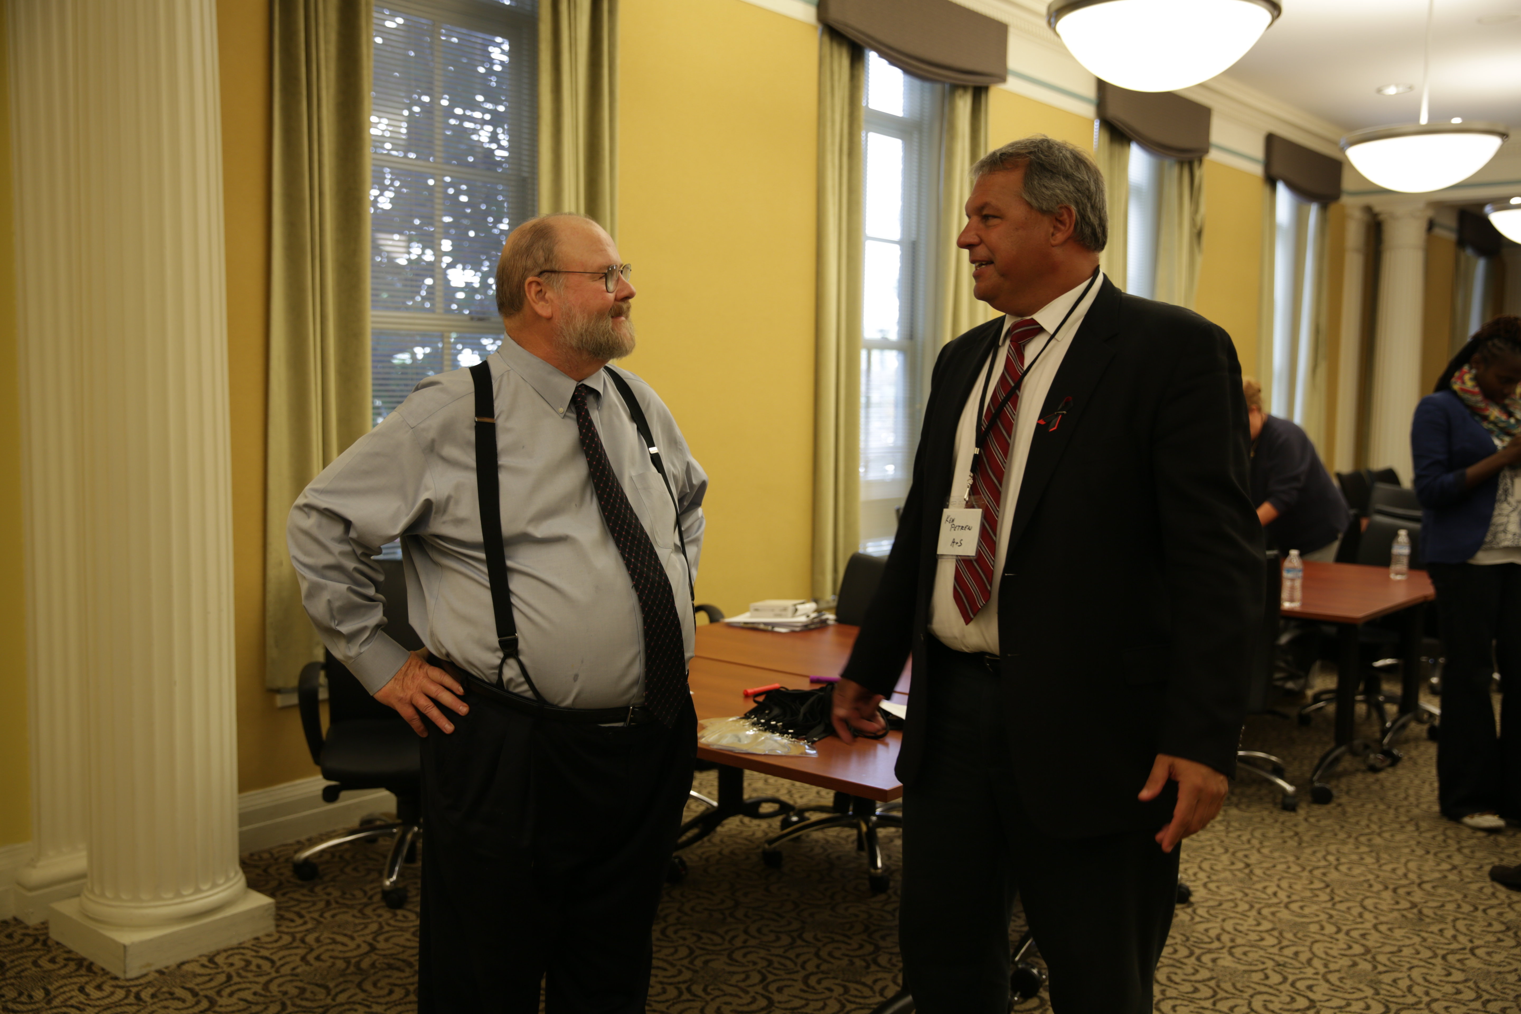
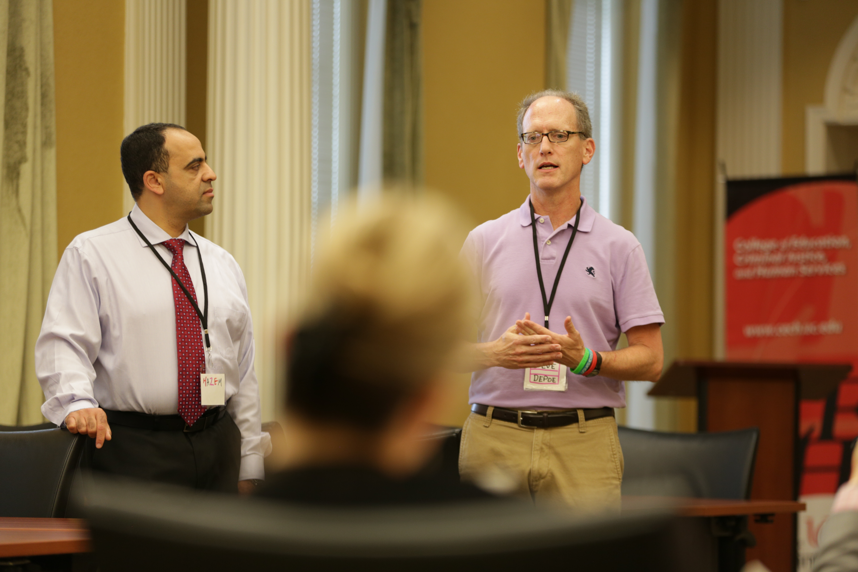
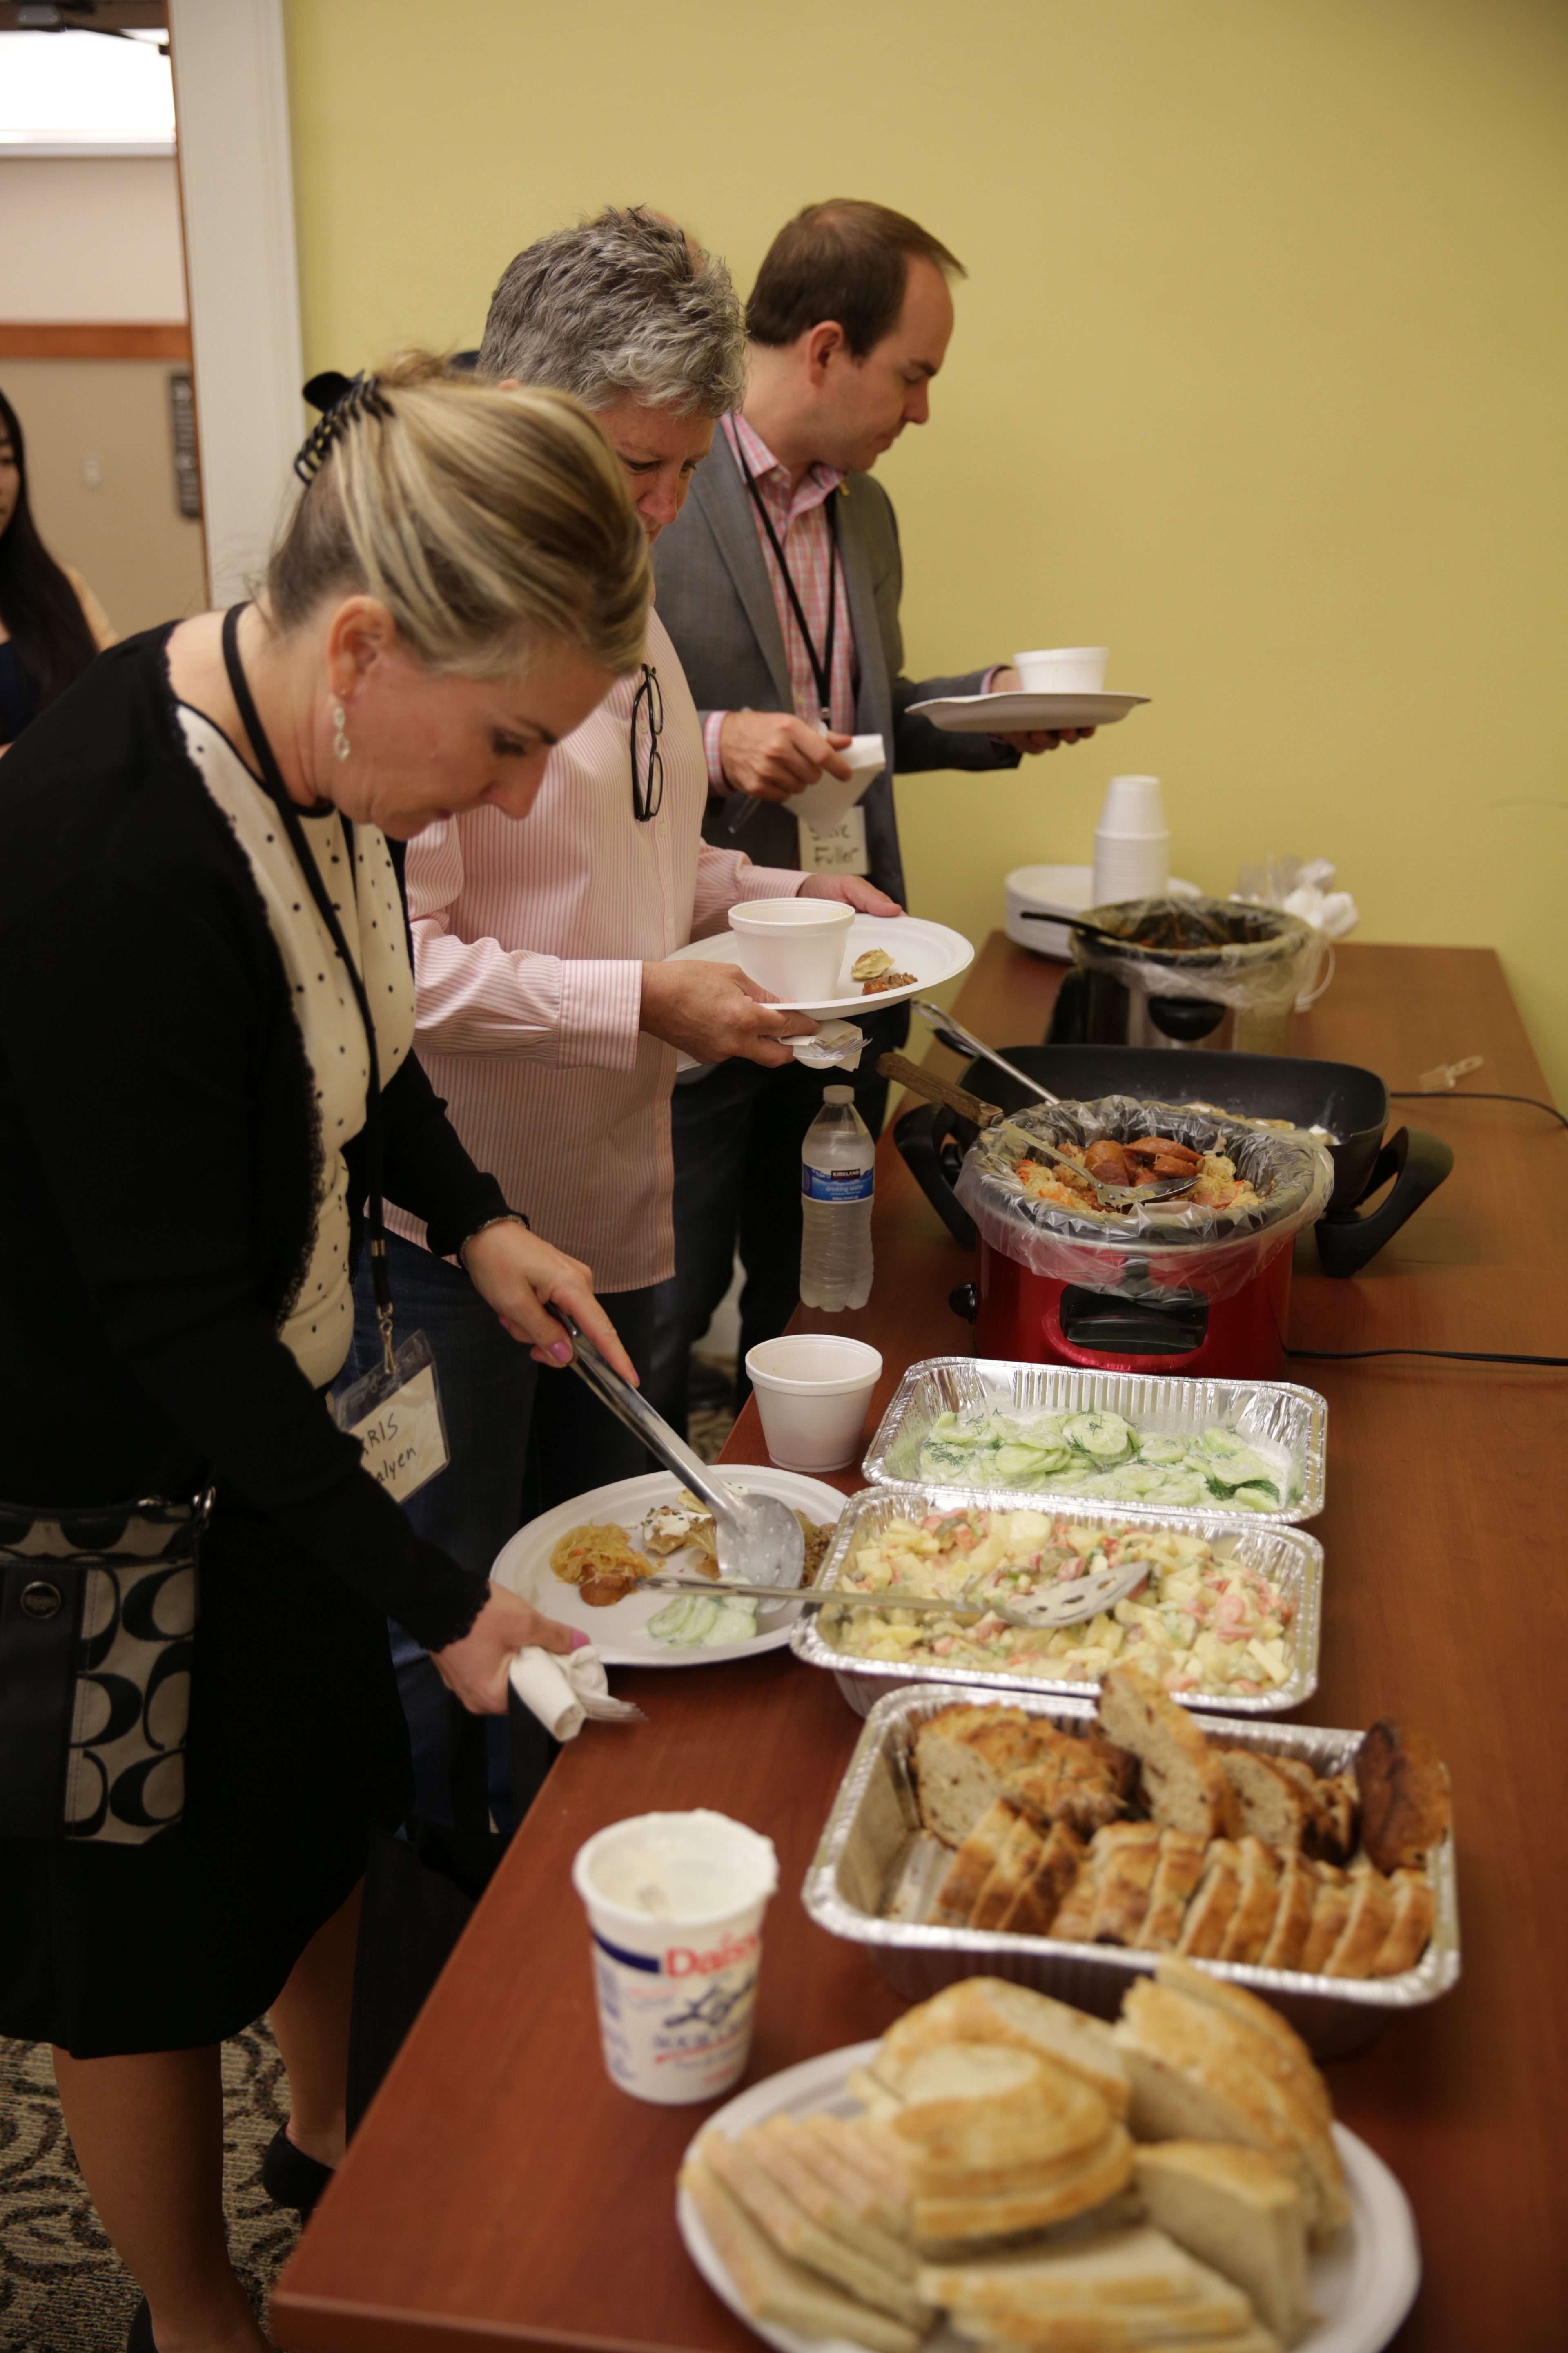
Communicate and Celebrate!
The partnership will advance ongoing collaboration and joint initiatives across the interrelated disciplines of communication and information technology.
Notes:
Deans Petren and Johnson, Unit Heads Hazem Said and Steve Depoe. Dean Johnson cooked and Dean Petren brought dessert.

Slide 8
Lessons Learned
In Person Meetings are Important
Each College and Unit Operates Differently
Know all Stakeholders

Slide 9
COMM-IT
Initiatives and Activities

Slide 10



Activities
Grants
Workshops
Research
Presentations

Slide 11
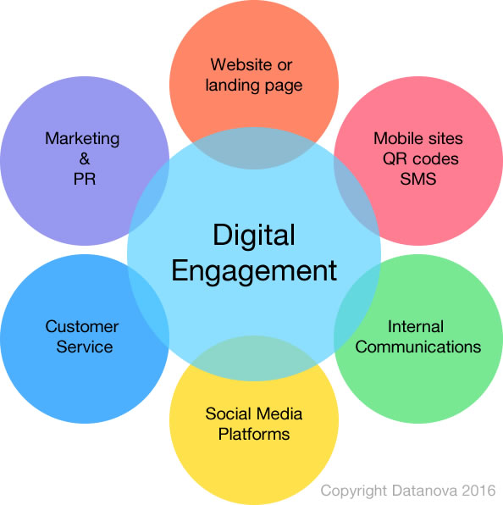
Initiatives
Curriculum
  Cross promotion of certificates and minors
  Applied Communication Certificate
    Add IT 1050
  New Digital Engagement Certificate

Slide 12
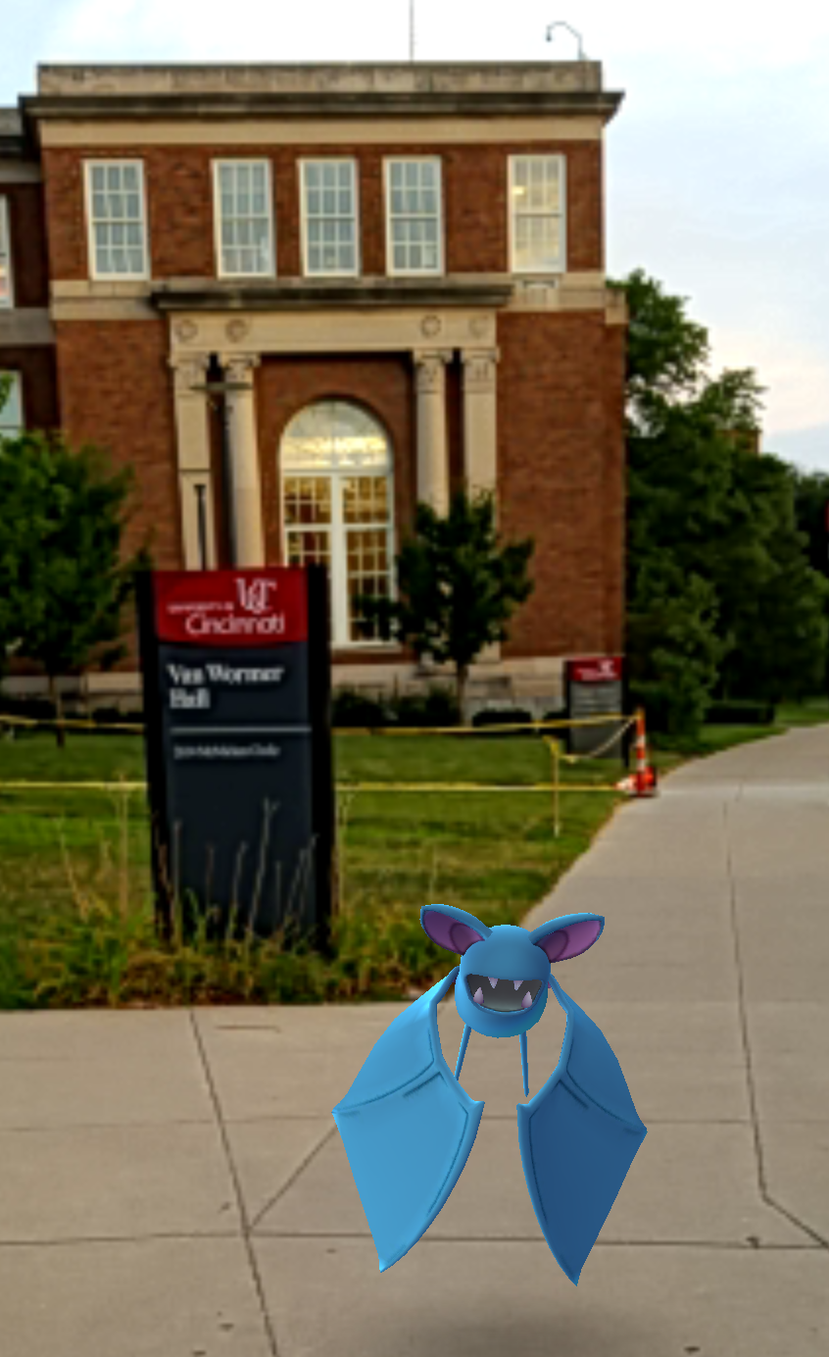
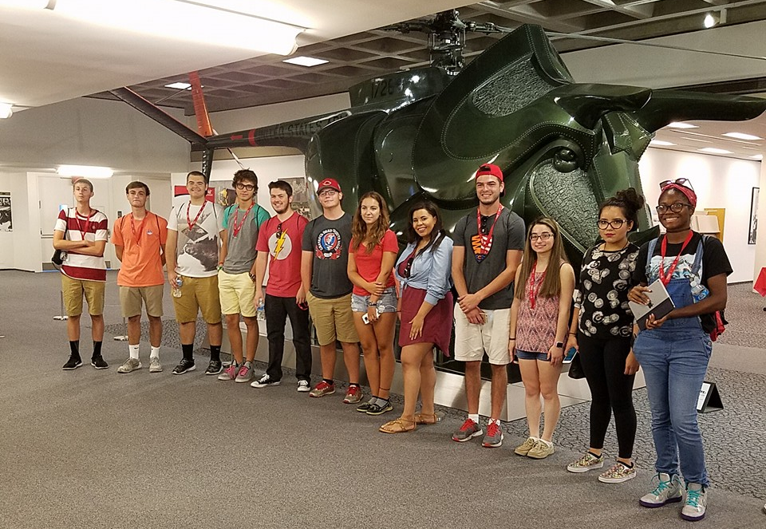
Activities
Learning communities
  Add IT1050 to COMM LCs
Joint Summer Recruitment activity
  Pokemon Go!
DITLE Camp
  COMM Guest Speaker
Notes:
UC Media, We See Experience Recruitment Day (August 12, 2016): 12 HS Jrs. attended a day-long immersion in the exciting fields of Communication/Public Relations, Information Technology, and Journalism. A select group of high school students and educators from around the region participated in interactive sessions with UC students and faculty. Attendees started the day with a Pokémon GO scavenger tour of UC's campus and cutting edge lab facilities. They then participated in small group sessions with top faculty in Communication/PR, Information Technology, and Journalism.
The DITLE Summer program is a 3 week intensive summer IT day camp designed to give students a solid foundation in computer fundamentals, computer application development, database and networking concepts. The program is a hands on, project based, team oriented learning experience at the University of Cincinnati campus using UC state of the art equipment and instructors.

Slide 13
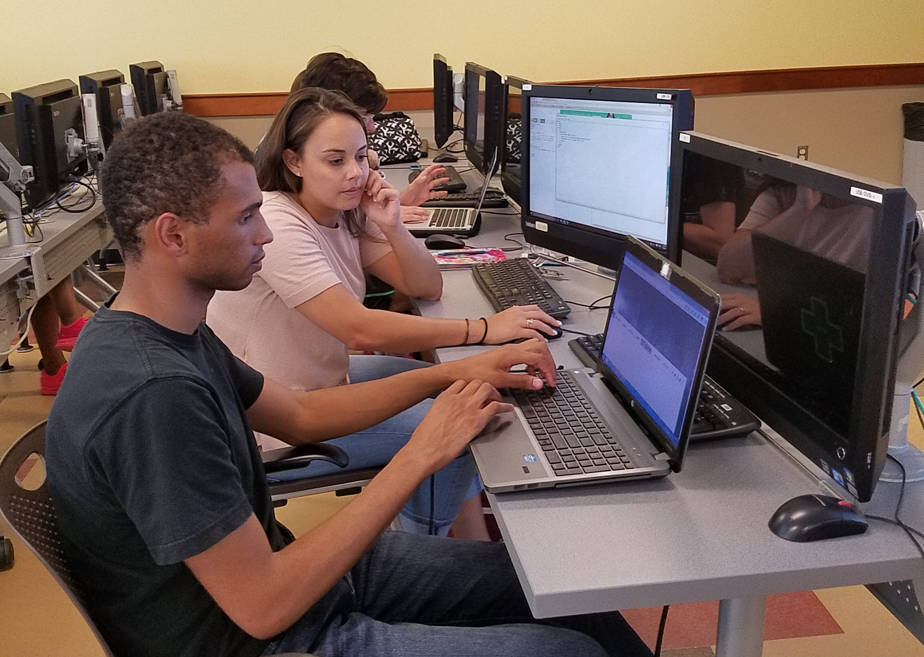
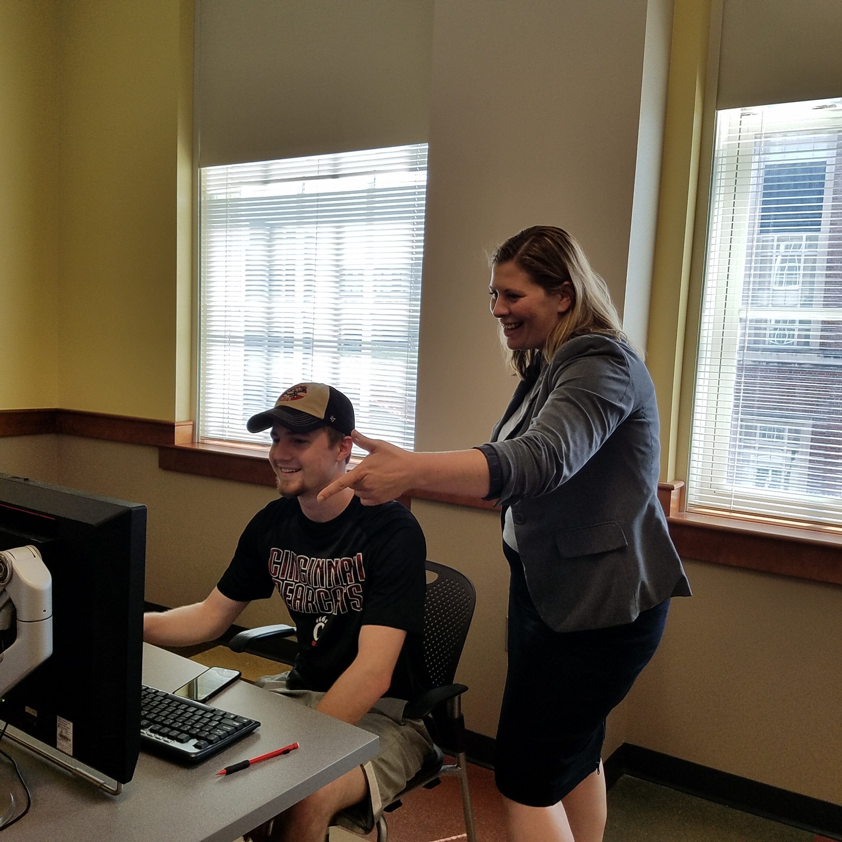
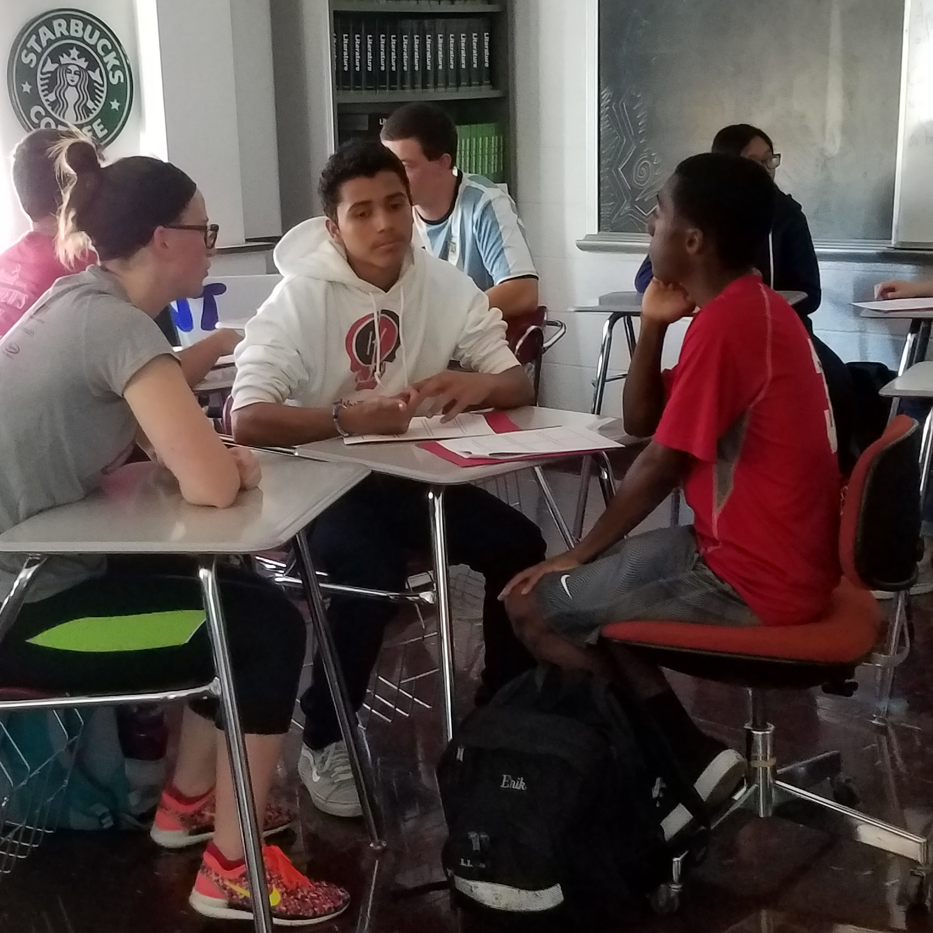
UCForward Course
Collaborators
  COMM
  JOUR
  IT
Community Partners
  CET-TV
  Deer Park High School
  Riverview East Academy

Slide 14


Conferences
IT-EXPO
WordCamp

Slide 15
Lessons Learned
Process of Certificate Approval
  Across Units
  Across Colleges
Importance of Mutual Respect
Branding and Promotion

Slide 16
COMM-IT
Future plans

Slide 17
Agenda for the Future
Research
Teaching
Service
Other plans

Slide 18
Research
Colloquiums
Grant proposals
Publications

Slide 19
Teaching
Joint certificates
Teaching workshops
Interdisciplinary courses

Slide 20
Service
Professional developments

Slide 21
Other Related Plans
Networking between students
Networking between faculty
Website & Blackboard site
Shared cloud folder
Student focus group & survey

Slide 22
Expected Challenges
Serving interests for both departments
Promoting the partnership to wider population
Assessing expertise within departments
Recruiting experts
Monitoring and evaluating the partnership

