Slide 1
This slideshow is available online:
Plotagon: Welcome To Your Digital Self
http://bit.ly/2mUXC0l
Case sensitive!

Slide 2
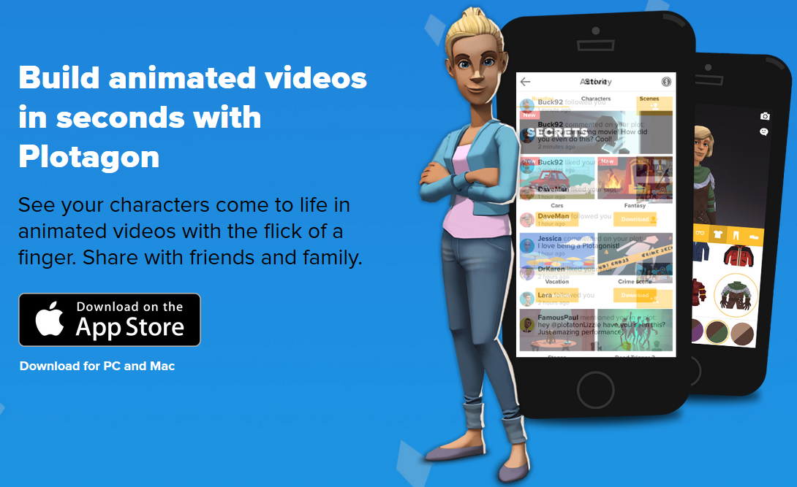
Plotagon: Welcome To Your Digital Self
3T Conference, Spring 2017
Bill Nicholson
nicholdw@ucmail.uc.edu
[1]

Slide 3

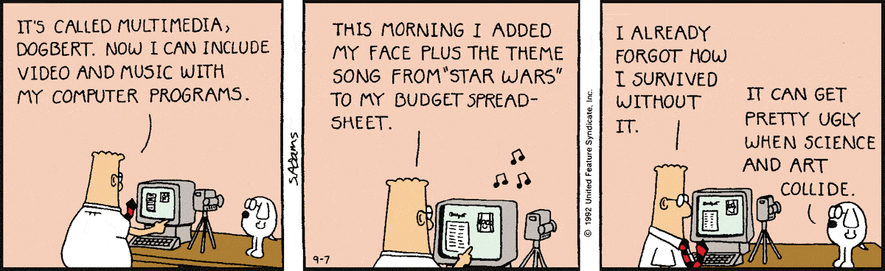
Introduction to Plotagon
https://www.youtube.com/watch?v=J_8tm25YRHw

Slide 4
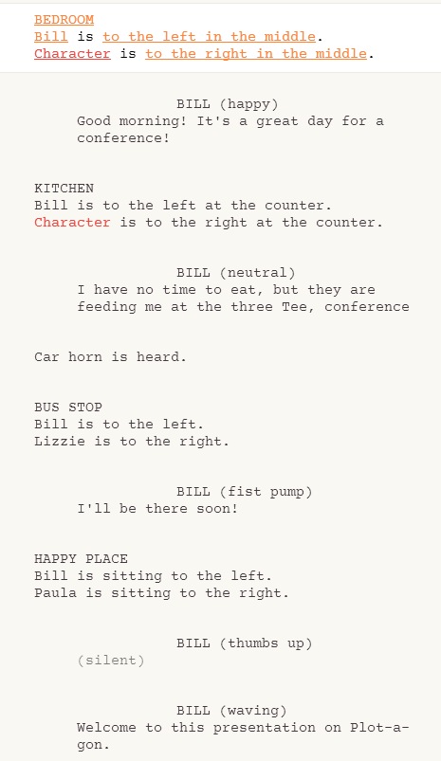
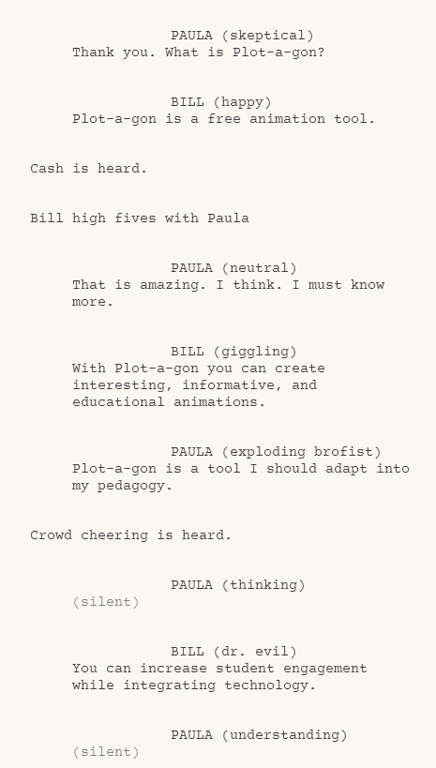
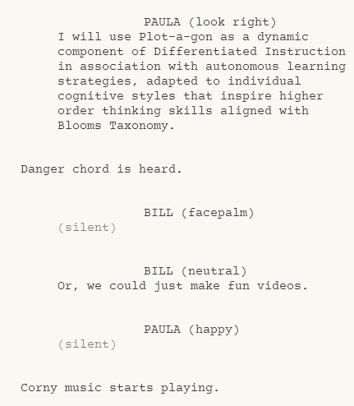
Transcript

Slide 5
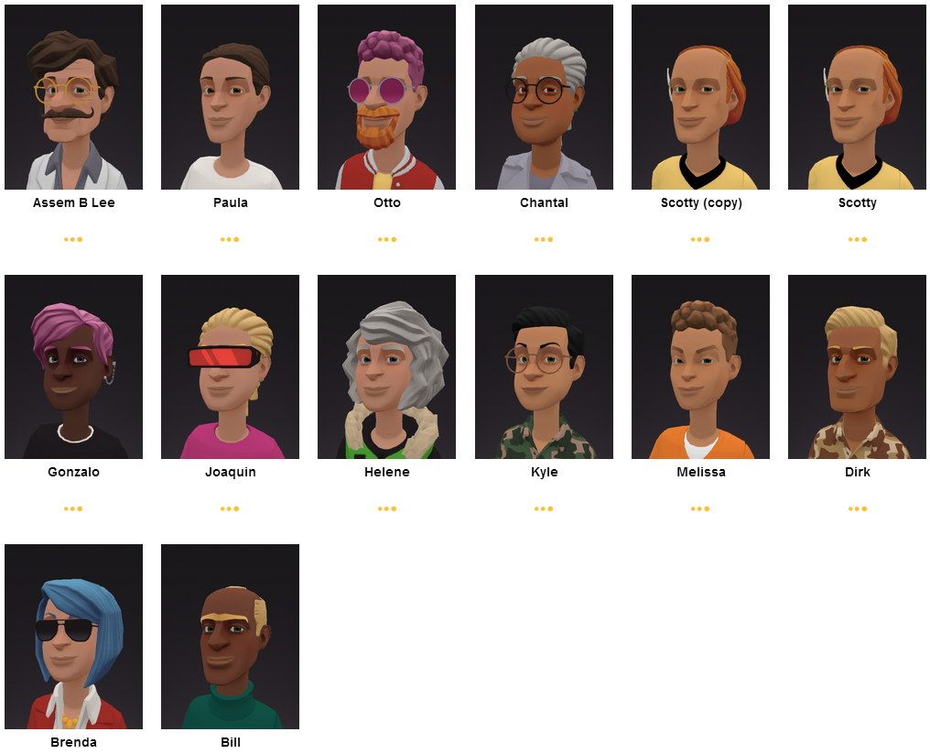
Create your own characters

Slide 6
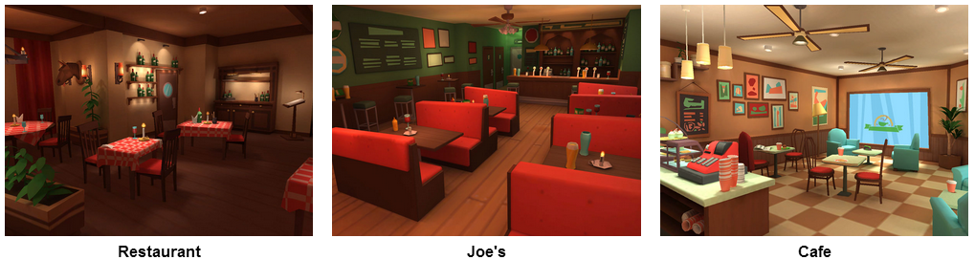
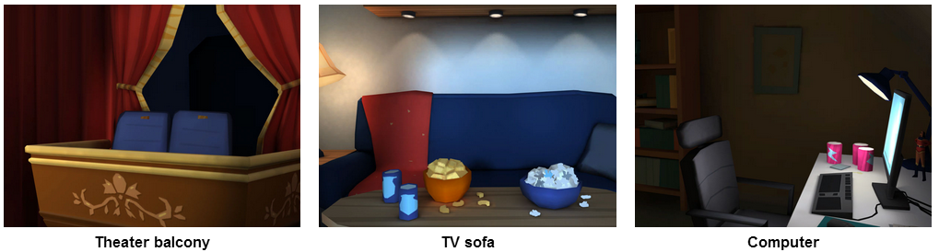
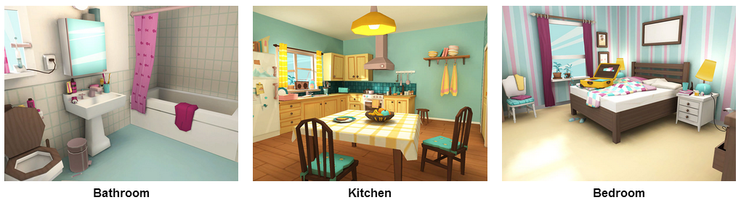
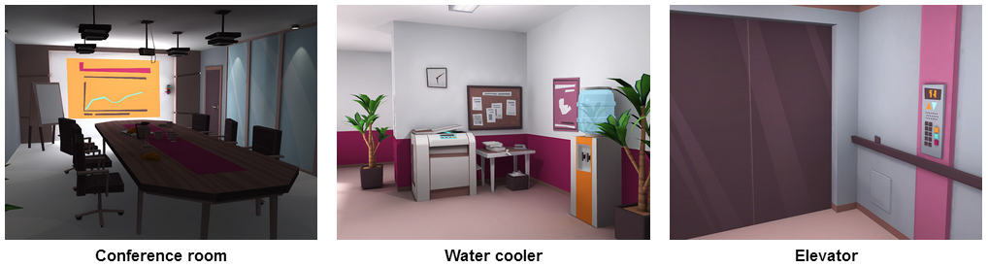
Pick Scenes

Slide 7



Samples
https://www.youtube.com/watch?v=lLEoHClwmqQ
https://www.youtube.com/watch?v=EvzNo6CD4qU
https://www.youtube.com/watch?v=pgoEpcMxFZU
[2]

Slide 8

Let’s do it

Slide 9
Future Work
Sign up for a 14-day ‘Teachers’ trial
Create a YouTube account to publish your videos
Integrate your videos with EdPuzzle to create online quizzes

Slide 10
References
[1] Plotagon.com
[2] Dilbert.com

