Slide 1
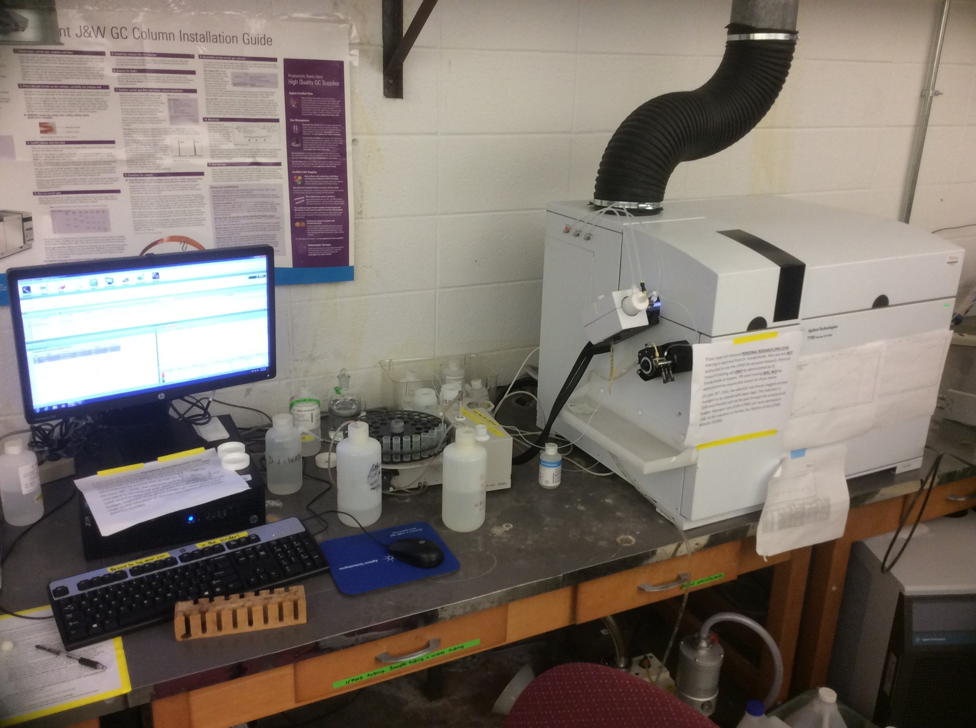
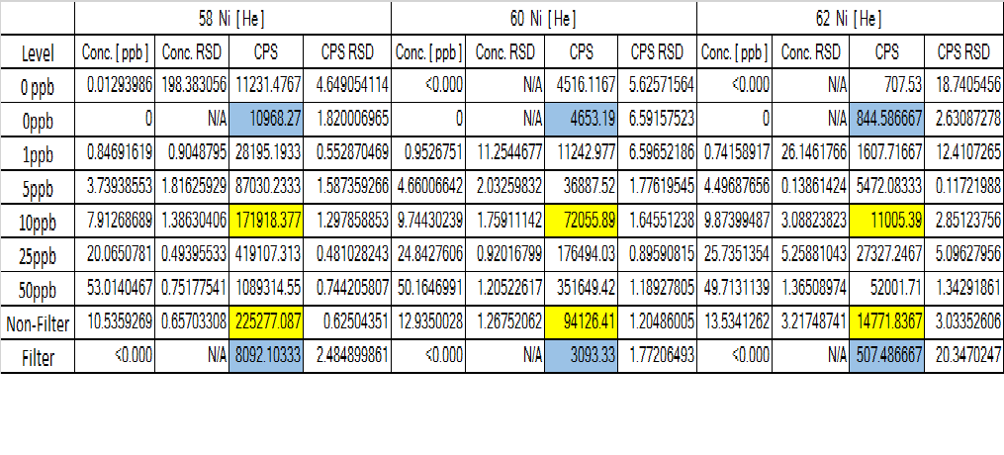
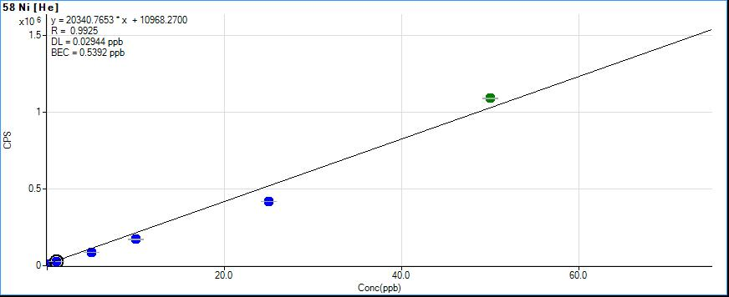
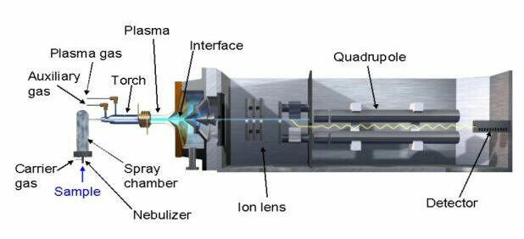
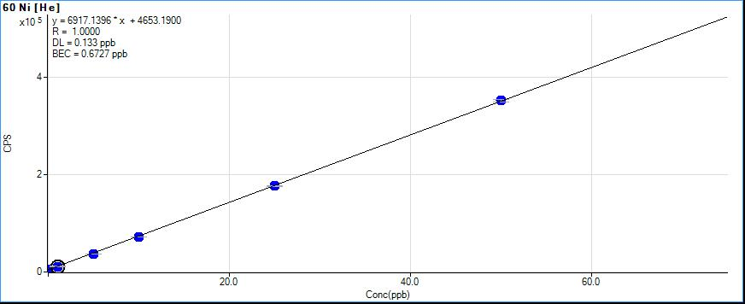
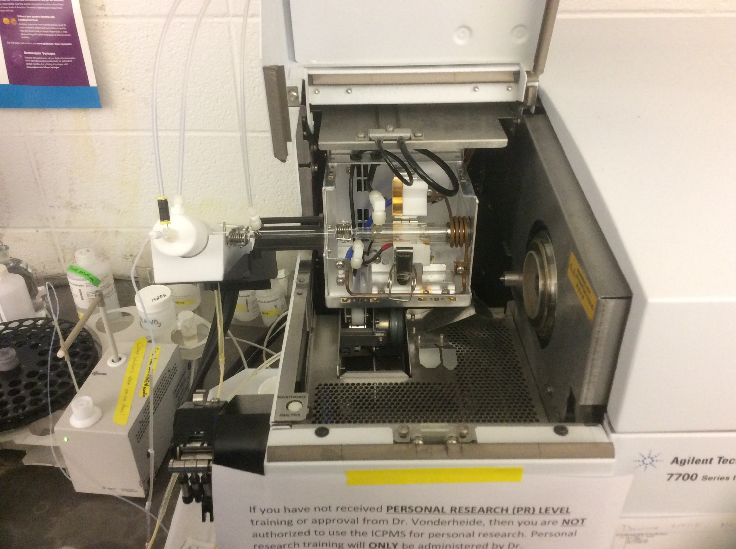
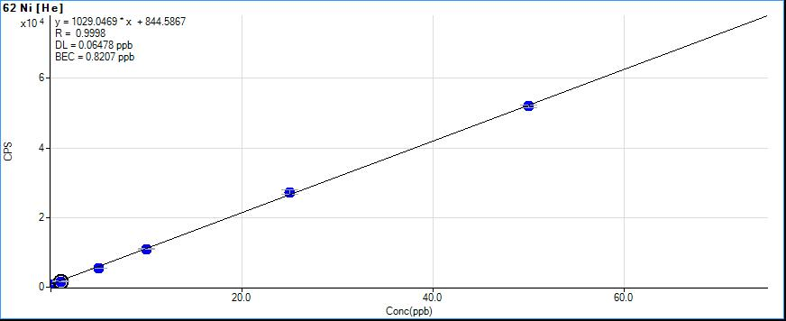
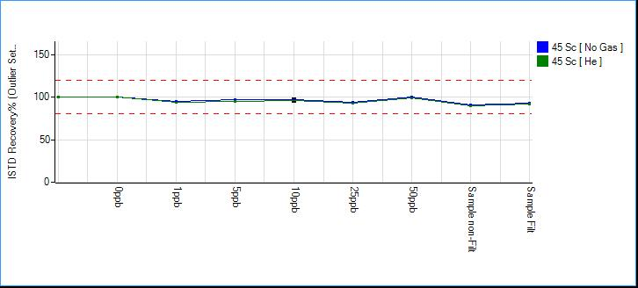
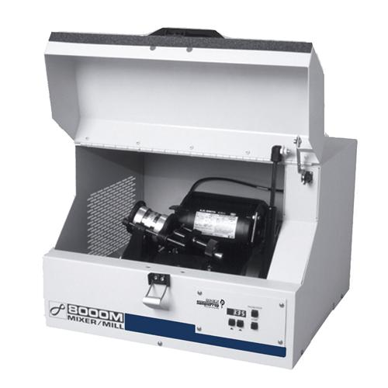

Analyzing Metal Residues In High Speed Ball Mill Synthesis Using ICP-MS
Eric Burgstrom, Rebecca Haley, Keaton Nahan, Dr. James Mack and Dr. Anne Vonderheide
BACKGROUND: Ball milling has been used in industry for the purpose of grinding minerals, ores, and ceramics. More recently ball milling has been utilized
in green chemistry synthesis. One specific compound that has been created is cyclooctatetraene using a nickel pellets as a catalyst.
A consequence of using nickel pellets as a catalyst is nickel residue will remain in the final product and needs to be filtered out. ICP-MS was
used to detect nickel residues as low as part per billion (ppb) concentrations to determine how effective the filtration process was in removing nickel.
ICP-MS PARAMETERS
RF Power – 1550 watts
RF Matching – 1.80 volts
Sample Depth – 8.5 mm
Nebulizer pump – 0.10 rps
S/C temperature – 2ºC
Nickel sampler cone
Nickel skimmer cone
Carrier gas - He
Materials & Procedure
Solid samples were dissolved initially in Pure HNO₃
Sample matrix was 2% HNO₃
All glassware, vials, and pipets
were acid washed in 10% HNO₃
Internal standard used was initially
Ga, then switched to Sc.
All containers used were rinsed with
DI water to minimalize Fe contamination
All elements analyzed were Ni, Cr, Fe.
ICP-MS Maintenance
The Sample cell and collision cell were cleaned
when it was noticed there was a decrease in
resolution.
Mass Spectrometer Oil replaced
General maintenance was conducted throughout.
  Replace waste tubing
  Refill argon gas
Results
Cr₅₀, Cr₅₂, and Cr₅₃ concentrations were all below the calibration limits (<0.00ppb)
For Fe₅₄, Fe₅₆, Fe₅₇ the concentrations can only be approximated 0-5ppb,
this is because too much Fe contamination varied each ICP-MS run greatly.
Non-filtered Ni₅₈ (10.5 ±1.2ppb) Ni₆₀ (12.9 ±0.46ppb) Ni₆₂ (13.3 ±0.30ppb)
Filtered Ni₅₈ (<0.00 ±0.05ppb) Ni₆₀ (<0.00 ±0.05ppb) Ni₆₂ (<0.00 ±0.05ppb)
Cyclooctatetraene synthesis
SPEX 8000M Mixer Mill
Stainless Steel Vial
1/8 inch nickel pellets
FORTHCOMING ANALYSIS
Future analysis of other ball milled compounds may require use of a clean room and involve
soaking the glassware in 10% HNO₃ followed by soaking the glassware in DI water. This will
pull out any Fe molecules that remain on the glassware and could contaminate the sample being analyzed.
Using plastic containers instead of glass containers may help decrease the amount of
Fe contamination we detect in the sample as well.

