Slide 1


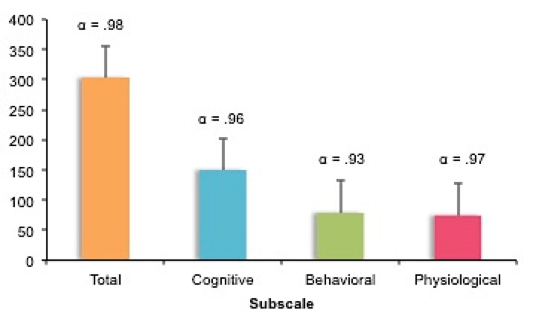
Initial Development and Validation of the School Anxiety Inventory (SAI-SV) for Use Among College Students
Emily A. Beckmann, Robert C. Gibler, BA, Kristen E. Jastrowski Mano, PhD
Department of Psychology, University of Cincinnati
INTRODUCTION
RESULTS
DISCUSSION
School anxiety is a multifaceted response to school related situations that elicits cognitive, behavioral, and physiological symptoms (García-Fernandez, Inglés, Marzo, & Martínez-Monteagudo, 2014).
The only existing measure of school anxiety was normed for use with children and adolescents attending school in Spain (García-Fernandez, Inglés, Marzo, & Marinez-Monteagudo, 2014).
Despite a large body of research suggesting that anxiety is a prevalent and disabling mental health concern among college students (Bland, Melton, Welle, & Bigham, 2012; Dixon & Kurpius, 2008; Holland, 2016), few studies have investigated school anxiety in this population.
We divided potentially anxiety-provoking school situations into cognitive, behavioral, and physiological manifestations of anxiety based on what was established by Garcia-Fernandez and colleagues (2014).
Convergent and discriminant validity correlations between the Depression, Anxiety, Stress Scale (DASS) (Lovibond, & Lovibond, 1995) anxiety, stress, and depression subscale scores and the modified SAI-SV total, cognitive, behavioral, and psychophysiological subscale scores were consistent with hypotheses (see Table 1).
Internal consistency (Cronbach’s alpha) of SAI subscale scores (cognitive, behavioral, and psychophysiological) was excellent, with values ranging from
.93 to .97 (Figure 2).
Principal Components Analysis (PCA) using the correlation matrix and direct oblimin rotation indicated that a 3-factor solution was appropriate, and explained approximately 37% of the total variance. However, a closer examination of item loadings suggested that a 2-factor model may be more fitting.
Results are consistent with research suggesting that cognitive and social concerns may elicit school-related distress (Abouserie, 1994).
Findings suggest that a two-factor model may best describe relations among measure items; however, a larger sample size is needed to determine the factor structure of this measure.
FUTURE DIRECTIONS
A larger sample size (N > 100) is needed to submit the obtained data to an exploratory factor analysis (EFA) to determine the number of factors underlying school anxiety among college students.
School situations themselves should also be examined using factor analysis in order to explore factor loadings of school situations onto cognitive, behavioral, and physiological manifestations of anxiety.
PURPOSE
The goal of the present study was to develop and validate the School Anxiety inventory
(School Anxiety Inventory- Short Version; SAI-SV) for use among college students.
METHOD
Figure 1. Sample school situations and sample thoughts, feelings, and behaviors. Participants indicate how frequently each thought, feeling, or behavior applies to them in a given school situation using a scale from 0 (“never”) to 4 (“almost always”).
REFERENCES
Participants in the study were 100 undergraduate students (M age = 19.14;
range = 18-23; 61% female) at a large Midwestern university.
A research group comprised of a pediatric psychologist, psychology graduate students (n = 2), and psychology undergraduate students (n = 6), conferred over the course of approximately three weeks in order to determine appropriate school situations to include in the modified SAI-SV (see Figure 1 for item examples).
The modified version of the SAI was piloted for approximately two weeks. Subsequently, a few minor adjustments were made to the measure prior to data collection.
In addition to the modified version of the SAI, participants completed a measure of anxiety, stress, depression (DASS).
Abouserie, R. (1994). Sources and levels of stress in relation to locus of control and self esteem in university students. Educational Psychology, 14(3), 323-330.
Bland, H. W., Melton, B. F., Welle, P., & Bingham, L. (2012). Stress tolerance: New challenges for millennial college students. College Student Journal, 46(2), 362-375.
Lovibond, S.H. & Lovibond, P.F. (1995). Manual for the Depression Anxiety Stress Scales. (2nd. Ed.) Sydney: Psychology Foundation.
Dixon, S. K., & Robinson Kurpius, S. E. (2008). Depression and college stress among university undergraduates: Do mattering and self-esteem make a difference?. Journal of College Student Development, 49(5), 412-424.
García-Fernández, J. M., Inglés, C. J., Marzo, J. C., & Martínez-Monteagudo, M. C. (2014). Psychometric properties of the school anxiety inventory-short version in spanish secondary education students. Psicothema, 26(2), 286-292.
Holland, D., & Wheeler, H. (2016). College student stress and mental health: Examination of stigmatic views on mental health counseling. Michigan Sociological Review, 30, 16-43.
Contact:
Emily Beckmann (beckmaea@mail.uc.edu)
Figure 2. Mean total scores and Cronbach’s alpha coefficients for modified SAI-SV subscales.

