Slide 1

Early Detection for Cerebral Palsy
Ann Coyne, Susan Kotowski, PhD, CPE,
Karen Harpster, PhD, OTR/L
College of Allied Health Sciences,
Department of Rehabilitation Sciences

Slide 2
What is Cerebral Palsy?
Various disorders of the developing brain affecting body movement, posture and muscle coordination. (Mayo Clinic Staff Print, 2016).
Caused by damage to one or more specific areas of the brain.
  Usually occurring during fetal development; before, during or shortly after birth; during infancy; or during early childhood.
Not progressive, nor communicable.
  (United Cerebral Palsy, 2016)

Slide 3
Cerebral Palsy in the United States
  According to the Centers for Disease Control and Prevention (CDC), each year about 10,000 babies born in the U.S. will develop cerebral palsy (United Cerebral Palsy, 2016).
Cerebral Palsy (CP) occurs in 1-3% of live born infants. This increases 8-40% in preterm infants. (Bosanquet, M., Copeland, L., Ware, R., & Boyd, R., 2013)
Cerebral palsy is typically diagnosed 18 months after a child is born because signs and symptoms aren’t immediately obvious.
  (Cerebral Palsy Guide, 2016)

Slide 4
Why is early detection in Cerebral Palsy important?
It can lead to the referral for early intervention services.
Early intervention aims to maximize motor and cognitive outcomes and the opportunities for appropriate support to families.
(Romeo, D. M., Ricci, D., Brogna, C., & Mercuri, E. ,2015; Morgan, C., Crowle, C., Goyen, T., Hardman, C., Jackman, M., Novak, I., & Badawi, N. , 2015) .

Slide 5

Early Intervention
At this time, there is no cure for the developmental brain damage that causes cerebral palsy.
Early intervention is a system of therapeutic/rehab services for children under the age of three with developmental delays/disabilities
Early intervention can lead to a more typical and improved quality of life. (Center for Parent Information and Resources, 2014).
(Government, P. W. , 2017).

Slide 6

How Can We Detect CP in infants?
Through the General Movements Assessment (GMA) and the Hammersmith Infant Neurological Examination (HINE).
(Einspieler, D. C. ,2009)
Notes:
As previously mentioned, CP is on average diagnosed when the child is approximately 1 to 2 years old. This is too late for early intervention as defined here to be initiated and therefore, early intervention requires early identification of infants that may develop CP. Additionally, the time from suspicion is raised and until diagnosis is made can be very stressful for the parents and should be minimized if possible.6 For the time being, techniques that can easily identify infants with early signs of CP are lacking. Infants with severe brain lesions are usually detected soon after birth on the Review 3 basis of neuroimaging such as ultrasonography and MRI and therefore they may benefit from intervention instigated very early. However, infants with severe lesions may require more intensive and long-lasting treatment efforts to achieve developmental effects. Age limits differ, but infants born after 28 to 30 weeks of gestation are not routinely examined with ultrasonography or MRI. This is partly due to the relatively low sensitivity of the modalities; ultrasonography: 66–79%51 and MRI: 71–88%,52 and partly to restricted time and financial resources. Thus, a brain injury that does not present clear clinical signs can go undetected for a long period of time, resulting in an intervention being initiated late. Additional methods for early identification are necessary
We end up by arguing that intervention should be initiated as early as possible and directed specifically towards infants selected on the basis of an effective neurodevelopmental evaluation
https://www.aacpdm.org/UserFiles/file/PC1_v1.pdf -1
Early identification and intervention in cerebral palsy

Slide 7
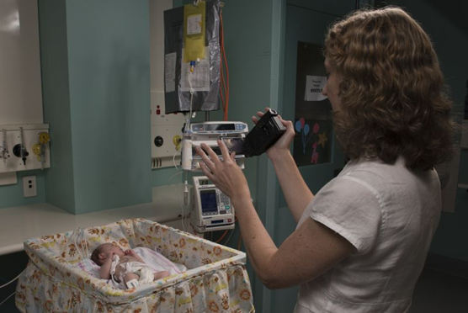
What is the General Movements Assessment (GMA)?
The General Movements Assessment is used to determine the quality of an infant’s movement
Indicates absent or abnormal (fidgety) general movements.
The assessment can be completed from birth to 20 weeks of age (Alliance, C. P. , 2016).
(Image from: The Sydney Children's Hospital Network, 2017)

Slide 8
Breakdown of the GMA
Who performs the assessment: allied health and medical professionals who are certified to do this assessment.
How is the assessment taken: through video, parents can take the video. Video is filmed from above to see the infant’s whole body.
How infant is presented: lying awake on their back, lightly dressed, and in a calm state
What to look for: spontaneous movements of the child (especially in hands and feet) for 3-5 minutes
Recommended: no distractions (toys, pacifiers) or interaction with the child.
(Alliance, C. P. , 2016)

Slide 9
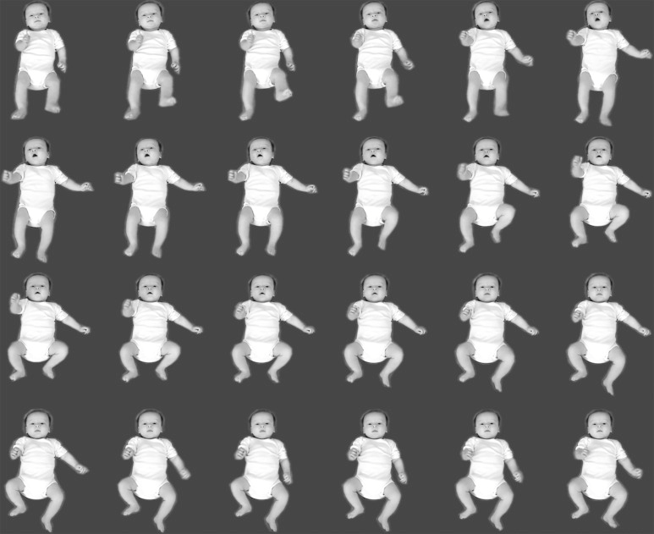
(Einspieler, C., Peharz, R., & Marschik, P. B. ,2016)

Slide 10
Why should we use the GMA?
Evidence shows that GMA is an excellent test for the early prediction of spastic CP in high risk infants due to its specificity (94%) and sensitivity (98%). (Morgan, C., Crowle, C., Goyen, T., Hardman, C., Jackman, M., Novak, I., & Badawi, N. ,2015).
The GMA can be highly predictive of CP by about 3 months of post term age, due to the type of general movements abnormality.
There is developing evidence that GMA can predict the distribution of CP, but not the severity.
Using the GMA, intervention for cerebral palsy can start very early with potentially better outcomes. (Alliance, C. P. , 2016)

Slide 11
Limitations on the GMA
It cannot predict the subtype or the severity of the CP (Einspieler, C., Marschik, P. B., Bos, A. F., Ferrari, F., Cioni, G., & Prechtl, H. F. , 2012).
Requires continuous training and upkeep of analytic skills and time for video analyses.
More research on the validity of low-risk populations of infants need to be performed. (Herskind, A., Griesen, G., & Nielsen, J. B., 2014).
It will not be able to replace the combination of frequent follow-up, clinical assessment, consideration of differential diagnoses, and considered investigation,(Bosanquet, M., Copeland, L., Ware, R., & Boyd, R., 2013; Morgan, C., Crowle, C., Goyen, T., Hardman, C., Jackman, M., Novak, I., & Badawi, N. , 2015) .

Slide 12
What is the Hammersmith Infant Neurological Examination?
It is a simple and scoreable assessment designed for evaluating after the neonatal period in infants between 2 months and 24 months of age.
Includes 26 items that assess different aspects of neurological examinations such as cranial nerves, posture, movements, tone and reflexes. (Romeo, D. M., Ricci, D., Brogna, C., & Mercuri, E. , 2015).

Slide 13
How is HINE performed?
Who performs it: allied health professionals
  Three Parts – Being Recorded
  Neurological Exam – postures, cranial nerve function, reflexes, tone, movements
  Development of Motor Function – head control, sitting, walking, crawling, rolling, grasping
  State of Behavior – consciousness, social orientation, emotional state
Scoring process: overall score of the neurological development index is estimated by adding scores of individual examinations. HINE scores can be correlated with the levels of Gross Motor Function Classification System (GMFCS) (Romeo, 2008)

Slide 14
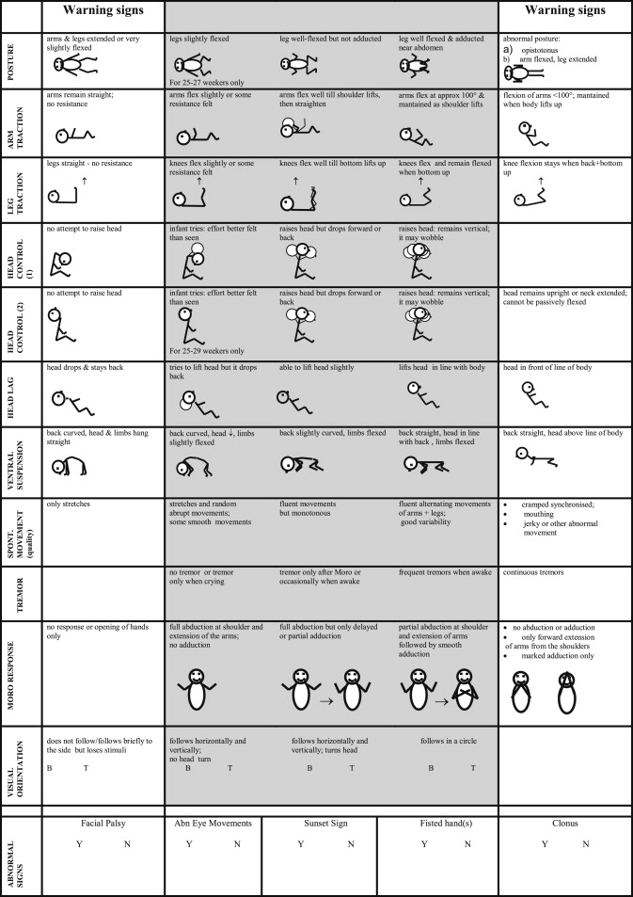
(Romeo, D. M., Ricci, D., Haastert, I. C., Vries, L. S., Haataja, L., Brogna, C. Mercuri, E. ,2012).

Slide 15
Why Should We Use HINE?
Non-invasive and affordable
Easily performed and accessible to all clinicians.
Has been used in different high- and low-risk populations both for preterm and for term-born infants. (Romeo, D. M., Ricci, D., Brogna, C., & Mercuri, E. (2015).
Predictive validity is generally good and estimated sensitivity and specificity for CP 88-92%
(Basu, A. P., & Clowry, G. J. , 2015).
Good interobserver reliability – even in inexperienced staff
HINE gives description of early signs which can provide additional information on the type and severity of different aspects of neurological outcomes.

Slide 16
Limitations on the Hammersmith Infant Neurological Examination
Not very detailed when talking about movement quality and quantity – not very descriptive not an indicator to tell difference between stage only pictures
Lacks a training course

Slide 17
The Integration of the Two Examinations
Domenico Marco Maurizio Romeo’s study Early neurologic assessment in preterm-infants: Integration of traditional neurologic examination and observation of general movements (2008)
Aim: To evaluate the possible benefits of combined assessments in terms of prognostic accuracy
Who: 908 preterm infants from the University of Catania
Method: GMA and HINE assessments at 3 months
Analysis: Outcomes were assessed at 2 years
Discussion: Integration of the two methods was more effective than the single assessment in predicting neurological outcome – additionally it discriminated between unilateral and bilateral cerebral palsy
Conclusion: The integrated use of the GMA and HINE can improve early prediction of neurodevelopmental outcome in preterm infants and it should accompany other clinical and instrumental exams in follow up programs.

Slide 18
Wrapping It Up
When CP is diagnosed early, tests for musculoskeletal and other comorbidities can be prompted and early intervention programs initiated.
From the child and family’s perspective- receiving a diagnosis of CP not only provides ‘an answer’ but also justifies appropriate funding and social support. (Romeo, D. M., Ricci, D., Brogna, C., & Mercuri, E. ,2015)
Furthermore, future research needs to be performed in order to rationalize that the integration of the HINE and GMA is the best predictor cerebral palsy in infants.

Slide 19
References
Basu, A. P., & Clowry, G. J. (2015). Improving outcomes in cerebral palsy with early intervention: new translational approaches. Frontiers Media S.A.
Bosanquet, M., Copeland, L., Ware, R., & Boyd, R. (2013). A systematic review of tests to predict cerebral palsy in young children. Developmental Medicine & Child Neurology, 55(5), 418-426. doi:10.1111/dmcn.12140
Center for Parent Information and Resources. (2014). Overview of Early Intervention. Retrieved April 05, 2017, from http://www.parentcenterhub.org/repository/ei-overview/
Cerebral Palsy Guide. (2016, December 12). Diagnosing Cerebral Palsy - Getting a Proper Diagnosis. Retrieved April 05, 2017, from https://www.cerebralpalsyguide.com/cerebral-palsy/diagnosis/
Einspieler, C., Marschik, P. B., Bos, A. F., Ferrari, F., Cioni, G., & Prechtl, H. F. (2012). Early markers for cerebral palsy: insights from the assessment of general movements. Future Neurology, 7(6), 709-717. doi:10.2217/fnl.12.60
Einspieler, C., Peharz, R., & Marschik, P. B. (2016). Fidgety movements – tiny in appearance, but huge in impact. Jornal de Pediatria, 92(3). doi:10.1016/j.jped.2015.12.003
Einspieler, D. C. (2009). General Movements Trust. Retrieved April 19, 2017, from http://general-movements-trust.info/
Government, P. W. (2017). Infant Toddler Services. Retrieved April 19, 2017, from http://www.pwcgov.org/government/dept/cs/pages/infant-toddler-services.aspx

Slide 20
References (continued)
Herskind, A., Griesen, G., & Nielsen, J. B. (2014). Early identification and intervention in cerebral palsy. DEVELOPMENTAL MEDICINE & CHILD NEUROLOGY. doi:DOI: 10.1111/dmcn.12531
Mayo Clinic Staff Print. (2016, August 25). Overview. Retrieved April 05, 2017, from http://www.mayoclinic.org/diseases-conditions/cerebral-palsy/home/ovc-20236549
Morgan, C., Crowle, C., Goyen, T., Hardman, C., Jackman, M., Novak, I., & Badawi, N. (2015). Sensitivity and specificity of General Movements Assessment for diagnostic accuracy of detecting cerebral palsy early in an Australian context. Journal of Paediatrics and Child Health, 52(1), 54-59. doi:10.1111/jpc.12995
Romeo, D. M., Guzzetta, A., Scoto, M., Cioni, M., Patusi, P., Mazzone, D., & Romeo, M. G. (2008). Early neurologic assessment in preterm-infants: Integration of traditional neurologic examination and observation of general movements. European Journal of Paediatric Neurology, 12(3), 183-189. doi:10.1016/j.ejpn.2007.07.008
Romeo, D. M., Ricci, D., Haastert, I. C., Vries, L. S., Haataja, L., Brogna, C. Mercuri, E. (2012). Neurologic Assessment Tool for Screening Preterm Infants at Term Age. The Journal of Pediatrics, 161(6), 1166-1168. doi:10.1016/j.jpeds.2012.07.037
Romeo, D. M., Ricci, D., Brogna, C., & Mercuri, E. (2015). Use of the Hammersmith Infant Neurological Examination in infants with cerebral palsy: a critical review of the literature. Developmental Medicine & Child Neurology, 58(3), 240-245. doi:10.1111/dmcn.12876
The Sydney Children's Hospital Network. (2017). Grace Centre for Newborn Intensive Care at The Children's Hospital at Westmead. Retrieved April 05, 2017, from https://www.schn.health.nsw.gov.au/parents-and-carers/our-services/neonatal-intensive-care/chw
United Cerebral Palsy. (2016). Cerebral Palsy Fact Sheet - United Cerebral Palsy. Retrieved from http://ucp.org/wp-content/uploads/2013/02/cp-fact-sheet.pdf

