Slide 1
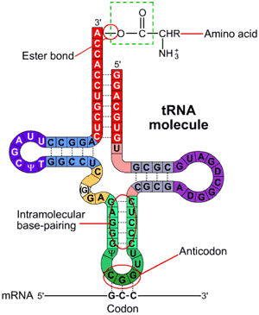
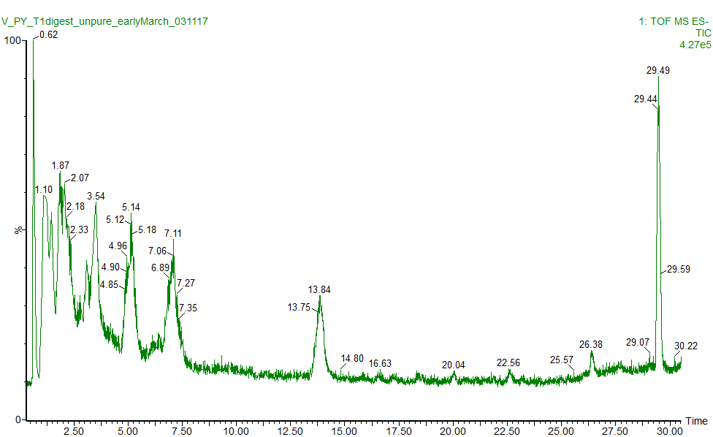
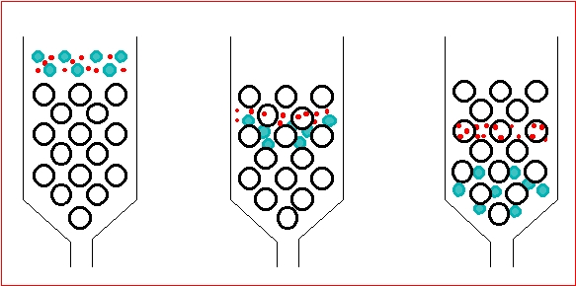
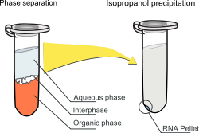
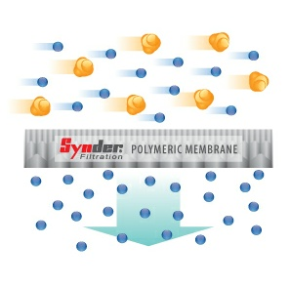
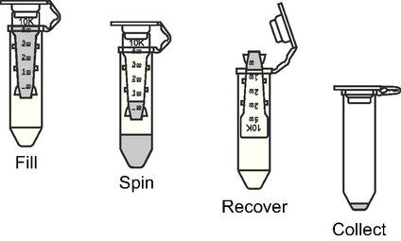
New Methods of Analyzing tRNA Fragments
Vamsi Cherukuri, Kayla Borland, Patrick Limbach and Balasubrahmanyam Addepalli
Background:
Goals:
Significance and potential applications:
tRNA carry amino acids to ribosomes in order to make proteins.
Currently there is no common and efficient way to isolate tRNA fragments following digestion with ribonuclease enzymes
Develop an efficient and reproducible way of isolating ribonuclease digestion products of tRNA
  Yeast tRNA(Phe) from RNase T1
Purified digestion products should be able to undergo another enzymatic reaction to add an azido-modified nucleotide.
Following nucleotide addition, the tRNA digest ion products will undergo the click reaction to use alkynes as chemical labels.
Method development for comparative analysis of tRNA sample under different stresses
Multiplex analysis to observe how tRNA modification profiles change over time
Currently only 2 samples can be analyzed at a time.
Materials:
RNase T1: Enzyme that cleaves tRNA after [m²G] and G. Approximately 11 KD in size.
PAPU: A small synthetic oligonucleotide used to check for digestive enzyme. Cleavage of this fragment means RNase T1 is still present.
PAP Enzyme: An enzyme that adds 1 azido modified nucleotide to the 3’ end of RNA
Azido Modified Tail: A tail added to the tRNA to allow for click reaction
tRNA: tRNA Phe from yeast was used in this experiment. This tRNA has a sequence of AUUUALCUCAGDDHCRCCAGABU#AAYAP?UG7UC?UGTPCG”UCCACAGAAUUCGCACCA
Control:
Sequence | Retention Time | Mass
DDG | 0.95 | 0.899 KD
TPCG | 1.10 | 1.214 KD
CUCAG | 1.87 | 1.528 KD
CACCA | 2.18 | 1.511 KD
CRCCAG | 3.50 | 1.900 KD
7UC?UG | 3.54 | 1.878 KD
AAUUCG | 5.14 | 1.858 KD
AUUUAL | 7.11 | 1.873 KD
“UCCACAG | 13.85 | 2.505 KD
ABU#AAYAP?UG | 29.48 | 4.084 KD
The Control sample was generated by digesting yeast Phe tRNA with RNase T1 and analysis by a mass spectrometer (MS)
A mass spectrometer is an instrument that measures mass to charge ratio of a compound in the mass spectrum.
MS data reveals whether the original RNA sample is clipped and elution time of these products, separated by liquid chromatography, and potentially their sequence.
Methods to Isolate digestion products of tRNA
Size Exclusion
Chromatography
Phenol Chloroform Extraction
3 KD MWCO Filters
5 KD MWCO Filters
Uses molecular sieves to separate tRNA and RNase T1 with the larger enzyme excluded and eluting first followed by the smaller oligos trapped in the pores
Separates tRNA digestion products into the aqueous phase and RNase T1 into the Phenol Chloroform phase
The molecular weight cut off filter separates molecules by size
Anything below 3 kDa makes it through the filter and above 3 kDa are retained
The molecular weight cut off filter separates molecules by size
Anything below 5KD makes it through the filter
Results
Size Exclusion Chromatography
Phenol-Chloroform Extraction
Not enough tRNA isolated through this method
40% fragments of Yeast tRNA(Phe) observed
  Process did not increase recovery of digestion products
31.2% unclipped PAPU
  A small amount of RNase T1 still remained
3 KD MWCO Filters
PAP Reaction
When PAP reaction was attempted not enough extended products were formed
Likely due to low abundance of digestion products
Mass spec data of purified tRNA from with PAPU incubation shows all the digestive enzyme was removed from the product fragments
no signal for ABU#AAYAP?UG because that segment of the RNA is too large to filter through the 3KD cut off.
Fragment | Retention Time
DDG | 0.94
TPCG | 1.17
CUCAG | 1.91
CACCA | 2.19
AUUUAL | 3.59
CRCCAG | 3.59
7UC?UG | 3.59
AAUUCG | 3.66
full PAPU | 3.66
"UCCACAG | 14.64
ABU#AAYAP?UG | no
5 KD MWCO Filters
Conditions | Observed Fragments | Amount unclipped PAPU
Spun 10000xg/15 min | 10% Not enough digestion products made it through | 100% No digestive enzyme
Spun 15000xg/8 min | 30% Not enough abundance | 100% No digestive enzyme
Spun 15000xg/15 min | 60% | 0% Rnase T1 still present
Spun 15000xg/13 min | 50% | 0% Rnase T1 still present
Spun 15000xg for 15 min Rinse 200 µL spin 7 min Refilter solution and spin 15000xg for 15min | 0% No digestion products made it through | 100% No RNase T1
5 kDa filters did not work as expected. The product from this vendor may not be suitable
Conditions | Observed Fragments | Amount unclipped PAPU
Baked 18 hours at 60° C Spun 14,000xg/30 min Rinsed and spun at 14,000 xg for 15 min | 50% of input observed Not enough tRNA made it through in high abundance | 100% No digestive enzyme
Baked 60 hours at 60° C Spun 14,000 xg/30 min Rinsed and spun at 14,000 xg for 15 min | 60% of input observed Not enough tRNA made it through in high abundance | 100% No digestive enzyme
Future Work
Chemically degrading MWCO filter membrane with formic acid, methanol, or acetonitrile
References:
"Cross Flow Membrane Operations." Synder Filtration. N.p., n.d. Web. 16 Apr. 2017.
M, Ajith Kumar. "Bio-Resource." Gel Filtration Chromatography (GF) / Size Exclusion Chromatography (SEC). N.p., 01 Jan. 1970. Web. 16 Apr. 2017.
Thundimadathil, Jyothi. "’Click’ Chemistry in Peptide Science." 'Click' Chemistry in Peptide Science. American Peptide Company, Inc., 13 Aug. 2012. Web. 16 Apr. 2017.
"Transfer RNA, and Its Biogenesis." Reasonandscience.heavenforum.org. N.p., 04 Jan. 2017. Web. 16 Apr. 2017.
Acknowledgements
Financial support for this work was provided by the National Science Foundation and the University of Cincinnati.
Notes:
Need charts

