Slide 1

Creating an Interactive Lecture
by Sarah D. Greywitt
Cuyahoga Community College
http://bit.ly/2mVainJ
Notes:
Brief Introduction
Teaching background – teaching in higher education since 2007; own classes since 2009
Not lectured much, but I also have taught classes in which lecturing really doesn’t work.
Teaching theatre courses, acting courses and public speaking
BRAIN ENGAGE
Prediction: What do you already know about lecturing vs. active learning?

Slide 2
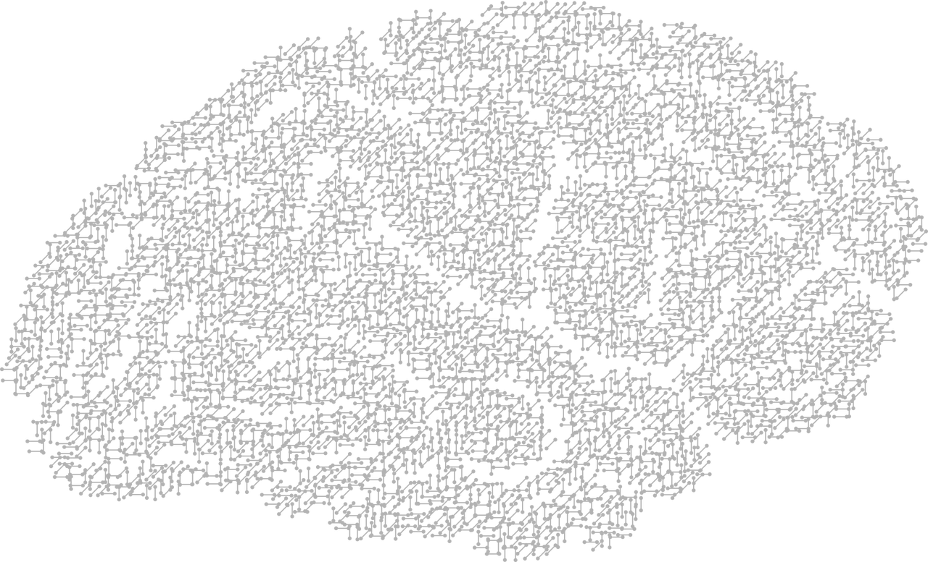
Brain Engage
Prediction:
What do you already know about
interactive lectures?
Or
How do you think this session will cover this topic?

Slide 3
What will we be able to do by the end of this session?
Define interactive lecture
Give examples of tech tools to use in an interactive lecture
Select no or low tech strategies and tools to use in an interactive lecture

Slide 4
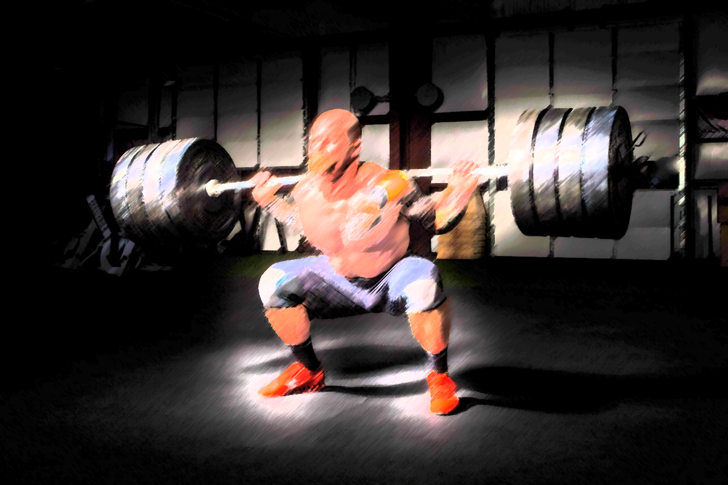
Why Active Learning?
Notes:
Quotes from Make it Stick by Brown, Roediger and McDaniel
“When learning is harder, it’s stronger and lasts longer”
(Brown, Roediger and McDaniel, p. 9)
“Effortful learning changes the brain, building new connections and capability”
(Brown, Roediger and McDaniel, p. 199)

Slide 5
Why Active Learning?
“When learning is harder, it’s stronger and lasts longer”
(Brown, Roediger and McDaniel, p. 9)
“Effortful learning changes the brain, building new connections and capability”
(Brown, Roediger and McDaniel, p. 199)
Notes:
Quotes from Make it Stick by Brown, Roediger and McDaniel
“When learning is harder, it’s stronger and lasts longer”
(Brown, Roediger and McDaniel, p. 9)
“Effortful learning changes the brain, building new connections and capability”
(Brown, Roediger and McDaniel, p. 199)

Slide 6
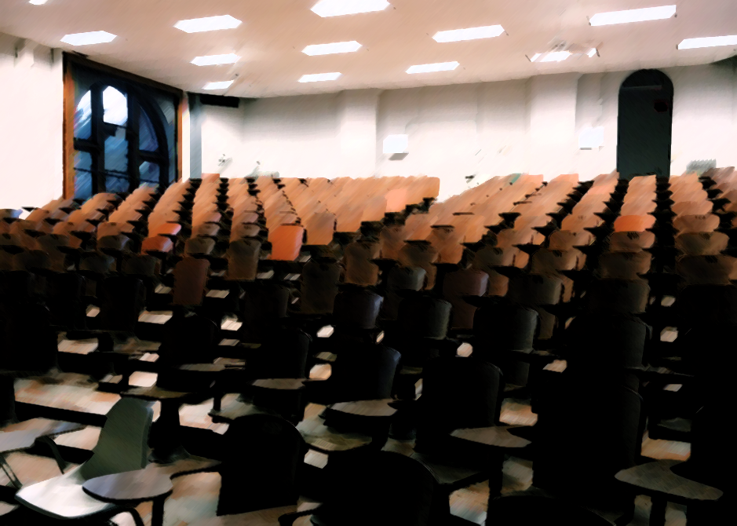
The Lecture
Notes:
However, this looks like several of my college classrooms, and it might look like yours. In fact, it might BE your classroom.
So when our spaces are not helping us (note the chairs facing the lectern, and bolted to the floor) what is one to do?
Enter the interactive lecture.

Slide 7
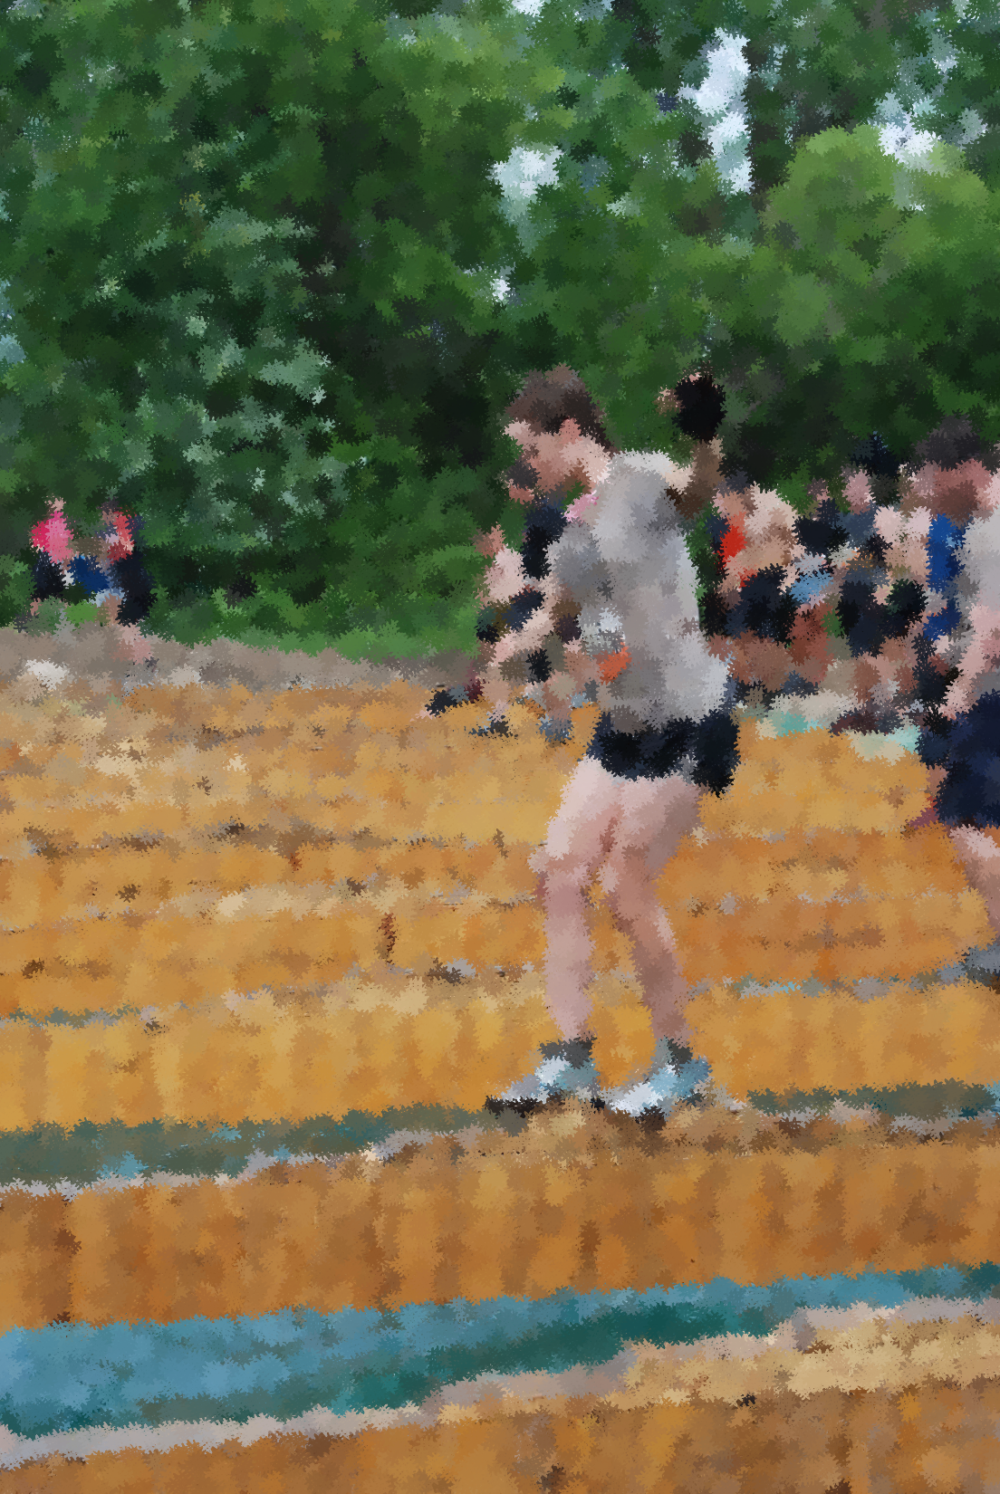
But, It’s Not that Easy!
Challenges…
We have to get used to it
Our students have to get used to it
And we all may be feeling
really out of sorts making this transition
Notes:
Active learning strategies, especially ones that completely change the way you teach can take a lot of getting used to.
Sometimes, we know we want to adjust and involve our students more, but the transition seems too difficult or we don’t know where to start.
And then sometimes it’s easier to just say, “forget it. I’ve been doing this for X amount of years, I get great evaluations from students, I’m entertaining, it’s good enough.”

Slide 8

What is an Interactive Lecture?
Longer lecture broken up into smaller lectures
Shorter lecture or
mini lecture
Learners are asked to respond,
ask questions,
engage with one another,
solve problems, compete, etc.
Lectures in which learners are involved
Notes:
Since working at the CLE, have been working with faculty on active learning, flipping a classroom, etc., etc.
Some faculty, understandably, are slow to move from a lecture even when they may desire to do so.

Slide 9

So, Why Create an Interactive Lecture?
“The one who
does the work,
does the learning”
(as quoted in
The New Science of Learning,
Doyle and Zakrajsek, p. 7)
Notes:
-Gives our students an opportunity to practice information as it is presented, which increases the chances of them retaining and learning.
-We can equate distributed practice to training for a race or lifting weights – we need to continue to practice, not just cram before an exam.
BRAIN BREAK:
Think/Pair/Share
Answer:
Write a question you have on the note card in front of you.
Answer:
1) What are the benefits of engaging our students when we lecture? OR Ask a question that is percolating.
2) Turn to the person next to you to discuss
3) Share out to the room
Depending on the size of your room, you could also consider doing a think/pair/square/share.

Slide 10
Brain Engage
Think/Pair/Share:
What are the benefits of engaging our students?
Or
Ask another question that is percolating.

Slide 11

Free Tech Tools to Support an Interactive Lecture
Go to
Todaysmeet.com/3T
Notes:
Advantages of using TodaysMeet
-Let introverts have a chance to respond in class
-Allow anonymous posting to the room so that less-confident students can participate
For TodaysMeet, you can assign student numbers or have other identifiers for you, but not a name that the whole class will see
-Encourage creative reactions to a lecture.
Question:
What other tech tools have you used to engage students?
What no and low tech engagement strategies have you used?

Slide 12
Brain Engage
Question:
What tech tools do you use to engage your students in class?

Slide 13

Low and No Tech Tools to Use in an Interactive Lecture
Thumbball from thumbball.com or amazon.com
Fist to Five
(in front of self instead of up high for all to see)
Respond to Multiple Choice with Four Corners
Lecture Competition (Blakeston, 2015)
Prediction – one of the strategies offered in Small Teaching
Notes:
Thumbball – explain how it works
Fist of Five
Four corners
Competition idea - Divide the room into two teams. Students on each team write down questions based on a 10 minute lecture. Questions recorded must be content-based, not based on irrelevant information (i.e. what color shirt is someone wearing on slide 5). Then each team asks the other team a question. If the other team answers correctly, they get a point. If they can’t answer the question, the team who asked the question gets a point. This idea is from Sandra Blakeston of Saint-Gobain PPL.

Slide 14
Brain Engage
Think/Pair/Share:
Based on everything we’ve learned today,
what tools or strategies might you implement?

Slide 15
Resources
Berk, R. A. (2016). Top 10 Evidence-Based, Best Practices for PowerPoint in the Classroom. Original Lilly Conference on College Teaching. Miami University, Oxford, Ohio.
Blakeston, Sandra. (2015). Training Session. Saint-Gobain PPL. Akron, OH.
Brown, P. C., Roediger, H. L. & McDaniel, M. A. (2014). Make it stick: The science of successful learning. Cambridge, MA: The Belknap Press of Harvard University Press.
Doyle, T. & Zakrajsek, T. (2013). The new science of learning: How to learn in harmony with your brain. Sterling, VA: Stylus.
Lang, J. M. (2016). Small teaching: Everyday lessons from the science of learning. San Francisco, CA: Jossey-Bass.
Lambert, C. (2012). Twilight of the Lecture. Harvard Magazine.
http://harvardmagazine.com/2012/03/twilight-of-the-lecture

Slide 16
Other Resources for Engaging Students
Ronald A. Berk books
Lynn and Robert Gillette and their Class Preparation Assignments
Major, C. H., Harris, M. S. & Zakrajsek, T. (2016). Teaching for Learning: 101 Intentionally Designed Educational Activities to Put Students on the Path to Success. New York, New York: Routledge.

