Slide 1

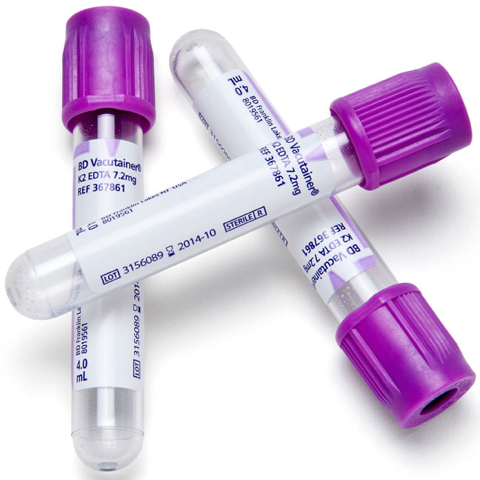
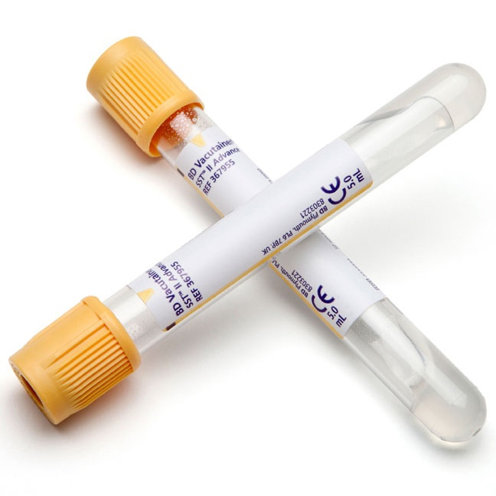
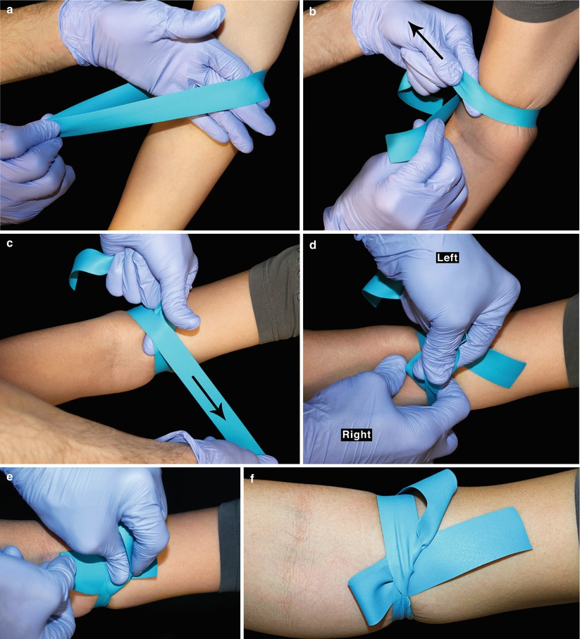
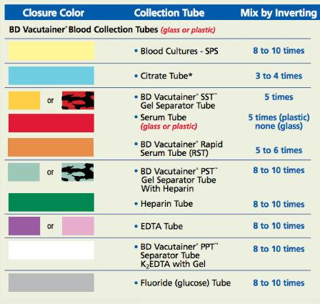
The Importance of Order of Draw in Phlebotomy and the
Reduction of Errors in the Clinical Laboratory
Jeremiah Brickler, Nikala Jackson, Victor Lescano, Beth Warning, MS, MLS (ASCP)
College of Allied Health Sciences, Clinical and Health Information Sciences
Medical Laboratory Science
Abstract
Clinical Findings
Discussion
Lab practices involving phlebotomy are critical for diagnostic purposes as erroneous results from incorrect collection can result in potentially life threatening misdiagnoses or treatment routes. This preanalytical error can result in misleading hyperkalemia and hypocalcemia illustrated in otherwise healthy patients. Improper order of draw can incur costs for both the patient and healthcare facility. Preventative measures must be employed to reduce such adverse events from recurring since this singular error can lead to a domino effect of continuous error if not recognized and investigated.
Table 1. Reference ranges for calcium and potassium
Other preanalytical errors can falsely represent hyperkalemia or rarely hypocalcemia. It was found that repeatedly clenching the hand into a fist after tourniquet application can cause a false increase in potassium at the time of collection. The source of the excess potassium was released from skeletal muscles during the act of excessive fist clenching. One study found that pseudohyperkalemia can occur with prolonged tourniquet time resulting in hemolysis of the red blood cells and the release of intracellular potassium. These preanalytical errors can be avoided by applying the tourniquet (Figure 3) for no more than one minute after application and emphasizing continued education for the phlebotomist.
Avoiding these preanalytical errors in the future is achieved through understanding phlebotomy principles and importance of good technique. The incorrect order of draw can be addressed through facility standard operating procedures (Figure 4) and retraining phlebotomists if necessary.
Analyte | Normal
Free Calcium | 1.15 – 1.33 mmol/L
Potassium | 3.5 – 5.1 mmol/L
Table 2. Patient values after the first and second draw
Analyte | Patient 1st Draw | Patient 2nd Draw
Free Calcium | 0.20 mmol/L | 1.27 mmol/L
Potassium | 8.7 mmol/L | 4.2 mmol/L
Background
The laboratory provides essential information that physicians and healthcare personnel utilize in medical decision-making for patients based on test results. This important source of information provided to the physician also holds the potential to be a critical source of error that may affect patient safety. The preanalytical phase refers to the steps involved from the time the physician orders the test until the specimen is analyzed.
Errors during the preanalytical phase such as improper order of draw during collection can adversely affect the patient by providing information that may not be an accurate representation of the patient’s actual clinical presentation and health status.
This can then lead to ordering additional tests by the physician or initiation of treatment for a diagnosis that is not the patient’s actual condition which can result in admission to the hospital when it may be unnecessary.
Conclusion
Overall, automation and advances in the medical laboratory enable technicians to expedite patient specimen values to the primary healthcare provider for better service and care. However, swift and accurate care cannot occur without proper patient specimen collection, as demonstrated with the healthy 24 year old patient with pseudohyperkalemia and psuedohypocalcemia. The standard phlebotomy procedure known as the order of draw was not performed correctly and falsely represented the patient’s current health status, which could have led to further misdiagnoses and unnecessary care. The subsequent recollecting and retesting of the patient’s specimen resulted in undue stress to the patient and wasted resources by the healthcare facility.
Figure 1. K₂EDTA plastic tube
(K₃EDTA glass tube is sealed with the same cap color)
Figure 2. Clot activator and gel separator tube
References
Case Study
BD Vacutainer 8.5 ml SST II Advance 16 x 100 Gold Top [Online image]. Retrieved April 14, 2017 from
https://www.capesmedical.co.nz/media/367958-bd-vacutainer-8.5ml-sst-ii-advance-16-x-100-gold-top-.jpg
Bishop, M. L., Fody, E. P., & Schoeff, L. E. (2013). Clinical chemistry: techniques, principles, correlations. Philadelphia, PA: Wolters Kluwer
Health/Lippincott Williams & Wilkins
Garza, D. & Becan-McBride, K. (2010). Phlebotomy handbook: Blood specimen collection from basic to advanced 8th edition. New Jersey, Pearson.
Green, S. F. (2013). The cost of poor blood specimen quality and errors in preanalytica processes. Clinical Biochemistry, 46(13-14), 1175-1179.
doi:10.1016/j.clinbiochem.2013.06.001
Lima-Oliveira, G., Lippi, G., Salvagno, G. L., Montagnana, M., Picheth, G., & Guidi, G. C. (2013, June). Incorrect order of draw could be mitigate the
patient safety: a phlebotomy management case report. Retrieved March 10, 2017, from https://www.ncbi.nlm.nih.gov/pmc/articles/PMC3900060/
Medical Laboratory and Biomedical Science: Is the Order of Draw Just a Myth? [Online image]. Retrieved April 14, 2017 from
https://4.bp.blogspot.com/-z22l35qkUzg/UeKY5308tGI/AAAAAAAAI9I/NNXwDk3QmwE/s1600/aa.jpg
Seimiya, M., Yoshida, T., Sawabe, Y., Sogawa, K., Umemura, H., Matsushita, K., & Nomura, F. (2010). Reducing the Incidence of Pseudohyperkalemia
by Avoiding Making a Fist During Phlebotomy: A Quality Improvement Report. American Journal of Kidney Diseases, 56(4), 686-692.
doi:10.1053/j.ajkd.2010.06.014
Sulaiman, R., Twomey, P., & Gama, R. (2011). Mitigation and detection of spurious potassium and sodium results. Clinica Chimica Acta, 412(1-2), 1-6.
doi:10.1016/j.cca.2010.08.028
TransMed Company BD Vacutainer Plus Blood Collection Tube 13 x 75mm 4mL Lavender Topp 100/Box [Online image]. Retrieved April 14, 2017
from http://www.transmedco.com/mm5/graphics/00000001/BD367861.jpg
Venipuncture | Plastic Surgery Key [Online image]. Retrieved April 14, 2017 from
http://plasticsurgerykey.com/wp-content/uploads/2016/05/A319561_1_En_10_Fig3_HTML.jpg
24 year old male
No previous conditions or complaints
Family history of high blood pressure
Collected complete metabolic panel and complete cell count with differential
Patient’s free calcium and potassium values indicate critical values (Table 1)
Results did not correlate with the physician’s findings
Phlebotomist admitted to drawing the K₃EDTA tube (Figure 1) before the clot activator and gel separator tube (Figure 2)
Recollection results were within normal range (Table 2)
Figure 3. Tourniquet Application
Figure 4. Order of Draw
Notes:
Posters must be no greater than 36” in width and be no greater than 48” in height!
The portrait-oriented template above is highly recommended.
If landscape orientation is important to you, simply make a smaller poster (e.g., 36” width by 24” height).
Feel free to change/adjust the following aspects of the poster according to your needs:
HEADINGS: no smaller than 50
Poster title: at least 60
Stuff under title: can be 25
Content: 30
PURPOSE
Background color
Size of the text boxes; add or delete them as necessary.
Text size (text size in content boxes is generally the same while smaller text is acceptable for figures, tables, and references)
Titles of the text boxes

