Slide 1

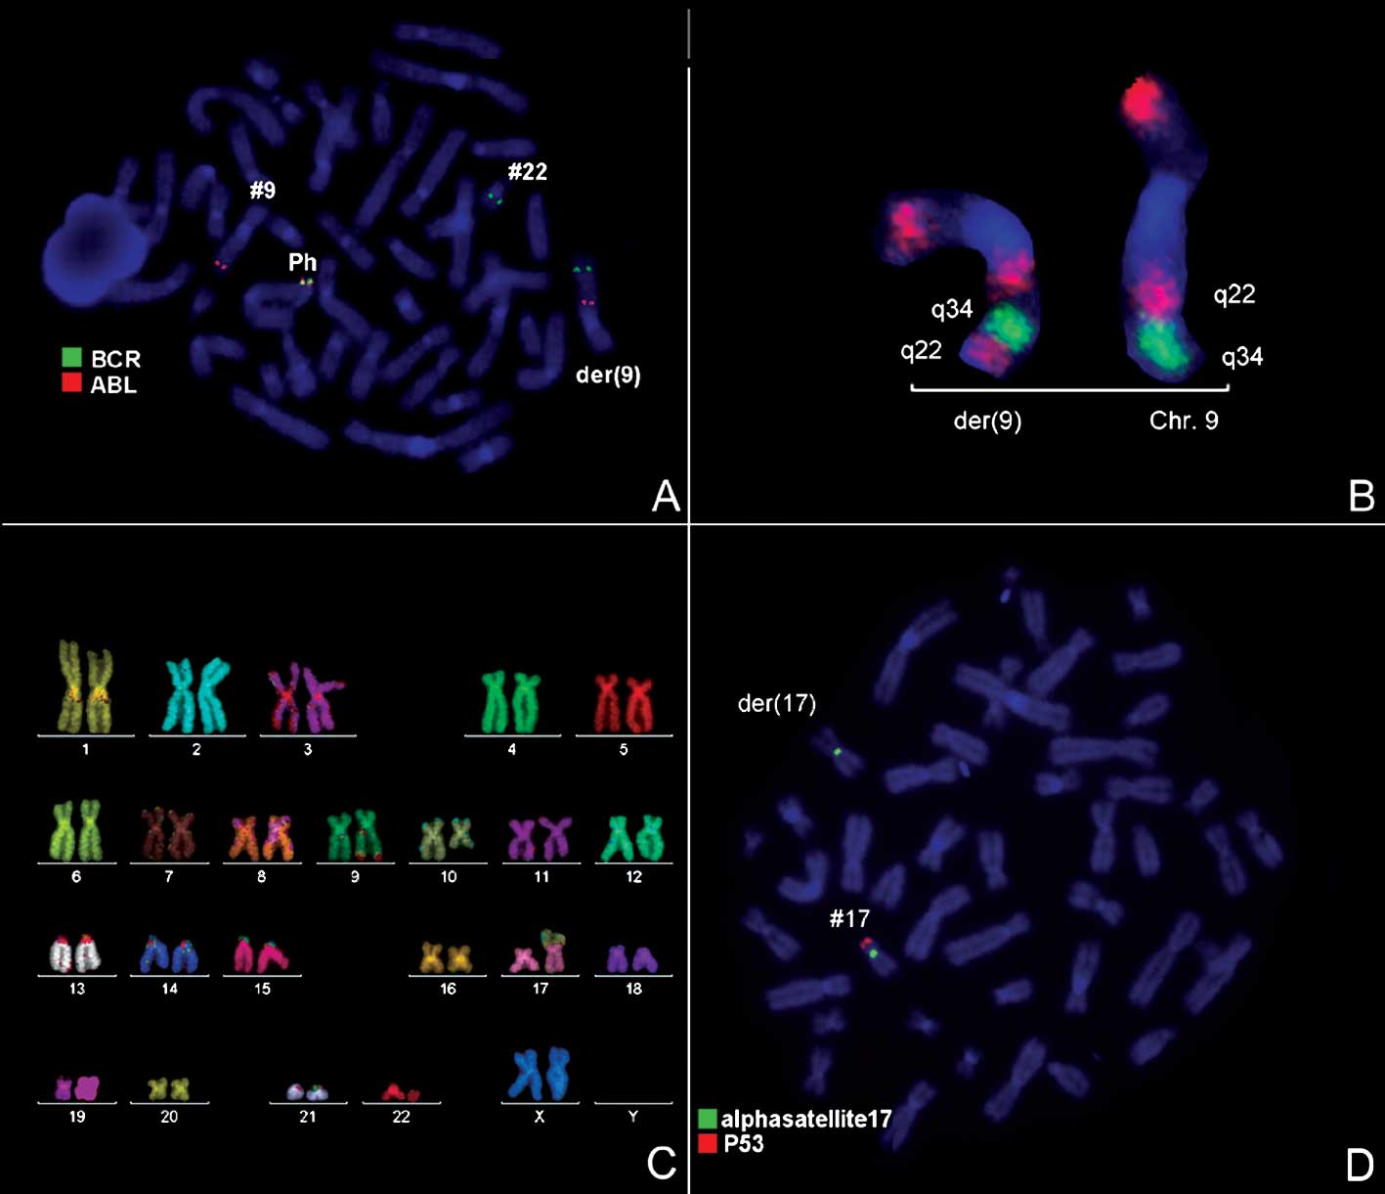
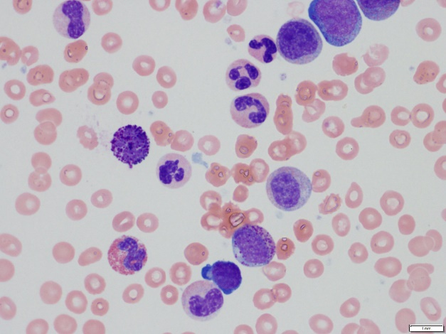
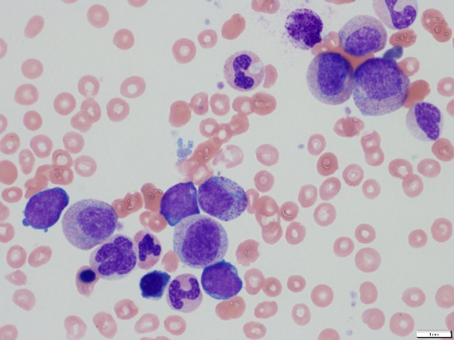
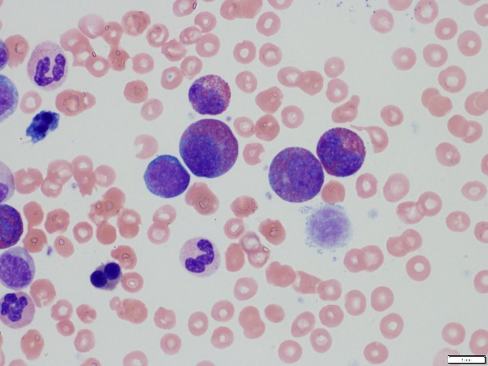
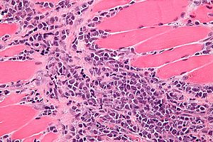
Cancer in the ER: Step by Step Observation of Diagnosing and Treating CML Progressing to Blast Crisis
Amy Frederick, Mannveet Dhillon, Brittany Gleich, Erin Rumpke, MS, MLS
Introduction
Diagnosis
Treatment
A 58 year old female entered the emergency room with a complaint of chronic back pain. Laboratory studies revealed an admitting diagnosis of Chronic Myelogenous Leukemia (CML), a cancer of the white blood cells. Further studies post admission discovered progression to blast crisis and transition to Acute Lymphocytic Leukemia.
Chronic Myelogenous Leukemia
transitioning to Acute Lymphocytic Leukemia
The first priority in treatment was to decrease the WBC count in order to prevent a stroke and increase the RBC count, due to the severity of anemia seen in the patient. Once the patient was stabilized standard treatment for CML began.
Hydroxyurea is used to treat leukocytosis short term by damaging RNA/DNA, which inhibits dell division and decreases the WBC counts
The patient’s red blood cell count was increased by a transfusion.
Standard Treatment for CML:
Current primary treatment for CML is Imatinib (Gleevec), which is a tyrosine kinase inhibitor that prevents the BCR-ABL protein production responsible for overproliferation of leukocytes
Imatinib will need to be taken indefinitely to treat CML or until the drug no longer works due to developed resistance
Once resistance to Imatinib is developed Allogenic stem-cell transplantation is recommended for treatment
Allogenic stem cell transplantation destroys the patients abnormal leukocytic stem cells and replaces them with stem cells from a donor to prevent proliferation of the patients mutated stem cells
Pathology of CML
Methods
Pathology of Chronic Myelogenous Leukemia
Transition of CML into Blast Crisis
Granulocytic Sarcoma
CBC and differential were processed on Beckman Coulter’s DxH
Peripheral blood smear was made using Beckman Coulter’s DxH automated slide maker
WBC differential was performed using Cellavision
Results and Data Anlysis
Critical CBC Values:
Elevated WBC
Low RBC
Low HCT
Low HGB
Low MCH
Low MCHC
Elevated RDW
Critical Differential Values:
Diagnosis:
The chief complaint upon entering the emergency department was back pain and physical examination revealed splenomegaly. The CBC (Table 1) showed that the leukocyte count was 202.4 10^3 L. This value far exceeds the reference range of 3.8-10.8. This data suggests an overproliferation of white blood cells. The CBC also indicated a normocytic hypochromic anemia by the decreased RBC count, hemoglobin, and hematocrit. The white blood cell differential values (Table 2) show varying stages of maturation in circulation. Overproliferation of leukocytes with varying stages of maturation is highly indicative of Chronic myelogenous leukemia (CML). After the initiation of treatment for CML, imaging studies revealed a lesion on the posterior rib. A biopsy demonstrated that the lesion was comprised of granulocytic blast cells a symptom present in ALL.
CBC | Patient Values | Evaluation | Units | Refrence Values
WBC | 202.4 | (H) | 10E3/uL | 3.8-10.8
UWBC | 202.4 |  | 10E3/uL
RBC | 2.71 | (L) | 10E6/uL | 3.80-5.10
HGB | 7 | (L) | g/dL | 11.7-15.5
HCT | 22.6 | (L) | % | 35.0-45.0
MCV | 83.5 |  | fL | 80.0-100.0
MCH | 25.8 | (L) | pg | 27.0-33.0
MCHC | 30.9 | (L) | g/dL | 32.0-36.0
RDW | 18.2 | (H) | % | 11.0-15.0
PLT | 240 |  | 10E3/uL | 140-400
MPV | 8.6 |  | fL | 7.5-11.5
Chronic Myelogenous Leukemia is caused by a translocation of the ABL gene from chromosome 9 to 22. The product is the BCR-ABL fusion gene. According to Baccarani, this gene repeatedly
stimulates the enzyme tyrosine kinase, which continuously signals for unregulated hematopoietic stem cell proliferation. These unregulated hematopoietic stem cells differentiate into different WBC precursors. Failure to inhibit this pathway will result in an increase of myeloblasts and progression of the disease.
Table 1
Elevated
PRO
MYEL
META
NEUT
Absolute leukocytosis
NEUT
Band
META
MYEL
PRO
BLAST
LYMPH
EOS
BASO
Cell Type | Patient Values | Evaluation | Units | Reference Range
WBC | 202.4 | (H) | 10E3/uL | 3.8-10.8
PLT EST | Adequate
BLAST | 13.6 | (H) | % | 0.0-0.0
PRO | 10.7 | (H) | % | 0.0-0.0
MYEL | 13.6 | (H) | % | 0.0-0.0
META | 9.7 | (H) | % | 0.0-0.0
BAND | 1.9 |  | % | 0.0-9.0
NEUT | 33 | (L) | % | 40.0-80.0
LYMPH | 2.9 | (L) | % | 15.0-45.0
MONO | 0 |  | % | 0.0-12.0
EOS | 10.7 | (H) | % | 0.0-8.0
BASO | 3.9 | (H) | % | 0.0-1.0
NRBC | 8 | (H) | /100 WBC | 0-0
ABS NEUT | 66792 | (H) | /uL | 1500-7800
ABS BAND | 3846 | (H) | /uL | 0-750
ABS META | 19633 | (H) | /uL | 0-0
ABS MYEL | 27526 | (H) | /uL | 0-0
ABS PRO | 21657 | (H) | /uL | 0-0
ABS BLAS | 27526 | (H) | /uL | 0-0
ABS LYMP | 5870 | (H) | /uL | 850-3900
ABS MONO | 0 | (L) | /uL | 200-950
ABS EOS | 21657 | (H) | /uL | 15-500
ABS BASO | 7894 | (H) | /uL | 0-200
RBCM | Normal
PMORPH | Normal
Statistics
CML represents roughly 0.5% of all new cancer cases diagnosed in the U.S. each year
Incidence in the U.S. is 1-2 cases per 100,000 people per year
Diagnosis of CML
90% are diagnosed in the initial chronic phase
67% progress into the accelerated phase
33% progress directly into blast crisis phase
5 year survival rate is 65.1% with a median death age of 76 years old (2006-2012)
Allogenic stem cell transplantation
Produces long term survival in 50-80% of patients
Disease-free survival in 30-70% of patients
Younger patients are shown to have a 60% disease free survival rate
Statistics drop to 30% disease free survival rate in older patients
Individuals with CML have a severe left shift in leukocytes having leukocyte precursors at varying stages of maturity in the peripheral blood. The longer an individual with CML goes on without treatment increases one’s risk of developing “blast crisis”. Blast crisis, as defined by the World Health Organization (WHO), is when at least 20% blast count in the bone marrow or blood must be noted (Hehlmann, R., Saussele, S., 2008).
Table 2
CONCLUSIONS
It is very uncommon for an individual to enter the ER and be admitted with a diagnosis of CML progressing into ALL without any prior history of cancer. This case study gives insight to how such a developed case of CML is diagnosis and treated.
Figure 1: Admitting WBC differential showing myeloid blasts, basophils, and erythrocytic precurosors.
Figure 2: Admitting WBC differential showing eosinophilic precursors and giant platelets
In this case study the patient did not meet the WHO criteria for blast crisis, however when a posterior rib lesion was discovered and biopsied to reveal a granulocytic sarcoma, it was then ascertained the patient was transitioning from CML to ALL. A granulocytic sarcoma is a tumor of malignant cells growing at proliferating in a separate location from the original site of the cancer. Granulocytic sarcomas can be found in 3-5% of patients with Acute Lymphocytic Leukemia, and if found in a patient with CML there is a high indication that the patient is in blast crisis.
REFERENCES
Levy, R. A., Mardones, M. A., Burch, M. M., & Krause, J. R. (2014). Myeloid sarcoma as the presenting symptom of chronic myelogenous leukemia blast crisis. Proceedings (Baylor University. Medical Center), 27(3), 246–249.
Jude Hudock, MD, Jane Chatten, MD, Markku Miettinen, MD; Immunohistochemical Evaluation of Myeloid Leukemia Infiltrates (Granulocytic Sarcomas) in Formaldehyde-fixed, Paraffin-embedded Tissue. Am J Clin Pathol 1994; 102 (1): 55-60. doi: 10.1093/ajcp/102.1.55
Deininger, M. (2005). The development of imatinib as a therapeutic agent for chronic myeloid leukemia. Blood , 105 (7), 2640-2653.
Faderl, S. (1999). Chronic Myelogenous Leukemia:Biology ad Therapy. Annals of internal medicine , 131 (3), 201-211.
Stamatovic, D. (2012). Allogenic stem cell transplant for chronic myeloid leukemia as a still promising option in the era of the new target therapy. Military medical & Pharmaceutical Journal of Servia , 69 (1), 37-42.
Radich, J. (2010). Stem Cell Transplant for Chronic Myeloid Leukemia in the Imatinib Era. Seminars in hematology , 47 (4).
Ren, R. (2005). Mechanisms of BCR-ABL in the pathogenesis of chronic myeogenous leukaemia . Nature Reviews Cancer , 5 (3).
S. (n.d.). Chronic Myelogenous Leukemia . Retrieved March 10, 2017, from http://surgpathcriteria.stanford.edu/mdsmps/chronic-myeloid-myelogenous-leukemia/differential-diagnosis.html
Baccarani, M., Pileri, S., Steegmann, J., Muller, M., Soverini, S., & Dreyling, M. (2012, October 01). Chronic myeloid leukemia: ESMO Clinical Practice Guidelines for diagnosis, treatment and follow-up. Retrieved March 10, 2017, from https://academic.oup.com/annonc/article/23/suppl_7/vii72/144183/Chronic-myeloid-leukemia-ESMO-Clinical-Practice
Hehlmann, R., & Saussele, S. (2008, December 01). Treatment of chronic myeloid leukemia in blast crisis. Retrieved March 10, 2017, from http://www.haematologica.org/content/93/12/1765
Calabretta, B., & Perrotti, D. (2004, June 01). The biology of CML blast crisis. Retrieved March 10, 2017, from http://www.bloodjournal.org/content/103/11/4010
Ng, P., MD, & Long, B., MD. (2016, September 10). Blast Crisis: ED-focused management (J. Robertson MD & A. Coyfman MD, Eds.). Retrieved March 10, 2017, from http://www.emdocs.net/blast-crisis-ed-focused-management/
Levy, R. A., Mardones, M. A., Burch, M. M., & Krause, J. R. (2014). Myeloid sarcoma as the presenting symptom of chronic myelogenous leukemia blast crisis. Proceedings (Baylor University. Medical Center), 27(3), 246–24
American Cancer Society. About Chronic Myeloid Leukemia. 2016. Retrieved from https://www.cancer.org/content/dam/CRC/PDF/Public/8684.00.pdf
Chronic myelogenous leukemia. (n.d.). Retrieved March 09, 2017, from http://www.mayoclinic.org/diseases-conditions/chronic-myelogenous-leukemia/diagnosis-treatment/treatment/txc-20202102
Leukemia - Chronic Myeloid - CML: Statistics. (2016, November 01). Retrieved March 09, 2017, from http://www.cancer.net/cancer-types/leukemia-chronic-myeloid-cml/statistics
Chronic myelogenous leukemia. (2016, May 26). Retrieved March 10, 2017, from http://www.mayoclinic.org/diseases-conditions/chronic-myelogenous-leukemia/symptoms-causes/dxc-20202071
Cancer, C. C. (n.d.). Hydroxyurea. Retrieved March 24, 2017, from http://chemocare.com/chemotherapy/drug-info/hydroxyurea.aspx
James, William D.; Berger, Timothy G.; et al. (2006). Andrews' Diseases of the Skin: clinical Dermatology. Saunders Elsevier.
Al Achkar, W., Wafa, A., Mkrtchyan, H., Moassass, F., & Liehr, T. (2010). A rare case of Philadelphia chromosome-positive chronic myelogenous leukemia with inversion in chromosome 9 and t(10;17) . Oncology Letters, 1, 793-795. http://dx.doi.org/10.3892/ol_00000138
Notes:
Posters must be no greater than 36” in width and be no greater than 48” in height!
The portrait-oriented template above is highly recommended.
If landscape orientation is important to you, simply make a smaller poster (e.g., 36” width by 24” height).
Feel free to change/adjust the following aspects of the poster according to your needs:
Background color
Size of the text boxes; add or delete them as necessary.
Text size (text size in content boxes is generally the same while smaller text is acceptable for figures, tables, and references)
Titles of the text boxes

