Slide 1
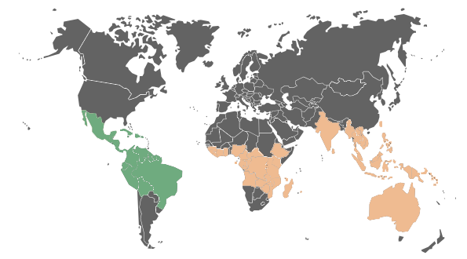
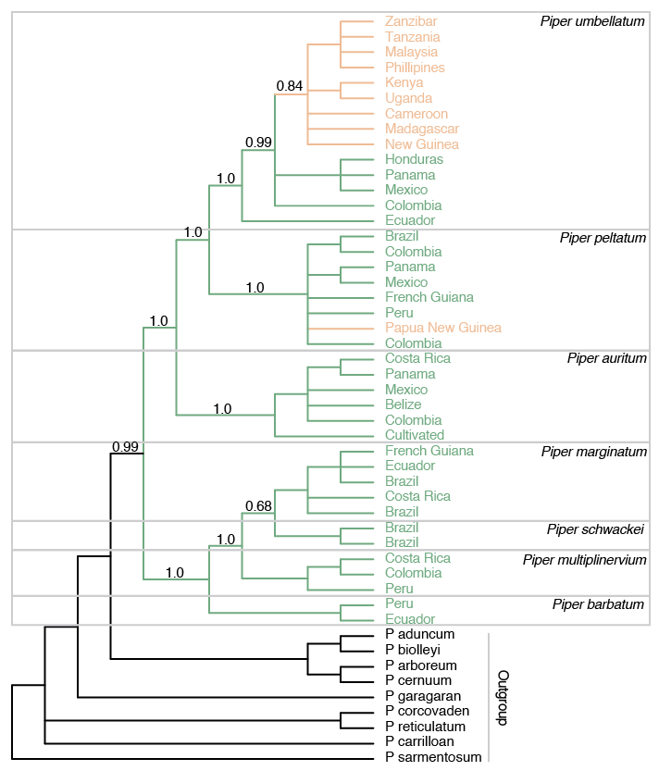
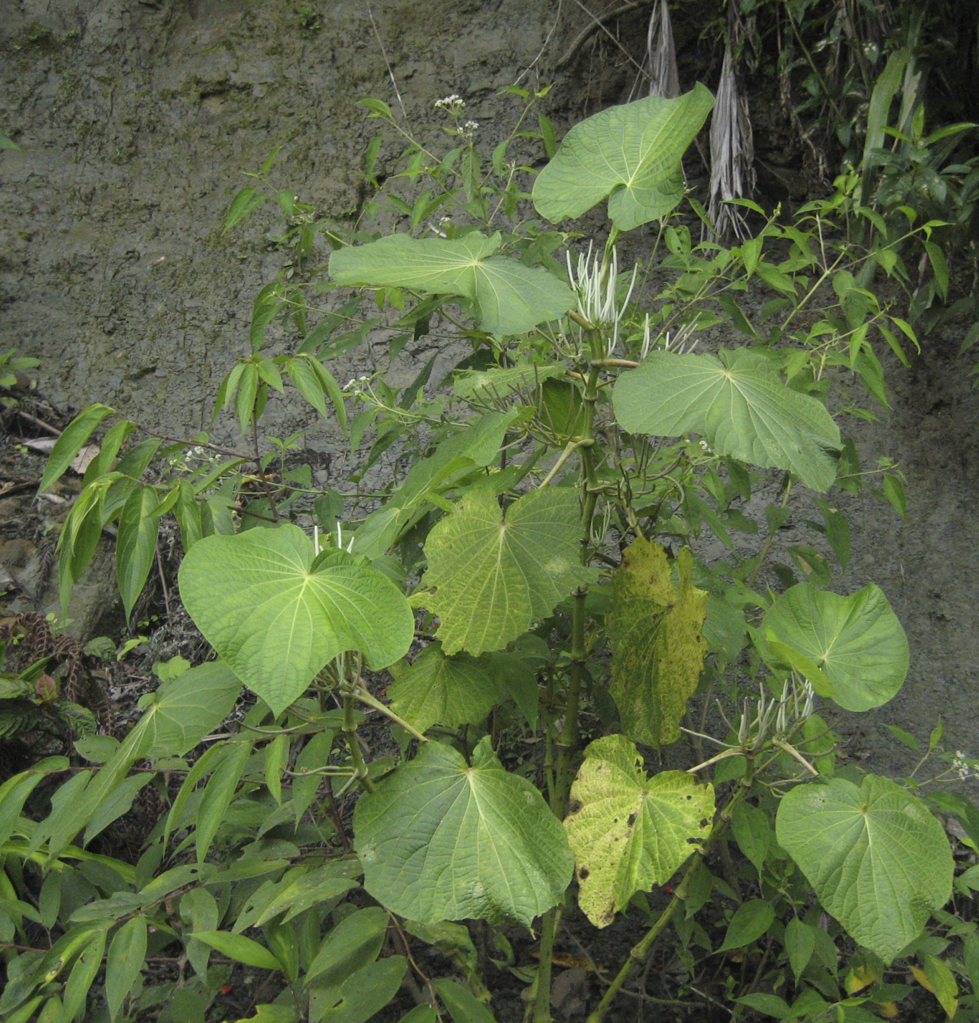
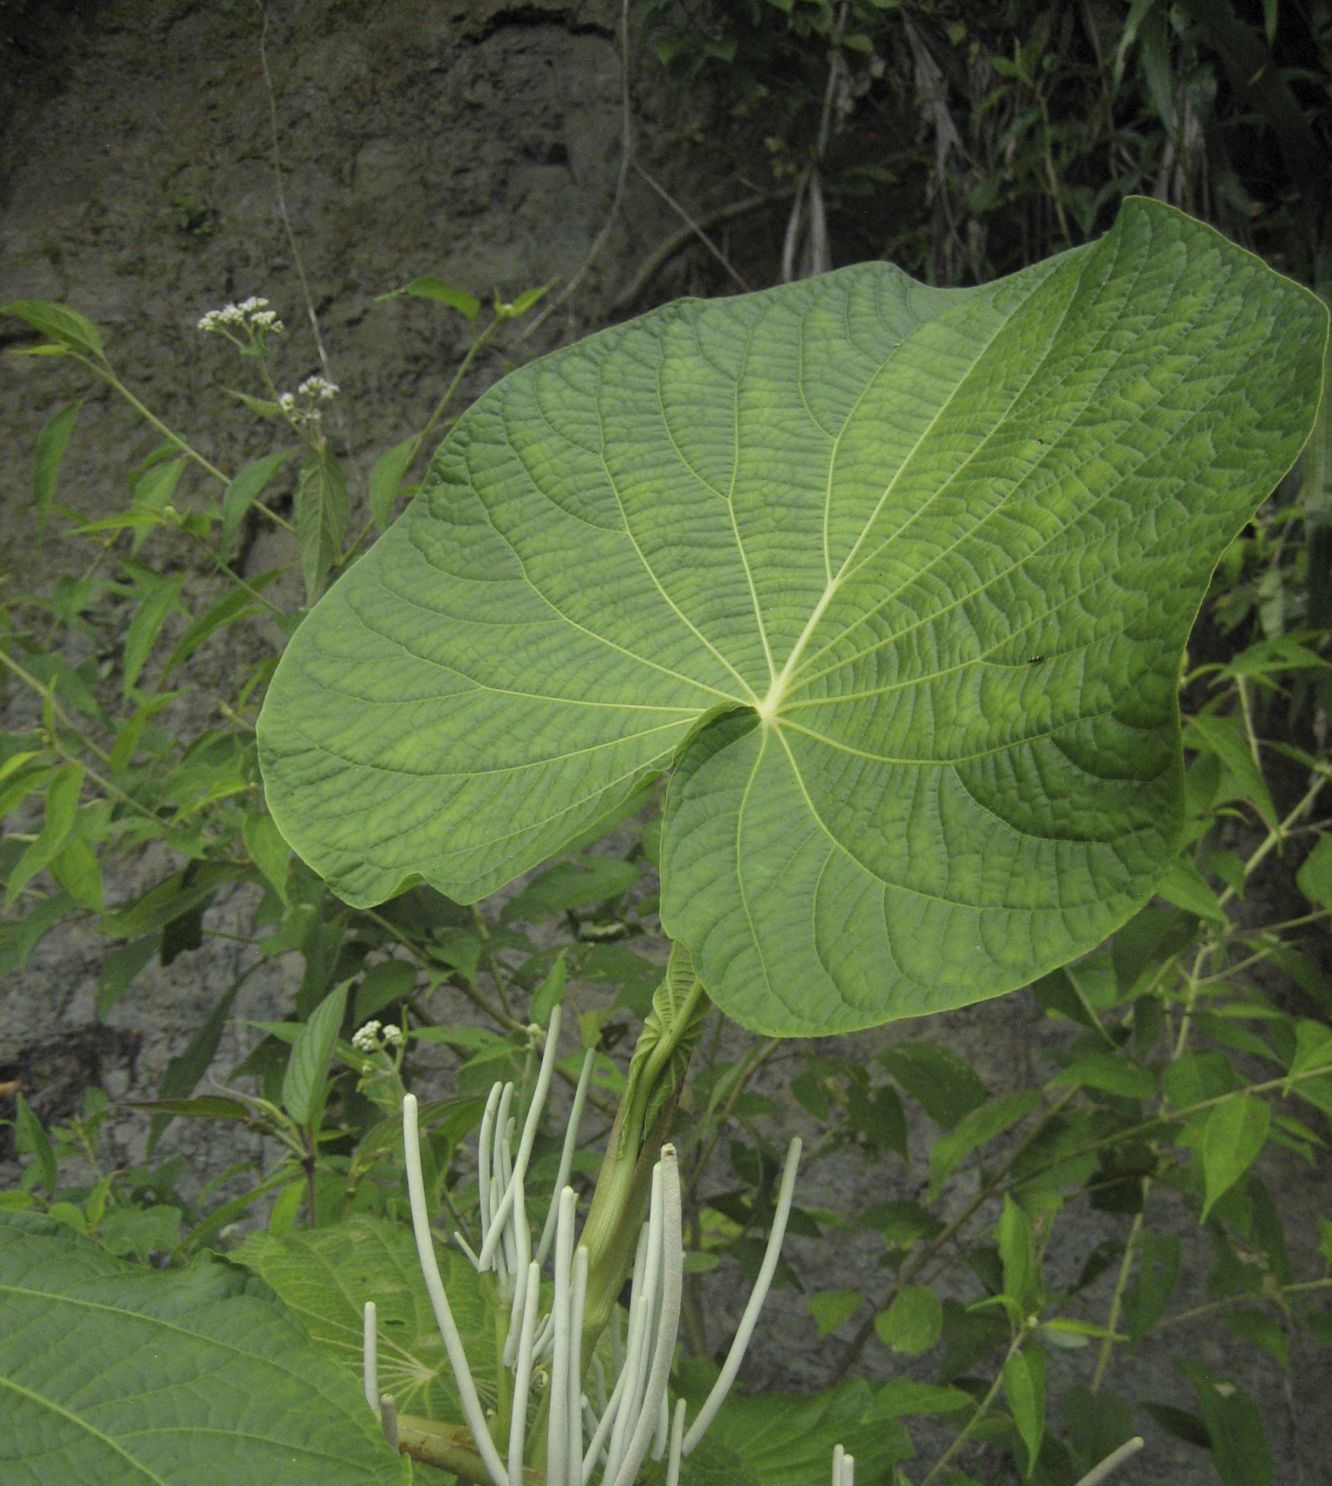
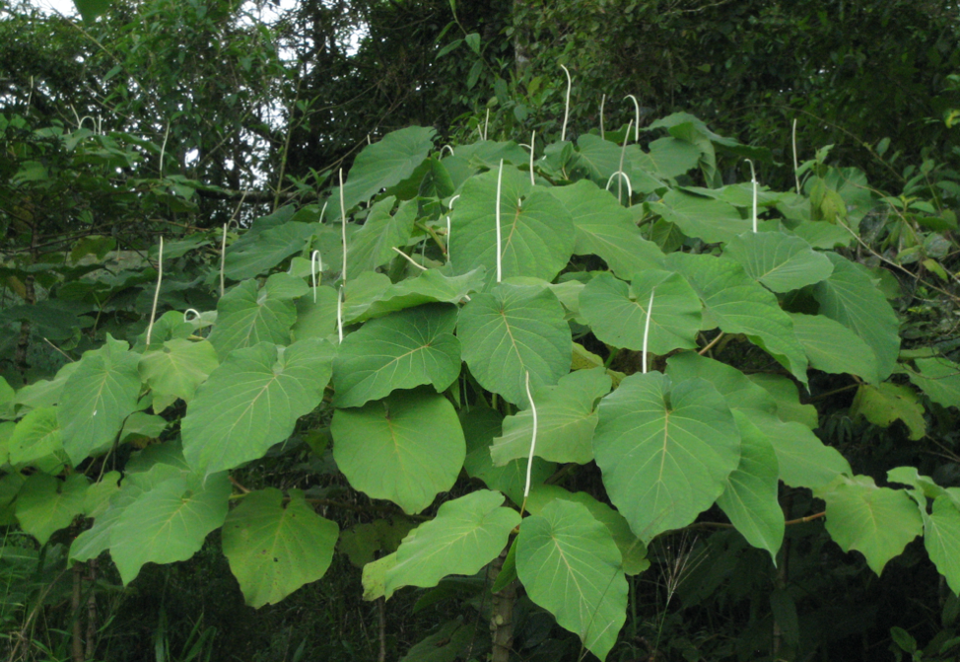
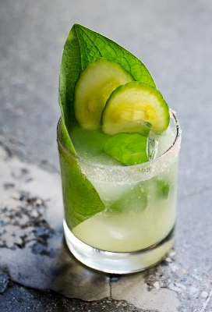
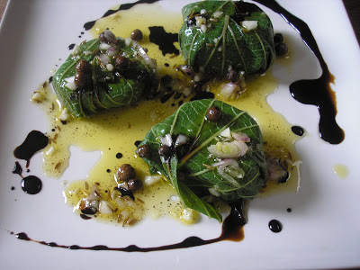
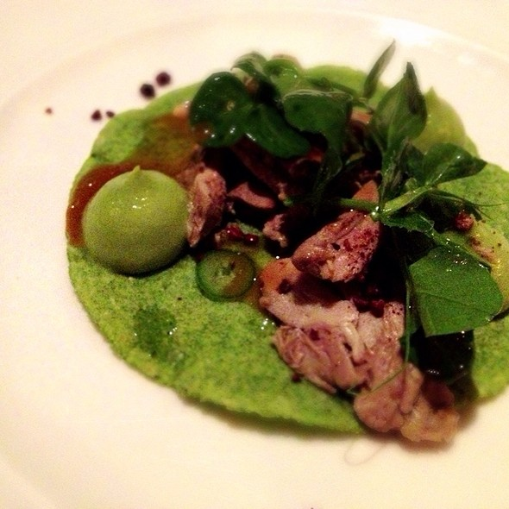
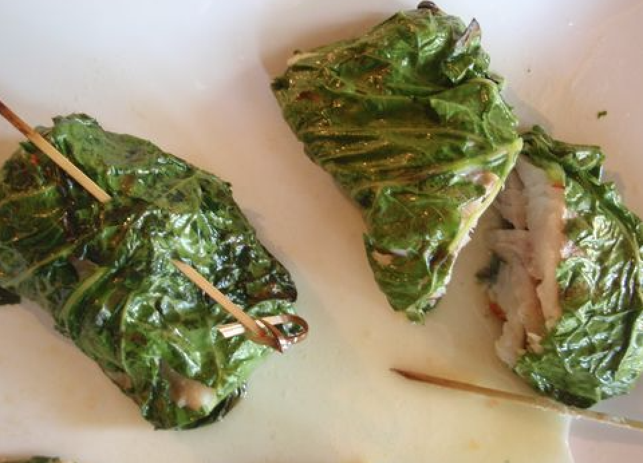
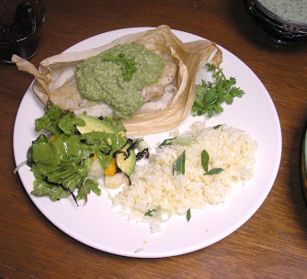

The Remarkable Journey of Piper umbellatum
Lindsey Miller¹ & Eric J. Tepe²
Department of Biological Sciences, University of Cincinnati, Cincinnati, OH 45202
¹mille3ln@mail.uc.edu ²eric.tepe@uc.edu
Piper umbellatum, a relative of the cultivated plants black pepper (P. nigrum) and kava (P. methisticum ), is believed to be native to the New World tropics. However, it can now be found in hot, humid habitats around the World. This plant is a bit enigmatic due to its native-like behavior in much of the Old World – occurring in very specific habitats – while behaving like an invasive weed throughout its supposed native habitat in the New World. Additionally, the first description of P. umbellatum in the Old World predates its first mention in the New World. These observations beg the question: is P. umbellatum truly New World in origin?
INDONESIA
Between 1653-1670, Rumpf described many medicinal uses of P. umbellatum among the natives of Ambon
JAMAICA
Plumier’s description in 1693 was the first New World mention of the species
Native
Non-native
The Pothomorphe Lineage of Piper
Medicinal Uses
Relatives
anemia
rheumatism
lung diseases
swellings
wounds
Pothomorphe contains seven to ten species of highly aromatic shrubs and vines
Due to its high concentration of safrole and other compounds, plants in the Piperaceae family have a strong, sweet, spicy aroma
P. umbellatum
urinary tract
skin irritation
respiratory tract
liver
dropsy
P. auritum
P. umbellatum
anti-inflammatory
calms birth pains
digestive tract
jaundice
fever
This is the 50% Majority rule, post burn-in tree from Bayesian analysis of nuclear ITS and chloroplast petA–psbJ sequences. Branch support values are Bayesian posterior probabilities. Accessions within the “Pothomorphe” lineage (enclosed in the boxes) are color coded according to geography with green for New World and peach for Old World.
analgesic
abdominal pains
antiseptic*
migraine
malaria*
P. auritum is the most well-known species in the Pothomorphe lineage with nicknames such as Hoja Santa, Acuyo, and the Rootbeer Plant
Leaves from P. auritum are used for cooking in parts of Mexico due to its sweet, spicy leaves
The leaves of P. auritum have a combination of flavors similar to sassafras, anise, black pepper, tarragon, and nutmeg
The leaves of P. auritum are used in many Mexican dishes to wrap food and add flavoring…
Results
DNA sequences indicate that the entire Pothomorphe lineage is New World in origin
Old World accessions we sampled all appear to have come from a single dispersal event from the New World to the Old World
Our results include the first account of P. peltatum outside its native range (in Papua New Guinea), and the evidence for inclusion of P. barbatum in this group
Most of the various traditional medicinal uses of P. umbellatum around the World have yet to be studied through clinical trials. However, several properties have been evaluated and show promising results (*). These include the significant reduction of malaria parasites in mice injected with P. umbellatum extract as well as considerable in vitro anti-microbial activity and a confirmed low toxicity of P. umbellatum leaves in vivo.
One of the local Mexican names for P. auritum is "Hoja Santa" which in Spanish means "sacred leaf"
Culinary
Hoja Santa Margarita
Hoja Santa & Green Mole Sauce
Hoja-Santa Wrapped Goat Cheese
Salsa de tomate y Hoja Santa
Grilled snapper wrapped in Hoja Santa
References
Amorim, C. Z., Flores, C. A., Gomes, B.E., Marques, A. D., Cordeiro, R. S. B., 1988. Screening for antimalarial activity in the genus Potomorphe. Journal of Ethnopharmacology 24, 101-106.
Ejele, A. E., Duru, I. A., Ogukwe, C. E., Iwu, I. C., 2012. Phytochemistry and Antimicrobial Potential of Basic Metabolites of Piper Umbellatum, Piper Guineense, Ocimum Gratissimium and Newbouldia Laevis Extracts. Journal of Emerging Trends in Engineering and Applied Sciences (JETEAS) 3 (2): 309-314.
Da Silva, I. F., De Oliveira, R. G., Mendes Soares, I., Da Costa Alvim, T., Donizeti Ascêncio, S., & De Oliveira Martins, D. T. (2014). Evaluation of acute toxicity, antibacterial activity, and mode of action of the hydroethanolic extract of Piper umbellatum L. Journal of Ethnopharmacology, 151(1).
Dyer, L. A. and Palmer, A. D. N. 2004. Piper: A Model Genus for Studies of Phytochemistry, Ecology, & Evolution. New York: Kluwer Academic/Plenum Publishers, 2004.
Jaramillo, M. A., & Manos, P. S. (2001). Phylogeny and patterns of floral diversity in the genus Piper (Piperaceae). American Journal of Botany, 88(4), 706–716.
Roersch, C. M. F. B. (2010). Piper umbellatum L.: A comparative cross-cultural analysis of its medicinal uses and an ethnopharmacological evaluation. Journal of Ethnopharmacology.
Photo credits: Piper images by E.J. Tepe, Grilled snapper wrapped on Hoja Santa image by Elaine Johnson, Hoja Santa and Green Mole Sauce and Hoja-Santa Wrapped Goat Cheese images by Victoria Challancin, Salsa de tomate y Hoja Santa image by Curio Gastro, Hoja Santa Margarita image by Gillian Ferguson, Dylan, and Jeni.
This work was made possible by funding from The National Science Foundation

