Slide 1
Understanding Culture and Diversity in Building UC Global Community:
UC Libraries’ Experience
UC 2015 Diversity Conference
Rosemary Franklin
Olga Hart
Anvita Shashidhar
Hongying Zhang

Slide 2
Presentation outline
UC Libraries’ activities funded by the Diversity Challenge Grant.
Lessons learned, tips, and takeaways from Grant-funded activities.
Ideas for helping students integrate and succeed academically.
Ways to raise the cultural competency of your staff/group.

Slide 3
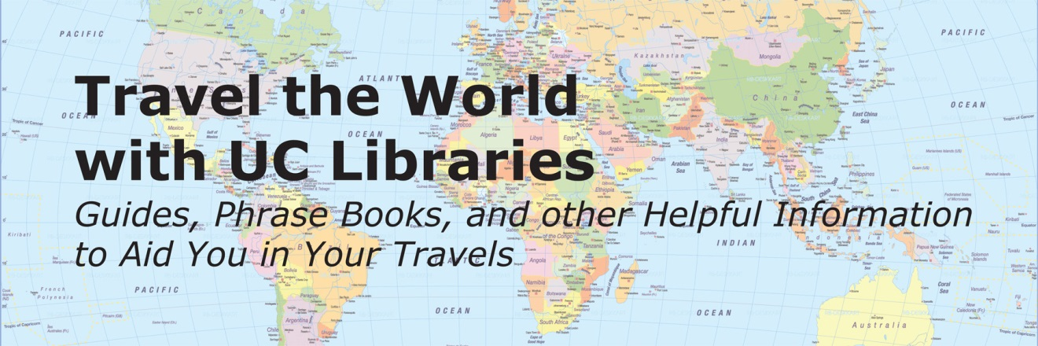
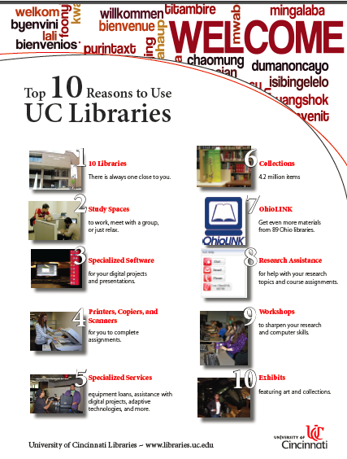
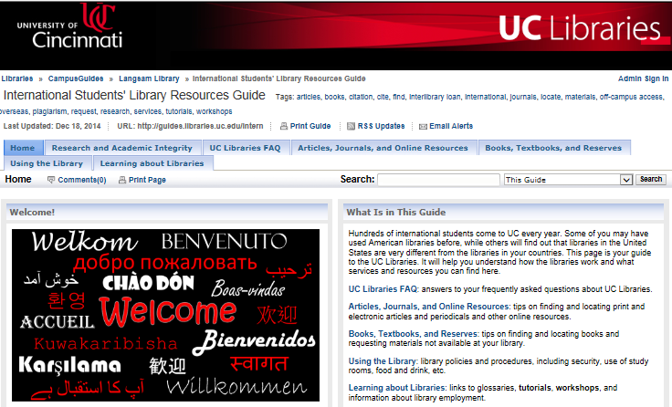

Slide 4
Grant
Enhance international student library orientation.
Give students keys to success living and studying in another country.
Provide diversity training to UCL staff and student employees.
Notes:
Enhance online and face-to-face international student library orientation to create a solid foundation for academic success by emphasizing concepts related to U.S. academic culture, libraries, and scholarship practices.
Provide diversity training to UCL staff and student employees to raise the level of awareness of issues around diversity and inclusion.

Slide 5
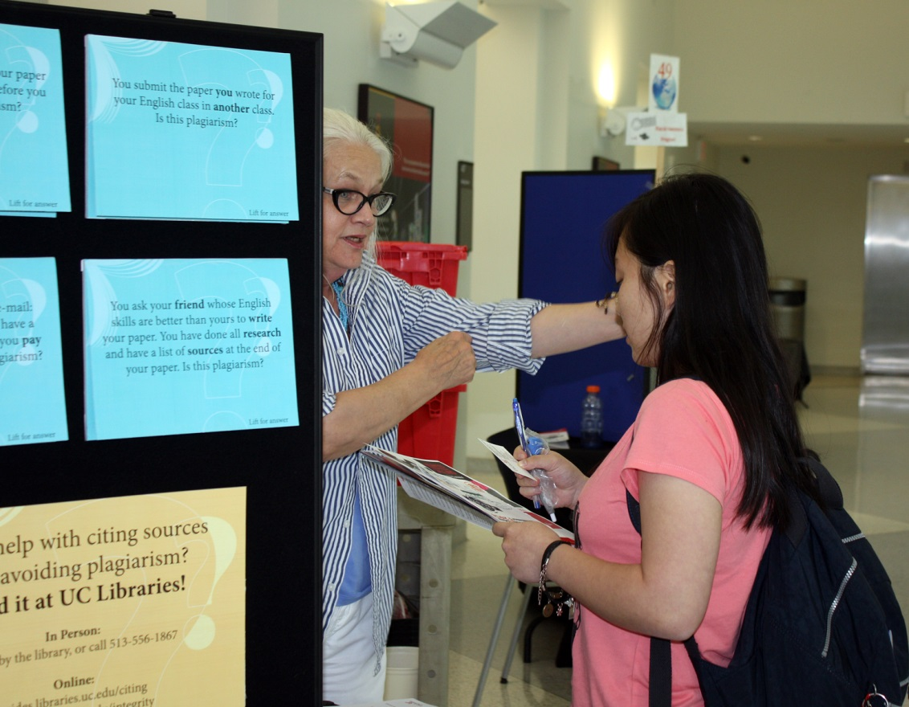
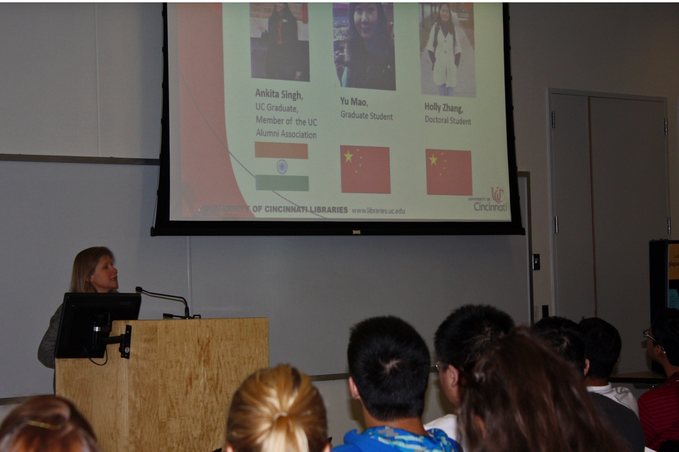
Orientation: Conference
Notes:
UC Libraries were honored to be part of UC’s first Orientation International Students Conference. We had an hour-long session with the students. The presentation was designed by 3 international student, a grad, an undergrad, and an alum. They helped to make sure that the presentation contains all essential information for new international students and at the same time not overwhelming, fun, and easy to understand. We were very happy with the level of interaction, but we wanted to make sure that we can meet more students and give an opportunity to students who might not have wanted to ask questions in front of an audience to learn what they needed to know, so we also provided a table at the resource fair. More students stopped by to talk to Rosemary and Holly and check their knowledge of plagiarism using a simple interactive lift-the-flap exhibit.

Slide 6
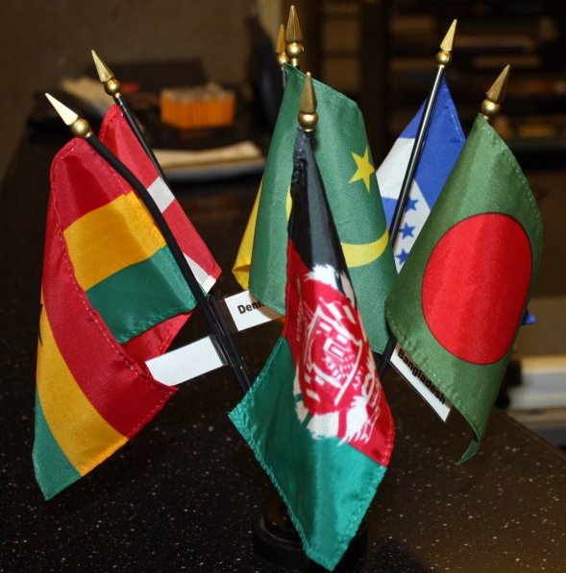
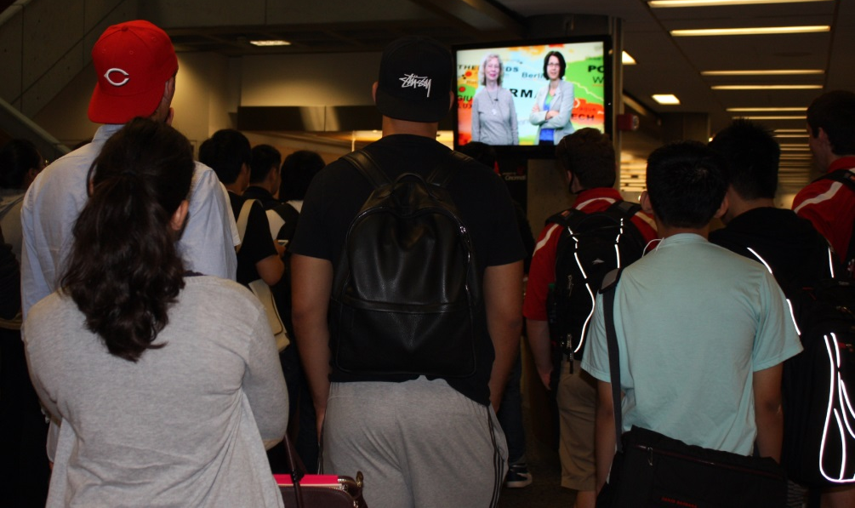
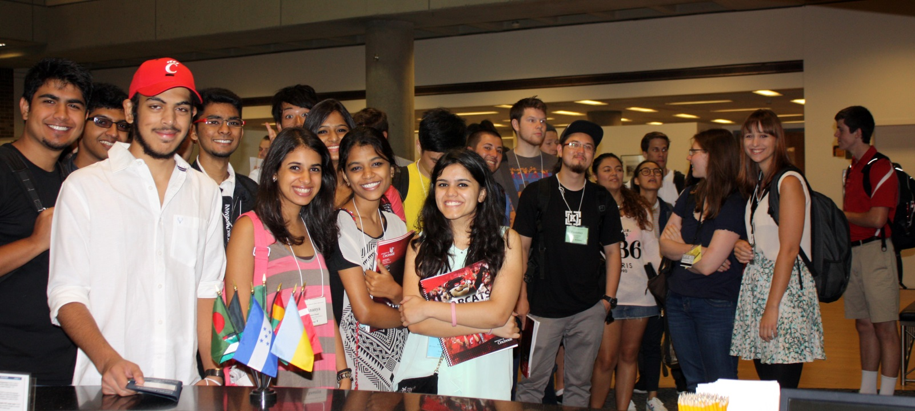
Undergraduate orientation: a warm welcome
Notes:
The next day we hosted active, hands-on orientation for undergraduate international students in Langsam Library. We wanted to make sure that students felt welcome the moment they step into the library. The library was decorated with the flags representing the 117 countries of the UC international family. At the very beginning of their library tour the students watched a video, in which Dean Wang, originally form China, greeted the students in English and Chinese. In 2014 we expanded the video by adding greetings in several other languages recorded by librarians, faculty, staff, and students. Let’s watch a snippet from this brief video, which set a wonderful tone for the orientation experience.

Slide 7
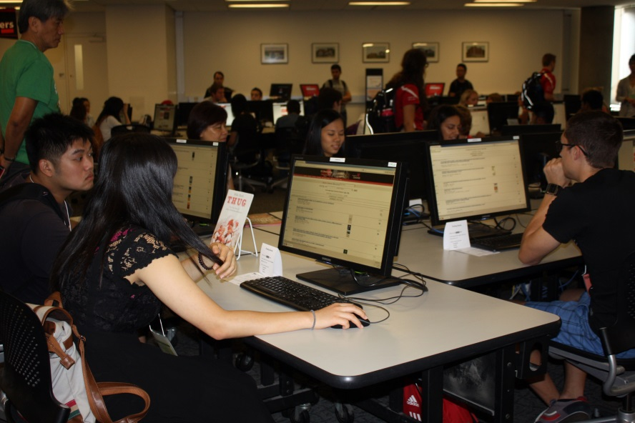
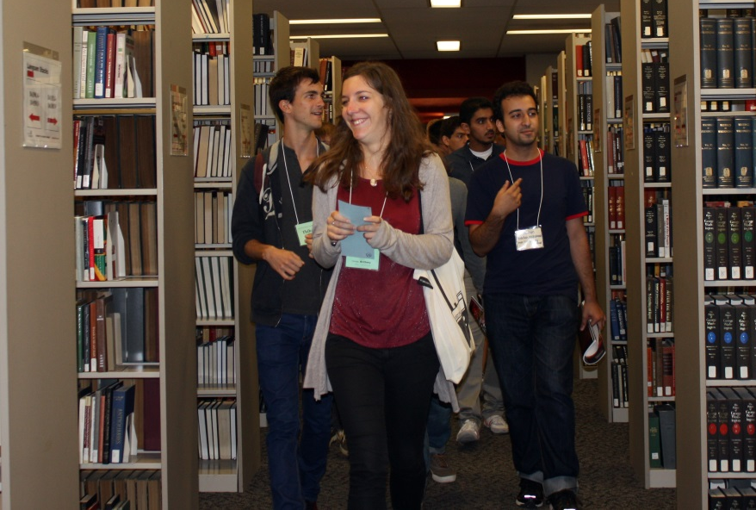
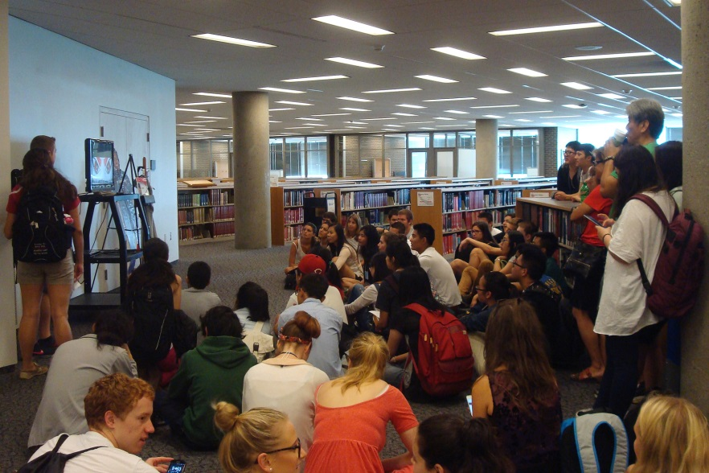
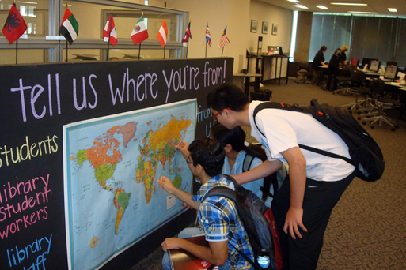
Undergraduate orientation: active exploration
Notes:
These pictures show some of the orientation activities. The students searched the catalog and located books in the stacks. We had carefully selected books for this activity. One of the learning outcomes we had in mind for the students was to show that in our collection we had books about different countries and cultures written by international authors. The students also learned about printing and safety. In the final activity we asked the studnets to put star stickers on the map of the world to indicate where they came from. We displayed the board throughout the Welcome week and added the map of the US so everyone walking into the library can put their star on the map.

Slide 8

Online orientation
Notes:
One of the grant objectives was to develop online orientation that students could watch prior to their arrival to UC or anytime they had a need to learn something. This is still in progress, because UC has licensed perfect software for this purpose and training will occur in three weeks, However Holly has done a lot of research for the content and she will talk about what this orientation will look like.

Slide 9
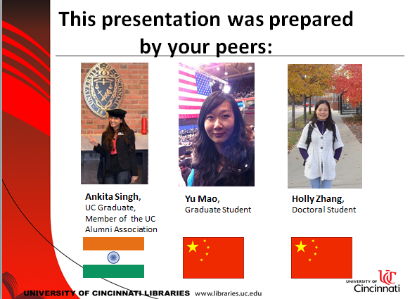
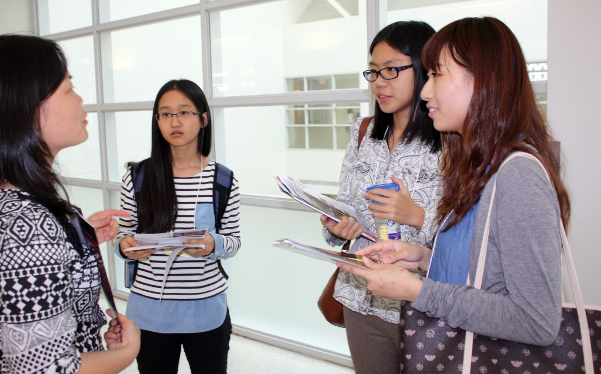
Key to success:
Engage international students in planning
and delivering orientation.
Notes:
Thanks to the matching grant from UC Libraries were we able to hire international students to serve as liaisons to students organizations and help with developing online resources, print materials, and events. We felt that this arrangement will benefit the libraries as well as the students. In addition some students including a student orientation leader volunteered to help. You can see how happy students were to talk to Holly: it was their first day at UC, the amount of information was overwhelming, and it was nice to give them an opportunity to chat with Holly in their native language.
At this point I would like to turn it over to Holly to speak about her experiences.

Slide 10
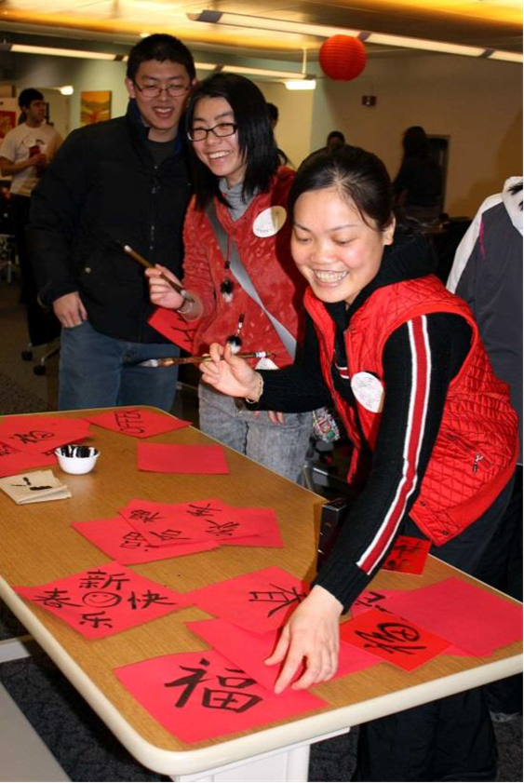
Student experiences: Holly
“UC Libraries provides an ideal environment for both domestic and international students.”

Slide 11
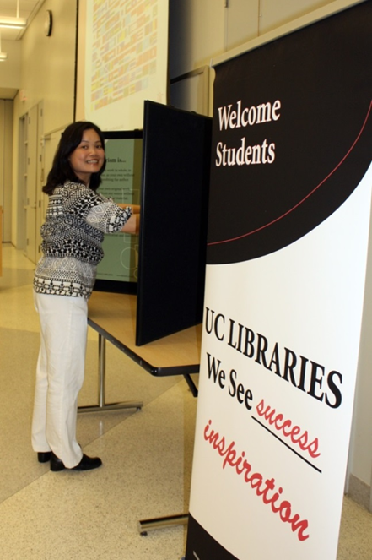
Work at the library: orientation
Notes:
From the job description: Assist librarians with projects for international students funded by the Diversity Grant:
August, 2014: orientations to UC Libraries for international students
From the job description: Assist librarians with projects for international students funded by the Diversity Grant:
October, 2014: table tennis tournament at Langsam
November, 2014: Event for domestic and international students “Coming Together to Give Thanks”
October - December, 2014: Research online library guides and orientation for international students

Slide 12
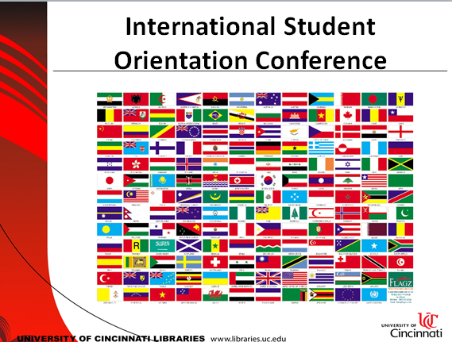
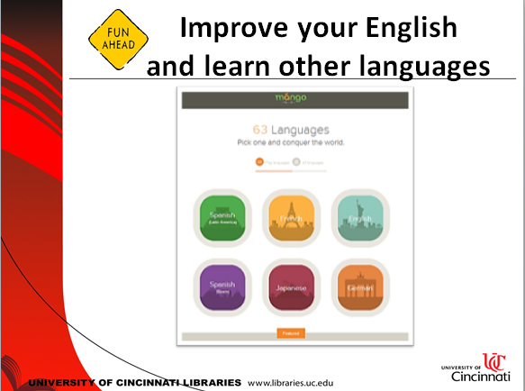
Holly’s approach to orientation: color and design

Slide 13
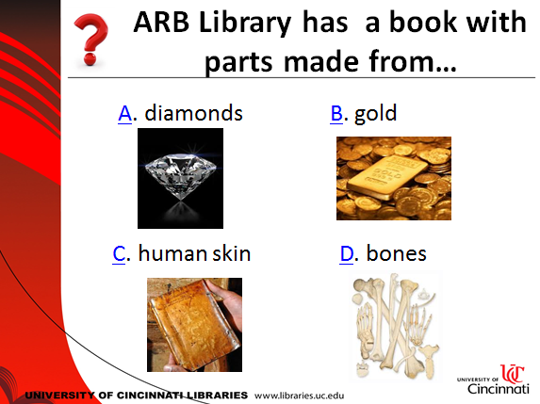
Holly’s approach to orientation: interactivity and fun

Slide 14
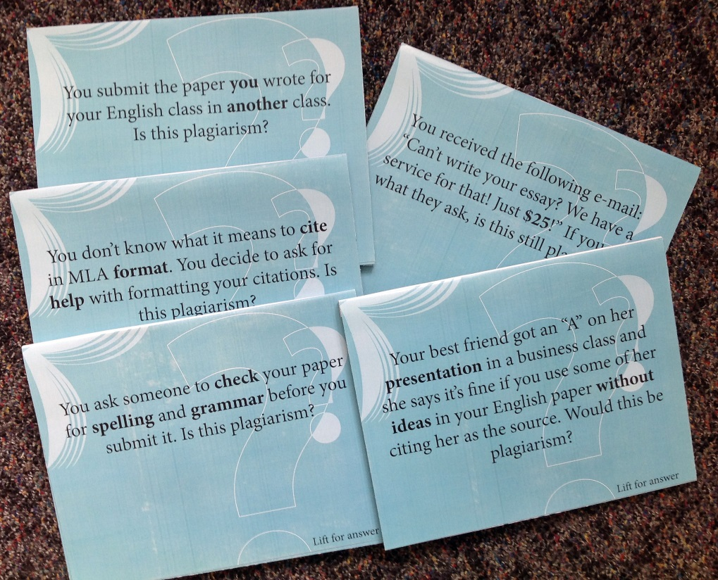
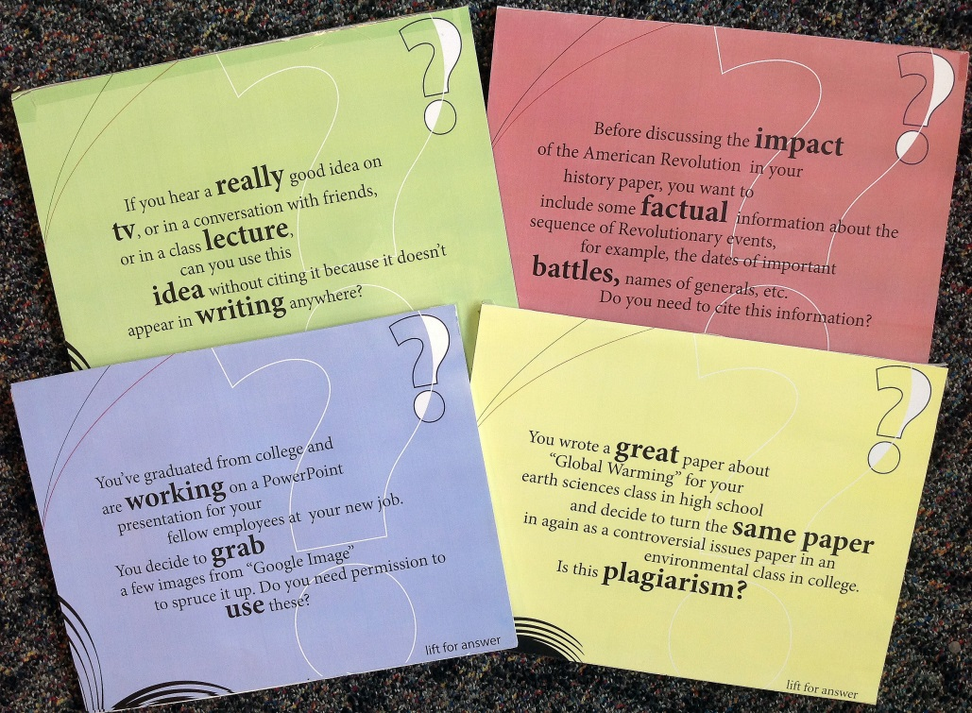
Holly’s approach to orientation: address language difficulties

Slide 15

Online orientation: building blocks
A place to share and interact
How to check out books
How to get books not at UC
How to print
About U.S. libraries
Video tour of UC libraries

Slide 16
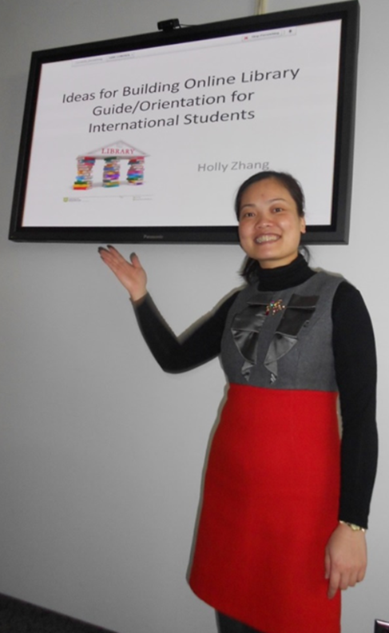
Online orientation concepts
convenience
information
intuitive design
interaction
open space
support

Slide 17
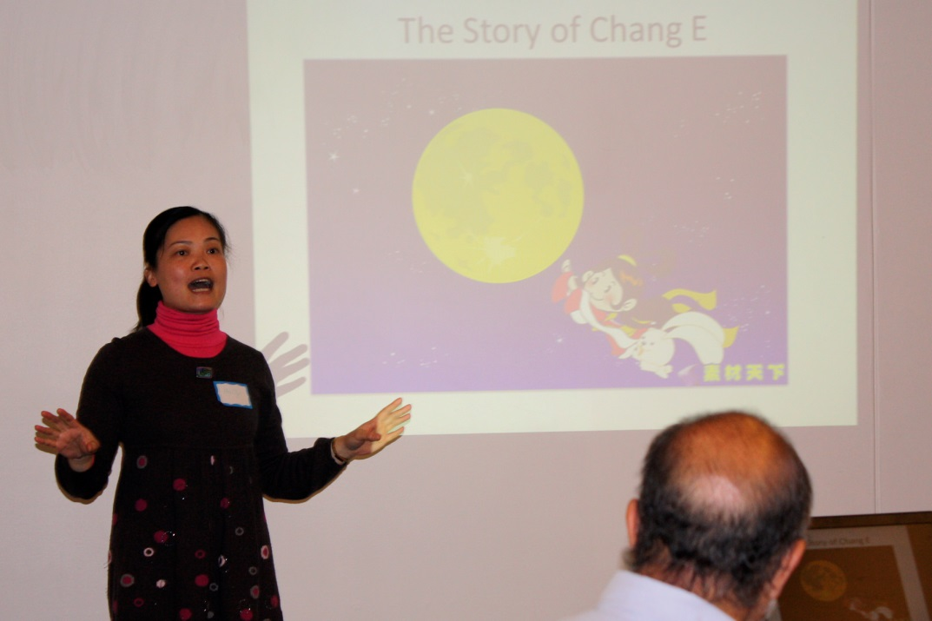
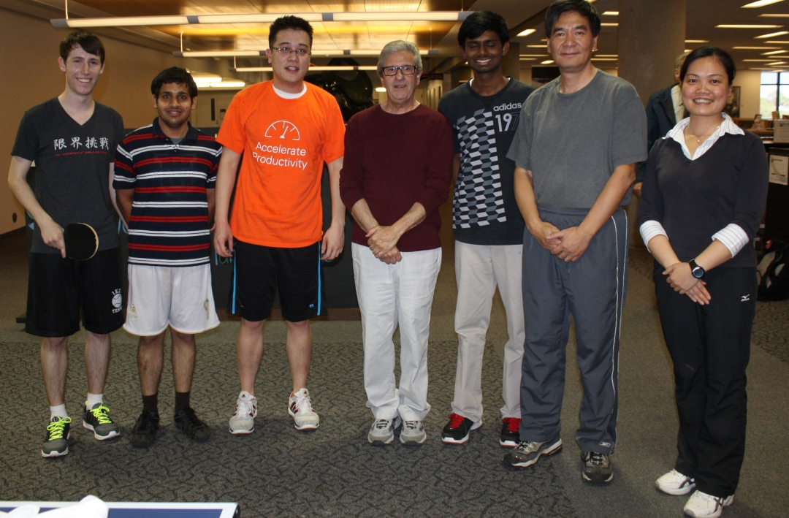
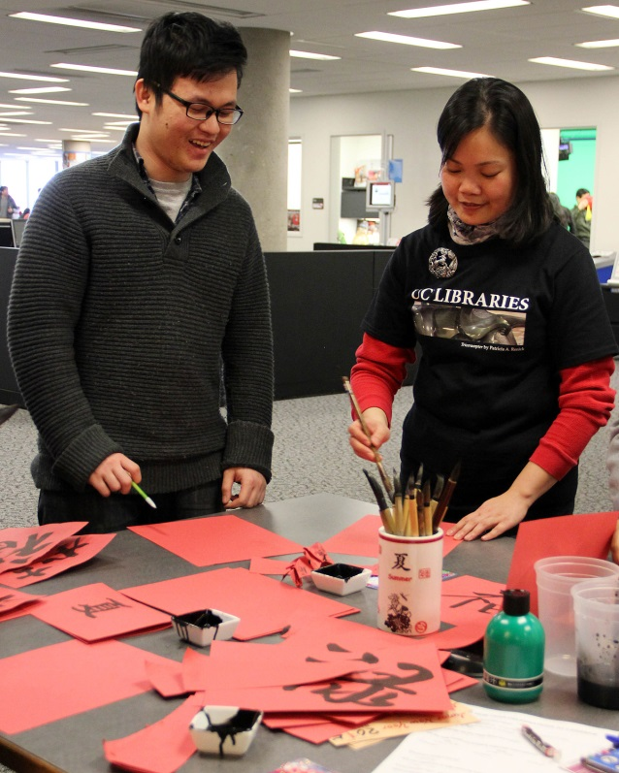
Work at the library: events
Notes:
From the job description: Assist librarians with projects for international students funded by the Diversity Grant:
October, 2014: table tennis tournament at Langsam
November, 2014: Event for domestic and international students “Coming Together to Give Thanks”
October - December, 2014: Research online library guides and orientation for international students

Slide 18
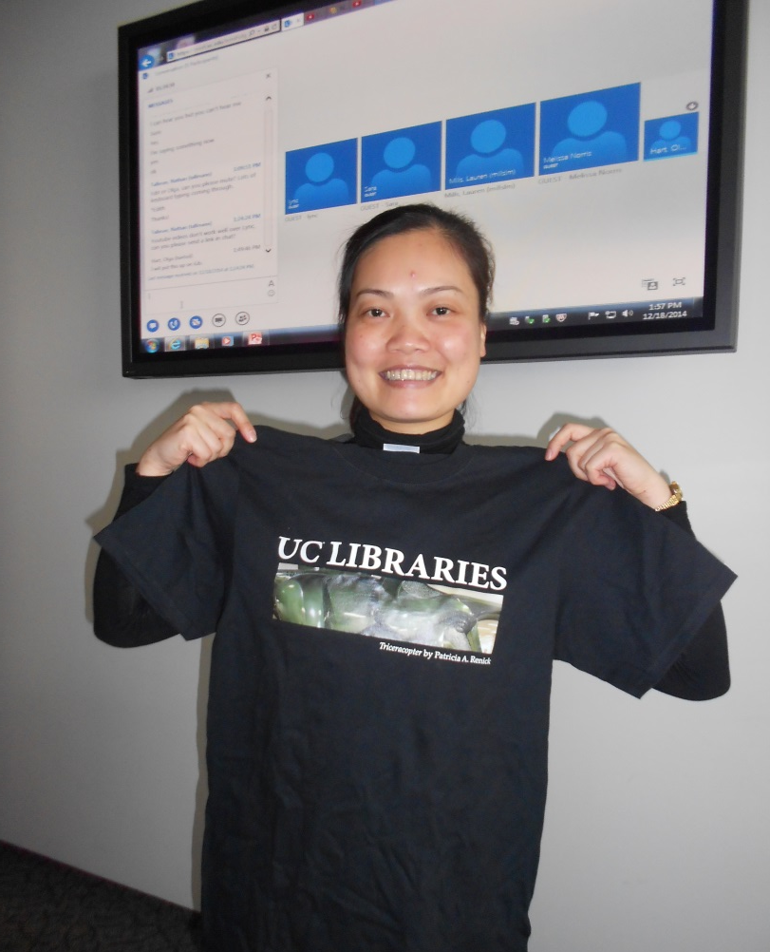
Holly’s takeaways from working at UC Libraries
increased knowledge of the libraries
acquired knowledge and skills
built up connections and friendships
improved awareness of diversity

Slide 19
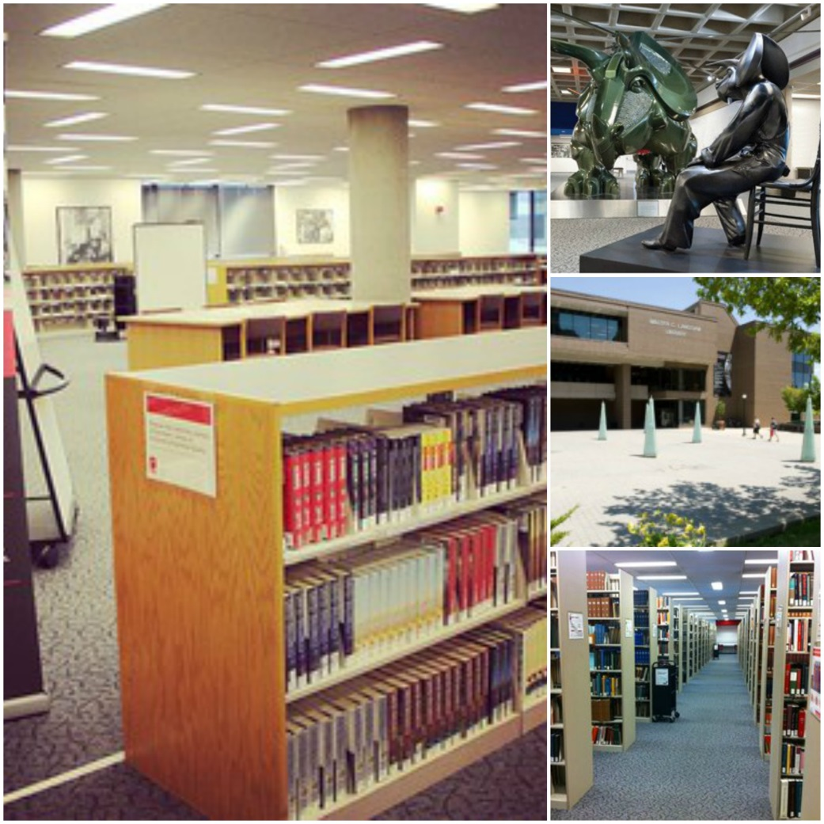
Student Experiences: Anvita
“Library: a building or room containing collections of books, periodicals, and sometimes films and recorded music for people to read, borrow, or refer to.”

Slide 20

“To build up a library is to create a life. It’s never just a random collection of books.”
–Carlos María Domínguez
“A library is the delivery room for the birth of ideas”
–Norman Cousins

Slide 21
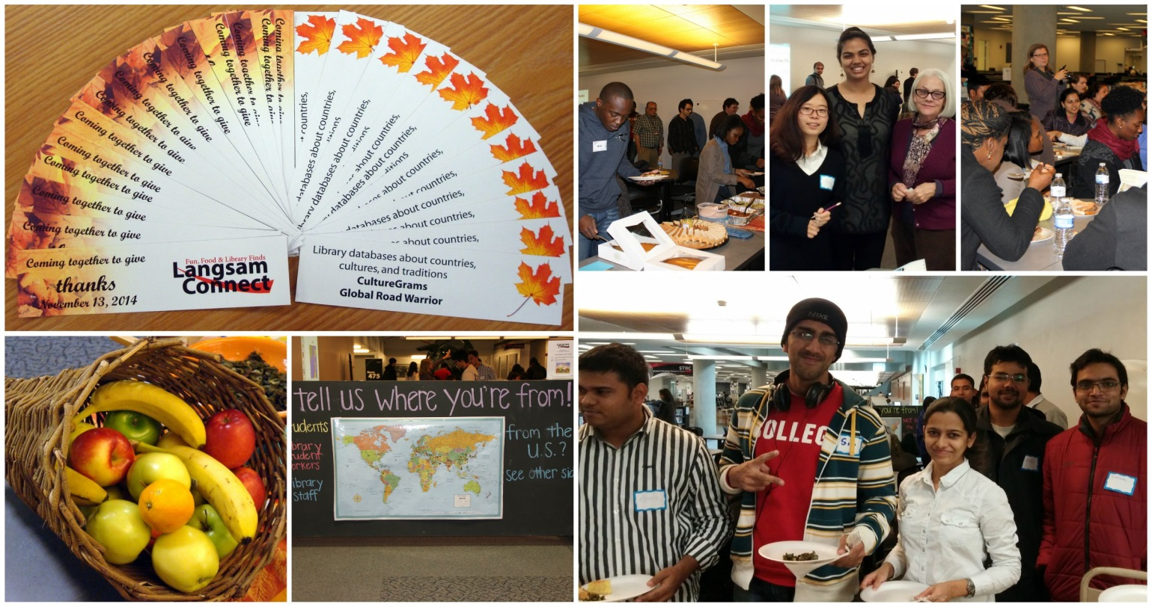
Where it all began
Volunteering to be a speaker at the
“Coming Together to Give Thanks” event.

Slide 22

I helped organize the “Lunar New Year” party at the library
I am also working on the Library video tour and orientation
I had the opportunity to participated in a Cultural Panel for library staff about cultural differences and experiences of international students

Slide 23
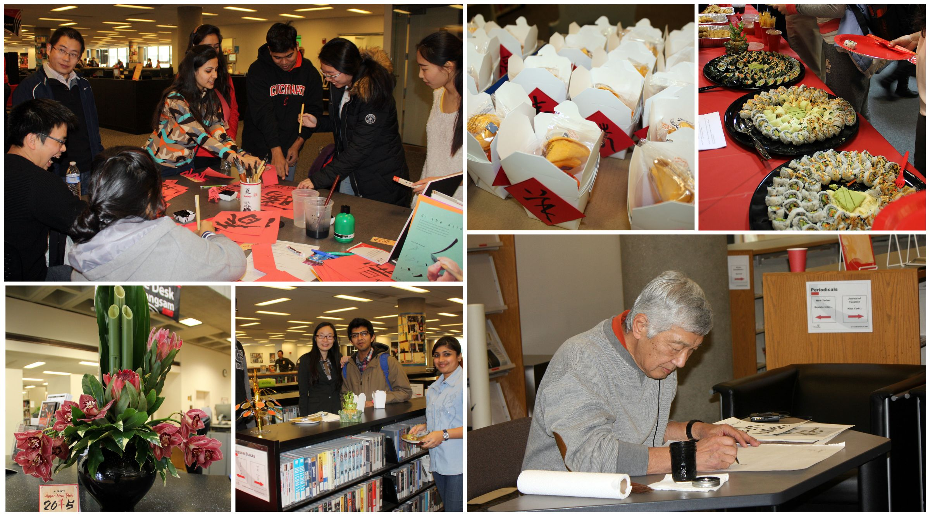

Slide 24
What I have learned..
By participating and then organizing events at the library it helped me make great connections with students as well as faculty at UC.
I learned about different cultures and overcoming stereotypes and preconceived notions about people from different cultures. 
It helped me meet people from different cultures and gets you out of your comfort zone of staying with people from your own culture.

Slide 25
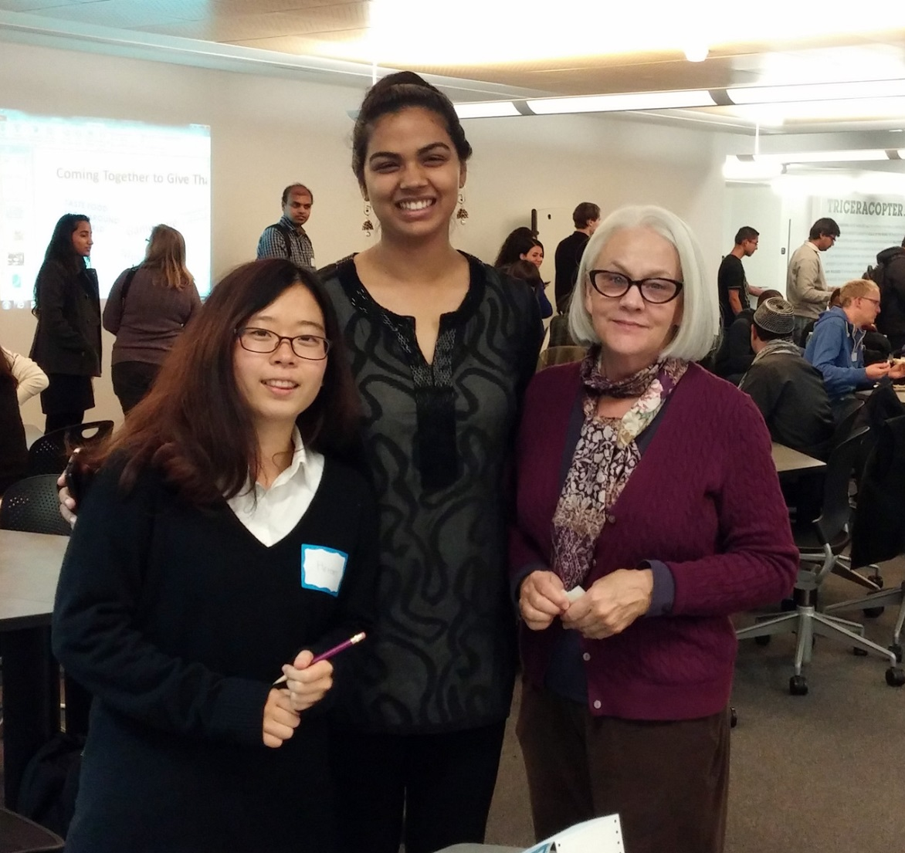
What I have learned..
It has helped me develop myself on an overall level and gave me the opportunity to give guidance to new students to make it easier for them to get accustomed to university life.
The events that are organized, help students to indulge in some fun activities and take a break from their hectic schedules.

Slide 26
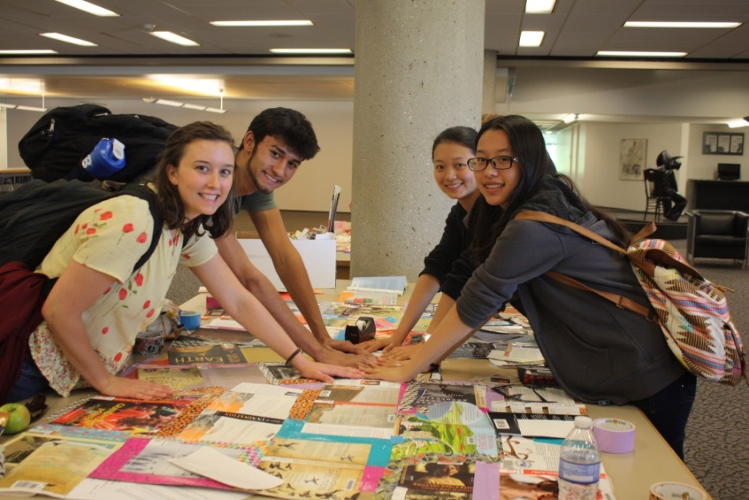
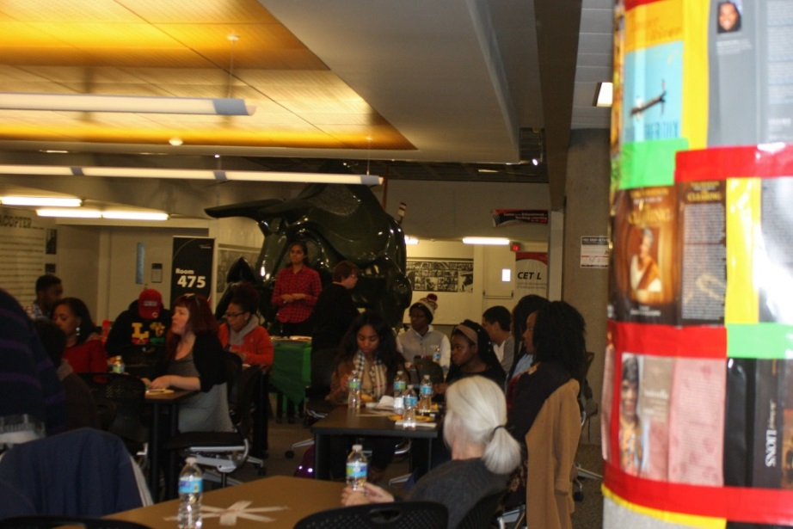
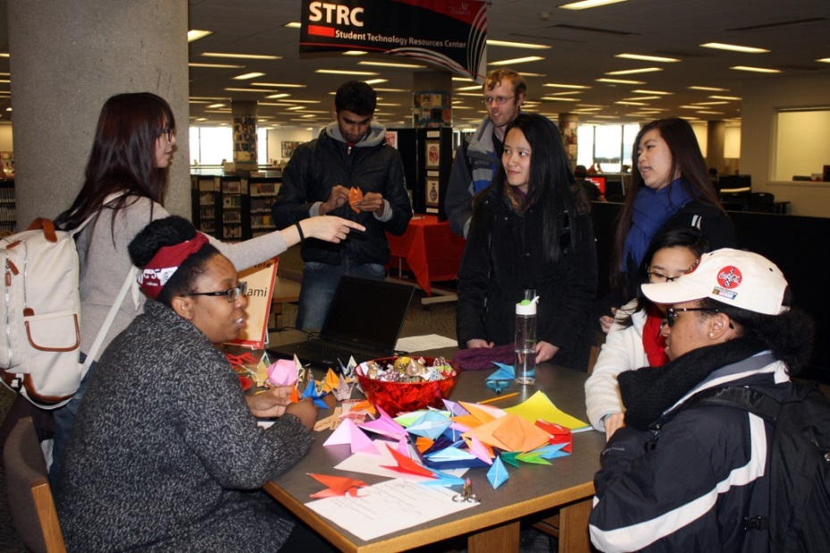
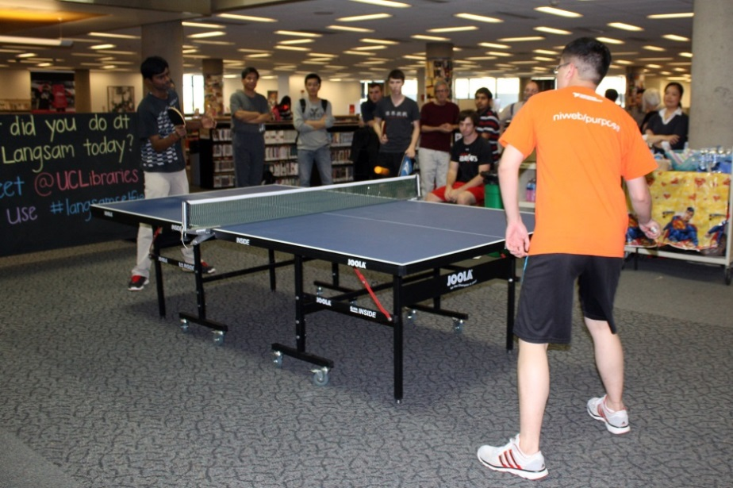
Events: creating a diverse multicultural community
Notes:
To recap what Holly and Anvita said, library events helped bring domestic and international students together, and build a better understanding of the diversity on campus.

Slide 27
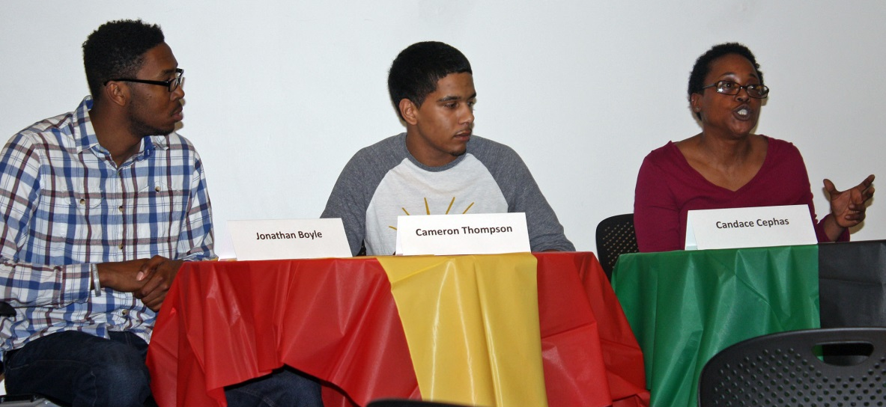
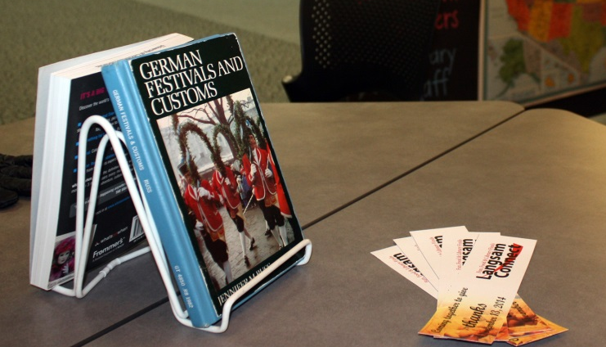
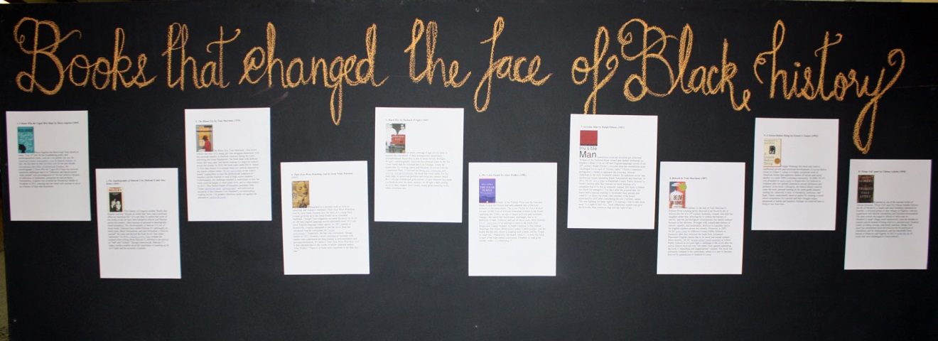
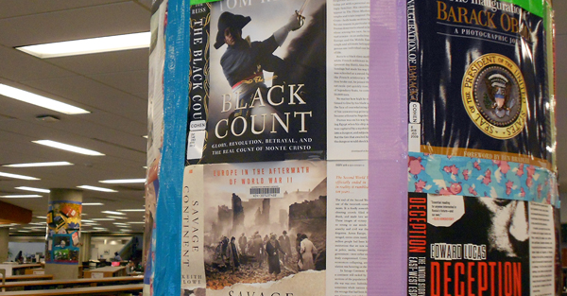
Events: helping students succeed
Notes:
At the same time most events also had educational learning outcomes. We helped students discover library resources and learn about collections and services. At the Discovering Your Roots event students talked how they had used the library edition of Ancestry.com to research gamily history. This event as well as our Thanksgiving event featured book form the library collection. At the beginning of the year we offered a fun event in which students created community art using dust jackets from the Cohen Enrichment collection. They learned about the collection and their work has been on display in Langsam Library for the whole year. Attractive cover designs draw students’ attention and if they become interested in a book they can see the book’s call number and check it out.

Slide 28
Events: invitations and tips
For students
watch library websites and social media for event announcements
volunteer or participate
suggest ideas for events
For faculty
help us spread the word to your students
encourage your students to volunteer
suggest event ideas to us; consider presenting
invite us to your events
Include students in event planning

Slide 29
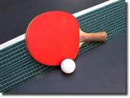





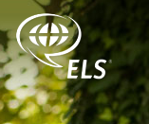

Building relationships with campus organizations
Table tennis club
Notes:
Through events library faculty and staff got to know our patrons better and this will help us provide better services to them. We have a network of friends, including a number of student organizations as well as campus services and academic departments.

Slide 30
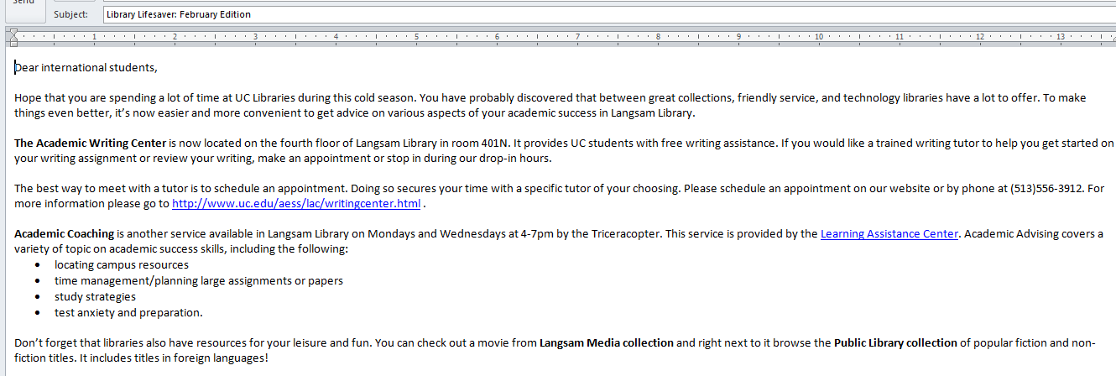
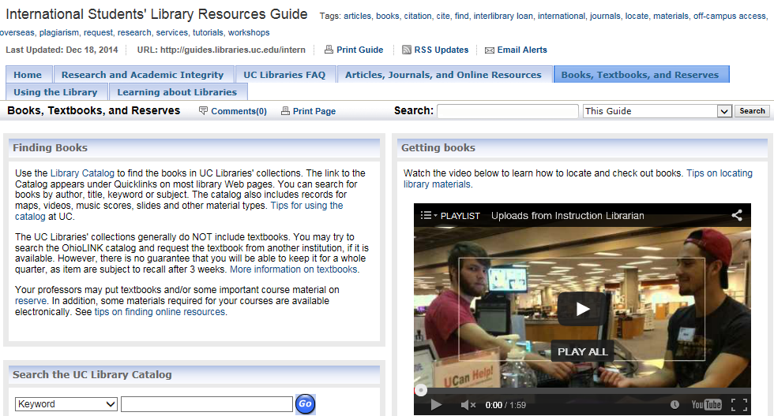
Helping student succeed: online support
monthly newsletter
improved
online guide
Notes:
In addition to orientation and events, we used other ways to help students succeed. We sent out a monthly email newsletter Library Lifesaver. It featured resources and services especially relevant at certain times of the semester, for example, library workshops, special services during the exam week, answers to frequently asked questions, etc. Thanks to Holly’s research and recommendations we have been able to enhance our online guide, for example, by embedding online videos.
Now I would like to turn it over to Rosemary.

Slide 31
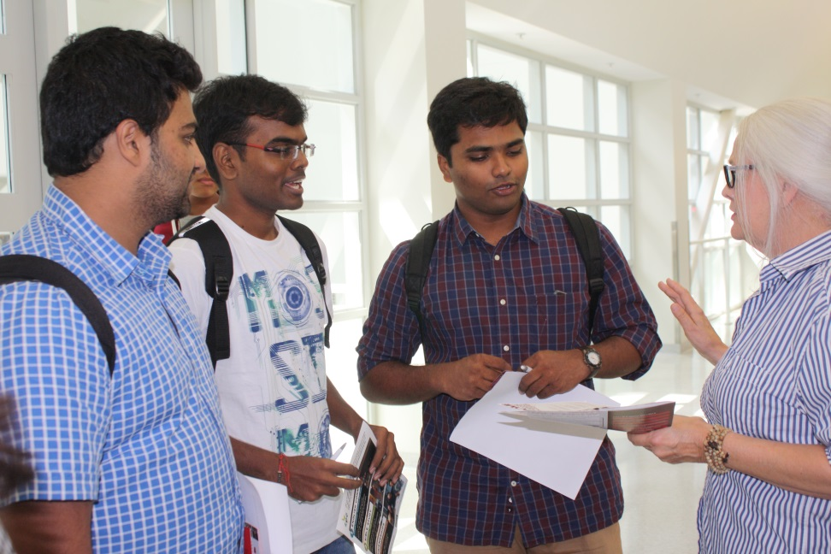
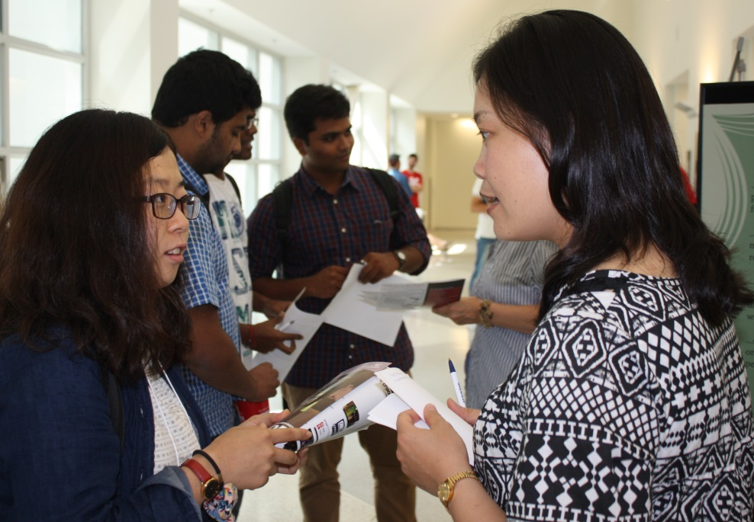
Mentoring
  student organizations
  international librarians
  student workers, international students

Slide 32
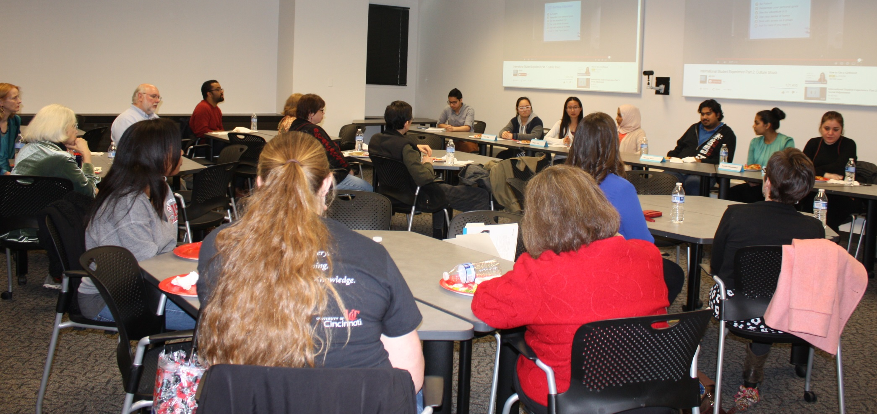
Diversity training: student panel
Notes:
Another important goal of our grant-funded activities was to provide diversity training to UCL staff and student employees to raise the level of awareness of issues around diversity and inclusion. We worked with the ESL Language Center to organize a student panel attended by library and UC International staff. During the panel students talked about their experiences of living in the US and studying at UC. They talked about misunderstandings and difficulties thy had had due to cultural differences and differences in education systems in the US and their countries. They students offered some great insights and advice to the university services in working effectively with students from diverse nationalities and academic backgrounds. The panel was recorded and we’ll be using it in the future to train student employees and have conversations with staff and students about diversity.

Slide 33
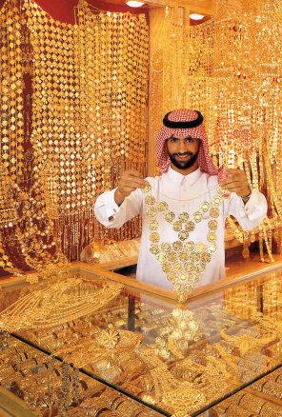
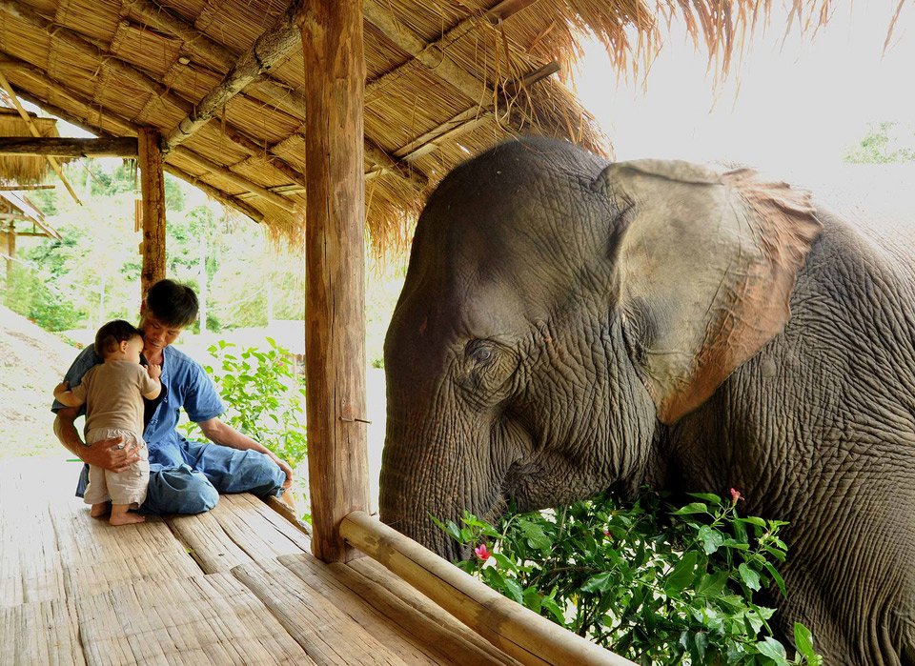
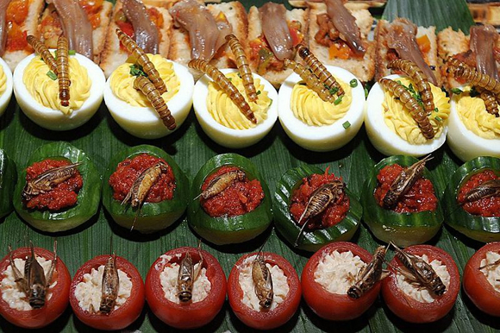
Student panel: dealing with stereotypes
Notes:
We also asked the students top describe situations in which they felt it necessary to be an ambassador for their country, including situations in which they needed to clarify incorrect stereotypes or assumptions about your home cultures.

Slide 34
Diversity panel: student quotes
“Everywhere we have good people, bad people, and everyone is representing himself… Bad things [we do] relate to ourselves, not the whole culture… The act of the government does not represent the whole people…
We are different in out perspectives. I think I am ambassador for you to them and for them to here…”
“Through events… you meet people from different cultures and it helps you understand other cultures better. As you meet people you understand their backgrounds better and why they are who they are. People surprise you all the time.”

Slide 35
Student panel: staff feedback
“I was impressed by all the information the students gave and learned that it is much harder for them than
I realized.”
“This was a wonderful event. I am so glad that we captured it on video. The students were fantastic. Venus’ words should be spread to the whole world, since she was so articulate. “
“… it was very forward-thinking for UC Libraries to provide this forum for the students. The panel on cultural differences was their first time several students got to speak to a large audience. “
“What a wonderful group of students. A couple of my takeaways included their honest perspective and in particular the student from Iran. “
Notes:
We received very positive feedback form the staff who attended the panel, including suggestions for future events to deepen our understanding of diversity and enhance our cultural competemcy, such as conversations with library staff who have traveled to other countries, panels of domestic and international students. On April 14th we are going to host another panel on study abroad experiences. Please help us spread the word.

Slide 36
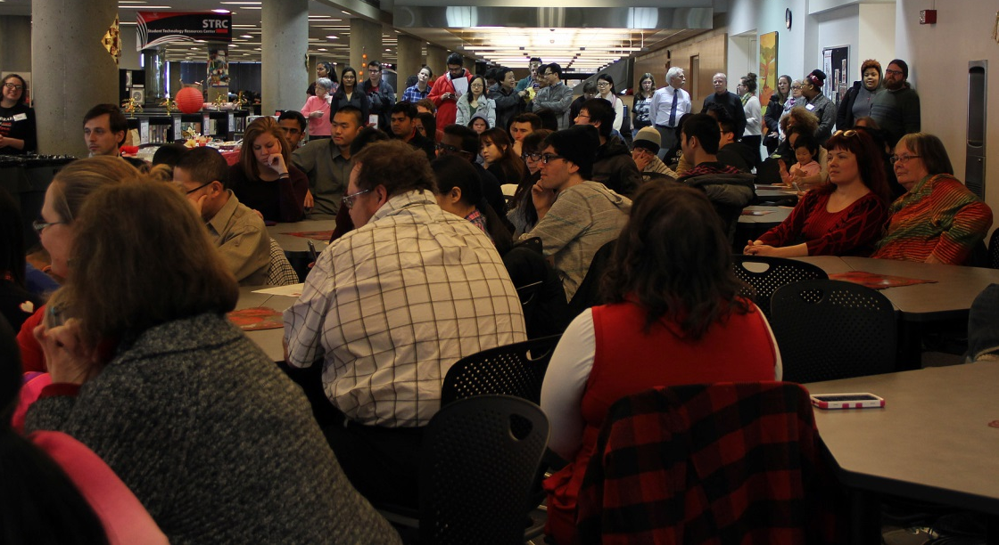
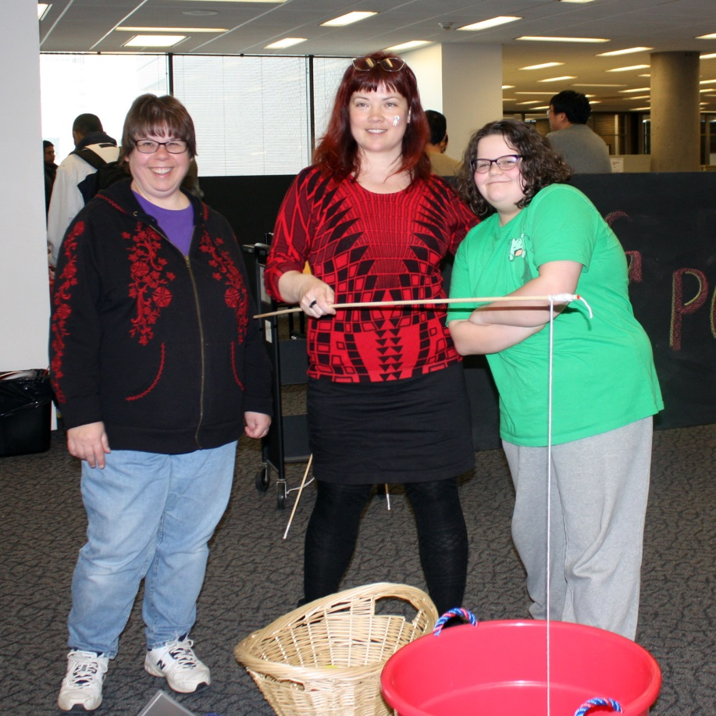

Diversity training: attending events (and working with students on events)
Notes:
As our staff said on multiple occasions, what really helped them deepen their understanding of diversty was attending library events with an international focus and especially being involved in the planning and presentation of those events working side by side with students.

Slide 37
Comments? Questions?
We’d love to hear from you!
Please contact us:
olga.hart@uc.edu
rosemary.franklin@uc.edu
shashiaa@mail.uc.edu (Anvita)
zhang2hg@mail.uc.edu (Holly)
Notes:
We would love to invite comments and questions. If you think of something later, you are very welcome to contact us. Also if you have an idea of an event or initiative please let us know and let’s work together.

Slide 38

Wrong Answer
Sorry!
Try again.
Image source: http://www.epa.gov/opptintr/itc/pubs/tscacbitesting/28e.htm

Slide 39

Wrong answer
Sorry!
Try again.
Image Source: http://www.thesimpsons.com/

Slide 40

Correct! Make an appointment to see the book!
Continue

