Slide 1
Engaging Diverse Voices:
Bridging Opposing Views to Build Commonality
IRL and Online
Stephanie Sesic Greer
Kent State University at Geauga

Slide 2
Building Commonality: Pedagogy
Rogerian argument can be applied and assessed by students in real-world and online settings to foster empathy for opposing viewpoints.
In “Communication: Its Blocking and Its Facilitation,” Rogers states, “[I]t is just when emotions are strongest that it is most difficult to achieve the frame of reference of the other person” (86).
According to data published in “What Makes Online Content Viral,” “Content that evokes more anger . . . is more likely to be shared” (Berger and Milkman 200).

Slide 3
Building Commonality: Objectives
Apply and assess Rogerian argument to:
Increase rhetorical knowledge of audience
Question underlying assumptions
Broaden perspective
Compose multimodally:
  Essay
  Online Discussion
  Presentation

Slide 4
Building Commonality: Assignment
Part 1: Survey of Student Politics
President Trump is going to make America great again.
The Trump administration is leading the country in the wrong direction.
Trans people should use the bathroom of the gender they identify as.
Trans people should use the bathroom that agrees with their assigned gender at birth.
Racial injustice is still a big problem in America.
Racism is no longer a large contributing factor to inequality in America.
Healthcare should be paid for by individuals or their employers.
The government should provide free healthcare to everyone.
We need stricter immigration policies.
We need more welcoming immigration policies.
We don’t really need feminism in this country anymore.
Women in America still aren’t equal to men.

Slide 5
Building Commonality: Assignment
Part 2: Partners Workshop 1
Stereotypes, Refutation, and Clarification
(adapted from Better Angels)
Stereotypes: What are the most common stereotypes that your opponents believe about you?
Refutation: Why are those stereotypes mistaken or exaggerated?
Clarification: What questions would you ask your opponents in order to better understand the experiences, feelings, and beliefs of those who differ with you?

Slide 6
Building Commonality: Assignment
  Part 2: Partners Workshop 2
  Summary of Partner’s Opposing View
  Students write a summary of their partner’s position on their assigned issue, then revise their summary based on feedback from their partner.
  “Each person can speak up for himself only after he has first restated the ideas and feelings of the previous speaker accurately, and to that speaker’s satisfaction” (Rogers 85).

Slide 7
Building Commonality: Assignment
Part 3: Argumentative Essay
Students write a five-page essay supporting their position on the topic assigned to them and their partner.
The essay uses five sources, including their partner workshop materials and one source that supports their partner’s opposing view.

Slide 8
Building Commonality: Assignment
Part 4: Using Rogerian Argument Online
“[C]ontent that evokes high-arousal emotions (i.e., awe, anger, and anxiety) . . . is more viral” (Berger and Milkman 197).
Using the “listening with understanding” principle of Rogerian Argument, students respond in an online forum to a post that represents the opposing view on their topic by:
1. Summarizing the post’s argument in an effort to demonstrate an understanding of the poster’s point of view.
2. Providing a counterargument to the post and stating their own position on the issue.

Slide 9
Building Commonality: Assignment
Part 5: Student Presentations
Analyzing Rogerian Argument IRL & Online
Students present a PowerPoint to the class in which they:
Discuss how their partner challenged their assumptions about those who disagree with them on a political issue
Present the results of their online discussion
Analyze the effectiveness of Rogerian Argument in-person versus online

Slide 10
Building Commonality: Outcomes
Survey of Student Politics Data:
Healthcare was the most important issue to half the students, with 60% favoring government-funded healthcare.
Immigration was the second most important issue, with 70% favoring more welcoming immigration policies.
Highest consensus: 80% (including Trump supporters), agree that racial injustice is still a large contributor to inequality in the U.S.
60% think the Trump administration is leading the country in the wrong direction, but the issue was ranked second lowest in overall importance.

Slide 11
Building Commonality: Outcomes
Student Findings: Challenges to assumptions
“At first I believed that people with the opposing viewpoint would be completely against the idea of the border, but I learned this is not always true. People who support more open borders feel passionate about immigrant families seeking better opportunities.”
“My opinion of people with the opposing view was challenged because usually, people who agree with transgender men and women using the bathroom of their choice are seen as more liberal and those who do not agree with that are more conservative and religious. My partner directly told me that she is religious but that it is a main reason why she believes what she does; she wants to love others and treat them equally.”

Slide 12
Building Commonality: Outcomes
Student Findings: Challenges to assumptions
“My opinions of those who hold the opposing view were challenged as I found that many in opposition provide valid reasons and address concerns that those in support tend to look over. I came to realize that not everyone who opposed universal healthcare were selfish and lacked empathy towards those in a difficult position.”
“Prior to this assignment I believed someone on the other side of this issue was a specific type of person, someone who is racist but pretends they are not, or an over privileged white man who refuses to see the unequal opportunities a black man is offered. . . . I believed we would not agree on other major topics of today such as freedom of religion, women’s rights to abortion and the bathroom use of transgender people, I was wrong. This assignment helped me to discover I am just as guilty of stereotyping and assuming I know someone based on their beliefs. It was refreshing to know although my partner and I disagreed on this particular topic, we shared views on other topics.”

Slide 13
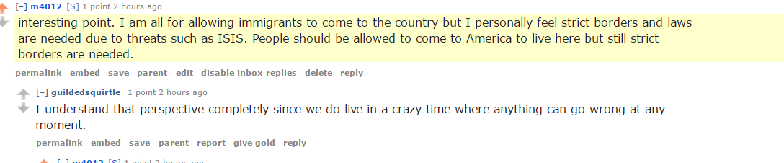
Building Commonality: Outcomes
Student Findings: Using Rogerian Argument Online

Slide 14
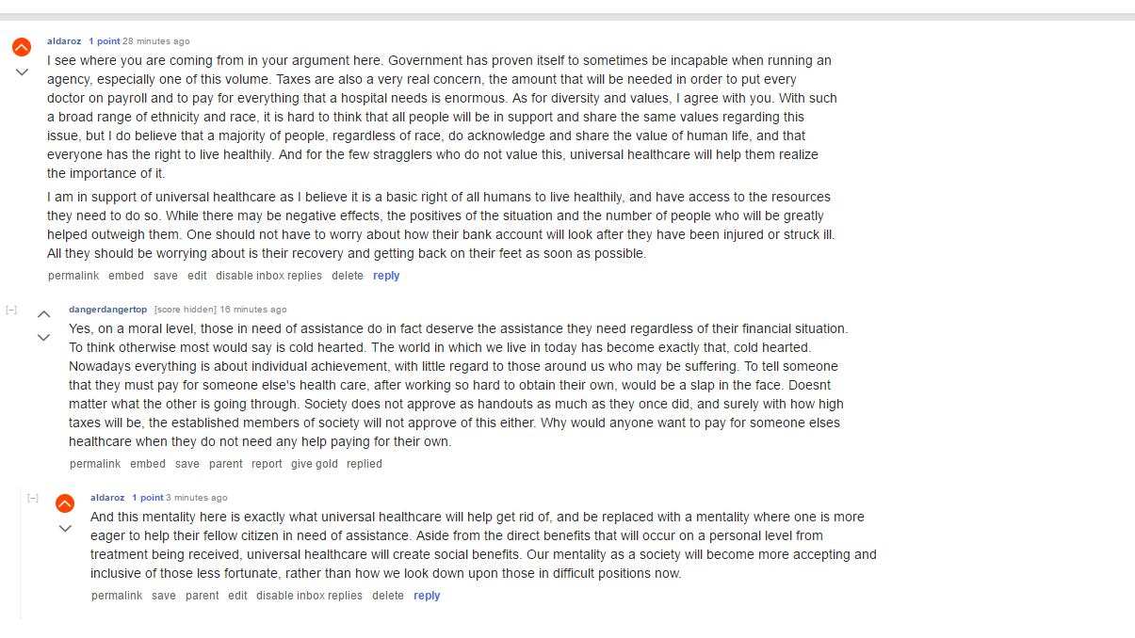
Building Commonality: Outcomes
Student Findings: Using Rogerian Argument Online

Slide 15
Building Commonality: Outcomes
Student Findings: Effectiveness of Rogerian Argument
“[Rogerian argument] is very good to online because it is hard to understand the tone of the argument unless you are in person. This way, you start off the argument with restated feelings that help give the other person an understanding, and it reduces the conflict and tension.”
“Using Rogerian Argument and relaying their beliefs and statements back to them definitely helped to create a more friendly conversation than the ones I had seen in reading previous comments on the same post. I still believe, though, that talking in-person is a much smarter and effective way to argue with someone on a specific topic.”

Slide 16
Building Commonality: Outcomes
Student Findings: Effectiveness of Rogerian Argument
“Sitting down and discussing president Trump with one of his supporters really opened my eyes and I was able to rise above my preconceived biases and see the world a little more clearly than I used to. I would like to imagine that my partner who I worked with on the subject was able to have an effect similar to this happen to his self. This form of argumentation has actually helped my recently with disagreements that I have had with my friends and family about various subjects from politics, current events and even to, ‘Whose doing the dishes tonight?’”
“For the first time I really sat down with someone and got the opposite point of view, something that rarely happens in a face to face conversation. I now see and understand more about Trump and why people dislike him than what people were saying in the last 3 years of his campaign and protests against him, because I heard the opposing point and the opposing point heard me back. Rogerian argument is in my opinion one of the most valuable and useful things we have learned.”

Slide 17
Works Cited
Berger, Jonah and Katherine L. Milkman. “What Makes Online Content Viral?” Journal of Marketing Research, vol. XLIX, April 2012, 192-205.
Better Angels. Institute for American Values, 2017. http://better-angels.org. Accessed 1 June 2017.
CGP Grey. This Video Will Make You Angry. YouTube. 10 Mar. 2015,
https://www.youtube.com/watch?v=rE3j_RHkqJc. Accessed 1 June 2017.
Rogers, Carl R. “Communication: Its Blocking and Its Facilitation.” Review of General Semantics, vol. IX, no. 2, Winter 1952, 83-8.

Slide 18
Contact Information
Stephanie Sesic Greer
For questions or follow-up discussion, feel free to email me at ssesic@kent.edu.

