Slide 1
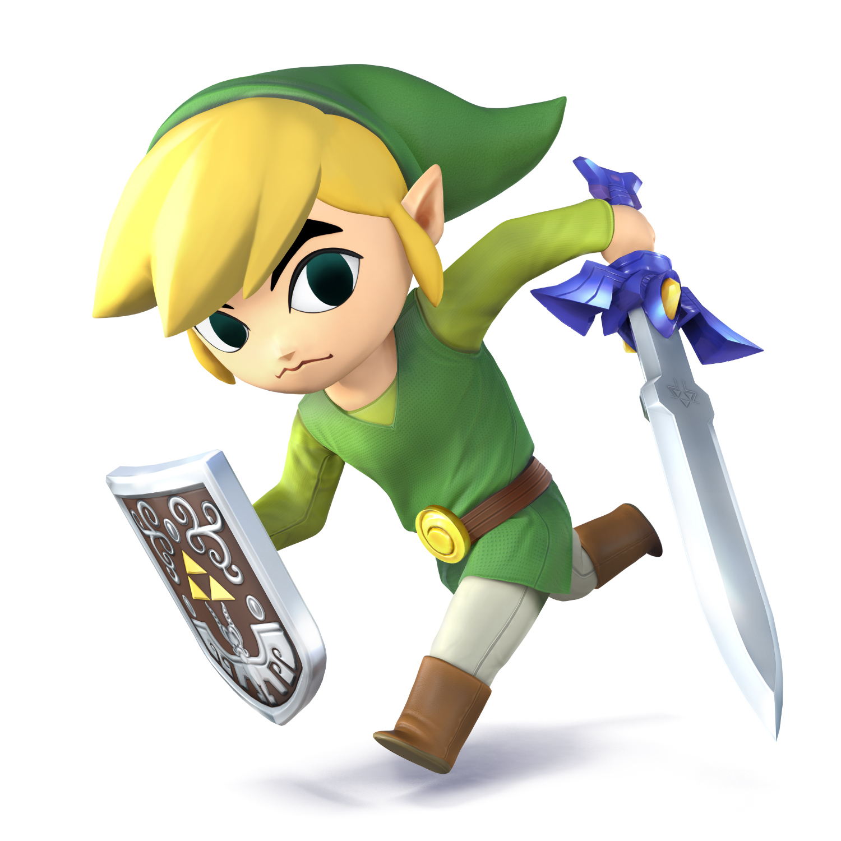
Links:
Linking Writing Activities to Make Classes Move
Scott Morgan
Assistant Prof. of English
Warner University

Slide 2

2010: My first college class
3-hour night class
30+ students
Business
majors

Slide 3
180 minutes
20 minutes
20 minutes
20 minutes
20 minutes
20 minutes
20 minutes
20 minutes
20 minutes
20 minutes

Slide 4

Statuettes
Draw & write
Literature Circles
Do Now
Think-Pair-Share
Jigsaw
Interviews
TV reporters
RAFTs
Exit slips
Choral Reading

Slide 5
20 minutes
Individual writing
20 minutes
Lecture
20 minutes
Literature circles
20 minutes
Small group activity
20 minutes
Break
20 minutes
Large group share
20 minutes
Close reading practice
20 minutes
Preview of next lesson
20 minutes
Reflection

Slide 6
Heroism in
The Epic of Gilgamesh
Opening
Writing
Lecture
Literature
Circles
Small group
Close Reading Activity
Small group
Close Reading Activity

Slide 7
Individual writing
Large group share
Defining “hero”
Small group activity
Literature circles

Slide 8

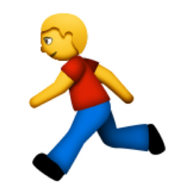


Side effects of linked activities

Slide 9
50 minute
Comp class?

Slide 10

Single topic or skill
Learning styles
Independent
Pairs
Large group
Analytical writing
Creative writing

Slide 11
5 minutes
10 minutes
10 minutes
10 minutes
10 minutes
5 minutes

Slide 12
Low-stakes writing
Lecture
Independent/Paired engaged reading
Small group activity
Large group share
Reflection

Slide 13
Activities
Learning Styles
Low-stakes
writing & drawing
Visual, Read-write
Lecture
Visual, Auditory
Independent/Paired engaged reading
Read-write
Small group activity
Visual, Auditory
Large group share
Visual, auditory, read-write, kinesthetic
Reflection
Read-write, Visual

Slide 14
Mobility
Lecture
Independent/Paired engaged reading
Small group activity
Large group discussion
Reflection

Slide 15

Mobility

Slide 16

Mobility

Slide 17

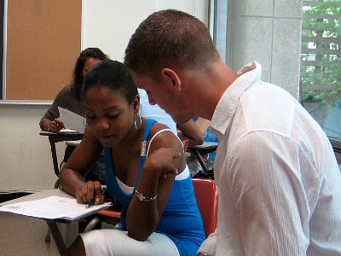


Student Engagement

Slide 18

Student Engagement

Slide 19
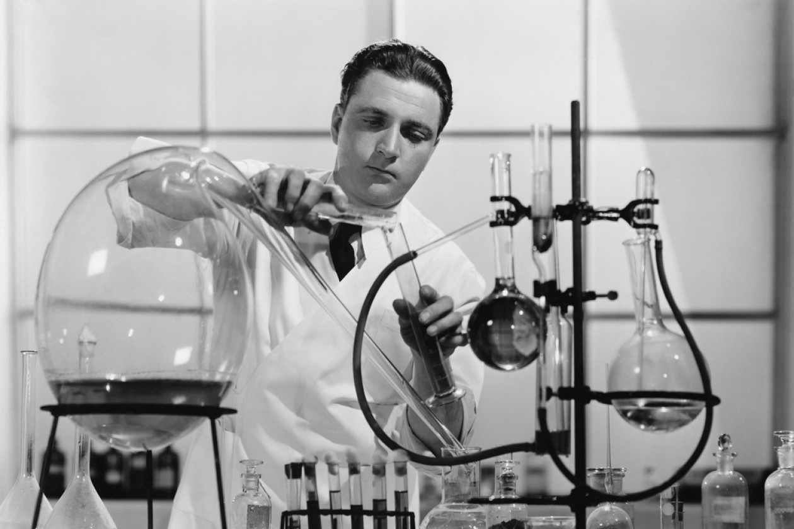
Student Engagement

Slide 20

Student Engagement

