Slide 1
Reading Strategies and Social Annotation in the Composition Course
Michelle L. Sprouse
@MichelleSprouse
Notes:
Introductions:
Name, what you teach, experience with annotations (paper, digital, social)

Slide 2
Agenda
Defining social annotation
Theoretical framework
Social annotation affordances
Social annotation in FYC study
Demonstration
Best practices
Discussion

Slide 3
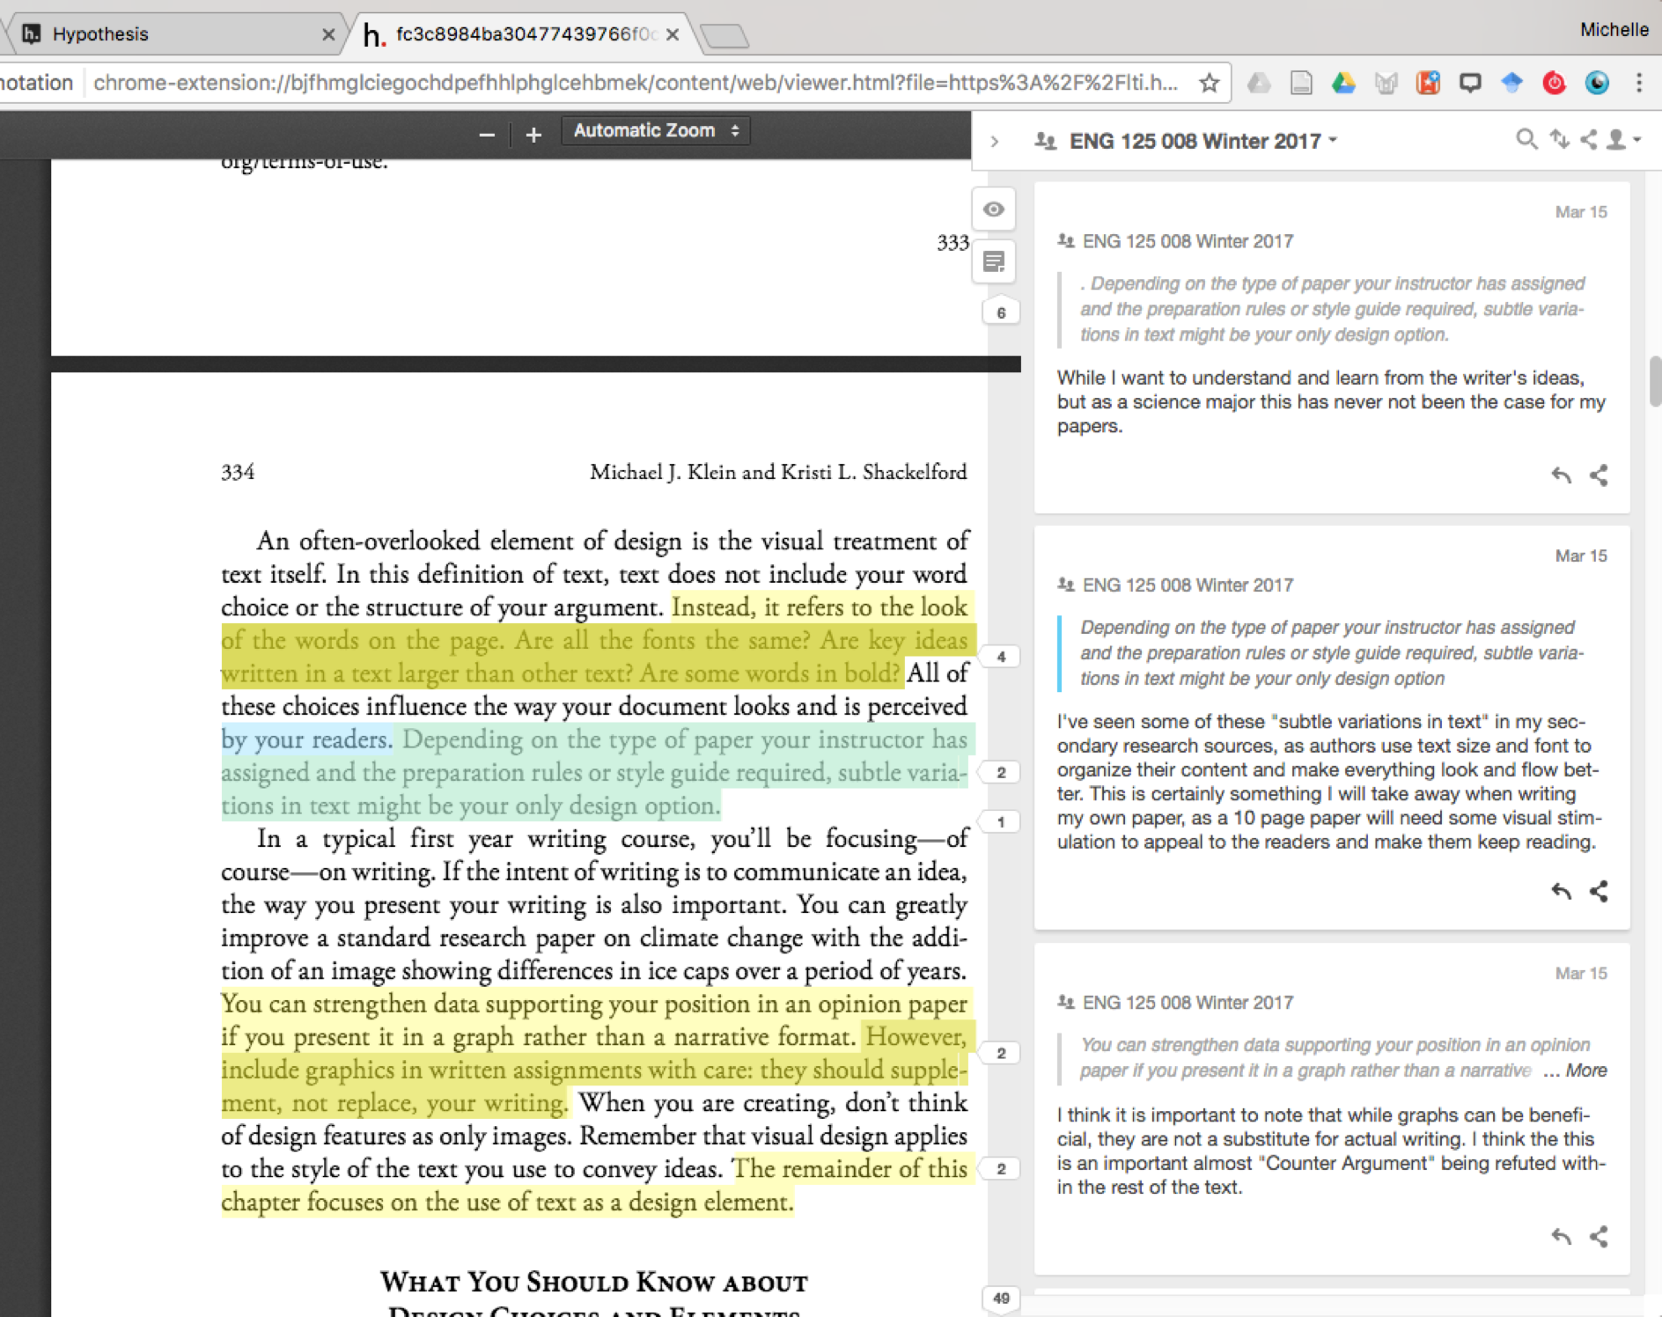

Slide 4
tacit
invisible
explicit
visible

Slide 5
Metacognition
Meta-knowledge

Slide 6
distance
difference
(Pintrich, 2002)
(Adler-Kassner, 2012; Edwards, 2015; Lockhart & Soliday, 2015)

Slide 7
Social annotation affordances
Seeing from a distance
Seeing difference
“I’ll just look at what I’ve been thinking about” (Lockhart & Soliday, 2016, p. 30).
Tags track patterns across texts
Compare expert, peer, and own readings in the margins
Replies allow conversations to develop

Slide 8
Context of Study
FYC: Writing and Academic Inquiry
  Reading-related course outcomes:
    Comprehending content
    Analyzing rhetorical strategies
    Adapting reading for specific purposes
    Using ideas from course readings to support own arguments
    Situating own writing in conversation with other texts
Participants
  8 female, 5 male
  6 freshman, 4 sophomores, 2 juniors, 1 senior
  10 L1 speakers, 3 L2 speakers
  7 white American, 3 Asian American, 3 Chinese international

Slide 9
Methodology
Hypothes.is embedded in university LMS
  1,192 annotations archived
Coding
  Relationships
    “the author”, named, none
    “the reader”, specific, self, none
  Ways of reading
    Comprehension, critical reading, rhetorical reading
Correlation with course outcomes
  Directed self-placement (pre-assessment)
  Research-based argument (3rd unit)

Slide 10
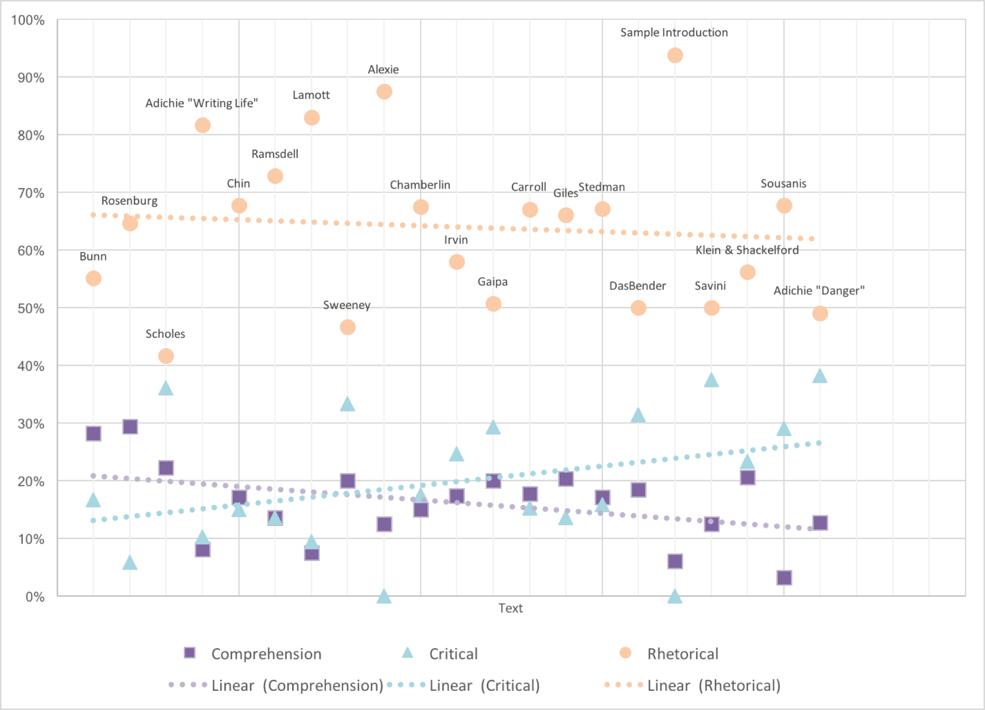

Slide 11
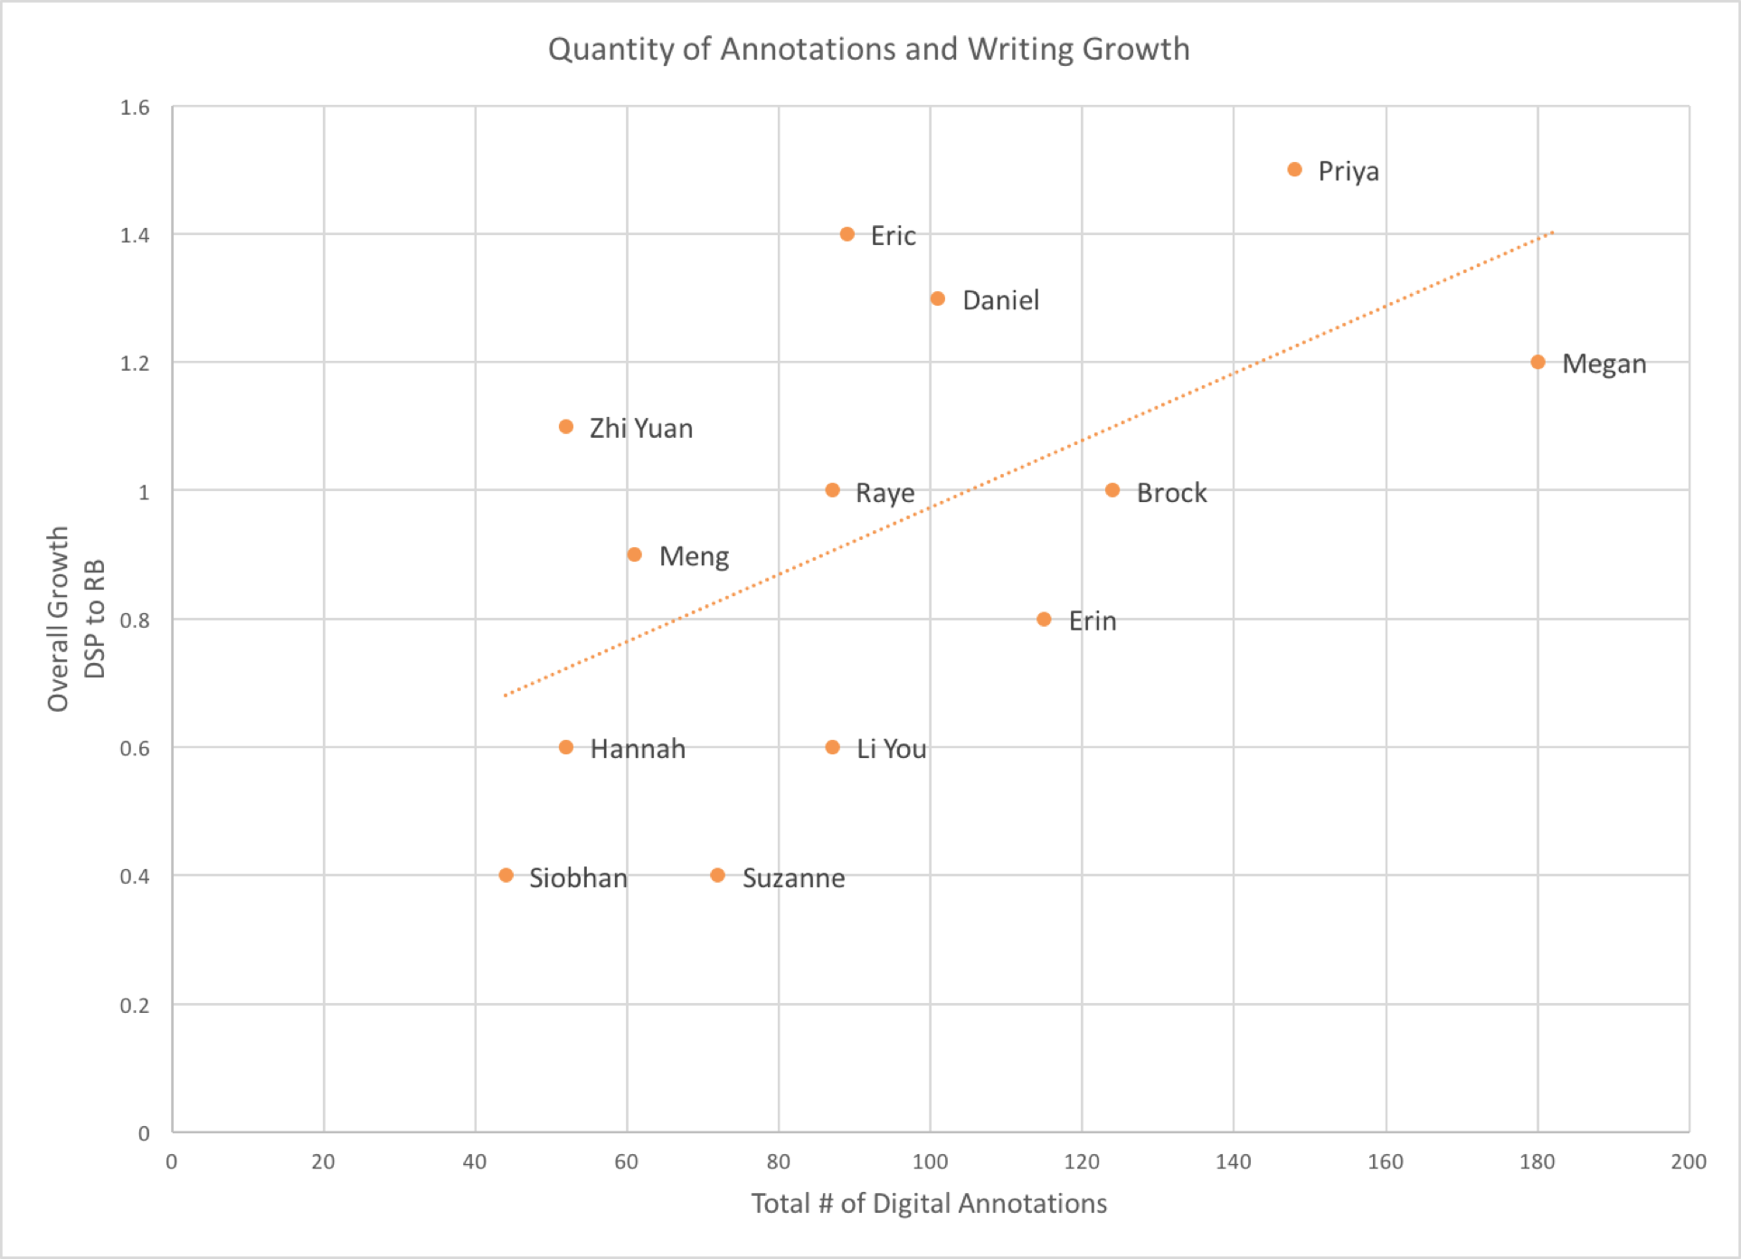

Slide 12
Emergent themes
Text-centered Relationships
Audience awareness
Peer/teacher reading annotations?
Amplification of peer responses
Metacognition
“Seeing their ideas and different perspectives helped me to see something that I maybe missed while reading.”
Authority to annotate for own purposes
Meta-knowledge
“I am making the goal to do research on the genre and audience of my assignment in order to make it as persuasive as possible.”
Expectations of genre and writing in intended fields

Slide 13
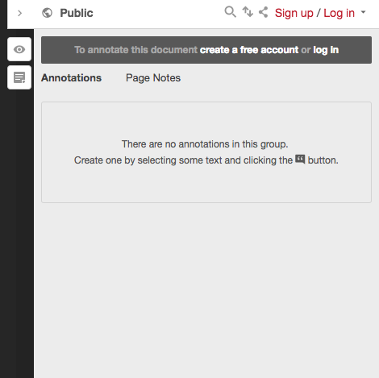
Practicing Social Annotation
Go to https://goo.gl/CbQLLB
Create a Hypothes.is account.
Select some text and add an annotation.
Try replying to another annotation.

Slide 14
Recommendations for best practices
Limit group sizes (3-5 members)
Encourage replies
Tag annotations with course topics
Offer feedback on reading strategies
Use controversial moments in class discussions
Provide opportunities for rereading annotated documents
Choose the annotation tool that best suits your students and instructional purposes:
  Ponder.co, Hypothes.is, Diigo, Google Docs

Slide 15
Contact me
@MichelleSprouse
sprouse@umich.edu

Slide 16
References
Adler-Kassner, L. (2012). The companies we keep or the companies we would like to try to keep: Strategies and tactics in challenging times. WPA: Writing Program Administration, 36(1), 119–40.
Carillo, E. C. (2015). Creating Mindful Readers in First-Year Composition Courses: A Strategy to Facilitate Transfer. Pedagogy, 16(1), 9–22.
Edwards, M. (2015). Unpacking the Universal Library: Digital Reading and the Recirculation of Economic Value. Pedagogy, 16(1), 137–152.
Gee, J. P. (2008). Social linguistics and literacies: ideology in discourses (3rd ed). London ; New York: Routledge.
Hypothes.is. (2017). (Version Revision 7e14c576) [Web]. Hypothes.is Project. Retrieved from web.hypothes.is
Keller, D. (2013). A Framework for Rereading in First-Year Composition. Teaching English in the Two Year College, 41(1), 44.
Lockhart, T., & Soliday, M. (2015). The Critical Place of Reading in Writing Transfer (and Beyond): A Report of Student Experiences. Pedagogy, 16(1), 23–37.
Mendenhall, A., & Johnson, T. E. (2010). Fostering the development of critical thinking skills, and reading comprehension of undergraduates using a Web 2.0 tool coupled with a learning system. Interactive Learning Environments, 18(3), 263–276. doi:10.1080/10494820.2010.500537
Paris, S. G., & Winograd, P. (1990). How metacognition can promote academic learning and instruction. In B. F. Jones & L. Idol (Eds.), Dimensions of Thinking and Cognitive Instruction (pp. 15–52). Hillsdale, NJ: Lawrence Erlbaum Associates.
Pintrich, P. R. (2002). The Role of Metacognitive Knowledge in Learning, Teaching, and Assessing. Theory Into Practice, 41(4), 219–225. doi:10.1207/s15430421tip4104_3
Salvatori, M. R. (1996). Conversations with Texts: Reading in the Teaching of Composition. College English, 58(4), 440–454. doi:10.2307/378854

