Slide 1
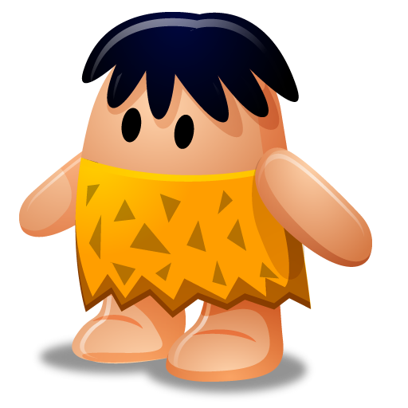
Planning for Digital Feedback
Even a Kaveman can do it!

Slide 2

Notes:
Video Scene 1:
In this scene, Dr. Sojka (caveman) is holding his bookbag when a student comes up to him and asks “what did I get on my quiz?”
Dr. Sojka digs around in his book bag and stuff goes flying everywhere, he gets more agitated…offers an apple
Never finds the quiz…very frustrated and tells student to wait until class next Thursday…which isn’t even the right day…sadness

Slide 3
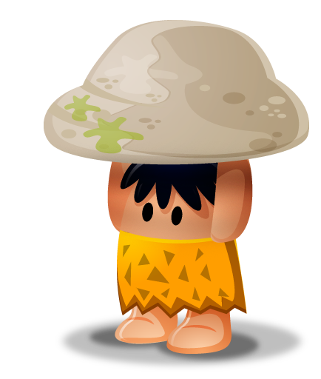
Teaching in a cave…
1976 – Earned PhD, began teaching
1976-1987– Paper Rules!
1987 – Transitioned to Dean
Notes:
1976 – earned PhD and began teaching
1976-1987– Paper Rules ! Paper textbooks, lesson plans, assignments, attendance records and gradebook
1987 – transitioned to Dean

Slide 4
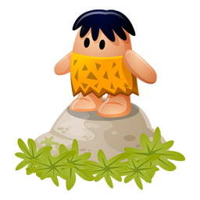
Teaching…out of the Cave
How will I…
Communicate?
Track Participation?
Provide Feedback?
Manage Assignments?
Notes:
How will I…
Communicate with over 100 students?
Take attendance, or track participation, in FOUR classes?
Provide timely and effective feedback on assignments?
Manage over 900 pieces of writing in a single semester??

Slide 5
Notes:
Video Scene 2:
In this scene, Dr. Sojka (caveman) is NOT holding his bookbag and when student comes up to him and asks “what did I get on my quiz?”
Dr. Sojka pulls his smartphone from his book bag and scene dissolves with us overhearing Dr. Sojka start his reply with…
Student details, grade, congratulations and see you next class—happiness!

Slide 6
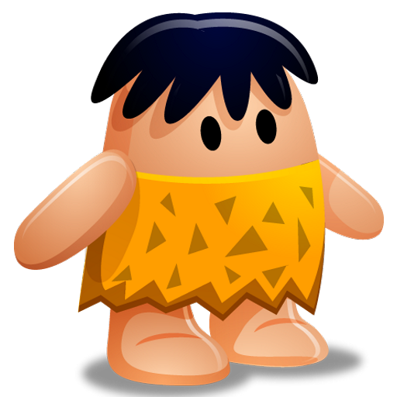
Even a Kaveman can Do it!
So you can Do it TOO!
Notes:
Optional slide—Closing slide if needed

