Slide 1
Developing an Ecosystem of Engaged Learners
Pamela Bach
Olga Hart
Deborah Tenofsky
ACRL Virtual Presentation 2015
Notes:
Welcome to our virtual presentation, Developing an Ecosystem of Engaged Learners. We’re each going to introduce ourselves. I’m Debbie Tenofsky. I’m the Head of Research, Teaching, and Services at the University of Cincinnati. Pam--Olya

Slide 2
Outline of Presentation
Learning Objectives
Overview of University of Cincinnati (UC) Orientation Program
Scenario-based Activity
International Orientation at UC
Notes:
In this presentation we will be discussing details of the University of Cincinnati new undergraduate student orientation, talk about a scenario-based activity we use with the students, and discuss details of our international undergraduate orientation.

Slide 3
Learning Outcomes
Objective 1
  Attendees will get practical tips on organizing an active, sustainable library orientation program that reaches up to 300 students a day.
Objective 2
  Attendees will learn how to moderate a quick scenario-based activity and modify it for classroom situations.
Objective 3
  Attendees will learn about the modifications made for international students’ orientation as well as reasoning and planning behind this.
Notes:
These are the learning outcomes we expect you will come away with by the end of the presentation. Each of us will be speaking for about 10 minutes on the 3 learning objectives (I will go first, then Pam, and finally Olga), and there will be time after each speaker for a few questions with time at the end for additional questions. Generally, you will get some practical tips organizing an orientation program, learn how to moderate a scenario-based activity, and learn about planning an orientation session for international students.

Slide 4
What is the size of your undergraduate orientation program?
100 students or less
100-500 students
500-1,000 students
Over 1,000 students
Do not have a formal orientation program
Notes:
To start off with we would like you to take a short poll about the size of your orientation program. This will give us a general idea of the size of your program.

Slide 5
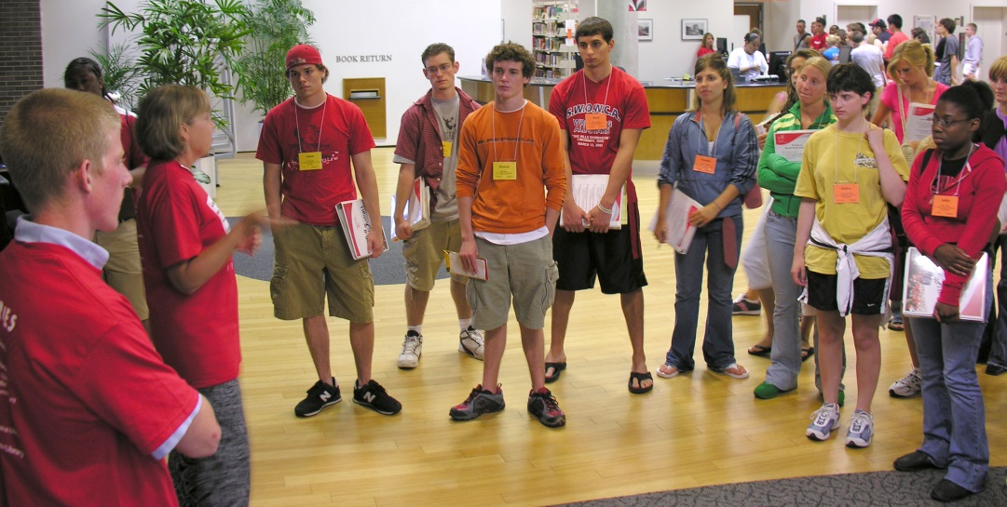
General Overview
Approximately 4,000 new students each year
21 orientation days starting in early June - mid July
One hour sessions
Can be over 300 students each orientation day
Unable to accommodate all students in one place
Notes:
Great! Thanks for this feedback. I see that…. The UC has about 4,000 students each year. The orientation program runs for 21 days starting in early June and ending mid-July. The library gets a one hour block each day. Since we have so many incoming students each orientation day can have over 300 students and we don’t have space in our library to accommodate all of the students. So, we had to be creative in thinking of ways to orient the students to the library.

Slide 6
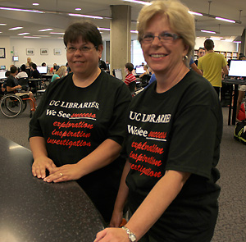
Goals
Very simple goals
  Keep students actively engaged
  Make the big, small
  We have friendly, helpful people
  We have useful academic resources
  We have cool, inviting spaces
Notes:
First, we decided to have simple goals, especially because we realized that some of the students hadn’t even finished high school during their UC orientation, and the rest of them wouldn’t be coming back to campus for at least a month. They were getting tons of information about the university beyond the library and probably weren’t going to remember a lot. Keeping it simple has proved to be beneficial in their retention of information.

Slide 7
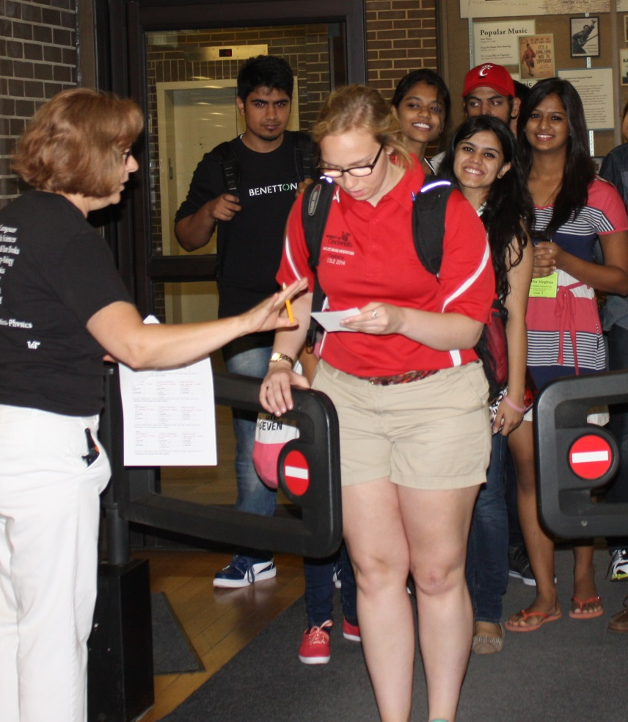
Logistic Solutions
Work closely with campus Orientation Office and IT Office
  The Orientation Office provides us with Student Orientation Leaders (SOLs) to assist.
Each day there are 12 SOL led groups
Library uses 2 floors
3 large sections divided into smaller activities
Notes:
Throughout this process we work closely with our Orientation Office and our IT department. Both units have been very supportive of keeping the 1 hour in the orientation program. The Orientation Office hires Student Orientation Leaders (SOLs) to facilitate the program and walk the students through the program. The students are divided into 12 SOL groups each day. To manage the 1 hour session in the library we have 3 large sections that are divided into several smaller activities. We use 2 floors of our 3 floor library during orientation.

Slide 8
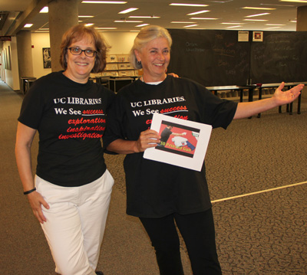
Logistics Continued
Each day involves 4 library staff, 5 students, and the SOLs
Each large section lasts 15 minutes; each activity lasts 7 minutes
Each group moves in a clockwise pattern throughout the library
Notes:
As you can imagine this is a big undertaking, and we use many staff members, library student workers, and SOLs to teach the students. As incentives we give our staff and students T-shirts. In this picture you can see Pam and other librarian modeling the T-shirts. Each large section of the program lasts 15 minutes and each activity about 7 minutes. We move the groups through the library in a clockwise pattern. Over the years this has become an art and a science of moving the groups through the building, and two of the librarian volunteers jobs is traffic person, who’s responsibility it is to keep all the group activities on time and the groups moving through the facility.

Slide 9
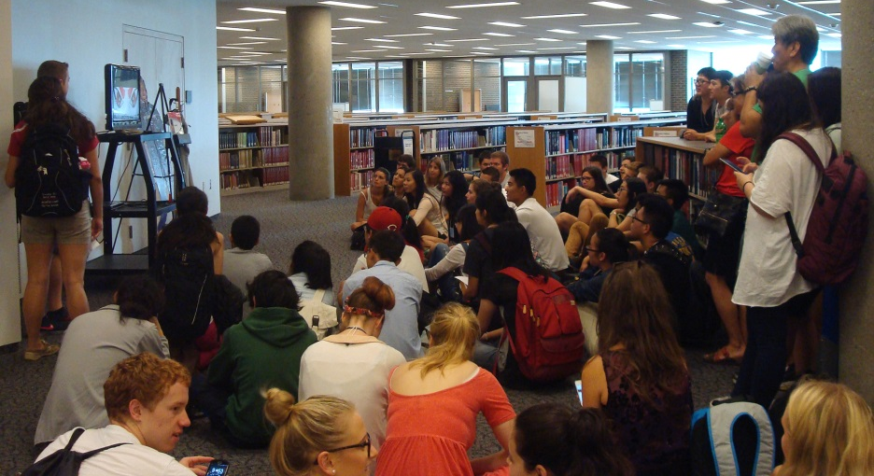
Activities
Front 4th floor
  Find a book in the catalog
  Printing video
  Reminder of safety in the building
Notes:
I am going to go quickly through our activities. On the front of the 4th floor we have 2 activities: we ask the students to find a book in the catalog. We have book jackets printed off and the students use these titles to find the books in our catalog. This gets them familiar with the catalog and our collection. This activity is run by our students. We have the SOLs show the students a printing video, which you can view from the link shown here. We also have the SOLs discuss ways to keep their possessions and selves safe in the library and on campus.

Slide 10
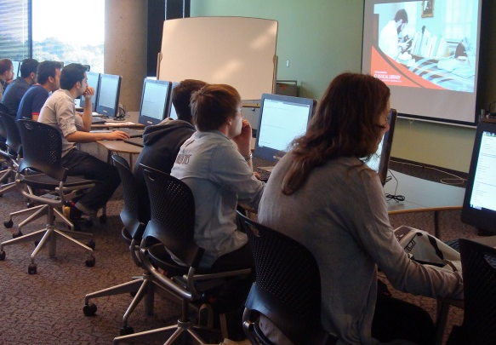
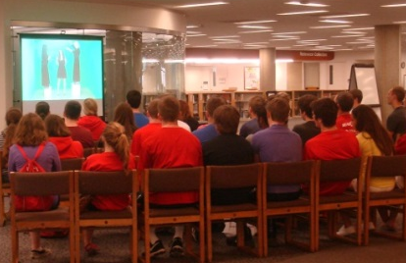
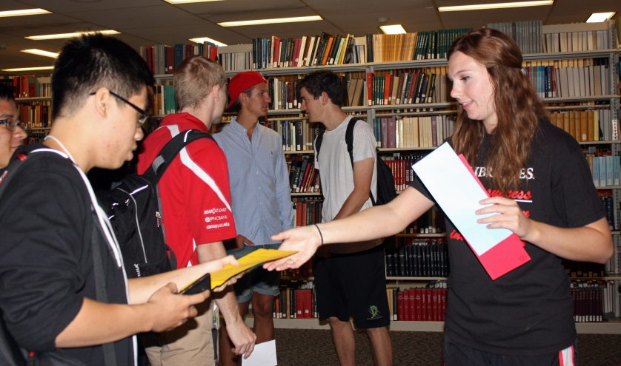
Activities
Back of 4th floor
  Survey
  Chalkboards
  Student Technology Resource Center video
5th floor
  IT introduction video
  Find books in the stacks activity
Notes:
In the back of the 4th floor we have ½ the groups take a survey, which Olga will discuss more in depth later. The other ½ the groups participate in a chalkboard scenario, which Pam will be talking about soon. All of the groups watch a video about our Student Technology Resource Center that has high end software and hardware, a green room for taking pictures and videos, and high end editing suites for videos. On the 5th floor the students learn about our IT resources and services through a video that is facilitated by our IT unit. They also participate in a fun activity of finding books in the stacks, since many of our students asked us “where are the books?” which are primarily located on the upper floors of the library.

Slide 11

Reflections
Designed to be sustainable
Most activities are reused from year to year
Modifications made based on feedback from survey, library staff/students, and SOLs
Notes:
Some final reflections on the overall program. It’s designed to be sustainable with a large number of staff members and so many sessions each summer. We reuse many activities year to year with modifications based on feedback from our survey, library staff and students, and the SOLs.

Slide 12

Any
Questions
or
Comments
Notes:
Now, we have time for a couple of questions from the chat. Thank you. I am going to turn it over to Pam to talk about the scenarios.

Slide 13
Scenarios
Text & Visual Prompts
Related to Common Reading Program
Demonstrate Libraries’ Role in the
Students’ Academic Experience
Notes:
One of our most successful interactive activities, has been based on current news events. We present a prompt that includes both text & an image. The past 2 years, we related the issue to the common reading book: Justice: What is the Right thing to do? by Michael Sandel which poses ethically problematic situations to the reader and challenges the reader to reflect on the principles and values that guide ones’ actions in these situations. We also use this activity to introduce our role in working with students and their academic research.

Slide 14
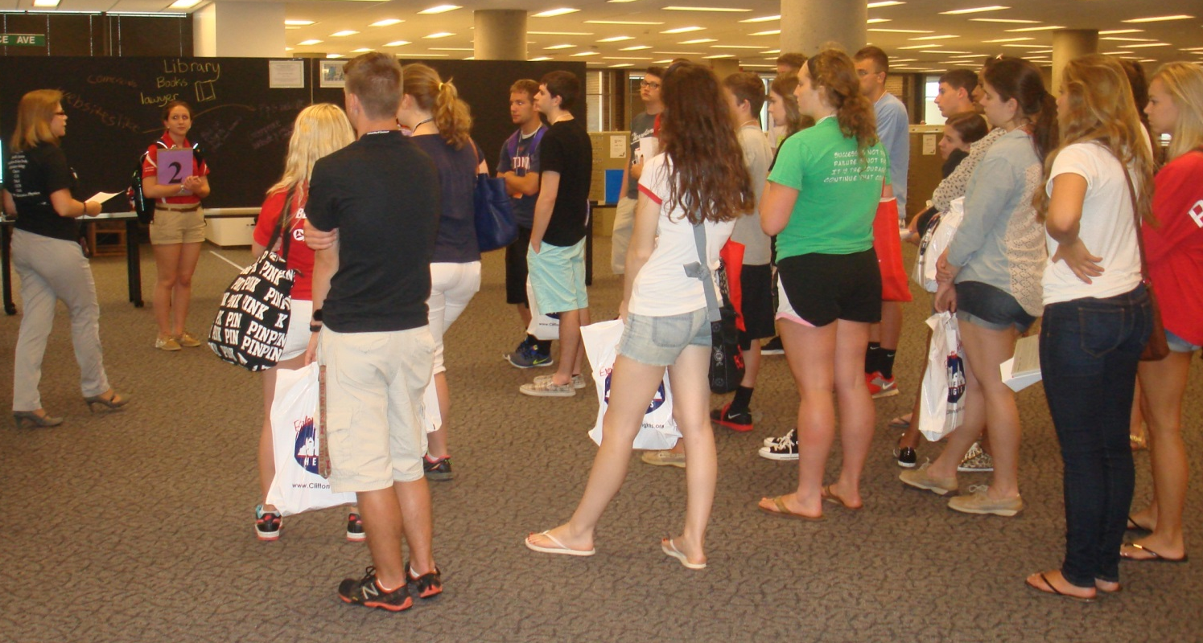
Setting the Stage
Notes:
We introduce the scenario with the text from a newspaper article and with a photo of the event, then divide a large group of about 25 students into 4 groups, giving them a question based on the pedagogy of problem based learning.
Knowledge: What do you know about….?
Information: What do you need to know to be informed about…?
Resources: Where are you going to find information?

Slide 15
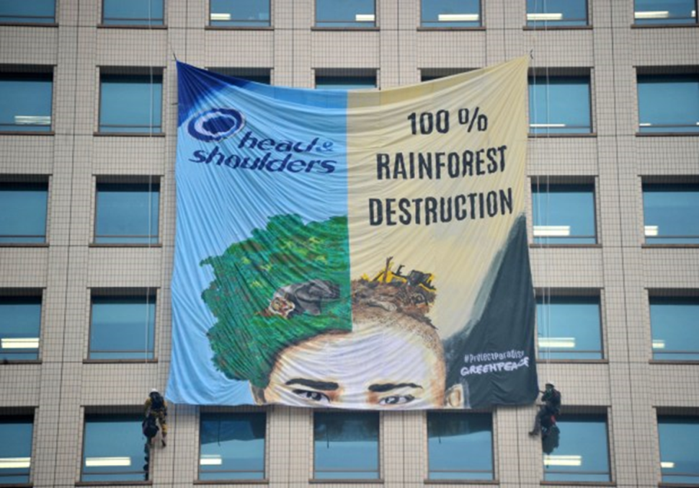
Greenpeace Pressure on Deforestation Prompts Procter & Gamble Retreat on Palm Oil
“Greenpeace stunned P&G on March 4 by using zip lines to unfurl banners from the company's two towers in downtown Cincinnati. Nine protesters have pleaded not guilty to felony burglary and vandalism charges stemming from the protest.”*
*http://www.wcpo.com/news/local-news/greenpeace-takes-pg-palm-oil-protests-worldwide
Notes:
Last year we used this scenario about a Greenpeace demonstration at the Procter & Gamble headquarters in Cincinnati. 9 protestors infiltrated the P&G towers using fake IDs, accessing the building exterior, and repelling to unfurl large banners about P&G products that used palm oil which has led to the destruction of the rainforest in Indonesia.

Slide 16
Knowledge
What do you already know about
commercial products,
environmental impact,
and advocacy?
Notes:
Here is the prompt that one group of students respond to. So let’s hear from you, what you know about…

Slide 17
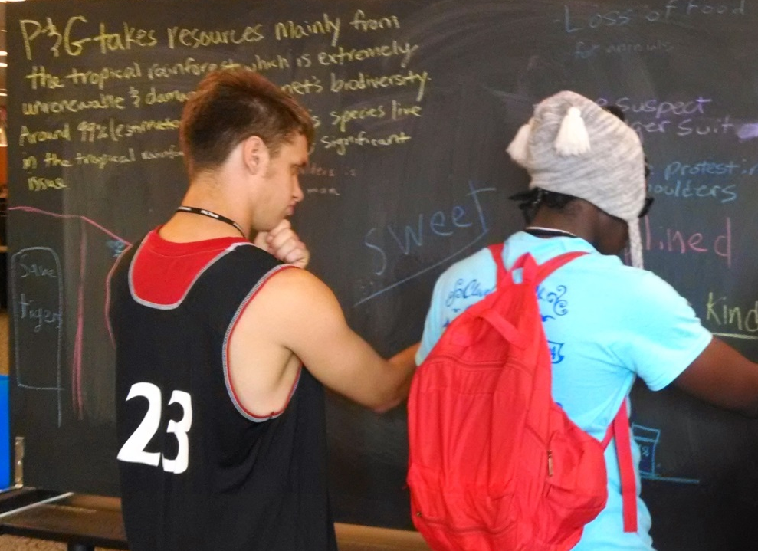
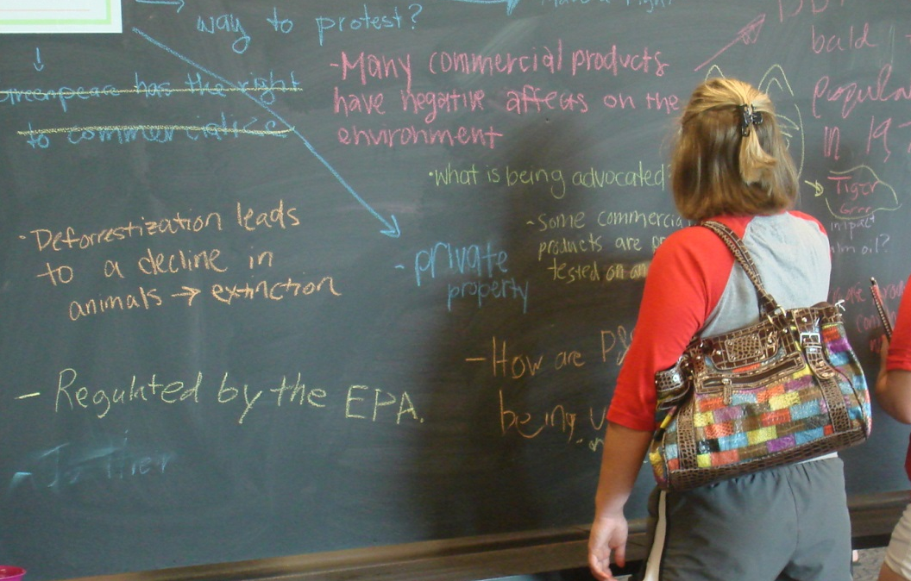
Knowledge
What do you already know about commercial products, environmental impact, and advocacy?
Notes:
Here are the students capturing their ideas on large chalkboard panels that we have created. 6 different groups respond to each of the prompts over the course of an hour so in the photo in the lower right hand corner, you can see one of the comments is crossed out and an additional comment has been made. Groups build on the content of a previous group. We do not allow students to erase comments.

Slide 18
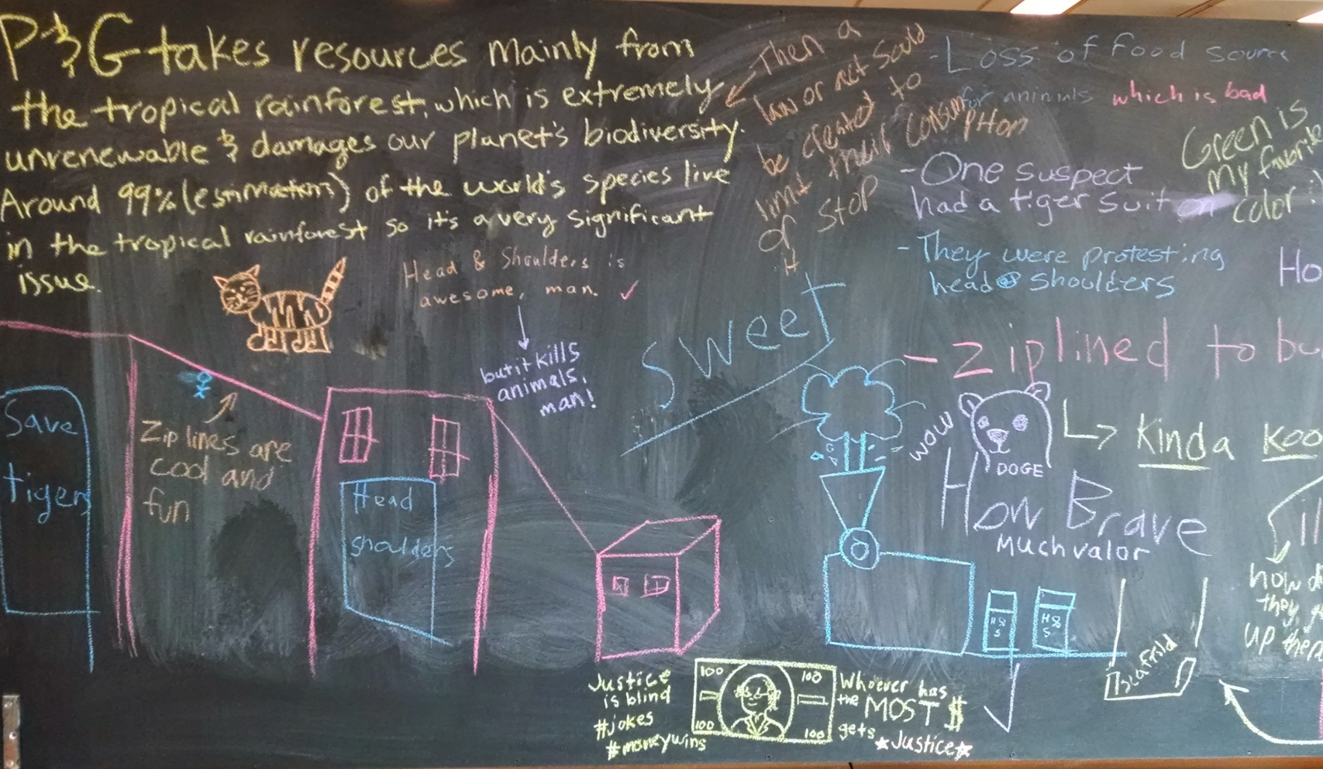
Knowledge
Notes:
As this chalkboard demonstrates some of the comments are very detailed as in the upper left hand corner and some use infographics.

Slide 19
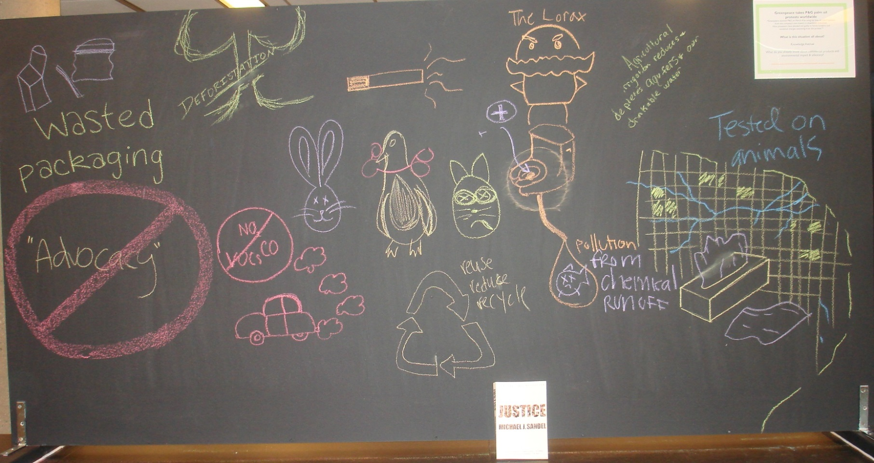
Knowledge
Notes:
On another day there were a lot of infographics that the students created.

Slide 20
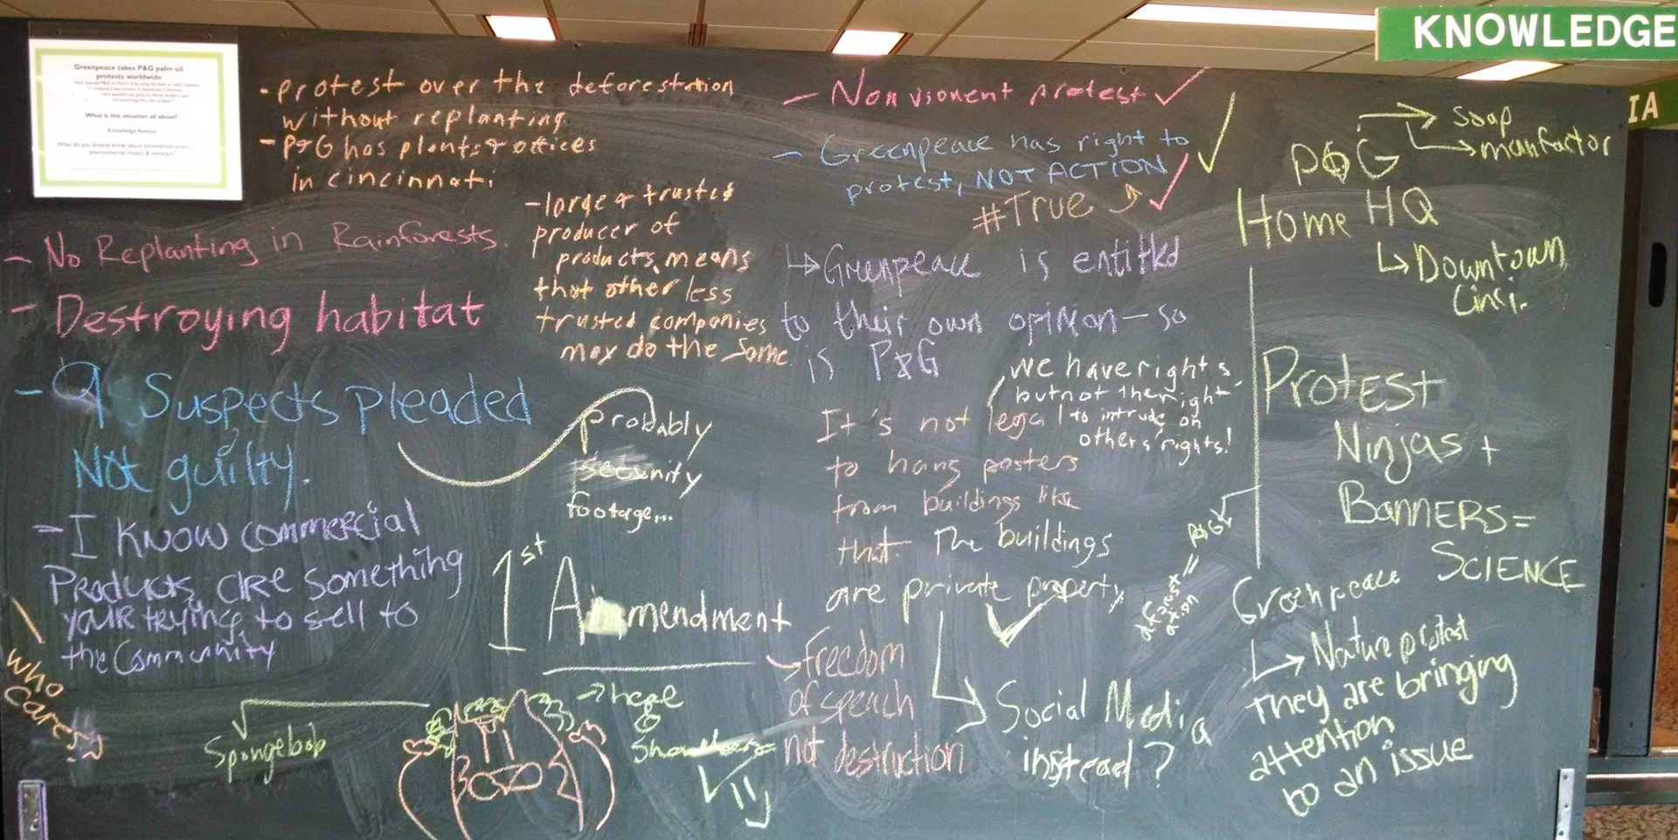
Knowledge
Notes:
The comments are very thorough and this chalkboard illustrates how students respond to previous comments, creating dialogue around the issue. It is quite surprising how much student’s come up in a very short time.

Slide 21
Information -> Research Question
What specific information
do you need know to better understand the controversy surrounding
commercial products,
environmental impact,
and advocacy?
Notes:
This is another prompt for a 2nd group – for this prompt we tell the students to consider what are some of the questions that come to mind that you would want to further investigate. So let’s get your thoughts on the questions that come to mind.

Slide 22
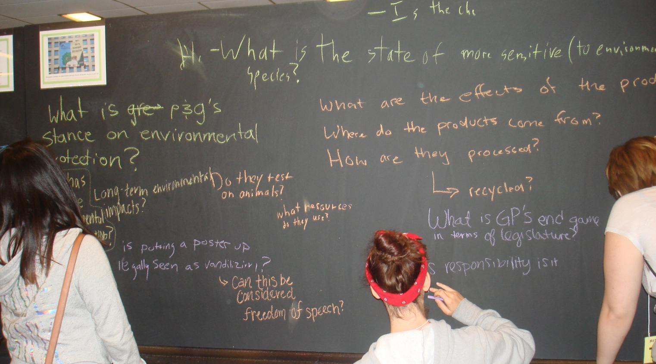
Information -> Research Question
Notes:
Here are the students capturing their ideas and coming up with the questions. During this process, we are roving working with individual groups, providing some suggestions or considerations.

Slide 23
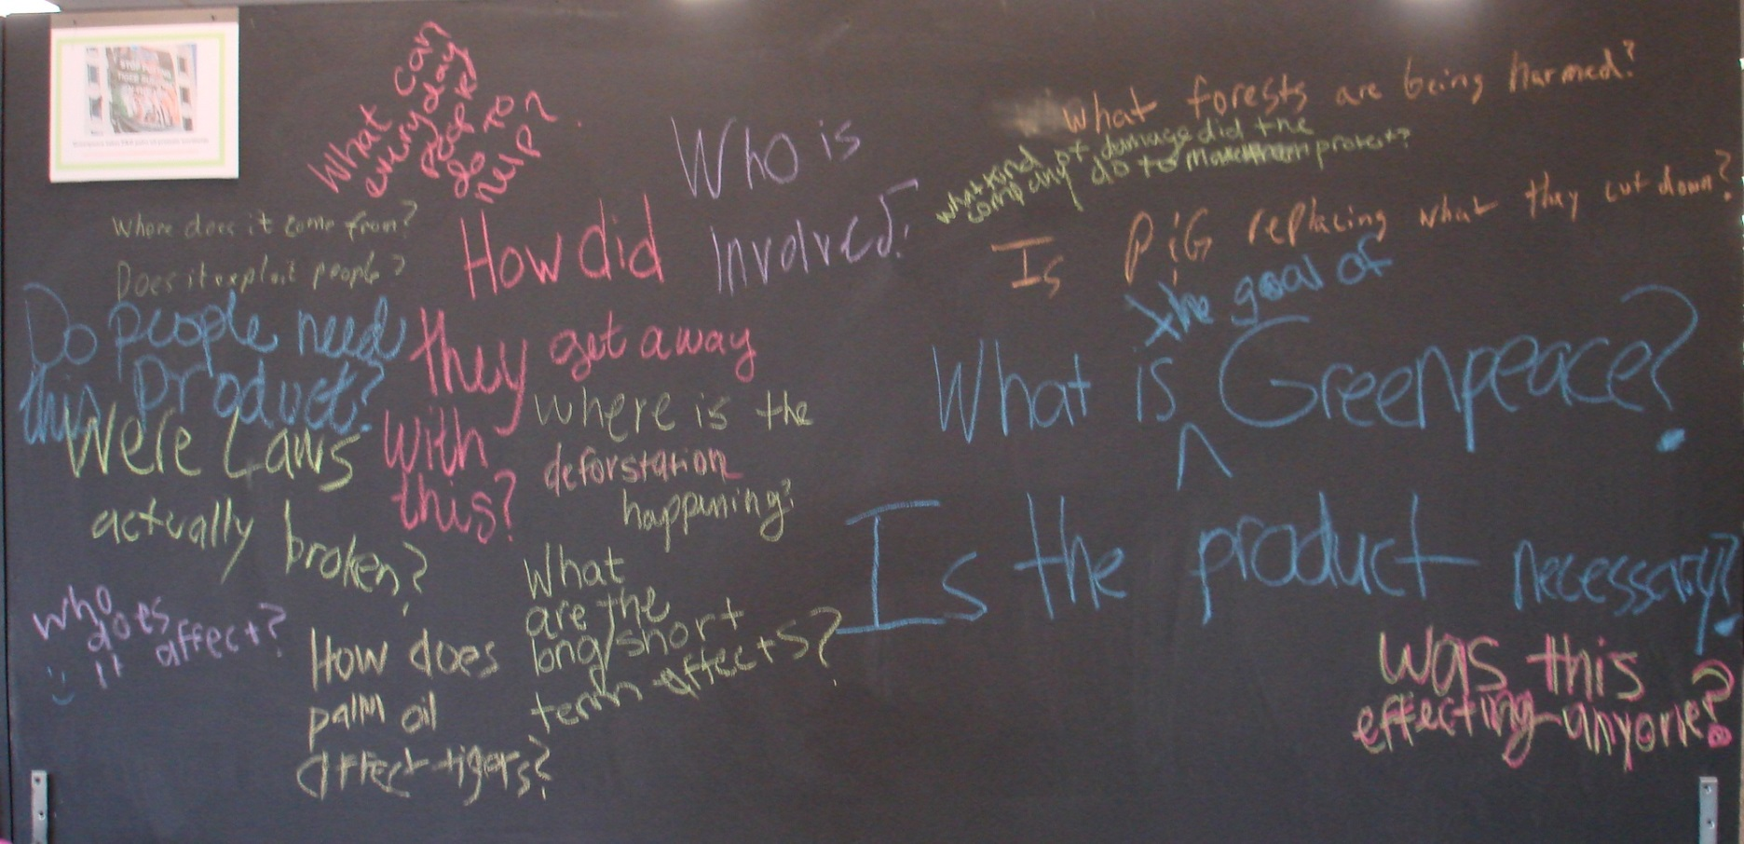
Information ->Research Question
Notes:
We also reinforce that the questions they are considering develop into a research question comparing this to the experience they will have as undergraduates.

Slide 24
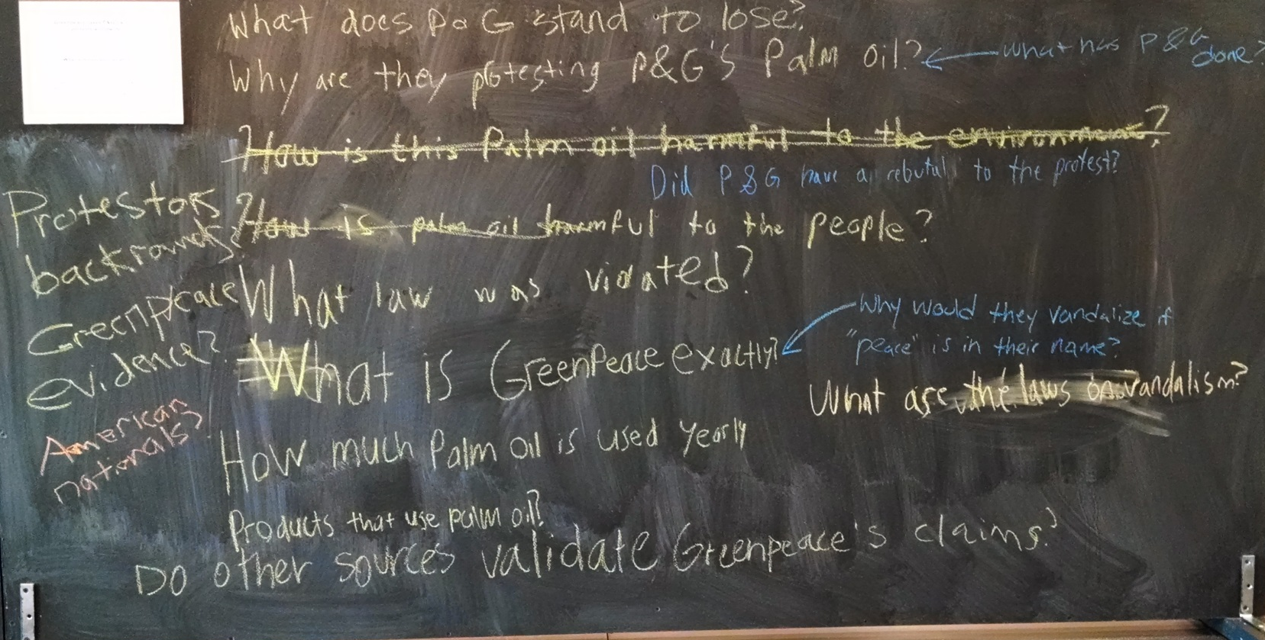
Information -> Research Question
Notes:
Very good questions about P&G – did they have a rebuttal, what has the company done, do other sources validate Greenpeace’s claims?

Slide 25
Resources
What resources or media sites will
you use to find information about the controversy surrounding
commercial products,
environmental impact,
and advocacy?

Slide 26
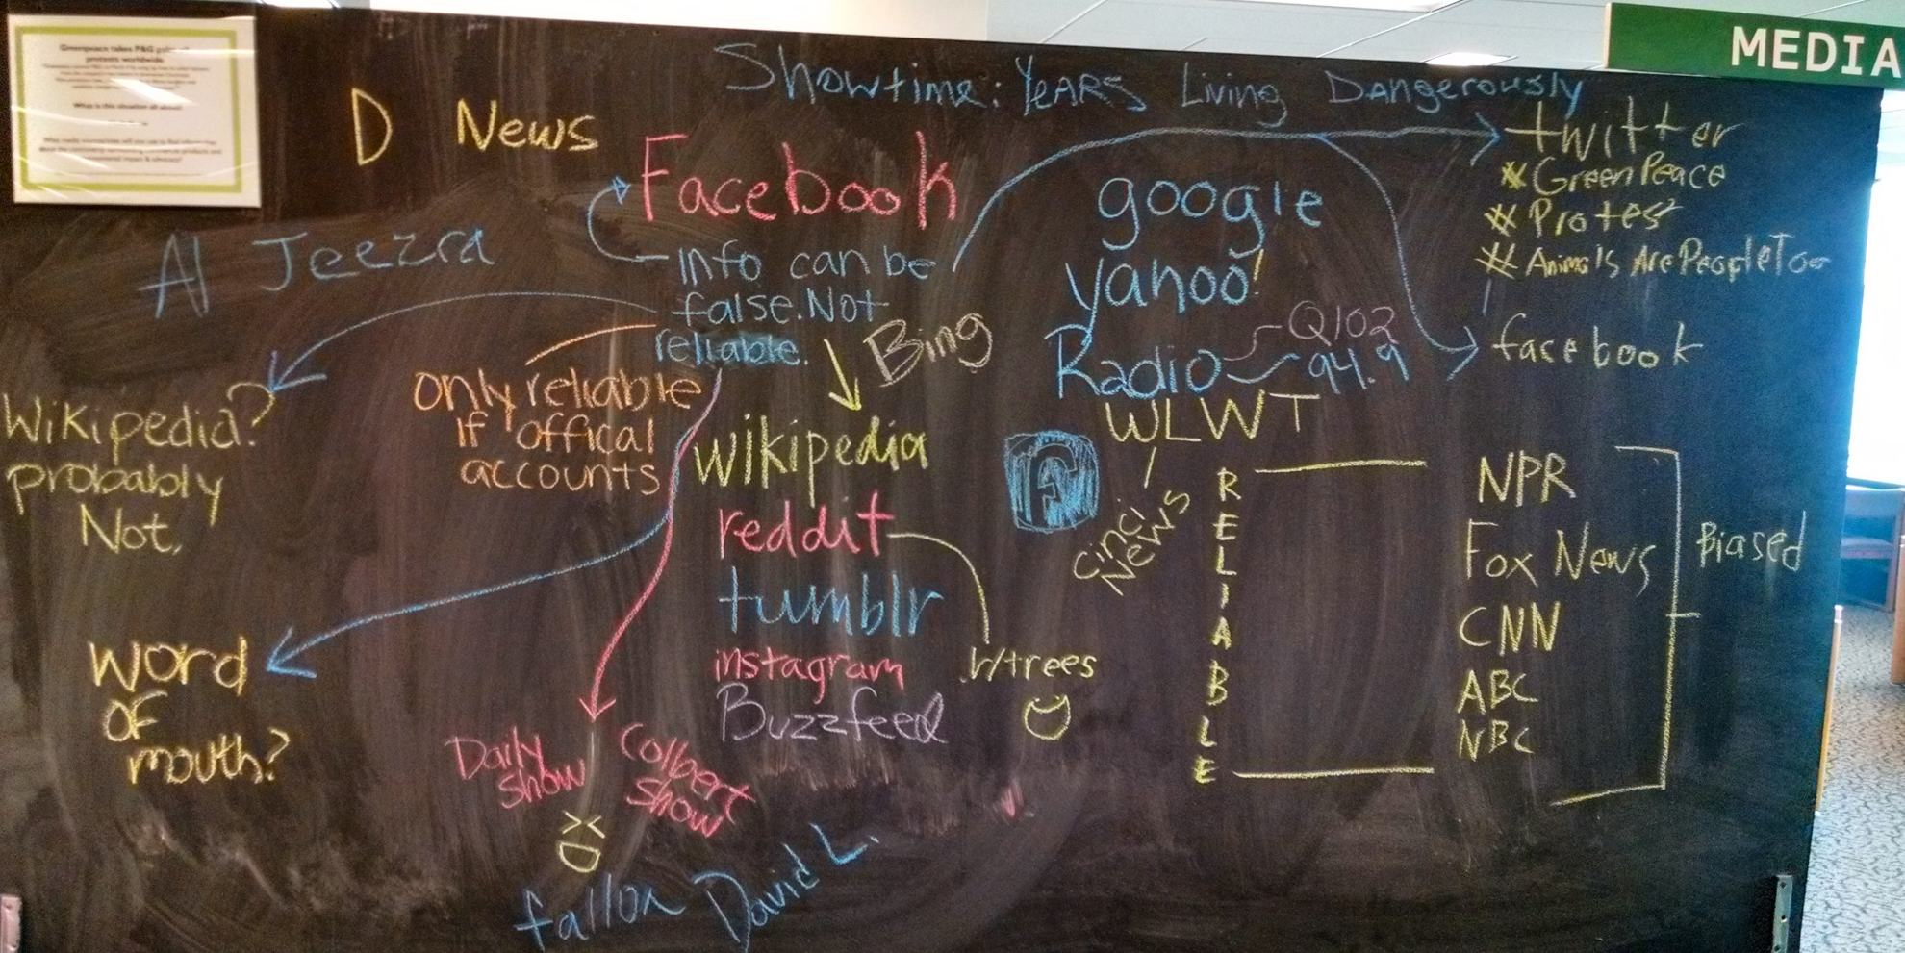
Media Resources
Notes:
Wide-range of media resource, student comments point out the importance of the “reliability” versus bias of sources.

Slide 27
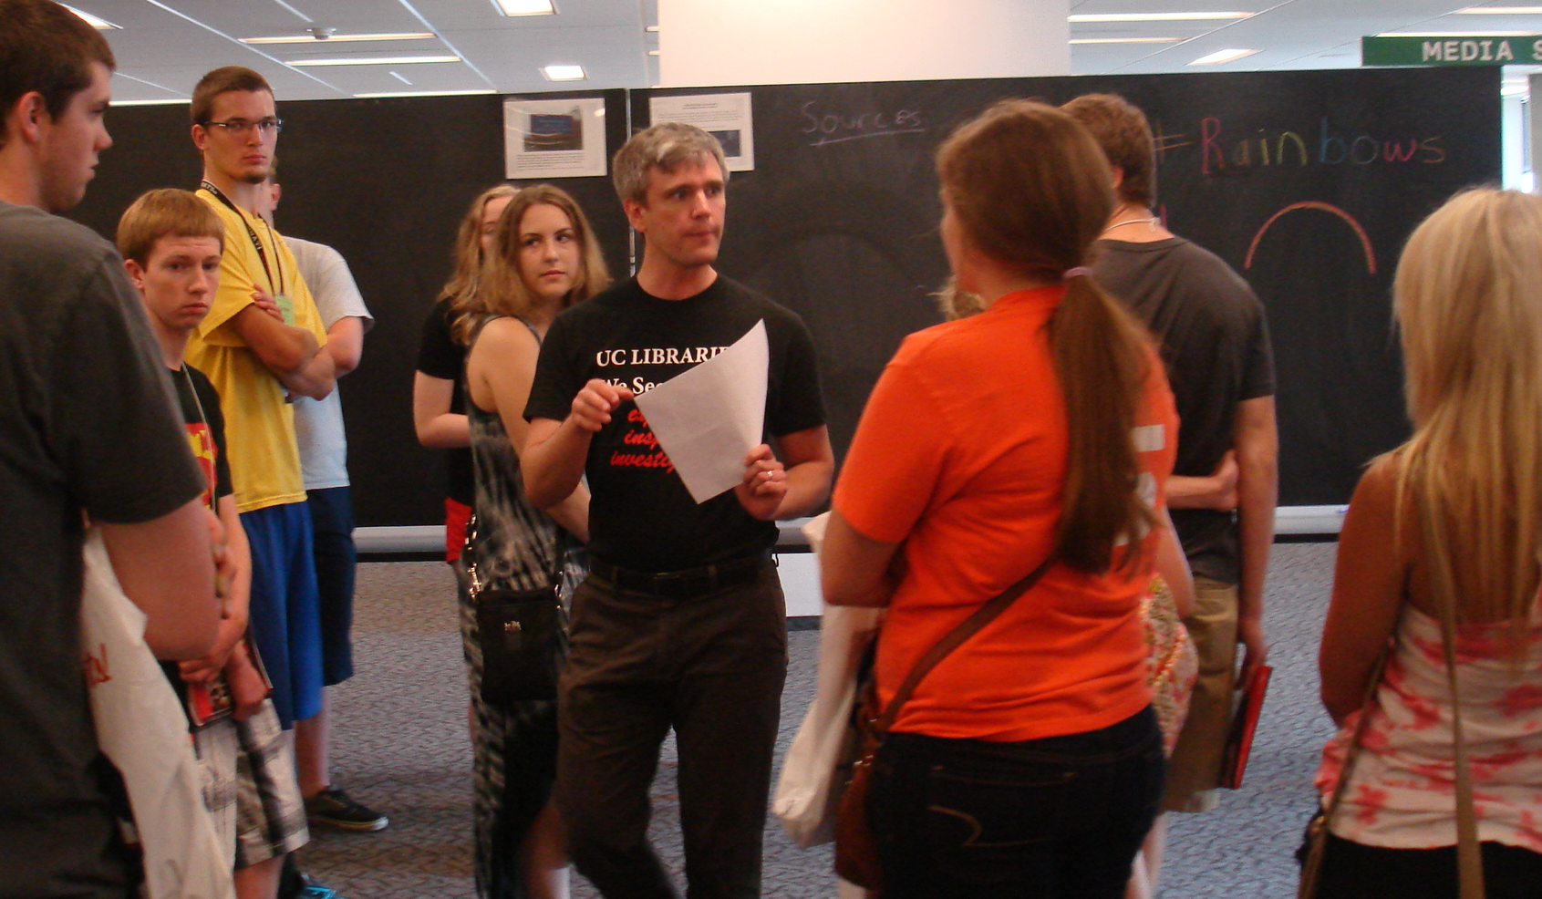
Wrapping it Up
Notes:
We end each session with the groups reporting out on their insights and indicate that this mirrors the research process as first beginning with personal knowledge about something, then investigating and discovering new information that leads to a research question while at the same time tapping resources in finding information. We emphasize our role in assisting them in using and evaluating resources, understanding the research process and citing sources. This method of active learning and using pedagogies like problem based learning reflects our teaching practice in our work with students.

Slide 28
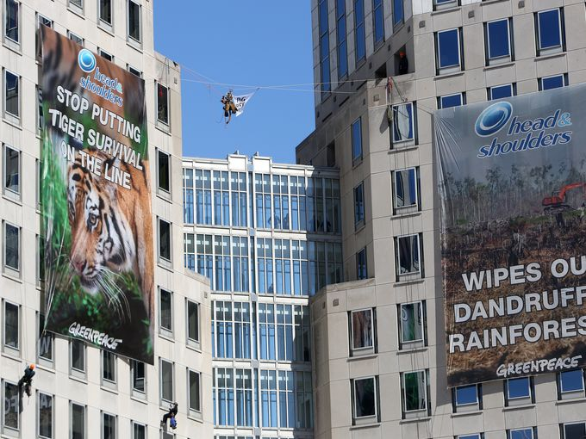
Notes:
Quite a coups by Greenpeace to pull this off. They did their research, figuring how to create fake IDs to get into the headquarters, access the roof. It was very well orchestrated; Greenpeace hired a helicopter in order to capture on video an post on their website. Although, the Greenpeace protestors were initially prosecuted for felony charges, these charges were reduced misdemeanor charges and the demonstrators had to do 80 hours of community service. In fact P&G asked the prosecutor to reconsider the charges against these defendants. Also, this demonstration did have the intended effect with P&G who changed their policy on new palm oil that includes sustainability and human rights goals.

Slide 29
What are some of your hot topics?
International
National
Local
Campus
Notes:
Every year in Cincinnati, there are several controversial, local issues that arise so pretty easy to come up with these scenarios. Sometimes we use events on campus that have generated publicity, tapping the student newspaper. So what are some of your hot topics?

Slide 30
Any
Questions
or
Comments

Slide 31

International Student Orientation
Notes:
University of Cincinnati Libraries participated in international students’ orientation for many years, but the form of the orientation and degree of our involvement varied from brief presentations in a large auditorium to a poster session to optional workshops.

Slide 32
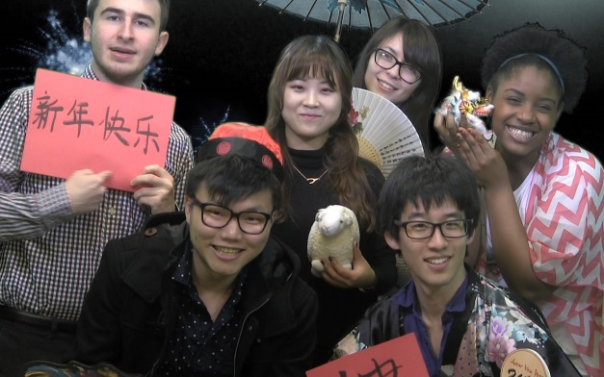
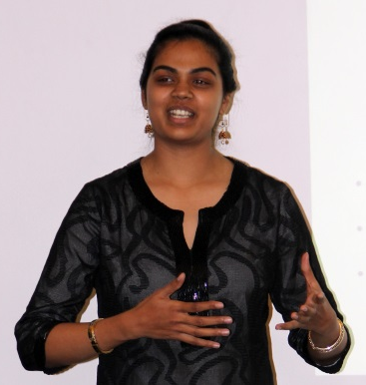
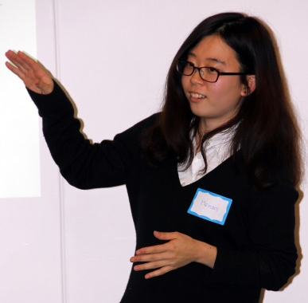
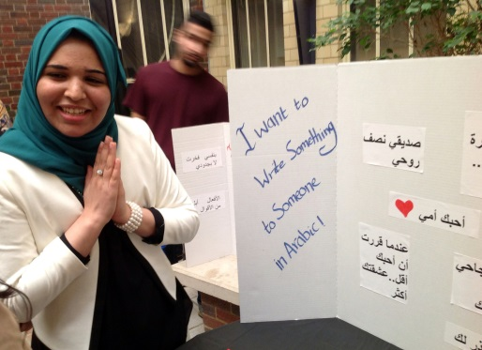
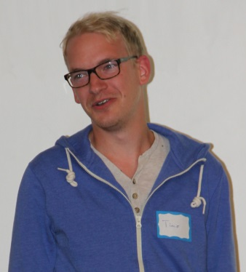
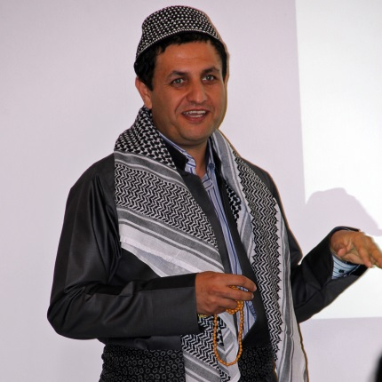
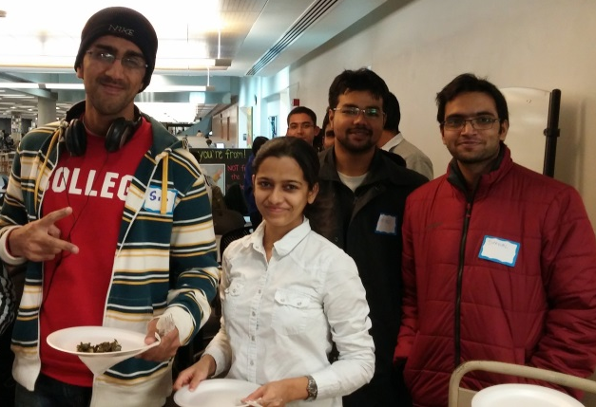
UC’s International Students
2014:
3,695 enrolled out of 43,691
2,012 graduate and doctoral
New: 406 undergraduate, 634 graduate
117 countries
Top 5 countries: China, India, South Korea, Saudi Arabia, Canada.
Notes:
I’d like to start with providing some basic information about UC’s international community and the size of our orientation. So as you see the incoming cohort is just over 1,000 students.

Slide 33
Poll
Do you provide a separate orientation for international students?
    Provide a separate orientation
    Same orientation as domestic
    No orientation
    Don’t have any or many international students
Notes:
Before we tell you what kind of orientation we provide for new international students, we would like to hear from you: how many if you provide orientation for international students and if your orientation is different from that for domestic students.
Thanks for your responses! As I just mentioned, the format of our orientation has evolved over time. Just like many great discoveries that happened by accident, our current design of undergraduate international students’ orientation developed from miscommunication. One year the Admissions Office included international students into the domestic students’ makeup session without letting us know. Of course we noticed international students among the audience and many of them were totally lost whereas others had good questions, for which we did not have enough time.
You probably noticed that I just said “undergraduate” and this is important: the interactive orientation in the library is offered only to undergraduates. However the day before all students attended the Orientation Conference, where introduction to libraries was one of the concurrent sessions. We understand that this year the library session will have a plenary format.

Slide 34
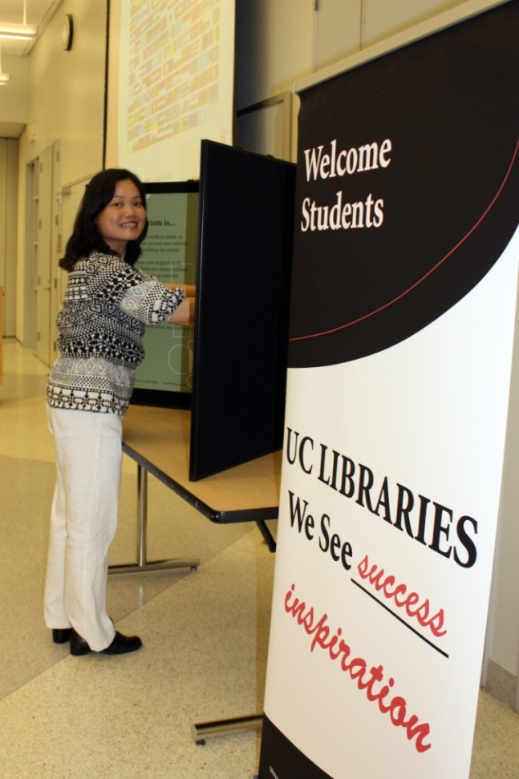
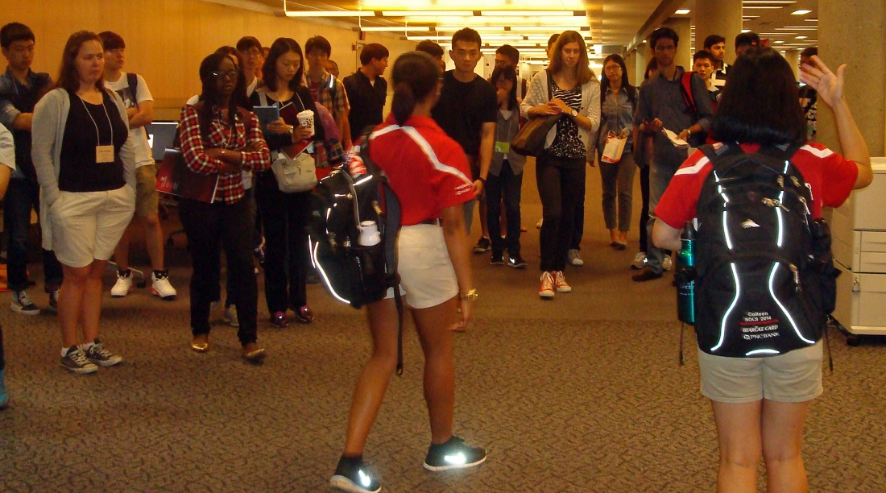
Key to Success
Engage international students in planning and delivering orientation.
Notes:
Our most successful student-directed initiatives have always involved including students in their planning. Thanks to the Diversity Challenge Grant the libraries received from the UC Diversity Office, we were able to hire an international student to help us with international students’ programming. Luckily the student had completed her graduate degree in education at UC, so when she was helping with designing the orientation she brought in the perspectives of an international student, a former graduate student, and an expert in education. Another person who was very helpful was a SOL who went through the our undergraduate international orientation the year before and this year she was an orientation leader for both domestic and international students. At our request she provided very helpful observations and suggestions which activities had not worked very well, what had confused students and what could be modified.

Slide 35
Tips from International Students
Language (simpler, shorter sentences; avoid jargon and ‘big words’)
Handouts to accompany activities
Modifications to activities used for domestic students
  The book activity
Notes:
With the help of our international students we developed brief handouts to accompany each activity to help students whose reading skills were better than their listening comprehension skills and reinforce the information students received. In creating the handouts we made sure to use simple, short sentences and avoid the use of jargon and advanced vocabulary. We did not offer the chalkboard activity to international students, because we felt that they might not be prepared it for it both in terms of language proficiency and the teaching styles the might be used to. For the book activity we offered a different set of books. The implicit learning outcome was to show that in our collection we had books about different countries, cultures, and customs written by authors from various countries.

Slide 36
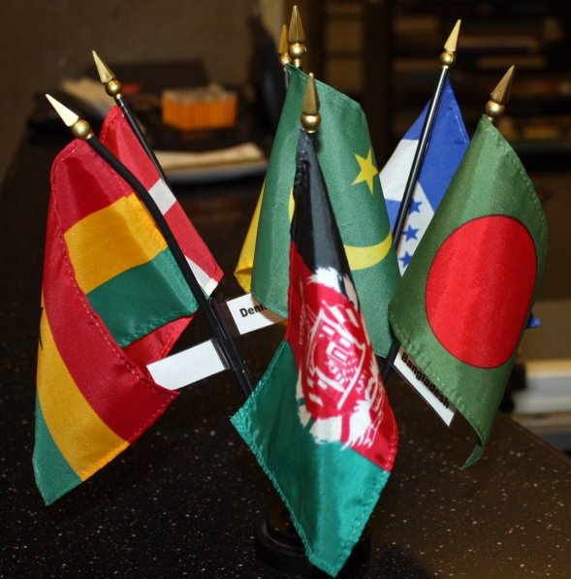
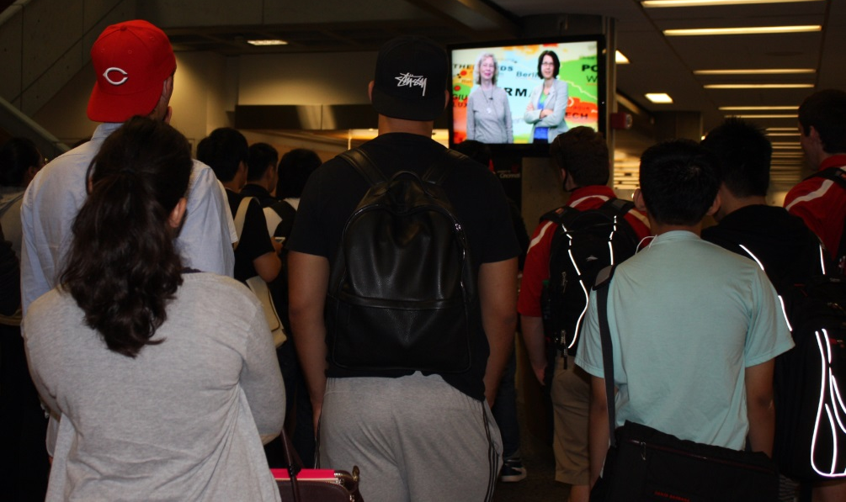
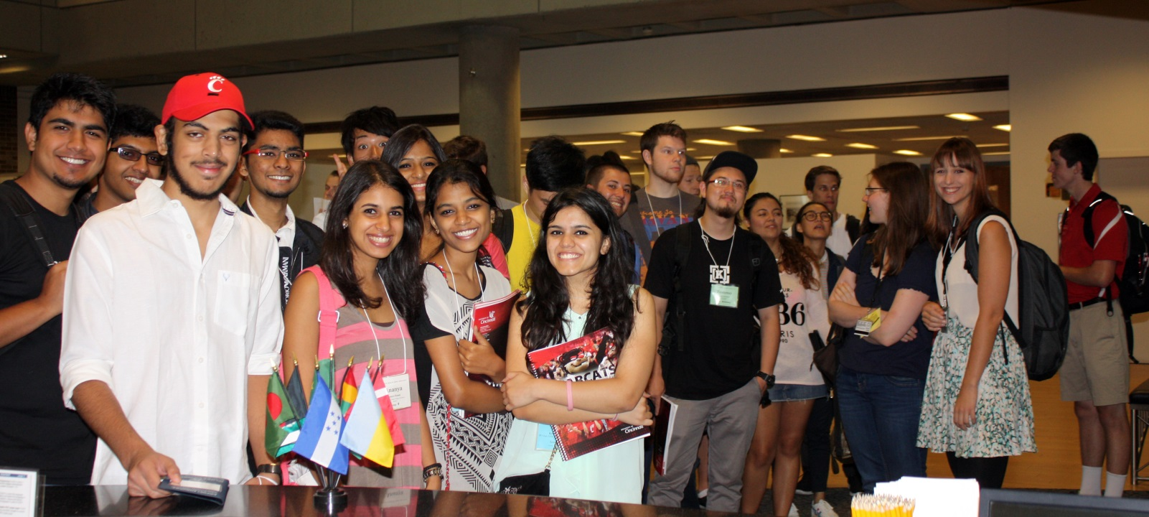
Undergraduate Orientation: a warm welcome
Notes:
We wanted to make sure that students feel welcome the moment they step into the library. The library was decorated with the flags representing the 117 countries of the UC international family. At the very beginning of their library tour the students watched a video, in which Dean Wand, originally form China, greeted the students in English and Chinese. In 2014 we expanded the video by adding greetings in several other languages recorded by librarians, faculty, staff, and students. You can watch the brief video at your convenience. It really set a wonderful tone for the orientation experience.

Slide 37
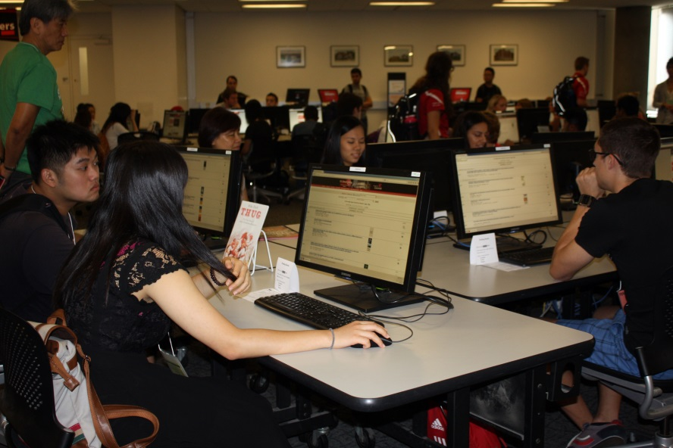
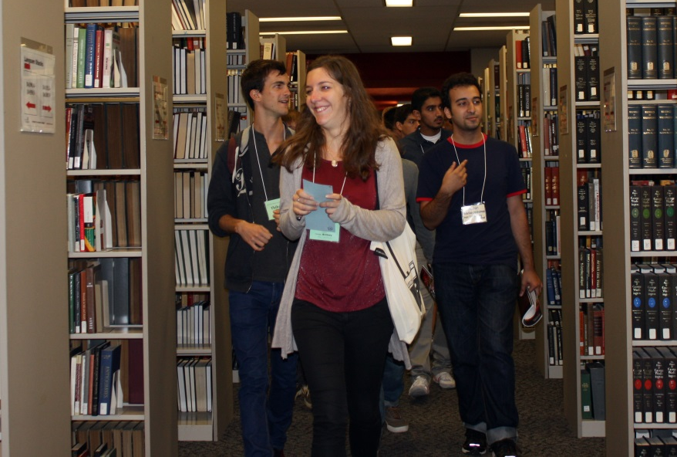
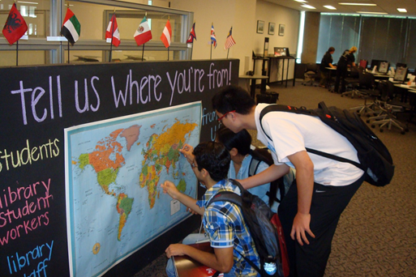
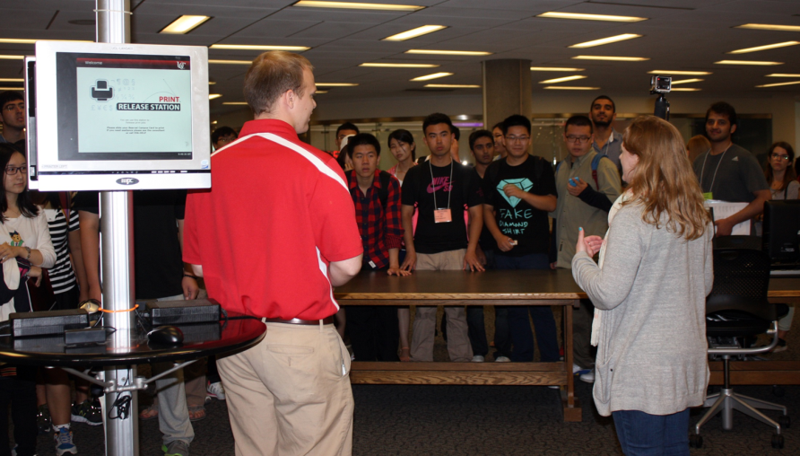
Undergraduate Orientation: active exploration
Notes:
These pictures show some of the activities that you have probably recognized. The students searched the catalog, located books in the stacks, and learned about printing and safety. The final activity was specific to the international students’ orientation: the students were asked to put star stickers on the map of the world to indicate where they came from. We displayed the board throughout the Welcome week and added the map of the US so everyone walking into the library can put their star on the map.

Slide 38
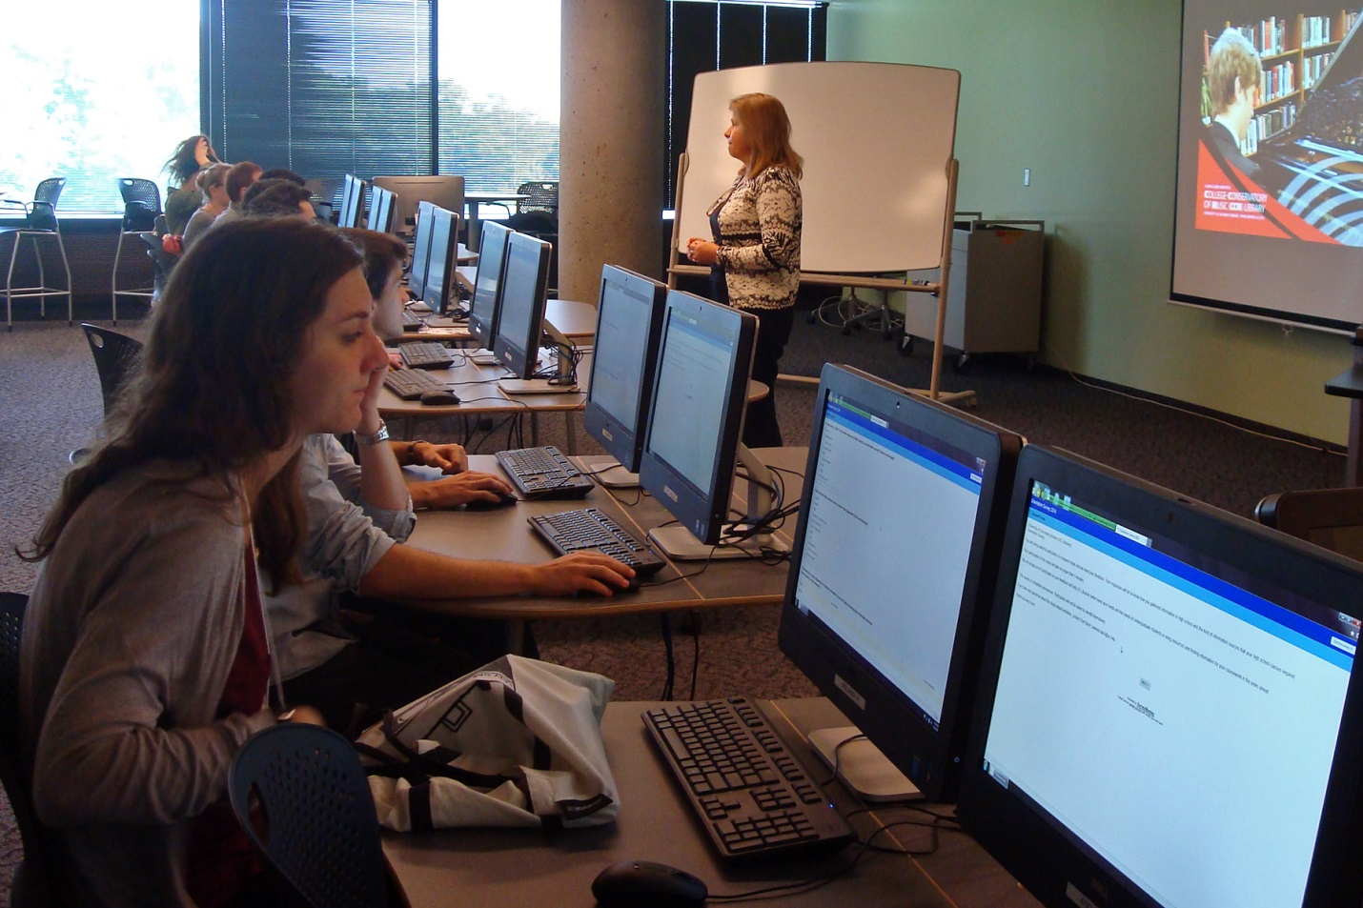
Survey
Notes:
We had debated for a while whether or not to offer a survey to international students. Some librarians felt that we should be spending time talking to students what libraries have to offer and answering their questions. However we decided that this was our opportunity to learn about the information skills and habits of our own students and have relevant recent data describing specifically our community. We also wanted to see how international students’ responses compare to those of domestic students. However we shortened the survey and modified some questions and/or answer options to make them easier to understand.

Slide 39
What kind of information resources did you use for papers & assignments?
Notes:
We started with asking students what kind of information resources students used for their papers. Actually we first asked international students if they had been required to use any sources in addition to textbooks at school and the number of those who said “no” was less than 10%. As you see, the results for the two groups are pretty similar. For the second year in a row we see that international students are less familiar with scholarly articles as sources, and this finding definitely has an implication for library instruction.

Slide 40
What kind of information resources did you cite papers & assignments?
Notes:
Before this question, we asked international students if they had to cite sources in their school papers. There was also an option to say they did not know what this meant. In 2013 76.3% answered “yes,” in 2014 this number was 82.1%. As you see, generally the pattern and comparison is similar to what we see with regard to using sources.

Slide 41
Who do you go to first for help with a research assignment?
Notes:
Here we see that international students are more likely to ask friends for help and would also seek help from teachers, librarians, and especially writing centers. Interestingly both years they indicated parents as the least likely source.

Slide 42
Which of the following constitutes plagiarism?
Notes:
Once again, international students were given an option to say that they did not know what plagiarism was. In 2013 16.3% students were not familiar with the concept, in 2014 the number was only 4.4%. The pattern has been consistent for the 2 years; international students have lower awareness that asking a friend to write up your ideas and recycling a paper constitute plagiarism. Also consistently a lot more domestic students believe that even facts mentioned in multiple sources need to be cited.

Slide 43
Modifications to the survey
Additional questions for international students:
  When you wrote papers at school, did you use any information sources besides textbooks?
  When you wrote papers at school, did you have to cite your sources?
Paraphrasing/simplifying sentences
Different questions
Notes:
To sum up, here are the modifications we applied to the international students’ survey.

Slide 44
What social media do you use? (domestic students)
Notes:
We asked only domestic students about their preferred social media sources, because we understand that many international students use the media popular in their culture. We use this information for outreach to students and other purposes.

Slide 45
What are the 3 main reasons you will be using libraries at UC? (international)
Notes:
We use this question for international students to get an idea of what their expectations are and what library functions they are aware of. Library workshops and checking out equipment consistently scored low. We make sure that we spread the word about these services to international students. We like to have a few minutes to talk to students after they complete the survey if there is time left. Some groups go through the survey very quickly and then we would ask if they have any questions and what they answered to this last question. Their responses give us a chance to talk briefly about the resources and services they may not expect to find in UC Libraries.

Slide 46
Any
Questions
or
Comments
Notes:
I would like to invite comments and questions. Since this is the last portion of the presentation, you are welcome to ask any questions that remained unanswered.

Slide 47

Takeaways
Time for upfront planning
Day to day…. runs on auto
Adapt as much as little as you need
  We’re happy to share our materials.
Activities can be repurposed for other groups

Slide 48
Thank you
Pamela Bach
Pamela.Bach@uc.edu
Olga Hart
Olga.Hart@uc.edu
Deborah Tenofsky
Deborah.Tenofsky@uc.edu
Notes:
Thank you for your interest in our presentation. Please feel free to contact us if you would like more information.

