Slide 1
Go Global, Act Local
Rosemary Franklin,
Olga Hart

Slide 2

Ohio is 8th in the nation
in number of international students studying in post-secondary institutions.
Ohio views educating international students as an investment in Ohio’s economic future.

Slide 3


Slide 4
UC Global
UC International Students (2014):
  3,695 enrolled out of 43,691
  2,012 graduate and doctoral
  Top 5 countries: China, India, South Korea, Saudi Arabia.
Language programs UC Libraries serve:
  Center for English as a Second Language
  English Language Services
    200 students per 12 week sessions;
    in top 5 of 65 US centers;
    17 countries, including China, Saudi Arabia, Iraq, South Korea, and Oman
Global engagement:
  International partners in
    Asia (including China and India)
    Europe
    Latin America
    Middle East & Northern Africa
    Sub-Saharan Africa
  Study abroad
    2012-13 profile report

Slide 5
History of library involvement
General orientation
Course instruction
Collection development

Slide 6
UC Diversity Incentive Grants
UC Libraries proposal focused on the UC international student body
  enhance and expand services
    Library was providing instruction for two international programs
  build external and internal community
    Connect staff and librarians to cultural awareness and to connect students to the campus (and library) culture and community.

Slide 7
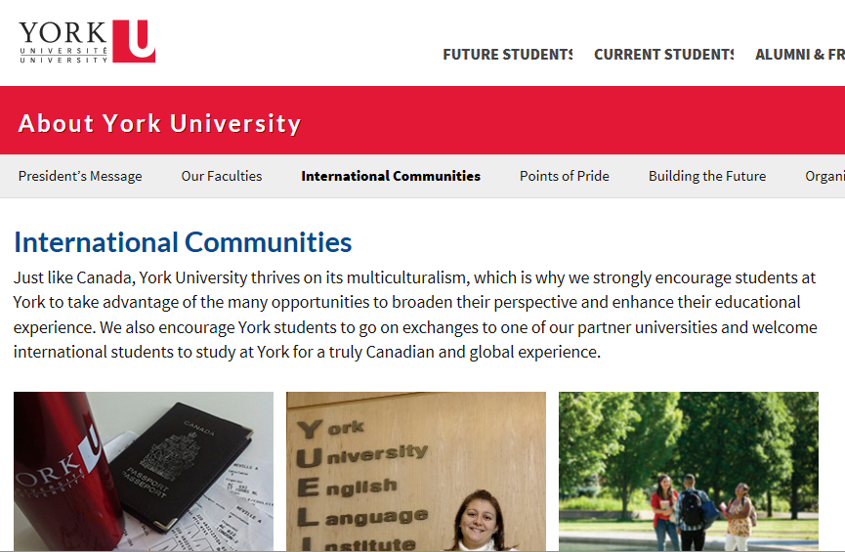
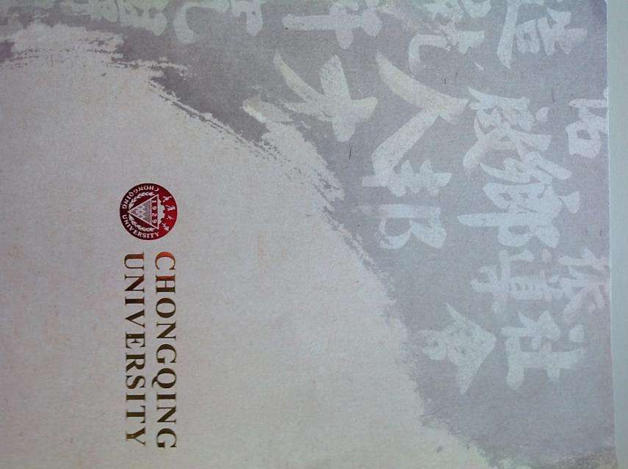
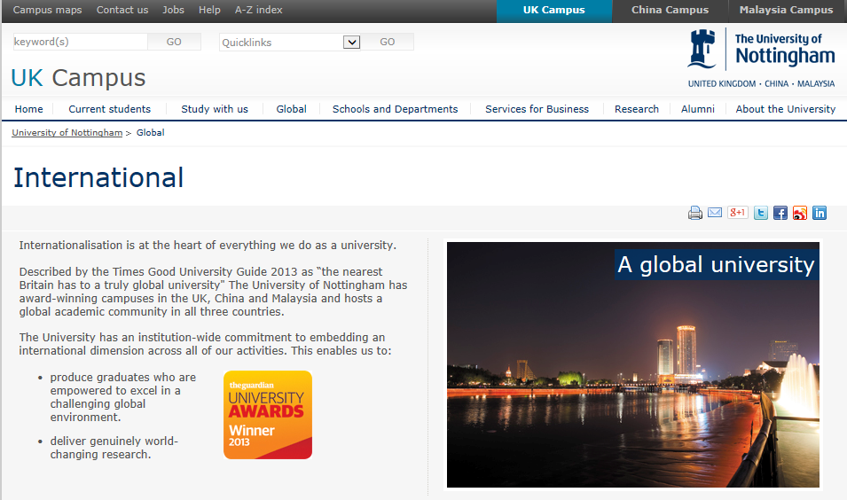
International developments
and best practices

Slide 8
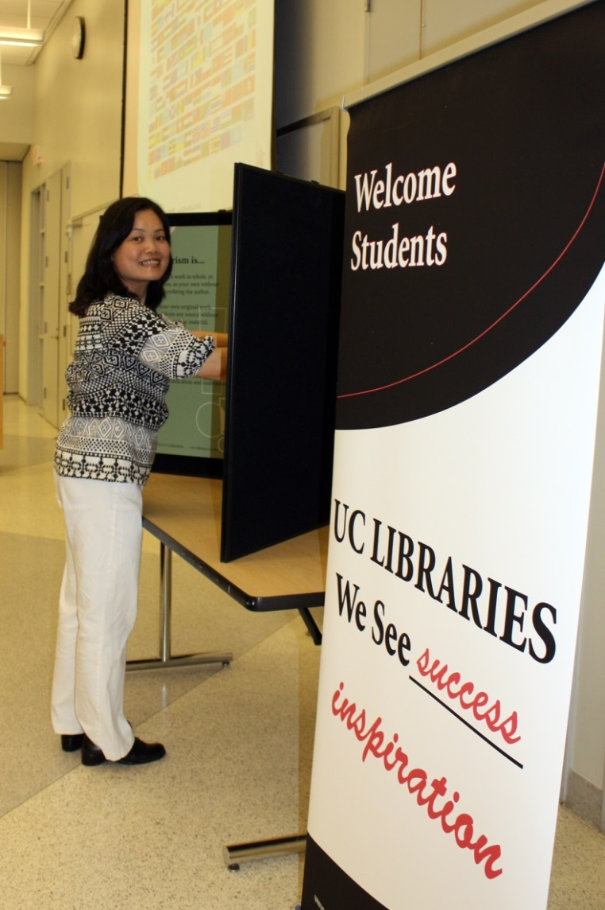
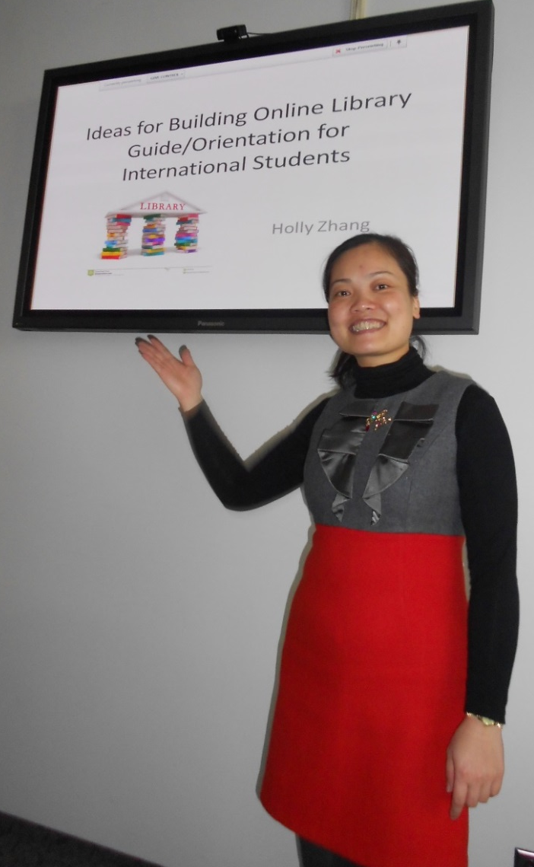
International student worker

Slide 9
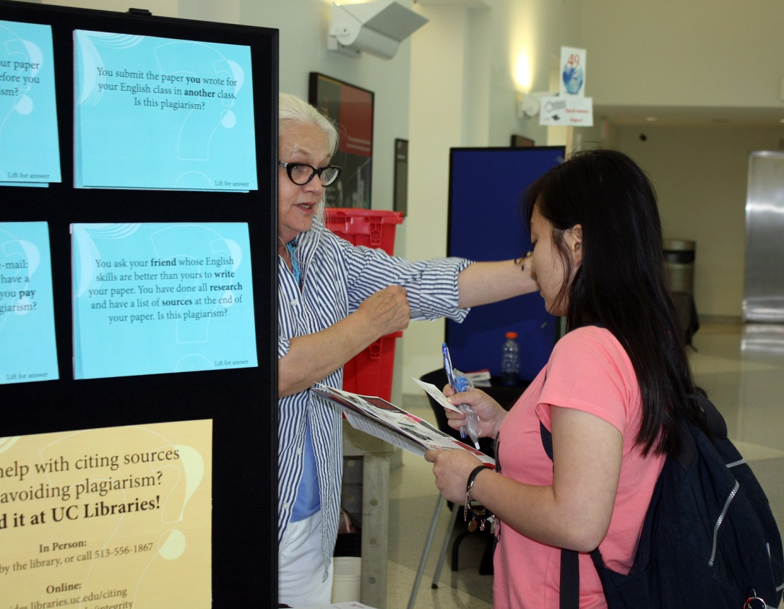
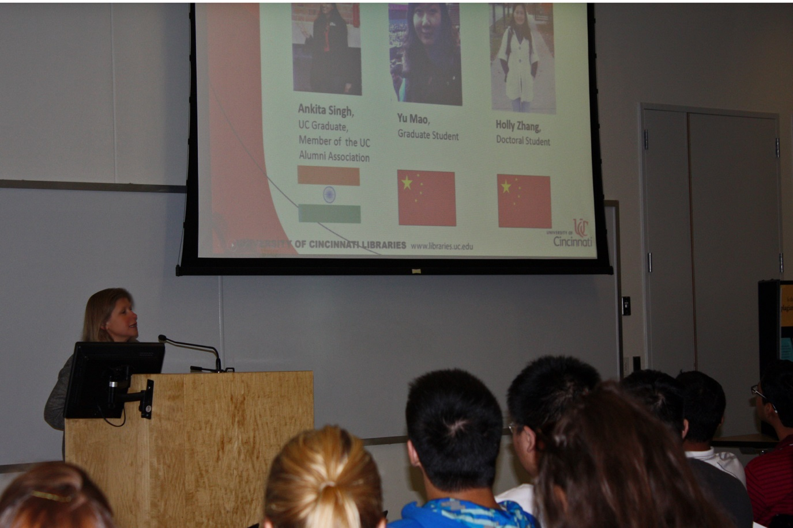
Orientation: Conference

Slide 10
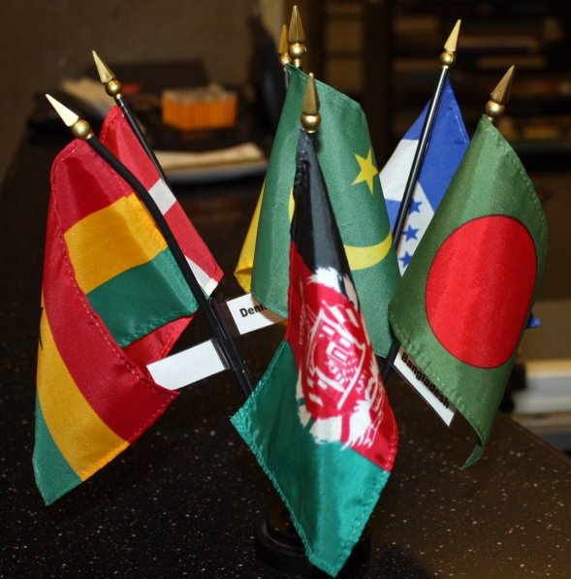
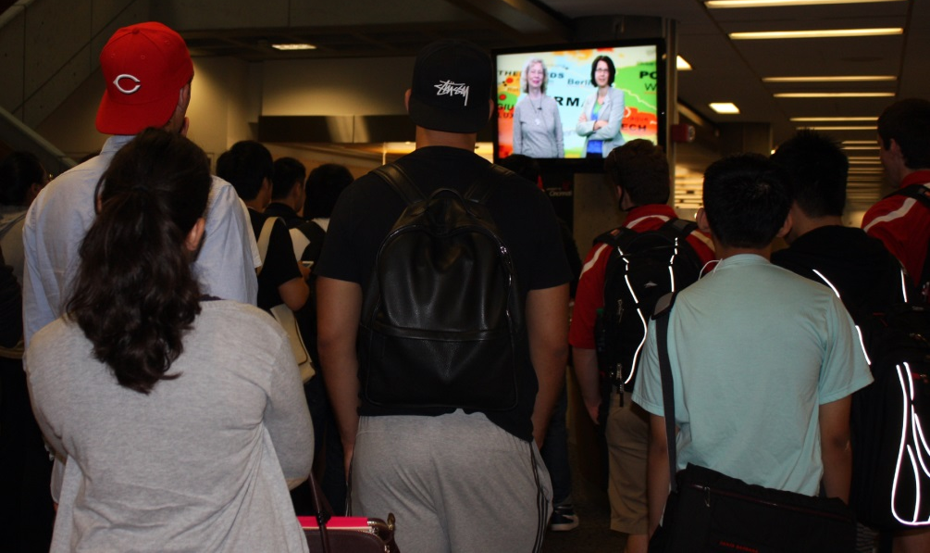
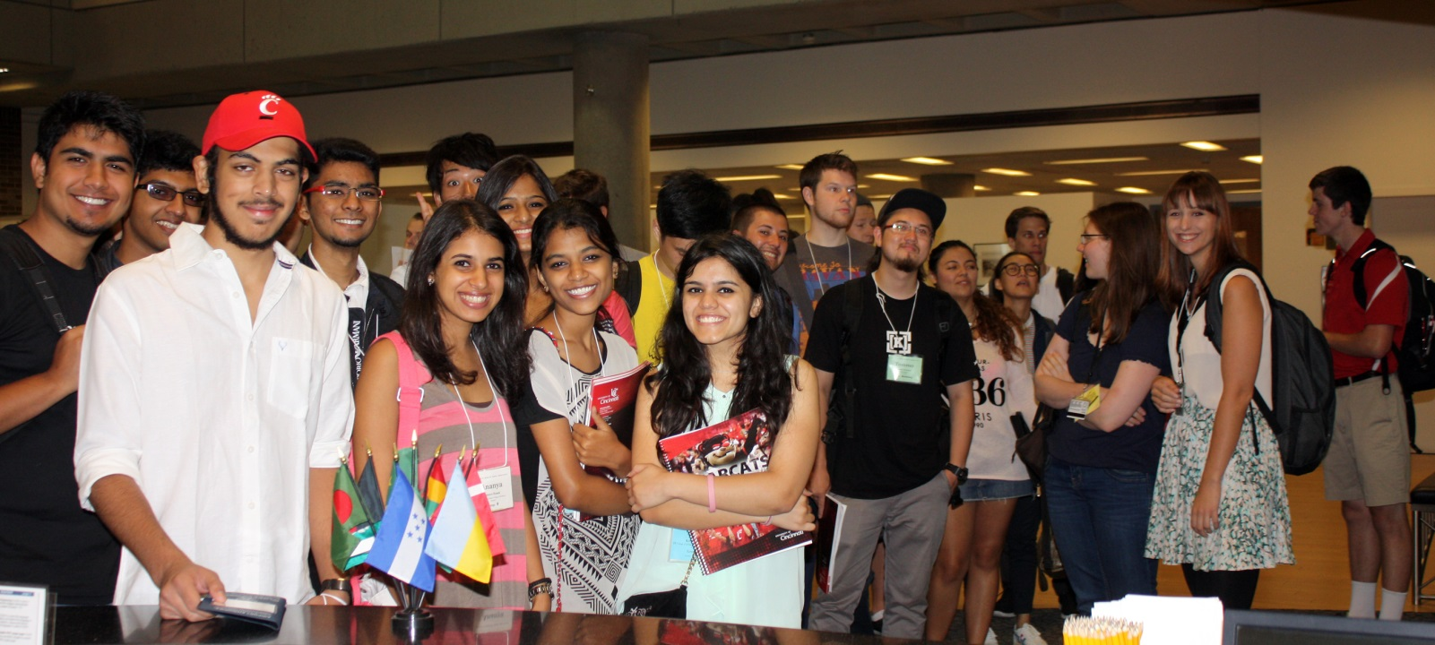
Undergraduate orientation: a warm welcome

Slide 11
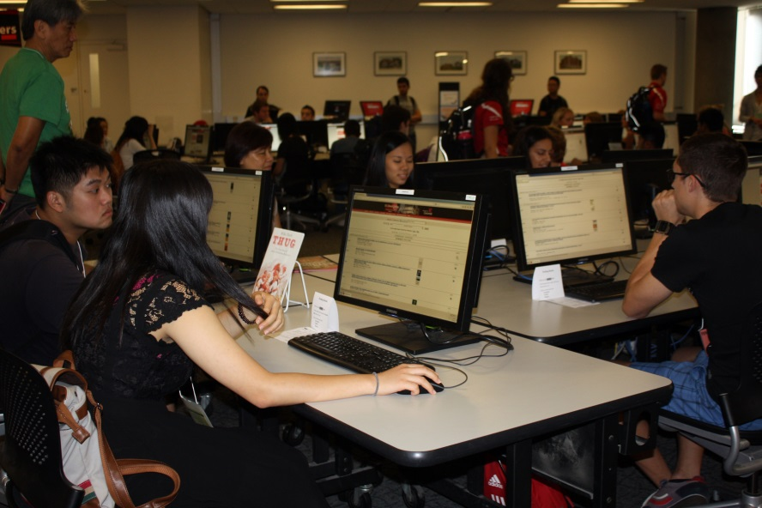
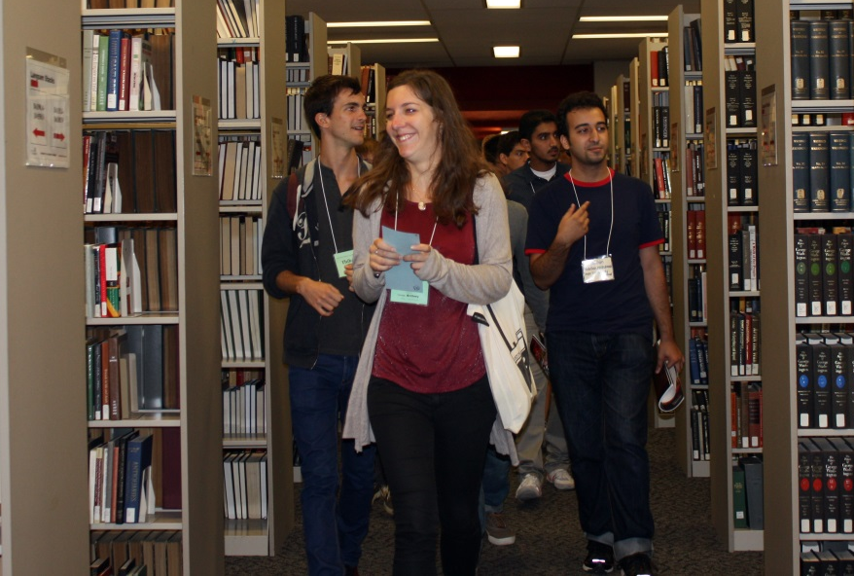
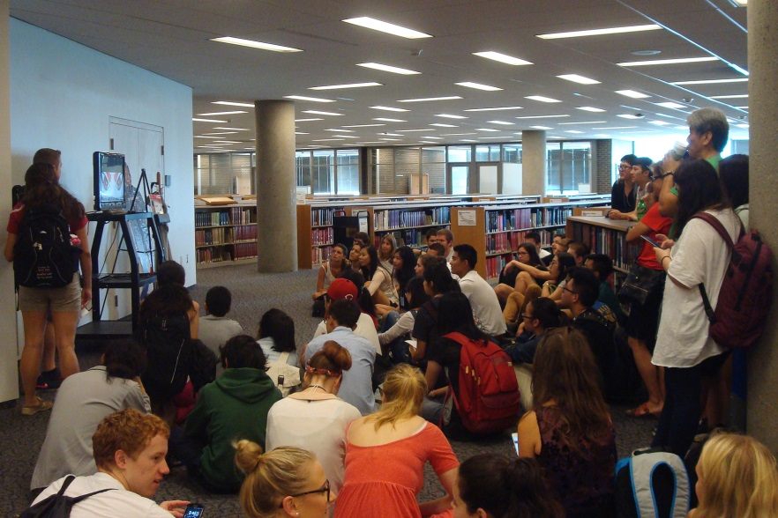
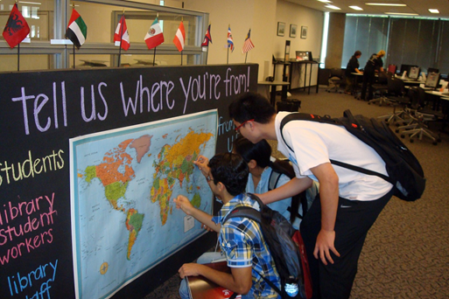
Undergraduate orientation: active exploration

Slide 12
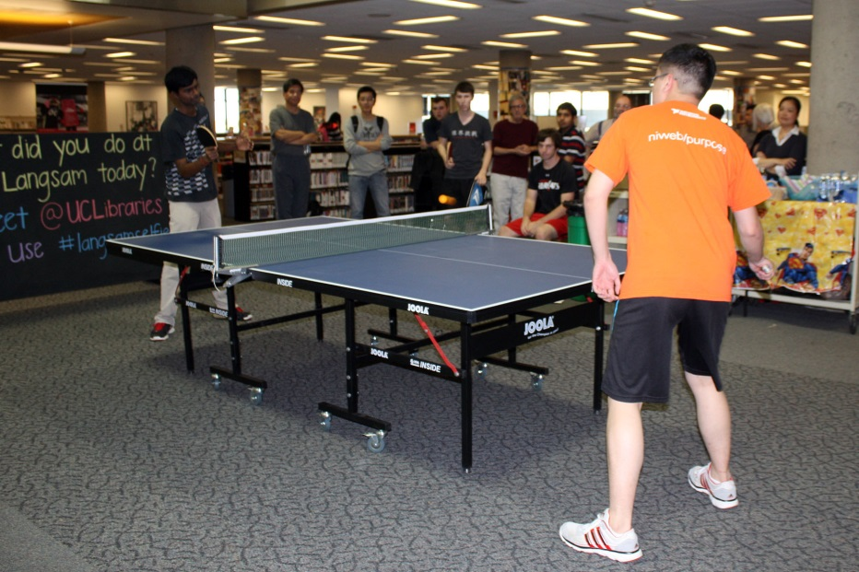
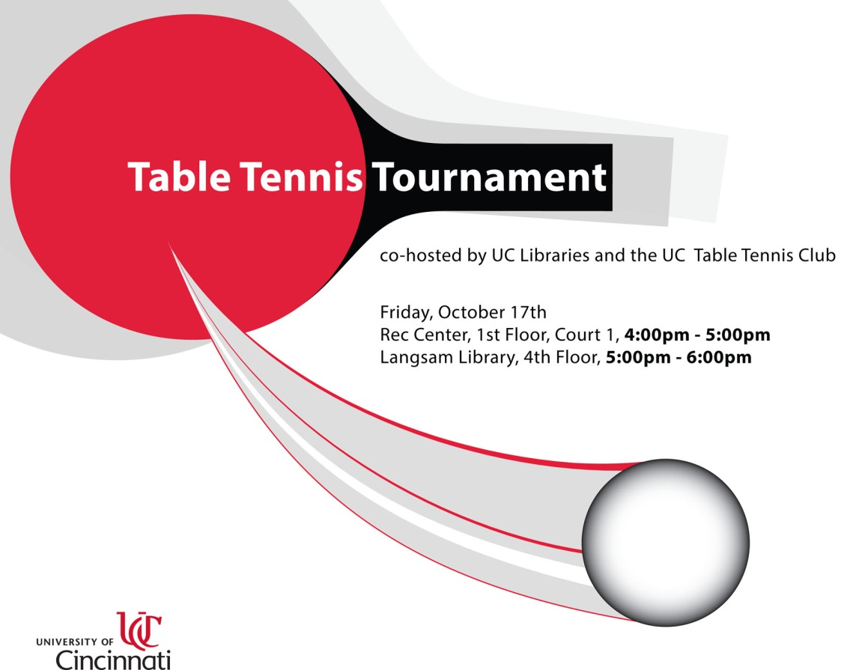
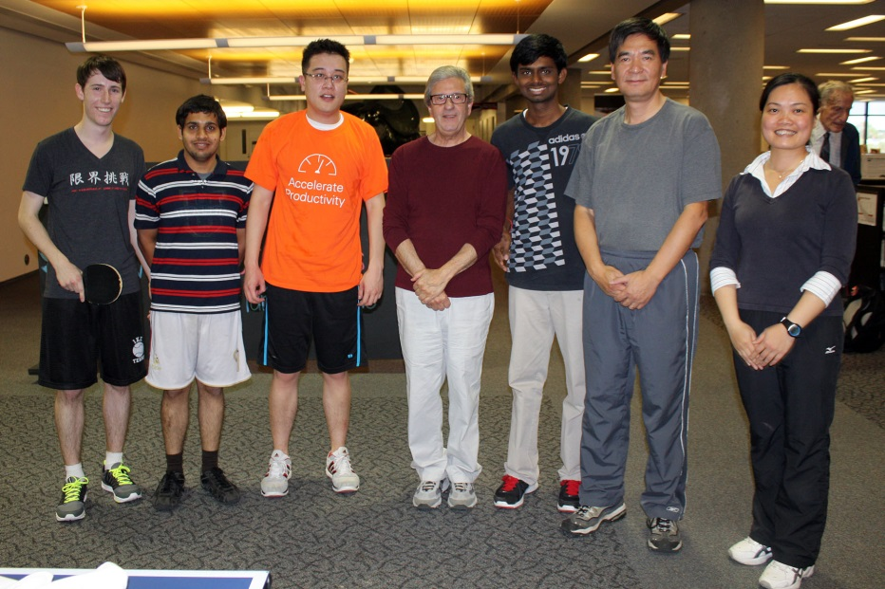
Events: student-driven

Slide 13

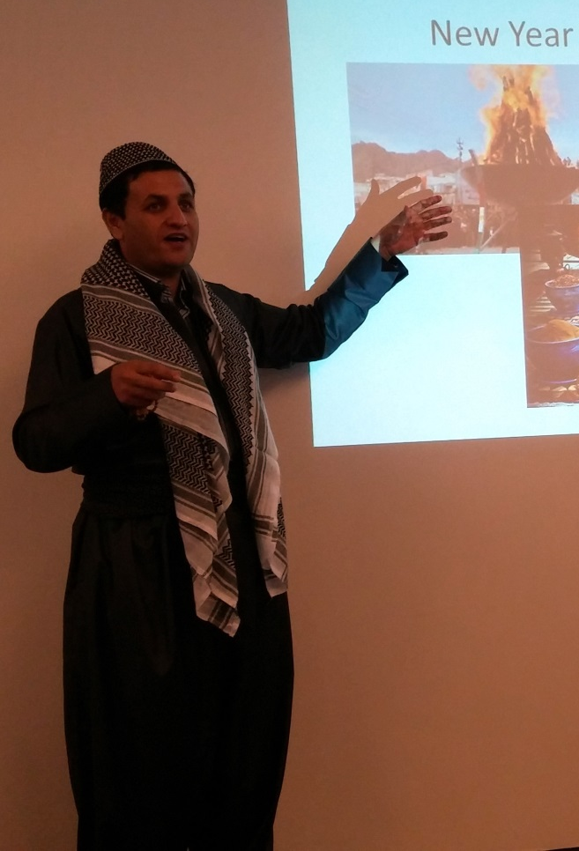
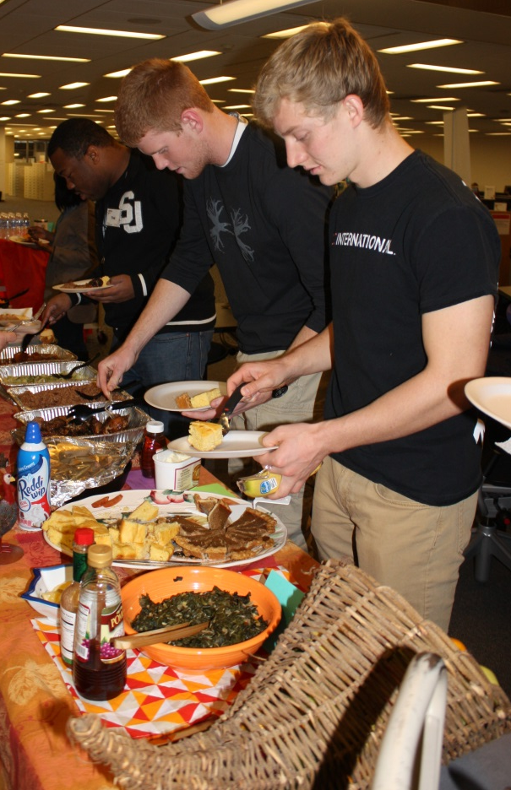
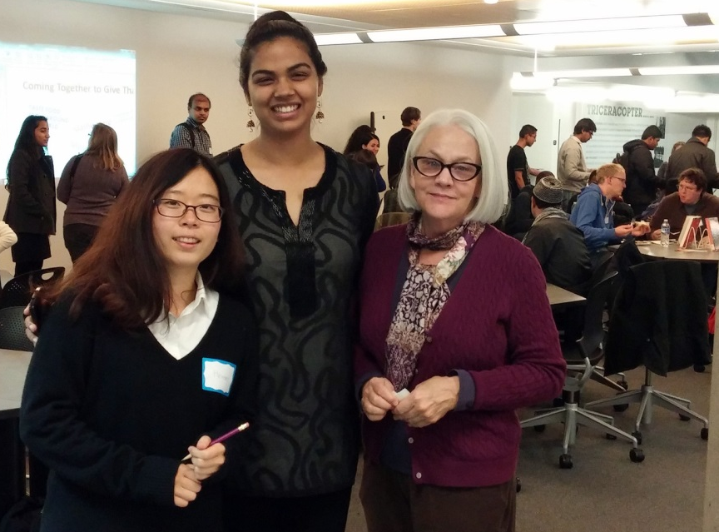
Events: student driven

Slide 14
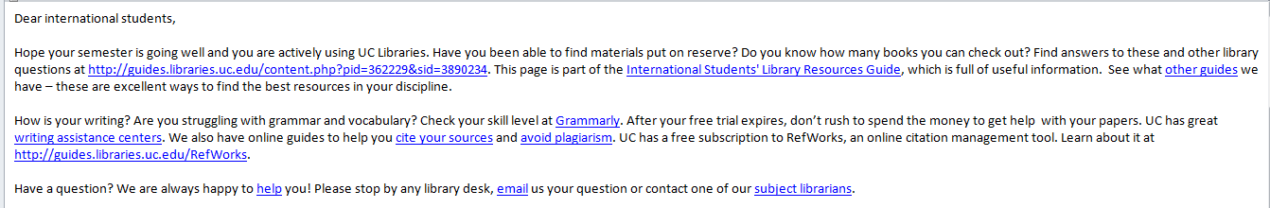
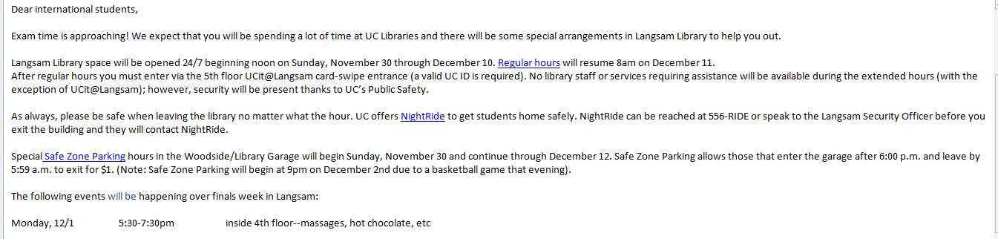
It’s not just fun…
Monthly newsletter

Slide 15
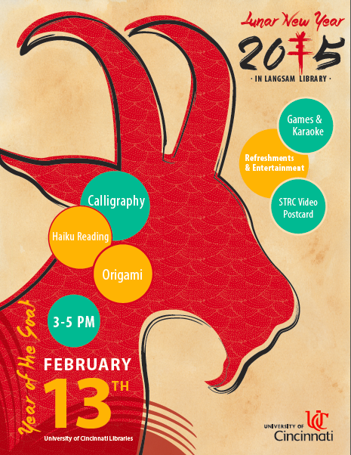
Coming up
Panel: “the culture bump”
LibGuide and panel
on study abroad
Online orientation

Slide 16
Plans for the future
Focusing on academic aspects of student success.
Collaborating with campus initiatives toward building cultural competency.

Slide 17
Thank you!
Questions?
Comments?
We’d like to hear about your experiences!
rosemary.franklin@uc.edu
olga.hart@uc.edu

