Slide 1
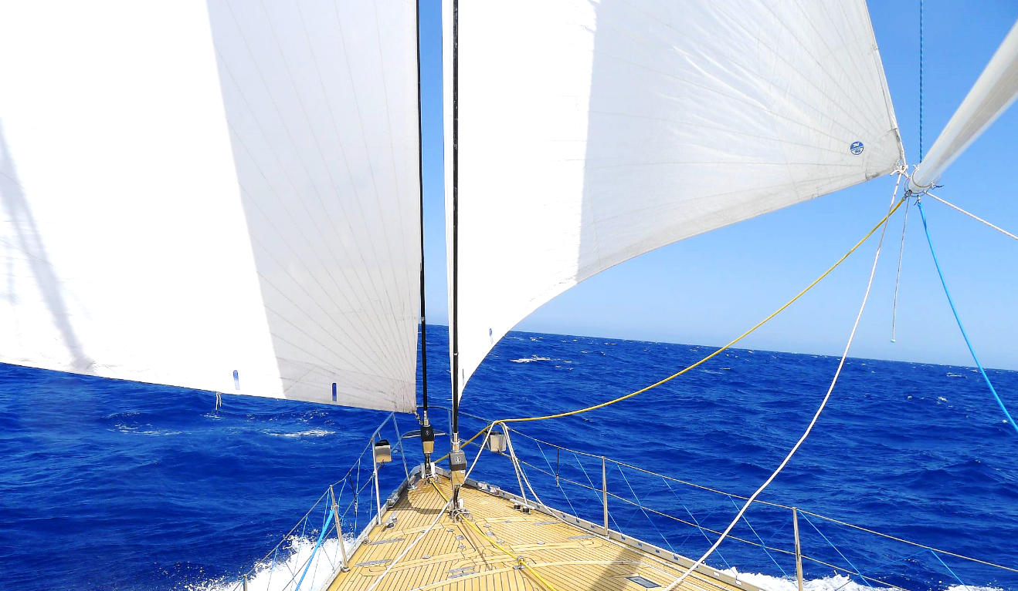
All Hands on Deck:
Launching Students
Toward Research Success
Pamela Bach
Robert Freeman
Olga Hart
Rebecca Leporati
ACRL 2017 Conference

Slide 2
Learning Outcomes
Learn simple and easy techniques to optimize touchpoints with undergraduates.
  First year students
  Mid-collegiate discipline courses
  Senior: Presentation formats
Learn strategies for scalability, using digital tools.
Learn how to embed the threshold concepts across the curriculum.

Slide 3

First Year Students
Notes:
Connect with students from the first time they are on campus as students.

Slide 4


New Student Orientation
Testing the waters
  70% received instruction on finding & using info from a librarian/media specialist
  Used variety of resources: websites, books, videos, images – top 4
    Only 56% had used scholarly journal articles
  Research databases: Google Scholar and EBSCO on par with Wikipedia
  Used variety of formats: PowerPoints, videos, brochures, Prezi
Notes:
During new student orientation in the summer, students spend a day and a half on campus. On day 2, students spend one hour in main library with about 300 students descending on us. We break up into smaller groups with 6 mini-sessions. One of the activities is a survey, that half the students complete (2200 responses). Give us a sense of the kind of research and projects did in high school.
Now it’s time to take the plunge and tell us what 3 words come to mind when you think of RESEARCH

Slide 5

Poll: Taking the Plunge
What 3 words come to mind when you think of
RESEARCH?
Notes:
During new student orientation in the summer, students spend a day and a half on campus. On day 2, students spend one hour in main library with about 300 students descending on us. We break up into smaller groups with 6 mini-sessions. One of the activities is a survey, that half the students complete (2200 responses). Give us a sense of the kind of research and projects did in high school.
Now it’s time to take the plunge and tell us what 3 words come to mind when you think of RESEARCH

Slide 6

In Synch with English Composition
    Libguides, course learning outcomes & threshold concepts
    One shot sessions
    University Composition Committee
    Annual Writing Award Ceremony
Notes:
As with a crew team it is critical to be in synch and heading in the same direction.
We have a long standing collaborative relationship with the English Comp folks on campus who view the libraries as partners in teaching their students research skills and using library resources.
In 2015 as we transferred our Libguides to the new platform, we involved English Comp faculty in the process, aligning with course learning outcomes and ACRL’s threshold concepts.
Each year we teach 130 classes for approximately 2300 students.
mix of instructors: tenured faculty, educators, adjuncts, GAs
Every year a new crop of GAs
Library Rep on University Wide Composition Committee
The finish line in spring term is a writing award ceremony that is held at the main library.
Libraries sponsor research award

Slide 7

Flipping to
Optimize Face to Face
Notes:
Flipped classroom activity to optimize f2f
Our libguide is our teaching tool. Most page includes a short video that introduces the content.
Formulate research question & Research Question to Keywords Videos
Concept map

Slide 8
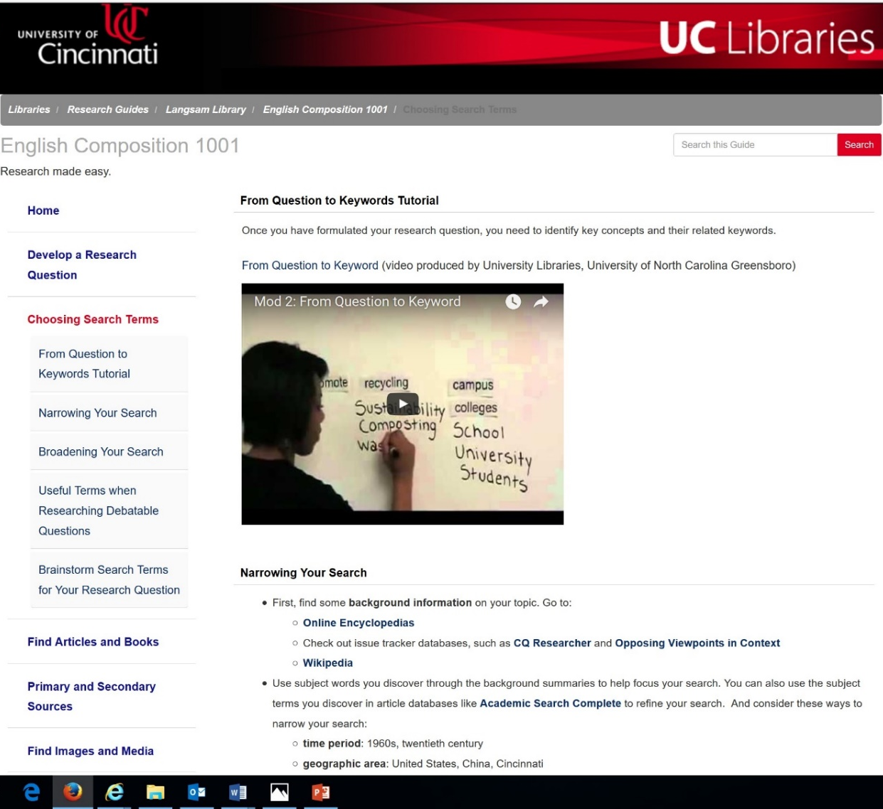
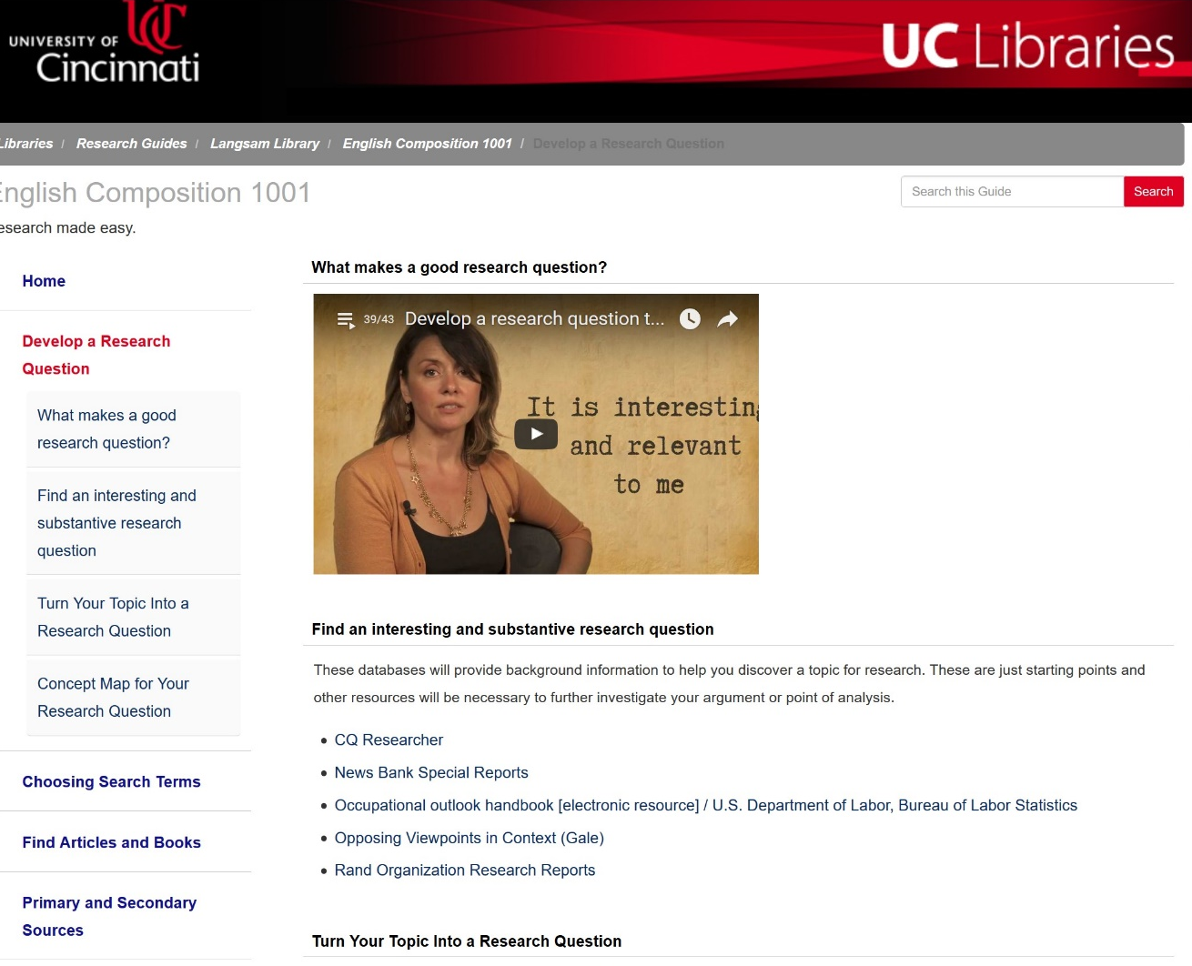
Research Guide
Notes:
Our Libguides are our teaching tool

Slide 9
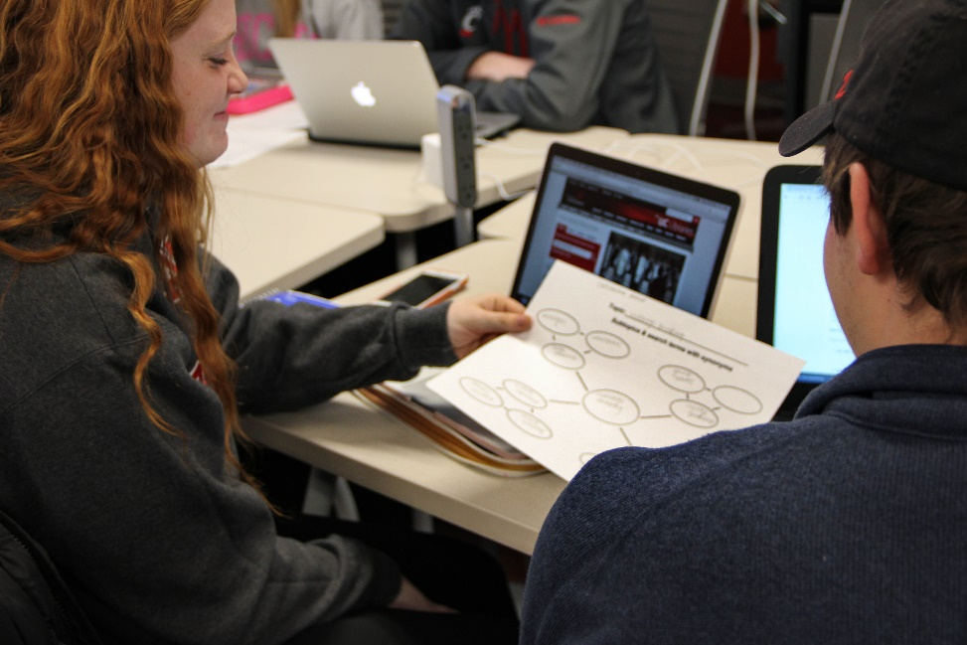
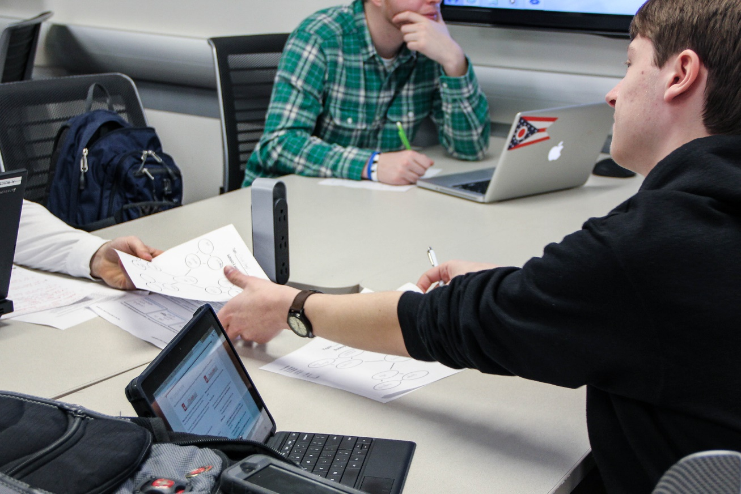
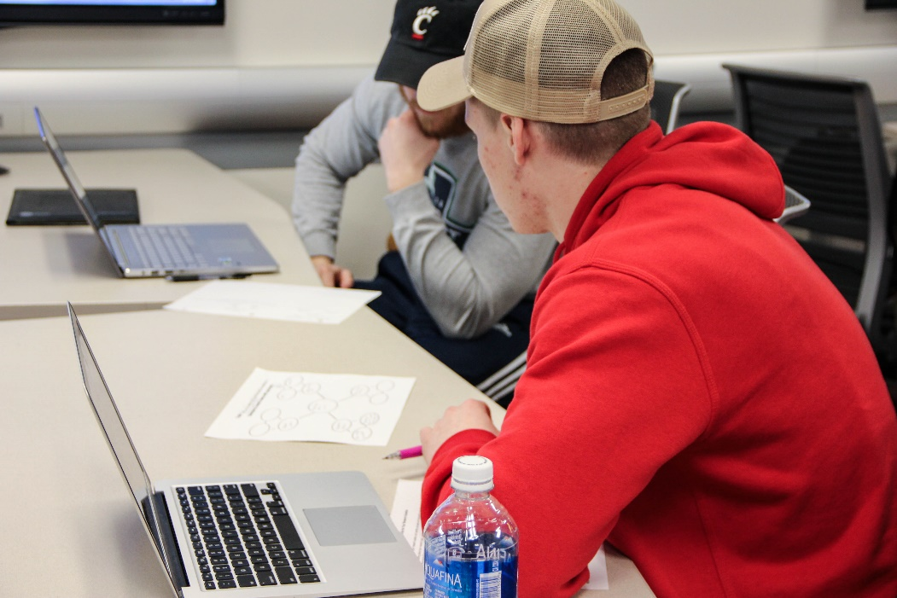
Pair and Share Concept Map
Notes:
In the F2F instruction session, we begin it with a pair and share of their concept maps which primes the pump. We have a few students report out to get a sense of range of topics and kind of discipline resources may need.
After introducing either Summon or Ebsco databases with a quick overview of the functionality and search strategies, the rest of the class time is spent on searching, discovery. We circulate, looking at individual search strategies and provide tips.

Slide 10
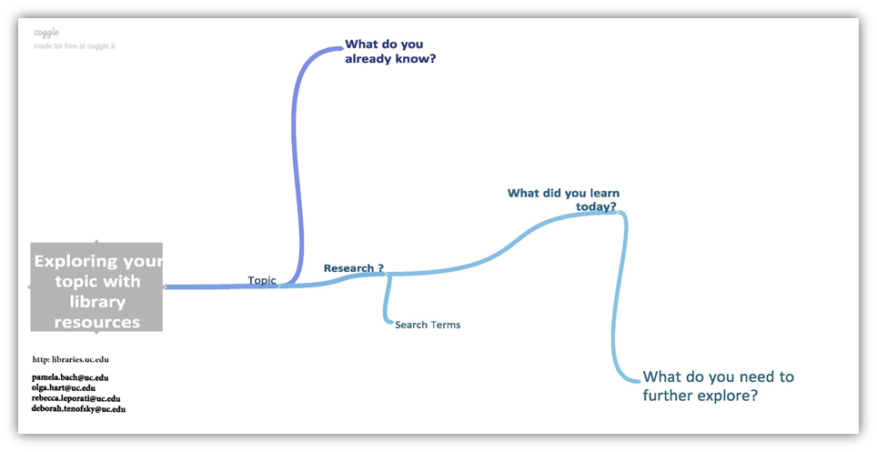
Reflection
Notes:
In fall term, we created this worksheet to help students be mindful that research is a process of inquiry as well as provide a take-away for them.

Slide 11
Testimonials
Students
  “Thanks again for taking time out of your day to show my class this. I never knew this even existed. But it looks like I will be using this a lot in the future.”
  “Thank you for the help. These sources will really add depth to my report. The higher education inequality and public good, is just the sort of reference I needed.”
Faculty
  “Thanks so much for the workshops you arranged for my four English Composition 1001 classes. It helped them immensely and they have turned in much better research for their essays since attending these workshops.”

Slide 12

Navigating the Storm
Charting a new course for first-year instruction

Slide 13
“Many assume that because young people are fluent in social media they are equally savvy about what they find there.
Our work shows the opposite.”
-Stanford History Education Group
Notes:
Two-thirds of university students studied did not research the source of information on social media to determine bias.

Slide 14
Flipped Classroom
Choose-Your-Own Research Path (interactive tutorial)
How to Evaluate Information Resources (video)
Submit a Source (article search activity)

Slide 15
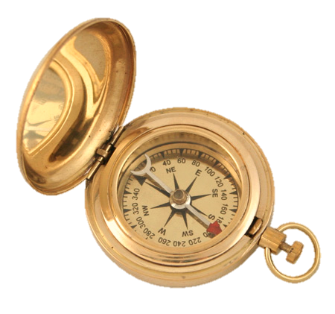
Flipped Classroom
Activity
Interactive tutorial where students choose their own research path.
Learning Outcome
Students will understand how to use different online information sources in their research.

Slide 16
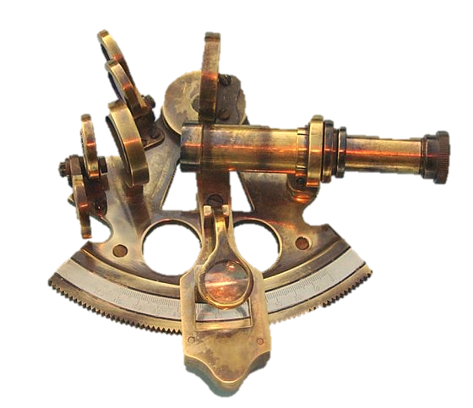
Flipped Classroom
Activity
Watch a short video examining various online sources.
Learning Outcome
Students will learn what elements of online sources to analyze

Slide 17
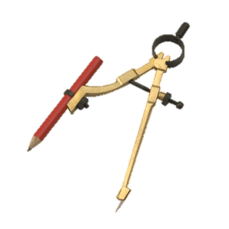
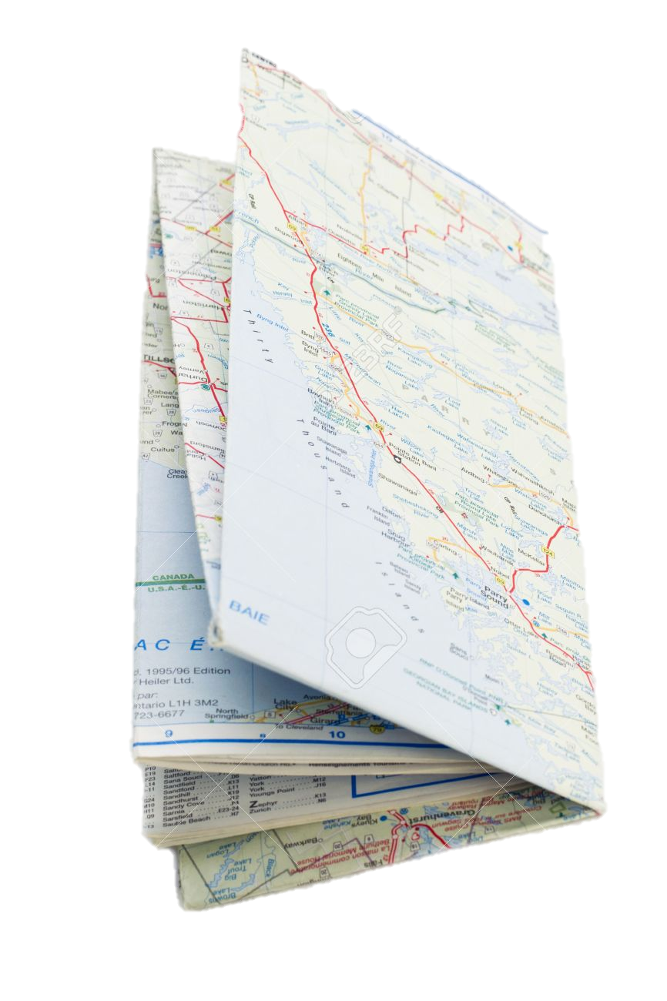
Flipped Classroom
Activity
Send in a source URL with a short evaluation of its trustworthiness.
Learning Outcome
Students will be able to analyze sources they find online.

Slide 18
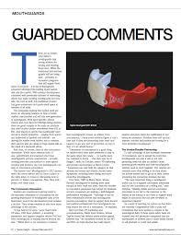
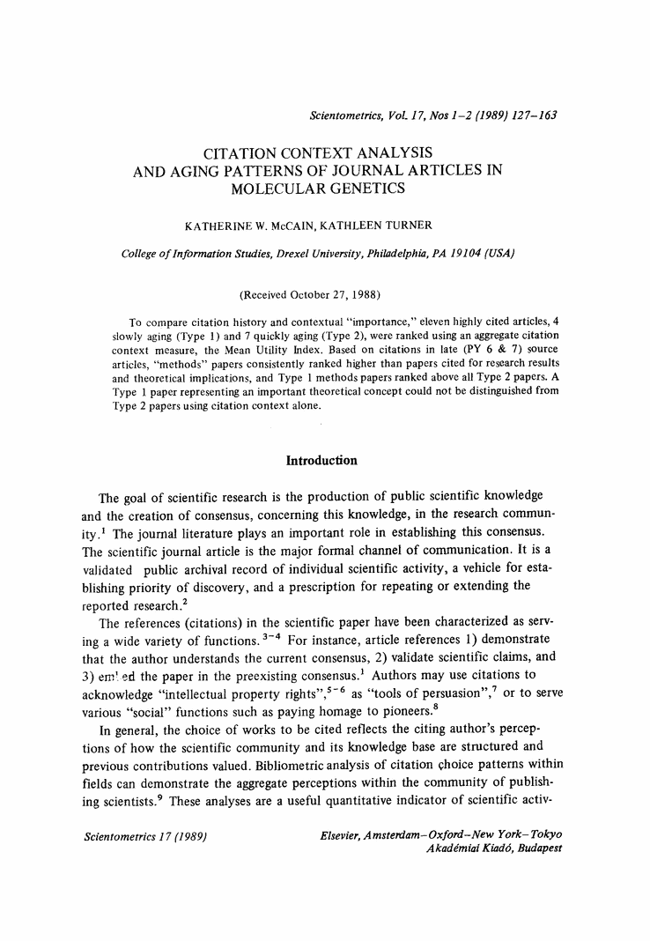
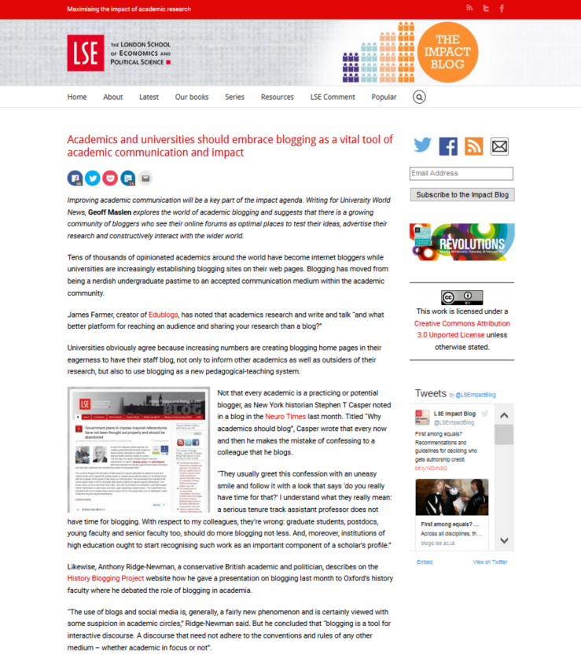
Pair & Share
A new focus for a successful tool. Students will analyze peer-submitted articles.

Slide 19
Research Hacks
“
“
How to make Google the ultimate keyword thesaurus.
How to use Wikipedia to jump-start your works cited.
Get peer-reviewed sources quick: Use the library catalog.
Use article databases to limit search results.
Skimming the easy way: Ctrl + F.
Or, how to keep the library orientation in a source-analysis focused instruction session.

Slide 20

Faculty Collaboration
We are leveraging well-established faculty relationships to:
Pilot activities
Tweak our tools
Notes:
Mention Cynthia Ris pilot activity

Slide 21


Any
Questions
or
Comments

Slide 22

Discipline Specific Classes

Slide 23

Expanding a discipline specific tutorial to be applicable for multiple disciplines.

Slide 24
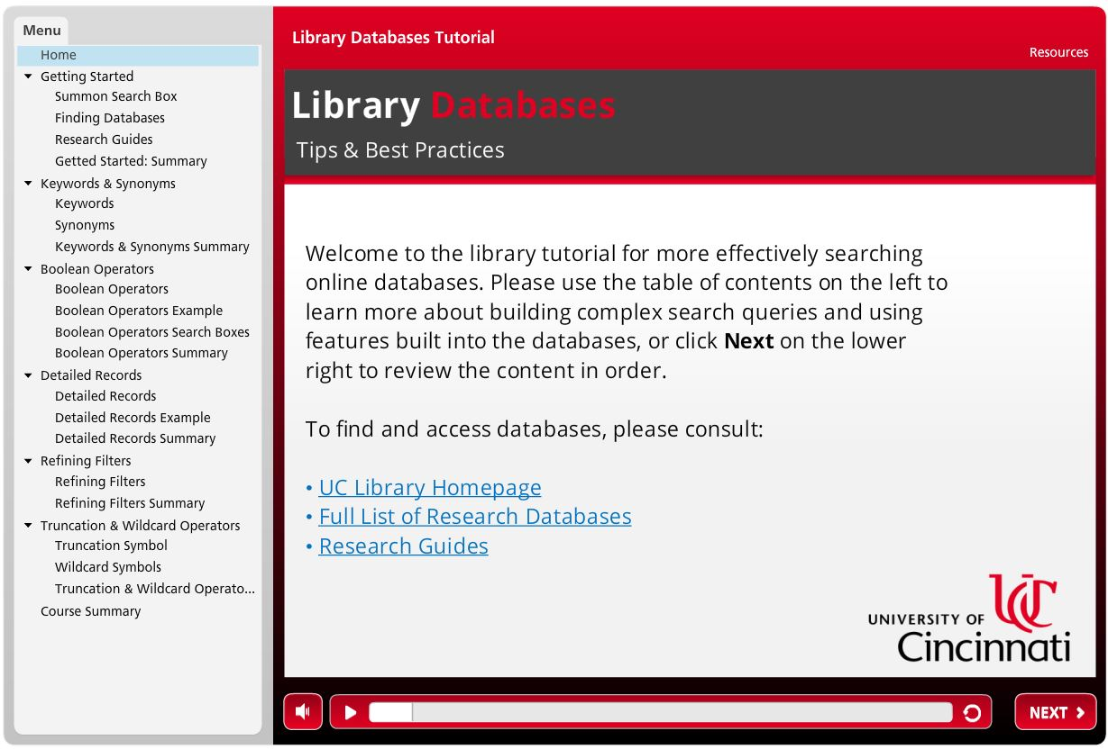
Universal Strategies
Encourage information seeking behaviors.
Give students the tools to search for themselves.

Slide 25
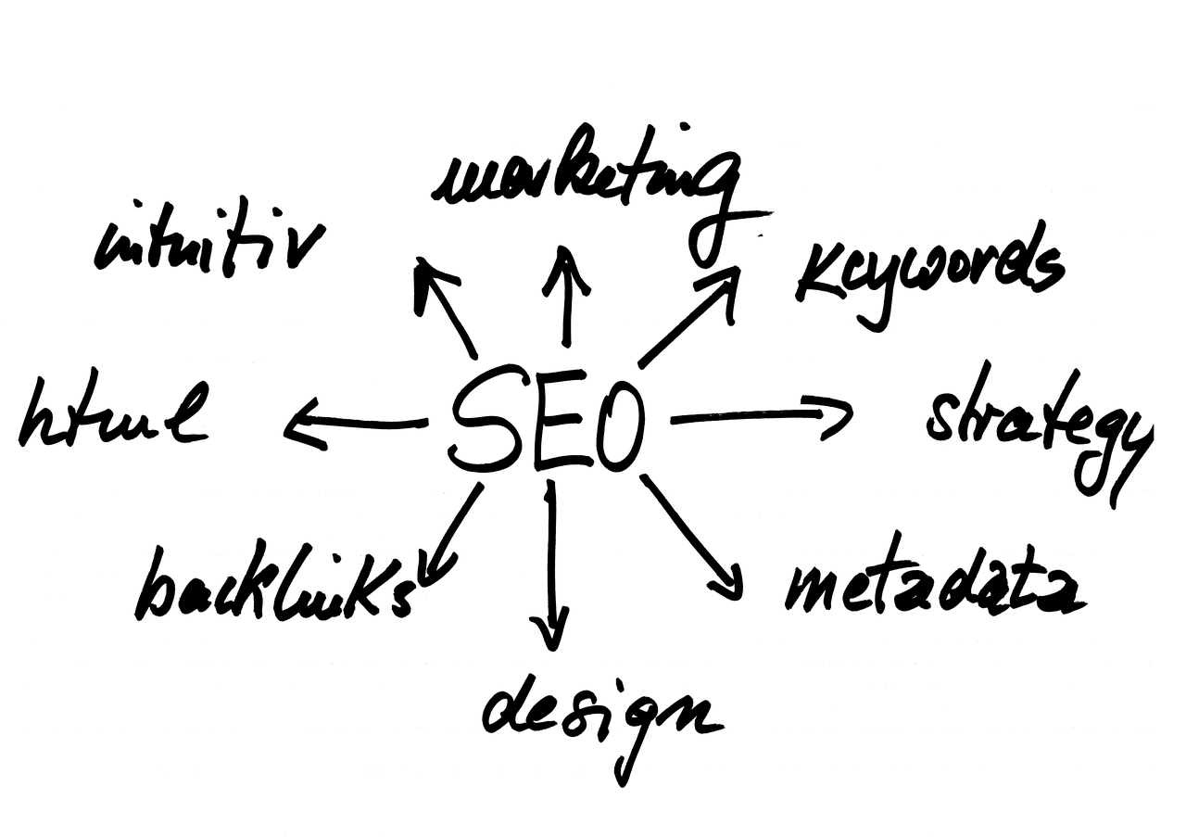
Universal Strategies
Search engine logic
  Keywords
  Boolean operators

Slide 26
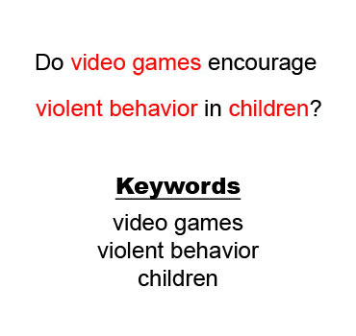
Universal Examples
Cross-disciplinary examples
  Information technology
  Education
  Counseling
  Criminal justice
Scalable & improves delivery

Slide 27
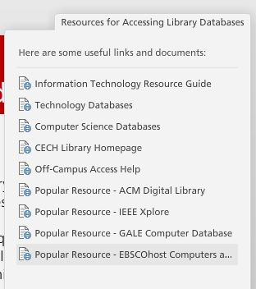
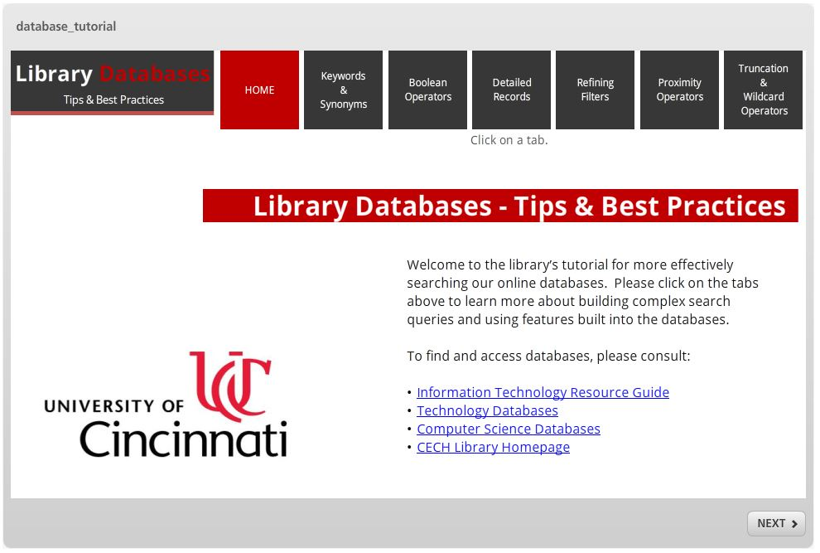
Modular Design
Supplemental Resource Areas can be customized for specific topics.

Slide 28

Modular Design
YouTube cannot replace videos.
Vimeo and Kaltura can.

Slide 29
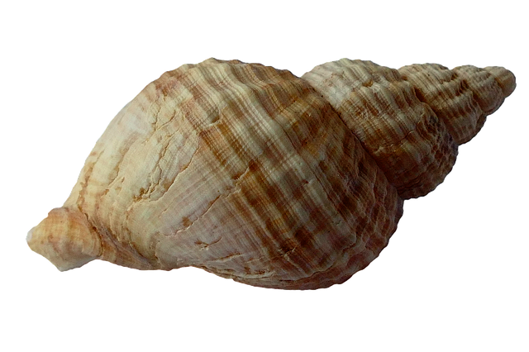
Expand Distribution
Embed the tutorial in LMS course shells.
Who manages your LMS?

Slide 30
Testimonials
“This was incredibly helpful for learning how to do research in the library. I wish I could have learned this information as a freshman.”
“I did not realize that we had the use of truncation and wildcard operators. Thank you for including this specifically.”

Slide 31
Any
Questions
or
Comments

Slide 32
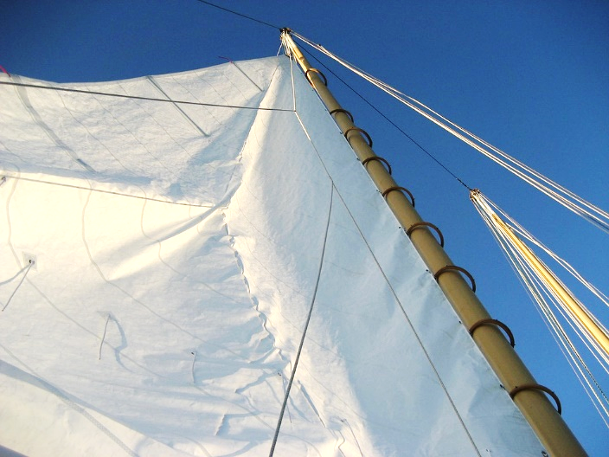
Senior: Presentation Formats

Slide 33
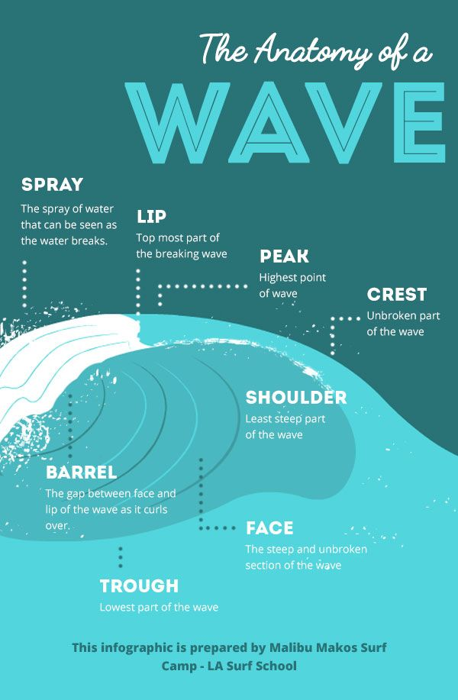
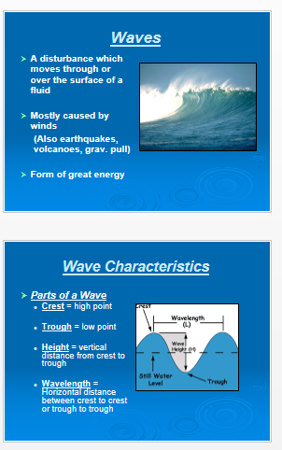
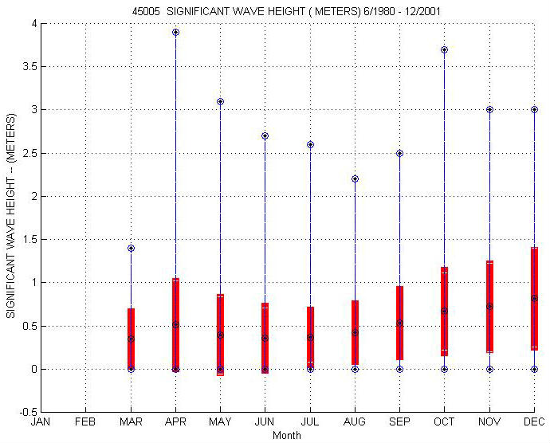
“Students have a greater role and responsibility in creating new knowledge…”
- Framework for Information Literacy for Higher Education

Slide 34

Poll: Do you think that we should provide such instruction?
Poll: Have you had a request for library instruction on visual presentation of information?

Slide 35
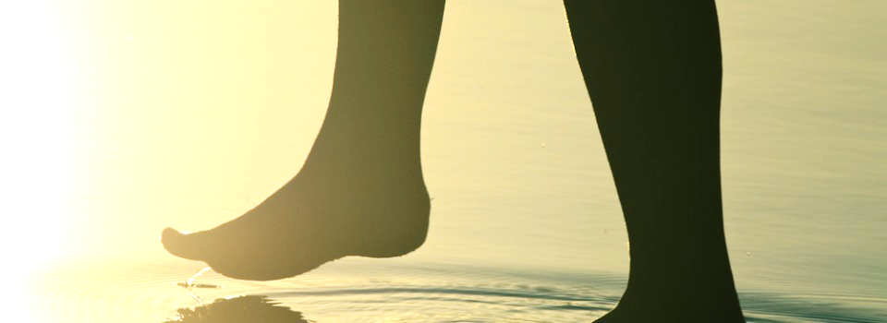
Getting My Feet Wet:
Introducing Students to Infographics
Notes:
The first instructional request I got for visual presentation of information had to do with inforgraphics.

Slide 36
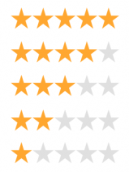
Activity I
Poll: Please rate the exhibits for the impact each of them made on you (1- lowest, 5 – highest)

Slide 37
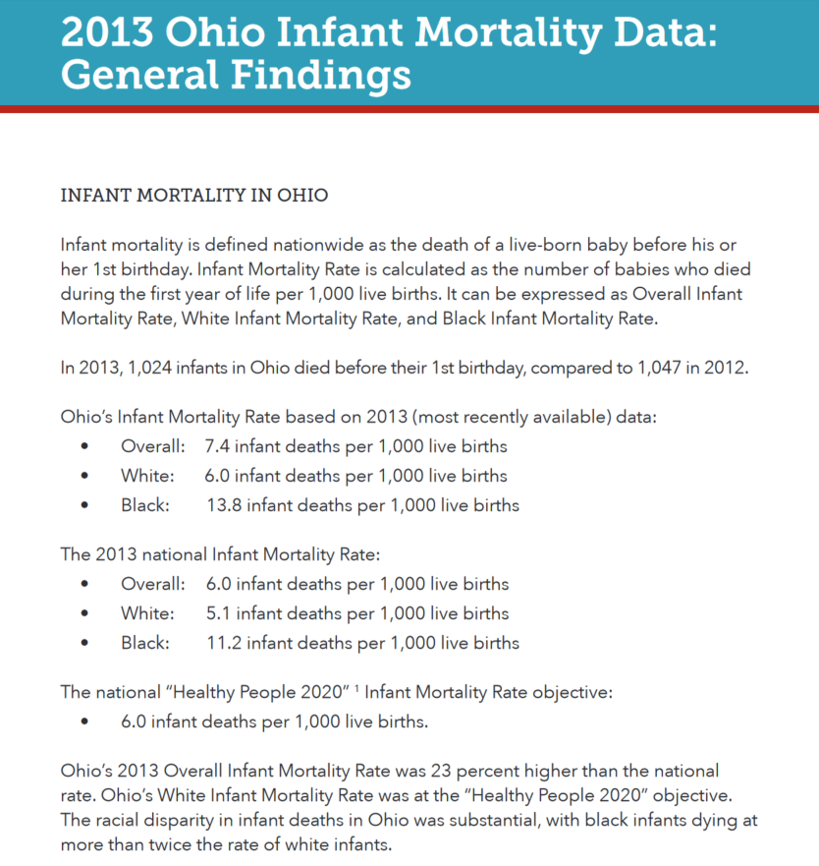
Exhibit 1
http://www.odh.ohio.gov/~/media/ODH/ASSETS/Files/cfhs/Infant%20Mortality/2013%20Ohio%20Infant%20Mortality%20Data%20Report%20FINAL.pdf

Slide 38
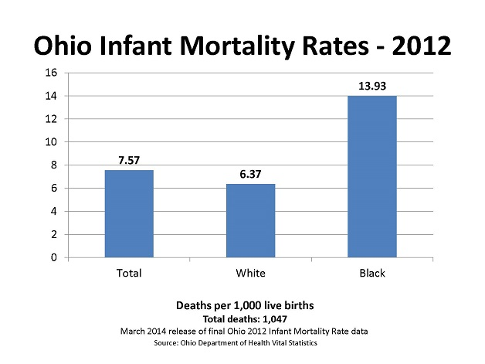
Exhibit 2
https://www.odh.ohio.gov/odhprograms/cfhs/octpim/infantmortality.aspx

Slide 39
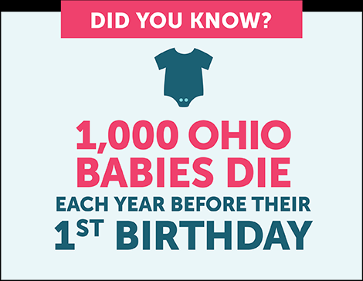
Exhibit 3
http://www.ourbabiescount.org/about.html

Slide 40
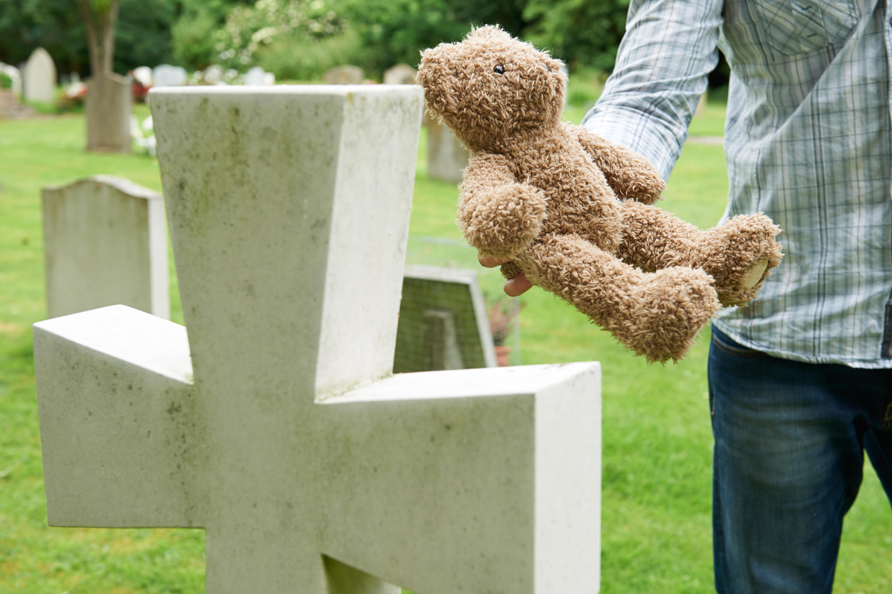
Exhibit 4
http://wvpublic.org/post/ohio-experiences-jump-infant-mortality#stream/0

Slide 41
Session Outline
  Power of visual information
  Importance of research and ideation
  Finding existing infographics and images
  Tools for creating infographics
  Infographics best practices

Slide 42
Activity II: Learn about SmartArt
and Edit a Simple Infographic
1 in 141 babies die in the U.S. each year
There are approximately 20,000 newborn deaths within their first month of life and close to 30,000 in the first year
Babies born in the US are twice as likely to die than babies in many other developed countries, including Sweden, Japan and Spain;
the United States is ranked 36th among 196 nations.
http://www.rbabyfoundation.org/resources-facts.php

Slide 43


Pregnancy, Birth, and Health (2014): Examples of Students’ Work
Notes:
This was a service learning course and these flyers were used for community education.

Slide 44
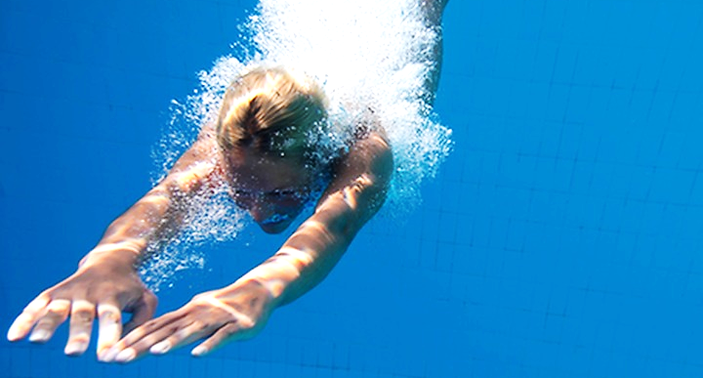
Diving In:
Presentation Best Practices
Notes:
As we know from literature and Project Information Literacy reports, employers look for good communication and presentation skills and I felt that it was time to step in and talk to students about best practices in visual communication.

Slide 45
Session Outline
  PowerPoint dos and don’ts
  Finding and using quality images
  Importance of research and ideation
  Tools for creating infographics
  Best practices for infographics, brochures, and newsletters

Slide 46
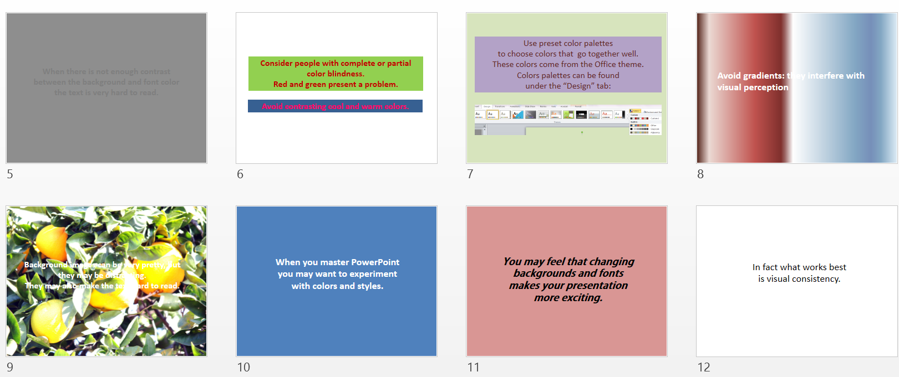
Activity I: Applying Best Practices to Slides
Notes:
We look at poorly designed slides, talk about improvements, and immediately apply them. I assume basic knowledge of PowerPoint. Students are ususallynot aware of many features of PowerPoint that help create interesting and professional presentations.

Slide 47
Activity II: Transforming Text into Slides

Slide 48
Additional Resource: Page in a Guide
http://guides.libraries.uc.edu/digliteracy/createpublish
Tools for creating various types of content
Best practices for various presentation formats
Links to sites for publishing content
Links to selected software tutorials

Slide 49
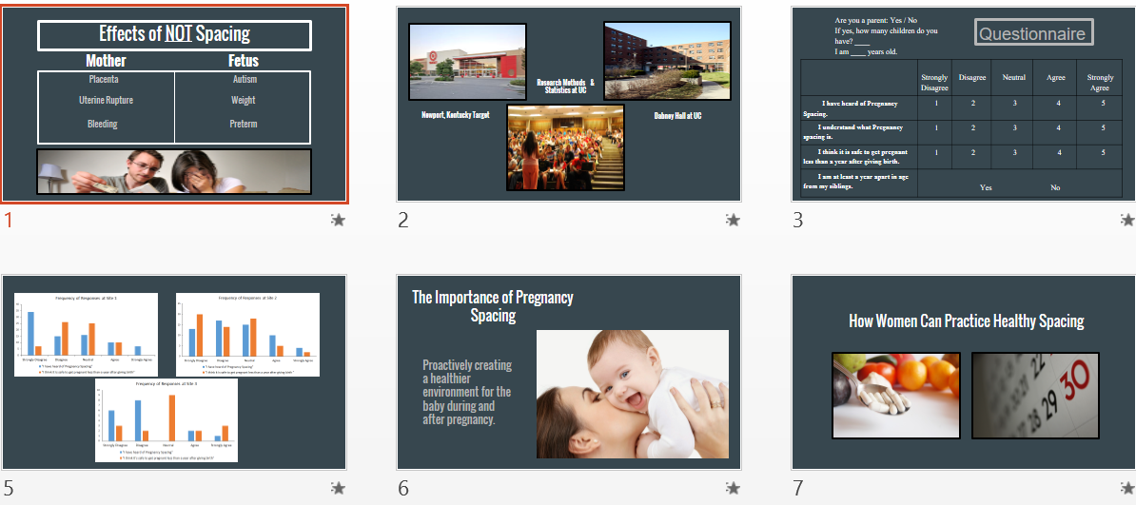
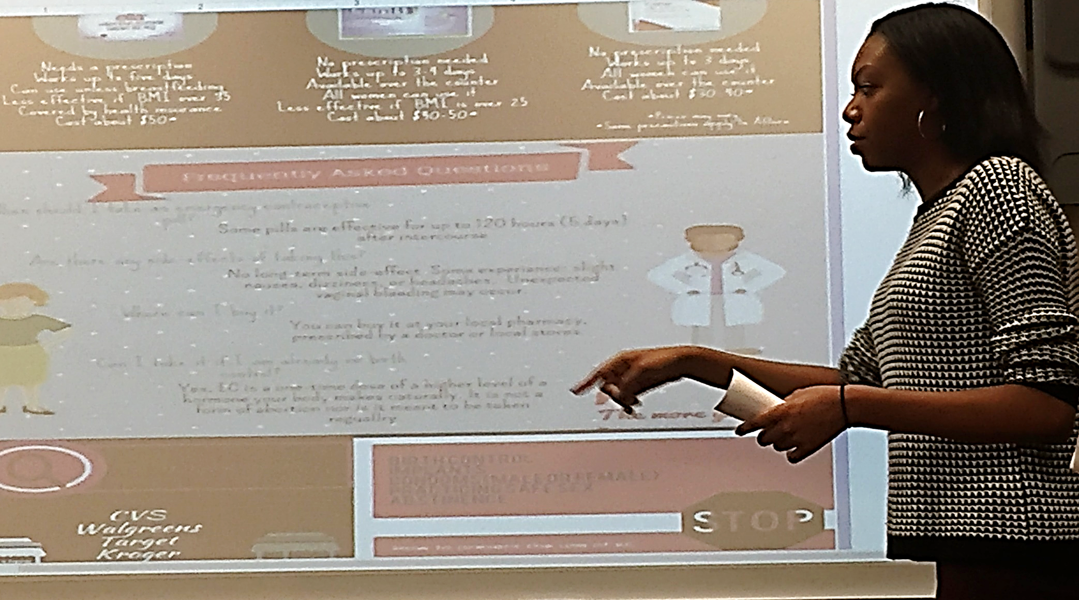
Pregnancy, Birth, and Health (2015): Examples of Students’ Work

Slide 50
Testimonials
Students
Faculty
“Taught us something we have been expected to know.”
"Knowing the techniques in presenting information in formats such as my slideshow has provided me a way to grab the audience's attention and inform them better of the topic, visually."
Included more graphics, fewer words.
Didn’t read off slides as much.

Slide 51

Research 3 Words: First Year Students

Slide 52

Research 3 Words: Webcast Participants
http://www.wordle.net/

Slide 53
Any
Questions
or
Comments

Slide 54




Image Credits
http://www.picserver.org/h/high-school.html
https://pixabay.com/en/rowing-oars-team-sport-pictogram-306072/
https://alejandrourtubia.wordpress.com/2012/02/07/cayendo/
https://www.growery.org/forums/showflat.php/Number/664033
http://www.orcabook.com/Assets/ProductImages/0656.jpg

Slide 55

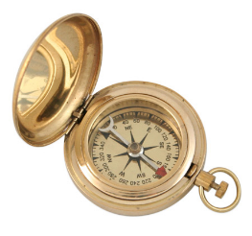
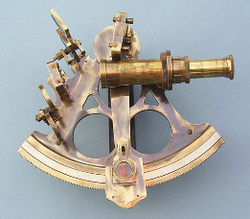
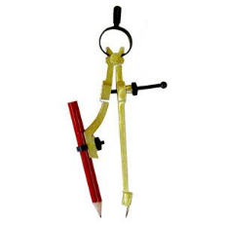

Image Credits
http://www.publicdomainpictures.net/view-image.php?image=3545&picture=stormy-sky
https://www.historicalemporium.com/store/002299.php?eesc=cat
http://www.stanleylondon.com/sext-6inspec.htm
http://www.highlandwoodworking.com/pencilcompass.aspx
http://local.union-bulletin.com/categories/food-and-beverage

Slide 56

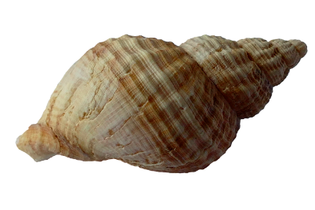
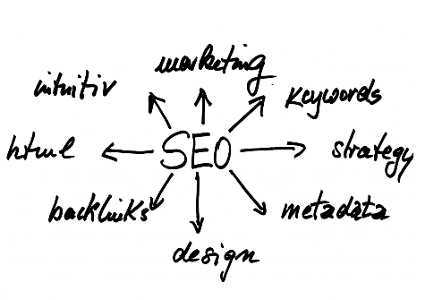
Image Credits
http://www.westnh.org/payday-loans-precarious-employment/
many-small-light-bulbs-equal-big-one/
https://pixabay.com/photo-1162757/
https://pixabay.com/photo-1359430/
http://www.kaltura.org/images/Kaltura-Sun.png

Slide 57




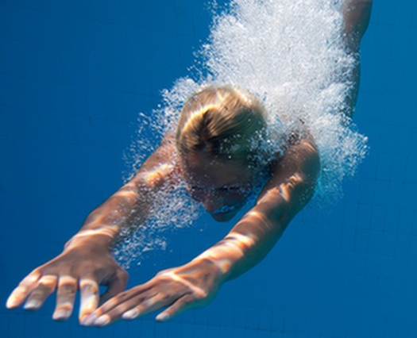
Image credits
Modified from https://www.vectorstock.com/royalty-free-vector/rope-exclamation-and-question-mark-vector-818749
http://www.lakeeriewx.com/CaseStudies/GayGamesSailing-2014/GayGamesSailing-2014.html
https://www.pinterest.com/pin/426786502167115889/
Waves PPT (Motion in the Ocean: Waves, Tides, and Currents) http://www.hamilton.k12.nj.us/webpages/aschwing/resources.cfm?subpage=358703
http://mocsa.org/how-help/volunteer
Modified from http://elizabethpresbytery.org/blogs-2/
Modified from http://ux.stackexchange.com/questions/67785/are-stars-a-good-rating-system
Modified from https://www.merriam-webster.com/words-at-play/dived-or-dove-which-is-correct

