Slide 1
Toolkit to Take to Workplace: Equipping Students for Success Beyond College
Olga Hart,
University Libraries
University of Cincinnati
European Conference on Information Literacy (ECIL)
September 20, 2017

Slide 2
“Information literacy is the set of integrated abilities encompassing the reflective discovery of information, the understanding of how information is produced and valued, and the use of information in creating new knowledge and participating ethically in communities of learning.”
- Framework for Information Literacy for Higher Education

Slide 3
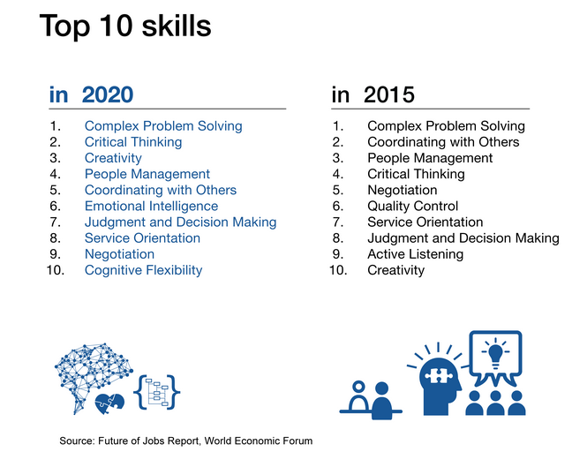
January 18, 2016
https://www.weforum.org/reports/the-future-of-jobs

Slide 4

collaboration
communication
adapting to information contexts
technology

Slide 5
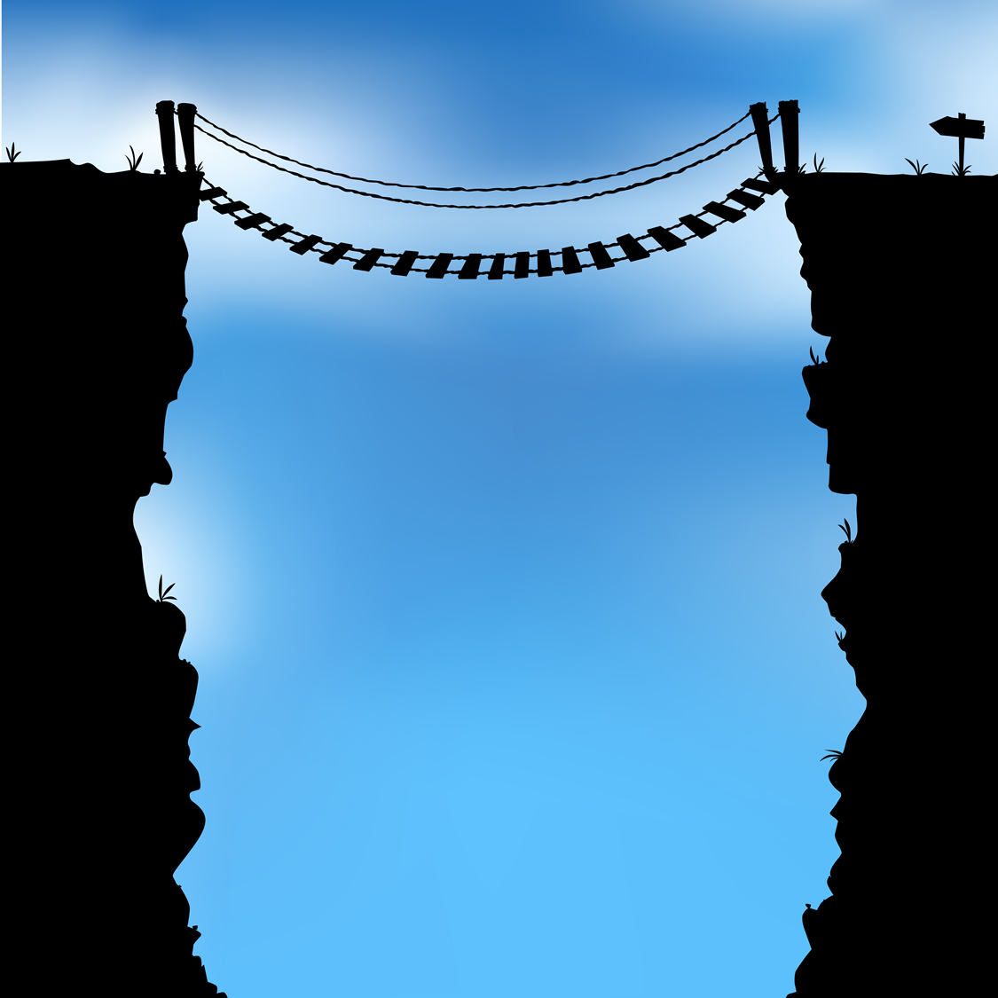
Competency gap
Solitary nature
of knowledge acquisition and application
Teamwork
W
O
R
K
P
L
A
C
E
C
O
L
L
E
G
E
Completion of assigned
practices
Ability to adapt to information context
Ability to recognize and adapt to non-academic needs
Stable set of texts or tools
Monge, R., & Frisicaro-Pawlowski, E. (2014). Redefining information literacy to prepare students for the 21st century workforce. Innovative Higher Education, 39(1), 59-73.

Slide 6
More on competency gap
Abilities graduates are lacking in:
engaging the team during the research process,
using a variety of formats,
finding patterns and making connections, and
being thorough in the research process.
W
O
R
K
P
L
A
C
E
C
O
L
L
E
G
E
Head, A.J., et al. (2013) “What information competencies matter in today’s workplace?” Library and Information Research, 37 (114): 74–104.

Slide 7

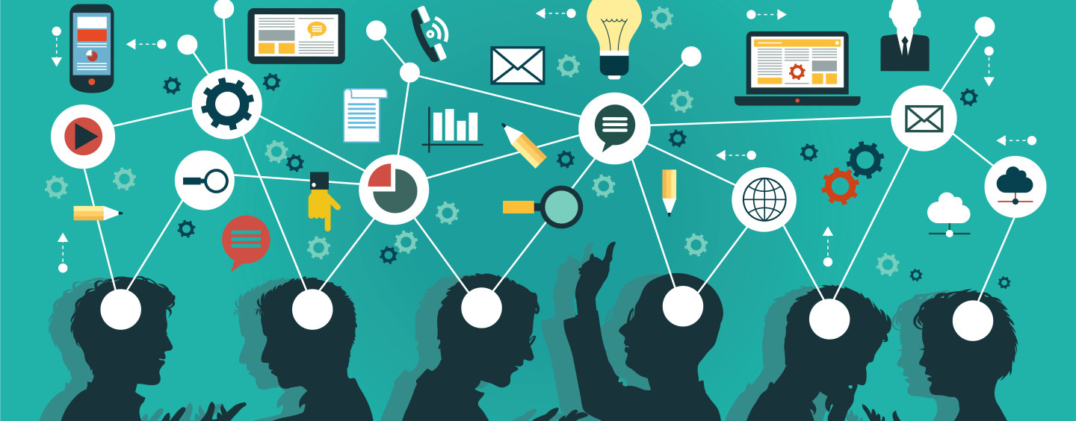

Slide 8

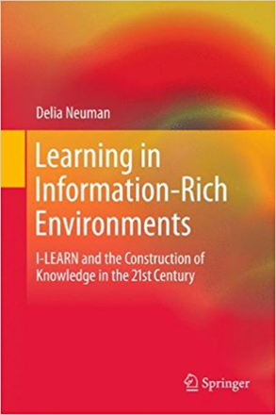
Identify
kNow
Locate
Reflect
Evaluate
Apply

Slide 9
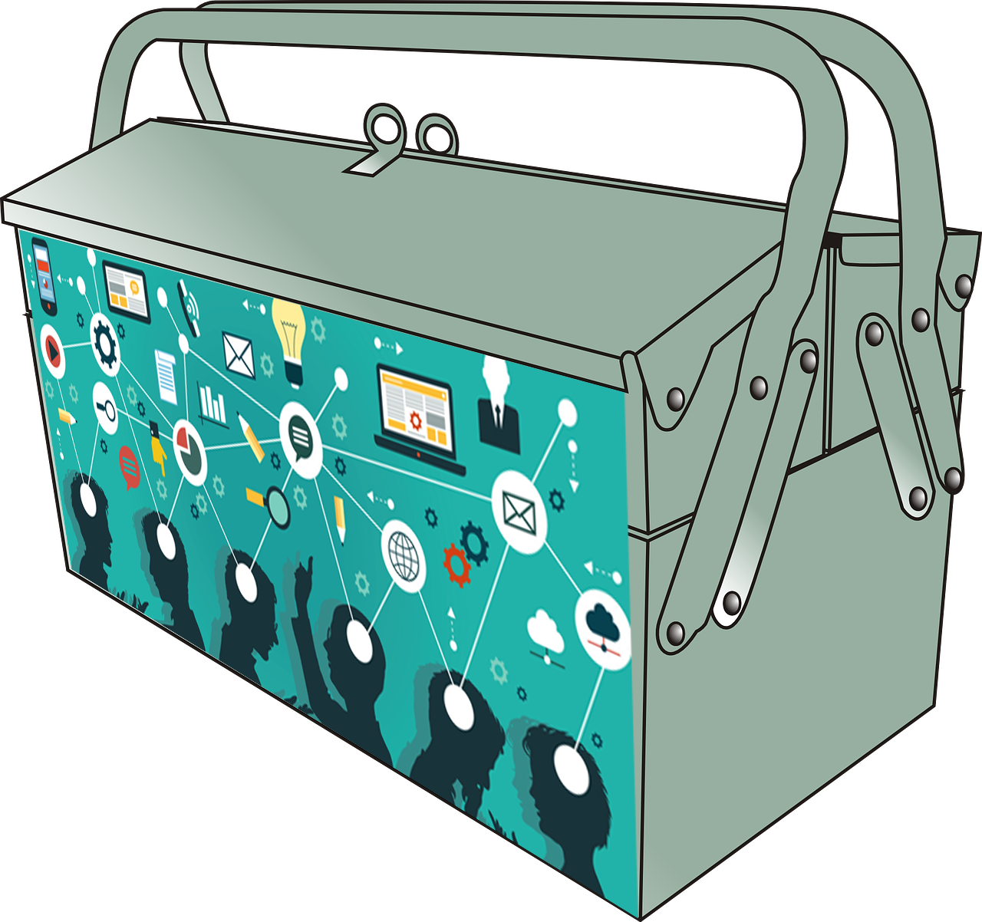
Goal: Create a good transferrable toolkit that would
  highlight institutional resources for various needs,
  identify similar free online resources,
  include important workplace competencies beyond “finding stuff,” and
  combines tools and best practices.

Slide 10
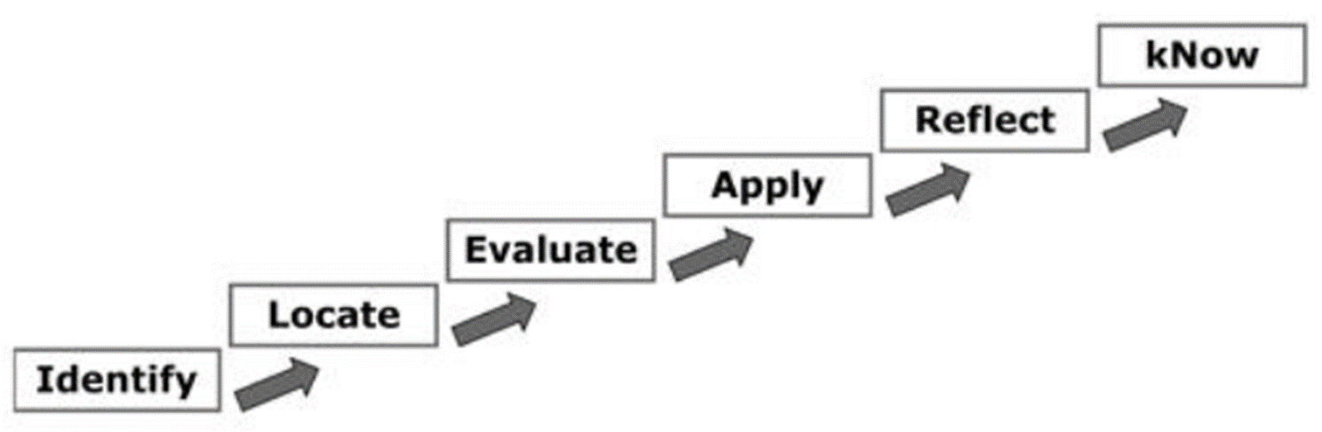
How do I tie it all together?
The I-LEARN Model
Skills valued by employers
New definition of information literacy

Slide 11

If I build it will they come?
Why would they want to use it?

Slide 12
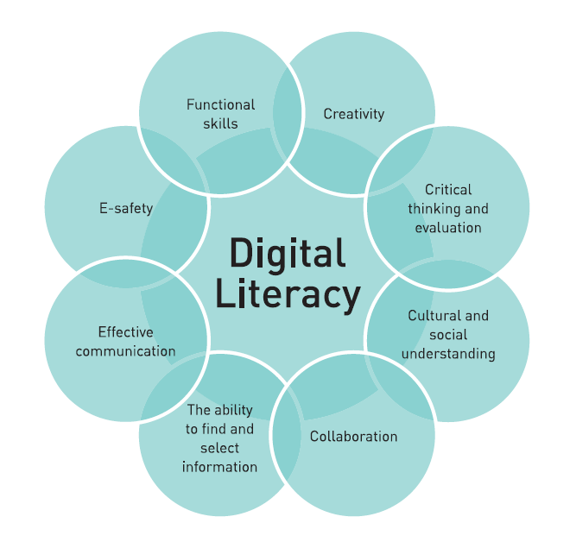
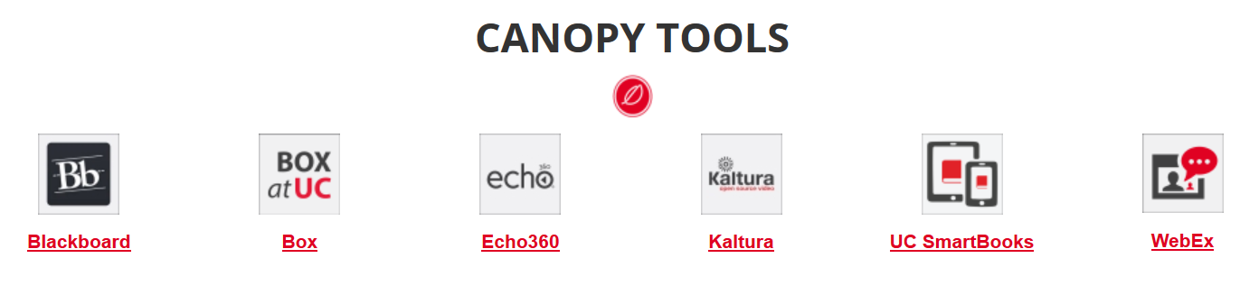
Right word, right moment
DIGITAL
Roll-out of the institutional IT ‘ecosystem’

Slide 13
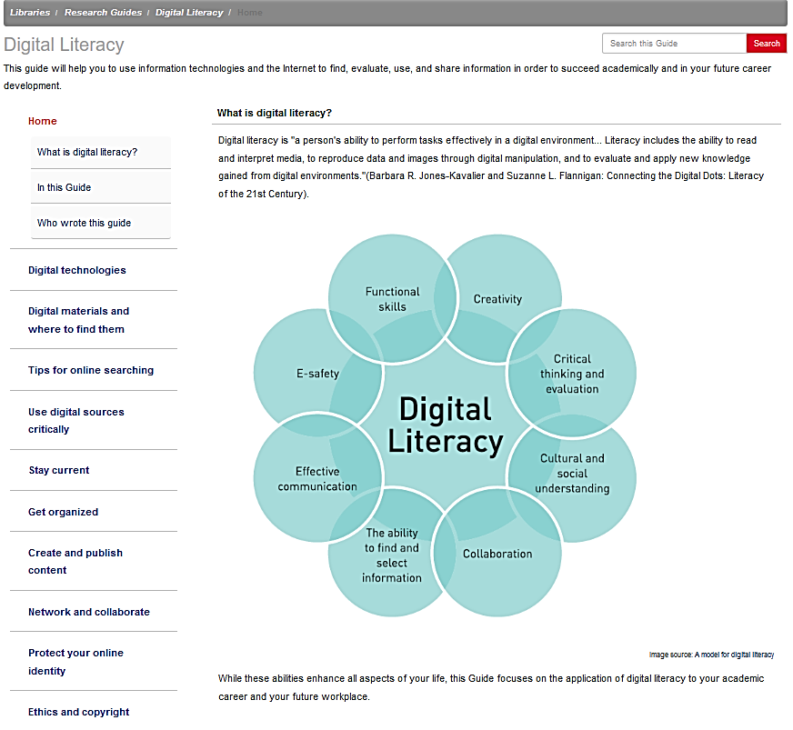
http://guides.libraries.uc.edu/digliteracy

Slide 14
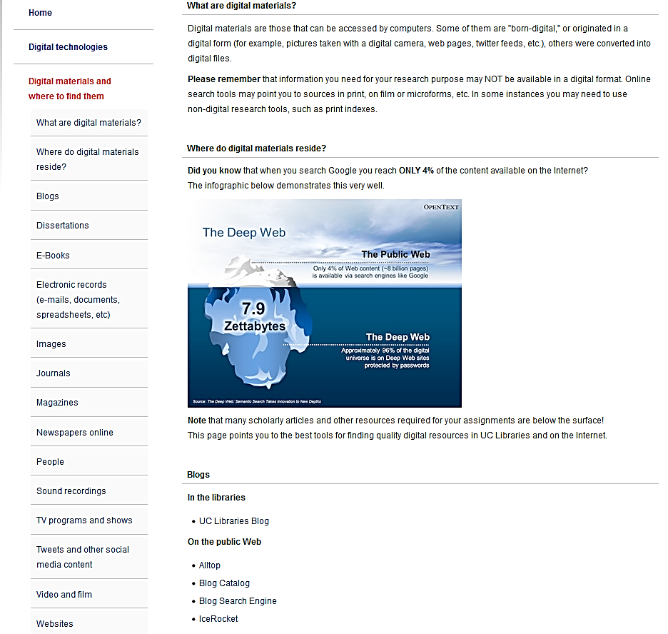
Digital materials and where to find them

Slide 15
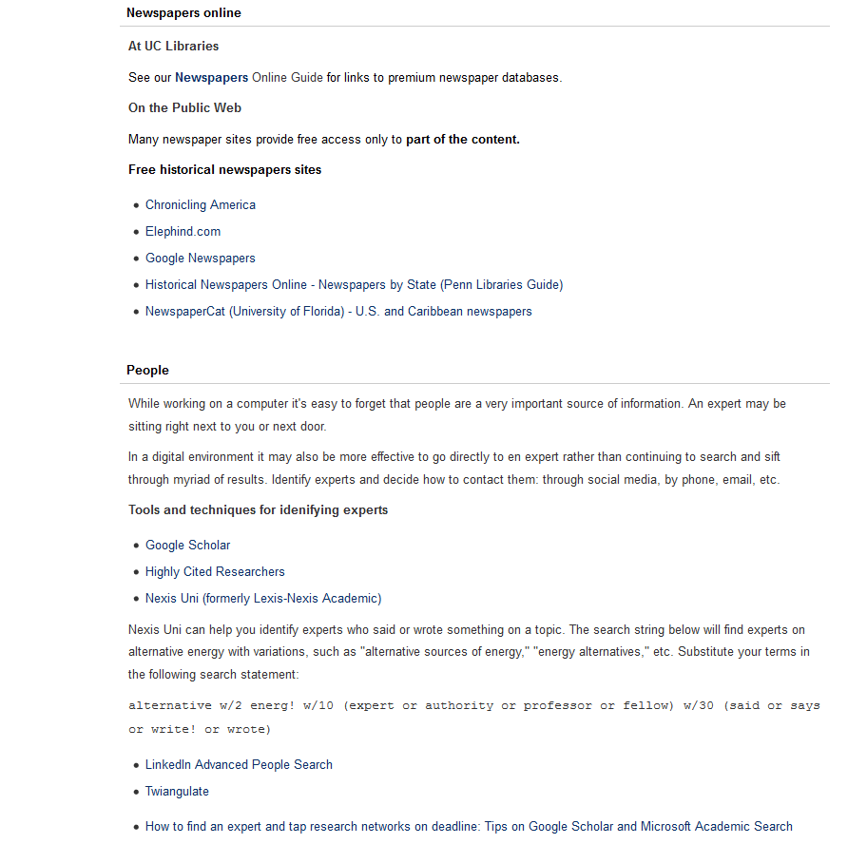
Digital materials and where to find them.
Recent addition: people as information sources

Slide 16
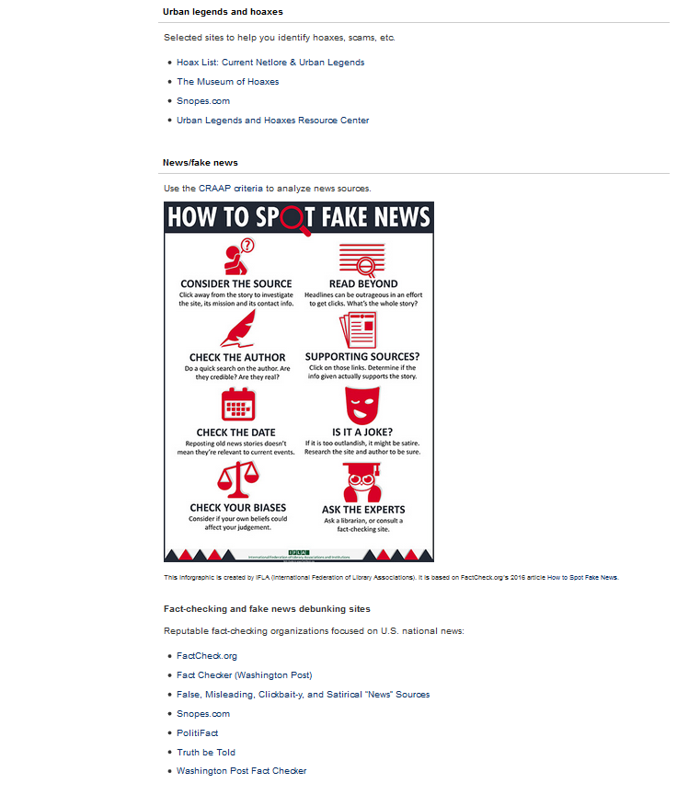
Use digital sources critically

Slide 17
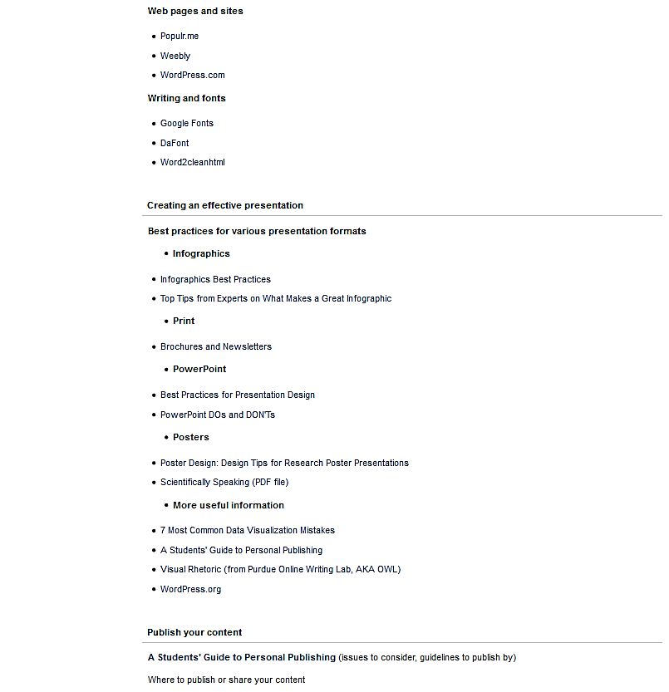
Create and publish content

Slide 18
So, did they come?
3044 views July 1, 2015 – September 1, 2017
Most popular pages:
  Tips for online searching
  Ethics and copyright
  Use digital sources critically
  Digital materials and where to find them
  Requests from other institutions to use as a template or copy content
  Repurposed content

Slide 19
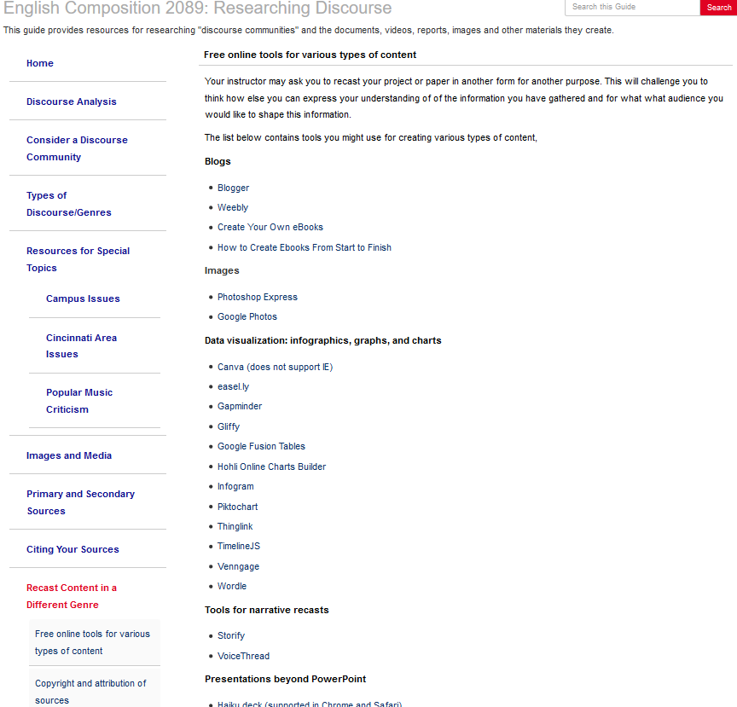
396 views;
similar page in English 1001 guide:
822 views
Faculty testimonial:
  “I referred my online students to your guide and students used Weebly, Infogram, Piktochart, and Kaltura. I linked them directly to the copyright and fair use resources on this page - that was their only source of information.”

Slide 20
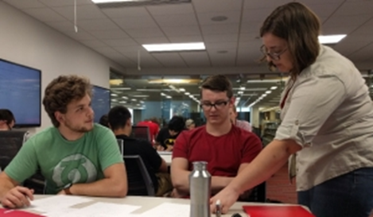
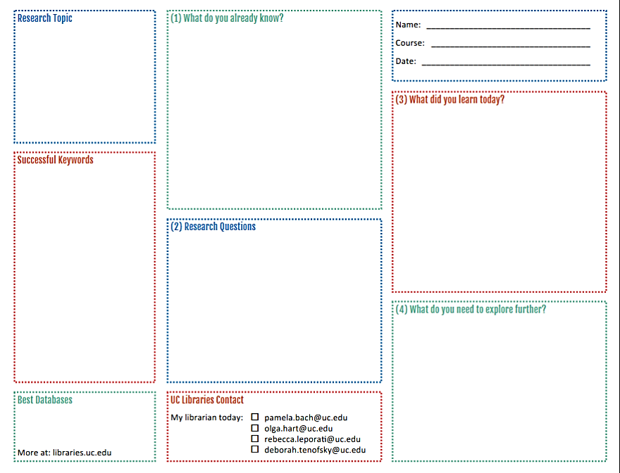
Classroom instruction strategies
focus on asking questions
collaborative active learning
source analysis
asking students to reflect on research and learning

Slide 21
Continuing to close the gap – future directions
Collaborate with faculty to design assignments that reflect workplace realities; involve subject specialists.
Encourage team consultations with librarians.
Teach identification of experts as sources.
Discuss tools and sources for collaboration and sharing during research; encourage faculty to incorporate social media into research assignments.
Go beyond the curriculum – reach out to campus groups that perform tasks similar to those at workplace.
Based on Head, A.J., et al. (2013) “What information competencies matter in today’s workplace?” Library and Information Research, 37 (114): 74–104.

Slide 22

Thank you!

Slide 23



Image credits
Modified from https://www.ezbob.com/go-offline-take-online-business-real-world/
http://coachesconsole.com/wp-content/uploads/RopeBridge.jpg
Modified from http://www.elcomcms.com/resources/blog/posts?tag=collaboration
http://gigix.thoughtworkers.org/
http://www.cps.neu.edu/news/northeastern-wins-top-innovation-prize.php
http://www.mathiaspoulsen.com/a-model-for-digital-literacy/
http://footage123.com/video/1767905-question-marks-blue-spinning-backgorund

