Slide 1



Open Research: Making Harmful Habits History
Presented by
Ashley Farley
Program Officer; Knowledge & Research Services; Bill & Melinda Gates Foundation
Notes:
Option 1 - Cover photo

Slide 2

Presentation Outline
Disclaimer
Today's Topics
Ecosystem Pain Points
Evidence Based Publishing
Copyright – Who has the right?
The Remedy
OPEN RESEARCH | @ASHLEYDFARLEY
FAIR Data

Slide 3


NEXT
Disclaimer
Before we begin...
  My career has been spent in libraries helping people access the knowledge they need to make their lives better - this is the perspective that shapes my thinking
  I work at a privileged institution
  Much of what follows are generalizations (#notallpublishers) - there are many nuances in this ecosystem. This is not meant to minimize anyone's work but having tough & critical conversations will make the ecosystem stronger
OPEN RESEARCH | @ASHLEYDFARLEY
Notes:
https://unsplash.com/photos/HH4WBGNyltc

Slide 4



NEXT
Ecosystem Pain Points
INFO OVERLOAD
PROLIFERATION OF POLICIES
BUSINESS MODELS
  Too much to read
  Preprints proliferating with little linkage
  Publish & Perish adds to volume
  This is a reaction to the inflexibility of many publishers
  Funders making concessions both for publishers & authors
  Affecting Author Choice/Freedom
  Need to move past "support" for open access & actualize it
  Abandon bad models: hybrid, subscription, APC
  Highly selective model not fit for purpose
OPEN RESEARCH | @ASHLEYDFARLEY

Slide 5
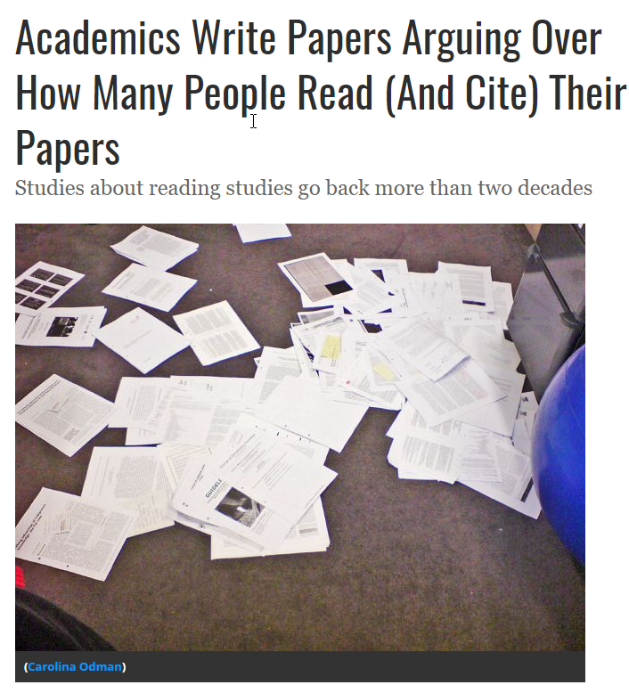
Info Overload
Estimated that over 2 million articles are published each year:
  Hard to stay up to date in even niche disciplines
  Strict copyright makes technical solutions difficult to create
  Cost burden to the entire system
OPEN RESEARCH| @ASHLEYDFARLEY
Notes:
https://www.smithsonianmag.com/smart-news/half-academic-studies-are-never-read-more-three-people-180950222/

Slide 6
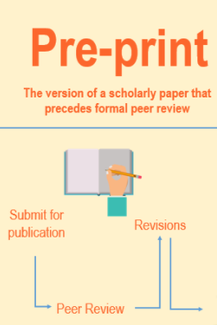
Pre-Prints
Pre-Prints have been critical in pushing the ecosystem to change:
  The volume has made it hard for them to be ignored by publishers
  A workaround to slow traditional publishing models but worry we are now being asked to support two publication systems
  Opened a new world of instant community peer review via PubPub, Twitter, and other platforms
  Need improved linkages to other components
OPEN RESEARCH| @ASHLEYDFARLEY

Slide 7

Faulty Metrics
Peverse Incentives
The discussion has grown as to what are good metrics for evaluating research - it's not easy!
  Funders are signaling a shift in what counts - this is difficult to quantify & shift
These are quite hard to shift:
Publish or Perish adds volume unnecessarily
Behavior/Cultural Change is needed
Many are “boogeyman” incentives that aren’t explicitly written down
Research is being done on PR&T
OPEN RESEARCH | @ASHLEYDFARLEY

Slide 8




NEXT
Proliferation of Policies
GROWTH
SHIFTING
COMPROMISE
CHOICE
Funders are beginning to see paying for publication is a critical part of research ecosystem & funding impact
Funders want to see change.
Change can be hard.
Compromise leads to differing &confusing policies.
Doesn't exist in the traditional system; academic freedom concerns research exploration not publication
OPEN RESEARCH |@ASHLEYDFARLEY
Many funders are adding strong mandates around openness & sharing of research output

Slide 9

Removal of Paywalls
Increased Use
The removal of paywalls during the pandemic has shown an increase in use of research that cannot be ignored. Data has shown that openness will
Increased Speed
Preprint submissions rose & traditional journals worked to speed up peer-review to publish COVID19 research quickly
OPEN RESEARCH | @ASHLEYDFARLEY
Increased Need for Transparency
Especially in the pandemic - but for quite some time proceeding - there is mounting evidence that we need more transparency in every aspect of research

Slide 10
Hybrid Journals - Bad Habit to Kick
The percentage of OA articles in hybrid journals is not increasing enough to ensure full transition in a reasonable time frame. Hybrid maintains the status quo and shows no commitment to progress towards full OA.
01.
HAVEN'T MADE OPEN ACCESS THE DEFAULT
By charging APC's for OA articles & subscription fees for closed articles these journals "double dip" in revenue. There is little data proving publishers offset costs. The average APC levied by hybrid journals is on average higher than that charged in fully OA journals.
02.
MORE EXPENSIVE
For authors: articles may still be paywalled (in error or for awaiting payment), attributed a wrong license, experience unreliable repository deposits, little price transparency
For readers: Unpredictable what articles are OA, will still hit paywalls for content in the same journal
OPEN RESEARCH |@ASHLEYDFARLEY
03.
MORE ERROR PRONE

Slide 11
NEXT
Evidence Based Publishing
The Evidence
Predatory Publishers
Pandemic Response
  Peer Review doesn’t work well as is
  Hard to reproduce results
  Rarely read/cited
  No standard definition
  Distraction from bad practices at reputable journals
  Demonstrated need for openness
  Liquidity of knowledge was key
  Collaboration was fundamental
OPEN RESEARCH | @ASHLEYDFARLEY

Slide 12

Are we ignoring the evidence?
Peer Review
  Over-burdened
  Costly to various stakeholders
  Data is rarely included
  Not transparent
Reproducibility
Most studies are not reproducible for a variety of reasons
No incentive to get it fundamentally right
OPEN RESEARCH | @ASHLEYDFARLEY
Why do we do what we do?
Notes:
Why does the scientific community not scrutinize the way the research is disseminated? Have we forgotten why do science in the first place?

Slide 13


Who Makes the Call?
Predatory Publishers
Threat to science?
Or a distraction?
OPEN RESEARCH | @ASHLEYDFARLEY
NEXT
Notes:
Photo source: https://unsplash.com/photos/9yvADFNcXOc
https://www.researchgate.net/publication/348200494_Why_I_Publish_in_Predatory_Journals--and_Why_You_Should_Too

Slide 14
Words to Live By
"If we think openness of communication is valuable in a crisis, it should surely be valuable in normal times as well".
CAMERON NEYLON
OPEN RESEARCH | @ASHLEYDFARLEY
Notes:
I worry that we are already losing

Slide 15
NEXT
Copyright
Who has the right?
Rights Retention Strategy
  Open Licensing
  Who adds “value” to a work to earn copyright?
  Is copyright held hostage by APC’s?
  Funders ensuring copyright remains with author/grantee
  Not waiting for publishers to change policies
OPEN RESEARCH | @ASHLEYDFARLEY

Slide 16
Copyright - Who has the right?
Open Licenses
  Essentially pay journals to free your research for others to build upon
  Major publishers will push for more restrictive licensing
  Little evidence of misuse of the CC-BY license
Rights Retention Strategy
Ensuring that grantees from cOAlition S funders retain sufficient rights to make their AAM open access with a CC-BY license
OPEN RESEARCH | @ASHLEYDFARLEY
Who owns what?
Holding Copyright Hostage
  Estimate of peer review volunteer time
  Research is funded by private & tax payer funds
Some publishers charge more for CC-BY & often you cannot retain copyright

Slide 17
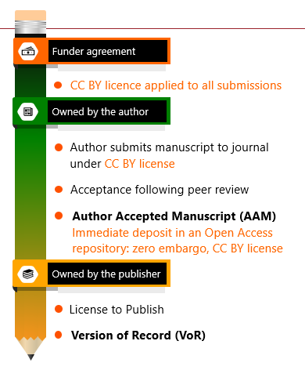
The Rights Retention Strategy
Funder Agreement
  Language change to grant agreement to protect rights
  Allows for any journal to be compliant
Publisher Pushback
OPEN RESEARCH | @ASHLEYDFARLEY
  Publishers are shook – no legal ramifications yet
  Ensuring that this strategy is not “needed”
  Where did author choice go?

Slide 18
NEXT
The Remedy
New Models
Community
Libraries
  Publish Review Curate
  Full transparency
  Author driven
  Speed
  Good partners in the space
  Orgs living their values
  Equity at the core
  Libraries leading with values
  More than content licensers
  Driving New Models
OPEN RESEARCH | @ASHLEYDFARLEY

Slide 19
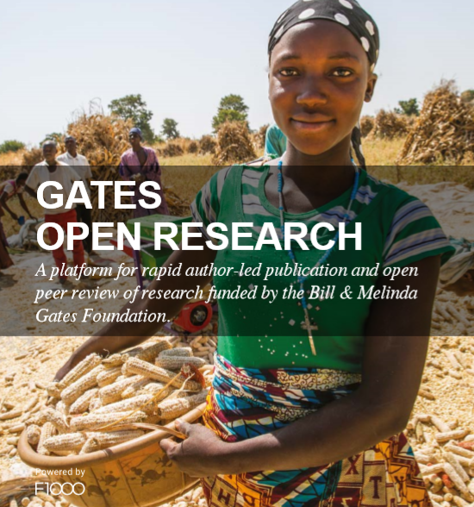
Gates Open Research
Open & Transparent
No paywalls.
Fully open, post publication peer review
Fully versioned control
Increased Speed
Hosted first as a preprint with days, available while under going peer review,
OPEN RESEARCH | @ASHLEYDFARLEY
Alleviates Pain Points
No journal shopping, lag to publication, lack of linkages, reliance on faulty metrics, fragmentation in updates & corrections

Slide 20
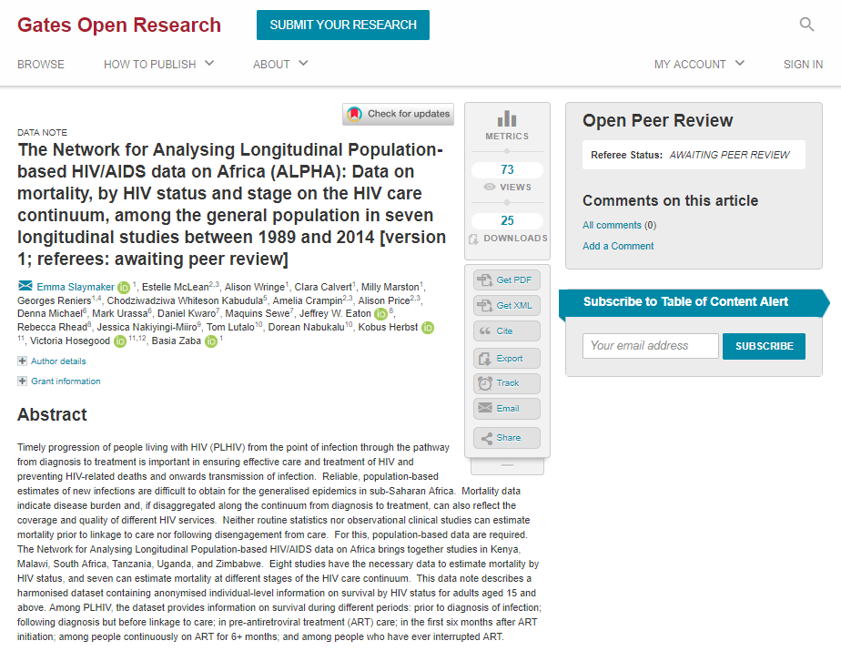
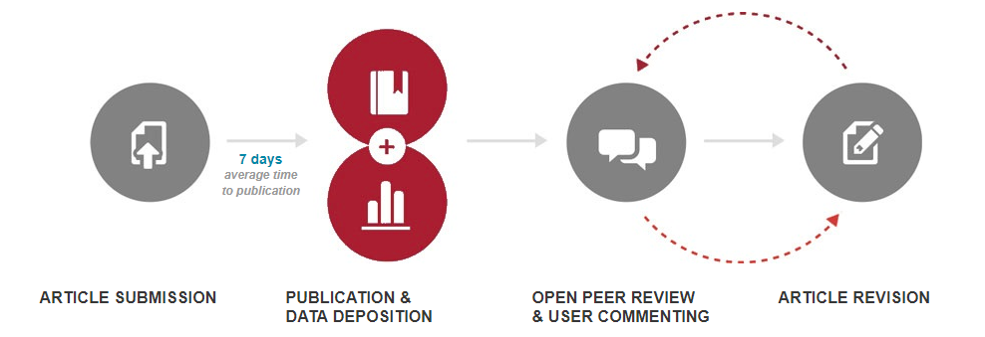
What it Looks Like
Post-publication peer review:
Passed
peer review
Indexed
OPEN RESEARCH| @ASHLEYDFARLEY

Slide 21


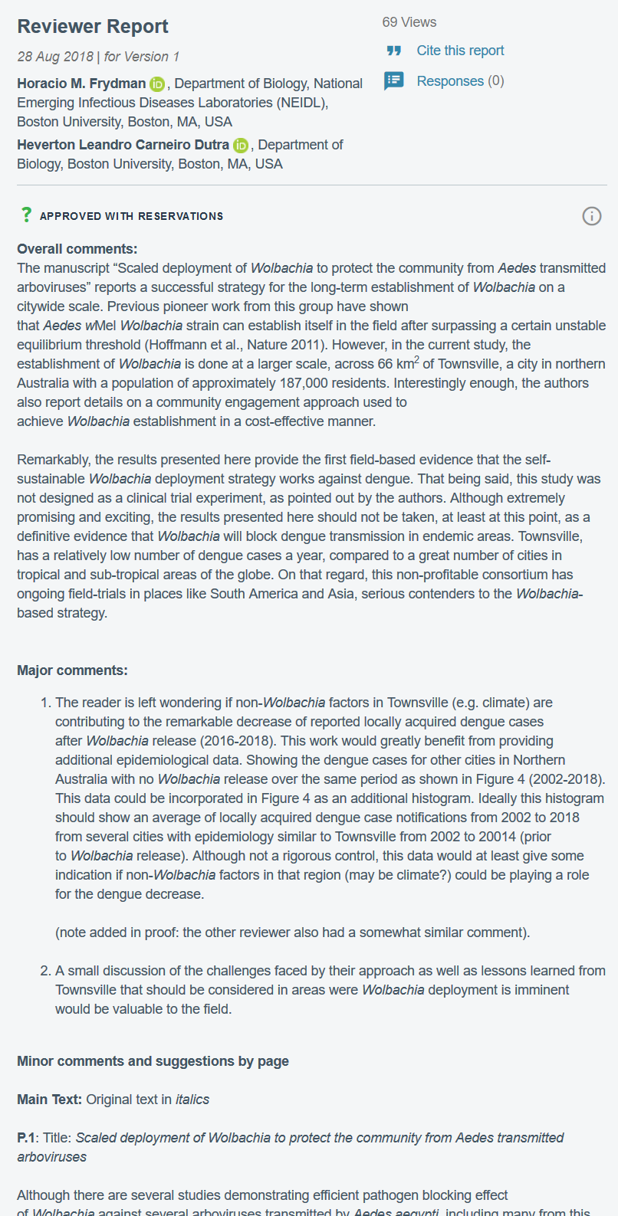

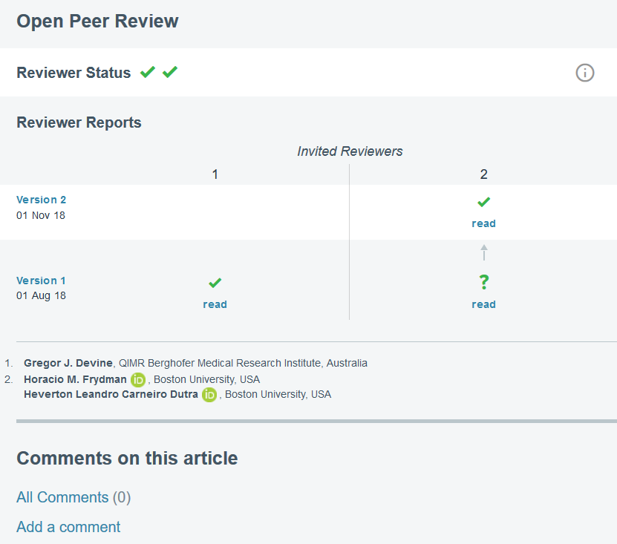
Referee ratings:
Approved
Approved with reservations
Not approved
What it Looks Like
Minimal requirements for indexing:
OPEN RESEARCH| @ASHLEYDFARLEY
or

Slide 22

The Remedy
Community
Focusing on those who espouse the mission and values that your organization shares
OPEN RESEARCH | @ASHLEYDFARLEY
NEXT

Slide 23






Support those making change happen
Organizations who are walking the talk
FUNDER SUPPORTED PLATFORMS
OPEN RESEARCH |@ASHLEYDFARLEY
COMMUNITY ACTION
Notes:
S2O

Slide 24



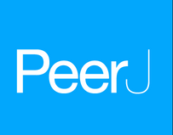

Support those making change happen
Taking risks and showing it's possible to make knowledge better
OPEN RESEARCH |@ASHLEYDFARLEY

Slide 25
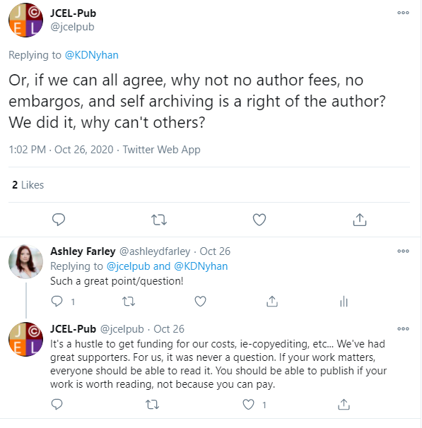

It's been done!
There are publishers and journals that have been successful it living their mission and placing open access and research integrity above profits
OPEN RESEARCH| @ASHLEYDFARLEY

Slide 26




Libraries in the Open Future
Community
Values Driven
Change
Choice
Shift to leading library work with values: collection development & vendor relationships
Budgets are becoming even tighter with cost continuing to rise
Libraries feel they have no choice or control over lending & access to information – want to shift from renters to lenders
OPEN RESEARCH |@ASHLEYDFARLEY
More alignment with the funder community to help best address needs of both institutions

Slide 27
NEXT
FAIR Data
Foundation Strategy
Lens.org
  Learning from past mistakes
  Leveraging current opportunities
  Start small then scale
  Open & comprehensive
  Stellar interface
  Competitive to expensive alternatives
OPEN RESEARCH | @ASHLEYDFARLEY

Slide 28
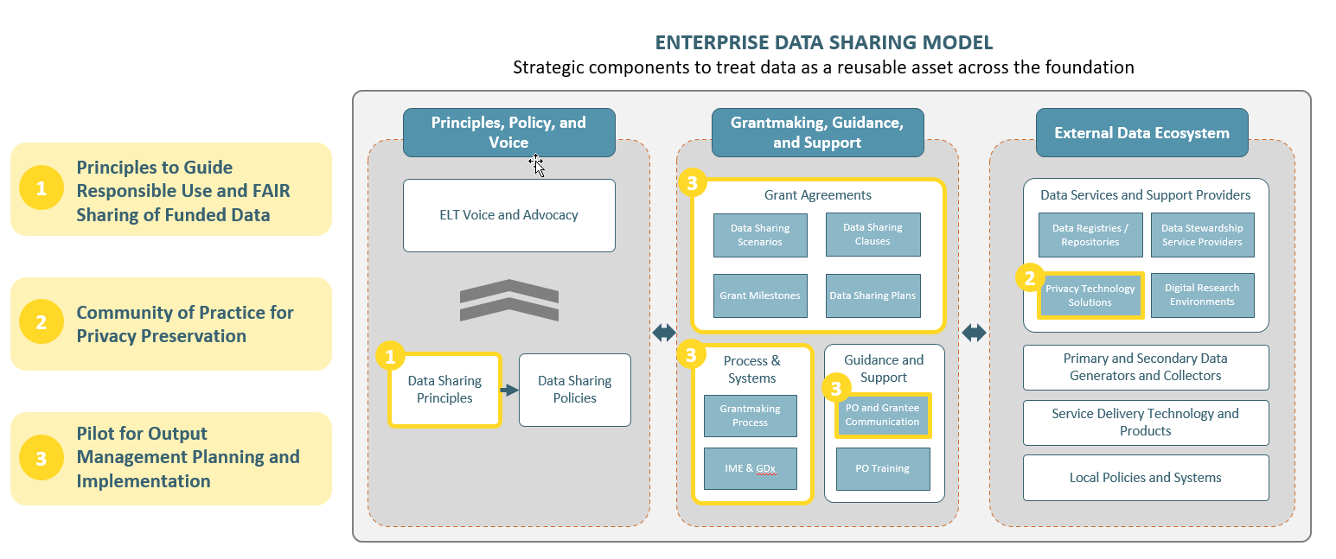
FAIR Data At the Foundation
OPEN RESEARCH | @ASHLEYDFARLEY

Slide 29
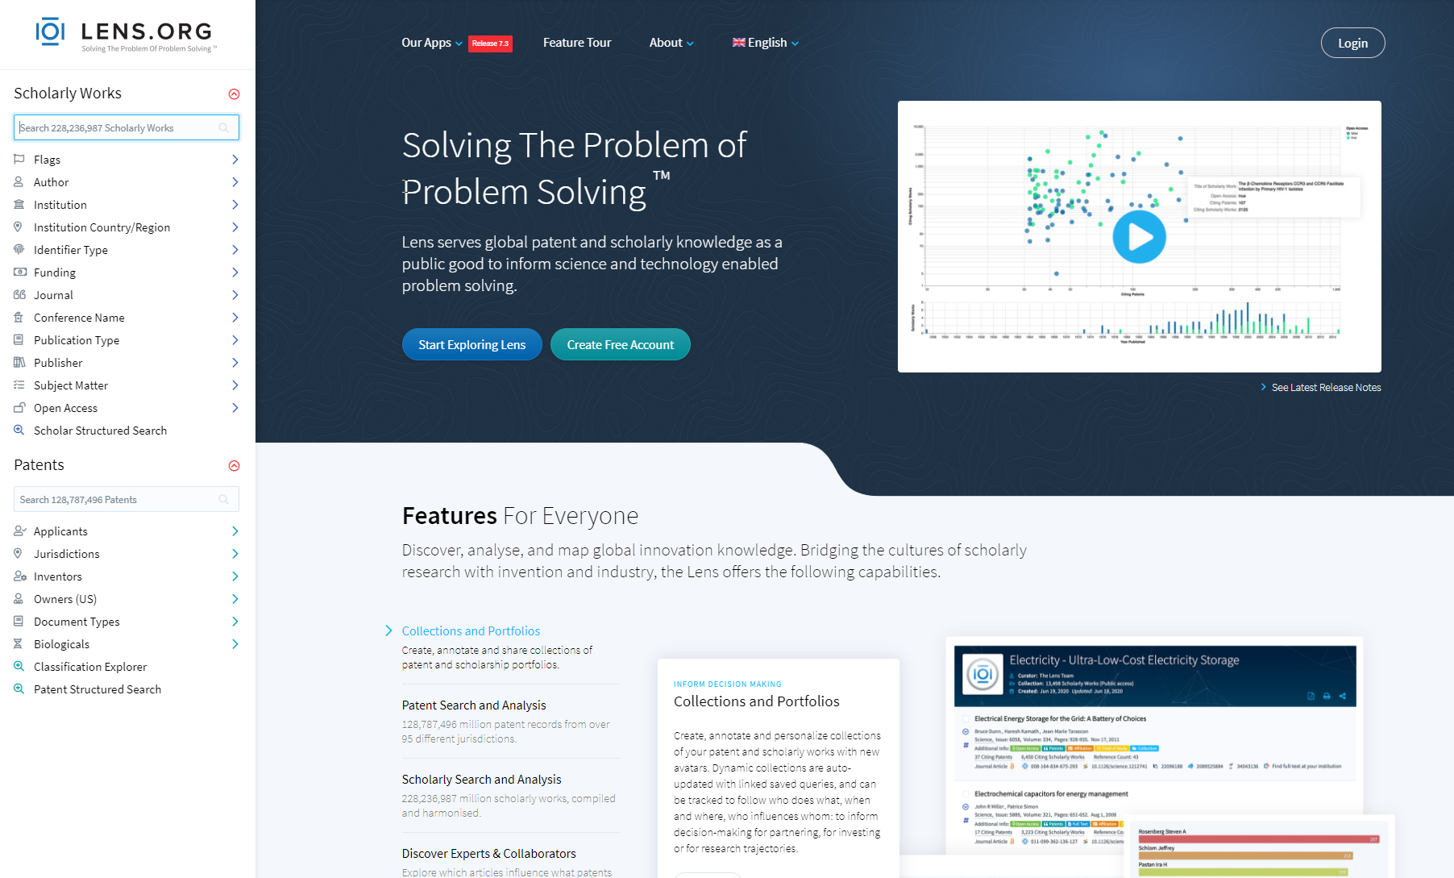
Lens.org – Open Knowledge
OPEN RESEARCH | @ASHLEYDFARLEY

Slide 30
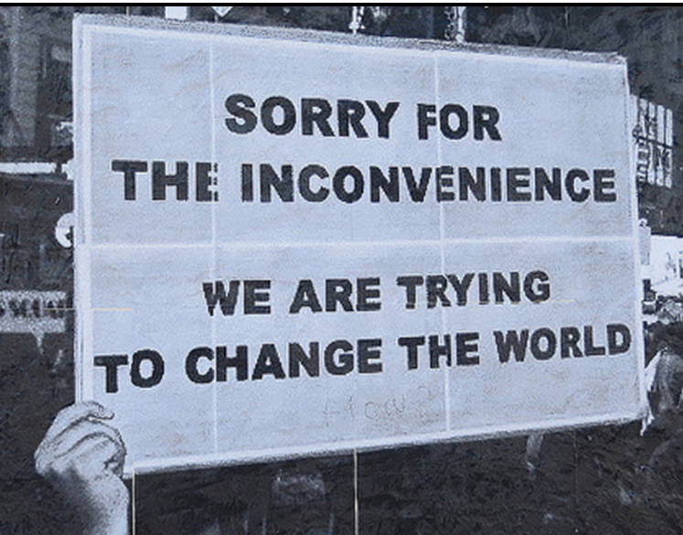
Contact Information
For questions, comments and inquiries
TWITTER
@ashleydfarley
EMAIL ADDRESS
ashley.farley@gatesfoundation.org
OPEN RESEARCH | @ASHLEYDFARLEY
GATES OPEN RESEARCH
www.gatesopenresearch.org

