Slide 1
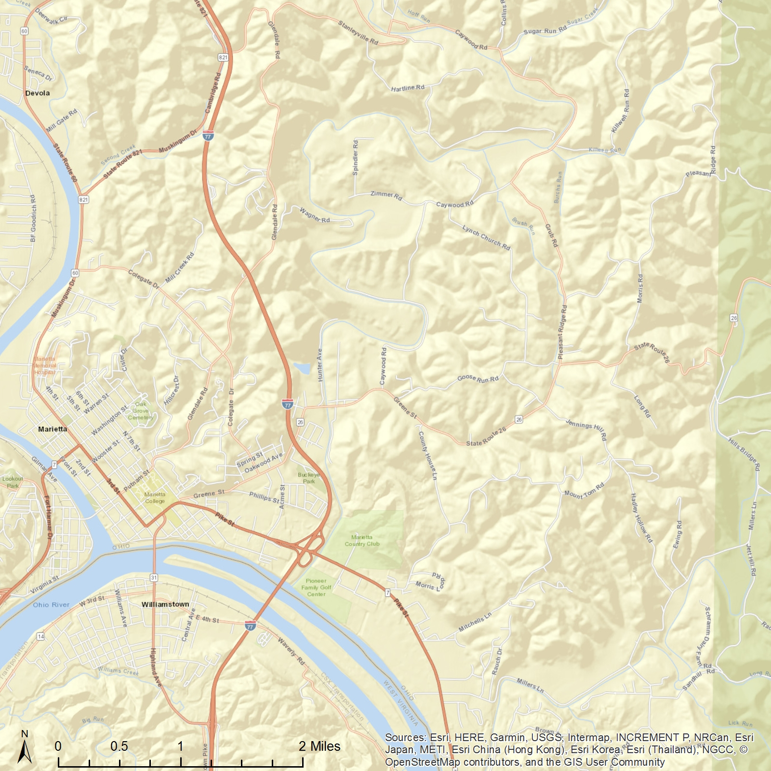
ATSDR Standard
Ohio Valley Educational Center
Marietta, OH
No data were collected between Dec. 2009 and Nov. 2011.
WHO Standard
1338 Colegate Dr, Marietta,
OH 45750
EPA Standard
The monthly average of the manganese (PM10) in the air was collected by a monitor at Ohio Valley Educational Service Center from Aug. 2009 to Feb. 2012. If you want to explore more, please visit our website: https://med.uc.edu/eh/research/projects/cares.
Airborne Manganese (PM10)
Monthly average
ATSDR Standard
WHO Standard
EPA Standard

Slide 2
ATSDR Standard
Ohio Valley Educational Center
Marietta, OH
No data were collected between Dec. 2009 and Nov. 2011.
WHO Standard
1338 Colegate Dr, Marietta,
OH 45750
EPA Standard
The monthly average of the manganese (PM10) in the air was collected by a monitor at Ohio Valley Educational Service Center from Aug. 2009 to Feb. 2012. If you want to explore more, please visit our website: https://med.uc.edu/eh/research/projects/cares.
Airborne Manganese (PM10)
Monthly average
ATSDR Standard
WHO Standard
EPA Standard

