Slide 1
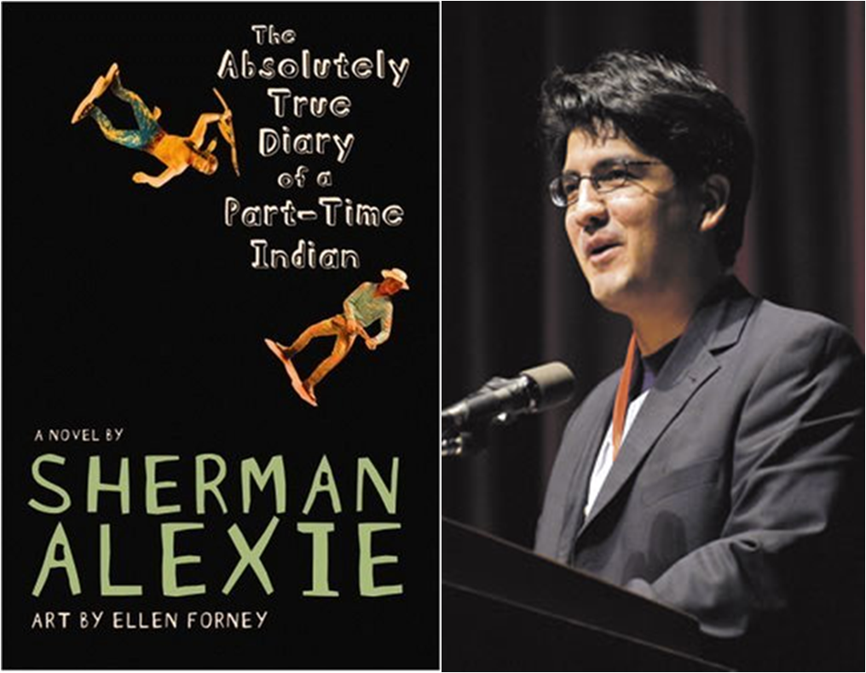
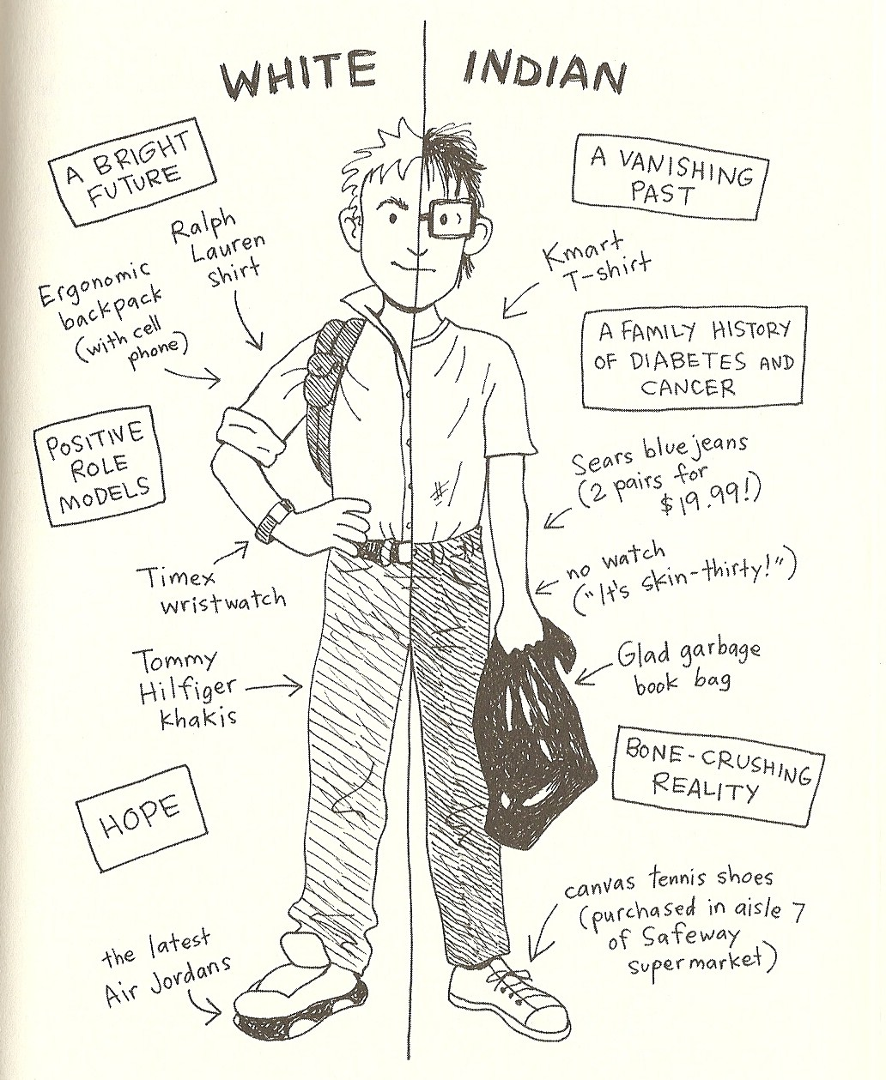
How Society is Racialized in America: A Content Analysis on Sherman Alexie’s YOUNG ADULT NOVEL The Absolutely True Diary of a Part-Time Indian
Thao Nguyen (Secondary Education) – Project Mentor: Dr. Mark Sulzer
"I was half Indian in one place and half white in the other. It was like being Indian was my job, but it was only a part-time job. And it didn't pay well at all" (Arnold, the narrator)
BACKGROUND
FINDINGS
METHODS
Problem: In high school English classrooms nowadays, the lack of concentrated lessons about race, especially underrepresented races, is one of the alarming issues. It is time for English teachers to “take an inquiry stance on teaching” (Donnell et all, 2011) in order to indicate the need to include lessons on racialization in America’s secondary English classrooms.
Solution: A possible solution is to create more lessons involving content analysis of different novels’ race related contents. Like authors Adams and Miles have explored important racial issues associated with Chinese Americans (Adams, 2006) and the black community (Miles, 2015) through The Joy Luck Club and Sula, including content analysis is a great way to deepen understanding of racial inequality in a cultural context.
Therefore, I selected Sherman Alexie’s The Absolutely True Diary of a Part-Time Indian. The novel’s mixture of textual and visual aspects and its approachable language that engage adolescents provide various and multimodal contents for an in-depth content analysis.
Table 1: Results of Content Analysis
I will do a content analysis of Sherman Alexie’s The Absolutely True Diary of a Part-Time Indian by using holistic coding based on Saldana’s The Coding Manual for Qualitative Researchers (2009) to demonstrate the racial aspect within the novel.
Racial Commentary that Reinforced Perception of Self with Psychological Consequences | Racial Commentary that Reinforced Social Construction | Other Racial Commentary
40% Examples of quotes and drawings: "But we reservation Indians don't get to realize our dreams" (p. 13) "It sucks to be poor, and it sucks to feel that you somehow deserve to be poor... And then you start believing that you're stupid and ugly because you're an Indian. And because you're an Indian you start believing that you're destined to be poor. It's an ugly circle and there's nothing you can do about it" (p. 13) “'Who has the most hope?' I asked...'White people,' my parents said at the same time" (p. 45) "I don't know if hope is white" and the flying horse drawing (p. 51) | 42% Examples of quotes and drawings: Indians chicken dancers (p. 19) "It was some kind of prison-work farm for our liberal, white, vegetarian do-gooders and conservative, white missionary saviors" (p. 31) "...We beat them [the rowdy ones]. That's how we were taught to teach you. We were supposed to kill the Indian to save the child" (p. 35) White vs Indian drawing (p. 57, Figure 2) | 18% Examples of quotes and drawings: "We Indians really should be better liars, considering how often we've been lied to (p. 10) "The Spokane Tribe holds their annual powwow celebration over the Labor Day weekend... there would be singing, war dancing, gambling, storytelling, laughter..." (p. 17)
Step 1: Data Capture
Complied all quotes and drawings about race in the book
Step 2: Paraphrase
Translated the quotes and drawings into short phrases
Grouped phrases by themes
Step 3: Coding
Coded phrases according to the commentary was a reflection of self or society
47 quotes
Generated 8 possible themes
Codes: Psychological Consequences
8 drawings
Social Construction
RESEARCH QUESTIONS
How is race and racism portrayed within American society in the novel?
What thematic characteristics of race and racism are displayed throughout the novel?
How is race and racism portrayed through the novel’s visual presentations?
Figure 1: Book Cover of The Absolutely True Diary of a Part-Time Indian
Figure 2: A Drawing from the Novel
Figure 3: Demonstration of Finding Summary
CLASSROOM INNOVATIONS
Internal Factors
RACE
External Factors
Lesson plan ideas to raise awareness of race in English classrooms:
Study Thoughts: instruct students to create their own tables of quotes, drawings and associated themes in this novel as well as similar ones
Research and Explore: encourages students to research on their own about issues within different races in America that result in psychological consequences and the way society is construct
Connection to Personal Experience: have students share their own stories about race through multiple platforms
Critical Inquiry: allow students to propose possible solutions to raise more awareness of the lack of teaching race in their classrooms
Psychological Consequences
Individual Characters
American Indian and White Communities
Social Construction
American Indians vs White Americans Relationships
Locations: “The rez” vs “White town Reardan
References
Adams, Bella. "Identity-in-Difference: Re-Generating Debate about Intergenerational Relationships in Amy Tan's The Joy Luck Club." Studies in the Literary Imagination, vol. 39, no. 2, 2006, pp. 79.
Donnell, K. A., Stairs, A. J., & Dunn, A. H. (2011). Urban Teaching in America: Theory, Research, and Practice in K-12 Classrooms. Thousand Oaks, CA: SAGE.
Miles, India R. Creating Myself: Friendship as Black Women's Liberation in Toni Morrison's "Sula" and Alice Walker's "the Color Purple", ProQuest Dissertations Publishing, 2015.
Saldaña, Johnny. The Coding Manual for Qualitative Researchers. Sage, 2010.

