Slide 1


ACRL Global Library Services Discussion Group
Online Open House
June 3, 2019

Slide 2
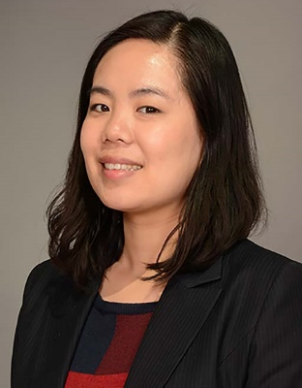
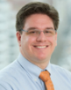
Today’s Open House Hosts:
Hong and Dan, Current Conveners
Hong Cheng is the Global Services Librarian at the University of Cincinnati (UC). She serves as the primary library and information services provider for the UC-Chongqing University Joint Co-operative Institution in China. She provides services to UC students, faculty, and staff based in China with occasional travel for on-site teaching. She also provides support for broader global initiatives of the UC Libraries as well as the university. She has many years of experience in teaching, instructional design, outreach and marketing. Her current position also incorporates work in science and engineering librarian communities.
I am Global Services Librarian at NYU, and serve students and faculty at NYU’s 11 Global Academic Centers, while also collaborating with librarians at NYU’s Shanghai and Abu Dhabi campuses. My primary duties focus on learning, reference and instruction support to undergraduates at these sites, but other duties include helping them setup and maintain local catalogs, working with access services to develop new services and improve old ones, and helping to setup communications norms between global sites and campuses with the library. In this role I have the opportunity to work with many service and support oriented services throughout the university.

Slide 3
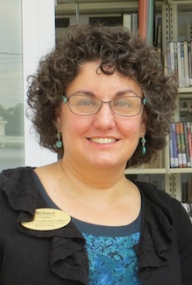
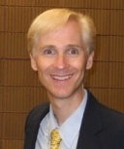
And, Incoming Conveners for
2019-20: Holly and John
In my role at Webster I oversee library instruction, collection development, and outreach, and I serve as liaison to Nursing, Nurse Anesthesia, and Biological Sciences. I am also the primary contact for the librarians at our international campuses. Webster has independent campuses with small libraries (with one or two librarians) in Austria, Ghana, Greece, Netherlands, Switzerland, and Thailand along with partnerships at universities in about six additional countries. My biggest challenge and greatest reward is trying to make sure communication is happening throughout this librarian network. When wearing my other hat, I help run the Global Leadership Academy, a professional development program for faculty and staff at the University. There is an international component to the program so each year we take the cohort to one of Webster’s international campuses for a week. I am a very lucky librarian!
I have been the International Outreach Librarian at my university for the last 20 years, and have thoroughly loved it. With a background in TESOL, working with ESL & international students is a professional passion for me. Since the majority of ESL/International students I’ve worked with are from Asia, I built various partnerships with Asian libraries. (For example, this year marks the 10th year of partnering with Pannasastra University of Cambodia on a literacy development project.) This year I became the Head of Information & Instruction services at my library, which has been a huge time demand, so apologies if I am slow/delayed in participating.

Slide 4
About Us
The Global Library Services discussion group serves as a unique venue for librarians to
participate in conversations regarding library support at an international level. It allows a
network of librarians to exchange knowledge and develop sustainable services to support
teaching and research.
The focus of this group is on providing library support to patrons who use library services
abroad, in different time zones, under different cultural, socio-political, and technological
circumstances. The librarians may travel abroad, but work primarily on location at their home
institutions. As such, they need to utilize unique support structures, deploy situation-
appropriate outreach strategies, and innovate solutions, all with well-developed intercultural
competences. In addition, this group also discusses how to provide support for broader global
initiatives of their libraries or institutions.

Slide 5
Brief History
The Global Library Services Discussion Group began in Fall 2016 when a small group of
librarians supporting global library users had the opportunity to meet. We share a common
job responsibility to provide service to our library constituencies who are situated abroad,
sometimes across vastly different time zones, under different cultural, socio-political, and
technological circumstances. These services include, but are not limited to, research support,
instruction, and collection development.
This group has informal, monthly conference calls to share ideas, best practices, and strategies
to meet the challenges of serving global users and engaging with them in this non-traditional
service environment. Over the past two years, this community and its outreach has grown.
Our next step is to formalize this group within the ACRL Discussion Group structure to
increase membership, facilitate discussion, and develop sustainable services to support the
increasingly globalized teaching, learning and research of our colleges and universities. The
proposed Discussion Group fills a gap in the existing ACRL coverage and helps ACRL meet an
emerging need in academic libraries.

Slide 6
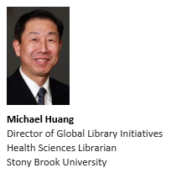
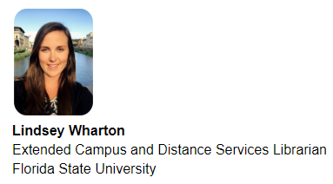
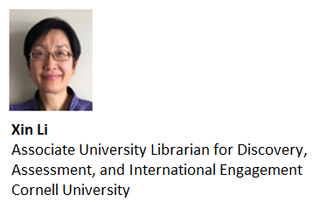
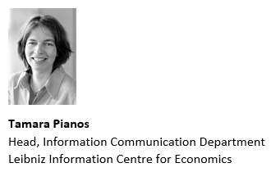
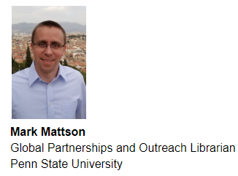
Some of our group’s members:

Slide 7
We are in a variety of roles
Some of us are assigned to our global librarianship exclusively
Others of us wear multiple hats
Some of us have dedicated funding for global librarianship
Others of us do not, and have to seek funding
Some of us are at a US institutions
Others of us are at institutions outside of the US
Some of us are looking for ways to increase library partnerships abroad
Others of us have other goals, like assisting international or Study Abroad students

Slide 8
Our Purpose/Goals
• Follow and share emerging trends in international education, research, and global
librarianship;
• Advance understanding of requirements of teaching and learning in overseas campus,
branches, or programs;
• Share creative ideas for developing library services to meet these needs and at the same
time develop strategies and solutions for seamless integration with services in home
institutions;
• Exchange best practices for promoting technological or instructional solutions to
enhance information literacy support abroad;
• Develop ways to broaden intercultural competencies among staff;
• Provide opportunities for librarians to collaborate on relevant projects and programs;
• Provide leadership and support to fellow librarians who are interested in or engaged in
this area of service;
• Exchange practical ideas for developing and maintaining partnerships from libraries’
global initiatives.

Slide 9
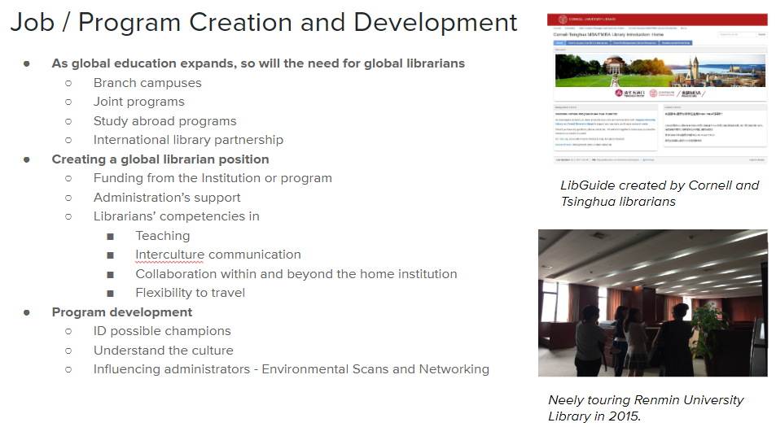
Our monthly video discussions: we discuss many things, like…

Slide 10
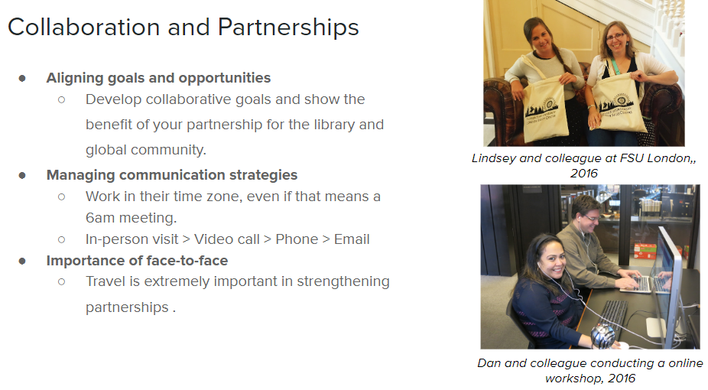
Our monthly video discussions: we discuss many things, like…

Slide 11
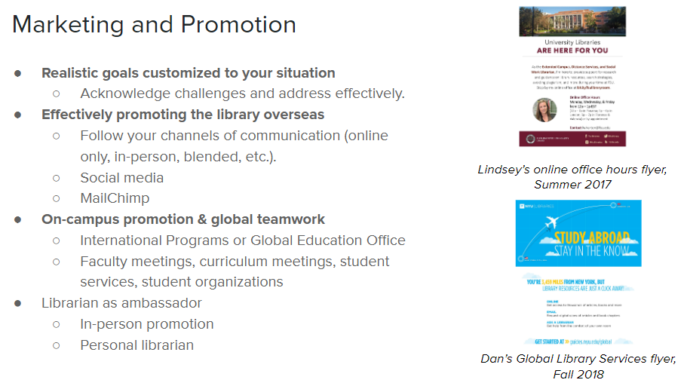
Our monthly video discussions: we discuss many things, like…

Slide 12
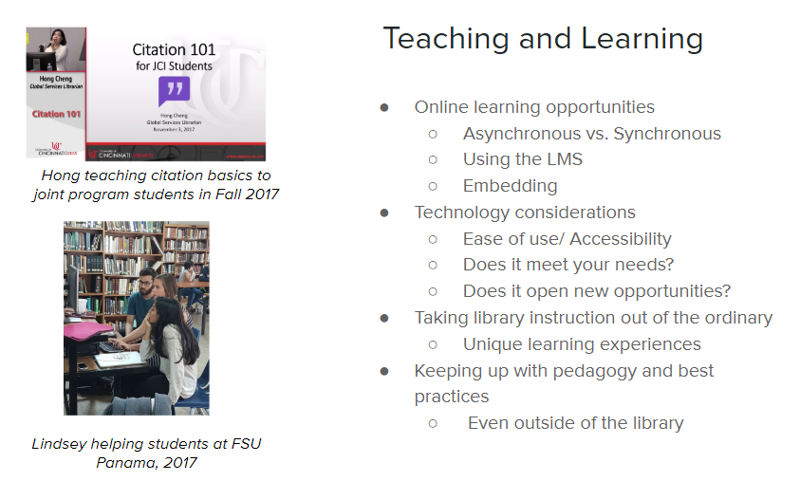
Our monthly video discussions: we discuss many things, like…

Slide 13

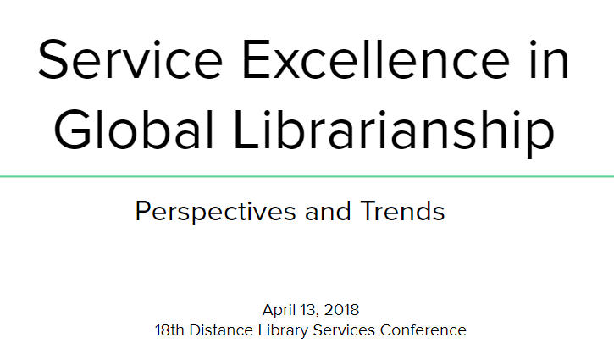
In addition to our monthly video calls, we try to participate in events

Slide 14
To give you an idea of our monthly discussion, we have some discussion topics for today…
How does your library map contributions
to internationalization on your campus?
How to get support/funding from your
university and elsewhere?

Slide 15
(Feel free to participate with questions or comments!)

Slide 16

Thank You!

