Slide 1
Vehicular Mobility Device Lift
By: Thomas Roth and Zachary Waas
Thesis Advisor: Janet Dong Ph.D
April 2020

Slide 2
Table of Contents
Problem Definition and Research
  Problem Background and Need
  Customer Profile
  Problem Definition
  Research of Existing Products/Technology
  Customer Features and Survey
  House of Quality
  Product Objectives
Design Analysis
  Design Alternatives/Concept Drawings
  Solid Model Assembly
  Loading Conditions, Assumptions, and Restrictions
  Component/Material Selection and Process
Planned Fabrication and Assembly
  Specialized Process/ Fixtures/ Tooling/ Assembly Methods and Build Instructions
Planned Testing and Proof of Design
  Testing Methods
  Proof of Design
Project Management
  Budget
  Bill of Materials
  Schedule
Future Work
Contact information
Bibliography

Slide 3
PROBLEM DEFINITION AND RESEARCH

Slide 4
Problem Background
Why
  Advisor’s suggestion to continue previous year’s project
  MKV expressed interest during the initial presentation in early Fall 2019
Need
  Increase independence for elderly residents
  Reduce restrictions of automobile choices
    No lifting device currently available for sedans
What
  Automated device to lift an electric wheelchair/scooter
    Labelled as “mobility device” in this project
How
  Conducted Customer Surveys at MKV
  Created a House of Quality
  Additional Research was conducted to confirm the concerns of the MKV survey group.

Slide 5


Customer Profile - Maple Knoll Village
Local assisted living facility / nursing home
Ongoing collaboration with UC
Survey group
  Seniors that require assisted living
  Experienced, friendly, direct
  Provided information, insights, and concerns
Content of meetings
  With survey group
    Discussions of problems/designs/solutions
    Customer surveys conducted
  With VP of Marketing and Business Development
    Approval of BoM budget and final design
    Updates via email

Slide 6
Problem Definition
Design
  Fits universally into sedan trunks
  Automated process
    No manual labor/easy-to-use
  “Plug-and-play” style lift for mobility devices
    Usable by MKV residents
  Affordable
    Existing products are very expensive
Goal
  Increase quality of life of residents by returning some independance to them
    Shouldn’t need help (un)loading their devices into their vehicles
Problems Solved
  Removes the requirement of manual labor to lift a mobility device
  Removes the requirement of having to purchase a specific size or style of vehicle to fit a lift
Notes:
To design a “plug-and-play” lift for mobility devices (scooters and wheelchairs) that fits universally into compact vehicles’ trunk space for MKV and its residents. The overarching goal is to increase the quality of life and to return some independence to consumers that cannot physically lift their own device(s) themselves.
Ideally, this new product will provide two solutions for its users when attempting to travel. First, to remove the requirement of manual labor from other individuals when lifting the device into and out of their vehicle. Second, to remove the requirement of having to purchase a specific size or style of vehicle, such as a large SUV.

Slide 7
Research
Current State of the Market
  Provides minimal solutions for people that need a mobility device but can still drive
Current solutions
  Purchasing large handicap-accessible vehicles
  Hiring personal assistants
  Asking friends/family for help
Those affected
  Handicapped individuals
  Elderly residents
  Those who can’t afford current solutions
Notes:
The current state of the market was found to provide minimal solutions for people that need a mobility device, such as a scooter or wheelchair, to get from point A to point B. Customers (like the study group at MKV) are forced to acquire additional assistance every time they need to travel distances that requires a vehicle.
Possible solutions might be in the form of large handicap-accessible vehicles and/or personal assistants to disassemble, lift, and reassemble their mobility device. Everyone who owns a mobility device is affected by this problem; however, not all can afford it.

Slide 8
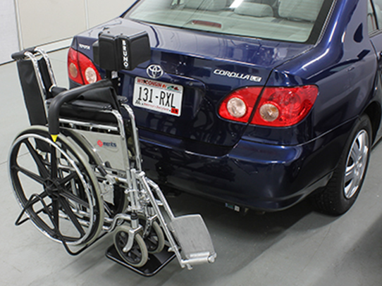
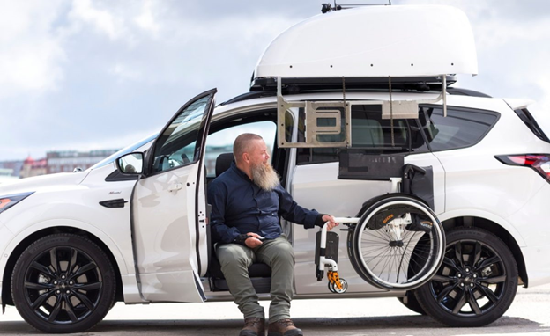
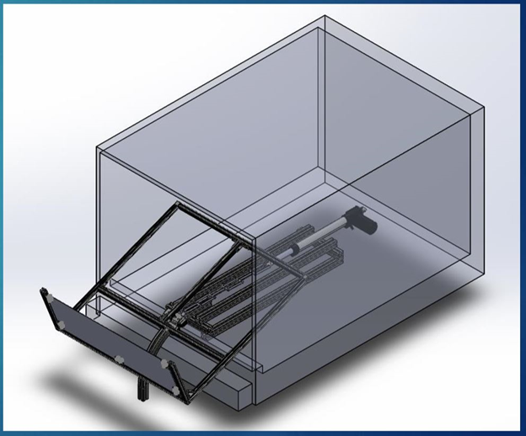
Research of Existing Products and Technology
Commercial products
Products recommended by residents
Previous group’s final design project

Slide 9
Existing Pros
Existing Cons
Automatic
Solo operation
Weatherproofing options
Convenient once installed
Safe and easy operation
Widely available
Difficult to install
Unsuitable for sedans
Low weight lifting capacity
Expensive
External storage
Ramps are too large and heavy for residents

Slide 10
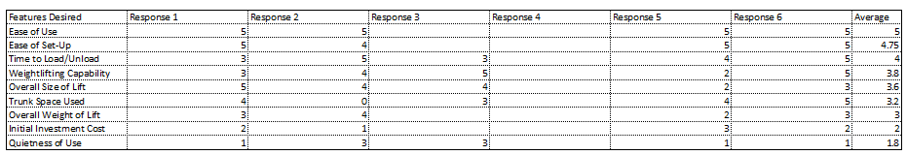
Customer Features and Relative Importance from Survey
Most desired features:
  Ease of setup
    Average score of 4.75 of 5
  Weight lifting capacity
    Average score of 3.8 of 5

Slide 11
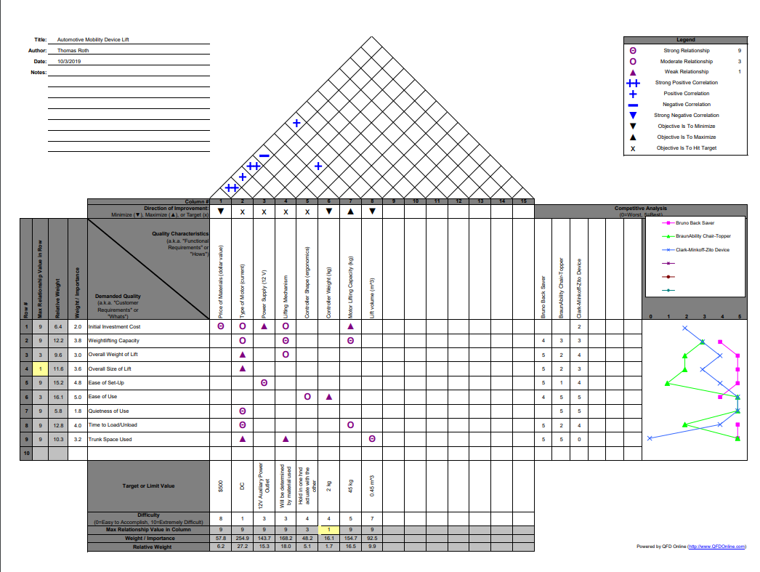
House of Quality
Quality Characteristics
  Price of material
  Type of motor
  Power supply
  Lifting mechanism
  Controller shape
  Controller weight
  Motor lifting capacity
  Lift volume
    Size limit of lift

Slide 12
Product Objectives and Weights
Ease of Use – 16.2
Ease of Set-Up – 15.2
Time to Load/Unload – 12.8
Weightlifting Capacity – 12.2
Overall Size of Lift – 11.6
Trunk Space Used – 10.3
Overall Weight of Lift – 9.6
Initial Investment Cost – 6.4
Quietness of Use – 5.8

Slide 13
DESIGN ANALYSIS
OF
LIFTING MECHANISM

Slide 14
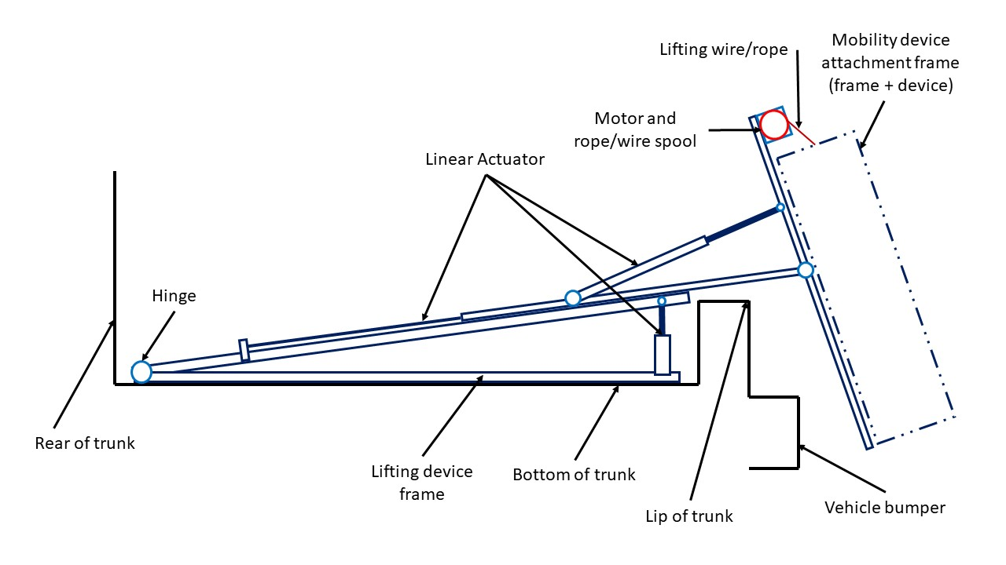
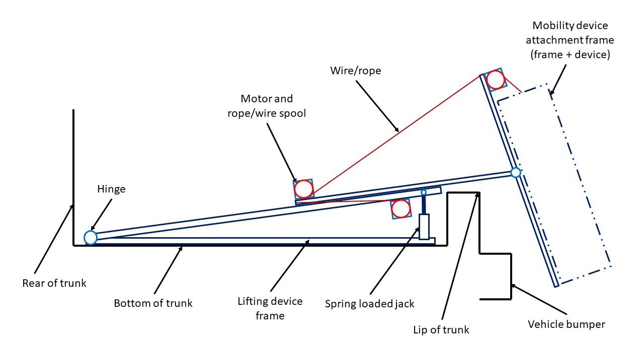
Lifting Mechanism - Design Alternatives
Relied on multi-powered-unit systems (pneumatics, pulleys, springs)
Too complex and expensive

Slide 15
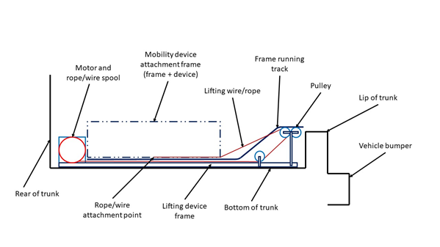
Lifting Mechanism - Chosen Design Alternative
Utilizes motors with rope/pulley system to (un)load mobility device
Easy-to-use - only requires one set of controls for motor direction and speed
Easy installation
Few moving parts
Automated process

Slide 16
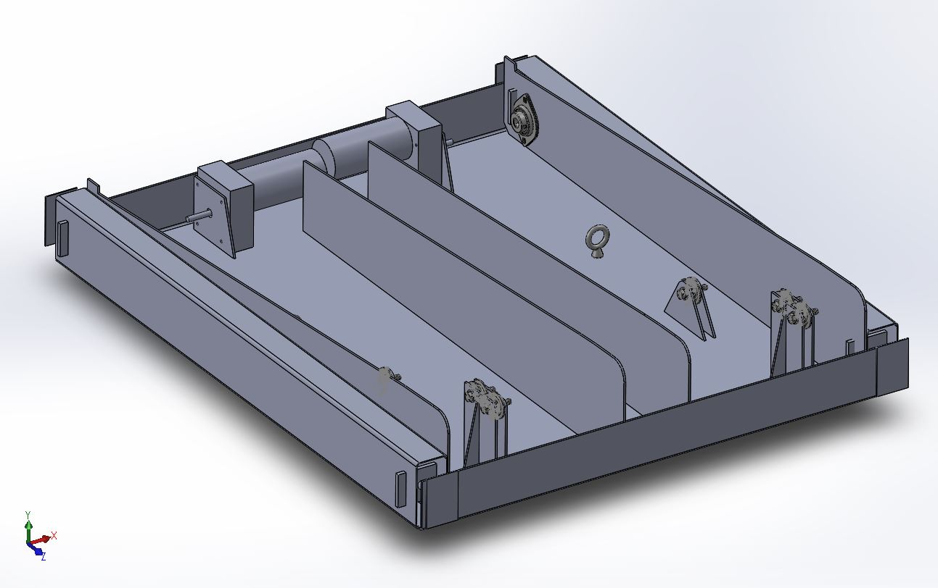
Solid Model Image

Slide 17
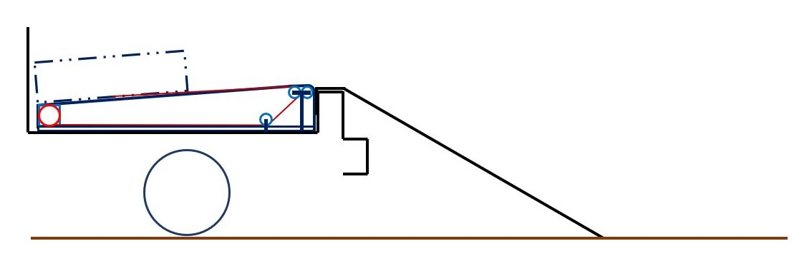
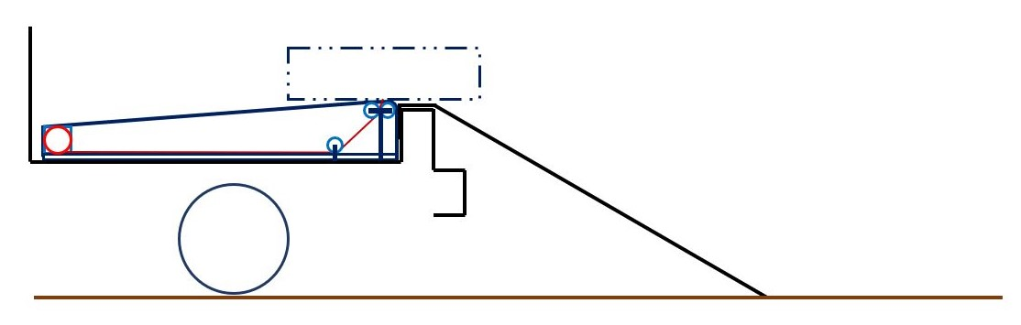
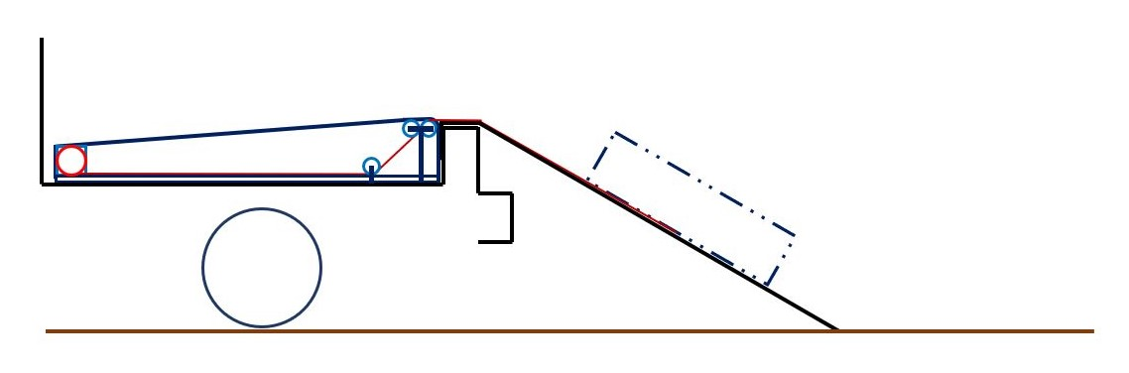
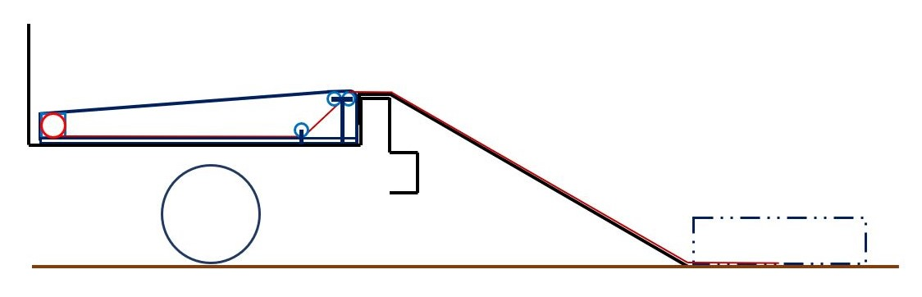
Operation
Four positions during unloading process
Fully Loaded Position
  Motor run in the spooling direction
Inflection Position
  Motor is reversed to unspooling
On-Ramp Position
Fully Unloaded Position
Process is reversed for loading process

Slide 18
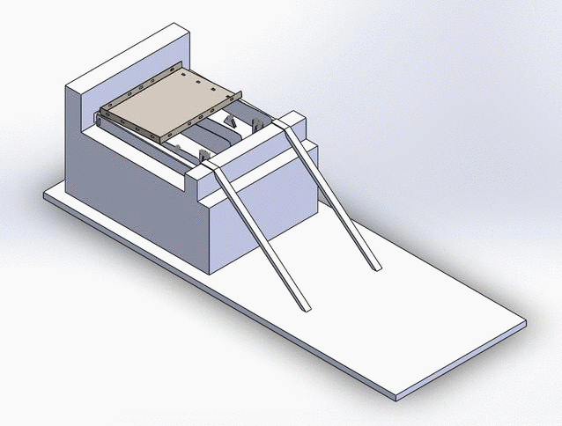
Operation Animation

Slide 19
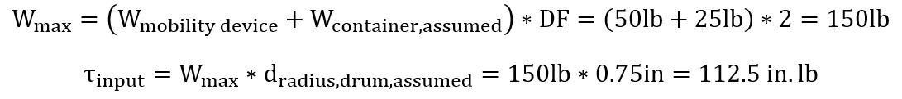
Loading Conditions and Technical Specifications
Maximum weight of the mobility device and attachment
  Design factor of 2
  150 lbs
Downscaled weight to less than typical mobility device
  Accommodates project budget
  Capacity of available motors
Winch drum radius of ¾” the maximum torque on the motor is 112.5 in.lbs

Slide 20
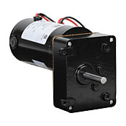
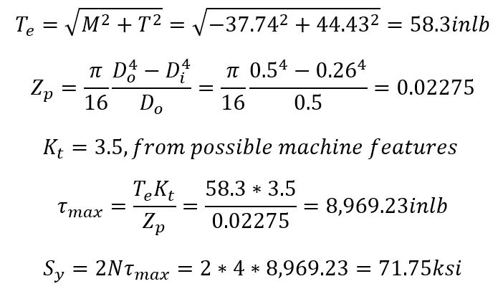
Motor and Shaft
2 IronHorse 12V DC gearmotors - 50 in.lbs per motor
ASTM A500 - 75 ksi yield strength
  Can withstand 71.75 ksi load from Max Shear Stress Theory

Slide 21
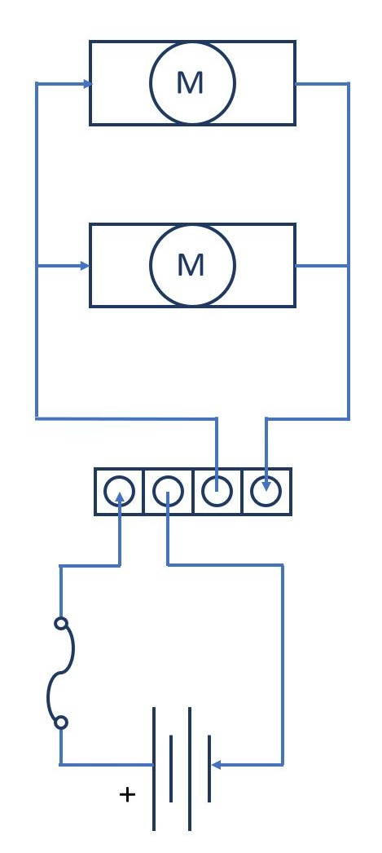
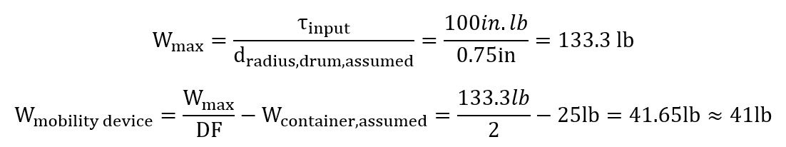
Electrical Components
Weight lifting capacity limited by motor power/cost
  Higher required torque → Higher cost
  Lower required torque → Lower cost
12V system powered by a single, lightweight battery
Made of inexpensive purchase parts
Easy to install, maintain, and use

Slide 22
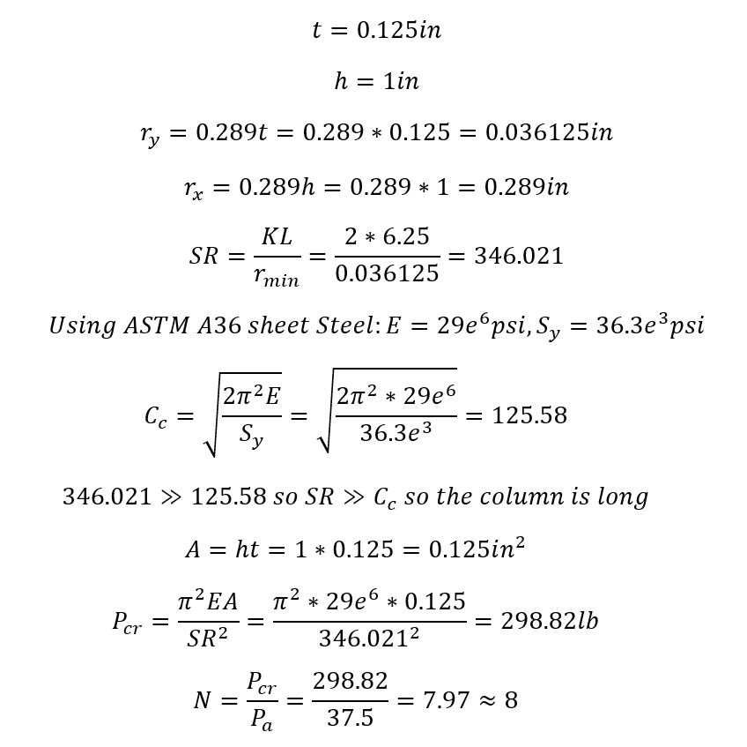
Base Plate, Slides, & Bearings
Calculations based on 1” point of contact
  Located at the tallest part of the slide
Factor of safety for ⅛ ” plate is 8
  ASTM A36 Steel
  Necessarily high for mounting hardware
    Motor
    Bearings
    Pulley stands
Bearings under 18.51 lbs of force
  Mounts directly to slides
  Reduces complexity

Slide 23
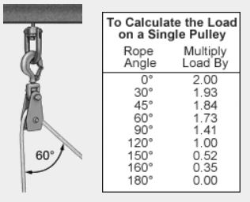
Ropes and Pulleys
Each of the two ropes could be expected to lift half the maximum load - 133 lbs.
Wear resistant rope with 550 lb capacity chosen for safety
Three pulleys per side each with different angles
  Pulley 1 - 120 degrees - 66.65 lbs
  Pulley 2 - as low as 30 degrees - 128.64 lbs
  Pulley 3 - also about 120 degrees - 66.65 lbs
Hubless pulleys with 525 lbs capacity chosen
  Stands made from same material as slides

Slide 24
DESIGN ANALYSIS
OF
DEVICE AND VEHICLE ATTACHMENTS

Slide 25
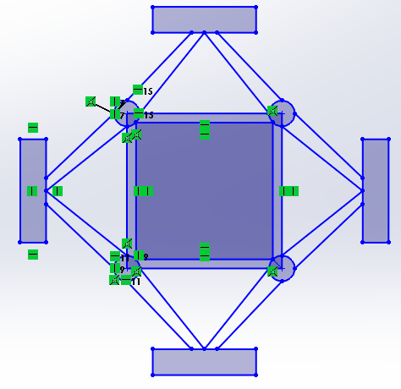
Design Alternatives and Selection
Concept #1: cross-joints
  Works in a similar way to that of a car jack
  Final thoughts
    Unstable (during travel)
    High cost ($450-650 each)
    Unique, but way too complex
    Long installation process
    Platform contact to prevent damage to vehicle
    Universal (compact storage until installation)

Slide 26
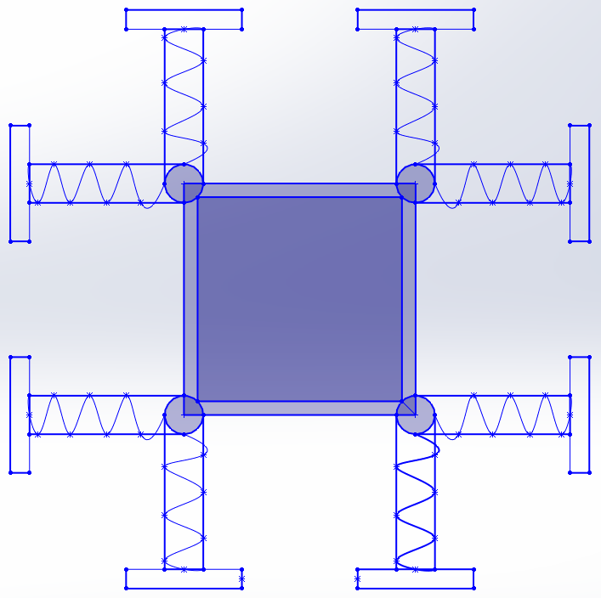
Design Alternatives and Selection
Concept #2: jackscrews
  Can be seen on construction catwalks’ feet
  Final thoughts
    Sturdy and safe
    High cost ($250-350 each)
    Needs experienced welder (outsourced)
    Easy installation
    Automated process
    Platform contact to secure load
    No damage to vehicle
    Universal

Slide 27
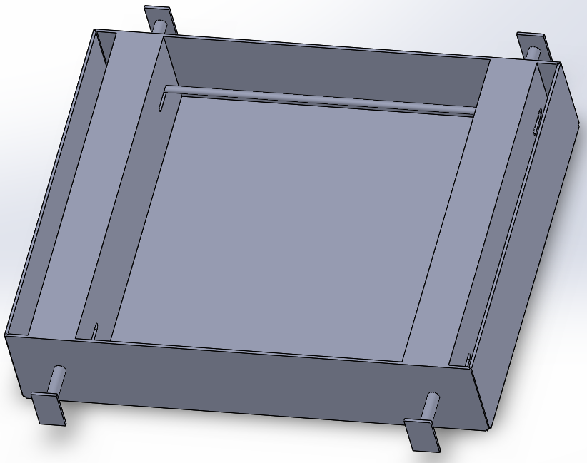
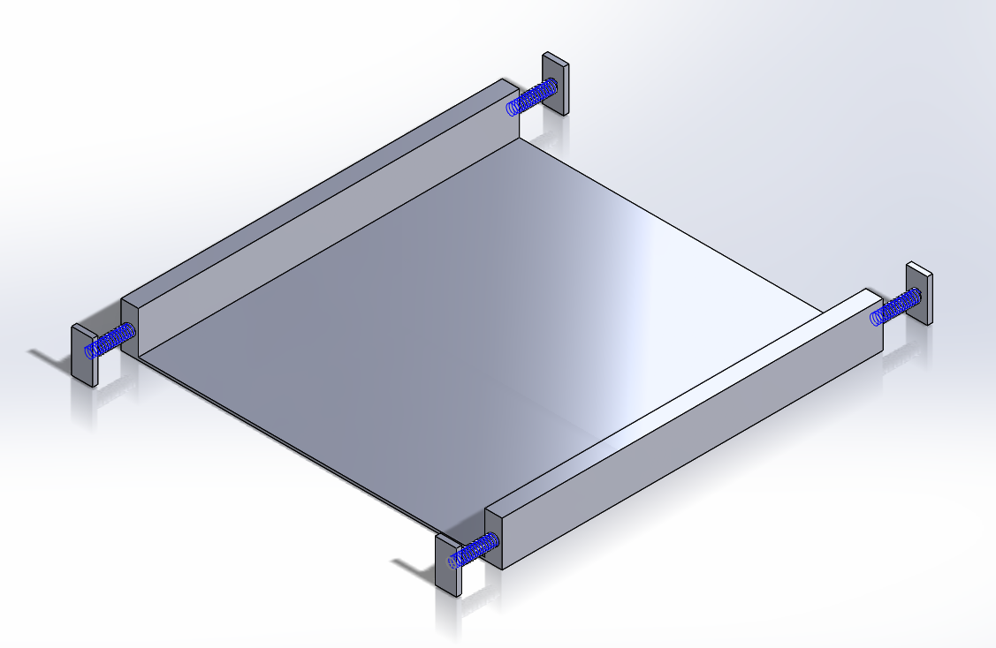
Solid Model Image
Vehicle Attachment
Without: bends, slotted installation bar
With: springs
With: bends, slotted installation bar
Without: springs

Slide 28
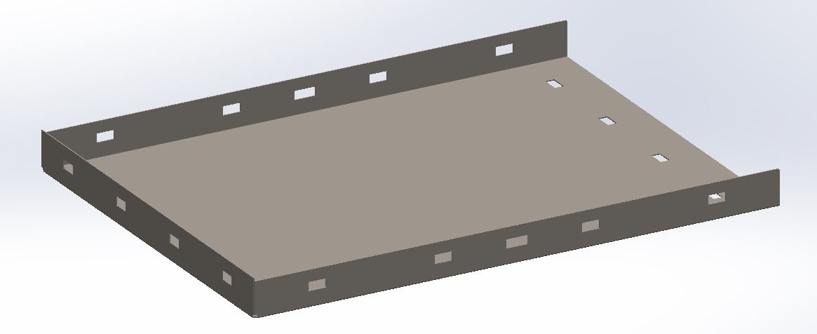
Solid Model Image
Device Attachment

Slide 29
Loading Conditions/Assumptions/Restrictions/Constraints
Restrictions
  Budget ($1000 total)
  Time
Dimensional constraints
  Overall lift (installed): 20”H x 40”W x 36”D
  Container: 14”H x 28”W x 24”D
  Trunk opening: 15”H x 31”W x 10”D
  Trunk capacity: 21”H x 40”W x 39”D
Assumptions
  If mobility device fits into device attachment, then it will fit into the trunk
  Mobility device maximum weight is capped at 125 lbs
    Final prototype is a downscaled version (40 lbs) of the original calculations
  Design Factor of 2
  Normal environmental conditions during operation (level surface, good weather, etc.)

Slide 30
Component and Material Selection
Strap with cam buckle
  Zinc plated steel with polyester (high capacity - won’t break)
Steel bars, rods, and sheets
  ASTM A36 steel
    Metal offered by sponsor
Springs
  Zinc-plated music-wire steel (220 lbs max load, correct size offered)

Slide 31
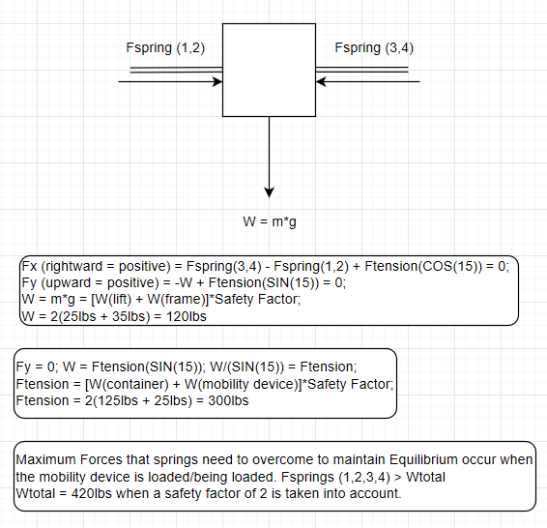
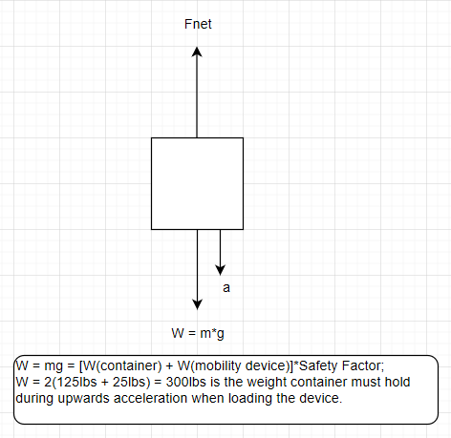
Calculations
Springs (4) are capable of up to 880 lbs
  Frame will hold safely
Container (1) is capable of up to 1220 lbs
  Container will hold safely
Notes:
Please note: final prototype is a downscaled version of these original calculations. Original calcs are kept to show the original design process, given the budget will not be an issue.

Slide 32
PLANNED FABRICATION AND ASSEMBLY

Slide 33
Specialized Fabrication, Assembly, and Tooling
Special fabrication provided by sponsor (Weiss-Technik)
  Sheet metal
    Bends via Salvagnini
      Ramp/frame/etc. in both attachments
    Essential structural welding via associates
      Corner welding for vehicle attachment
    Cuts via laser machine
      Straight slots for installation bar and straps
      Holes for pulley system/motors/bearings
Assembly welding will be performed in Victory Parkway
  Installation bar/pulley system/sanding
Standard tooling and other building
  Springs/plastic trim/final touches

Slide 34
PLANNED TESTING AND PROOF OF DESIGN

Slide 35
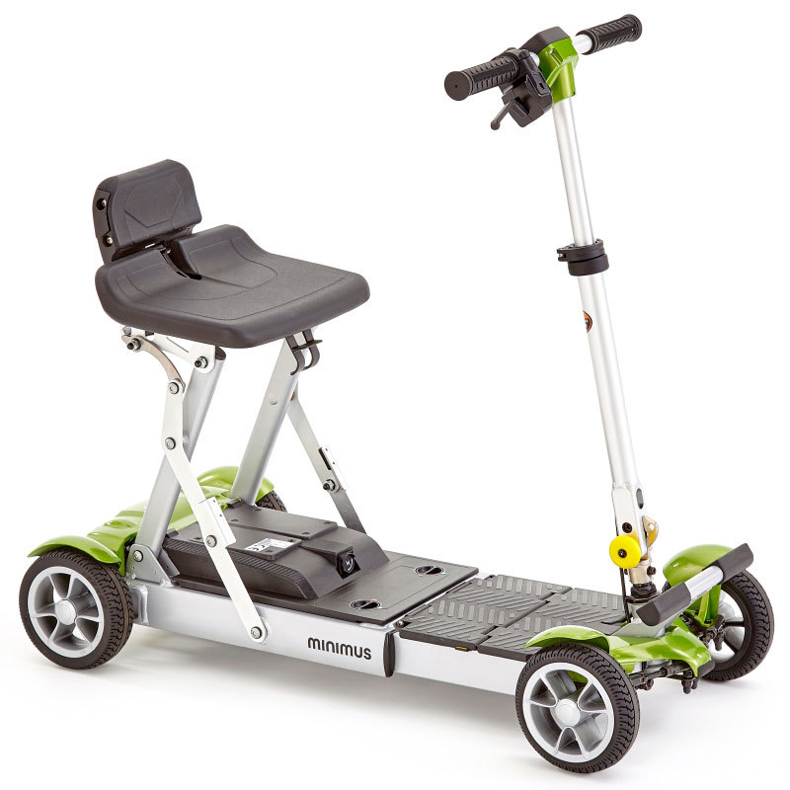
Proposed Testing Methods
Testing to be performed using a compact sedan (2012 Ford Focus, 2018 Mazda 3, etc). All tests should be performed using a mockup of a Minimus Folding Mobility Scooter (40lb) Testing should include:
Installation, (un)loading mobility device, and reversible lifting process
  Frame is extendable, retractable, and correctly secured to trunk
  Attachments to mobility device and trunk are stable
  Mobility device is able to be loaded, attached, detached, and unloaded
  Frame is properly removed from trunk
  No damage to vehicle
Power supply and motor function
  System is functional while unloaded and loaded

Slide 36
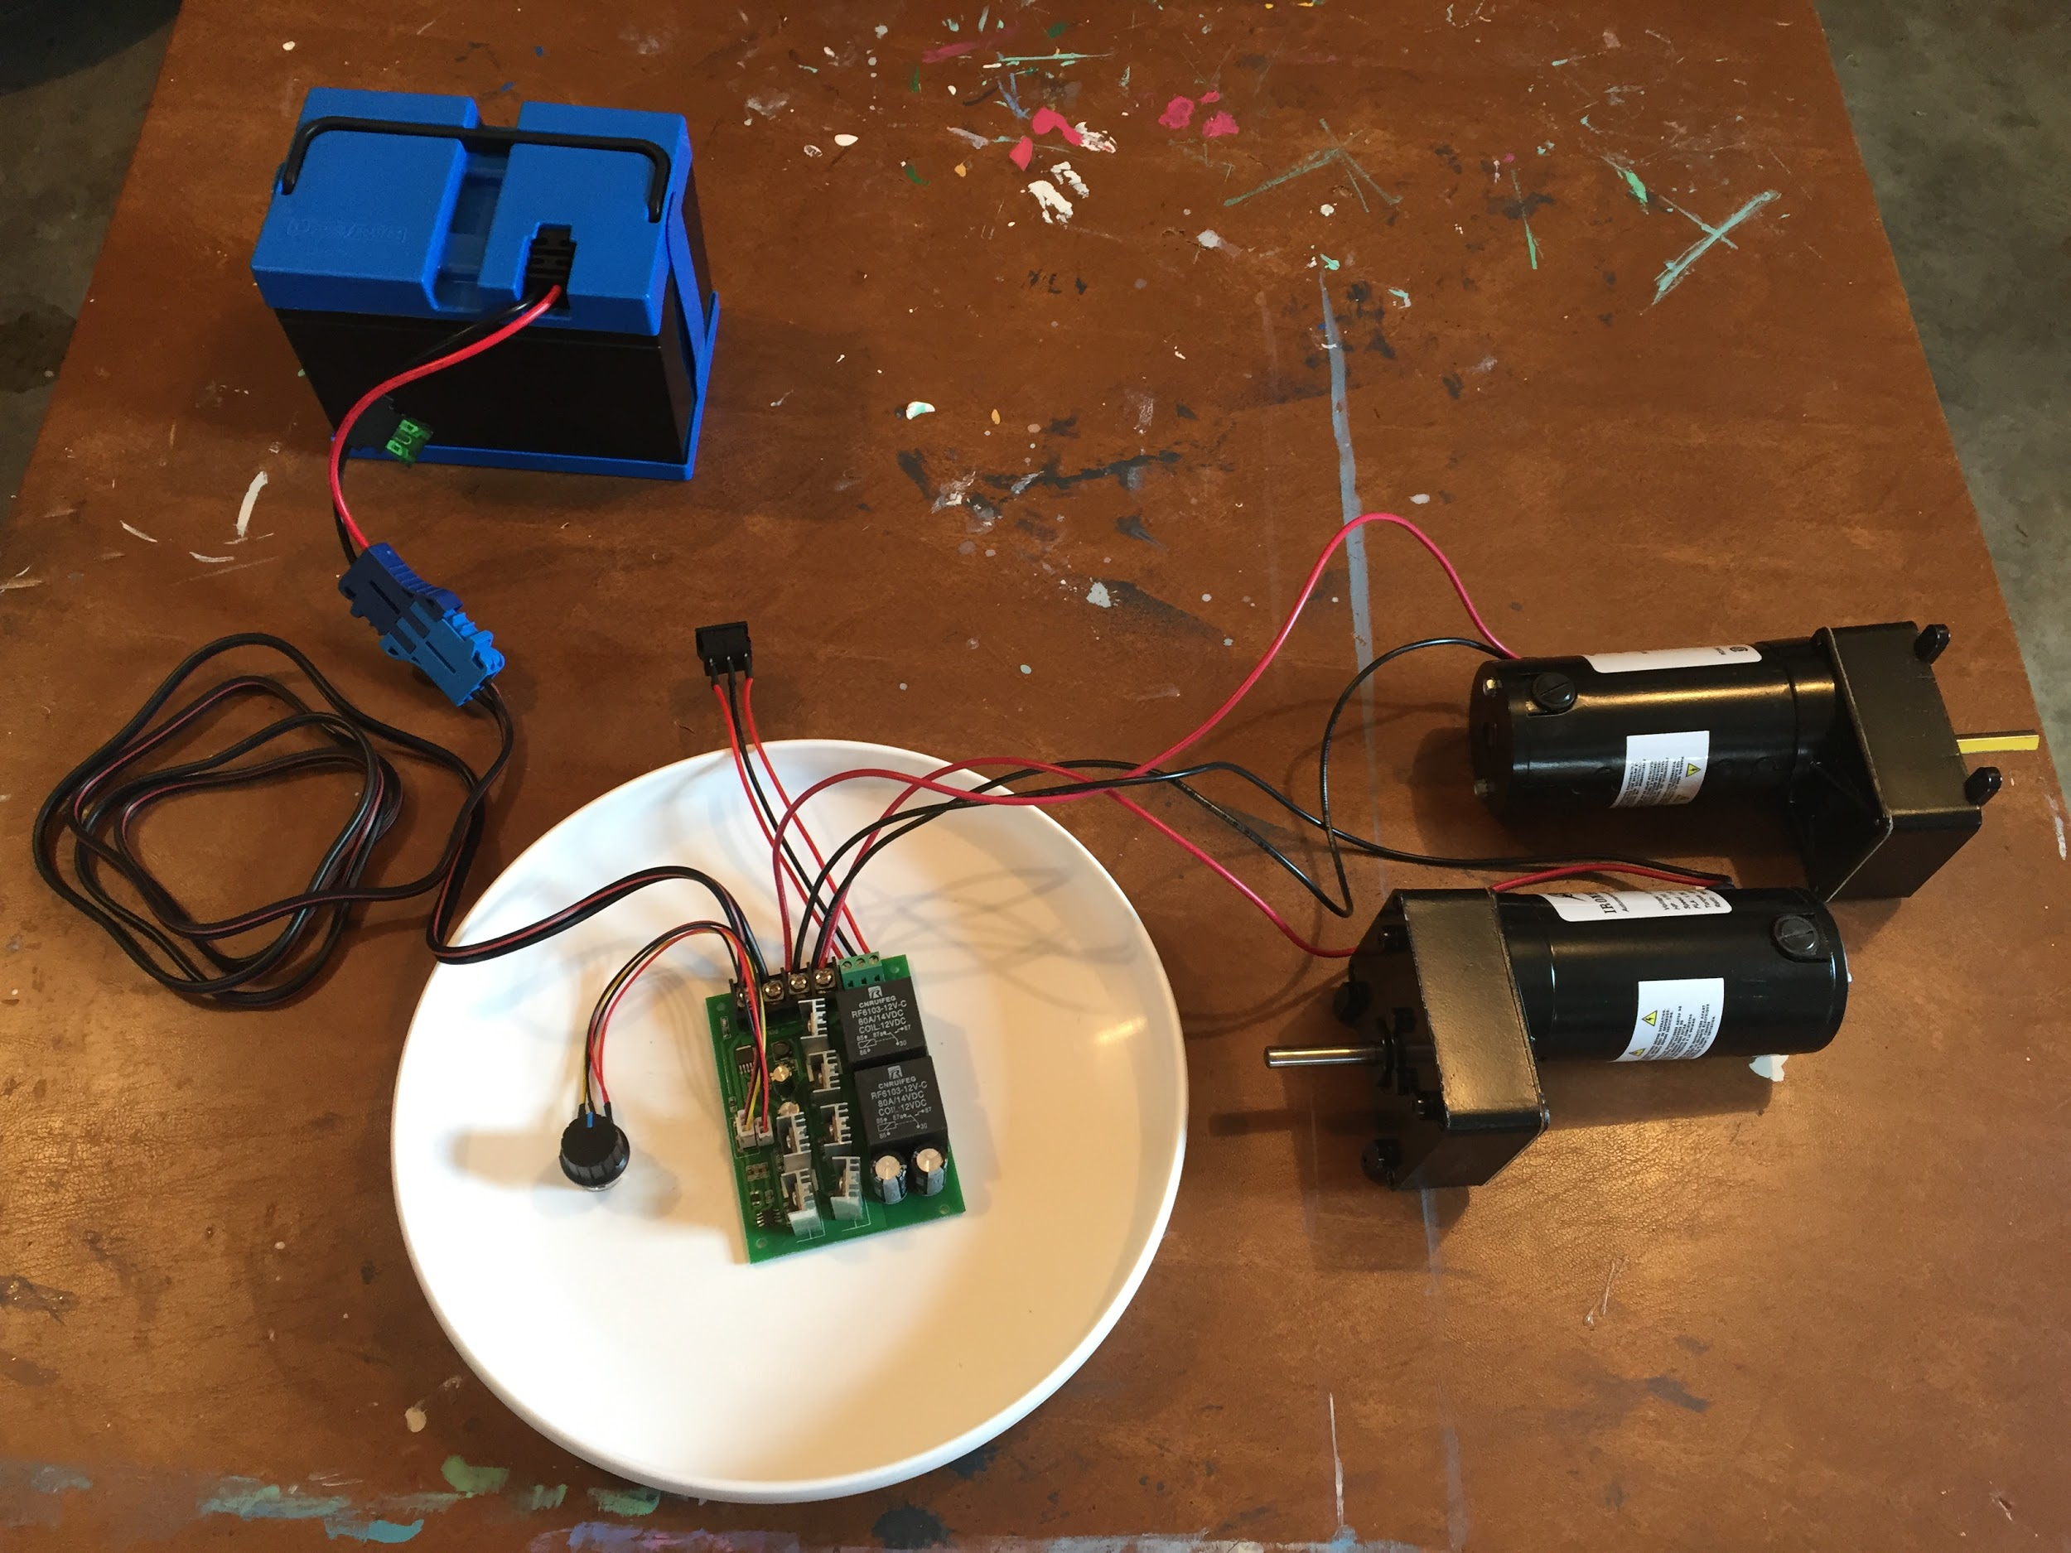
Proof of Design - Electrical System Test
Electrical components assembled
Tested for:
  On/off capability
  Rotation direction control
  Speed control
All tests passed
System ready for use

Slide 37
PROJECT MANAGEMENT

Slide 38
Budget, Proposed
Restrictions
  MKV estimated a total budget of $1000, $500 to each partner
Complications
  Several designs came in over budget
  Budget restrictions required late redesigns around lighter weight capacity
    Target load adjusted
    Smaller, less expensive motor
    BoM revisions

Slide 39
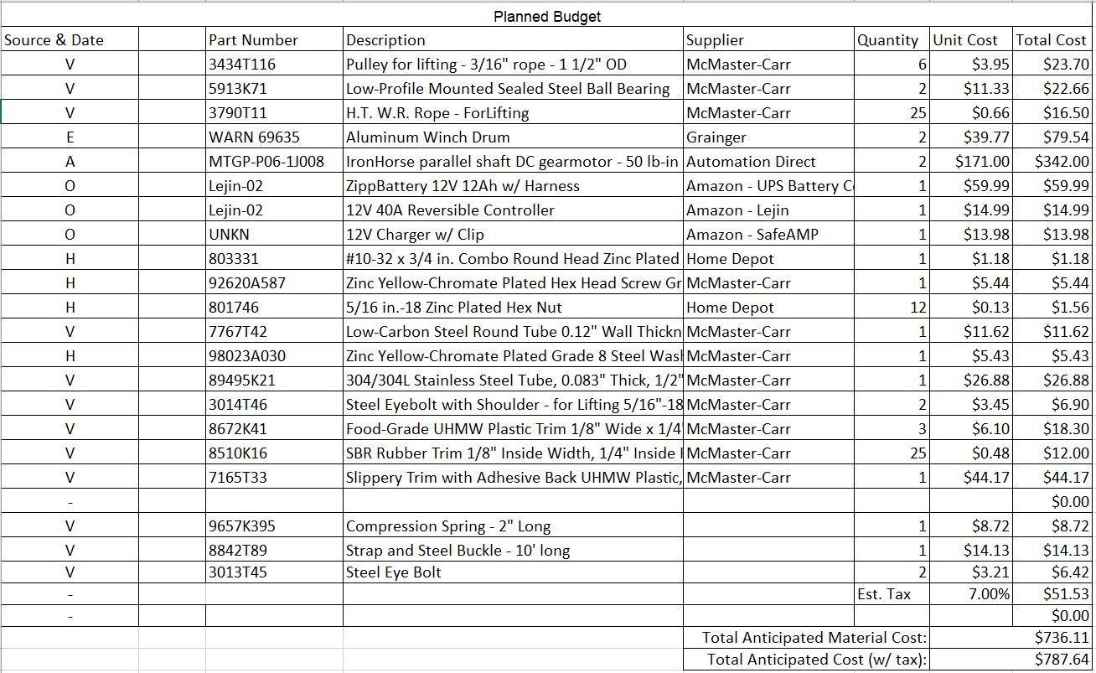
Bill of Materials
Anticipated material cost: $736.11
Assumed tax: 7% - $51.53
Final expected cost: $787.64
$212.36 under budget

Slide 40
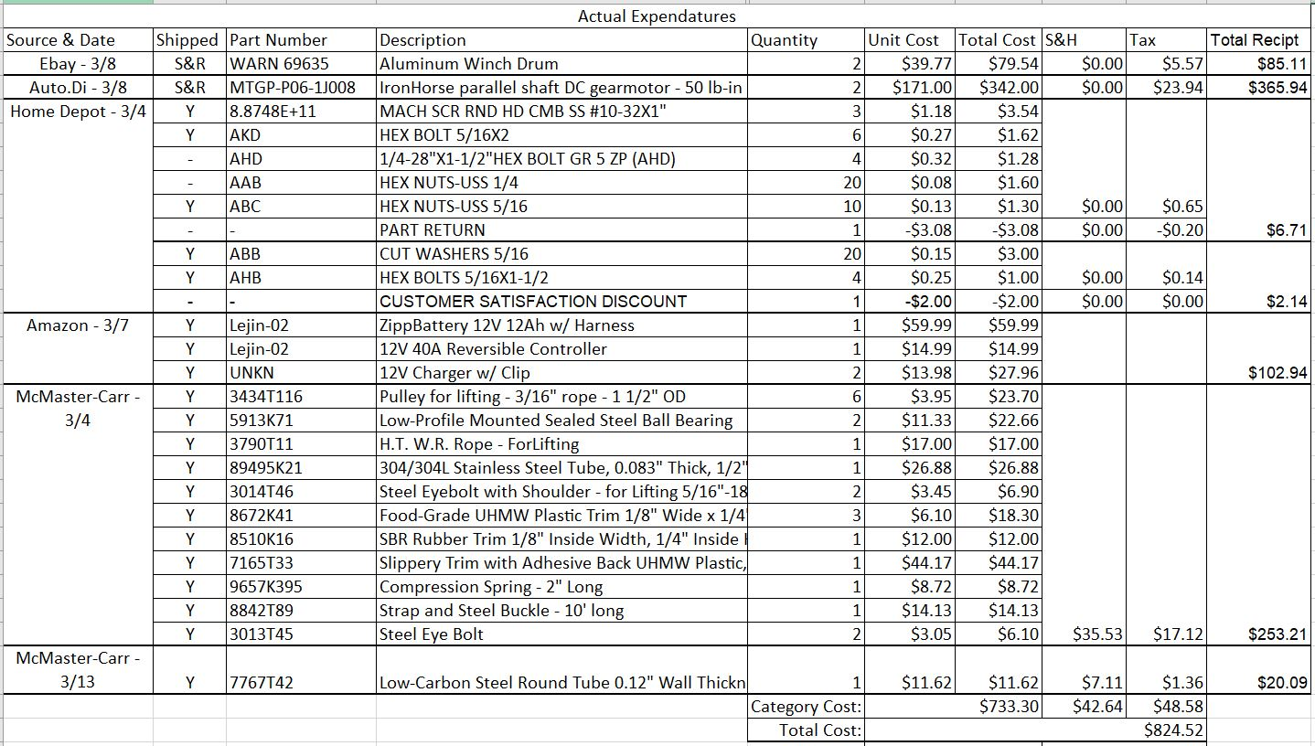
Budget, Actual
Final material cost of $824.52
Reduced by purchasing commodity fasteners locally
Additional costs from shipping and handling and tax
$175.48 under budget

Slide 41
Schedule, Proposed
September
  First MKV meeting: project pitch and approval
October
  Advisor meeting, discuss scheduling
  Second MKV meeting, discuss concept designs
  Begin calculations and gather assumptions
November
  Advisor meeting, discuss MKV findings/concerns
  Draft Bill of Materials
  Start designing 3D models
  Third group session MKV for build approval
December
  Advisor meeting, discuss progress and challenges
  Adjust material costs and timeline
  Winter Break
January
  Advisor meeting, recap from break
  SD II Presentation
February
  Get funding from MKV
  Order parts on BOM
  Finalize simulations while parts are received
March
  Advisor meeting, discuss Tech Expo draft
  Edit build instructions during building phase
  Build prototype
  Initiate testing
April
  Advisor meeting, review prototype
  Tech Expo Presentation
  Deliver prototype to MKV with advisor approval

Slide 42
Schedule, Actual
January
  Senior Design II presentation to staff board
    Lead to redefining the budget
    Redesigned prototype for proof of design rather than actual usage
February
  Final MKV Meeting with Megan to approve prototype budget
    All parts purchased and ordered, arrived in mid-March
March
  UC COVID-19 Shutdown ordered through summer
    Prototype and project to be finished by future students
  Electrical assembly completed
April
  All deliverables rescheduled to be due (Online) April 18th
  Purchased parts to be delivered to Dr. Dong (final update to MKV)

Slide 43
Future Work
Project immensely impacted by COVID-19 Pandemic
  University and workplaces closed across the country
Sheet metal needs to be sourced and funded
  Unable to acquire frame/ramp/mounting features/attachments from Weiss-Technik
Welding/cutting/bending completed via VPC machinery
  Assuming UC reopens their facility by the time this project is picked up again
  Further tooling can be completed as needed with at-home solutions/gear
Proof of concept will need to be built and tested
  Design based around lifting the Minimus Mobility Scooter
    Actual dimensions (foam stand-in [prototype])
      Ensures it can fit into trunk
    Downscaled weight (free weights safely anchored [prototype])
      Ensures weight can be lifted

Slide 44
Contact Information for Future Groups
Students
Zachary Waas
  Class of 2020
    Mechanical Engineering Technology
  Cell: (513) 673-0302
  Emails:
    Waaszc@mail.uc.edu
    Zack.waas@gmail.com
Thomas Roth
  Class of 2020
    Mechanical Engineering Technology
  Cell: (513) 967-7951
  Emails:
    rothts@mail.uc.edu
    t.j.f.roth@gmail.com
Supervisor
Dr. Janet Dong
  Associate Professor, UC CEAS MET
  dongjg@ucmail.uc.edu
  Phone: (513) 556-5305
Maple Knoll Village
Building Information:
  11100 Springfield Pike, Cincinnati, OH 45246
  http://www.mapleknoll.org
Contact Information: Megan Gresham-Ulrich
  VP of Marketing and Business Development
  Work: (513) 782-2423
  Cell: (513) 312-2546
  Fax: (513) 782-4324
  Email: MUlrich@mkcommunities.org

Slide 45
Bibliography
Superior Van and Mobility. Interior Mounted Handicap Scooter & Wheelchair Lifts Kentucky, Indiana, Tennessee, Louisiana & Nebraska. superiorvan.com. [Online] Bruno, 2013. [Cited: Sept 10, 2019.] https://www.superiorvan.com/scooter-lifts/interior-scooter-lifts.
Discount Ramps LLC. EZ-ACCESS® SUITCASE® Tri-Fold AS Wheelchair Ramp. discountramps.com. [Online] 2019. [Cited: September 13, 2019.] https://www.discountramps.com/ez-acesstrifold_ramp/p/Trifold-AS/.
United States Census Bureau. The Nation's Median Age Continues to Rise. census.gov. [Online] June 22, 2017. [Cited: June 26, 2019.] https://www.census.gov/library/visualizations/2017/comm/median-age.html.
Bruno Independent Living Aids. Back Saver. bruno.com. [Online] Bruno Independent Living Aids, 2019. [Cited: September 10, 2019.] https://www.bruno.com/scooter-lifts/back-saver.

Slide 46
Bibliography Cont.
BraunAbility. Convenient Wheelchair Carrier for Car Top. braunability.com. [Online] BraunAbility, 2019. [Cited: September 10, 2019.] https://www.braunability.com/us/en/mobility-products/wheelchair-carrier-for-car/chair-topper.html.
Clark, Benjamin B., Minkoff, Noah S. and Zito, Rhiannon R. Maple Knoll Wheelchair Stow. Cincinnati, OH : s.n., 2019.
M M Robins et al 1984 J. Phys. D: Appl. Phys. 17 1349, https://iopscience.iop.org/article/10.1088/0022-3727/17/7/009/pdf.
Careco UK Limited. Minimus Folding Mobility Scooter. CareCo Website. [Online] Careco UK Limited, 2020. [Cited: 11 3 2020.] https://www.careco.co.uk/item-s-ms01097/minimus-folding-mobility-scooter/.

