Slide 1
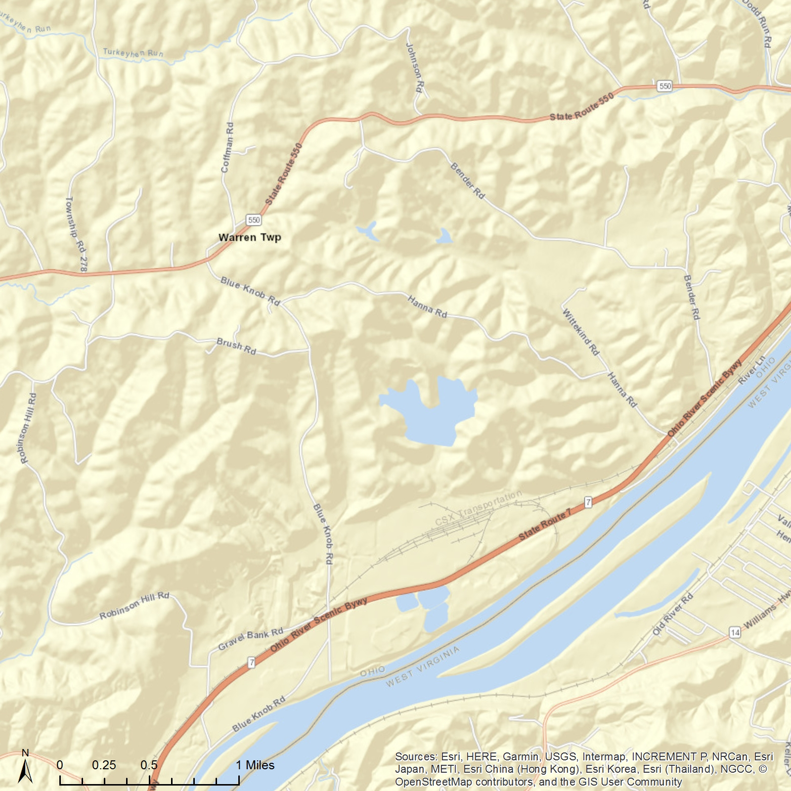
ATSDR Standard
Warren Elementary School
Marietta, OH
No data were collected between Dec. 2009 and Nov. 2011.
WHO Standard
16855 OH-550, Marietta,
OH 45750
EPA Standard
The monthly average of manganese (PM10) in the air was collected by a monitor at Warren Elementary School from Aug. 2009 to Feb. 2012. If you want to explore more, please visit our website: https://med.uc.edu/eh/research/projects/cares.
Airborne Manganese (PM10)
Monthly average
ATSDR Standard
WHO Standard
EPA Standard

Slide 2
ATSDR Standard
Warren Elementary School
Marietta, OH
No data were collected between Dec. 2009 and Nov. 2011.
WHO Standard
16855 OH-550, Marietta,
OH 45750
EPA Standard
The monthly average of manganese (PM10) in the air was collected by a monitor at Warren Elementary School from Aug. 2009 to Feb. 2012. If you want to explore more, please visit our website: https://med.uc.edu/eh/research/projects/cares.
Airborne Manganese (PM10)
Monthly average
ATSDR Standard
WHO Standard
EPA Standard

