Slide 1

Data Management for
GIS Projects
Amy Koshoffer MLIS, MS| Jennifer Latessa MCP
Assistant Director, RDS | Student Research Consultant
UC Libraries
Paula Marques Figueiredo PhD
Research Assistant, MEAS
NCSU

Slide 2


Webinar Sponsors
https://www.ucgis.org/
https://rdapassociation.org/

Slide 3
Agenda for Webinar
5 mins Introduction – who we are, webinar objectives
15 mins Jenny - Review – basic GIS project data management best
practices
15 mins Amy - Good DMP for projects with GIS data
15 mins Paula and Amy -
Navigating the US grant system particularly NSF grants
Recent experiences
Use of institutional repositories for data archiving
10 mins Q/A
Notes:
I changed the duration, I think 10 minutes is too much, 5 minutes is more than enough...

Slide 4
Webinar presenters
UC Libraries
Amy Koshoffer MLIS, MS - Assistant Director, Research and Data Services,
Jennifer Latessa MCP - RDS Student Research Consultant
NCSU
Paula Marques Figueiredo PhD - Research Assistant, MEAS
Notes:
Amy Koshoffer MLIS, MS, Assistant Director, RDS (https://orcid.org/0000-0001-8130-103X)
Amy has been the Assistant Director of Research and Data Services at UC Libraries since December 2018. She completed her MLIS at Kent State (2007), and her GIS certificate at UC (2017). She coordinates the strategic direction of the UC Libraries Research and Data Services Team especially in the areas of research data management, Geographic Information Systems (GIS), data preservation, open science and research reproducibility. She was a UCGIS 2019 TRELIS fellow, and met many inspiring early career Women GIS faculty through the program.
Jennifer Latessa MCP, Student Research Consultant
Jenny has been a student research consultant with UC Libraries since May 2017. She is a PhD student in UC College of Design, Art, Architecture and Planning (DAAP)’s Regional and Urban Planning program. She has expertise in QGIS, ArcGIS, and other mapping tools. She has worked with over 80 students, staff and faculty from various disciplines to assist them with their mapping and spatial analysis needs.
Paula Marques Figueiredo Ph, Research Assistant, MEAS, NCSU (https://orcid.org/0000-0002-5625-9295)
Dr. Marques Figueiredo joined MEAS in the Fall 2019 to work in the new Geochronology Laboratories applying Optical Stimulated Luminescence (OSL) and Terrestrial Cosmogenic Nuclides (TCN, 10Be/26Al and 36Cl) techniques to several research questions. Her main research themes explore Active Tectonics and Neotectonics, Tectonic Geomorphology and Surface Processes. Presently, she has active research projects across the globe from California (1- several locations along the San Andreas and the San Jacinto faults, 2- Eastern California Shear Zone, Camp Rock Fault), Nevada (Paleoseismology of the Pleasant Valley Fault), and in Portugal (uplifted Pleistocene marine terraces).

Slide 5
Webinar Objectives
Highlight best practices for project data management
Advice for writing a good data management plan
Draw from real experiences with real GIS projects
Take a data management plan to data management planning through action

Slide 6
During the webinar, please type your questions into the question box. We will answer them at the end of the presentations

Slide 7
Organizing and working in GIS projects

Slide 8

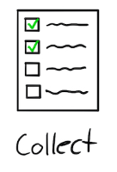

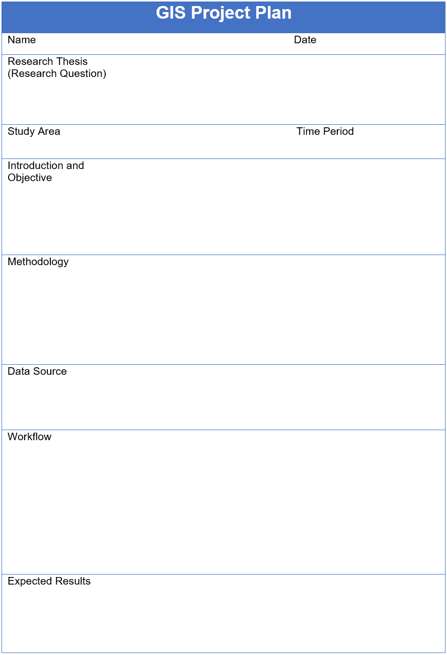

GIS Project Management Basics: Sources
https://thesweetsetup.com/mikes-system-for-ideas-part-1/
Start of a project:
A researcher has idea, but do they have data?
Do they know the best ways to keep their data organized?
And in ways that will make their research replicable and reproducible in the future?
Documentation starts with first contact and continues throughout the life of the project:
  Set up a text file and record steps and metadata throughout the process.
Notes:
Often softwares such as GIS or ArcGIS will save processed results in map document files for replication reference. The records are not associated with the data itself, so the data may be available, but since it is not saved in a map project file, the processed information is not.

Slide 9
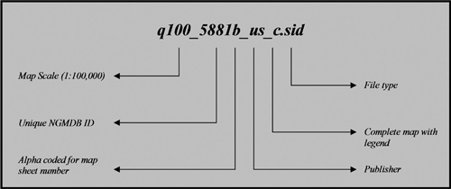
GIS Project Management Basics: Labeling
Labeling should clearly identify files/attributes, be concise, and follow validity rules of software(s) used for project.
Consistency is key! Use/Create a labeling system and keep it up!
  Could model a system such as USGS file naming convention - https://lta.cr.usgs.gov/DD/ARDTile.html#tile_identifier

Slide 10

GIS Project Management Basics: Storage
The structure of the folders may vary depending on your organizational needs.
Set up folders: raw data and processed data in separate folders.
One “master” or “root” folder is useful for storing all project materials.
Keep a copy of the original, “raw,” untouched data (source of data could be researcher or downloaded) and store in the raw data folder.
3-2-1 rule: It is always a great idea to back up your work (at least 3 different copies), using (at least 2) different formats/mediums, and in (1) geographically separate location.
Notes:
*When labeling your spatial data avoid using spaces and beginning names with numbers.

Slide 11
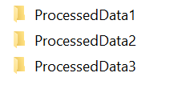
GIS Project Management Basics: Versioning
Consider the original, “raw,” untouched data, stored within the project folder, version 0. Label it as such if you wish.
Any processed data thereafter should be kept separately with versions indicated (1, 2, 3, …) for each new change to the data. That way, if you need to go back to a certain step you are able retrace the process.
  A .txt file or something similar may be included as a helpful reminder to explain each version’s goal.
    For example: Processing rasters with different statistical methods.
Dating processing folders is also a useful technique for storing and labeling different iterations of processed data.
Notes:
*Processed data file naming rules in software are different than your operating systems’. When making new shapefiles you may change the settings to allow longer names.

Slide 12

GIS Project Management Basics: Workflow
Work through the idea, doing any processing needed, label with specific names and versions.
Save map project .mxd or .qgs results directly into the Master Project folder for convenient access.
  Make sure to check the relative pathways option in ArcGIS, QGIS does it automatically.

Slide 13





GIS Project Management Basics: Workflow
There are many different software options available for spatial data projects so knowing different coding languages is a big advantage to be able to interchange data sets depending on the application.
Notes:
When labeling new attributes fields keep the previously mentioned rules in mind and limit the name to no longer than 10 characters. In ArcGIS once you create field name, you may not change it, though you may change the alias. This may be problematic when using python. QGIS has the ability to change attribute field properties to work around this problem using the “refactor fields” function.

Slide 14
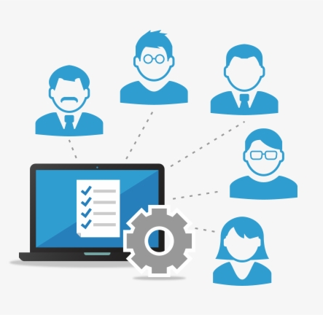
GIS Project Management Basics: Sharing
Your work has value and may be of great interest to others!
Consider the levels of knowledge for each user differs and there are many different applications for use.
Consider saving different formats of the same data (i.e. as a CSV and a Shapefile) along with documentation clearly and concisely explaining the most basic information in training notes. Examples:
  Metadata
  Readme files
  Project specific explanations
This amplifies the potential for future use and helps with preservation of data.

Slide 15
Data management Plans for GIS projects

Slide 16
Writing a Data Management Plan for GIS projects
All data management plans should address these major five areas
What data will be produced
What standards will be used to document the data?
How will the data be protected especially restricted data?
How will the data be archived and preserved?
How will reuse of the data and access to the data be facilitated?
https://figshare.com/articles/Data_Management_Plan_Checklist/1130852
Source- Kristin Briney

Slide 17
What data will be produced
GIS projects produce many types of data, particularly data with geospatial aspects and in various formats - numeric tables, images, shapefiles, mapfiles, text readme files, CAD files, and others
Use open formats if possible - example for images tiffs instead of .psd, .csv over .xlsx, .txt over .docs files
Open formats can be opened in multiple programs or by open source software - i.e. QGIS uses .qgs. QGIS can also open .osm files created in Open Street Map
Programs are adapting, though open practices will promote sharing and long term access
https://gisgeography.com/gis-formats/

Slide 18
 | Excellent statement | Fair statement | Poor statement
Describes what types of data will be captured, created, or collected | This project will produce: observational data in binary format, which is then converted by proprietary instrumentation software into ASCII text; Matlab mat-files for working data during the analysis phase; CSV and/or HDF5 files for data sharing and preservation.” | "We will collect zooplankton data from net tows. We will also collect elemental ratio data from preserved samples." | We will collect the necessary data
The DART Project: https://doi.org/10.17605/OSF.IO/KH2Y6

Slide 19
What standards are used to document the data?
Metadata is the information about the data, helps ensure the integrity of the data. Particular agencies/repositories require certain schema
  USGS - Metadata Review - https://prd-wret.s3-us-west-2.amazonaws.com/assets/palladium/production/atoms/files/MetadataReviewChecklist_20191015.pdf
  Guide to finding appropriate schema http://www.dcc.ac.uk/drupal/resources/metadata-standards
    Content Standard for Digital Geospatial Metadata (CSDGM) created by the Federal Geographic Data Committee (FGDC)
    ISO standard 19139 Geographic information — Metadata — XML schema implementation
    North American Profile of ISO 19115:2003 – Geographic information – Metadata (NAP)
    European INSPIRE Metadata Directive.
http://www.fgdc.gov/metadata
https://www.fgdc.gov/resources/factsheets/documents/GeospatialMetadata-July2011.pdf
https://www1.usgs.gov/csas/training/dm-module1/
https://desktop.arcgis.com/en/arcmap/latest/manage-data/metadata/what-is-metadata.htm

Slide 20
How will the data be protected especially restricted data?
Are you dealing with human subjects* - do regulations like HIPAA, FERPA, others cover your data
  Do you have the proper consent of study participants
  Planning for sensitive data collection should happen in the project planning process
What spatial resolution is appropriate - census tract - block group - block
Who on the research team really needs to access the data
Who is responsible for data security
Will the project generate intellectual project and what considerations need to be in place for this
*Sensitive data about humans should have a shelf life - it is best to destroy the data after the project. If this is not the plan, then language should be in the consent form informing study participants that the data will be stored long term. Also to share this data, the researcher will need to de-identify the data.

Slide 21
How will the data be archived and preserved?
How long do you plan to keep the data - institutional policies and grant policies apply here
File formats are important - consider open formats
Where will you archive your data
  “Will share data as requested” is not best practices
  Subject repository is the best option
  Grant or Publisher may have requirements and specific repository
  Institutional repository is a good option

Slide 22
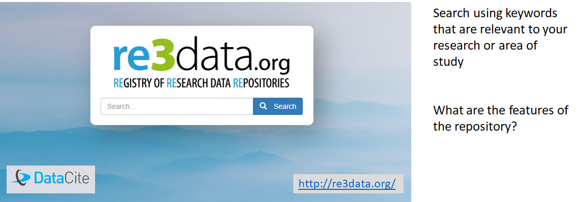
How will the data be archived and preserved?
Start with Subject Specific repositories
http://re3data.org

Slide 23

UC’s institutional repository
Scholar@UC
Accepts data
Multiple file types
Metadata (modified Dublin Core
DOI (DataCite)
PURL
Up to 3 Gb file upload through browser, larger files with developers help
Embargo
Can restrict access to UC only
https://scholar.uc.edu

Slide 24
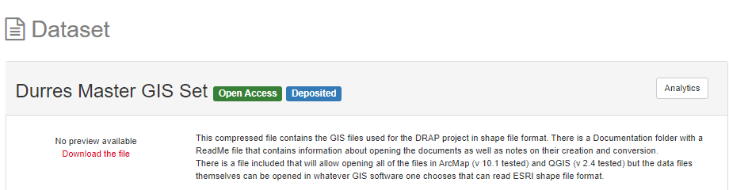
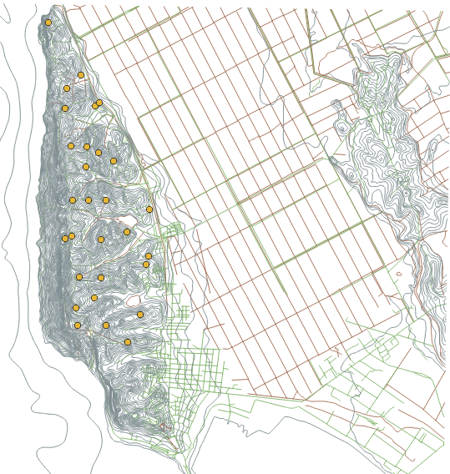

Example of a GIS dataset in Scholar@UC
https://scholar.uc.edu/show/j9602146z

Slide 25
Making your project reproducible
Best to start at the beginning - document your process, variables, and codes along the way
Final documentation should include a readme file that explains your process, the files, the data set sources, the variable meanings (data dictionary), any metadata schema used, and code (including version information). In essences, this is the instructions for how to recreate your project.
Documentation
for the Durres Maps

Slide 26
Readme File
Durres Regional Archaeological Project GIS Files
This folder contains the files used in 2002 for the Durres Regional Archaeological Project (DRAP). This project was a surface survey of the Durres, Albania region conducted under the auspices of the International Center of Albanian Archaeology in Tirana and the Department of Classics at the University of Cincinnati. The citation for the main publication of this research project is:
Davis, J.L., A. Hoti, I. Pojani, S.R. Stocker, A.D. Wolpert, P.E. Acheson, and J.W. Hayes. 2003. January 1. “The Durrës Regional Archaeological Project: Archaeological Survey in the Territory of Epidamnus/Dyrrachium in Albania.” Hesperia: The Journal of the American School of Classical Studies at Athens 72 1 (January 1): 41–119. doi:10.2307/3182036.
These files are largely unaltered from their 2002 form used in the analysis of the data.
The background GIS files were digitized from 1:50000 plans of Durres by Chris Dore. This includes the Roads, Powerlines, Water, and Durres (contours) layers. Those were converted into MapInfo 4 for Mac files on site. To those files we added the three Ancient Features layers (AncFeatures, AncFeaturesLines, and AncFeaturesPoints) as well as the Tracts, Sites, and Zones layers.
The original files were created and used in the Albanian National Grid projection, which was defined for us by the Albanian Rescue Archaeology Unit as a customized version of the Pulkovo 1942 GK Zone 24N projection, and that is the current projection of these maps.
At the end of the project the plans were converted from MapInfo files into ArcMap shape files. The original ArcView apr file is included but could not be converted to ArcMap v10 mxd files. The DRAPArcMap.mxd file represents a new visualization of the 2002 shape data.
To open these in ArcMap (lasts opened in v 10.1), you can use the DARPArcMap.mxd file.
To open these in QGIS (last opened in v 2.4) you can use the DRAPQGIS.qgs file.
Other files in this documentation folder can explain the data structure and codes used in the GIS.

Slide 27
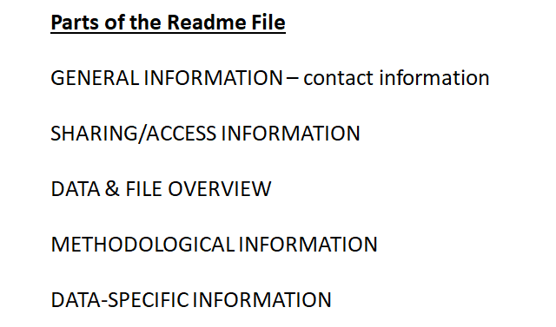
This readme.txt file was generated on <YYYYMMDD> by <Name>
-------------------
GENERAL INFORMATION
-------------------
1. Title of Dataset
2. Author Information
Principal Investigator Contact Information
Name:
Institution:
Address:
Email:
ORCID:
Associate or Co-investigator Contact Information
Name:
Institution:
Address:
Email:
ORCID:
https://z.umn.edu/readme

Slide 28
How will reuse of the data and access to the data be facilitated?
“Will share data as requested” is not best practices
Grant or Publisher may have requirements
Who do you want to share with - colleagues, students, general public
Are there DOI’s, PURLs, metadata for access and discovery

Slide 29
Real life GIS projects

Slide 30

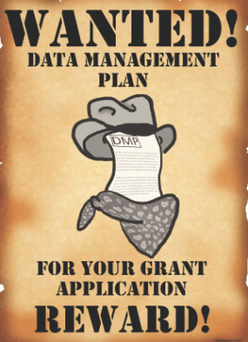
Writing your 1st Grant as a Early Career Scientist
You have an idea and want funding
Ok! You are trained to think and write about science
And then.. A what?...Data Management Plan?!
Submit proposal with a poor DMP (your best try..)
  Proposal not funded (although not only DMP)
  Frustration & “waste” of your research time

Slide 31

How to improve?
Attend Workshops Grant Writing
Talk / Listen to successful researchers
Learn what a Data Management Plan should be
  Your institution should have training about it
  Think and delineate a DMP for your proposal
  Ask for suggestions
  Look for storage options within your institution
and external specific/ thematic pre-existing databases

Slide 32


I Did IT! Now I have a DMP to run...
Organizing the data production:
  Project colleagues, students
  Consistency (data names, methods, storage)
  Planning the sharing
Contact Institutional/External Repositories
GIS data: what type of data, create organizational system!
Document, Save & Backup! Document, Save & Backup!

Slide 33
ADVICE:
Document all steps
BE SPECIFIC and CONSISTENT
Plan, Plan, Plan, then write the data management plan
Put the DMP into Action
Document, Document, Document
Adjust plan as project evolves

Slide 34
Bibliography
Geographic Information Centre. (n.d.) Project Design. McGill. Accessed January 22, 2020 from http://gic.geog.mcgill.ca/project-design/.
Pratt, M. (2004). ArcUser. “Working With Excel in ArcGIS.” January-March p.48-50. Accessed January 22, 2020 from https://www.esri.com/news/arcuser/0104/files/excel.pdfhttps://www.esri.com/news/arcuser/0104/files/excel.pdf
Michener, W.K. (2015) “Ten Simple Rules for Creating a Good Data Management Plan”. https://doi.org/10.1371/journal.pcbi.1004525
Whitmire, A. L., Carlson, J., Westra, B., Hswe, P., & Parham, S. (2017, March 24). The DART Project: using data management plans as a research tool. https://doi.org/10.17605/OSF.IO/KH2Y6
Nicole Ningning Kong, “Exploring Best Management Practices for Geospatial Data in Academic Libraries”. Journal of Map & Geography Libraries Advances in Geospatial Information, Collections & Archives Volume 11, 2015 - Issue 2: Geospatial Data Management, Curation, and Preservation https://doi.org/10.1080/15420353.2015.1043170 Accessed January 23, 2020
DMPTool - http://dmptool.org/
For Canadian researchers - Portage - https://assistant.portagenetwork.ca/

Slide 35
Thank you for your attention.
Happy to take questions.
Contact us at AskData@UC.Edu
Amy Koshoffer & Jennifer Latessa
Contact Paula Marques Figueiredo PhD at paula_figueiredo@ncsu.edu

