Slide 1
All of Us
Research Program
Supporting Data-Powered Health for Researchers Participants, and Communities
Amanda J. Wilson
Head, National Network Coordinating Office
National Library of Medicine, All of Us Research Program partner
Notes:
Thank you,

Slide 2

Dara Richardson Heron, M.D.
Chief Engagement Officer, All of Us Research Program
Katherine D. Blizinsky, Ph.D.
Policy Director, All of Us Research Program
With Thanks

Slide 3


Learn More
JoinAllofUs.org
ResearchAllofUs.org
@AllofUsResearch
#JoinAllofUs
Precision Medicine Initiative, PMI, All of Us, the All of Us logo, and “The Future of Health Begins with You” are service marks of the U.S. Department of Health and Human Services.

Slide 4
Precision Medicine Initiative

Slide 5
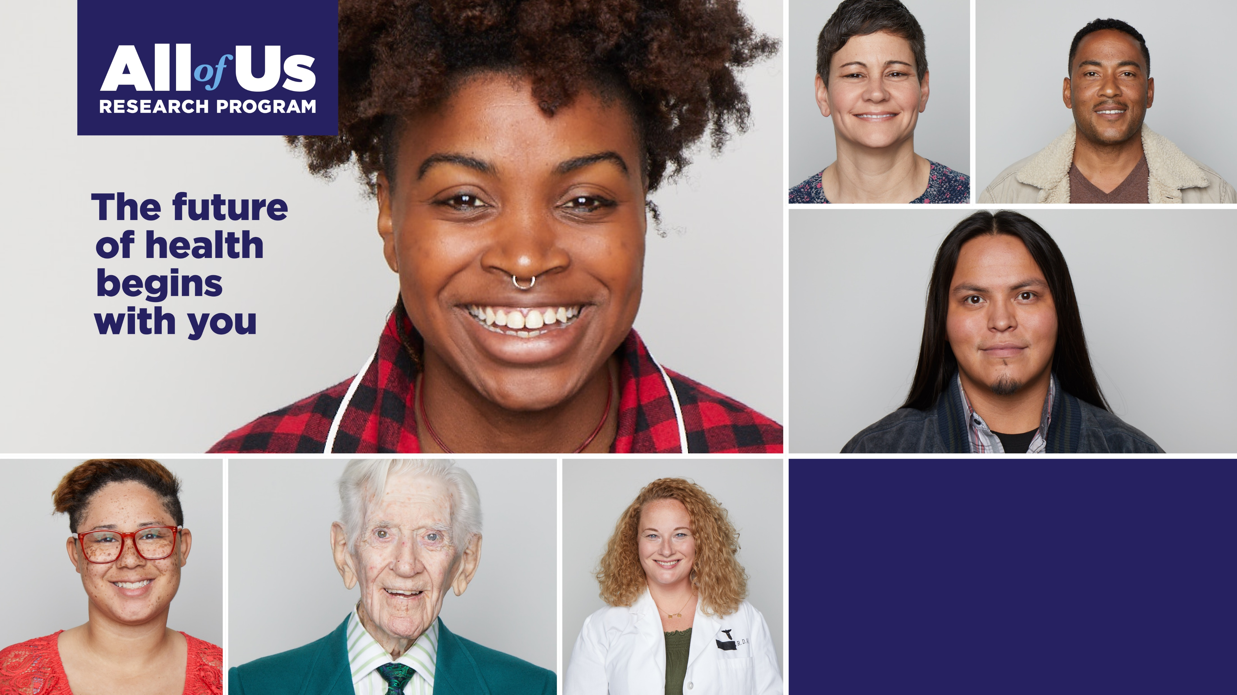
precision medicine:
the right treatment for the right person at the right time

Slide 6



The Cost of Imprecise Medicine
Patients
Providers
Researchers
Health care is often targeted to the average patient, not the individual
Health problems can take years to unravel, with significant trial and error
Not enough research to draw on for clinical evidence, especially in diverse populations
Medical records scattered in different places
Not enough time to analyze one patient at a time
Enormous time and cost spent building IT systems vs. doing research
Siloed data resources and funding opportunities
Challenges acquiring large sample sizes
Slow translation of data into knowledge

Slide 7
what is All of Us?
2015: White House announced the Precision Medicine Initiative

Slide 8
what is All of Us?
2015: White House announced the Precision Medicine Initiative
MISSION: To enable a new era of medicine through research, technology, and policies that empower patients, researchers, and providers to work together toward development of individualized care

Slide 9
what is All of Us?
2015: White House announced the Precision Medicine Initiative
  Privacy and Trust Principles
  Data Security Policy Principles
MISSION: To enable a new era of medicine through research, technology, and policies that empower patients, researchers, and providers to work together toward development of individualized care

Slide 10
what is All of Us?
2015: White House announced the Precision Medicine Initiative
  Privacy and Trust Principles
  Data Security Policy Principles
2016: Codified and Statutorily Mandated by the 21st Century Cures Act
MISSION: To enable a new era of medicine through research, technology, and policies that empower patients, researchers, and providers to work together toward development of individualized care

Slide 11
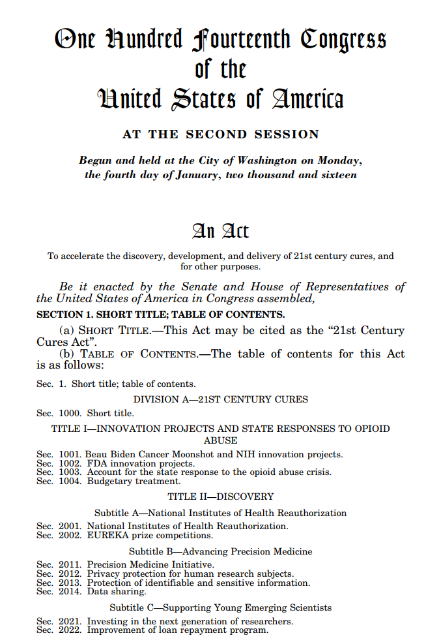
21st Century Cures Act
H.R.34. (Pub. L. 114-255) enacted December 13, 2016
Provides the Precision Medicine Initiative with $1.455 billion over 10 years
Language on:
  Diversity
  Data sharing
  Privacy

Slide 12

What is the All of Us Research Program?
  Rich, Longitudinal Resource: Deliver a national resource of deep clinical, environmental, lifestyle, & genetic data from one million participants who are consented & engaged to provide data on an ongoing, longitudinal basis (60+ years!)
  Diversity of Participants: Reflect the broad diversity of the U.S.—all ages, races/ ethnicities, gender, SES, geographies, & health status—by over-recruiting those underrepresented in biomedical research
  Diversity of Researchers: Build the tools & capabilities that make it easy for researchers from community scientists to premier university labs to make discoveries using the data & biosamples and through ancillary studies w/ the cohort

Slide 13
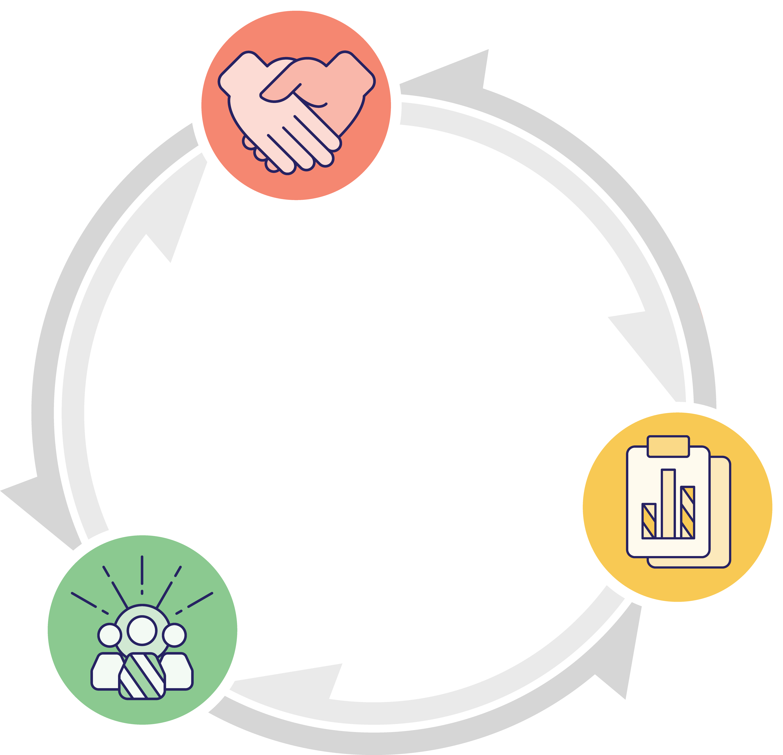
All of Us Mission and Objectives
Nurture relationships
with one million or more
participant partners, from all
walks of life, for decades
Our mission
To accelerate health research
and medical breakthroughs, enabling individualized prevention, treatment,
and care for all of us
Deliver the largest, richest biomedical dataset ever
that is easy, safe,
and free to access
Catalyze a
robust ecosystem
of researchers and funders hungry to use and support it

Slide 14
All of Us Research Program Core Values
Participation is open to all.
Participants reflect the rich diversity of the U.S.
Participants are partners.
Trust will be earned through transparency.
Participants will have access to their information.
Data will be accessed broadly for research purposes.
Security and privacy will be of highest importance.
The program will be a catalyst for positive change in research.

Slide 15
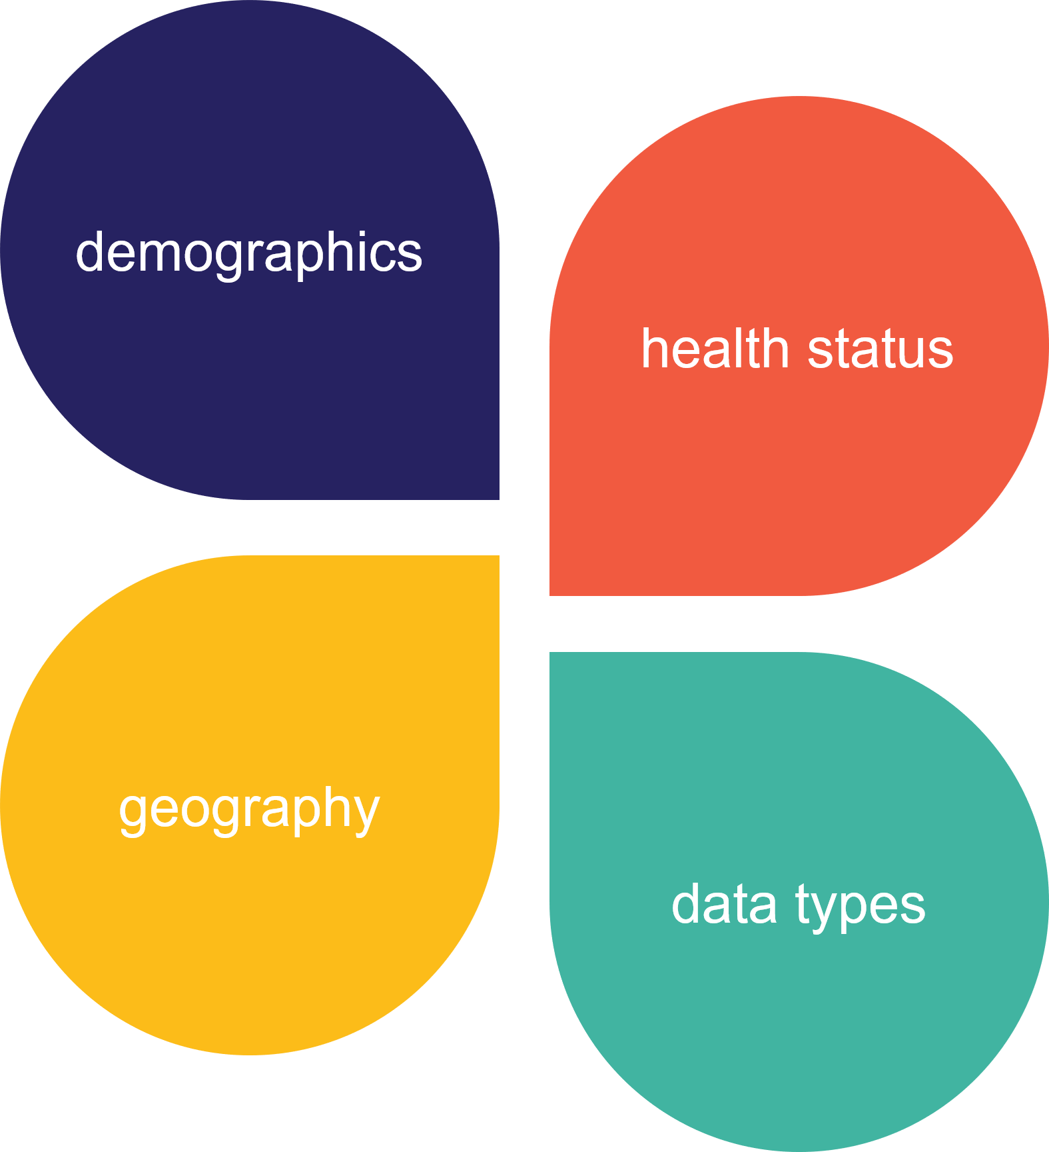

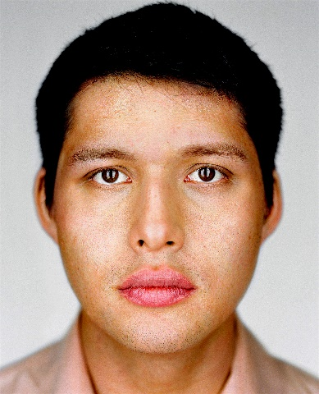
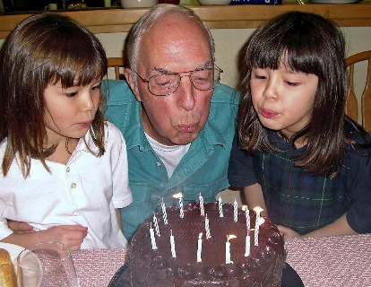
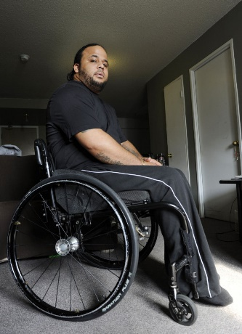
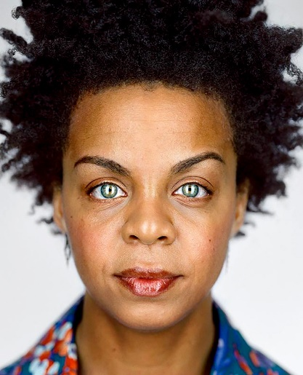
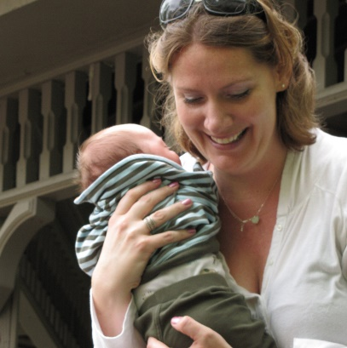
A Transformational Approach to Diversity
Reﬂect the country’s rich diversity to produce meaningful health outcomes for communities historically underrepresented in biomedical research.

Slide 16
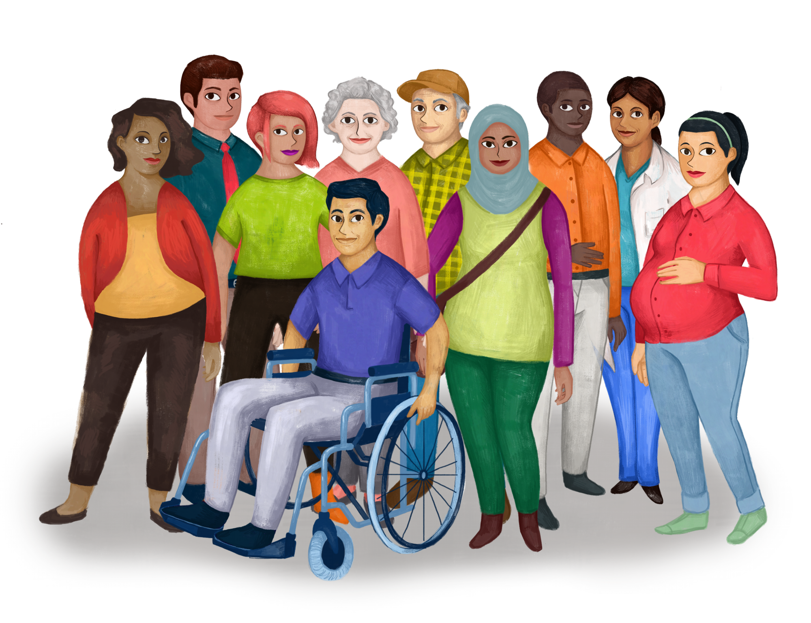
A Transformational Approach to Participation
Participants are true partners - not patients, not subjects - in the research process.
They are involved in helping us think through:
  What data we collect
  What lab analyses we do
  What research is conducted
  How data gets returned

Slide 17

What is the Promise for Participants?
An opportunity to fight disease and improve the health of future generations
The opportunity to be part of a movement to make our health care more precise, more personal, and more effective
The opportunity to ensure that your community is included in the studies that may lead to new understanding and new treatments
An opportunity to learn some of your own health indicators and get your own data

Slide 18
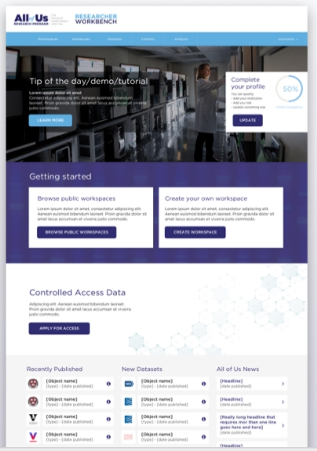
What is the Promise for Researchers?
The opportunity to save time and resources and accelerate your research breakthroughs
The ability to easily share workspaces and analyses with research partners and reviewers.
The chance to learn from the program’s pilots and experiments and leverage innovations for other studies and cohorts.

Slide 19
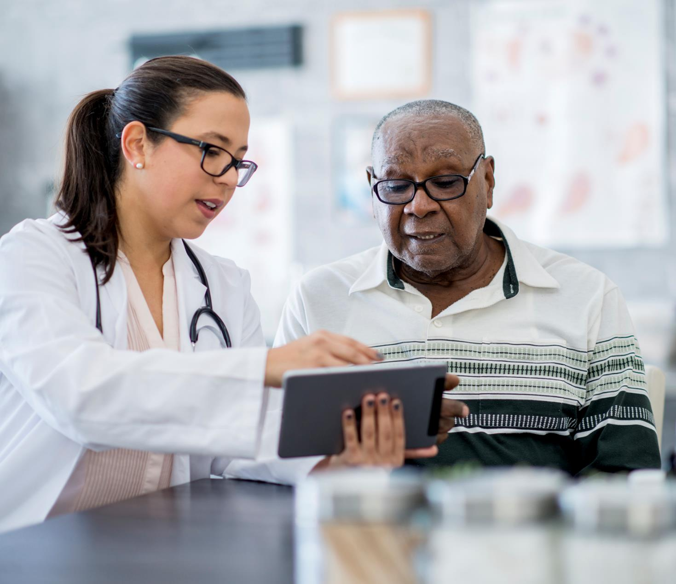
What is the Promise for Providers?
Over time, increased scientific evidence and improved guidelines to enable precision medicine opportunities for more people and conditions:
  Better understanding of the impact of environment and lifestyle factors on health.
  Increased knowledge of differences in risk factors and response to treatments among diverse populations.
  More information on the development of conditions that will allow for earlier detection.
  Deeper understanding of different conditions that may allow for better stratification.
Innovations that may make it easier to share electronic health records with other providers and patients.
New knowledge to help address health disparities, increase patient engagement, and understand the usefulness of consumer health devices and apps.

Slide 20

Approach to Privacy and Security
Guided by privacy, trust, and data security principles developed by experts with input from the public.
Data warehouse is built with the most advanced security available.
Experts have done and will continue to do rigorous security testing.
Data is encrypted and direct identifiers are removed.
Researchers must agree to a code of conduct before accessing the data.
Participants’ preferences will be respected.
Protected by a Certificate of Confidentiality.
Committed to transparency in the event of a data breach.
Safeguarding identity and data is our most important responsibility.

Slide 21
All of Us Research Program Building Blocks

Slide 22
All of Us Research Program Consortium
DATA AND RESEARCH
CENTER
Big data capture, cleaning, curation,
& sharing in secure environment
Vanderbilt, Verily, Broad Institute
BIOBANK
Repository for processing, storing,
and sharing biosamples (35+M vials)
Mayo Clinic
PARTICIPANT
TECHNOLOGY
SYSTEMS CENTER
Web and phone-based platforms
for participants
Vibrent Health
PARTICIPANT CENTER /
DV NETWORK
Direct volunteer participant enrollment,
digital engagement innovation, and
consumer health technologies
Scripps Research Institute
(with multiple partners)
HEALTHCARE
PROVIDER ORGS NETWORK
HPOs with clinical & scientific expertise, enrollment & retention of participants
30+ regional medical centers, FQHCs, VA, and future awards to grow network
COMMUNICATIONS &
COMMUNITY NETWORK
Communications, marketing, and design expertise; engagement coordination and community partners network
Wondros, HCM, community partners, and future awards to grow network
Notes:
Drh jan 25
Kate B

Slide 23


























































All of Us Consortium Members
DV Network
(Direct Volunteers)
Biobank
HPO Network
(Health Care Provider Organizations)
RMCs
Illinois
Precision
Medicine
Consortium
New England
Precision
Medicine
Consortium
Trans-American Consortium for the Health Care Systems Research Network
New York City
Precision Medicine
Consortium
California Precision
Medicine Consortium
Southern
All of Us Network
SouthEast Enrollment Center
All of Us, Wisconsin
University of Arizona
University of Pittsburgh
FQHCs (Federally Qualified Health Centers)
VA
Medical Centers
Communication & Engagement
Platform
Development
Notes:
Drh apr 3

Slide 24





Two Methods of Enrollment
DIRECT VOLUNTEERS
HEALTH CARE PROVIDER ORGANIZATIONS

Slide 25


Potential Activities Asked of Participants
Enroll, Consent and Authorize EHR
Answering
Surveys
Physical Measurements*
Provide
Biosamples*
Wearables and Digital Apps
Recruiting 18+ years old initially; plan to include children in 2019
Online, interactive consent
Includes authorization to share Electronic Health Record (EHR) data
Surveys:
The Basics, Overall Health, Lifestyle, Family History, Health Care Access and Utilization
Additional surveys will be released on an ongoing basis.
Blood pressure
BMI
Heart rate
Height
Hip circumference
Waist circumference
Weight
Blood (or saliva, if blood draw is unsuccessful)
Urine specimen
Biosamples will be stored at the program’s biobank
Share data from wearable fitness devices, starting with FitBit
Share data about mood & cardio-respiratory fitness through integrated apps
More integrations to come
*Based on diverse sampling and capacity
*Based on diverse sampling and capacity
Coming soon

Slide 26
All of Us Today and into the Future
Present
> 200,000 participants registered
> 100,000 core participants
~ 75% of current participants self-identify as belonging to one or more population that has been historically underrepresented in biomedical research
Future
Broaden inclusion to additional demographics
Provider outreach to engage with and educate clinical stakeholders
Expand linguistic support for non-English or Spanish speakers
Launch the researcher portal
Notes:
As of January 7, 2019 weekly must read

Slide 27
Importance of Historically Underrepresented Populations

Slide 28
All of Us Research Program Core Values
Participation is open to all.
Participants reflect the rich diversity of the U.S.
Participants are partners.
Trust will be earned through transparency.
Participants will have access to their information.
Data will be accessed broadly for research purposes.
Security and privacy will be of highest importance.
The program will be a catalyst for positive change in research.

Slide 29
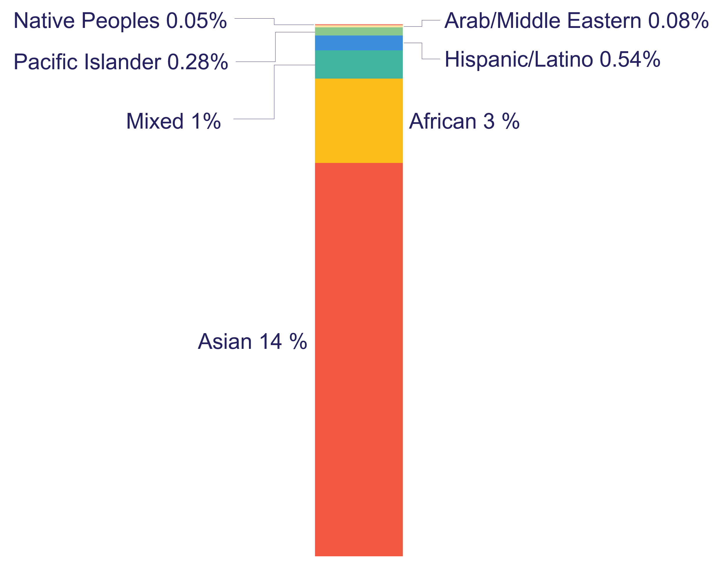

Persistent Racial and Ethnic Bias in GWA Studies
19%
81%
Adapted from: Popejoy and Fullerton, Nature, 2016

Slide 30
underrepresentation in biomedical research populations includes dimensions of race and ethnicity, as well as age, sex, gender, sexual orientation, income, education, geography, access to care, and disability.
Minorities make up
38%
of the US population.
Minority populations to rise to over
56%
of overall population.
Minority enrollment in clinical trials
<10%

Slide 31
Potential Improvements in Minority Health
Health disparities are well known but NOT well understood.
  Why do African-Americans have a higher mortality rate from chronic diseases, including cancer, Alzheimer’s, diabetes, and heart disease?
  Why is stroke more common among rural communities?
  Why is Hepatitis B more common in the Asian and Pacific Islander population?
Precision medicine asks us to look even beyond racial or ethnic group and into unique biological information to determine likelihood of developing and dying from disease.
But we can only determine these genetic variations if we increase minority participation in research– then, we will be able to speed treatments and cures for the conditions and diseases that afflict minority populations the most.

Slide 32
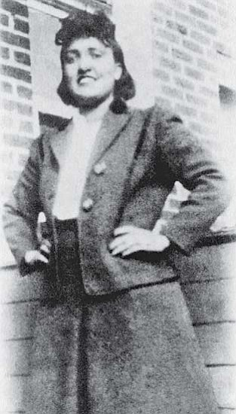
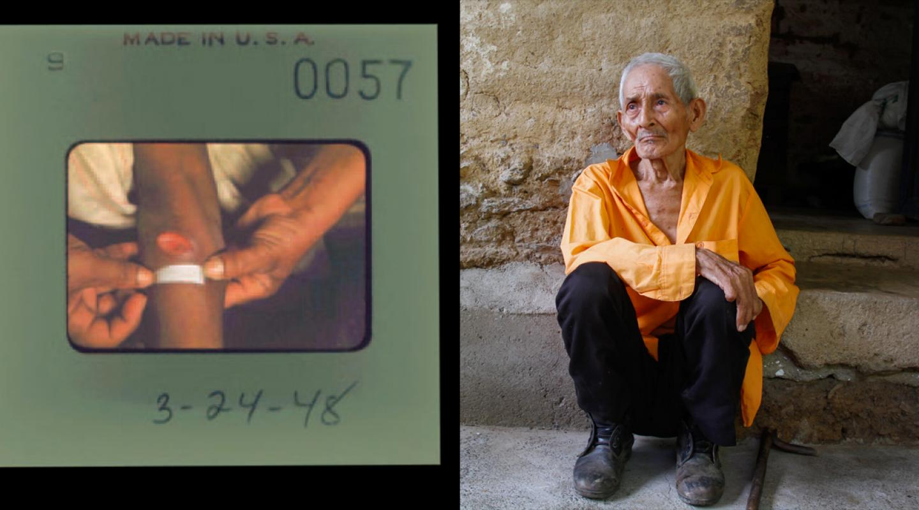
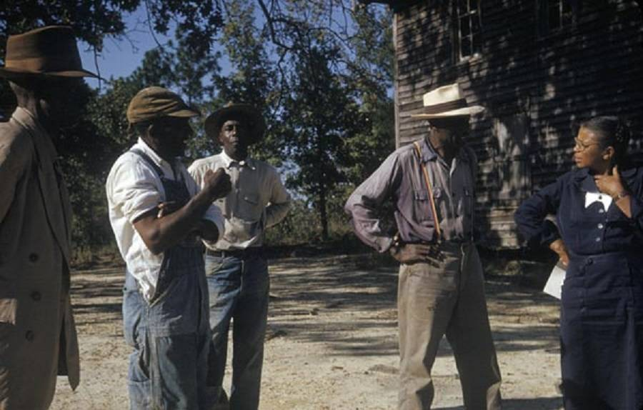
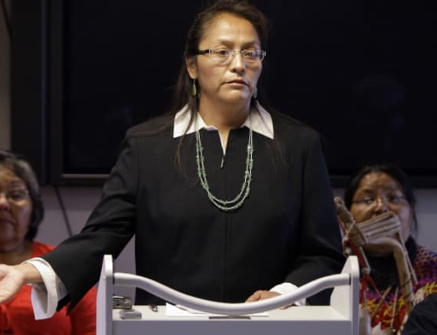
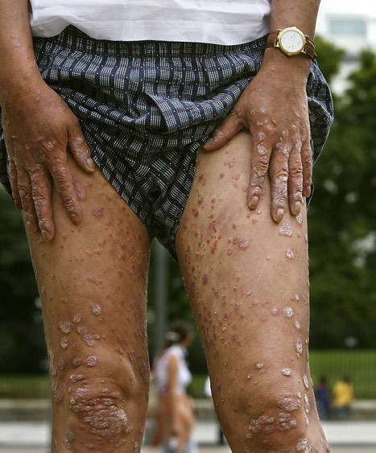
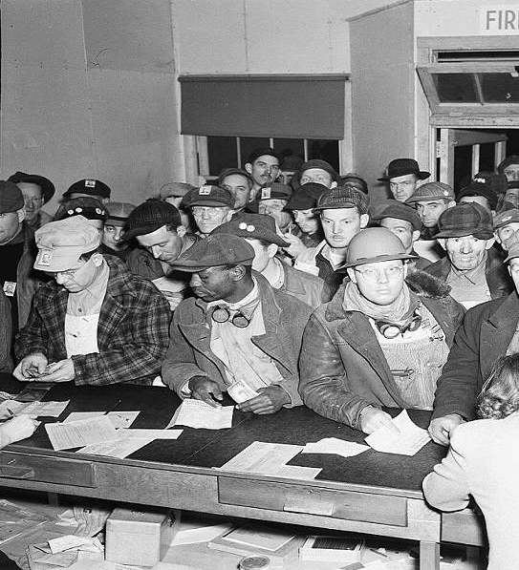

Disenfranchisement and Historical Abuses
32
Notes:
But the elephant in the room here is that many of the populations the program aspires to over-represent have not only been historically underrepresented in research, but have in fact been taken advantage of and abused by researchers in the not so distant past. Henrietta Lacks, unwitting participants in the Guatemala and Tuskegee Syphilis Trials, the Havasupai Tribe, inmates subjected to dioxin experiments. These TUNA disproportionately affect TUNA

Slide 33
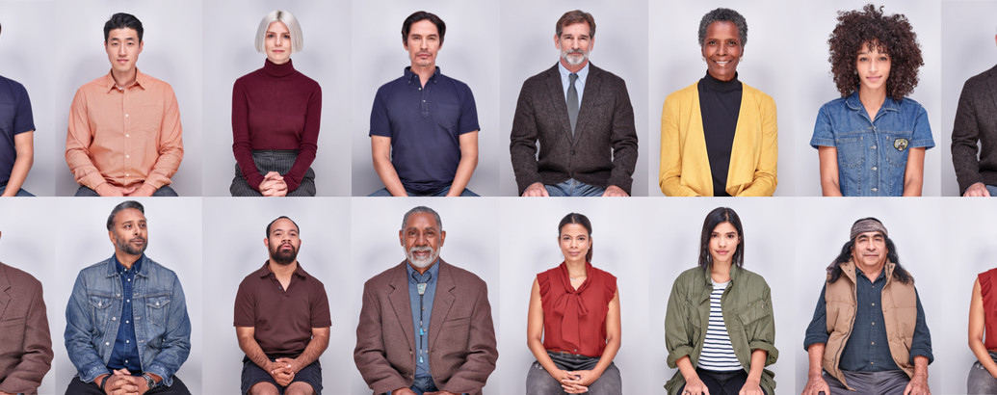
UNDERREPRESENTED IN BIOMEDICAL RESEARCH
Build Trust & Create Value

Slide 34
trust will be earned through robust engagement and full transparency.

Slide 35




























All of Us Community and Provider Partner Network

Slide 36
All of Us Data Access

Slide 37
All of Us Research Program Core Values
Participation is open to all.
Participants reflect the rich diversity of the U.S.
Participants are partners.
Trust will be earned through transparency.
Participants will have access to their information.
Data will be accessed broadly for research purposes.
Security and privacy will be of highest importance.
The program will be a catalyst for positive change in research.

Slide 38






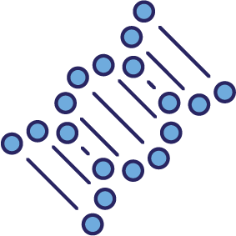










return of results
data transfer
and storage
data access
and use
enrollment
and data
collection

Slide 39
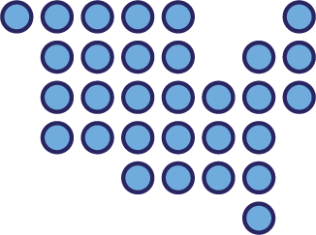
All of Us Research Program Data
Participant Surveys
Electronic Health Records
Physical Measurements
Biospecimens and Assays
Mobile/Wearable Tech
Geospatial/Environmental Data
Data types will grow and evolve with science, technology, and trust

Slide 40

considerations
Sharing Data with Researchers
Data ownership and control
Participant privacy and identifiability
Rules for appropriate access and use
Prevention and penalizing misuse
Balancing openness and oversight
Balancing paternalism and autonomy
Ethical, legal, and regulatory obligations
Potential benefits and harms
Content and context of data return
Feasibility
Sharing Data with Participants

Slide 41
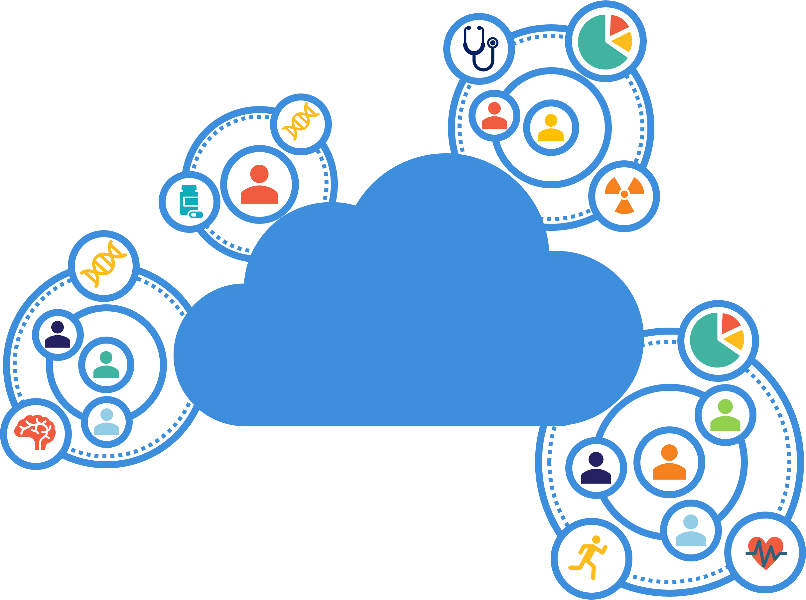
sharing data with researchers

Slide 42
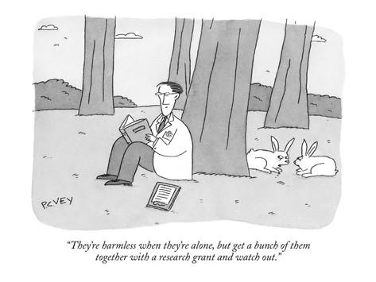
Balancing Openness with Oversight
What is an appropriate standard of deidentification?
What privacy and security provisions (should) apply?
Who should get access to the data, and how much should they be trusted?
What responsibilities are borne by the data user?
What are the potential avenues and harms of data misuse?
What can be done to dissuade and/or punish bad actors?

Slide 43
The All of Us Approach to Data Access
NIH will invest to level the playing field so diverse researchers can play
All of Us data will be available to all types of users

Slide 44
The All of Us Approach to Data Access
NIH will invest to level the playing field so diverse researchers can play
All of Us data will be available to all types of users
The All of Us Data Resource will employ a cloud-based analysis platform

Slide 45
The All of Us Approach to Data Access
NIH will invest to level the playing field so diverse researchers can play
All of Us data will be available to all types of users
The All of Us Data Resource will employ a cloud-based analysis platform
Access will be tiered
Public
Registered
Controlled

Slide 46
The All of Us Data Resource Code of Conduct (examples)
I WILL:
I will NOT:
know and follow all applicable federal, state, and local laws regarding human data access and privacy.
contact the All of Us Research Program Resource Access Board (RAB) within 24 hours if I become aware of any uses or disclosures of All of Us data that endanger the security or privacy of research participants, including any unintended re-identification of participants through the process of my work.
use All of Us Research Program data for research that is discriminatory or stigmatizing of individuals, families, or communities.
attempt to re-identify research participants or their relatives.
use or disclose the information other than as permitted by this DUA.
make copies of or download individual-level data resources outside of the All of Us research environment without approval from RAB.

Slide 47

The All of Us Approach to Data Access
NIH will invest to level the playing field so diverse researchers can play
All of Us data will be available to all types of users
The All of Us Data Resource will employ a cloud-based analysis platform
Access will be tiered
Users will be granted data passports

Slide 48




The All of Us Approach to Data Access
NIH will invest to level the playing field so diverse researchers can play
All of Us data will be available to all types of users
The All of Us Data Resource will employ a cloud-based analysis platform
Access will be tiered
Users will be granted data passports
Project information will be made public and auditable
contributors
project description
data used

Slide 49
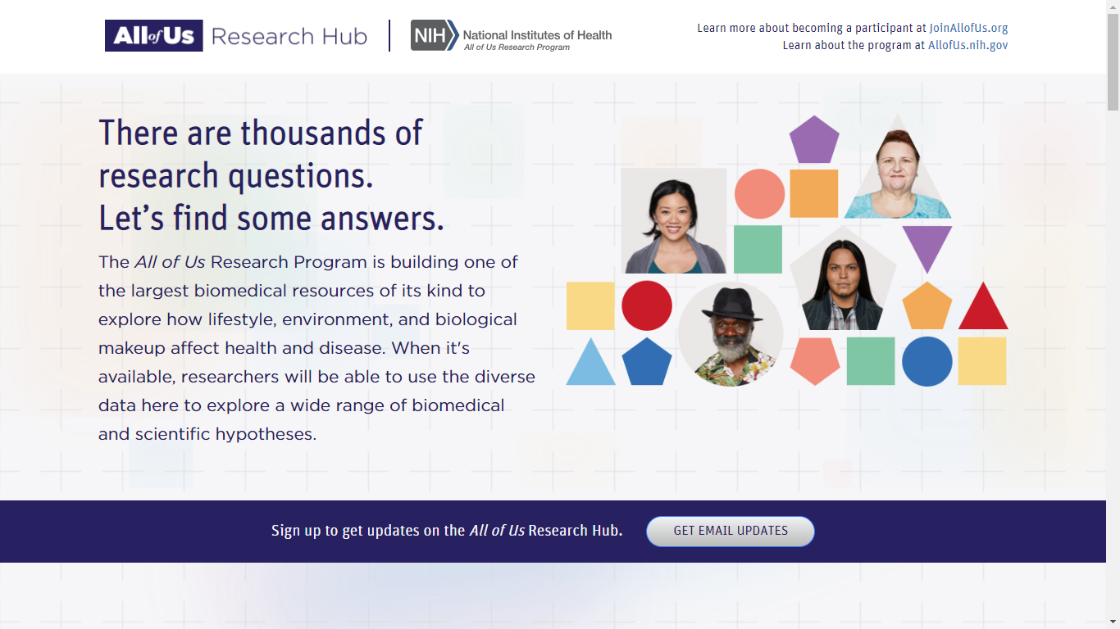
All of Us Research Hub
www.ResearchAllofUs.org

Slide 50
Sample Scientific Opportunities
Develop quantitative estimates of risk for a range of diseases by integrating environmental exposures and biological factors
Identify the causes of individual variation in response to commonly used therapeutics = pharmacogenomics
Discover biological markers that signal
increased or decreased risk of developing common diseases
Use mobile health technologies to correlate activity, physiological measures, and environmental exposures with health outcomes
Develop solutions to health disparities
Create a platform to enable trials of targeted therapies
Empower study participants with information to improve their own health

Slide 51
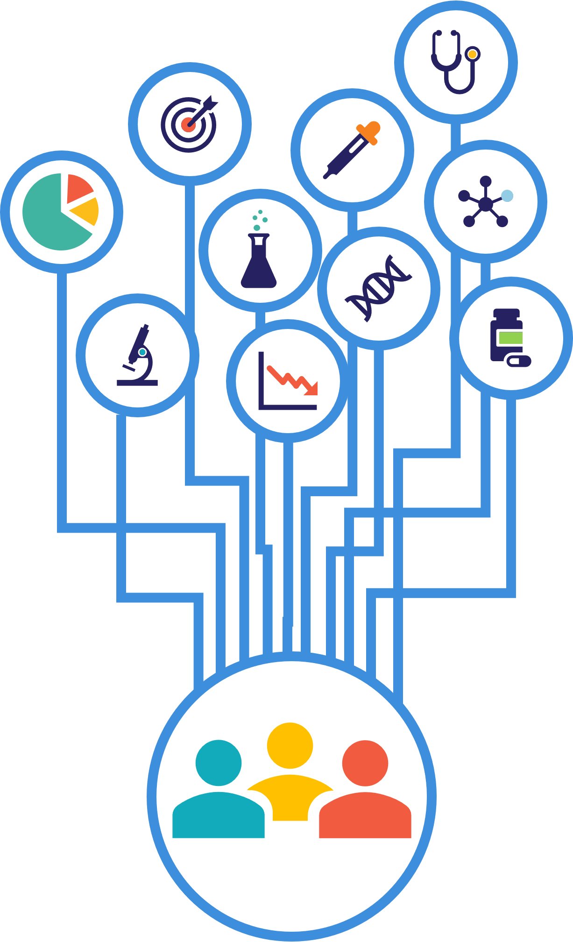
sharing data with participants

Slide 52

Research Participants Want Information Back
PLOS ONE published a public opinion survey conducted by the Foundation for the NIH.
2,601 responses were analyzed.
79% supported the program after reading a short description.
54% said they would definitely or probably participate if asked—not predictive of enrollment numbers, but encouraging.
Little variability among demographic groups
Most important incentive for participation: learning about one’s health information
Kaufman DJ, Baker R, Milner LC, Devaney S, Hudson KL (2016):
A Survey of U.S. Adults’ Opinions about Conduct of a Nationwide Precision Medicine Initiative Cohort Study of Genes and Environment.
PLOS ONE 11(8): e0160461. doi:10.1371/journal.pone.0160461

Slide 53
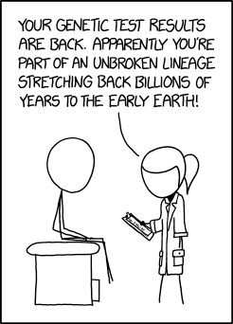
Balancing Paternalism with Autonomy
What information should participants receive? What information do participants have a right to receive?
What are the potential benefits and harms to the receipt of that information?
Are there means of mitigating negative outcomes resulting from the return of information?
Where is the apposite limen between research and clinical care?
Is there an obligation to provide participants with a choice to receive some or all of the information?

Slide 54




Return of Genetic Results in the All of Us Research Program
Workshop
March 6-7, 2017
#joinallofus
on Twitter
WORKSHOP GOALS:
Assess the state-of-the-field for the return of genomic information.
Establish guidelines for return of genetic results considering the distinctive features and core principles of the All of Us Research Program.

Slide 55

Key Insights
Ask participants if they want data about themselves, and how they want it
Develop multiple means of communication
Challenges of the digital divide and low literacy/health literacy
Start small, test, and then build
Be realistic and clearly communicate with participants
Build upon best practices

Slide 56
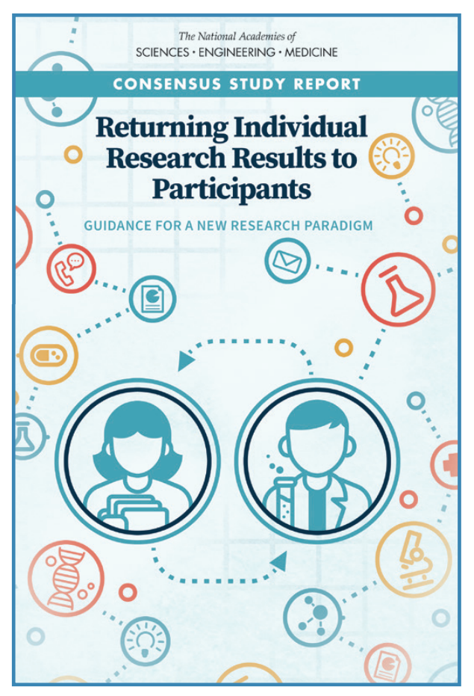
National Academies Report
Support decision making regarding the return of results on a study-by-study basis
Promote high-quality individual research results
Foster participant understanding of individual research results
Revise and harmonize current regulations

Slide 57

All of Us ELSI Priorities: The Four Buckets
Policy Implications
Value to Stakeholders
Research Practice
Convenings Support

Slide 58
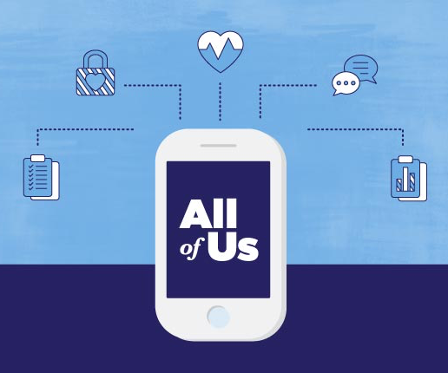
The All of Us Approach to Return of Results
Opportunities for participant education will be provided to promote informed decision making.
Participants must opt in to receive information carrying more than minimal risk.
Medically actionable pathological genetic variant positivity will be returned in a way to maximize participant safety and understanding.
Support services will be available to anyone, regardless of results.

Slide 59
Return of Information
Individual and Comparative Information
  Survey data
  EHR data, claims data
  Assays, including genomics
Study Results
  Aggregated results
  Scientific findings
Program and Research Information
  Ongoing study updates
  Opportunities to be contacted for other research opportunities

Slide 60
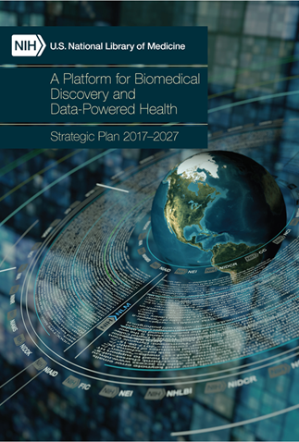
All of Us + NLM

Slide 61
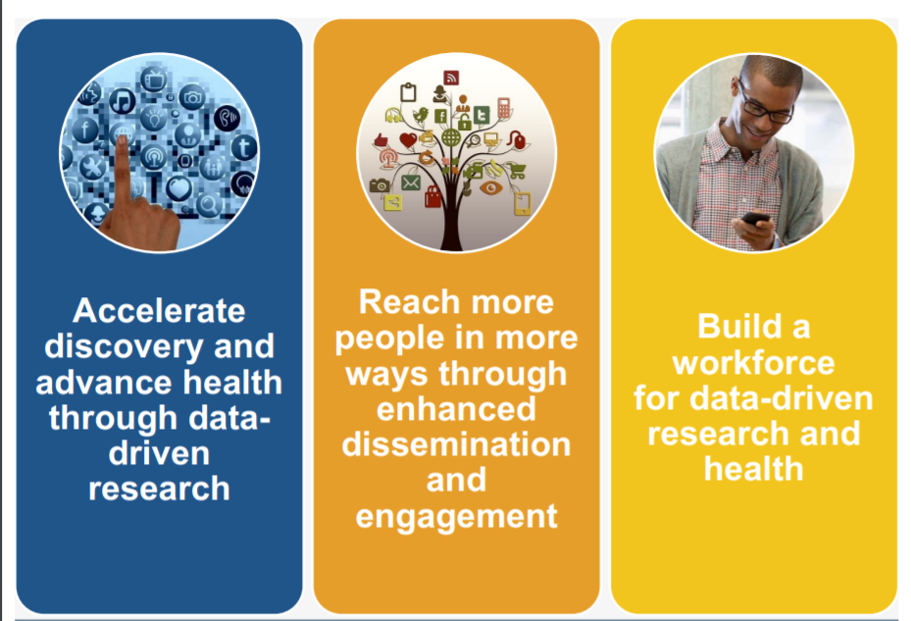
Goals of the NLM Strategic Plan 2017-2027

Slide 62
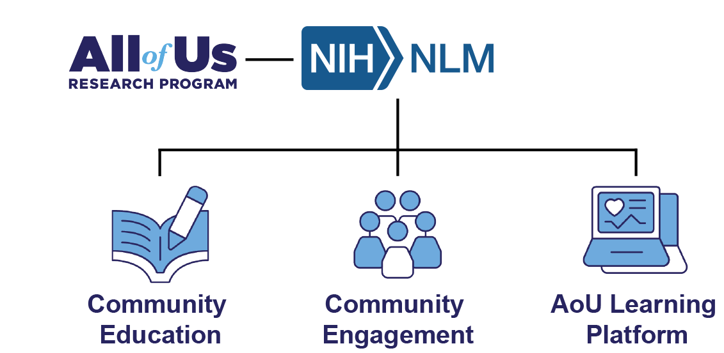

Slide 63
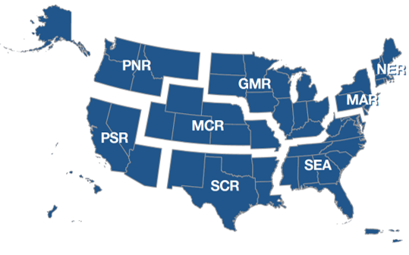
National Network of Libraries of Medicine (NNLM)
7100+ organizational members

Slide 64

*training
*funding
*community partnerships
Notes:
Learn more: http://www.ala.org/news/press-releases/2019/03/public-library-association-national-network-libraries-medicine-join

Slide 65
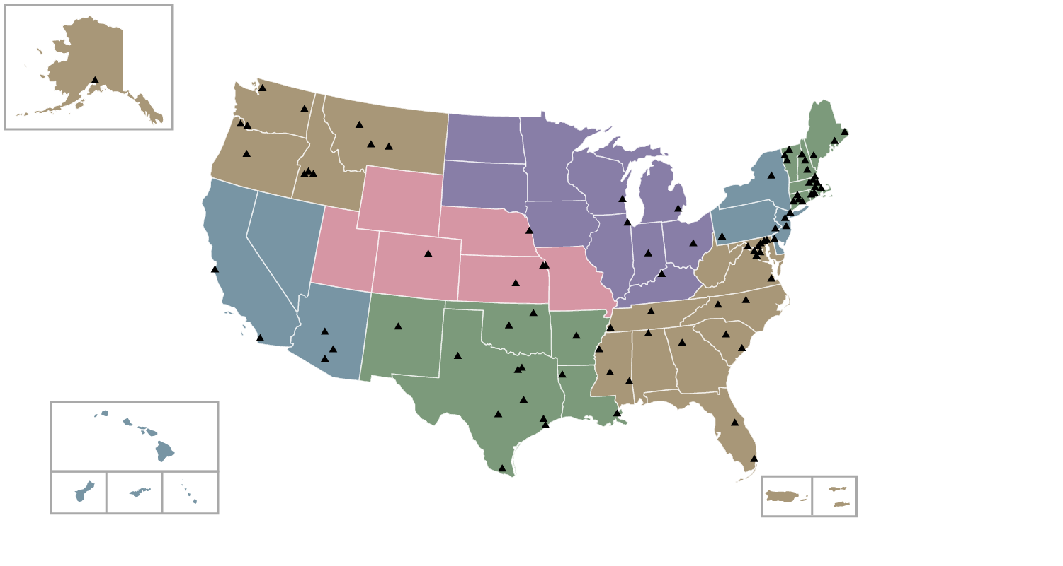








NNLM All of Us Community Engagement Network
MidContinental Region
George Strawley
Greater Midwest Region
Darlene Kaskie
New England Region
Catherine Martin
Pacific Northwest Region
Michele Spatz
Middle Atlantic Region
Veronica Leigh Milliner
Pacific Southwest Region
Kelli Ham
Southeastern/Atlantic Region
April Wright
Contact your
Engagement Coordinator at
LIB-nnlmallofus@uiowa.edu
South Central Region
Rachel Tims
Notes:
Here are the specific places within each state that we are actively engaging in All of Us work.

Slide 66
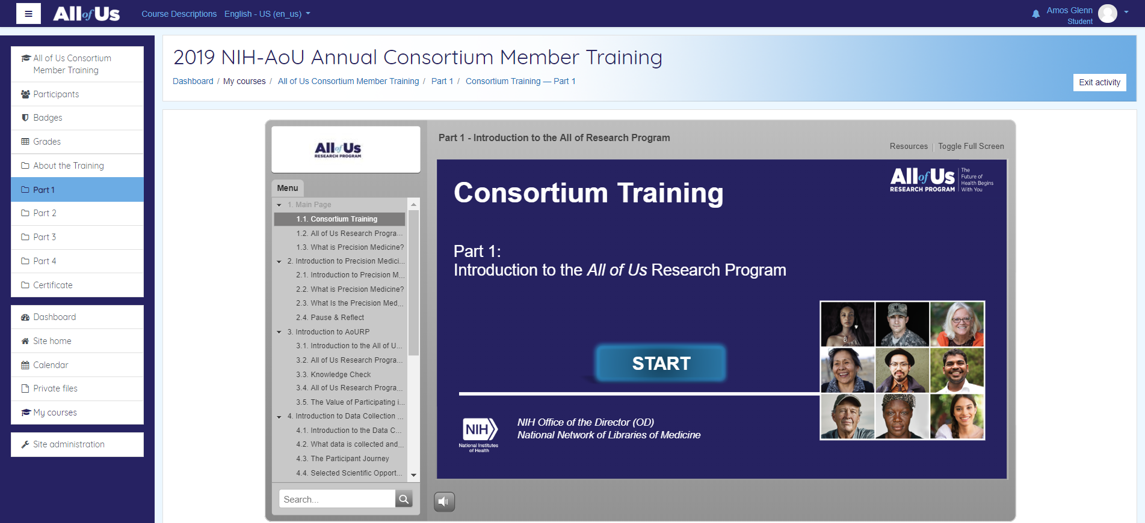

NNLM All of Us Training and Education Center

Slide 67
Community Engagement through NNLM + All of Us
Education Topics
Engagement Activities
Book Mobiles/Book Bikes
Citizen Science Projects
Community Conversations
Health/Science Fairs
Health and Wellness Programming
Online Games
Summer Reading
All of Us Training
Digital Literacy
Evaluating Health Information
Genetics
Health Literacy
Health Numeracy
Researcher Ethics
Return of Genomic Results

Slide 68
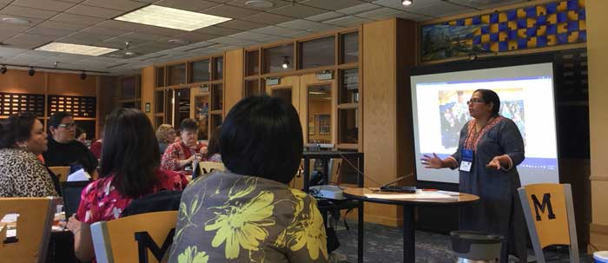
NNLM + All of Us: Community Engagement Examples
TRAINING
opportunities and consultations
FUNDING
for projects to “blanket the nation”
CONNECTING
communities via libraries

Slide 69
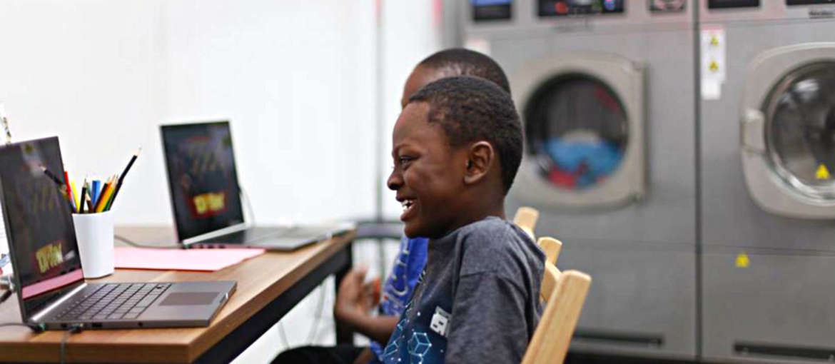
NNLM + All of Us: Community Engagement Examples
TRAINING
opportunities and consultations
FUNDING
for projects to “blanket the nation”
CONNECTING
communities via libraries

Slide 70
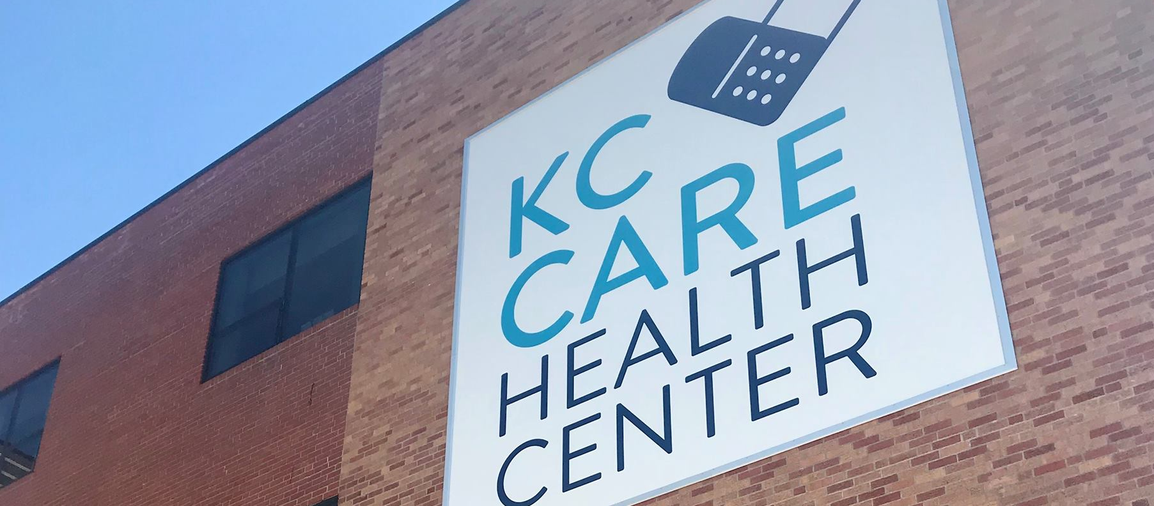

NNLM + All of Us: Community Engagement Examples
TRAINING
opportunities and consultations
FUNDING
for projects to “blanket the nation”
CONNECTING
communities via libraries

Slide 71
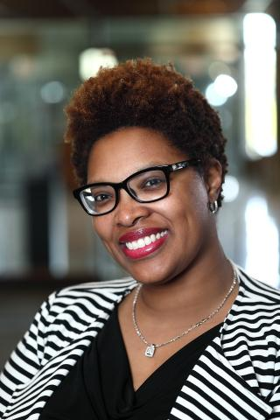
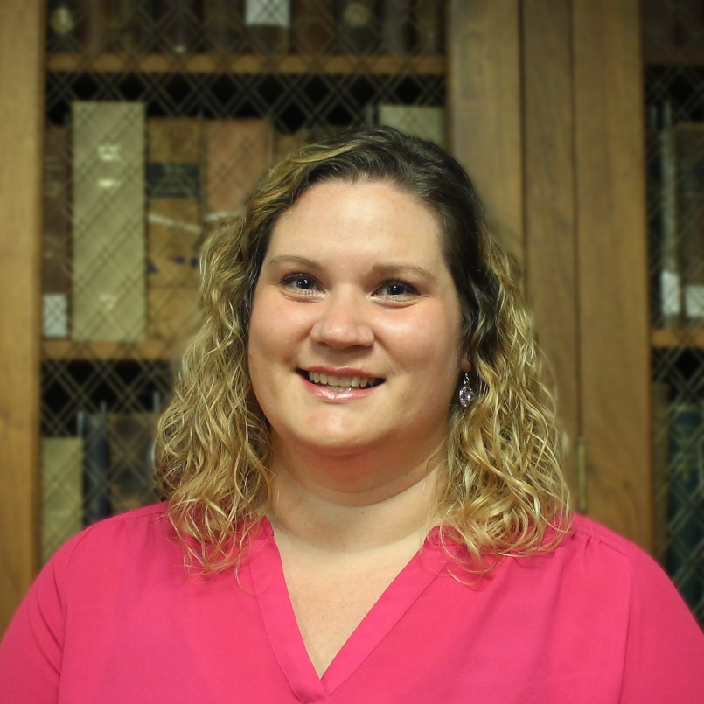
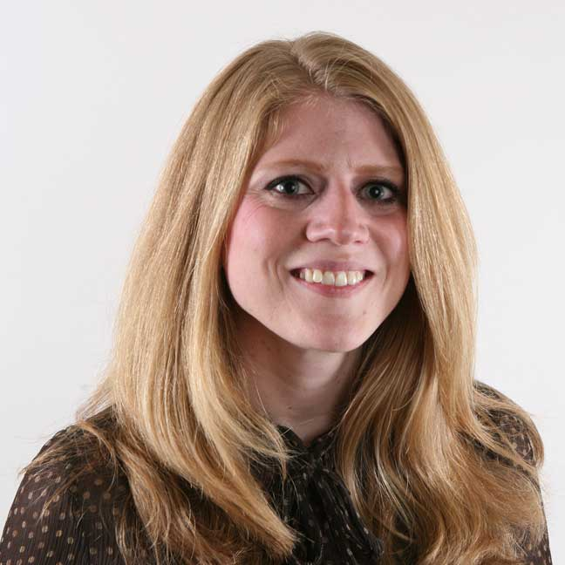
NNLM All of Us Partnership Leadership Team
Community Engagement
at
University of Iowa
Amanda J. Wilson
Head, National Network Coordinating Office
National Library of Medicine
amanda.wilson@nih.gov
Jennifer R. Jones
Executive Director, NLM Training and Education Center for the All of Us Research Program
NNLM Middle Atlantic Region
jrj25@pitt.edu
Training and Education
at
University of Pittsburgh
Brittney Thomas
Manager, NNLM All of Us Community Engagement Center
NNLM Greater Midwest Region
brittney-thomas@uiowa.edu

Slide 72
Learn More
JoinAllofUs.org
ResearchAllofUs.org
@AllofUsResearch
#JoinAllofUs
Precision Medicine Initiative, PMI, All of Us, the All of Us logo, and “The Future of Health Begins with You” are service marks of the U.S. Department of Health and Human Services.

